Slide 1

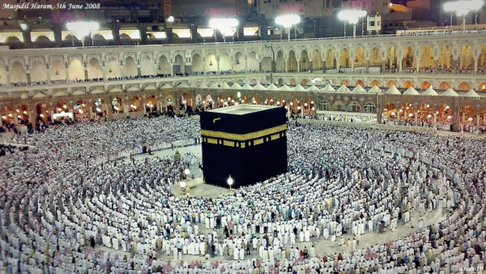
O my Lord! Expand for me my chest [with assurance] and ease for me my task and untie the knot from my tongue that they may understand my speech. (Quran 20 : 25-28)

Slide 2
Algorithm Analysis
Recurrence
(Formal Analysis)

Slide 3
Introduction
Iterative Algorithms
Informal Analysis
Formal Analysis
RAM Model Analysis
Recursive Algorithm
Informal Analysis
Formal Analysis
Forwards Substitution Method
Backwards Substitution Method
Substitution Method
Recursion Tree Method
Master Theorem Method

Slide 4
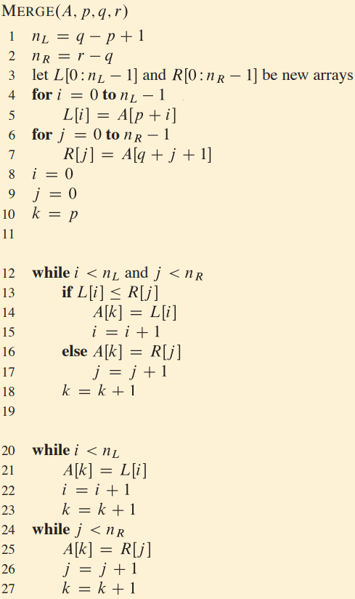

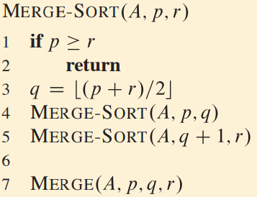
Merge Sort - Recurrence

Slide 5
Substitution Method
It has TWO steps
Guess the solution
Use Mathematical Induction to find the constant and show that solution works
Powerful method to solve
But demands practice
Can solve either upper or lower bounds

Slide 6






Substitution Method - Merge Sort
Guess The Solution
Prove by Mathematical Induction
Assumption:
Any specific value of n
Prove for all values “n”
T(n)
Boundary Conditions
n = 1, 2, 3, 4, … etc
Upper Bound
Lower Bound

Slide 7


Merge Sort – Upper Bound
Guess Solution:
Step 02 : Prove for all “n”
Prove using M . I. :
Step 01 : Assumption

Slide 8




Merge Sort – Upper Bound
Recurrence:
Solution:
Step 03 : Boundary Conditions
False

Slide 9



Merge Sort – Upper Bound
Recurrence:
Solution:
Step 03 : Boundary Conditions
True for c>=2

Slide 10



Merge Sort – Upper Bound
Recurrence:
Solution:
Step 03 : Boundary Conditions
True for c>=2
Hence proved

Slide 11


Merge Sort – Lower Bound
Guess Solution:
Step 02 : Prove for all “n”
Prove using M . I. :
Step 01 : Assumption

Slide 12
Merge Sort – Lower Bound
Recurrence:
Solution:
Step 03 : Boundary Conditions
True

Slide 13
Merge Sort – Lower Bound
Recurrence:
Solution:
Step 03 : Boundary Conditions
True for 0 < c <= 2

Slide 14

Merge Sort – Lower Bound
Recurrence:
Solution:
Step 03 : Boundary Conditions
True for 0 < c <= 2
Hence proved

Slide 15
Merge Sort – Analysis
=> T (n) = O (n lg n)
=> T (n) = Ω (n lg n)
Hence proved
T (n) = θ (n lg n)

Slide 16
Recurrence
Substitution Method
(Sample Exercises)

Slide 17


Class Exercise
Guess Solution:
Prove using M . I. :
Step 01 : Assumption

Slide 18
Class Exercise
Recurrence:
Guess Solution:
Step 02 : Prove for all “n”
For very large value of “n” , we may ignore 17

Slide 19
Recurrence
Substitution Method
(Challenges & Solution)

Slide 20








Subtracting Lower Order Term
Suppose we have
Guess the Solution
Prove that
Assumption
Substitute

Slide 21






Subtracting Lower Order Term
Suppose we have
New Guess
Prove that
Assumption
Substitute

Slide 22












Changing Variable

Slide 23

Allah (Alone) is Sufficient for us, and He is the Best Disposer of affairs (for us).(Quran 3 : 173)

