Slide 1
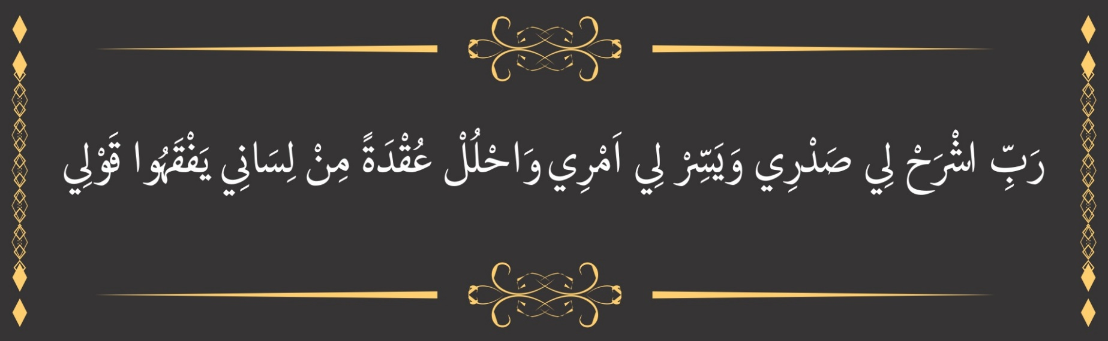
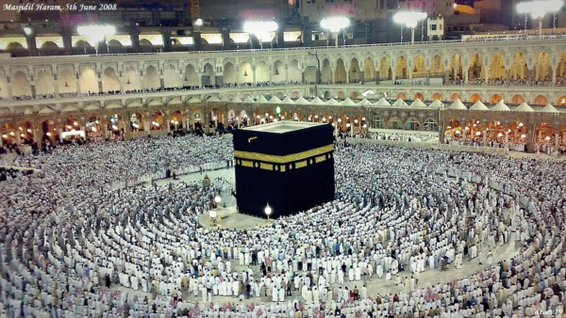
O my Lord! Expand for me my chest [with assurance] and ease for me my task and untie the knot from my tongue that they may understand my speech. (Quran 20 : 25-28)

Slide 2
Algorithm Analysis
Recurrence
(Formal Analysis)

Slide 3
Introduction
Iterative Algorithms
Informal Analysis
Formal Analysis
RAM Model Analysis
Recursive Algorithm
Informal Analysis
Formal Analysis
Forwards Substitution Method
Backwards Substitution Method
Substitution Method
Recursion Tree Method
Master Theorem Method

Slide 4
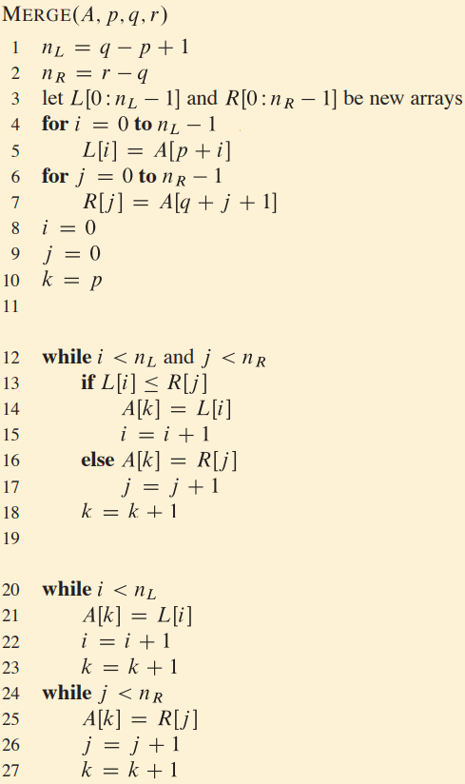

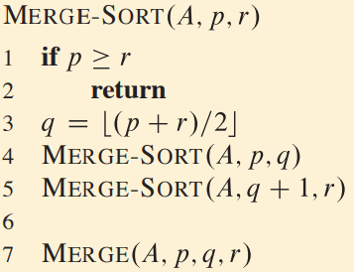
Merge Sort - Recurrence

Slide 5
Steps for Recursion Tree Method
Construct the Tree
Find the problem size on each level
Determine the cost for each node
Find no. of nodes on each Level
Determine the cost of each level
Determine the total no. of levels
Determine the last level and its cost
Sum the cost of each level
Verify the results with help of Substitution Method

Slide 6

Merge Sort Recurrence

Slide 7

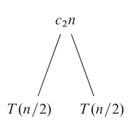
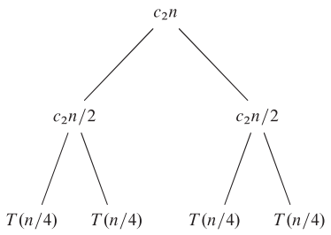
Recursion Tree - T(n) = 2 T(n/2) + c₂n

Slide 8
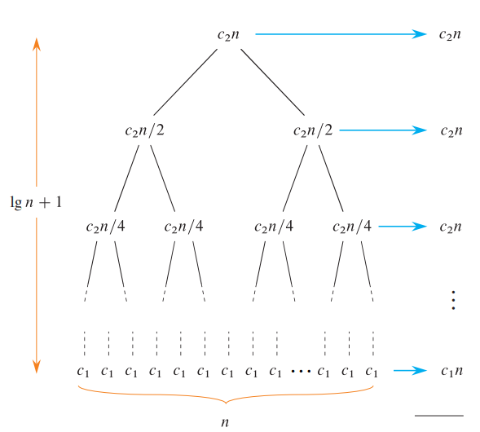
Recursion Tree(T(n) = 2 T(n/2) + cn)

Slide 9
Recursion Tree(T(n) = 2 T(n/2) + cn)

Slide 10
Recursion Tree(T(n) = 2 T(n/2) + cn)

Slide 11

Recursion Tree(T(n) = 2 T(n/2) + cn)

Slide 12
Recursion Tree(T(n) = 2 T(n/2) + cn)
T (n) = θ (n lg n)

Slide 13
Recursion Tree Method
T(n) = 3 T (n/4) + Θ(n²)

Slide 14
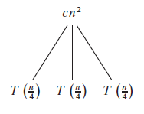

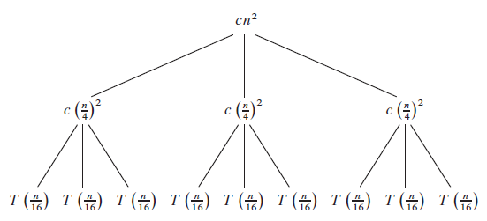
Recursion Tree – T(n) = 3 T(n/4) + c n²

Slide 15
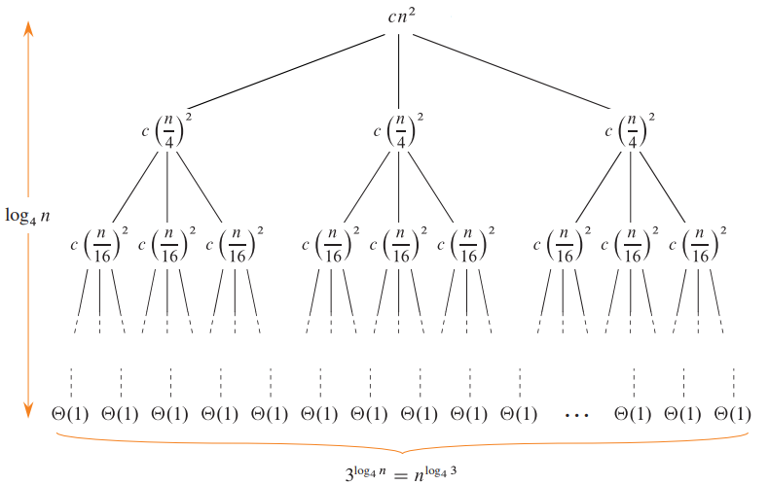
Recursion Tree – T(n) = 3 T(n/4) + c n²

Slide 16





Recursion Tree – T(n) = 3 T(n/4) + c n²
Problem Size at level “i”
Cost of node at level “i”
No. of nodes at level “i”
Cost of level “i”
Last Level number
No. of nodes at last Level
Cost of last Level

Slide 17
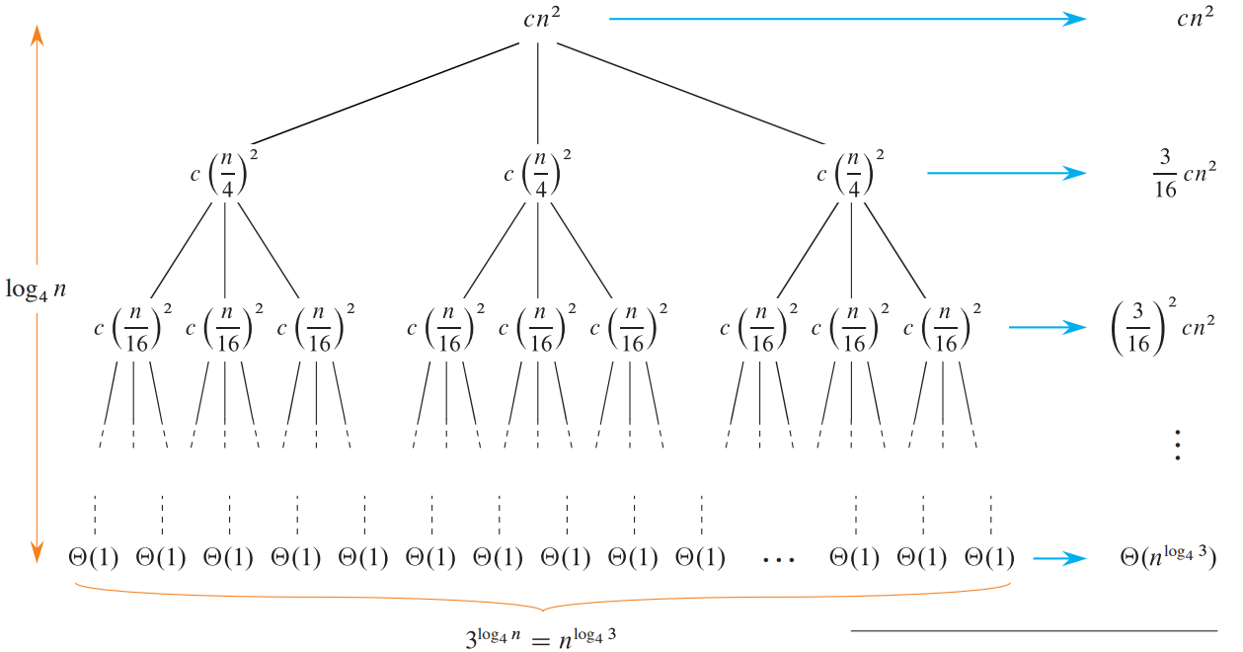
Recursion Tree – T(n) = 3 T(n/4) + c n²

Slide 18







Recursion Tree – T(n) = 3 T(n/4) + c n²

Slide 19
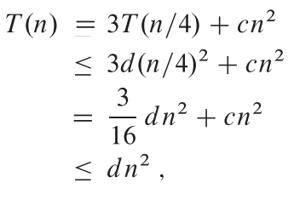

Recursion Tree – T(n) = 3 T(n/4) + c n²
Verification by Substitution Method
T (n) = O (n²)

Slide 20
Recursion Tree
T(n) = T(n/3) + T (2n/3) + O(n)

Slide 21
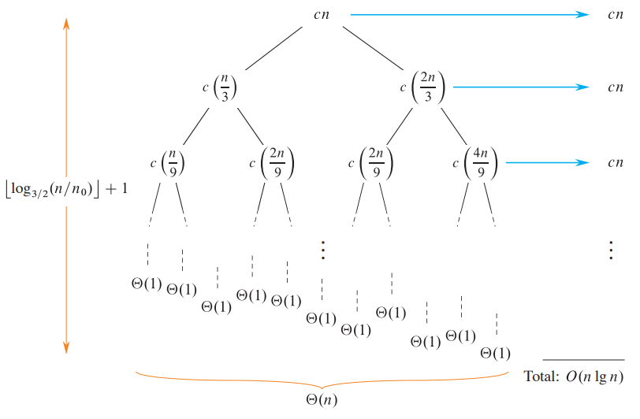
T(n) = T(n/3) + T (2n/3) + c n

Slide 22
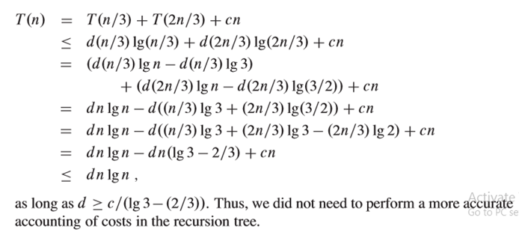
T(n) = T(n/3) + T (2n/3) + c n
T (n) = O (n lg n)

Slide 23
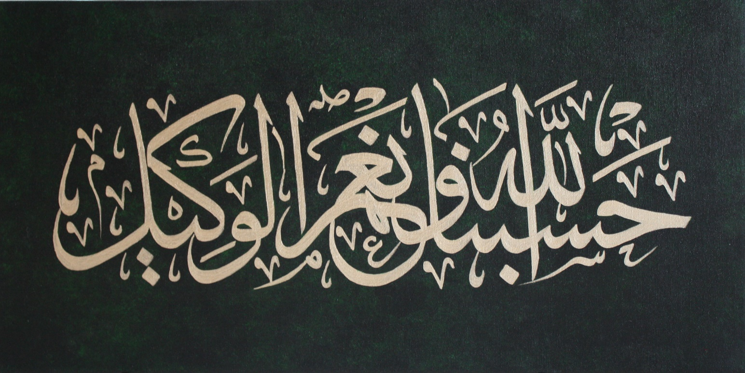
Allah (Alone) is Sufficient for us, and He is the Best Disposer of affairs (for us).(Quran 3 : 173)

