Slide 1

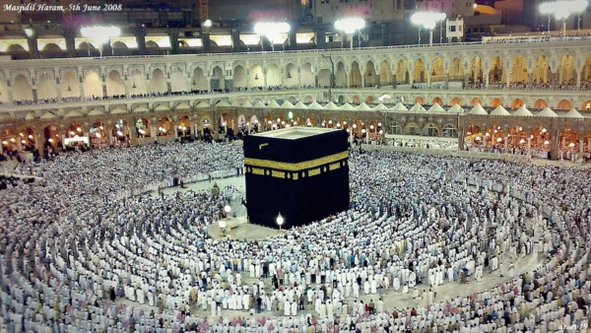
O my Lord! Expand for me my chest [with assurance] and ease for me my task and untie the knot from my tongue that they may understand my speech. (Quran 20 : 25-28)

Slide 2
Algorithm Analysis

Slide 3
Introduction
Algorithm Analysis
Methodology
Empirical Analysis
Experimental based analysis
Mathematical / Theoretical Analysis
Mathematical based analysis

Slide 4
Empirical Analysis
Method 01
w.r.t. Problem Size and Hardware Variations

Slide 5
Empirical Analysis of Time Efficiency
Select multiple hardware setup
Select a specific (typical) sample of inputs
Use physical unit of time (e.g., milliseconds) or Count actual number of basic operation’s executions
Analyze the empirical data

Slide 6
Empirical Analysis
Type of Computer | Time (ms)
Home Computer | 51.915
Desktop Computer | 11.508
Minicomputer | 2.382
Mainframe Computer | 0.431
Supercomputer | 0.087
Time to sort an array of 2000 integers

Slide 7
Empirical Analysis
Array Size | Home Comp | Desktop Comp
125 | 12.5 | 2.8
250 | 49.3 | 11.0
500 | 195.8 | 43.4
1000 | 780.3 | 172.9
2000 | 3114.9 | 690.5
Insertion Sort Running Time for Different Input Size

Slide 8
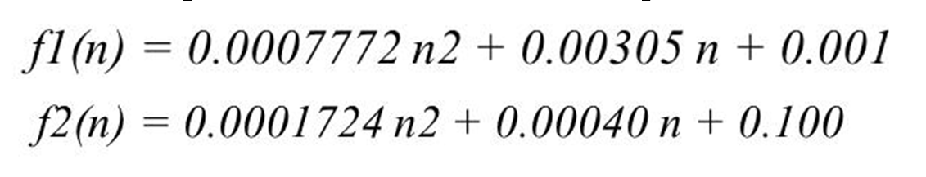
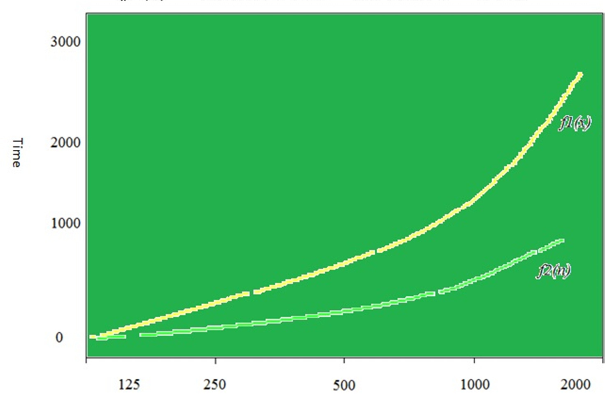
Empirical Analysis

Slide 9
Empirical Analysis
n | f(n) | a n² | % of an²
125 | 2.8 | 2.7 | 96.4
250 | 11.0 | 10.8 | 98.1
500 | 43.4 | 43.1 | 99.1
1000 | 172.9 | 172.4 | 99.7
2000 | 690.5 | 689.6 | 99.9
f(n) = a n² + b n + c
where a = 0.0001724, b = 0.0004 and c = 0.1

Slide 10
Empirical Analysis
Method 02
W.r.t. Problem Size

Slide 11
General Plan
Understand the experiment’s purpose
Decide on the efficiency metric M to be measured and the measurement unit (an operation count vs. a time unit)
Decide on characteristics of the input sample (its range, size, and so on)
Prepare a program implementing the algorithm (or algorithms) for the experimentation
Generate a sample of inputs
Run the algorithm (or algorithms) on the sample’s inputs and record the data observed
Analyze the data obtained

Slide 12
General Plan
Understand the experiment’s purpose
Checking the accuracy of theoretical analysis results
Comparison of efficiency of different algorithms of same problem
Developing the hypothesis about the algorithm’s efficiency
Ascertaining the efficiency of the algorithm on a particular machine

Slide 13
General Plan
Decide on the efficiency metric M to be measured and the measurement unit (an operation count vs. a time unit)
Operation Count
insert a counter (or counters) into a program implementation
Count number of times the basic operation is implemented
Basic Operation may be executed in several places in the program
Time Measurement
Use stopwatch to measure the time taken to complete the task
Use a system’s command, such as the time command in UNIX
measure the running time of a code fragment by asking for the system time right before the fragment’s start (t_{start}) and just after its completion (t_{finish}). The difference between the two (t_{finish}− t_{start})
In Java, the method currentTimeMillis() in the System class is available

Slide 14
General Plan
Decide on characteristics of the input sample (its range, size, and so on)
start with a relatively small sample
increase it later if necessary
range of instance sizes; neither trivially small nor excessively large

Slide 15
General Plan
Prepare a program implementing the algorithm (or algorithms) for the experimentation
Select any suitable high-level programming language
C, C++, Java etc.
May be implemented in multiple languages
Observe the consistency in the running time

Slide 16
General Plan
Generate a sample of inputs
empirical analysis requires generating random numbers
random number generator available in computer language libraries
value of a (pseudo)random variable uniformly distributed in the interval between 0 and 1
an appropriate transformation may be used for desired range of value
if x is a continuous random variable uniformly distributed on the interval 0 ≤ x < 1
y = l + floor (x(r − l))
Generate the value between integers l and r − 1
where (l < r)

Slide 17
General Plan
Run the algorithm (or algorithms) on the sample’s inputs and record the data observed
Using Table
Numerical data will be presented
Manipulated easily
Ratio M(n) / g (n) e.g. M (2n) / M(n)
Change slightly Logarithmic
Converge to 2, 3, 4 etc. Linear
Converge to 4, 9, 16 etc. Quadratic
Converge to 8, 27, 64 etc. Cubic
Graphical – Scatterplot
Draw points in a Cartesian coordinate systems
Concave Logarithmic
Points aggregation around line Linear
Convex Shape n lg n or n2
Convex with rapid increase n³

Slide 18
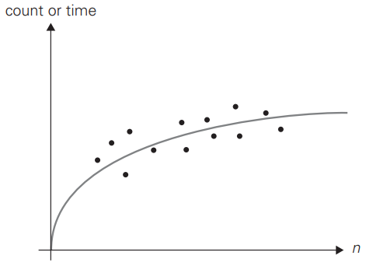
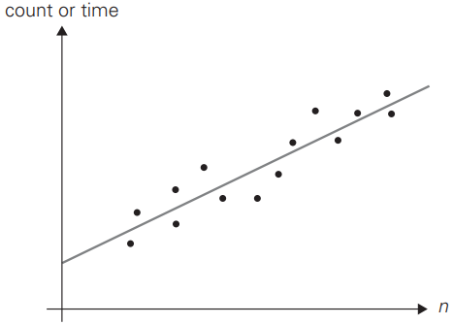
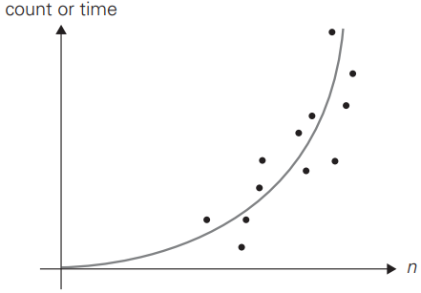
General Plan
Run the algorithm (or algorithms) on the sample’s inputs and record the data observed
Logarithmic
Linear
Quadratic

Slide 19
Algorithm Visualization

Slide 20
Introduction
The use of images to convey some useful information about algorithms
Standard Simulation Tools
Microsoft Excel
Customized Application
High Level Language, Visual Tool etc.
Introduced first in 1970
Sorting Out Sorting
Ronald Baecker & D. Sherman (University of Toronto)
30-minute color sound film
09 sorting algorithms were presented

Slide 21
Methods & Tools
Methods
Static Algorithm Visualization
shows an algorithm’s progress through a series of still images
Dynamic Algorithm Visualization / Algorithm Animation
shows a continuous, movie-like presentation of an algorithm’s operations
Tools
Bar graph
via vertical or horizontal bars or sticks of different heights or lengths
Rearranged according to their sizes
Useful for small inputs
Scatterplot
Useful for larger files
Presenting points on a coordinate plane
first coordinate representing an item’s position in the file
second one representing the item’s value

Slide 22
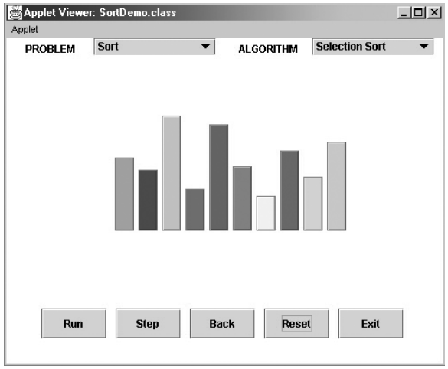
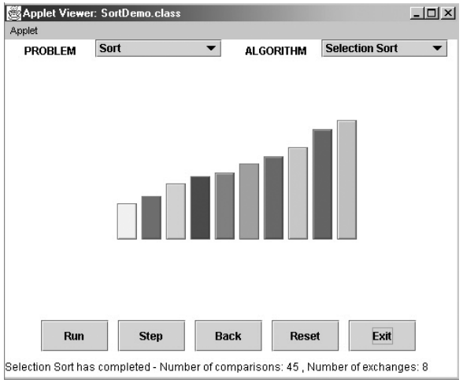
Bar Graph
Before Sorting
After Sorting

Slide 23
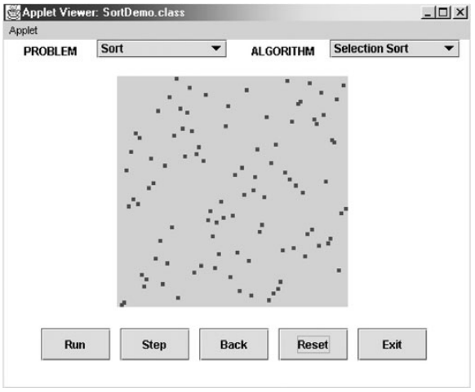
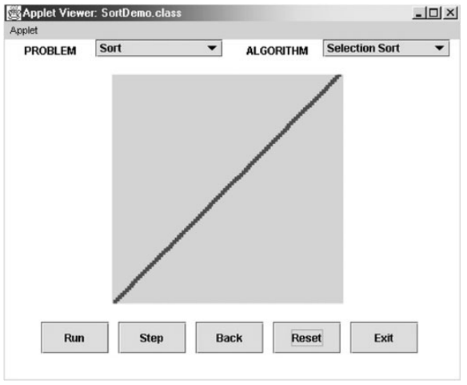
Scatterplot
Before Sorting
After Sorting

Slide 24

Allah (Alone) is Sufficient for us, and He is the Best Disposer of affairs (for us).(Quran 3 : 173)

