Slide 1


O my Lord! Expand for me my chest [with assurance] and ease for me my task and untie the knot from my tongue that they may understand my speech. (Quran 20 : 25-28)

Slide 2
Algorithm Design
Introduction

Slide 3
Main Issues Related to Algorithms
How to analyze algorithm efficiency
How to design algorithms

Slide 4
Important Problem Types
Sorting
Searching
String processing
Graph problems
Geometric problems
Numerical problems ………..

Slide 5
Algorithm Design Techniques/Strategies
Brute force
Divide and conquer
Decrease and conquer
Transform and conquer
Space and time tradeoffs
Greedy Approach
Dynamic Programming
Iterative Improvement
Backtracking
Branch and bound

Slide 6
Algorithm Design Techniques/Strategies
Brute force
Divide and conquer
Decrease and conquer
Transform and conquer
Space and time tradeoffs
Greedy Approach
Dynamic Programming
Iterative Improvement
Backtracking
Branch and bound

Slide 7
Brute Force Algorithms
Introduction

Slide 8
Introduction
Literally to mean
exceptional physical power in the figurative sense.
The origin
comes from Latin brutus, for “heavy, stupid, unreasoning.”

Slide 9
Introduction
Relying on or achieved through the application of force, effort, or power in usually large amounts instead of more efficient, carefully planned, or precisely directed methods

Slide 10
Introduction
A straightforward approach, usually based directly on the problem’s statement and definitions of the concepts involved
Examples
a^{n}, n!, multiplying matrices, search

Slide 11
Max Number of 1’s
You are given an n x n integer array
Say, for example, a 100x100 sized array
Each row is filled with several 1’s followed by all 0’s
Example:
Row 1 may have 38 1’s followed by 62 0’s
Row 2 may have 73 1’s followed by 27 0’s
Row 3 may have 12 1’s followed by 82 0’s
You get the idea
The goal of the problem is to identify the row that has the maximum number of 1’s.

Slide 12
Max Number of 1’s (Basic Solution)
Brute Force solution:
Make a variable called MaxOnes and set equal to 0
For each row do the following:
Start from the beginning of the row on the left side
Scan left to right, counting the number of 1’s until the first zero is encountered
If the number of 1’s is greater than the value stored in MaxOnes, update MaxOnes with the number of 1’s seen on this row
Clearly, this works
But let’s see how long this algorithm will take

Slide 13
Max Number of 1’s (Example 01)
1 | 1 | 0 | 0 | 0 | 0
0 | 0 | 0 | 0 | 0 | 0
1 | 1 | 1 | 0 | 0 | 0
1 | 1 | 1 | 0 | 0 | 0
1 | 1 | 1 | 1 | 1 | 0
1 | 1 | 1 | 1 | 0 | 0

Slide 14
Max Number of 1’s (Example 01)
1 | 1 | 0 | 0 | 0 | 0
0 | 0 | 0 | 0 | 0 | 0
1 | 1 | 1 | 0 | 0 | 0
1 | 1 | 1 | 0 | 0 | 0
1 | 1 | 1 | 1 | 1 | 0
1 | 1 | 1 | 1 | 0 | 0
Rows 6 & Columns 6
# of Comparison 23
Max. Number of comparisons 6 x 6 = 36

Slide 15
Max Number of 1’s (Example 02)
0 | 0 | 0 | 0 | 0 | 0 | 0 | 0
1 | 1 | 0 | 0 | 0 | 0 | 0 | 0
1 | 0 | 0 | 0 | 0 | 0 | 0 | 0
1 | 1 | 1 | 0 | 0 | 0 | 0 | 0
1 | 1 | 1 | 1 | 0 | 0 | 0 | 0
1 | 1 | 1 | 1 | 1 | 1 | 0 | 0
1 | 1 | 1 | 1 | 1 | 1 | 1 | 0
Rows 7 & Columns 8
# of comparisons 30
Max. Number of comparisons 7 x 8 = 56

Slide 16
Max Number of 1’s (Analysis)
Analysis of Straightforward Solution:
Basically we iterate through each square that contains a 1, as well as the first 0 in each row
If all cells were 0, we would only “visit” one cell per row, resulting in n visited cells
However, if all cells were 1’s, we would “visit” all of the cells (n² total)
So in the worst case, the number of simple steps the algorithm takes would be approximately n²
This makes the running time of this algorithm O(n²)
The meaning of this Big-O will be discussed later in the semester

Slide 17
Max Number of 1’s (Optimal Solution)
Efficient algorithm:
Initialize the current row and current column to 0
While the current row is less than n (or before the last row)
While the cell at the current row and column is 1
Increment the current column
Increment the current row
The current column index represents the maximum number of 1’s seen
Now let’s trace through a couple of examples

Slide 18
Max Number of 1’s (Example 01)
1 | 1 | 0 | 0 | 0 | 0
0 | 0 | 0 | 0 | 0 | 0
1 | 1 | 1 | 0 | 0 | 0
1 | 1 | 1 | 0 | 0 | 0
1 | 1 | 1 | 1 | 1 | 0
1 | 1 | 1 | 1 | 0 | 0
Rows 6 & Columns 6
# of comparisons 11 (previously 23)
Max. Number of comparisons 6 + 6 = 12

Slide 19
Max Number of 1’s (Example 02)
0 | 0 | 0 | 0 | 0 | 0 | 0 | 0
1 | 1 | 0 | 0 | 0 | 0 | 0 | 0
1 | 0 | 0 | 0 | 0 | 0 | 0 | 0
1 | 1 | 1 | 0 | 0 | 0 | 0 | 0
1 | 1 | 1 | 1 | 0 | 0 | 0 | 0
1 | 1 | 1 | 1 | 1 | 1 | 0 | 0
1 | 1 | 1 | 1 | 1 | 1 | 1 | 0
Rows 7 & Columns 8
# of comparisons 14 (previously 30)
Max. Number of comparisons 7 + 8 = 15

Slide 20
Max Number of 1’s (Analysis)
Analysis of Better Solution:
How many steps will this algorithm take, in terms of n?
Each “step” taken by the algorithm either goes to the right or down in the table.
There are a maximum of n-1 steps to the right
And a maximum of n-1 steps down that could be taken
Thus the maximum number of “steps” that can be done during this algorithm is approximately 2n
And this is the worst case
So the running time of this algorithm is O(n)
An improvement of the previous algorithm
Input size of 100 for n
n² would be 10,000 steps and 2n would be 200 steps

Slide 21
Selection Sort
Example 01
Introduction

Slide 22
Selection Sort - Introduction
Scan the array to find its smallest element and swap it with the first element. Then, starting with the second element, scan the elements to the right of it to find the smallest among them and swap it with the second elements. Generally, on pass i (0 ≤ i ≤ n-2), find the smallest element in A[i..n-1] and swap it with A[i]:
A[0] ≤ . . . ≤ A[i-1] | A[i], . . . , A[min], . . ., A[n-1]
in their final positions
Example: 7 3 2 5

Slide 23
Selection Sort
Example 01
Algorithm and Tracing

Slide 24
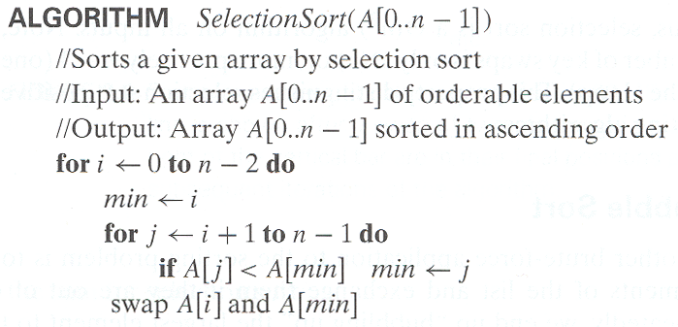
Selection Sort - Algorithm

Slide 25
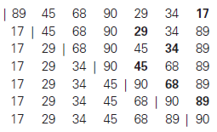
Selection Sort – Tracing

Slide 26
Selection Sort – Tracing

Slide 27
Selection Sort – Tracing

Slide 28
Selection Sort – Tracing

Slide 29
Selection Sort – Tracing

Slide 30
Selection Sort – Tracing

Slide 31
Selection Sort – Tracing

Slide 32
Selection Sort
Example 01
Analysis

Slide 33

Selection Sort – Analysis
Basic Operation
Number of comparisons
For “n” elements
C(n)
Polynomial Equation

Slide 34




Selection Sort – Analysis

Slide 35
Bubble Sort
Example 02
Algorithm & Tracing

Slide 36
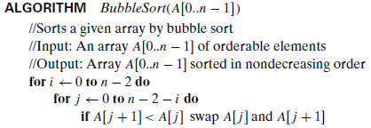
Algorithm

Slide 37
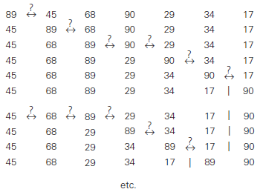
Tracing

Slide 38
Tracing

Slide 39
Bubble Sort
Example 02
Analysis

Slide 40
Analysis

Slide 41
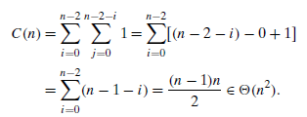
Analysis

Slide 42
Analysis

Slide 43
Sequential Search
Example 03
Chapter 03 – Text Book
Section 3.1

Slide 44
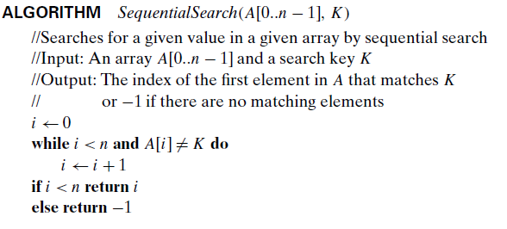
Algorithm

Slide 45
Tracing

Slide 46
Analysis

Slide 47
Sequential Search
with Sentinel Value

Slide 48
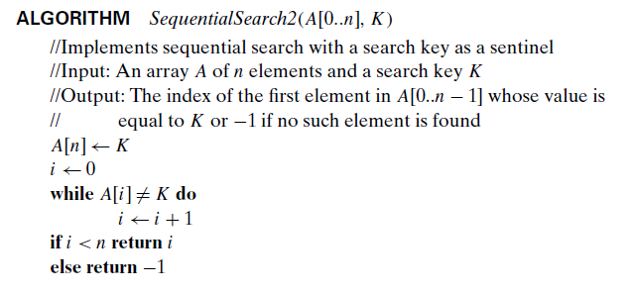
Algorithm

Slide 49
Tracing

Slide 50
Analysis

Slide 51
Students’ Exercise
Another straightforward improvement can be incorporated in sequential search if a given list is known to be sorted
Design an algorithm for above said scenario.
Trace the algorithm for any one set of data containing 10 values
Find the efficiency of your proposed algorithm.

Slide 52
String Matching
Example 04
Introduction

Slide 53
String Matching - Introduction
pattern: a string of m characters to search for
text: a (longer) string of n characters to search in
problem: find a substring in the text that matches the pattern
Pattern: 001011
Text: 10010101101001100101111010
Pattern: happy
Text: It is never too late to have a happy childhood.

Slide 54
String Matching
Example 04
Algorithm and Tracing

Slide 55
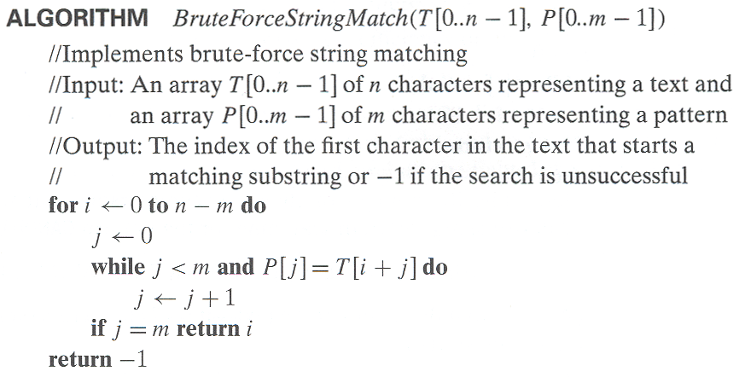
String Matching - Algorithm

Slide 56
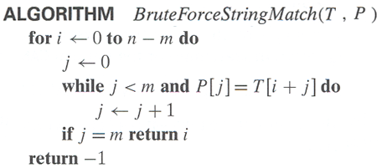
String Matching – Tracing

Slide 57
String Matching
Example 04
Analysis

Slide 58
String Matching – Analysis
Basic Operation
Number of comparisons
For “m” characters
C(n)
Max. Comparisons
m ( n – m + 1 )
O(n m)

Slide 59
Closest Pair Problem
Example 05
Introduction

Slide 60
Closest-Pair Problem
Find the two closest points in a set of n points (in the two-dimensional Cartesian plane).

Slide 61
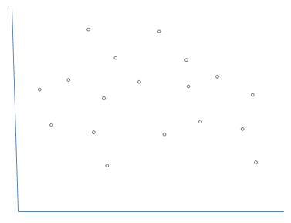
Closest-Pair Problem
Find the two closest points in a set of n points (in the two-dimensional Cartesian plane).

Slide 62
Closest-Pair Problem
Find the two closest points in a set of n points (in the two-dimensional Cartesian plane).
Brute-force algorithm

Slide 63
Closest-Pair Problem
Find the two closest points in a set of n points (in the two-dimensional Cartesian plane).
Brute-force algorithm
Compute the distance between every pair of distinct points

Slide 64
Closest-Pair Problem
Find the two closest points in a set of n points (in the two-dimensional Cartesian plane).
Brute-force algorithm
Compute the distance between every pair of distinct points
and return the indices of the points for which the distance is the smallest.

Slide 65
Closest-Pair Problem
Distance Formula

Slide 66
Closest-Pair Problem
Distance Formula
That the distance between two points pi (xi, yi) and pj (xj, yj ) is the standard Euclidean distance

Slide 67

Closest-Pair Problem
Distance Formula
That the distance between two points pi (xi, yi) and pj (xj, yj ) is the standard Euclidean distance

Slide 68
Closest Pair Problem
Example 05
Algorithm

Slide 69
Closest-Pair Algorithm

Slide 70
Closest Pair Problem
Example 05
Analysis

Slide 71
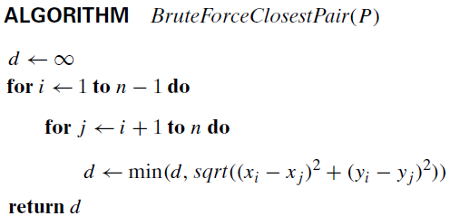
Closest-Pair Algorithm (Analysis)
Basic Operation
Square root may be ignored
Taking Square of value

Slide 72






Closest-Pair Algorithm (Analysis)

Slide 73
Convex Hull Problem
Example 06
Introduction

Slide 74



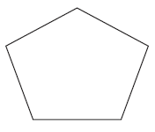


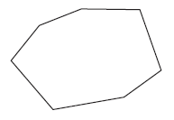
Convex

Slide 75

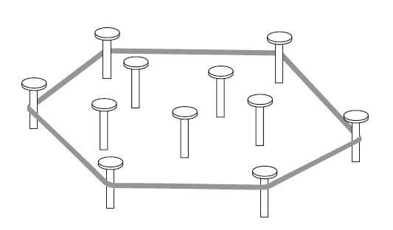
Convex-Hull

Slide 76
Convex Hull Problem
Example 06
Algorithm

Slide 77
Convex-Hull Problem
Brute Force Solution

Slide 78
Convex-Hull Problem
Brute Force Solution
Draw line segments making up the boundary of a convex hull

Slide 79
Convex-Hull Problem
Brute Force Solution
Draw line segments making up the boundary of a convex hull
a line segment connecting two points p_{i} and p_{j} of a set of n points is a part of the convex hull’s boundary if and only if all the other points of the set lie on the same side of the straight line through these two points

Slide 80
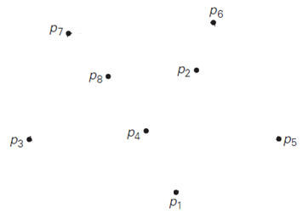
Convex-Hull Problem
Construct the convex hull for a given set S of n points

Slide 81
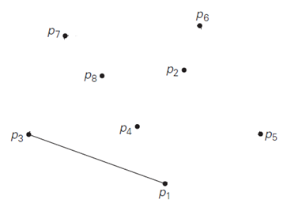
Convex-Hull Problem
Construct the convex hull for a given set S of n points

Slide 82
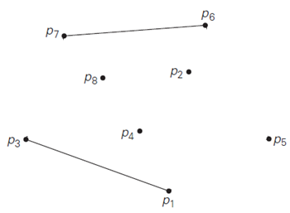
Convex-Hull Problem
Construct the convex hull for a given set S of n points

Slide 83
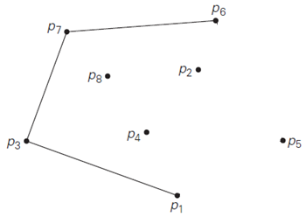
Convex-Hull Problem
Construct the convex hull for a given set S of n points

Slide 84
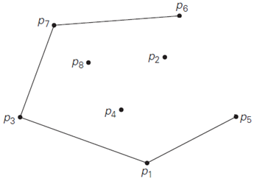
Convex-Hull Problem
Construct the convex hull for a given set S of n points

Slide 85
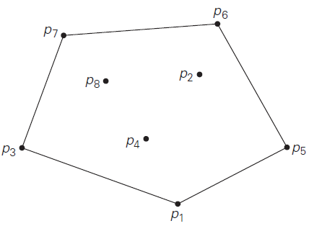
Convex-Hull Problem
Construct the convex hull for a given set S of n points

Slide 86
Convex-Hull Problem
Line Equation

Slide 87
Convex Hull Problem
Example 06
Analysis

Slide 88
Convex-Hull Problem
Analysis

Slide 89
Convex-Hull Problem
Analysis
# of distinct pairs of points
n(n-1) / 2
# of points to process
n - 2
O(n³)

Slide 90
Brute Force Algorithms
Strengths

Slide 91
Brute Force Algorithms
Strengths
wide applicability

Slide 92
Brute Force Algorithms
Strengths
wide applicability
simplicity

Slide 93
Brute Force Algorithms
Strengths
wide applicability
simplicity
yields reasonable algorithms for some important problems (e.g., matrix multiplication, sorting, searching, string matching)

Slide 94
Brute Force Algorithms
Weaknesses

Slide 95
Brute Force Algorithms
Weaknesses
rarely yields efficient algorithms

Slide 96
Brute Force Algorithms
Weaknesses
rarely yields efficient algorithms
some brute-force algorithms are unacceptably slow

Slide 97
Brute Force Algorithms
Weaknesses
rarely yields efficient algorithms
some brute-force algorithms are unacceptably slow
not as constructive as some other design techniques

Slide 98

Allah (Alone) is Sufficient for us, and He is the Best Disposer of affairs (for us).(Quran 3 : 173)

