Slide 1


O my Lord! Expand for me my chest [with assurance] and ease for me my task and untie the knot from my tongue that they may understand my speech. (Quran 20 : 25-28)

Slide 2
Exhaustive Search
Introduction

Slide 3
Exhaustive Search
A brute force solution to a problem involving search for an element with a special property, usually among combinatorial objects such as permutations, combinations, or subsets of a set.
Method:
generate a list of all potential solutions to the problem in a systematic manner
evaluate potential solutions one by one, disqualifying infeasible ones and, for an optimization problem, keeping track of the best one found so far
when search ends, announce the solution(s) found

Slide 4
Exhaustive Search
Travelling Salesman Problem (TSP)

Slide 5
Travelling Salesman Problem (TSP)
Given n cities with known distances between each pair, find the shortest tour that passes through all the cities exactly once before returning to the starting city

Slide 6
Travelling Salesman Problem (TSP)
Find shortest Hamiltonian circuit in a weighted connected graph
2
a
b
5
3
8
4
c
d
7

Slide 7
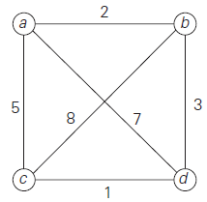

TSP
1
2
3
2
3
1

Slide 8
Exhaustive Search
Knapsack Problem

Slide 9
Knapsack Problem
Given n items of known weights w1, w2, . . . , wn and values v1, v2, . . . , vn and a knapsack of capacity W, find the most valuable subset of the items that fit into the knapsack

Slide 10
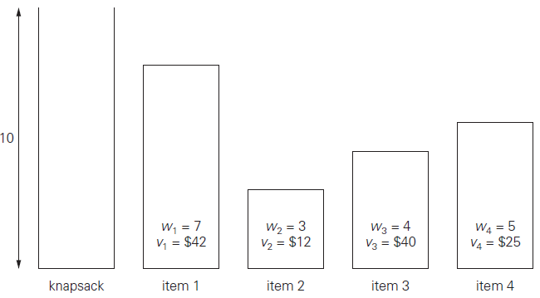
Knapsack Problem

Slide 11

Knapsack Problem

Slide 12

Knapsack Problem

Slide 13
Knapsack Problem

Slide 14
Knapsack Problem

Slide 15
Knapsack Problem

Slide 16
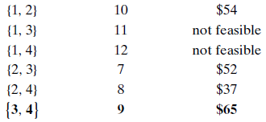
Knapsack Problem

Slide 17
Knapsack Problem

Slide 18
Knapsack Problem

Slide 19
Knapsack Problem

Slide 20
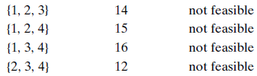
Knapsack Problem

Slide 21
Knapsack Problem

Slide 22
Knapsack Problem

Slide 23
Knapsack Problem

Slide 24
Knapsack Problem

Slide 25
Knapsack Problem

Slide 26

Knapsack Problem

Slide 27
Knapsack Problem

Slide 28
Assignment Problem
Input: There are n people and n jobs
Criteria: each job is assigned to exactly one person
Cost: j^{th} job is assigned to the i^{th} person; is a known quantity C[i, j ]
Output: Assign jobs with the minimum total cost.

Slide 29
Assignment Problem (Solution)
It will be described by
<j₁, j₂, …, j_{n}>
J₁ job is assigned to person 1
J₂ job is assigned to person 2
………
J_{n} job is assigned to person n
<2, 3, 4, 1>

Slide 30
Assignment Problem (Solution)
It will be described by
<j₁, j₂, …, j_{n}>
J₁ job is assigned to person 1
J₂ job is assigned to person 2
………
J_{n} job is assigned to person n
<2, 3, 4, 1> means job 2 is assigned to person 1, job 3 is assigned to 2 and so on

Slide 31
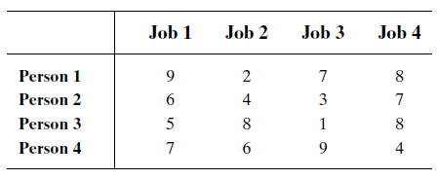
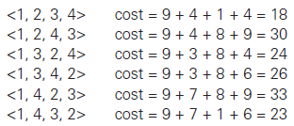
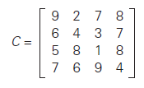
Assignment Problem

Slide 32
Exhaustive Search
Graph Traversal Algorithms

Slide 33
Introduction
Many problems require processing all graph vertices (and edges) in systematic fashion
Graph Traversal Algorithms:
Depth-first search (DFS)
Breadth-first search (BFS)

Slide 34
Depth First Search DFS
Graph Traversal Algorithms

Slide 35
DFS
Visits graph’s vertices by always moving away from last visited vertex to unvisited one, backtracks if no adjacent unvisited vertex is available.
Uses a stack
a vertex is pushed onto the stack when it’s reached for the first time
a vertex is popped off the stack when it becomes a dead end, i.e., when there is no adjacent unvisited vertex
“Redraws” graph in tree-like fashion (with tree edges and back edges for undirected graph)

Slide 36


DFS

Slide 37
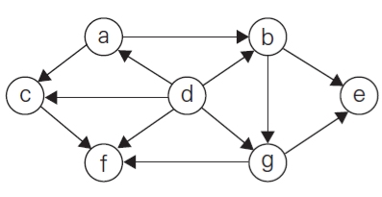
DFS (Example)
Start with “d”
d → (a, b, c, f, g)
a → (b, c)
b → (e, g)
e → *
g → (e, f)
f → *
c → (f)
Pop-off Sequence:
Traversal Sequence:
d, a, b, e, g, f, c

Slide 38
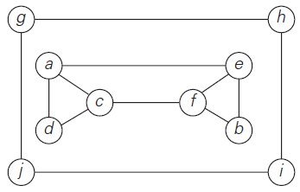
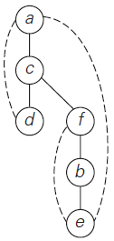

DFS (Example)

Slide 39
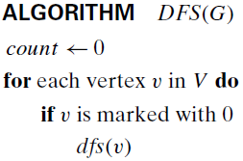
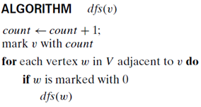
















7
8
9
10
Count
Vertex | a | b | c | d | e | f | g | h | i | j
Traverse
Pop
0
1
2
3
4
5
6
0
5
3
4
7
0
0
2
0
0
0
0
0
0
0
1
6
8
9
10
j
i
h
g
e
b
f
d
Traversal: a, c, d, f, b, e, g, h, i, j
PopOff:
d
e
b
f
c
a
j
i
h
g
c
a

Slide 40
DFS
DFS can be implemented with graphs represented as:
adjacency matrices: Θ(V²)
adjacency lists: Θ(|V|+|E|)
Yields two distinct ordering of vertices:
order in which vertices are first encountered (pushed onto stack)
order in which vertices become dead-ends (popped off stack)
Applications:
checking connectivity, finding connected components
checking acyclicity
finding articulation points and biconnected components
searching state-space of problems for solution (AI)

Slide 41
Breadth First Search BFS
Graph Traversal Algorithms

Slide 42
BFS
Visits graph vertices by moving across to all the neighbors of last visited vertex
Instead of a stack, BFS uses a queue
Similar to level-by-level tree traversal
“Redraws” graph in tree-like fashion (with tree edges and cross edges for undirected graph)

Slide 43


BFS

Slide 44
BFS (Example)

Slide 45
Final Comments on Exhaustive Search
Exhaustive-search algorithms run in a realistic amount of time only on very small instances
In some cases, there are much better alternatives!
Euler circuits
shortest paths
minimum spanning tree
assignment problem
In many cases, exhaustive search or its variation is the only known way to get exact solution

Slide 46

Allah (Alone) is Sufficient for us, and He is the Best Disposer of affairs (for us).(Quran 3 : 173)

