Slide 1
William Stallings
Computer Organization and Architecture
6th Edition
Chapter 11
Instruction Sets:
Addressing Modes and Formats

Slide 2
Addressing Modes
Immediate
Direct
Indirect
Register
Register Indirect
Displacement (Indexed)
Stack
Notes:
2

Slide 3
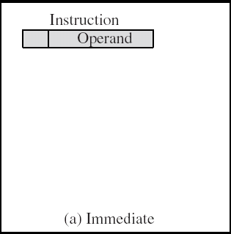
Immediate Addressing
Operand is part of instruction
Operand = address field
e.g. ADD AX, 5h
LDA #5
  Add 5 to contents of accumulator
  5 is operand
No memory reference to fetch data
Fast
Limited range
Notes:
3

Slide 4
Direct Addressing
Address field contains address of operand
Effective address EA = address field (A)
ADD AX, value
Value DB 05h
  Add contents of cell value to accumulator AX
  Look in memory at address value for operand
Single memory reference to access data
No additional calculations to work out effective address
Limited address space
Notes:
5

Slide 5
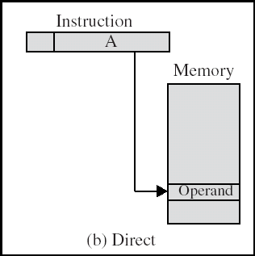
Direct Addressing Diagram
Notes:
6

Slide 6
Indirect Addressing (1/2)
Memory cell pointed to by address field contains the address of (pointer to) the operand
EA =(A)
  Look in A, find address (A) and look there for operand
e.g. ADD AX, (A)
  Add contents of cell pointed to by contents of A to accumulator
Notes:
7

Slide 7
Indirect Addressing (2/2)
Large address space
2^{n} where n = word length
May be nested, multilevel, cascaded
  e.g. EA = (((A)))
    Draw the diagram yourself
Multiple memory accesses to find operand
Hence slower
Notes:
8

Slide 8
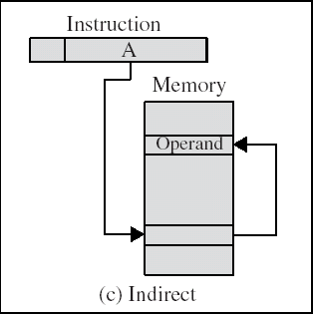
Indirect Addressing Diagram
Notes:
9

Slide 9
Register Addressing (1/2)
Operand is held in register named in address filed
EA = R
Limited number of registers
Very small address field needed
  Shorter instructions
  Faster instruction fetch
  MOV AX, BX
  ADD AX, BX
Notes:
10

Slide 10
Register Addressing (2/2)
No memory access
Very fast execution
Very limited address space
Multiple registers helps performance
  Requires good assembly programming or compiler writing
  N.B. C programming
    register int a;
c.f. Direct addressing
Notes:
11

Slide 11
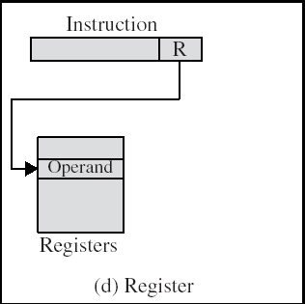
Register Addressing Diagram
Notes:
12

Slide 12
Register Indirect Addressing
C.f. indirect addressing
EA = (R)
Operand is in memory cell pointed to by contents of register R
Large address space (2^{n})
One fewer memory access than indirect addressing
Notes:
13

Slide 13
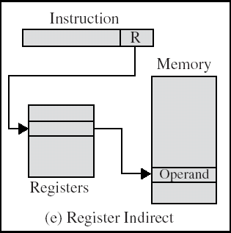
Register Indirect Addressing Diagram
Notes:
14

Slide 14
Displacement Addressing
EA = A + (R)
Effective address=start address + displacement
Effective address=Offset + (Segment Register)
Use direct and register indirect
Address field hold two values
  A = base value
  R = register that holds displacement
  or vice versa
Notes:
15

Slide 15
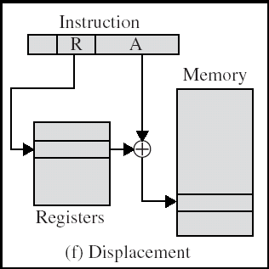
Displacement Addressing Diagram
Notes:
16

Slide 16
Relative Addressing (PC-Relative)
A version of displacement addressing
R = Program counter, PC
EA = A + (PC)
i.e. get operand from A cells from current location pointed to by PC
c.f locality of reference & cache usage
Notes:
17

Slide 17
Base-Register Addressing
A holds displacement
  EA = (CS) + A
R holds pointer to base address
R may be explicit or implicit
e.g. segment registers in 80x86
Notes:
18

Slide 18
Indexed Addressing
A = base
R = displacement
  EA = A + (R)
Good for accessing arrays
  EA = A + (R)
  R++
Notes:
19

Slide 19
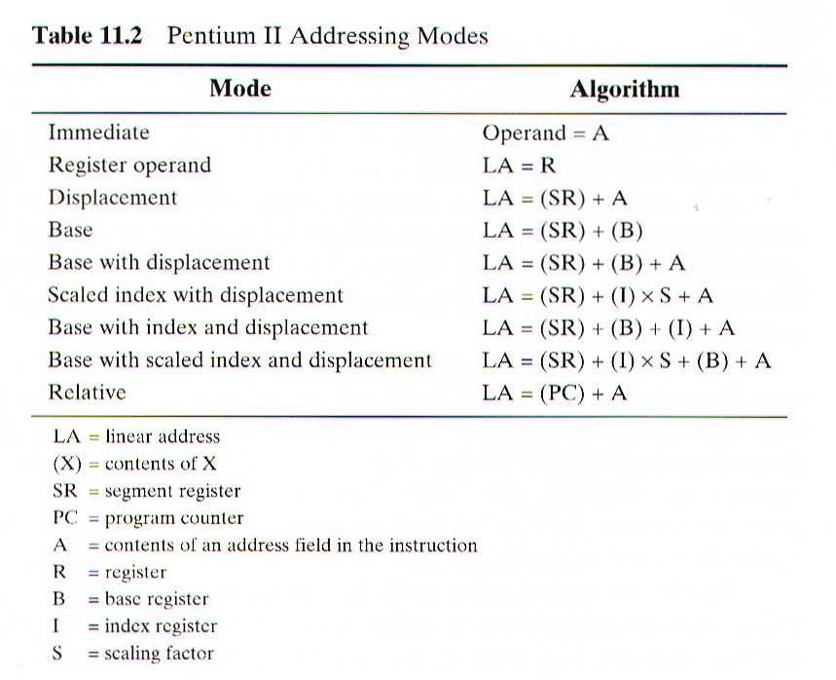
Combinations
Postindex
  EA = (A) + (R)
Preindex
  EA = (A+(R))
Notes:
20

Slide 20
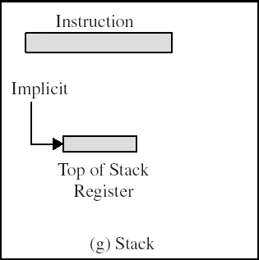
Stack Addressing
Operand is (implicitly) on top of stack
e.g.
  ADD Pop top two items from stack and add and push
Notes:
21

Slide 21
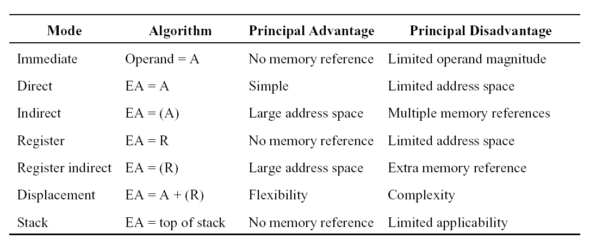

Slide 22
ADDRESSING MODES - EXAMPLE
Address
Memory
200
Load to AC Mode
PC = 200
201
Address = 500
202
Next instruction
R1 = 400
XR = 100
400
700
AC
500
800
Addressing
Mode
Effective
Address
Content
of AC
600
900
  Direct address 500 /* AC ← (500) */ 800
  Immediate operand - /* AC ← 500 */ 500
  Indirect address 800 /* AC ← ((500)) */ 300
  Relative address 702 /* AC ← (PC+500) */ 325
  Indexed address 600 /* AC ← (XR+500) */ 900
  Register - /* AC ← R1 */ 400
  Register indirect 400 /* AC ← (R1) */ 700
702
325
800
300

