Slide 1
Decoder & Multiplexer
Dr. M. Khamis

Slide 2
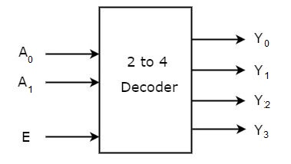
Decoder
is a combinational circuit that has n input lines and maximum of 2^{n} output lines. One of these outputs will be active High based on the combination of inputs present, when the decoder is enabled. That means decoder detects a particular code.
Let 2 to 4 Decoder has two inputs A₁ & A₀ and four outputs Y₀, Y₁, Y₂ and Y₃. The block diagram of 2 to 4 decoder is shown in the following figure.

Slide 3
Truth table and design equations
The design equations
Y₀=E.A₀′.A₁′
Y₁=E.A₀.A₁′
Y₂=E.A₀ ′.A₁
Y₃=E.A₀.A₁
Inputs |  |  | Outputs
E | A₁ | A₀ | Y₀ | Y₁ | Y₂ | Y₃
1 | 0 | 0 | 1 | 0 | 0 | 0
1 | 0 | 1 | 0 | 1 | 0 | 0
1 | 1 | 0 | 0 | 0 | 1 | 0
1 | 1 | 1 | 0 | 0 | 0 | 1
0 | x | x | 0 | 0 | 0 | 0

Slide 4
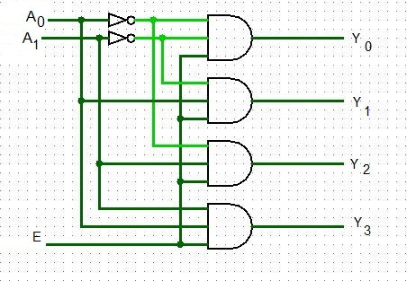
The circuit of 2x4 circuit
As you see from the design equations, each output of the decoder corresponds to one minterm of its inputs when enabled (i.e. E= 1).
You can give the design equations for the decoder of any size by the same way as illustrated in the above example

Slide 5
The decoder uses
The decoder is used for 2-functions
To implement any logical expression
To identify the destination for the data (this function is illustrated later in multiplexer section)
To use Decoder to implement logical expression you have to get the logic ex pressin using its minterms (i.e. not the simplified form).
Ex-1: implement the following logic expression F= XYZ’+ X’Y’Z + x’Y’Z’
We can represents in numerical form as
F= ∑ 3, 4, 1 (based on X is LSB).
The corresponding implementation using 3x8 decoder in the next slide.

Slide 6
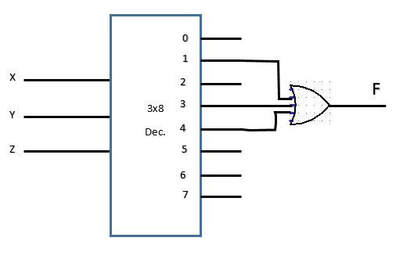
implementation of the expression

Slide 7
Example 2
Assume that the expression is not represented by its minterms, then we will have 2-choices.
Consider F=(x+y)z+ x’y’ (this expression not represented by minterms)
The first convert the expression to be represented by minterms as follow:
F=xz+ yz+ x’y’ , then bring to each term its missed leteral without changing to the original expression as follow:
F=xz(y+ y’)+ yz(x+x’)+ x’y`(z+z’)= xyz+xy’z+xyz+x’yz+x’y’z+x’y’z’ (these form is using minterms)
(consider only one expression of the repetitive expressions i.e. if xyz is repeated as in the expression consider only one and drop the rest)
F= ∑7, 5, 6, 4, 0
(these form is using minterms represented in numerical based on consideration that X is LSB)
The implementation in the next slide

Slide 8
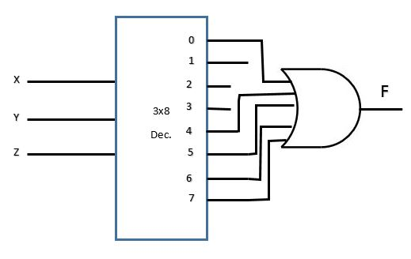
implementation of the expression

Slide 9
How to obtain big decoder using smaller once
The smaller decoder are organized in cascading levels in which the output level consists of number of small decoders that give the total number of output lines (i.e. to implement 3x8 using 1x2 decoders). In this case the output is 8 and the small decoder (1x2) consists only of 2 –output (i.e. we will need 4 (1x2 decoder) to get 8 outputs, now in the next level we need number of decoders to enable the 4 decoders in the output level this is done using 2 (1x2). Finally we end with 1 (1x2 decoder) to derive the 2 decoders of the former level.
Also you can use big decoder to work in place of small decoder.

Slide 10
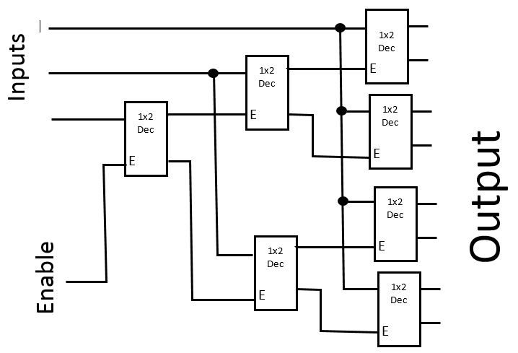
Implementation of 3x8 decoder using 1x2 decoders

Slide 11
Multiplexer
is a combinational circuit that has maximum of 2^{n} data inputs, ‘n’ selection lines and single output line. One of these data inputs will be connected to the output based on the values of selection lines.
Since there are ‘n’ selection lines, there will be 2^{n} possible combinations of zeros and ones. So, each combination will select only one data input. Multiplexer is also called as Mux.

Slide 12
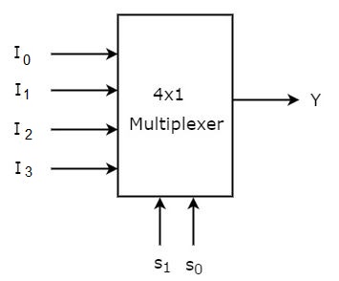
4x1 Multiplexer
4x1 Multiplexer has four data inputs I₀, I₁, I₂ and I₃, two selection lines s₀ & s₁ and one output Y. The block diagram of 4x1 Multiplexer is shown in the following figure.

Slide 13
4x1 Multiplexer
One of these 4 inputs will be connected to the output based on the combination of inputs present at these two selection lines. Truth table of 4x1 Multiplexer is shown below.
∴ Y= S’₁S’₀ I₀ + S’₁S₀ I₁+ S₁S’₀ I₂+ S₁S₀ I₃
Selection |  | Output
s₁ | s₀ | Y
0 | 0 | I₀
0 | 1 | I₁
1 | 0 | I₂
1 | 1 | I₃

Slide 14
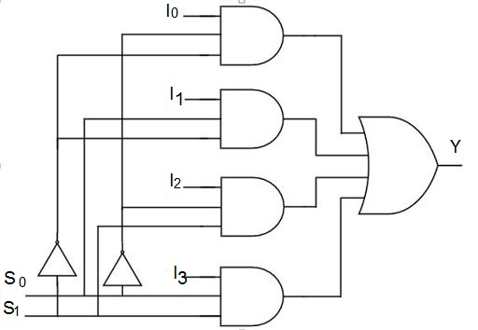
Implementation of 4x1 Multiplexer

Slide 15
Implementation of Higher-order Multiplexers using small one
let us implement 8x1 Multiplexer using 4x1 Multiplexers and 2x1 Multiplexer. We know that 4x1 Multiplexer has 4 data inputs, 2 selection lines and one output. Whereas, 8x1 Multiplexer has 8 data inputs, 3 selection lines and one output.
So, we require two 4x1 Multiplexers in first stage in order to get the 8 data inputs. Since, each 4x1 Multiplexer produces one output, we require a 2x1 Multiplexer in second stage by considering the outputs of first stage as inputs and to produce the final output.
Let the 8x1 Multiplexer has eight data inputs I₀ to I₇, three selection lines s₀, s₁ and s₂ and one output Y. The Truth table of 8x1 Multiplexer is shown on next slide.

Slide 16
Truth table of 8x1 Multiplexer
Selections |  |  | Outputs
S₂ | S₁ | S₀ | Y
0 | 0 | 0 | I₀
0 | 0 | 1 | I₁
0 | 1 | 0 | I₂
0 | 1 | 1 | I₃
1 | 0 | 0 | I₄
1 | 0 | 1 | I₅
1 | 1 | 0 | I₆
1 | 1 | 1 | I₇

Slide 17
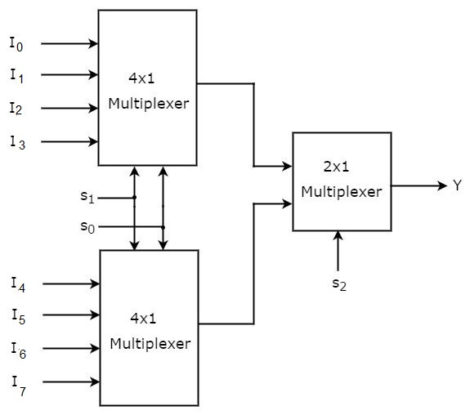
Implementation of Higher-order Multiplexers

Slide 18
Implementation of Higher-order Multiplexers
The same selection lines, s₁ and s₀ are applied to both 4x1 Multiplexers. The data inputs of upper 4x1 Multiplexer are I₀ to I₃ and the data inputs of lower 4x1 Multiplexer are I₄ to I₇. Therefore, each 4x1 Multiplexer produces an output based on the values of selection lines, s₁ & s₀.
The outputs of first stage 4x1 Multiplexers are applied as inputs of 2x1 Multiplexer that is present in second stage. The other selection line, s₂ is applied to 2x1 Multiplexer.
If s₂ is zero, then the output of 2x1 Multiplexer will be one of the 4 inputs I₀ to I₀₃ based on the values of selection lines s₁ & s₀.
If s₂ is one, then the output of 2x1 Multiplexer will be one of the 4 inputs I₄ to I₇ based on the values of selection lines s₁ & s₀.
Verify the correctness of this schematic your self

Slide 19
Function of Multiplexer
The multiplexer has 2-functions:
Identify data source
Implements any logical expression
Let us give an example for the second use in the follow:
Basically it depends on converting any logical expression into its corresponding truth table, let us consider the logical expression
F=(x+y)z+ x’y’
Also we can put it as
F=xz+ yz+ x’y’ (∴ F=1 if one of these condition occurred
(X=1 and z=1) or (y=1 and z=1) or (x=0 and y=0). Then we drive the corresponding truth table as in the next slid.

Slide 20
Implementing logical expression using multiplexer
z | y | x | F | remarks
0 | 0 | 0 | 1 | x=0 and y=0
0 | 0 | 1 | 0
0 | 1 | 0 | 0
0 | 1 | 1 | 0
1 | 0 | 0 | 1 | x=0 and y=0
1 | 0 | 1 | 1 | x=1 and z=1
1 | 1 | 0 | 1 | y=1 and z=1
1 | 1 | 1 | 1 | x=1 and z=1

Slide 21
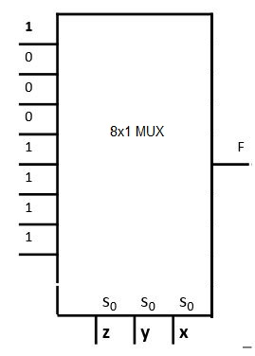
Implementation using 8x1 MUX

Slide 22
Implementation using 4x1 MUX
In this case we use two of the inputs as select lines for the Mux and find a relation between the output F with the other inputs (in this case 1 input) for the different values of the select (i.e. when select = 0, 1, 2 or 3)
I will use yz as select because the lines of their equal values are subsequent to each other.
Select yz | z | y | x | F | remarks
0 | 0 | 0 | 0 | 1 | x=0 and y=0
 | 0 | 0 | 1 | 0
1 | 0 | 1 | 0 | 0
 | 0 | 1 | 1 | 0
2 | 1 | 0 | 0 | 1 | x=0 and y=0
 | 1 | 0 | 1 | 1 | x=1 and z=1
3 | 1 | 1 | 0 | 1 | y=1 and z=1
 | 1 | 1 | 1 | 1 | x=1 and z=1

Slide 23
Implementation using 2x1 MUX
In this case we use one of the inputs as select lines for the Mux (we use z) and find a relation between the output F with the rest of the inputs (in this case 2 input x and y) for the different values of the select (i.e. when select = 0, 1)
I will use z as select because the lines of their equal values are subsequent to each other as you see in the table.
select | z | y | x | F | remarks
0 | 0 | 0 | 0 | 1 | x=0 and y=0
 | 0 | 0 | 1 | 0
 | 0 | 1 | 0 | 0
 | 0 | 1 | 1 | 0
1 | 1 | 0 | 0 | 1 | x=0 and y=0
 | 1 | 0 | 1 | 1 | x=1 and z=1
 | 1 | 1 | 0 | 1 | y=1 and z=1
 | 1 | 1 | 1 | 1 | x=1 and z=1

Slide 24
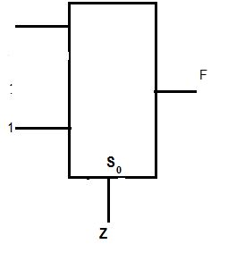



Implementation using 2x1 MUX
When select=0 ( z=0 )we find F= x’y’
When select=1 (z=1 )we find F has fixed value = 1
X
y
2x1 Mux

Slide 25
Using Mux to identify source and decoder to identify Destination
Consider that we have 4 registers contains data. Their labels are R₀, R₁, R₂ and R₃ now in order to transfer data from any one them, then we have to connect them to 4x1 MUX (the output of the Mux will be the value of one of these register based on the value of the selects) if selects =0 then the output from the Mux will be the value of R₀
To transfer the output of the MUX to any register from the 4-registers, then we connect the output of the Mux to all registers’ input. But because all register are unable to receive the data. The only register that receive this data is the register which is enable=1.
This is done by 2x4 decoder via connecting its output to Enable lines of the different register.
The if you want to move the data into R₂ set the decoder inputs=2 to enable this register (i.e. R₂) as shown in the next slide

Slide 26
Using Mux to identify source and decoder to identify Destination
To move data from R₂ ← R₀
Simply set S₀S₁= 00
and set x= 0 and Y=1
R₀
L₀
2x 4 Dec
4x1 MUX
R₁
X
L₁
Y
R₂
L₂
R₃
S₁
S₀
L₃

