Slide 1
Flip Flops and Counters
Dr. M. Khamis

Slide 2
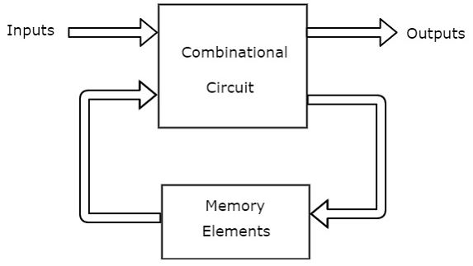
Digital Sequential Circuits
We discussed various combinational circuits in earlier section. All these circuits have a set of outputs, which depends only on the combination of present inputs. On the contrary there is other type of logic circuit called sequential circuits. In this type outputs are function of the “inputs” and values coming from storage inside the circuit called “state”
The following figure shows the block diagram of sequential circuit.

Slide 3
Type of sequential and type of triggers
Regarding types of sequential we find synchronous (in which the output change according to clock) and asynchronous (no clock exists and the output change according immediately in events of change in the inputs or state).
Regarding to triggers: there are level and edge triggers. The edge trigger is either positive or negative.

Slide 4
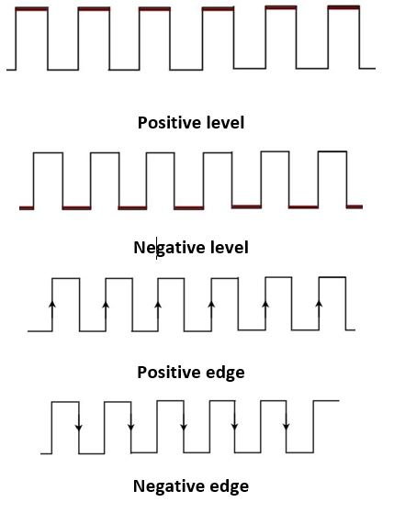
Level and edge clock

Slide 5
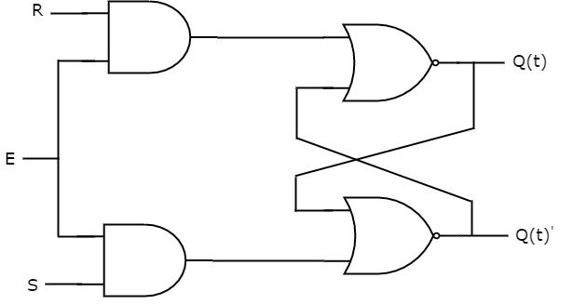
SR Latches
Latches operate with enable signal, which is level sensitive. See the SR latch in the figure and truth table and transition tables.
S | R | Q _{t+1}
0 | 0 | Q _{t} | No change
1 | 0 | 1 | Set
0 | 1 | 0 | reset
1 | 1 | invalid
Q _{t} | Q _{t+1} | S | R
0 | 0 | 0 | d
0 | 1 | 1 | 0
1 | 0 | 0 | 1
1 | 1 | d | 0

Slide 6
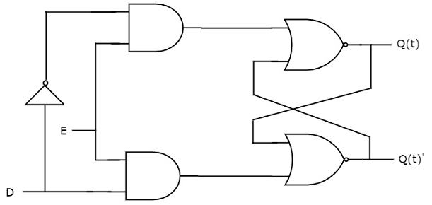
D-Latches
There is one drawback of SR Latch. That is the next state value can’t be predicted when both the inputs S & R are one. So, we can overcome this difficulty by D Latch. It is also called as Data Latch. The circuit diagram of D Latch is shown in the following figure.
D | Q _{t+1} | Remarks
0 | 0 | reset
1 | 1 | set
Q _{t} | Q _{t+1} | D
0 | 0 | 0
0 | 1 | 1
1 | 0 | 0
1 | 1 | 1

Slide 7
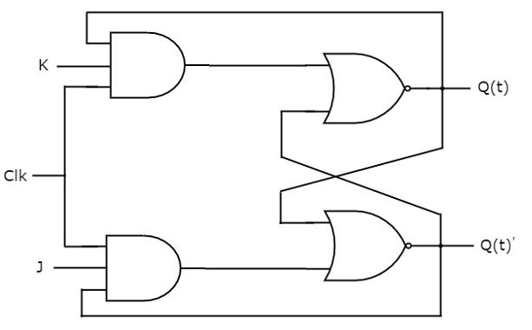
JK Flip Flop
J | K | Q _{t+1}
0 | 0 | Q _{t} | No change
1 | 0 | 1 | Set
0 | 1 | 0 | reset
1 | 1 | Q’ _{t} | change
JK flip-flop is the modified version of SR flip-flop. It operates with only positive clock transitions or negative clock transitions. The circuit diagram of JK flip-flop and its truth table and transition tables are:
Q _{t} | Q _{t+1} | J | K
0 | 0 | 0 | d
0 | 1 | 1 | d
1 | 0 | d | 1
1 | 1 | d | 0

Slide 8
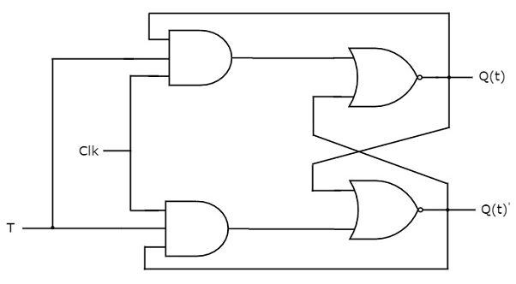
T Flip Flop
T flip-flop is the simplified version of JK flip-flop. It is obtained by connecting the same input ‘T’ to both inputs of JK flip-flop. It operates with only positive clock transitions or negative clock transitions. The circuit diagram of T flip-flop is shown in the following figure:
T | Q _{t+1}
0 | Q _{t} | No change
1 | Q’ _{t} | change
Q _{t} | Q _{t+1} | T
0 | 0 | 0
0 | 1 | 1
1 | 0 | 1
1 | 1 | 0

Slide 9
Design Synchronous counters
Determine the counting sequence.
Determine the next state for all states which are not in the counting sequence.
Give table shows each counting sequence and its next sequence.
Use the transition table of the Flip flop used in the implementation to determine the input of each FF, that drives for the next sequence.
Example: design counter to count in sequence 1, 2, 3, 5, 7 and to repeat the same sequence again. Consider 1 is the next state for all other which are not in the counting sequence.
Implement the above counter using a) SR-FF b) JK-FF C) T-FF

Slide 10
Design Using SR-FF
Current state |  |  | Next State |  |  | 1st FF (Q₀) |  | 2nd FF (Q₁) |  | 3rd FF (Q₂)
Q₂ | Q₁ | Q₀ | Q₂ | Q₁ | Q₀ | S₀ | R₀ | S₁ | R₁ | S₁ | R₂
0 | 0 | 0 | 0 | 0 | 1 | 1 | 0 | 0 | d | 0 | d
0 | 0 | 1 | 0 | 1 | 0 | 0 | 1 | 1 | 0 | 0 | d
0 | 1 | 0 | 0 | 1 | 1 | 1 | 0 | d | 0 | 0 | d
0 | 1 | 1 | 1 | 0 | 1 | d | 0 | 0 | 1 | 1 | 0
1 | 0 | 0 | 0 | 0 | 1 | 1 | 0 | 0 | d | 0 | 1
1 | 0 | 1 | 1 | 1 | 1 | d | 0 | 1 | 0 | d | 0
1 | 1 | 0 | 0 | 0 | 1 | 1 | 0 | 0 | 1 | 0 | 1
1 | 1 | 1 | 0 | 0 | 1 | d | 0 | 0 | 1 | 0 | 1

Slide 11
Design equations using SR-FF
 |  | Q₂Q₁ |  |  |  |  |  |  | Q₂Q₁ |  |  |  |  |  | Q₂Q₁
 |  | 00 | 01 | 11 | 10 |  |  |  | 00 | 01 | 11 | 10 |  |  | 00 | 01 | 11 | 10
Q₀ | 0 | 1 | 1 | 1 | 1 |  | Q₀ | 0 | 0 | d | 0 | 0 | Q₀ | 0 | 0 | 0 | 0 | 0
 | 1 | 0 | d | d | d |  |  | 1 | 1 | 0 | 0 | 1 |  | 1 | 0 | 1 | 0 | d
S₀= Q’₀ |  |  |  |  |  |  |  |  | S₁= Q₀Q’₁ |  |  |  |  |  |  | S₂=Q₀Q₁Q’₂
 |  | Q₂Q₁ |  |  |  |  |  |  | Q₂Q₁ |  |  |  |  |  | Q₂Q₁
 |  | 00 | 01 | 11 | 10 |  |  |  | 00 | 01 | 11 | 10 |  |  | 00 | 01 | 11 | 10
Q₀ | 0 | 0 | 0 | 0 | 0 |  | Q₀ | 0 | d | 0 | 1 | d | Q₀ | 0 | d | d | 1 | 1
 | 1 | 1 | 0 | 0 | 0 |  |  | 1 | 0 | 1 | 1 | 0 |  | 1 | d | 0 | 1 | 0
R₀=Q₀Q’₁Q’₂ |  |  |  |  |  |  |  |  | R₁=Q₀Q₁+ Q₁Q₂ |  |  |  |  |  |  | R₂=Q’₀+ Q₁Q₂

Slide 12
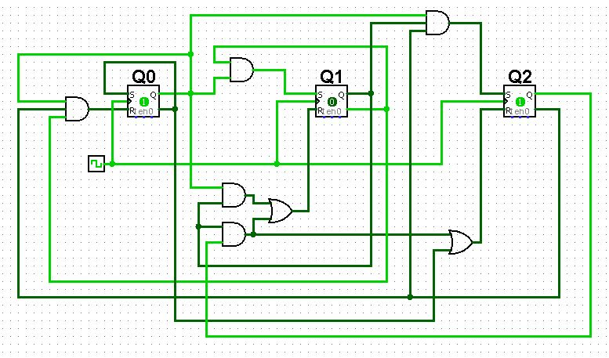
Implementation Using SR-FF

Slide 13
Design Using T-FF
Current state |  |  | Next State |  |  | 1st FF (Q₀) | 2nd FF (Q₁) | 3rd FF (Q₂)
Q₂ | Q₁ | Q₀ | Q₂ | Q₁ | Q₀ | T₀ | T₀ | T₁
0 | 0 | 0 | 0 | 0 | 1 | 1 | 0 | 0
0 | 0 | 1 | 0 | 1 | 0 | 1 | 1 | 0
0 | 1 | 0 | 0 | 1 | 1 | 1 | 0 | 0
0 | 1 | 1 | 1 | 0 | 1 | 0 | 1 | 1
1 | 0 | 0 | 0 | 0 | 1 | 1 | 0 | 1
1 | 0 | 1 | 1 | 1 | 1 | 0 | 1 | 0
1 | 1 | 0 | 0 | 0 | 1 | 1 | 1 | 1
1 | 1 | 1 | 0 | 0 | 1 | 0 | 1 | 1

Slide 14
Design equations using T-FF
 |  | Q₂Q₁ |  |  |  |  |  |  | Q₂Q₁ |  |  |  |  |  | Q₂Q₁
 |  | 00 | 01 | 11 | 10 |  |  |  | 00 | 01 | 11 | 10 |  |  | 00 | 01 | 11 | 10
Q₀ | 0 | 1 | 1 | 1 | 1 |  | Q₀ | 0 | 0 | 0 | 1 | 0 | Q₀ | 0 | 0 | 0 | 1 | 1
 | 1 | 1 | 0 | 0 | 0 |  |  | 1 | 1 | 1 | 1 | 1 |  | 1 | 0 | 1 | 1 | 0
T₀= Q’₀ +Q’₁Q’₂ |  |  |  |  |  |  |  |  | T₁= Q₀+ Q₁Q₂ |  |  |  |  |  |  | T₂=Q₀Q₁+ Q’₀Q₂

Slide 15
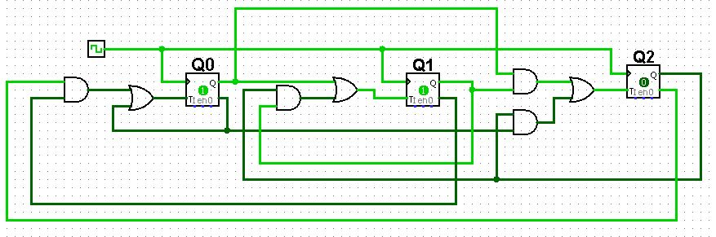
Implementation Using T-FF

Slide 16
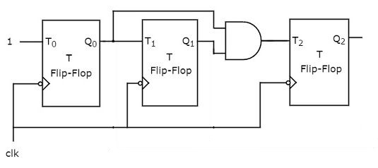
Sequential circuit Analysis
In this regard a circuit is given and student are required to get corresponding counting sequence. Consider the next circuit and analysis to get its counting sequence.
From the circuit we can find that:
T₀=1 T₂= Q₀
T₃=Q₀Q₁
Current state |  |  | Next Input |  |  | Next state
Q₂ | Q₁ | Q₀ | T₂ | T₁ | T₀ | Q₂ | Q₁ | Q₀
0 | 0 | 0 | 0 | 0 | 1 | 0 | 0 | 1
0 | 0 | 1 | 0 | 1 | 1 | 0 | 1 | 0
0 | 1 | 0 | 0 | 0 | 1 | 0 | 1 | 1
0 | 1 | 1 | 1 | 1 | 1 | 1 | 0 | 0
1 | 0 | 0 | 0 | 0 | 1 | 1 | 0 | 1
1 | 0 | 1 | 0 | 1 | 1 | 1 | 1 | 0
1 | 1 | 0 | 0 | 0 | 1 | 1 | 1 | 1
1 | 1 | 1 | 1 | 1 | 1 | 0 | 0 | 0
In the table we have to consider all possible states (in this case 0-7 because we have 3-T FF). For each state we calculate the values of T’s and then if T=0 no change occurs and if T=1 change occur. After applying that you can find that the circuit counts sequentially from 0-7 in ascending order

