Slide 1
Logic gates & Derivation and Simplification of logic Expressions
Dr. M. Khamis

Slide 2
Logic gates
Inverter gate (NOT gate_
this gate has only 1 input and only one output.
The output is False if the input is True and vice versa (output is true if input is false).
Consider NOT gate with input A and output Y. its symbol and its Truth Table TT (table determine the output for all possible input values) are shown on next slide

Slide 3
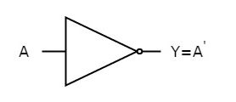
Logic gates
If the inputs donated by A and the output denoted by symbol Y
We say Y=A’ or F= A (all these expressions are synonym)
A | Y
0 | 1
1 | 0
NOT gate Symbol
NOT gate Truth Table

Slide 4
Logic gates
AND gate
this gate has 2 or more inputs and only one output.
The output is true if all of its inputs are true otherwise output is false. True and false are binary values which are represented by logic 1 and logic 0.
Logic 1: represented inside computer with signal strength of 5 volt.
Logic 0: represented inside computer with signal strength of 0 volt.
Consider AND gate with 2-input its symbol and its truth table T T (table determine the output for all possible input values) are shown on next slide

Slide 5
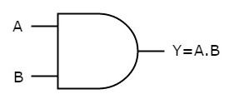
Logic gates
If the inputs donated by A and B and the output denoted by symbol Y
We say Y=A.B or F=AB or F=A AND B (all these expressions are synonym)
B | A | Y
0 | 0 | 0
0 | 1 | 0
1 | 0 | 0
1 | 1 | 1
AND gate Symbol
AND gate Truth Table

Slide 6
Logic gates
OR gate
this gate has 2 or more inputs and only one output.
The output is False if all of its inputs are False otherwise output is True.
Consider OR gate with 2-input its symbol and its Truth Table TT (table determine the output for all possible input values) are shown on next slide

Slide 7
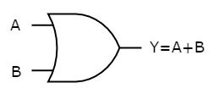
Logic gates
If the inputs donated by A and B and the output denoted by symbol Y
We say Y=A+B or F=A OR B (all these expressions are synonym)
B | A | Y
0 | 0 | 1
0 | 1 | 1
1 | 0 | 1
1 | 1 | 0
OR gate Symbol
OR gate Truth Table

Slide 8
Logic gates
NAND gate
this gate has 2 or more inputs and only one output.
The output is False if all of its inputs are true otherwise output is True (the complement of The AND gate’s output).
Consider NAND gate with 2-input its symbol and its Truth Table TT (table determine the output for all possible input values) are shown on next slide.

Slide 9
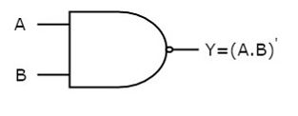
Logic gates
If the inputs donated by A and B and the output denoted by symbol Y
We say Y=(AB)’ or F=AB (all these expressions are synonym)
B | A | Y
0 | 0 | 0
0 | 1 | 0
1 | 0 | 0
1 | 1 | 1
NAND gate Symbol
NAND gate Truth Table

Slide 10
Logic gates
NOR gate
this gate has 2 or more inputs and only one output.
The output is TRUE only when all inputs are false otherwise output is false (the complement of The OR gate’s output).
Consider NOR gate with 2-input its symbol and its Truth Table TT (table determine the output for all possible input values) are shown on next slide.

Slide 11
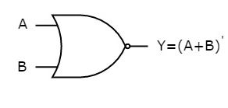
Logic gates
If the inputs donated by A and B and the output denoted by symbol Y
We say Y=(A+B)’ or F=A+B (all these expressions are synonym)
B | A | Y
0 | 0 | 1
0 | 1 | 0
1 | 0 | 0
1 | 1 | 0
NOR gate Symbol
NOR gate Truth Table

Slide 12
Logic gates
XOR gate (Exclusive OR)
this gate has 2 inputs and only one output.
The output is TRUE when inputs are different otherwise output is false (i.e. when all inputs are equal).
Consider XOR gate with 2-input its symbol and its Truth Table TT (table determine the output for all possible input values) are shown on next slide.

Slide 13
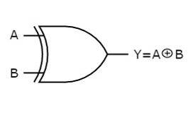
Logic gates
If the inputs donated by A and B and the output denoted by symbol Y
We say Y=A ⊕ B
B | A | Y
0 | 0 | 0
0 | 1 | 1
1 | 0 | 1
1 | 1 | 0
NOR gate Symbol
XOR gate Truth Table

Slide 14
Converting Physical problem to truth table
Three partners in a company their names (Mohamed, Ali and Hassan), they holding shares of 400, 300 and 200 share respectively. During their establishment of their business they agreed on the policy to take a decision for the different affairs of this company. The policy was is to use voting, the voting is considered in favor if the sum of shares of the partners in favor are 400 shares or more.
For example, if the partners will vote in order to know the partners ’decision to buy a computer for the company, if the voters in favor of the purchase hold 400 shares or more, then the decision is considered in favor of the purchase, otherwise it is considered not valid in the purchase. Give the logic expression to represent this problem.

Slide 15
Converting Physical problem to truth table
The voting for each partners can be represented by a logical variable which cane take values of {1: when be in favor of 0: when be against}. Consider the voting variables for Mohamed, Ali and Hassan are X, Y and Z respectively and the result of voting is F {1: when the decision in favor purchase and 0 for against}.
This problem is represented using the next truth table

Slide 16
Converting Physical problem to truth table
Z | Y | X | F
0 | 0 | 0 | 0
0 | 0 | 1 | 1
0 | 1 | 0 | 0
0 | 1 | 1 | 1
1 | 0 | 0 | 0
1 | 0 | 1 | 1
1 | 1 | 0 | 1
1 | 1 | 1 | 1
This Table consider all possible voting cases of the partners and the decision for purchase in each case which is represented by logical variable F

Slide 17
Deriving logic expression Using Sum-of-Product
Voting in favor will be represented by 1 and voting against is represented by 0. In truth table 1st case (row) all partners vote against and is represented by X’Y’Z’ , while the 2nd case mohamed vote in favor and the other two were against so it represented by XY’Z’ called the product term represent this case and we call it minterm as well.
the sum of minterms for cases in which F=1 are used to represent the logic output function of this problem and this is called Sum-of_Product (SOP).
F=XY’Z’+ XYZ’ + XY’Z + X’YZ + XYZ
(is also called canonical form in SOP)
SOP: Is the sum of mintermes for which F=1
Canonical form is a standard form that all of us will get the same form because it does not contains any kind of simplifications.

Slide 18
Deriving logic expression Using Product-of-Sum
As you see in the previous case the logical expression is sum of all minterms in which F=1 occurred.
We can state the expression in another way, by saying (if all cases in which F=0 did not occurred) then the function also will be true. Not occur for minterm is called Maxterm.
Product of Sum : is the product of Maxterms for which F= 0.
In the above example we Say F(x,y, z)= Π M (0,2, 4)
Maxterm of 0 is the complement of minterm(0) which is x’y’z’, its complement (Maxterm) will be x+y+z.
Therfore F= (x+y+z)(x+y’+z)(x+y+ z’)
this expression is equivalent to the previous expression derived using SOP.
POS : is the product of Maxterms for which F=0

Slide 19
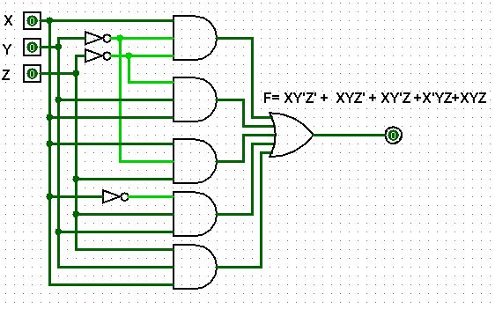
Converting Logic Expression into logic circuit
The Expression of F is implemented as in the next logic circuit
F=XY’Z’+ XYZ’ + XY’Z + X’YZ + XYZ

Slide 20
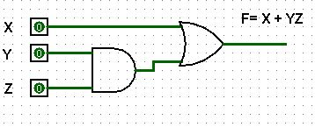
Simplified Logic expression
By your embed logic you can give different expression for the previous problem when I asking you the following question:
When is the company eligible to purchase any property?
I will expect your logical answer to be as:
If mohamed agreed (OR) both Ali (AND) Hassan
The previous statement is formulated as
F= X+ YZ
Which has the implementation of the shown figure.
Both of the circuit here and the previous implementation give the same output (the Function here called the simplified function).

Slide 21
Why we need simplification
The simplification has the following advantages:
Low Cost as the circuit need less components.
Faster where passing electrical signal in the gates embeds delay, the more gates electrical signal pass through, the more accumulated delay. According to this fact the circuit implemented by its simplified expression will produce its output faster than the other.
Low power consumption as less components embeds less warming up from the components. If you know fact that the component which warm up above certain limit will cause malfunction and its device will not function correctly (simplification means devices implemented using simplified logic function will be robust than the not simplified).

Slide 22
Logic Function Simplification
The Simplification can be performed using:
Laws of Boolean Algebra.
Karnaugh map (K-map)

Slide 23
Laws of Boolean Algebra
Logical OR operations
x + 0 = x
x + 1 = 1
x + x = x
x + x’ = 1
Logical AND operations
x.1 = x
x.0 = 0
x.x = x
x.x’ = 0
The complement of complement of any Boolean variable is equal to the variable itself.
X = X

Slide 24
Laws of Boolean Algebra
Commutative Law: two Boolean variables give the same result irrespective of the order of those two variables.
x + y = y + x
x.y = y.x
Associative Law: a logical operation of any two Boolean variables is performed first and then the same operation is performed with the remaining variable gives the same result.
(X+ Y) + Z = X + (Y+Z)
(XY) Z = X (YZ)

Slide 25
Laws of Boolean Algebra
Distributive Law: If any logical operation can be distributed to all the terms present in the Boolean function, then that logical operation is said to be Distributive.
X(Y+ Z) = XY+ XZ
XY + Z = (X+ Z)(Y+Z)

Slide 26
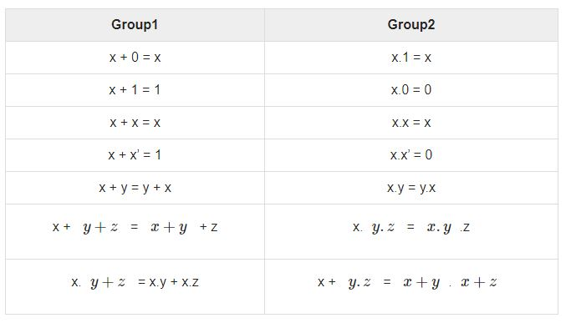
Duality Theorem
This theorem states that the dual of the Boolean function is obtained by interchanging the logical AND operator with logical OR operator and zeros with ones. For every Boolean function, there will be a corresponding Dual function.

Slide 27
DeMorgan’s Theorem
It states that the complement of logical OR of at least two Boolean variables is equal to the logical AND of each complemented variable.
X+ Y = X Y
Apply the duality theorem for the above expression we get:
X Y = X + Y

Slide 28
Simplification Using Boolean Laws
Consider the previous Function obtained from SOP
F=XY’Z’+ XYZ’ + XY’Z + X’YZ + XYZ
try to find pairs of terms differs only in one variable
1st with 3rd and 2nd with 5th then 4th with 5th to get F as follow:
F= XY’(Z’+ Z) + XY (Z’ + Z) + YZ( X’+ X)
All values inside brackets are equal to 1 so ;
F= XY’ + XY+ YZ
Still we can reduce the expression more
F= X (X’ + X) + YZ
F= X + YZ
(the same as the simplified expression we obtained to this function using our natural logic)

Slide 29
Simplification Using Boolean Laws
Consider the previous Function obtained from POS
F=(x+y+z)(x+y’+z)(x+y+z’)
F= (xx+xy’+ xz + xy + yy’ + yz + xz +y’z + z.z)(x+y+z’)
F=(x + xy’ + xz + xy + 0 + yz + xz + y’z + z)(x+y+z’)
For all elements inside the first bracket that contains x takes x as common factor and for the rest take z as common factor
F=[x(1+y’+ z+ y+ z+)+ z(y+y’+ 1)](x+y+z’)
According to law E+1=1 (i.e any logic expression +1 will be equal to 1)
F=(x+z)(x+y+z’)= xx+xy+xz’+xz+yz+zz’= x+ xy+ xz’+ xz+ yz+ 0
Take x as common factor among all elements contains x
F=x(1+y+z’+z)+ yz ) and again According to law E+1=1 F= x+ yz (which is the simplified expression we derived from SOP expression).
Conclusion: Product of sum or Sum of Product produce the same simplified function (i.e they are Similar)

Slide 30
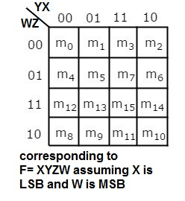
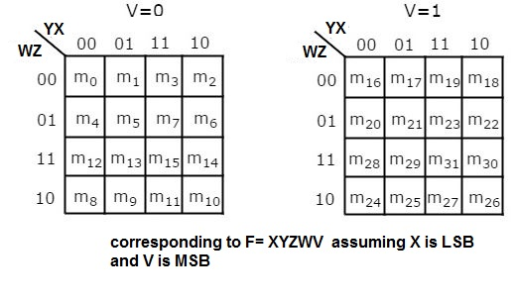
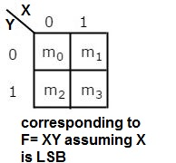
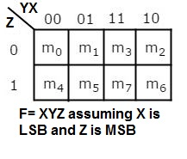
Simplification Using K-map
K-Map method is most suitable for minimizing Boolean functions of 2 variables to 5 variables. Now, let us discuss about the K-Maps for 2 to 5 variables one by one.
The number of cells in 2 variable K-map is four, and 3 variables are 8 .. The general rule for the number of cells in K-map is of n variables is 2^{n} as shown in figure:
The map contains cell for each possible input combination.

Slide 31
Rules for Simplifying K-maps
Select the respective K-map based on the number of variables present in the Boolean function.
If the Boolean function is given as sum of min terms form, then place the ones at respective min term cells in the K-map. If the Boolean function is given as sum of products form, then place the ones in all possible cells of K-map for which the given product terms are valid.
Check for the possibilities of grouping maximum number of adjacent ones. It should be powers of two. Start from highest power of two and up to least power of two. Highest power is equal to the number of variables considered in K-map and least power is zero.
Each grouping (cube) will give either a literal or one product term. It is known as prime implicant. The prime implicant is said to be essential prime implicant, if at least single ‘1’ is not covered with any other groupings but only that grouping covers.

Slide 32
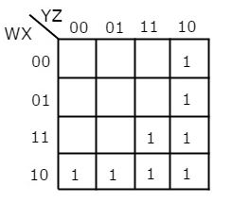
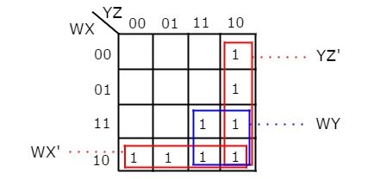
Example-1
Let us simplify the following Boolean function represented in SOP.
F(x,y,z,w)= WX’Y’ + WY + W’YZ’
Solution: we need K-map of 4-variables
Put 1 in each cell correspond to any of product term in the
expression
There are three possibilities of grouping 4
adjacent ones as in figure.
Simplified F=wx’+wy+yz’
In this case in each group (cube) if variable is fixed
Unchanged and =1 then use the variable without
complement while If variable fixed and =0 use the variable
with complement

Slide 33
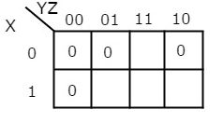
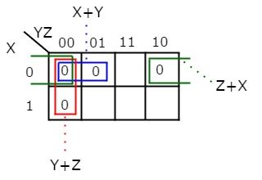
Example-2
Let us simplify the following Boolean function represented in POS as
In this case each sum term is represented by zero in the corresponding cell
F(x,y,z)= Π M(0,1, 2, 4) Consider Z is LSB
This represented in the K-map as follow
Grouping the zeros to get the simplified expression in
in POS form.
This produce simplified expression F=(x+y)(y+z)(z+x)
In this case in each group (cube of zeros) if variable is
fixed and =0 then use the variable without complement
While If variable fixed and =1 use the variable with complement

