Slide 1
INTRODUCTION TO INFORMATION TECHNOLOGY
CPIT-220

Slide 2
DEFINING DATA & INFORMATION
What is data?
      Data is information when dealing with the machine
      Data is in a Raw Form.
What is Information?
      Information is any knowledge that comes to our attention. That could be voice, image, text and video
      Information is processed Data
E.g. Assignment Marks, exam marks, Quiz Marks and Detail Mark Certificate(DMC).

Slide 3
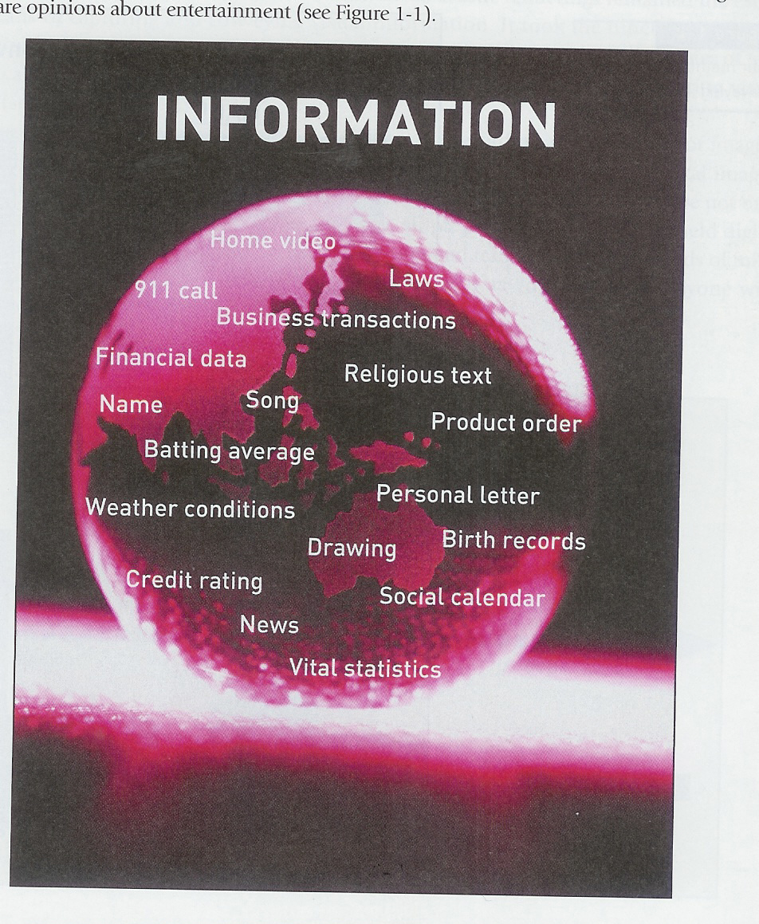
WHAT COUNTS AS INFORMATION

Slide 4
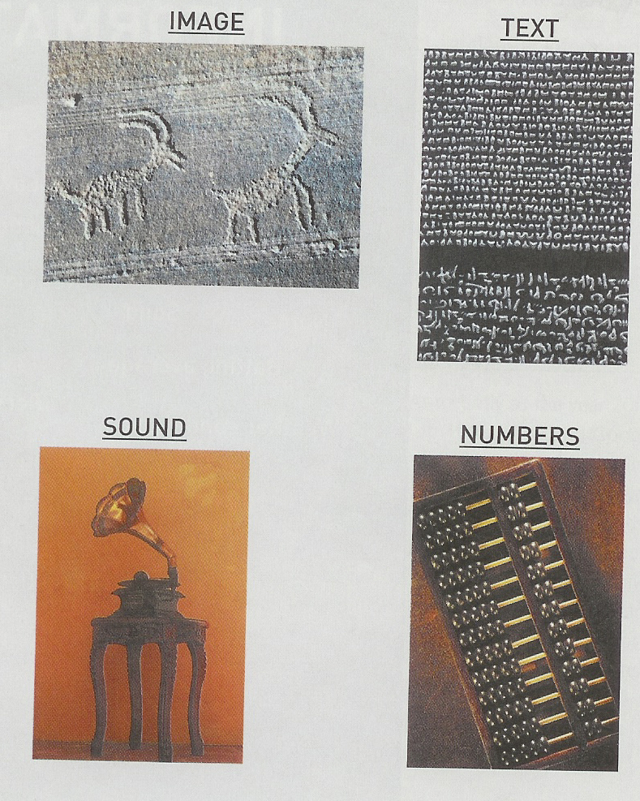
METHODS FOR CONVEYING INFORMATION

Slide 5
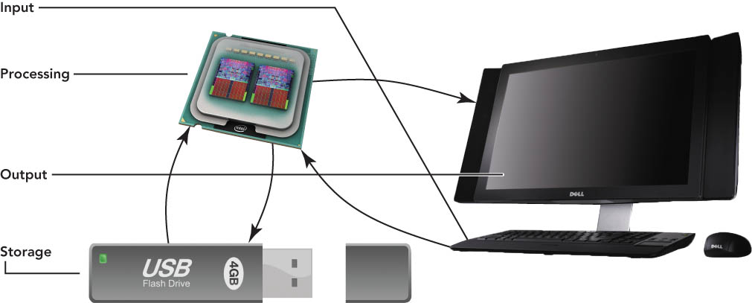
INFORMATION PROCESSING CYCLE
The information-processing cycle consists of four basic operations: input, processing, output, and storage.

Slide 6
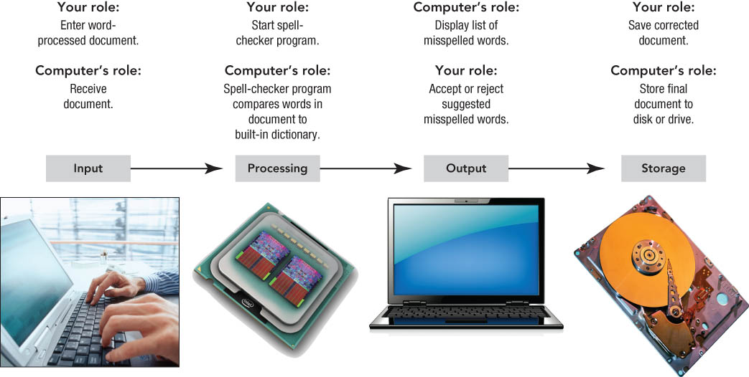
INFORMATION PROCESSING CYCLE

Slide 7
DEFINING INFORMATION TECHNOLOGY
Information Technologies are systems of hardware and/or software that capture, process, exchange, store and/or present information using electrical, magnetic and/or electromagnetic energy.

Slide 8
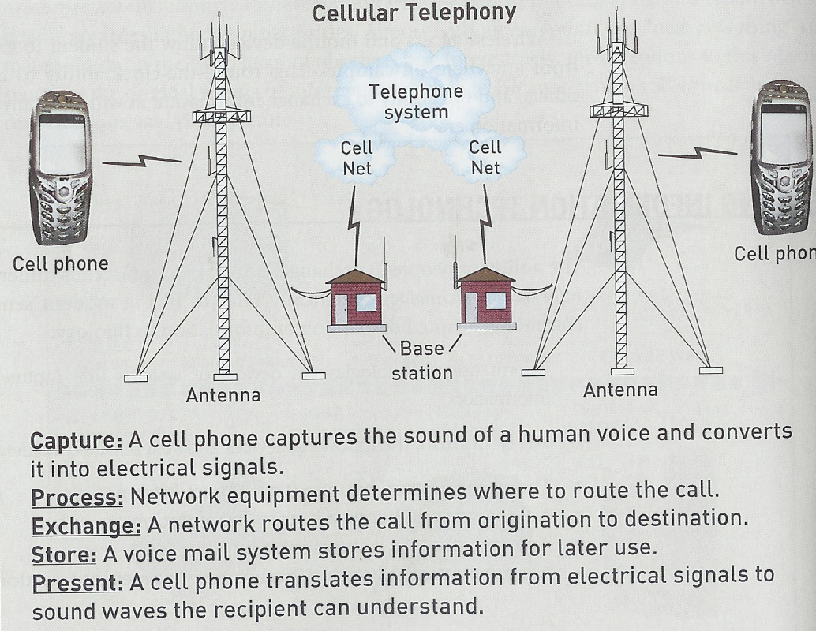
IT EXAMPLE: CELLULAR TELEPHONY

Slide 9
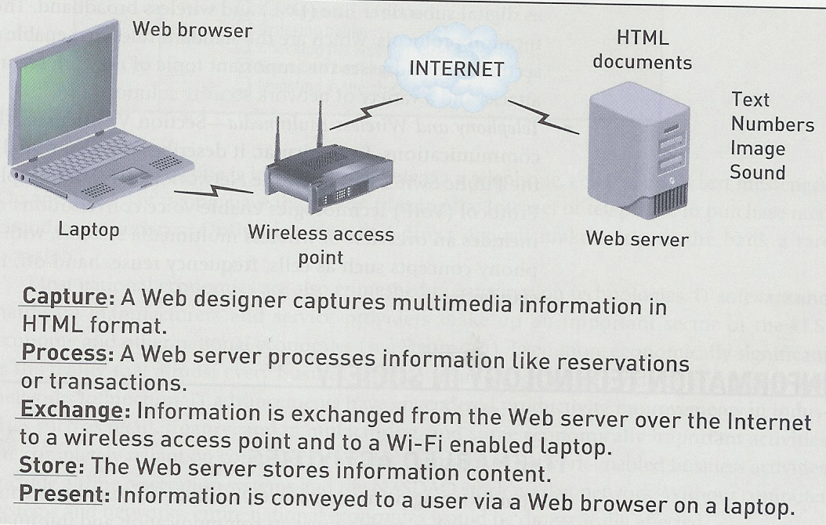
IT EXAMPLE: WIRELESS INTERNET

Slide 10
IT IN SOCIETY (PEOPLE)
Personal Communication
  Conversations (phone, cell)
  Messaging (E-mail, SMS)
  Video Coms
Entertainment
  Web surfing
  Downloading video and audio files
  Interactive gaming
Day-to-Day living
  Buying airline tecket
  Ordering books
  Electronic banking/ stock market

Slide 11
IT IN SOCIETY (BUSINESS)
Internal Communication
  Computer network
  Corporate website
  Video teleconferencing
  Messaging (SMS, email)
Electronic Commerce
  Call Centres
  Electronic transactions
  Online sales
Business operations
  Factory operation systems
  Inventory Tracking
  Databases

Slide 12
CAREERS IN IT
Analyse, Design, Implementation and R&D departments in Information Technology
Appliction Development
Consultant
Data Analyst or Administrator
Information Analyst
IT Analyst
Network Engineer
Network Administrator
Programmer
Project Manager
Security Specialist
Software Developer
Software Engineer
Software Support or Tester
Web Developer
Governmental and private consulting companies.
King Abdulaziz City for Science and Tecnology (KACST)

Slide 13
EXAMPLES ON IT CAREERS
Information Security Jobs
  Address information security
IT Analyst
  Translate business requirement into technical specification
Network Administration
  Configure and operate computer network
Management Consulting
  Provide consulting for government and orgnisations
Database Administration
  Managing corporate database
Computer Forensics Expert
  Extracts computer evidence for detecting/preventing /prosecuting crimes
IT Sales:
  people on frontline to sell products
Software development:
  develop software solutions

Slide 14
IT AND ITS RELATED DISCIPLINES
Computer Science
Software Engineering
Information Systems
Cognitive Science
Computer Engineering
Mathematics and Statistics
Others such as Natural Sciences, Linguistics, Sociology etc.

Slide 15
IT Related Fields: Computer Science (CS) ,Information Systems (IS),Information Technology (IT), System Engineering and Software Engineering
Computer science or computing science (abbreviated CS) is the study of the theoretical foundations of information and computation, and of practical techniques for their implementation and application in computer systems. It is frequently described as the systematic study of algorithmic processes that create, describe, and transform information.

Slide 16
IT RELATED FIELDS: COMPUTER SCIENCE (CS) ,INFORMATION SYSTEMS (IS),INFORMATION TECHNOLOGY (IT), SYSTEM ENGINEERING AND SOFTWARE ENGINEERING
Systems engineering is concerned with all aspects of computer-based systems development including hardware, software and process engineering.
Software Engineering (abbreviated as SE and sometimes S/W Engr.) is a collection of methodology, techniques, and tools that help with the production of a high quality software system developed with a given budget before a given deadline while change occurs.

Slide 17
IT RELATED FIELDS: COMPUTER SCIENCE (CS) ,INFORMATION SYSTEMS (IS),INFORMATION TECHNOLOGY (IT), SYSTEM ENGINEERING AND SOFTWARE ENGINEERING
Information System (abbreviated as IS) is a combination of people, hardware, software, communication devices, network and data resources that processes (can be storing, retrieving, transforming information) data and information for a specific purpose.

Slide 18
APPLICATION DOMAINS OF IT
Business applications
Law enforcement
Political processes
E-commerce
Manufacturing
Education
Entertainment
Agriculture
Software development

