Slide 1

Computers Are Your Future Twelfth Edition
Chapter 6: The Internet and the World Wide Web

Slide 2
Objectives
Define the Internet, and explain how it works.
Describe methods for accessing the Internet.
Differentiate between the Internet and the World Wide Web, and describe the elements that enable Web content to be displayed.

Slide 3
Objectives
Describe several methods of finding information on the Web including the use of a URL, surfing, conducting searches, and sharing with other Web users through RSS feeds, blogs, wikis, and podcasts.
Identify features to look for when evaluating a Web site or its content.

Slide 4
Objectives
List, the most popular Internet services, and explain what they do.
Describe the three types of e-commerce.
List the rules of netiquette.
List safe surfing procedures, and identify hazards of the Web.

Slide 5
What Is the Internet and How Does It Work?
Internet
A global system of computers of thousands of privately and publicly owned computers and networks
Also known as the Net
Started in the 1960s
U.S. Department of Defense project
ARPANET (Advanced Research Projects Agency Network)
The purpose was to
Create a form of secure communication for military and scientific purposes
Create a method for transferring such communication between computers

Slide 6
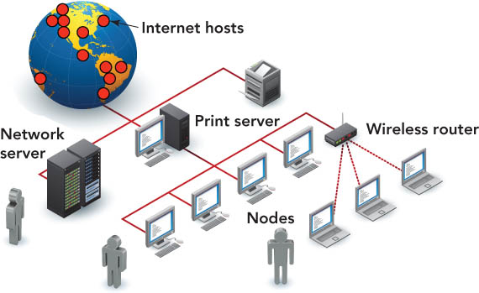
What Is the Internet and How Does It Work?
Internet—composed of more than 750 million hosts
Host—computer that has two-way access to other computers:
Receives requests
Replies to those requests

Slide 7
What Is the Internet and How Does It Work?
Volunteers maintain the Internet networks.
Private and public groups provide the equipment.
Network service providers (NSPs)
Maintain the Internet backbone—the main high-speed routes

Slide 8
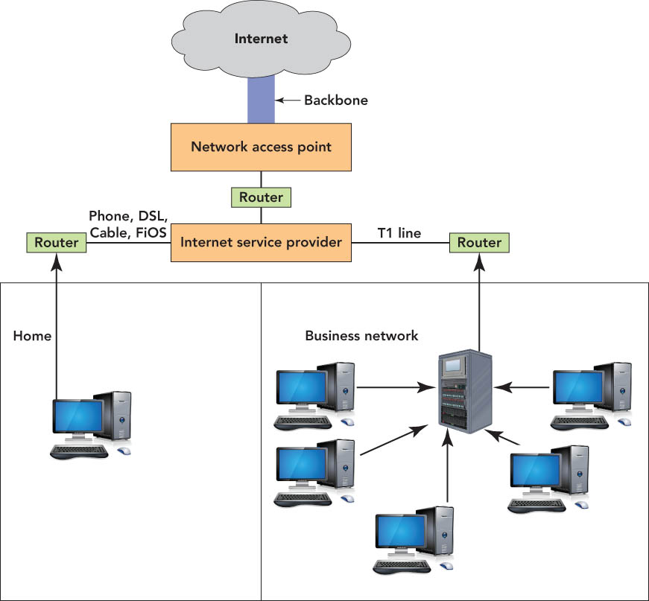
What Is the Internet and How Does It Work?

Slide 9
What Is the Internet and How Does It Work?
Network access points (NAPs)
How NSPs are linked
NAPs allow data to start on one network, then cross over to another network
Routers
Specialized devices that connect networks, locate the best path of transmission, and ensure that data reaches its destination

Slide 10
What Is the Internet and How Does It Work?
Interoperability
Ability to work with different brands and models of computers
Transmission Control Protocol/Internet Protocol (TCP/IP)
Provides methods for packaging and transmitting information

Slide 11
What Is the Internet and How Does It Work?
Transmission Control Protocol
Manages assembling of a message or file into smaller packets
Packets are transmitted over the Internet
TCP layer on the destination computer reassembles the packets into the original message
Internet Protocol
Handles the address part of each packet so that it gets to the right destination

Slide 12
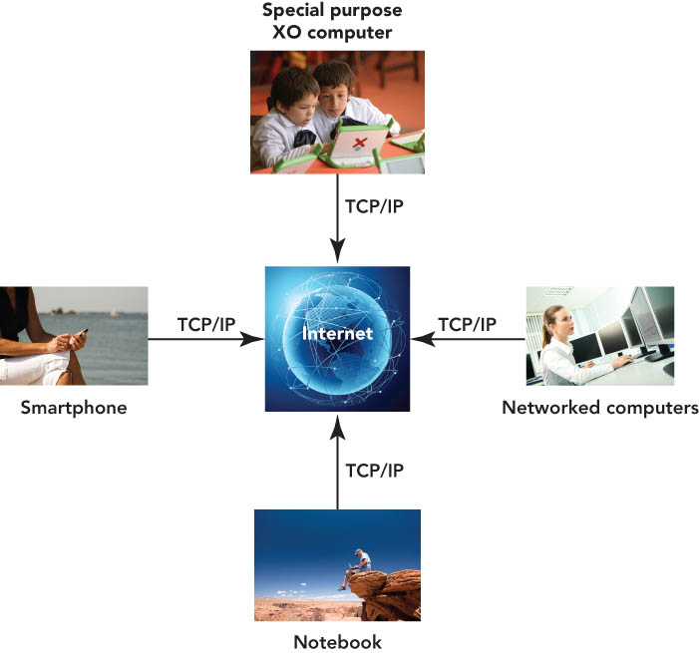
What is the Internet and How Does It Work?

Slide 13
Accessing the Internet: Going Online
Internet service providers (ISPs)
Supply and sustain user connections to the Internet
Maintain the hardware and software
Protect their sites and networks from outside threats
Online service provider (OSP)
A for-profit firm that provides a proprietary network
Offers special services only available to subscribers
Examples: MSN and AOL

Slide 14
Accessing the Internet: Going Online
Wireless Internet service provider
A company that provides wireless Internet access
Examples: AT&T, T-Mobile, and Verizon Wireless
Hot spot
Public location that provides Internet access for wireless devices
Examples: airport, college campus, or coffee shop

Slide 15
Accessing the Internet: Going Online
Methods to access the Internet
Dial-up access—uses modem and telephone line
Digital subscriber line (DSL)—high-speed online connection—external modem with telephone lines
Cable access—high-speed Internet connection—cable modem not a phone line
Satellite—high-speed Internet service with antenna and dish connected to indoor receive unit (IRU) and indoor transmit unit (IRU)
Fiber-optic service—high-speed Internet—fiber-optic lines direct

Slide 16
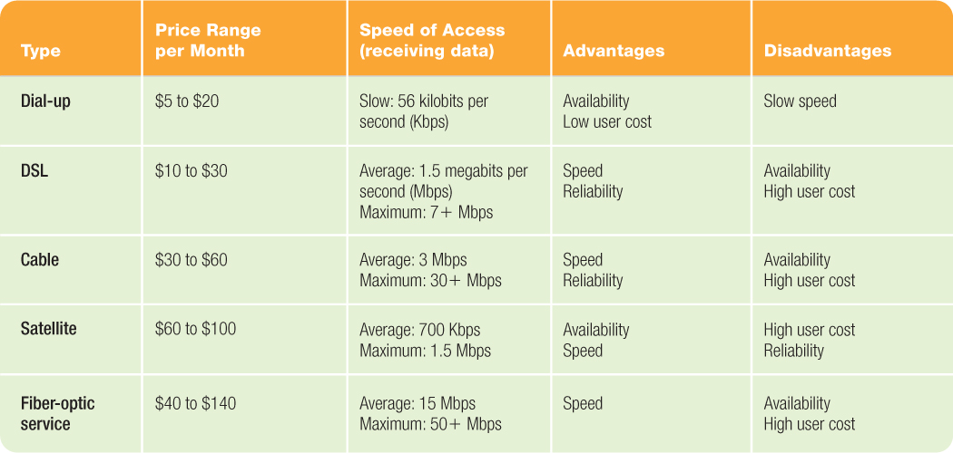
Accessing the Internet: Going Online

Slide 17
The Internet and the Web: What’s the Difference?
World Wide Web (also known as the Web or WWW)
Contains billions of documents
Part of the Internet
Uses the Internet to transport information
Separate entity from the Internet
No one owns the Web
Standards and guidelines for the Web are published by the World Wide Web Consortium (W3C)

Slide 18
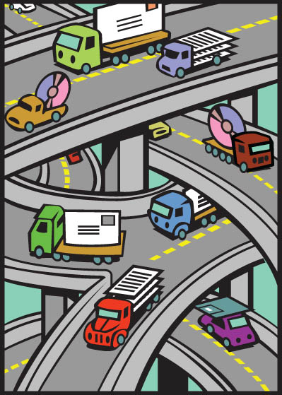
The Internet and the Web: What’s the Difference?
Web contains the information.
Internet transports information to and from users.

Slide 19
The Internet and the Web: What’s the Difference?
Web page
Document that may include text, graphics, sound, animation, and video
Web browser
Program that displays Web pages and linked items
Web site
Collection of Web pages
Typically contains a home page (also called an index page)—default page displayed when you enter a site
Notes:
Click to add notes

Slide 20
The Internet and the Web: What’s the Difference?
Hypertext
Uses links to connect to additional related information
Hyperlinks or links
Words and images that bring other documents into view when clicked
Hypertext Markup Language (HTML)
Uses tags to specify how a Web page should display
Extensible Hypertext Markup Language (XHTML)
HTML combined with Extensible Markup Language (XML) to reduce the complexity of HTML
Notes:
Click to add notes

Slide 21
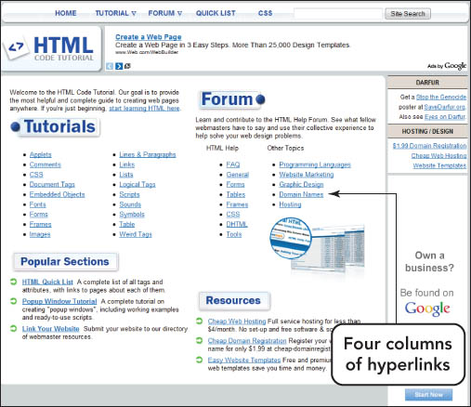
The Internet and the Web: What’s the Difference?

Slide 22
The Internet and the Web: What’s the Difference?
Distributed hypermedia system
Network-based content development system
Uses multimedia resources as a means to of navigation or illustration
Web 2.0
Current generation of the Web
Provides opportunities to collaborate, interface, and create new content using blogs, Wikis, and podcasts
Some issues with Web distribution include:
Dead links (also known as broken links)
Information posted on the Web is not validated.
Information overload due to too much data

Slide 23
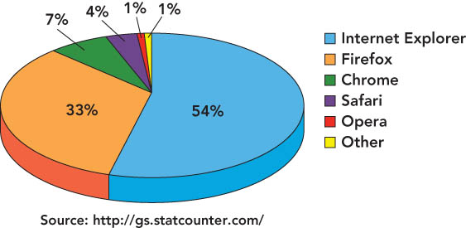
The Internet and the Web: What’s the Difference?
The most popular Web browsers

Slide 24
The Internet and the Web: What’s the Difference?
Plug-ins
Additional software programs to extend the ability of the browser
Examples:
Acrobat Reader
Adobe Flash Player
Adobe Shockwave Player
Apple QuickTime
Real Player
Windows Media Player
Browser cache
Stores Web page files and graphics on a computer hard drive when the user visits a site for the first time

Slide 25
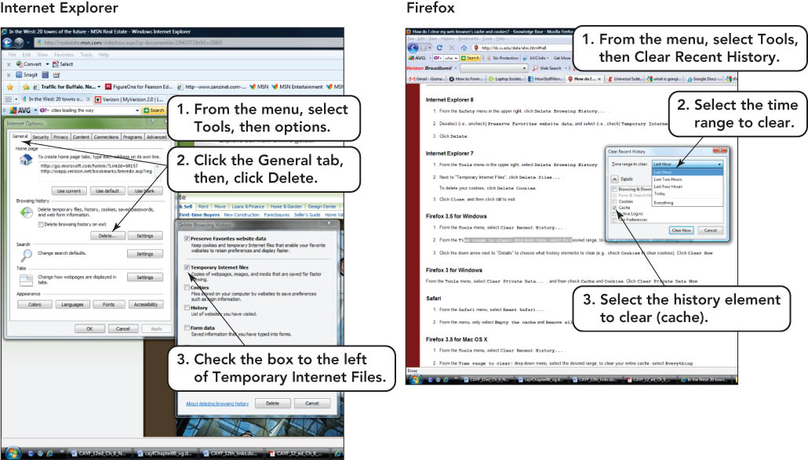
The Internet and the Web: What’s the Difference?

Slide 26
The Internet and the Web: What’s the Difference?
Web servers
Web sites and their associated information are stored here
Used to recognize information requests, process the requests, and send the requested documents

Slide 27
Finding Information on the Web
Internet Protocol (IP) address
Every device connected to the Internet, including PCs and servers, is given a unique network identifier
Numerical identification and logical address
Uniform Resource Locator (URL)
Identifies Internet resource’s type and location

Slide 28
Finding Information on the Web
Complete URL is made up of the Hypertext Transfer Protocol (HTTP), domain name, path, and resource name.

Slide 29
Finding Information on the Web
Surfing the Web
Type a URL into the address bar
Click a tab in the browser window
Click a hyperlink
History list
Compiles a list of the Web pages visited
Favorites or Bookmarks feature
Allows Web pages visited often to be marked

Slide 30
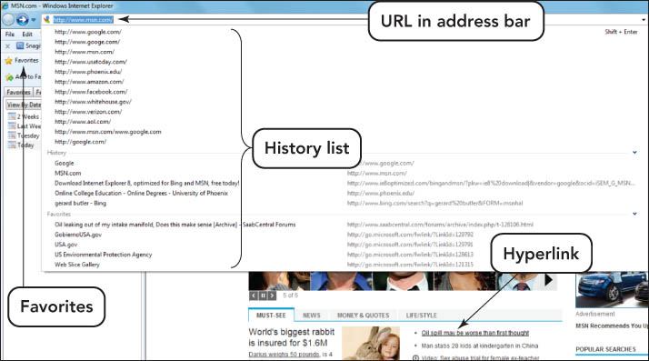
Finding Information on the Web

Slide 31
Finding Information on the Web
Downloading
Process of transferring a file or document from one computer to user’s computer
Uploading
Process of transferring a file or document from user’s computer to another computer
Notes:
Click to add notes

Slide 32
Finding Information on the Web
Really Simple Syndication (RSS)
Connection to a Web site that allows users to receive constant updates
Aggregator
Regularly checks each site on your subscriptions list and sends alerts if new information has been published

Slide 33
Finding Information on the Web
Wiki (short for the Hawaiian word for “fast”)
Simple Web page where any visitor can post text or images, change posted information, and track earlier changes
Blog (short for Weblog)
Internet equivalent of a journal or diary where bloggers post opinions, thoughts, and interesting links

Slide 34
Finding Information on the Web
Podcasts
Audio, image, or video files released by Web syndication
Pod-catchers
Automatically identify and retrieve new files in a given series and make them available
Examples: iTunes or Winamp

Slide 35
Finding Information on the Web
Subject guide
Web pages grouped under specific headings—offered by some search sites
Portal
Web page that acts as a gateway to diverse sources and presents them in an organized way
Clickstream
Trail of Web links followed to arrive at a particular site

Slide 36
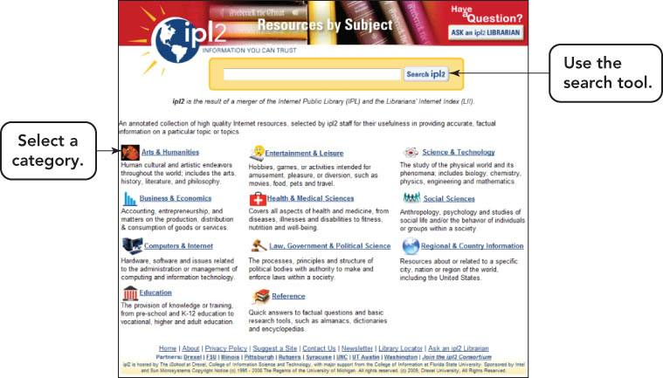
Finding Information on the Web

Slide 37
Finding Information on the Web
Search engines
Index databases of Web pages to enable fast information searches
Spiders
Programs that roam the Web to add new Web pages to search engine indexes
Link rot
Results from hyperlinks that no longer work or Web pages that have been removed or restructured

Slide 38
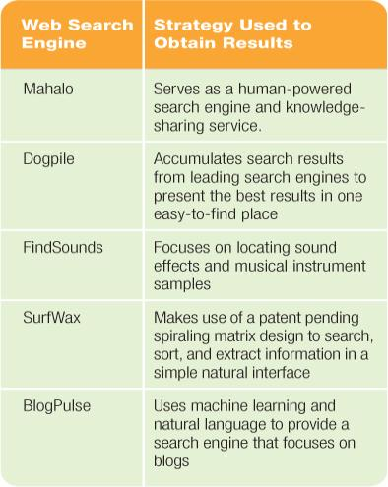
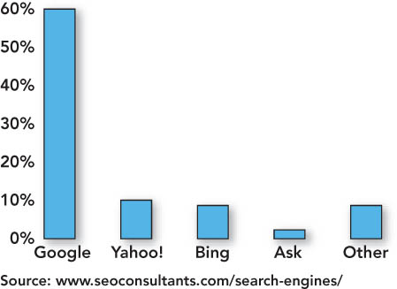
Finding Information on the Web

Slide 39
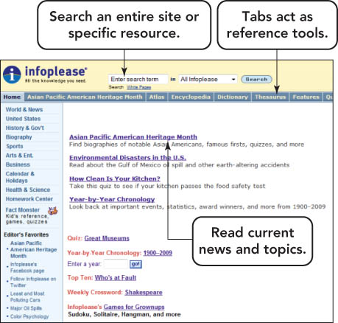
Finding Information on the Web
Specialized search engines
Index information, such as job advertisements, and names and addresses

Slide 40
Finding Information on the Web
Search operators
Perform complex searches
Wildcard symbols (also called truncation symbols)
Replace the zero or additional characters in search words to improve search accuracy
Examples: ? and *
Phrase searching
Place quotation marks around a phrase to create a complete unit for search purposes
The result—search engines retrieve only those sites that contain the exact phrase
Notes:
Click to add notes

Slide 41
Finding Information on the Web
Inclusion operators
Used so only Web pages including those criteria are retrieved
Example: plus sign (+)
Exclusion operators
Used so only Web pages excluding those criteria are retrieved
Example: minus sign (-)
Notes:
Click to add notes

Slide 42
Finding Information on the Web
Boolean searches
Link search words by using logical operators such as AND, OR, and NOT
Using the AND, OR, and NOT logical operators provides additional criteria for a search engine to use when retrieving documents
Nesting
A Boolean search operator that uses parentheses
The search engine evaluates the expression from left to right, and searches for content in the parentheses first
Notes:
Click to add notes

Slide 43
Using Information from the Web
Evaluate information obtained from the Web:
Who is author?
Does the author reference sources?
Who is the Web page affiliated with? Who pays for it?
Is the language objective/dispassionate or strident/argumentative?
What is the purpose of the page?
Does the information appear to be accurate?
Is the page current?
Notes:
Click to add notes

Slide 44
Using Information from the Web
Use Web information for schoolwork.
Access authoritative online sources.
Locate published works.
Provide appropriate online and offline reference citations in your work.
Notes:
Click to add notes

Slide 45
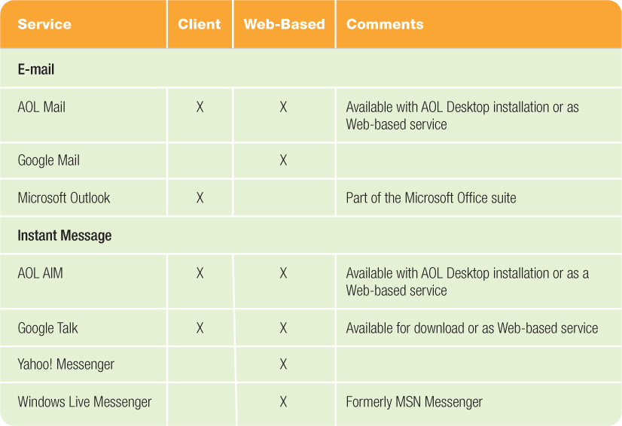
Exploring Internet Services
Internet service
Set of standards or protocols that identify how computers communicate through the Internet

Slide 46
Exploring Internet Services
Electronic mail (e-mail)
Type of application software that makes sending and receiving messages through computer networks possible
E-mail attachment
Computer file included with an e-mail message
Notes:
Click to add notes

Slide 47
Exploring Internet Services
E-mail address
Unique cyberspace address for each individual
Consists of a user name, the name of the hosting e-mail service, and the top-level domain
Spam
Unsolicited e-mails, usually from advertisers
Do not open spam

Slide 48
Exploring Internet Services
Malware
Malicious software that places a computer in the spammer’s control
Spyware
Gathers data from a system without knowledge
Botnet
Set of infected computers that places computers under the control of a bot herder
Notes:
Click to add notes

Slide 49
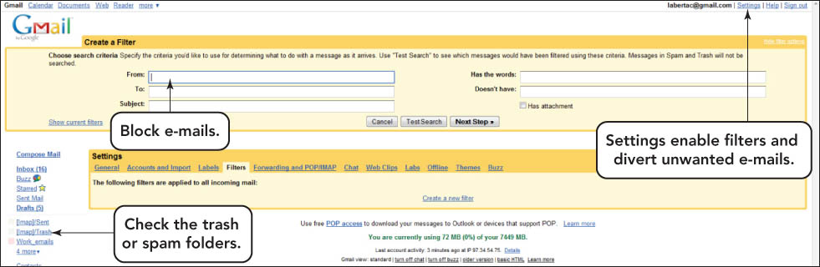
Exploring Internet Services
.

Slide 50
Exploring Internet Services
Instant messaging (IM) systems
Allow immediate, real-time communication with contacts
Requires additional software
Notifies users when a contact is connected to the Internet
Spimming—spam for instant messaging

Slide 51
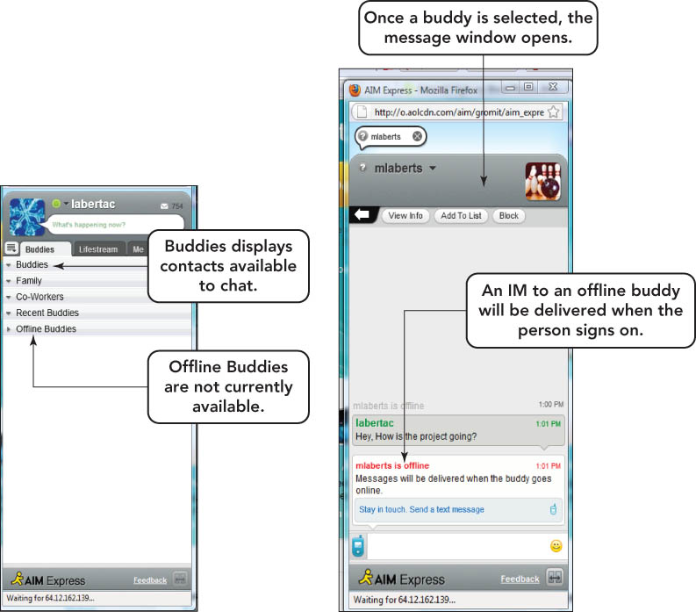
Exploring Internet Services

Slide 52
Exploring Internet Services
Internet relay chat (IRC)
Special type of Internet service that gives users the ability to join chat groups called channels
Social networking
Helps people connect
Sites such as MySpace provide the ability to create large communities online.
Notes:
Click to add notes

Slide 53
Exploring Internet Services
Usenet
Worldwide discussion system available through the Internet
Made up of many newsgroups—discussion groups dedicated to one topic
Discussions within newsgroups are in threads—groupings of commentaries on a particular subject
Standard newsgroups—of high-quality discussions
Alt newsgroups—created by anyone
Biz newsgroups—devoted to commercial use
Notes:
Click to add notes

Slide 54
Exploring Internet Services
Message board
Similar to a newsgroup
Easier to use
Does not require a newsreader
Notes:
Click to add notes

Slide 55
Exploring Internet Services
Electronic mailing lists
Similar to newsgroups and forums, except that:
Only subscribers can receive and view messages.
Messages posted to the mailing list are automatically sent to everyone on the list.
Majordomo is a common freeware electronic mailing list manager.
Notes:
Click to add notes

Slide 56
Exploring Internet Services
VoIP (Voice over Internet Protocol)
Users can speak to others over a broadband Internet connection instead of an analog phone line
Requires a broadband Internet connection
A VoIP service provider such as Skype
A VoIP adapter or computer with supporting software
Calls are usually free to others using the same service.

Slide 57
Exploring Internet Services
File Transfer Protocol (FTP)
Method to transfer files over the Internet
Use when files are too large to attach to e-mails
Usually requires a user name and a password
Use to upload Web pages
Anonymous FTP
Files are available publicly available for downloading
Lack of security
Do not send sensitive material

Slide 58
E-Commerce
E-commerce
Conducting business through the use of networks or the Internet
E-tailers (Web-based retailers)
Online merchants
Business-to-business (B2B) e-commerce
Refers to a business providing supplies to other businesses via the Internet
Notes:
Click to add notes

Slide 59
E-Commerce
Consumer-to-consumer (C2C) e-commerce
Refers to the exchange of business between individuals
Example: eBay
Business-to-consumer (B2C) e-commerce
Refers to shopping online rather than at a physical store
Notes:
Click to add notes

Slide 60
E-Commerce
Online shopping
Shop for good deals
Use shopping portals to compare prices and products
Example: PriceGrabber.com
Look for coupons and rebates
Notes:
Click to add notes

Slide 61
E-Commerce
The dot.com phenomenon
E-commerce primarily uses Web sites with a .com suffix.
Period between 1995 and 2000 called the dot-com boom.
Many dot-coms crashed in 2000.
Amazon.com is a profitable company.
Drawbacks to B2C e-commerce
Buyers miss speaking with real sales clerks.
Buyers cannot touch merchandise before purchase.
Buyers have to wait for delivery of merchandise.
Online e-commerce solutions to drawbacks
Online chats with live customer service representatives
Provide a wide variety of shipping options
Provide good customer service by responding quickly to customer inquiries
Notes:
Click to add notes

Slide 62
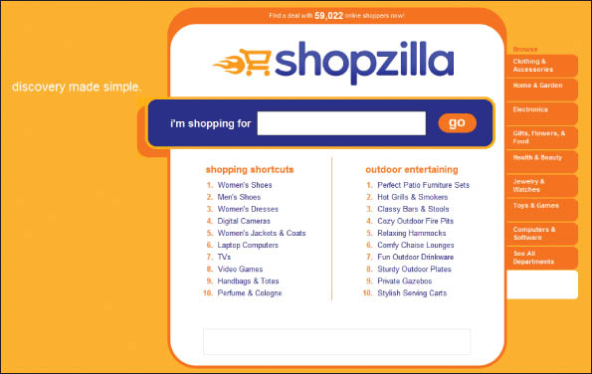
E-Commerce

Slide 63

E-Commerce
Building your own business
Only needs a low capital investment
Requires an ISP, a Web site, and the ability to ship purchases

Slide 64
E-Commerce
Other growth areas
Travel reservations
Banking
Online stock trading
Nonretail services, such as health, news, and dating services
Notes:
Click to add notes

Slide 65
Rules of Netiquette
Netiquette
Series of guidelines for good manners when using an Internet service
Flames
Angry messages sent by other users
Notes:
Click to add notes

Slide 66
Safe Surfing
Guidelines for safe surfing
Never give out identifying information.
Never respond to suggestive messages.
Never open e-mail from an unknown source.
Never allow a child to make arrangements for a face-to-face meeting alone.
Remember individuals online may not be who they claim to be.
Set reasonable rules and guidelines for computer use by children.
Make using the computer a family activity.
Notes:
Click to add notes

Slide 67
Safe Surfing
Additional online hazards to avoid:
Malware
Identity theft
Threats to you and your family
Unscrupulous vendors

Slide 68
Safe Surfing
Protecting your identity
Avoid shoulder-surfers, people who stand close enough to see PIN numbers
Look for secure Web site features before entering information.
https:// in the address instead of http://
Site seal provided by a security vendor such as VeriSign
Locked padlock symbol on the Web site—be sure it is not a fake image
Logo from other site-security entities, such as Verified by Visa
Message box that identifies you are entering or leaving a secure site

Slide 69
Safe Surfing
Protecting children in cyberspace
Cyber-bullying
When a child is targeted for some form of torment or abuse through digital tools
Cyber-stalkers
Use e-mail, instant messaging, chat rooms, pagers, cell phones, and other forms of information technology to make repeated, credible threats of violence against an individual or family

Slide 70
Summary
Define the Internet, and explain how it works.
Describe methods for accessing the Internet.
Differentiate between the Internet and the World Wide Web, and describe the elements that enable Web content to be displayed.

Slide 71
Summary
Describe several methods of finding information on the Web including the use of a URL, surfing, conducting searches, and sharing with other Web users through RSS feeds, blogs, wikis, and podcasts.
Identify features to look for when evaluating a Web site or its content.

Slide 72
Summary
List the most popular Internet services, and explain what they do.
Describe the three types of e-commerce.
List the rules of netiquette.
List safe surfing procedures, and identify hazards of the Web.

Slide 73
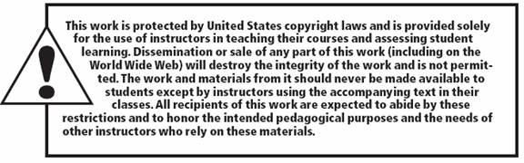
All rights reserved. No part of this publication may be reproduced, stored in a retrieval system, or transmitted, in any form or by any means, electronic, mechanical, photocopying, recording, or otherwise, without the prior written permission of the publisher. Printed in the United States of America.
Copyright © 2012 Pearson Education, Inc.
Publishing as Prentice Hall

