Slide 1
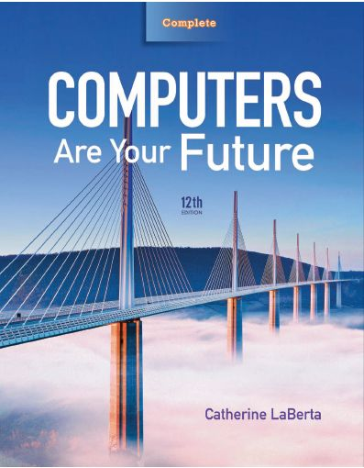
Computers Are Your Future Twelfth Edition
Chapter 4: System Software

Slide 2
Objectives
List the two major components of system software.
List the five basic functions of an operating system.
Explain why a computer needs an operating system.
Explain what happens when you turn on a computer.

Slide 3
Objectives
List the three major types of user interfaces.
Discuss the strengths and weaknesses of the most popular operating systems.
List the system utilities that are considered essential.

Slide 4
Objectives
Discuss data backup procedures.
Understand troubleshooting techniques and determine probable solutions to any operating system problems you may encounter.

Slide 5
System Software
System software
Consists of all the programs that enable the computer and its peripheral devices to function smoothly
Divided into two main categories:
The operating system
System utilities (utility programs)

Slide 6
http://www.youtube.com/watch?v=pTdSs8kQqSA

Slide 7
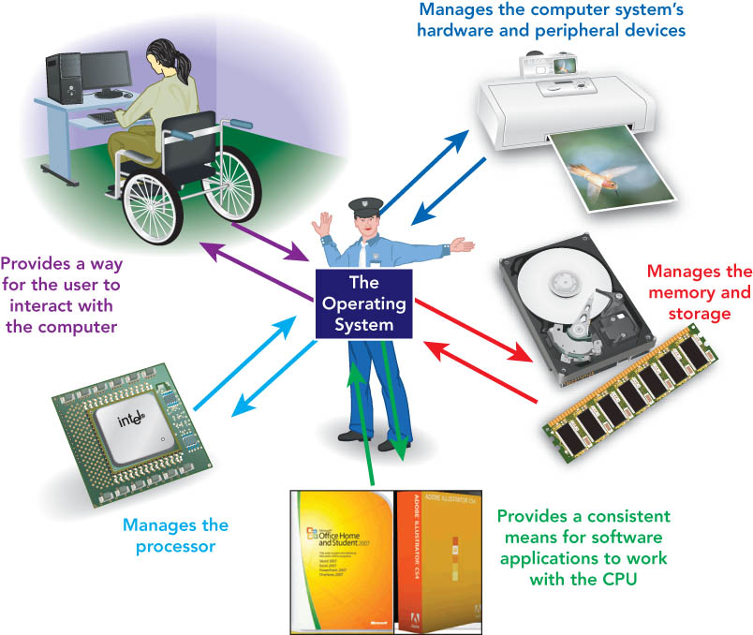
The Operating System
Five basic functions
Starts the computer
Manages applications
Manages memory
Handles input and output device messages
Provides a user interface for communication

Slide 8
http://www.youtube.com/watch?v=5AjReRMoG3Y

Slide 9
The Operating System
Operating system (OS)
Set of programs that coordinates:
Interactions of hardware components to each other
Interaction between application software and computer hardware

Slide 10
The Operating System
Kernel
Core programs for running a computer
Kernel allows other parts of the OS to run
You don't see or run the kernel, it runs in the background automatically
Shell
The graphical parts and executable programs of the OS
It paints the user interface
The shell depends on the kernel to run

Slide 11
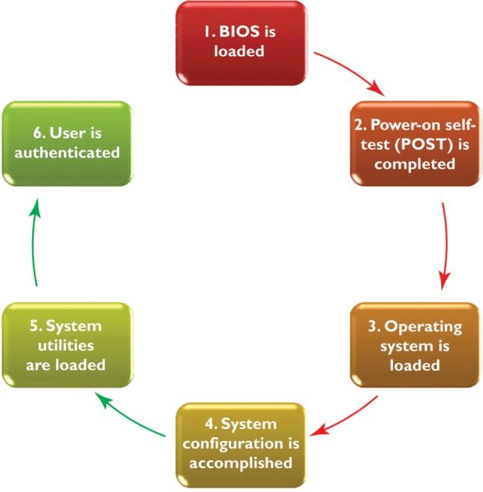
The Operating System
The Six Steps of Booting a System

Slide 12
Operating Systems
For computers
Microsoft Windows
Windows 8 is the latest version
MAC OS
OS X
Linux
Hundreds of distributions
UBUNTU, SUSE, Fedora, PARDUS
For portable devices
Apple IOS
Android
Windows Mobile
Symbian
Notes:
Bilgisayarimizdaki OS’i yukledikten sonra farkli OS’ler oldugunu, temel islevlerinin ayni oldugunu ama yapma bicimlerinin ve altyapilarinin farkli oldugunu soyleyelim. Ardindan da farkli OS’lerin desktop’larini gosterelim.
*

Slide 13
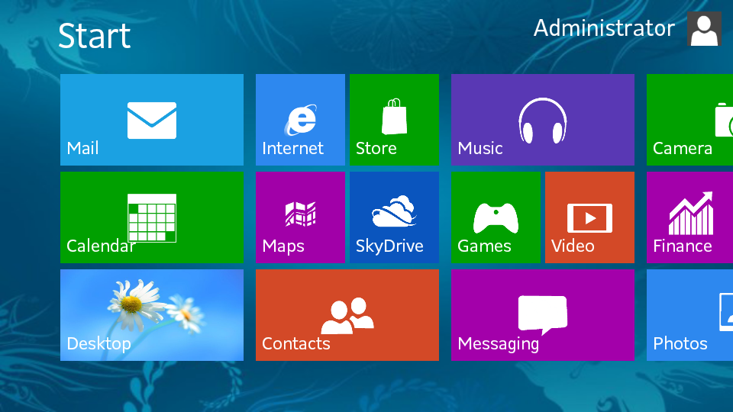
Windows 8

Slide 14
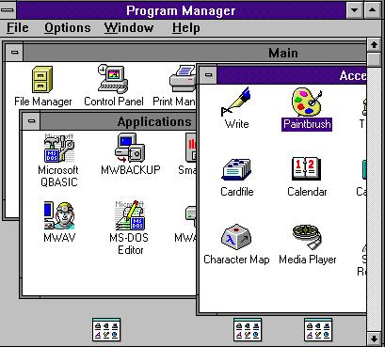
Windows 3.1

Slide 15
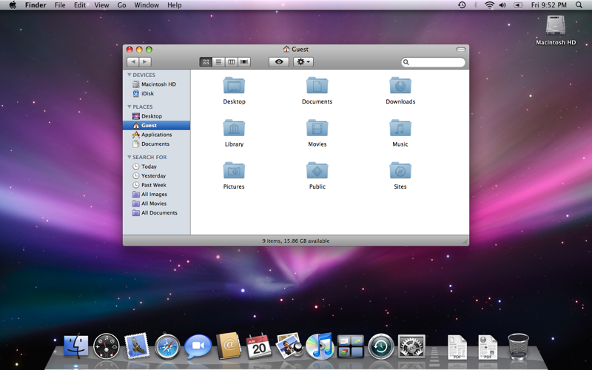
Mac OS X

Slide 16
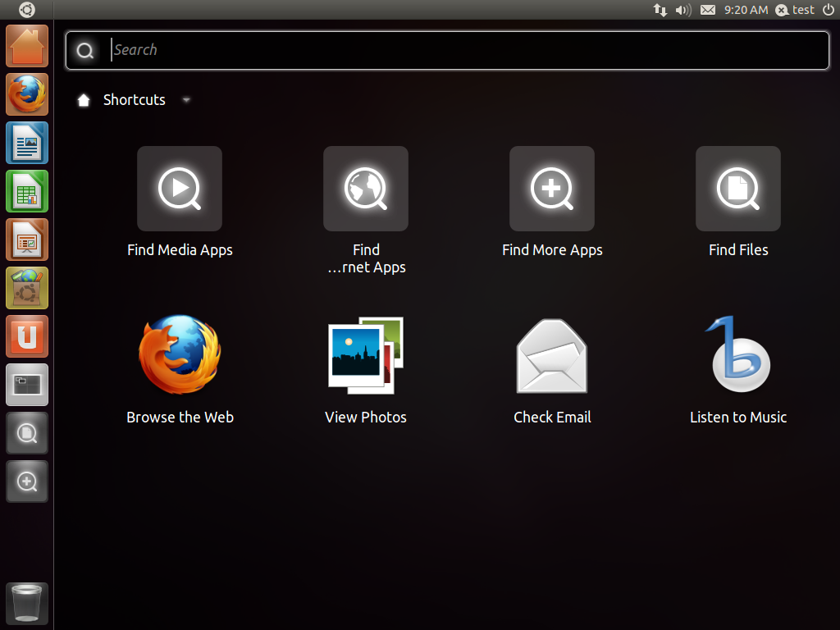
Linux – UBUNTU

Slide 17
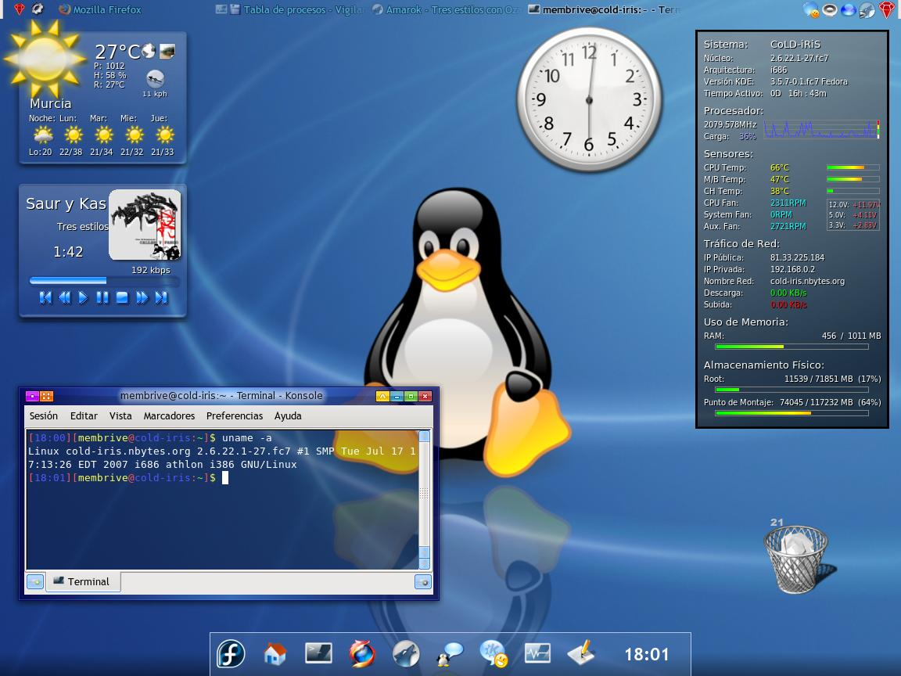
Linux - Fedora

Slide 18
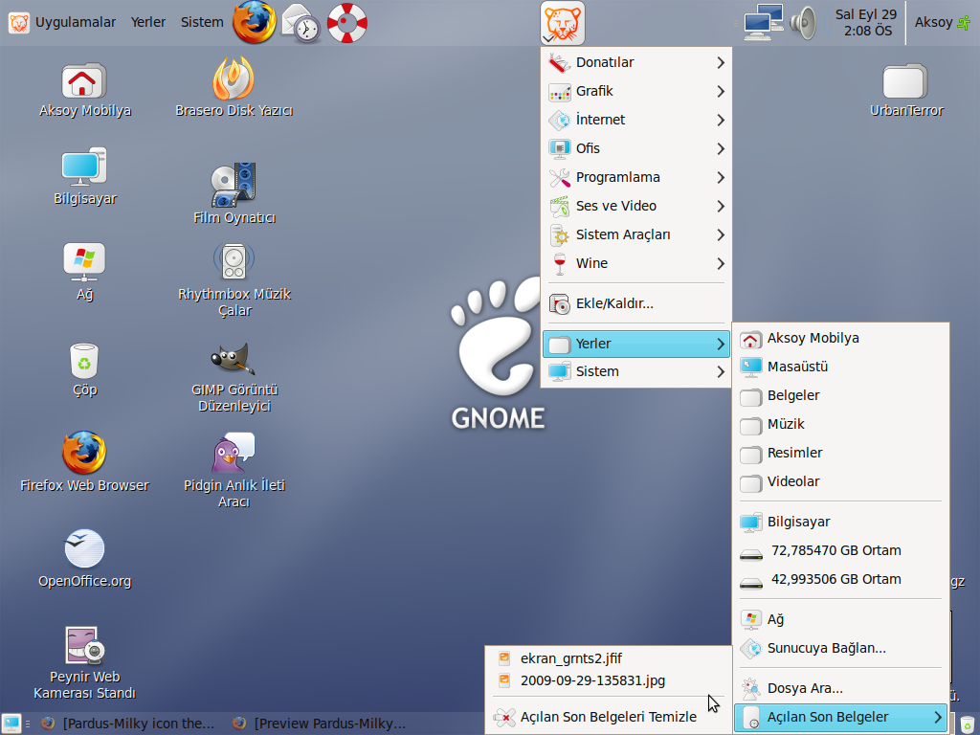
Linux – Pardus

Slide 19
The Operating System
Managing applications
Single-tasking operating systems—run only one application at a time
Multitasking operating systems—permit more than one application to run at the same time
The foreground application is the active one.
Background applications appear inactive.
Preemptive multitasking—ensures all applications have fair access to the CPU
Notes:
Burada bence tum OS’lerin multitasking is yapmaya calistigini anlatalim, daha onceki core, multi-processing turu tartismalara da atifa bulunabiliriz. Bir sonraki slide’da da ayni anda youtube’da mac izlerken Word’de birseyler yazabilirisiniz diyebiliriz.
*

Slide 20
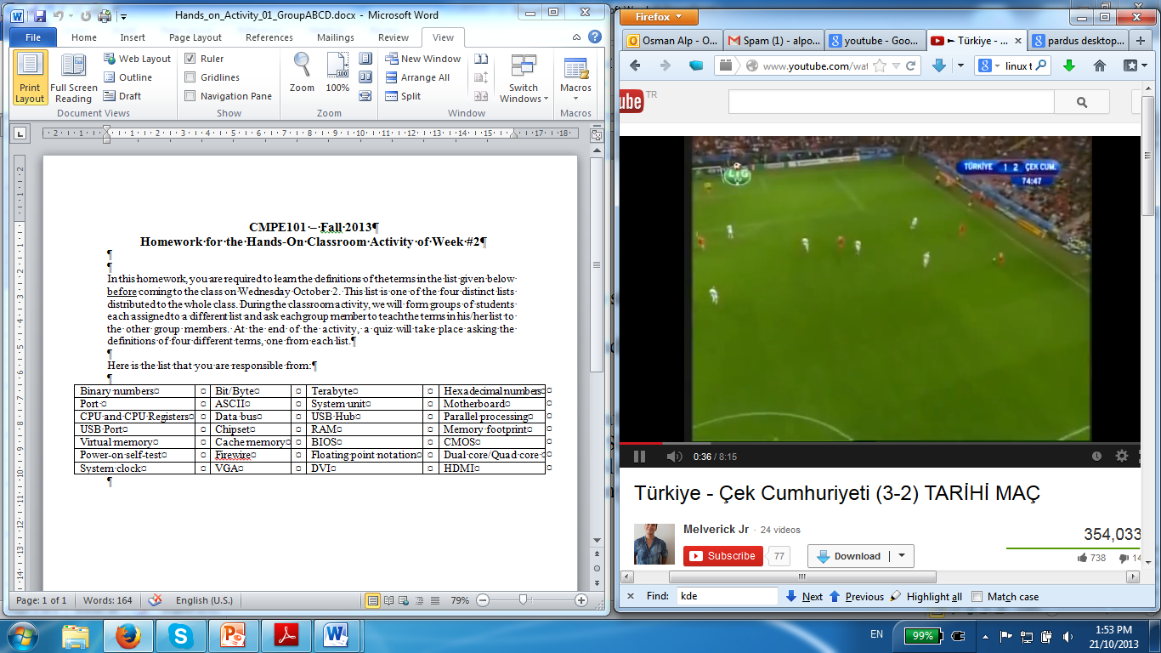
Multi-tasking

Slide 21
The Operating System
Managing memory
RAM memory functions as the buffer.
OS gives each program a portion of RAM memory and keeps them from interfering with each other.

Slide 22
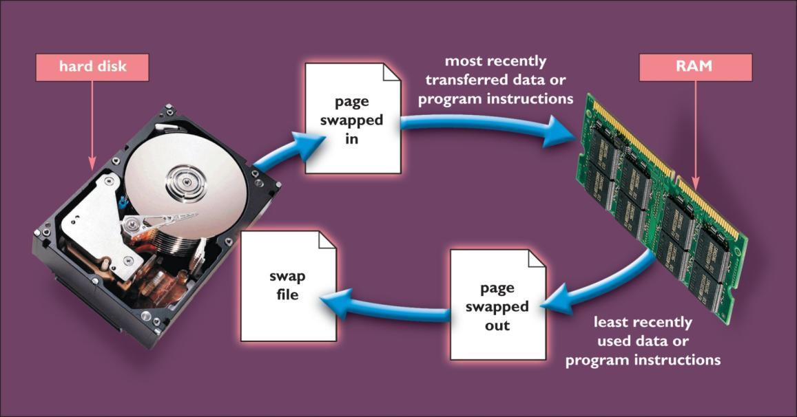
The Operating System
Managing memory (con’t.)
Virtual memory—uses portion of hard disk to extend RAM
When RAM is full, copies of pages are temporarily stored in a swap file, a special hard disk file.
Transferring files between RAM and the hard disk—paging
Excessive paging—thrashing
Notes:
Bir onceki slide’la birlestirebilir miyiz? Yine onceki derslere atifta bulunabiliriz.
*

Slide 23
The Operating System
Managing memory (con’t.)
Adding more RAM—best way to improve computer performance:
Paging slows computer.
Accessing data from hard disk is slower than accessing from RAM.
Windows Vista and Windows 7 come with Windows ReadyBoost
Use USB disk as RAM
Faster than harddisk

Slide 24
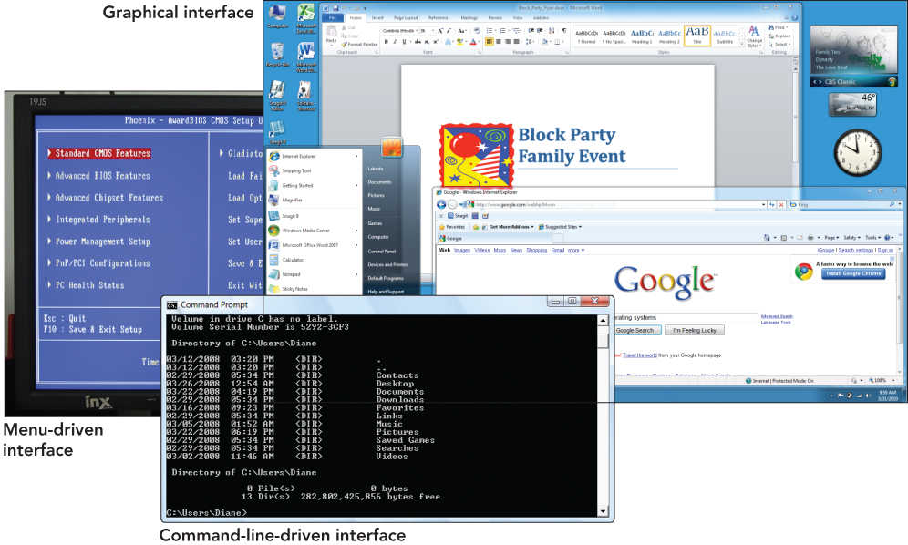
The Operating System
Types of user interfaces
Graphical user interface (GUI)
Menu-driven user interface
Command-line user interface

Slide 25
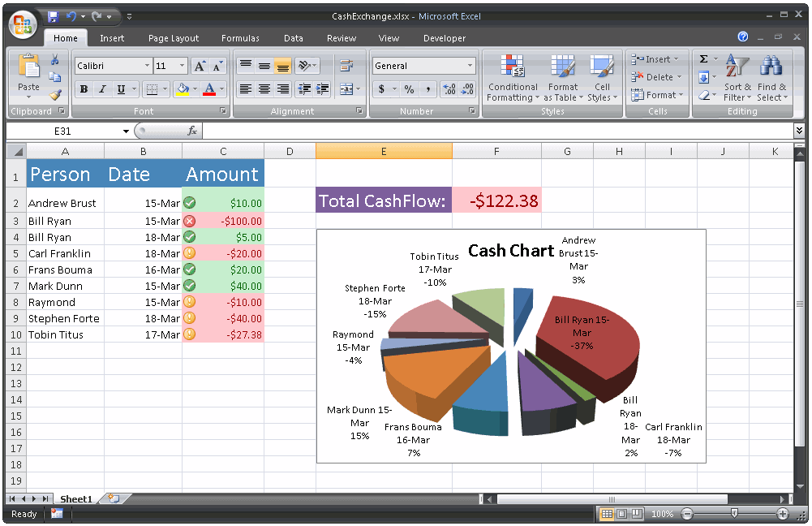
Graphical User Interface

Slide 26
UNIX
Features preemptive multitasking
ensures all applications have fair access to the CPU
Has many versions that are not compatible
Hard to use—defaults to a command-line user interface
Mac OS X is based on UNIX

Slide 27
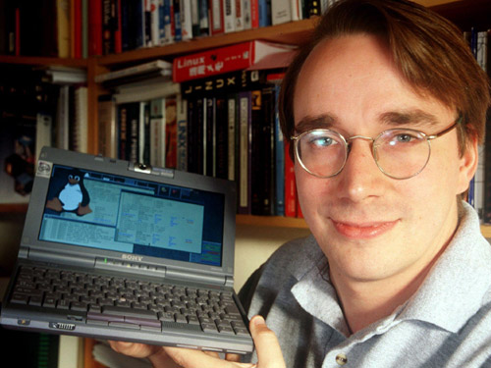
Stand-Alone Operating Systems
Linux
Developed by Linus Torvalds in 1991
He was a computer science student in Finland between 1988 – 1996
Linux was his Master’s thesis
Open source software
source code is available to users
Powerful, free
Linux is actually a kernel not an OS

Slide 28
What does Free and Open Source Mean
Free: Free to download, install, distribute and change
Open Source
Anybody can see, change and redistribute the source code
If you change the source code, you have to distribute it freely

Slide 29
Stand-Alone Operating Systems
Linux
Gaining acceptance for Web servers
Disadvantages
Lack of technical support prevents adoption in corporate environments
Difficult to run Microsoft Office applications
About 60% of the servers in the world use Linux
Supercomputers also prefer linux
Android is also based on linux open source

Slide 30
Stand-Alone Operating Systems
Windows Vs Mac Vs Linux
Platform—determined by combination of processor chip & OS
Windows
Dominate marketplace
Intel or AMD chip
More software available
Macs
Mac OS
Motorola or IBM chip
Most current OS can run Windows software
Linux based OS
Can be installed on PC or Mac
More secure—fewer viruses
Free to download, use and distribute
Hundreds of variants

Slide 31
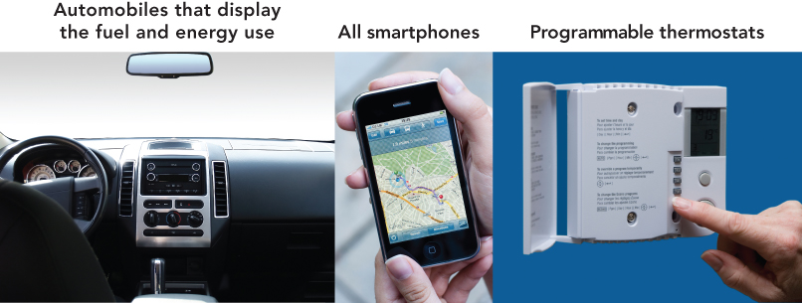
Stand-Alone Operating Systems
Embedded operating systems
Designed for specific applications
Compact and efficient
Eliminate many unneeded features of OSs
Used in PDAs, cell phones, kitchen appliances, point-of-sale devices, industrial robots, etc.

Slide 32
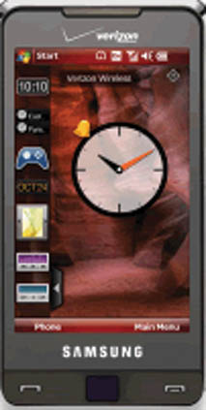
Stand-Alone Operating Systems
Microsoft Windows Mobile
Designed for smartphones and PDAs
Includes simplified versions of Windows programs
Supports handwriting recognition and voice recording
Supports synchronizing with corresponding programs on desktop computers

Slide 33

Stand-Alone Operating Systems
Designed for smartphones, tablets, computers, mini-pcs, netbooks
Synchronizes with PC
Supports touchscreen, voice recognition, usb devices
Most popular smartphone OS

Slide 34
Stand-Alone Operating Systems
More embedded operating systems
Window CE
Used in devices such as hand-held PCs, video game players, digital cameras, and industrial products such as barcode readers
Palm OS
Developed for PDAs—currently used in smartphones such as Palm Pixi
Symbian OS
Open industry standard operating system for data-enabled mobile phones with many add-on devices
iOS
Apple iPhone only

Slide 35
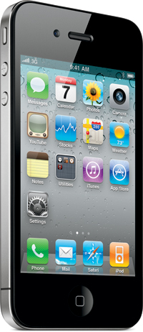
Stand-Alone Operating Systems
More embedded operating systems
iPhone OS
Features
Genius Mixes
Genius Recommendations
Saving video from mail and MMS into Camera Roll
Save a New Clip option

Slide 36
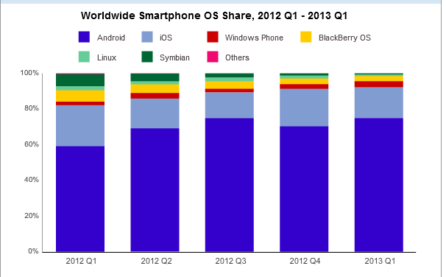
Mobile OS Market Share

Slide 37
http://www.telegraph.co.uk/technology/google/8187962/Google-Chrome-comparison-of-operating-systems.html

Slide 38
System Utilities: Housekeeping Tools
System utilities (utility programs)
Software programs—essential to effective management of the computer system
Perform tasks such as:
Backing up files
Providing antivirus protection
Searching for and managing files
Compressing files
Providing accessibility utilities to individuals with special needs

Slide 39
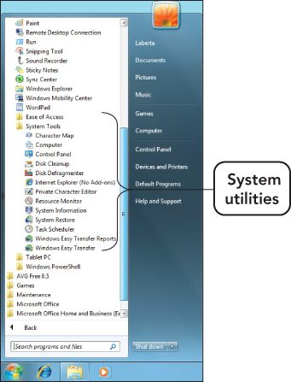
System Utilities: Housekeeping Tools
Backup software—copies data found on the hard disk to a backup device
Full backups—include all files and data
Incremental backups—include only those files changed or added since the previous backup
Drive imaging software—creates a mirror image of the entire hard drive

Slide 40
System Utilities: Housekeeping Tools
Antivirus software—protects the computer from viruses
Popular antivirus programs:
BitDefender Antivirus
Kaspersky Anti-virus
Norton AntiVirus
McAfee

Slide 41
System Utilities: Housekeeping Tools
Searching for and managing files
File manager—utility software that organizes and manages data
Copy files
Determine how and where files are stored
Delete files
Search utility—enables you to locate files

Slide 42
System Utilities: Housekeeping Tools
Scanning and defragmenting disks
Disk scanning programs—find and resolve disk file storage problems
Bad sector—irregularity on the disk’s surface that renders a portion of the disk unable to store data reliably
Disk cleanup utilities—remove unnecessary files to save space
Fragmented disk—results from computer creating and erasing files on hard disk
Causes disk access to slow while system looks in several locations to find all file segments
Disk defragmentation programs—reorganize stored data in a more efficient manner

Slide 43
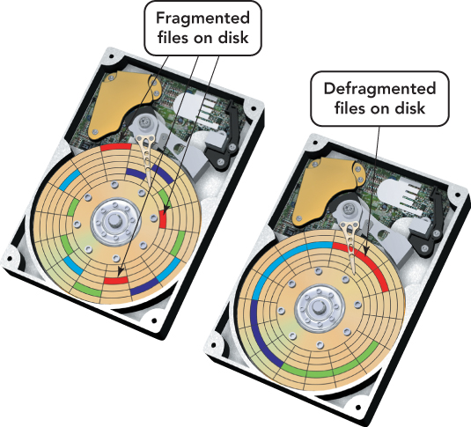
System Utilities: Housekeeping Tools
Defragmentation process repositions the sectors of a file into adjacent locations.

Slide 44
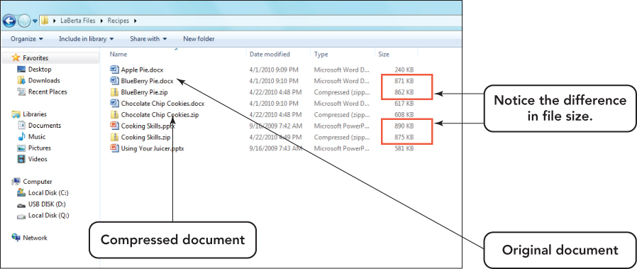
System Utilities: Housekeeping Tools
File compression utilities
Decrease the size of files, resulting in faster downloads
Create archives by storing files in a special format

Slide 45
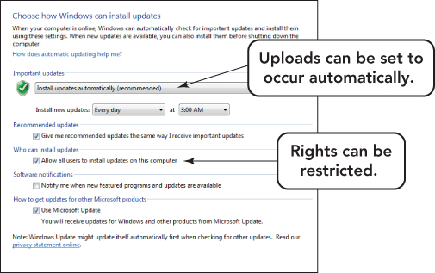
System Utilities: Housekeeping Tools
Systems update
Windows Update for Windows 7 and Vista automatically downloads and installs updates.
Includes service packs, version upgrades, and security updates

Slide 46
System Utilities: Housekeeping Tools
Troubleshooting
Ask for help if you are not sure!
Shut down the system properly.
Use correct procedure; don’t just turn the power off.
Put in sleep mode, a low-power state, as an alternative.

Slide 47
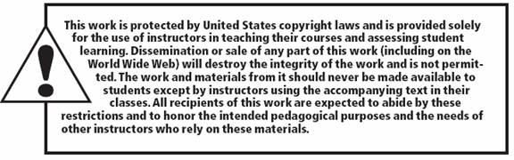
All rights reserved. No part of this publication may be reproduced, stored in a retrieval system, or transmitted, in any form or by any means, electronic, mechanical, photocopying, recording, or otherwise, without the prior written permission of the publisher. Printed in the United States of America.
Copyright © 2012 Pearson Education, Inc.
Publishing as Prentice Hall

