Slide 1
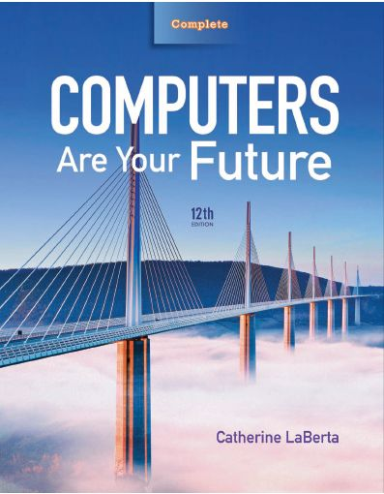
Computers Are Your Future Twelfth Edition
Chapter 2: Inside the System Unit
CPIT 220
Dr. Sabeen Tahir

Slide 2
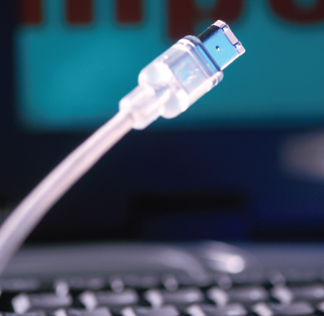
Inside the Computer System

Slide 3
Objectives
Understand how computers represent data.
Understand the measurements used to describe data transfer rates and data storage capacity.
List the components found inside the system unit and explain their use.

Slide 4
Objectives
List the components found on the computer’s motherboard and explain their role in the computer system.
Discuss (in general terms) how a CPU processes data.
Explain the factors that determine a microprocessor’s performance.

Slide 5
Objectives
List the various types of memory found in a computer system and explain the purpose of each.
Describe the various physical connectors on the exterior of the system unit and explain their use.

Slide 6
How Computers Represent Data
Binary numbers
Only 0s and 1s
Bit
Smallest piece of data a computer can work with
Either “on” or “off,” a 0 or a 1
Eight bits—byte—a single unit of storage

Slide 7
How Computers Represent Data
Modem’s data transfer rate is in bits per second
Example—gigabits per second (Gbps)
Data storage is in bytes
Kilobyte (KB)—one thousand bytes
Megabyte (MB)—one million bytes
Gigabytes (GB)—one billion bytes
Terabyte (TB)—one trillion bytes

Slide 8
How Computers Represent Data
Computers convert binary numbers into hexadecimal (hex) numbers
Which use the numbers 0 through 9, followed by letters A through F

Slide 9
How Computers Represent Data
Floating point notation
Has no fixed number of digits before or after a decimal point
Enables a computer to work quickly with very large or small numbers
Requires special processing circuitry

Slide 10
How Computers Represent Data
Characters
Letters, numbers, and symbols—converted into numbers the computer understands
Character code
Performs the conversion
American Standard Code for Information Interchange (ASCII)
Extended Binary Coded Decimal Interchange Code (EBCDIC)
Unicode

Slide 11
Introducing the System Unit
System unit
Case that contains the major hardware components of a computer
Come in different styles
Footprints
Amount of space that the unit uses

Slide 12
Introducing the System Unit
System unit (con’t.)
Some have embedded biometric authentication devices such as fingerprint readers, retina scanners, and face recognition systems to prevent unauthorized access.
Form factor—specifies how the internal components are located within the system unit.

Slide 13
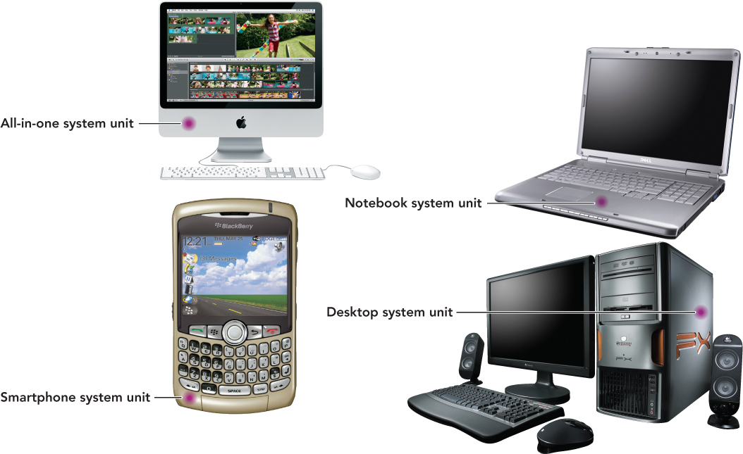
Inside the System Unit

Slide 14
Inside the System Unit
System unit main components
Motherboard
CPU
Power supply
Cooling fan
Internal speaker
Drive bays
Expansion slots

Slide 15
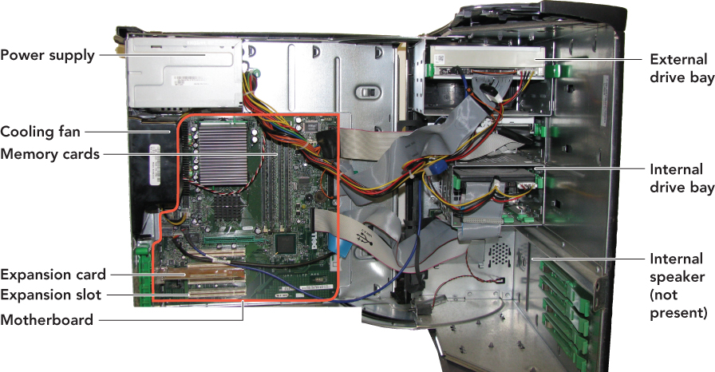
Inside the System Unit

Slide 16
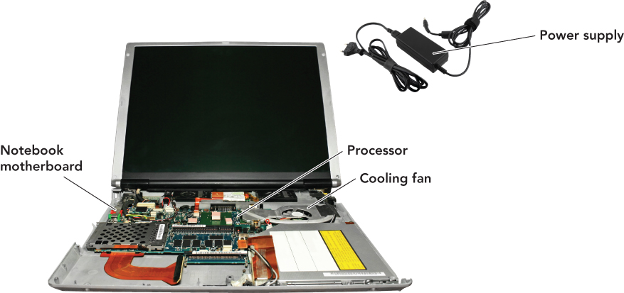
Inside the System Unit

Slide 17
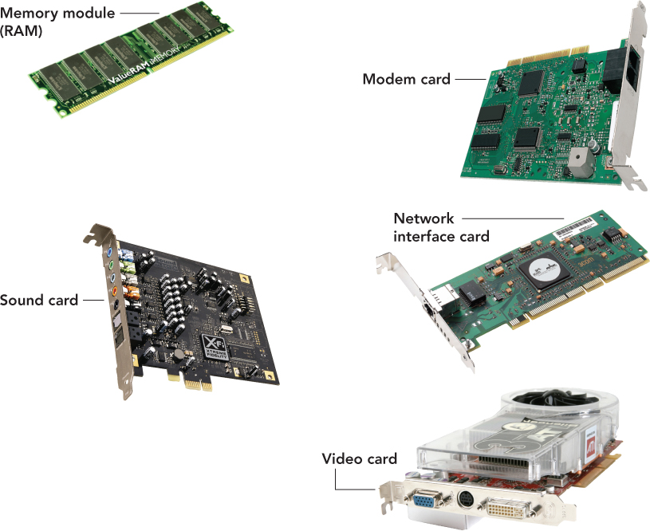
What’s on the Motherboard?

Slide 18
What’s on the Motherboard?
Motherboard
Printed circuit board that contains the electrical circuitry for the computer
The majority of parts found on the motherboard are integrated circuits.
Includes millions of transistors and carries electrical current
A switch that is able to control the electrical signal flow to the circuit

Slide 19
What’s on the Motherboard?
Central processing unit (CPU)
Integrated circuit chip that processes electronic signals
Also known as a microprocessor or processor

Slide 20
What’s on the Motherboard?
CPU (con’t.)
Is usually covered by a heat sink
A heat-dissipating component that drains heat from the chip
Instruction—An operation performed by the CPU and assigned a specific number
Instruction set—The list of CPU instructions for the operations

Slide 21
What’s on the Motherboard?
CPU (con’t.)
Control unit—one of the two main parts
Retrieves instructions from memory
Interprets and performs those instructions
Manages the machine cycle or processing cycle, the four-part process performed by the CPU
Arithmetic logic unit (ALU)—one of the two main parts
Performs arithmetic and logical operations
Involve adding, subtracting, multiplying, dividing
Logical operations involve comparisons between two or more data items.

Slide 22
What’s on the Motherboard?
Machine cycle
Instruction cycle
Fetch: Retrieves program instructions
Decode: Determines what the program is telling the computer to do
Execution cycle:
Execute: Performs the requested action
Store: Stores the results to an internal register
Registers—store data when it must be temporarily stored in the CPU

Slide 23
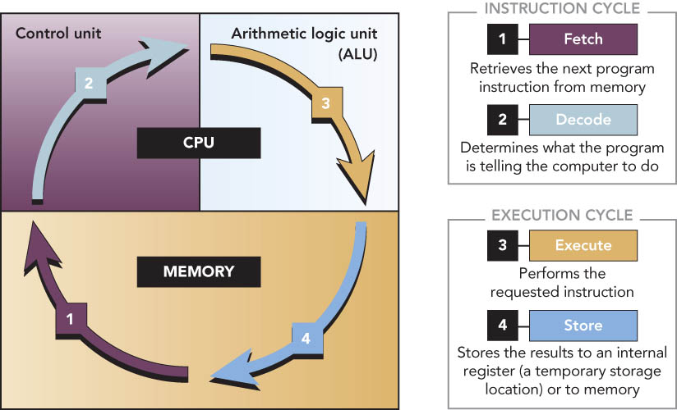
What’s on the Motherboard?

Slide 24
What’s on the Motherboard?
Factors that affect the performance of a CPU include:
Number of existing transistors
Data bus width and word size
Clock speed
Operations per microprocessor cycle
Use of parallel processing
Type of chip

Slide 25
What’s on the Motherboard?
Data bus
Group of parallel wires that connect the CPU’s internal components
Width measured in bits
Maximum number of bits the CPU can process at once is called the word size
Determines which operating systems and software a CPU can run

Slide 26
What’s on the Motherboard?
System clock
Electronic circuit that produces rapid pulses and coordinates the computer’s internal activities.
Clock speed—measurement of the electrical pulses generated by the system clock, usually measured in gigahertz (GHz)

Slide 27
What’s on the Motherboard?
System clock (con’t.)
Superscalar architecture—enables the CPU to perform more than one instruction for each clock cycle
Pipelining—enables the CPU to process more than one instruction at a time improving performance

Slide 28
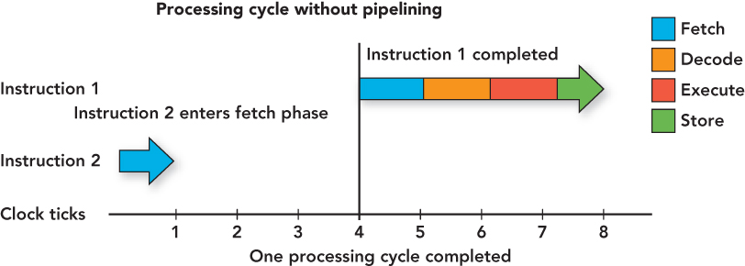
What’s on the Motherboard?

Slide 29
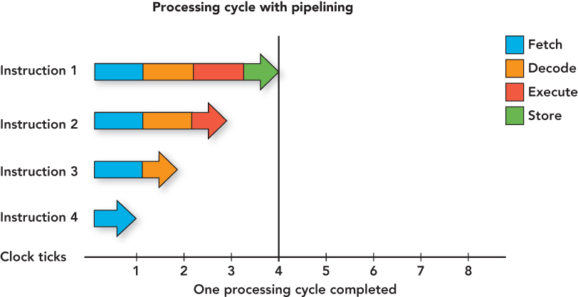
What’s on the Motherboard?

Slide 30
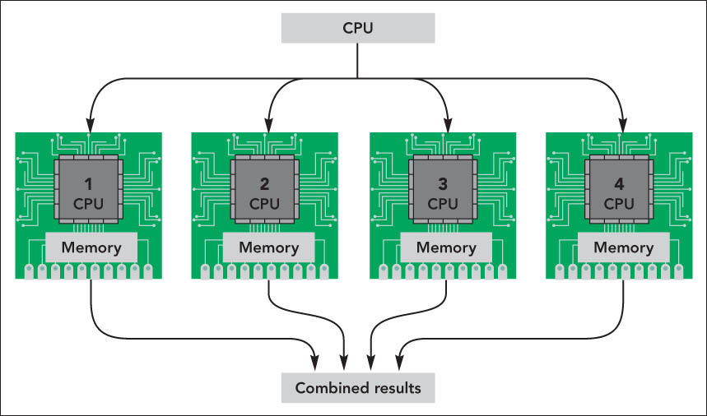
What’s on the Motherboard?
Parallel processing
Method where more than one processor performs at the same time—faster processing

Slide 31
What’s on the Motherboard?
Multi-core processing
Access time reduced
Processing time improved
Each core handles incoming streams of data or instructions at the same time
Two basic types:
Dual core
Quad core

Slide 32
What’s on the Motherboard?
Chipset
Set of chips that supply the switching circuitry the CPU requires to move data throughout the computer
The CPU and the input/output (I/O) bus linked through the chipset
Provides a means to communicate with input and output devices

Slide 33
What’s on the Motherboard?
Memory
Chips on the motherboard or within the CPU that retain instructions and data
Random access memory (RAM)
Temporarily stores data and instructions for the CPU
Volatile—contents erased after computer is shut off
Allows CPU to access or store data and instructions quickly through RAM’s memory address feature
Identifies and locates stored data

Slide 34
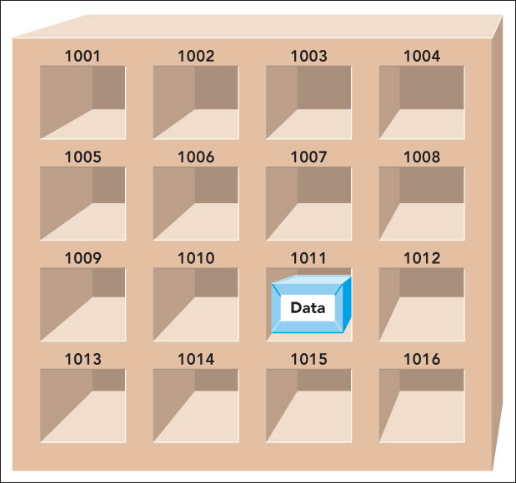
What’s on the Motherboard?

Slide 35
What’s on the Motherboard?
RAM (con’t.)
Comes in the form of memory modules or memory cards
Memory modules (memory cards)—small circuit boards that hold several RAM chips and fits into special slots on the motherboard
Types of RAM:
Dual inline memory modules (DIMM)—most common today
168-pin connector
64-bit transfer rate
Single inline memory modules (SIMM)—older technology
72-pin connector
32-bit transfer rate

Slide 36
What’s on the Motherboard?
Memory footprint
Amount of RAM the operating system uses while it operates
Virtual memory
Section of the hard drive set aside to use when RAM gets full

Slide 37
What’s on the Motherboard?
Cache memory
Small unit of ultrafast memory built into or near the processor
Used to store frequently or recently access program instructions or data
Faster than RAM
More expensive than RAM
Three levels of cache on a system:
Level 1 (L1) cache (primary cache)
Level 2 (L2) cache (secondary cache)
Level 3 (L3) cache
Found on some newer microprocessors
Primarily used in servers and workstations

Slide 38
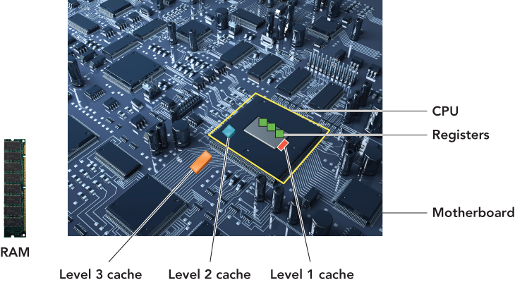
What’s on the Motherboard?

Slide 39
What’s on the Motherboard?
Read-only memory (ROM)
Contains prerecorded instructions to start the computer
Nonvolatile—contents stored when CPU power off
Basic input/output system (BIOS)
First code run when the system is powered on
Bootstrap loader
Program—locates and loads the operating system into RAM
Complementary metal-oxide semiconductor (CMOS)
Starts the power-on self-test and verifies other system components are operating correctly
Power-on self-test (POST)
Checks circuitry and RAM, marking defective locations

Slide 40
What’s on the Motherboard?
ROM (con’t.)
Programmable ROM (PROM)
Electrically-PROM (EPROM)
Electrically erasable PROM (EEPROM)
Flash EPROM

Slide 41
What’s on the Outside of the Box?
Front panel
Power switch
Used to turn the computer on
Drive activity light
Advises the user that the hard drive is retrieving data
Power-on light
Shows whether the power is on

Slide 42
What’s on the Outside of the Box?
Outside a system unit
Connector—physical receptacle used to plug a peripheral device into the computer
Example: telephone jack
Port—electronically defined pathway used to send data into and retrieve data from the computer
Example: USB port

Slide 43
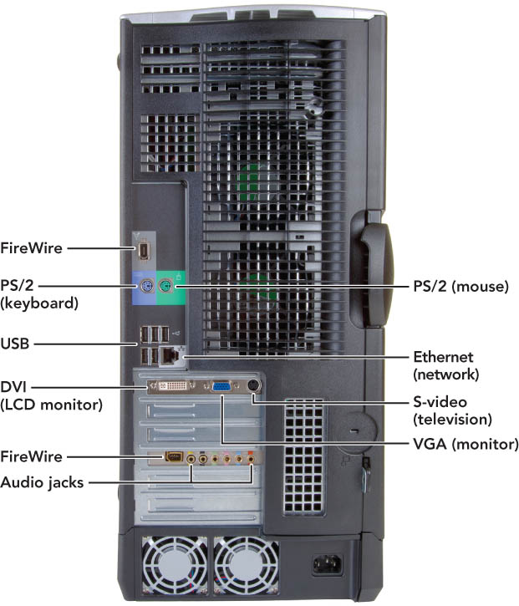
What’s on the Outside of the Box?

Slide 44
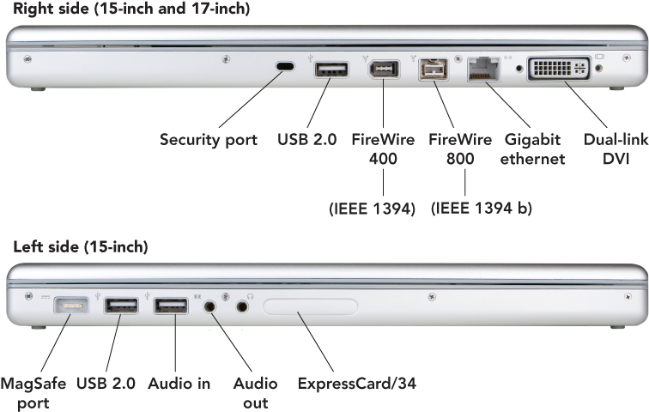
What’s on the Outside of the Box?
Connectors on a notebook may vary
Notes:
This is Figure 2.29.

Slide 45
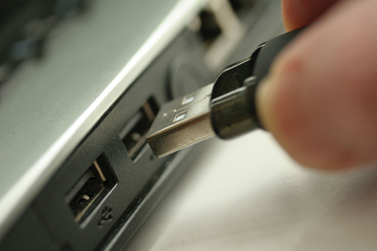
What’s on the Outside of the Box?
USB (universal serial bus) ports
Connects up to 127 peripheral devices
USB 2.0 (high-speed USB)—fully compatible with USB 1.1 products, cables, and connectors
Designed to replace older parallel and serial ports
Connects a variety of devices to the computer, including:
Keyboards
Mice
Printers
Digital cameras

Slide 46
What’s on the Outside of the Box?
USB 2.0
Uses an external bus
Supports data transfer rates of 480 Mbps between the computer and the peripheral device
Supports hot swapping—ability to connect and disconnect devices without shutting down the computer
Plug-and-play (PnP)—allows computers to automatically detect the device when you plug it in
USB hub
Device that plugs into existing USB port
Contains four or more additional ports
Notes:
This is Figure 2.20.

Slide 47
What’s on the Outside of the Box?
FireWire (1395 ports)
Created by Apple in 1995
IEEE 1394 Higher Performance Serial Bus, also known as Sony i.Link
Offers high-speed connections for dozens of peripheral devices (up to 63)
Enables hot swapping and PnP
Data transfer rates of FireWire
FireWire 400—400 Mbps
FireWire 800—800 Mbps
FireWire S3200—next generation (expected to transfer data at 3.2 Gbps)
Notes:
This is Figure 2.20.

Slide 48
What’s on the Outside of the Box?
Video connectors
VGA (video graphics array)
15-pin male connector—works with standard monitor cables
Transmits analog video signals
Used for legacy technology cathode ray (CRT) monitors
DVI (Digital visual Interface) port—lets LCD monitors use digital signals
Onboard video—video circuitry built into the motherboard where the video connector is on the back of the system unit case
Notes:
This is Figure 2.20.

Slide 49
What’s on the Outside of the Box?
Additional connectors
Telephone
Network
PC card slot
PC card
ExpressCard
Sound card
Game card
TV/sound capture board

Slide 50
What’s on the Outside of the Box?
Legacy technology
Older technology that is being phased out
Examples:
Serial ports
Parallel ports
PS/2 ports
SCSI (small computer system interface) ports

Slide 51
Summary
Understand how computers represent data.
Understand the measurements used to describe data transfer rates and data storage capacity.
List the components found inside the system unit and explain their use.

Slide 52
Summary
List the components found on the computer’s motherboard and explain their role in the computer system.
Discuss (in general terms) how a CPU processes data.
Explain the factors that determine a microprocessor’s performance.

Slide 53
Summary
List the various types of memory found in a computer system and explain the purpose of each.
Describe the various physical connectors on the exterior of the system unit and explain their use.

Slide 54
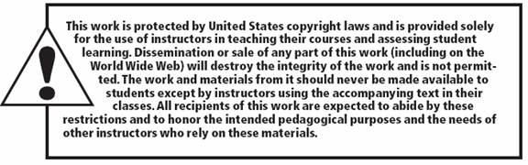
All rights reserved. No part of this publication may be reproduced, stored in a retrieval system, or transmitted, in any form or by any means, electronic, mechanical, photocopying, recording, or otherwise, without the prior written permission of the publisher. Printed in the United States of America.
Copyright © 2012 Pearson Education, Inc.
Publishing as Prentice Hall

