Slide 1

Computers Are Your Future Twelfth Edition
Chapter 13: Systems Analysis and Design

Slide 2

Systems Analysis and Design

Slide 3
Objectives
Define systems analysis.
Explain the goals and activities of a systems analyst.
Understand the concept of a system and its life cycle.
Discuss why the systems development life cycle (SDLC) is so widely used.
List the five phases of the SDLC.

Slide 4
Objectives
Describe the classic mistakes of failed information systems development projects and how systems analysts can avoid them.
Discuss the activities in each of the five phases of the SDLC.
Name the deliverables of each of the five phases of the SDLC.
Recognize the importance of security in each of the five phases of the SDLC.

Slide 5
System Analysis: Communication Counts
Systems analysis
Involves information systems planning, development, and implementation of artificial systems
Communication key to the development of a system that is:
Functional
Meets the needs of the company
Positively received by users

Slide 6
System Analysis: Communication Counts
Human components
Systems analysts
Determine information system requirements
Work with users and management
Have good listening and communication skills
Information technology steering committee
Includes representatives from senior management, information systems, and middle management
Provides guidance on key issues
Project team
Acts as liaison between systems analysts and others
Project manager
Manages project according to plan
Communicates to management strategies

Slide 7
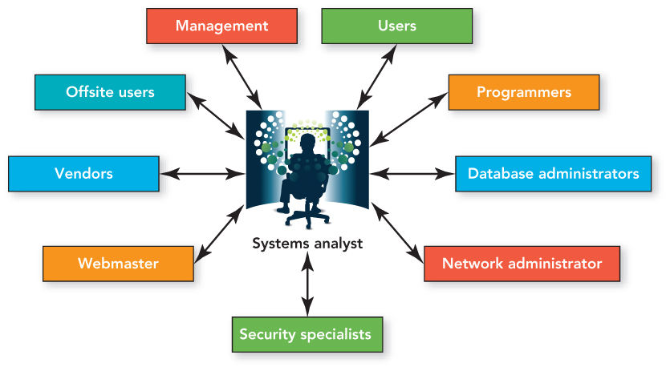
System Analysis: Communication Counts

Slide 8
The Systems Development Life Cycle
SDLC (Systems development life cycle)
Provides structure for system development
System
Collection of components organized to accomplish a goal
Artificial systems
Deliberately constructed by the people to serve some purpose
Life cycle
Systems are born, live, and become obsolete
Seeks to improve system quality
Consists of five phases
Planning, analysis, design, implementation, maintenance

Slide 9
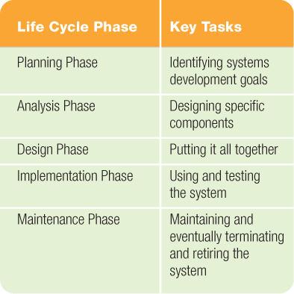
The Systems Development Life Cycle

Slide 10
The Systems Development Life Cycle
SDLC philosophy
Don’t proceed to the next phase before the current one works properly.
Each phase must provide a deliverable or outcome that often serves as the input for the next phase.

Slide 11
The Systems Development Life Cycle
Avoid mistakes
Involve users to ensure that the system meets their needs.
Use problem-solving methodology to provide effective results.
Use strong project management skills.

Slide 12
The Systems Development Life Cycle
Avoid mistakes (con’t.)
Document all important facts.
Documentation
Recording of all information relating to the project
Project notebook
Digital file maintained online
Microsoft Project and SharePoint provide monitoring tools, such as Gantt charts and calendars.
Use checkpoints to keep work on target.
Anticipate future growth and change while designing the system.

Slide 13
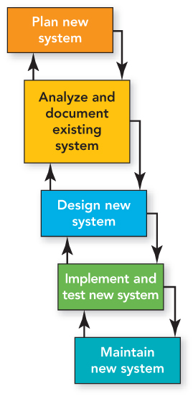
The Systems Development Life Cycle
Waterfall model
Each phase—individual entity
Must be completed before next one begins
Feedback loops exist between phases
Evaluate to continue, return to previous phase, or abort
Simple and easy to use
Better for small projects with minimal changes

Slide 14
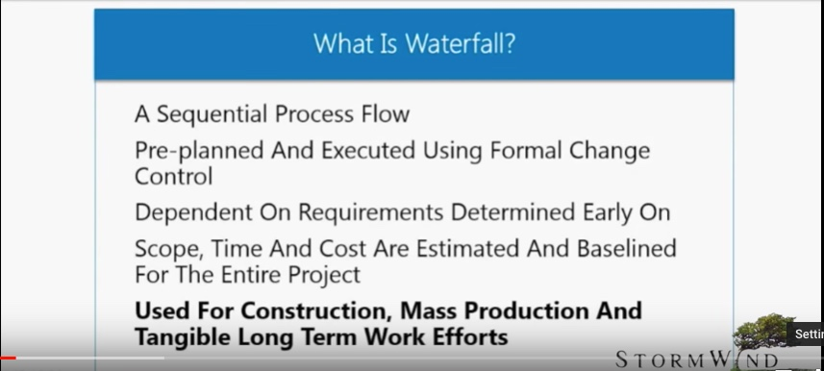

Slide 15
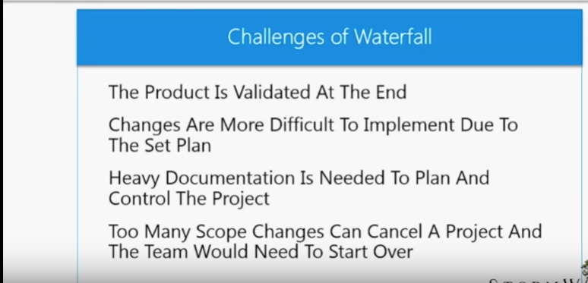

Slide 16
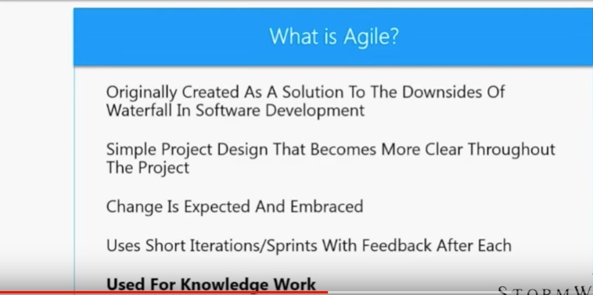

Slide 17
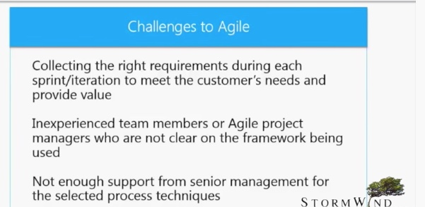

Slide 18
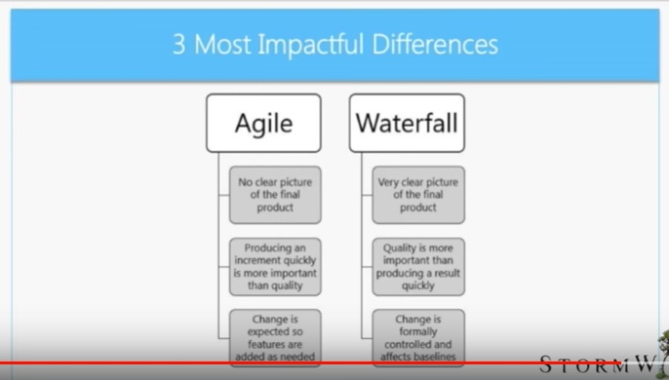

Slide 19
The Systems Development Life Cycle
Modern approaches to software development
Prototyping
Small scale mock-up of a system, with drawbacks:
Incomplete analysis
User confusion
Time consuming

Slide 20
The Systems Development Life Cycle
Modern approaches to software development (con’d.)
RAD (Rapid application development)
Active user involvement
Prototyping and repeated testing
Re-using software components
Less formality in communication
JAD (Joint application development)
Conducts SDLC phases 1–4 at the same time
Involves intense team member interaction

Slide 21
The Systems Development Life Cycle
Modern approaches to software development (con’d.)
Agile
Enables organizations to deliver systems quickly, change them quickly, and change them often
Quick adaptability
Faster decisions
Projects may complete sooner

Slide 22
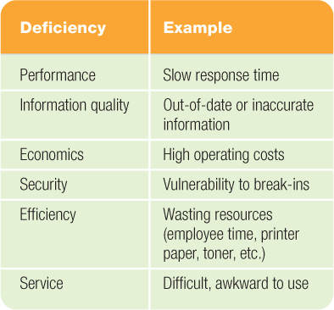
Phase 1: Planning the System
Recognizing the need may come from acknowledging deficiencies.

Slide 23
Phase 1: Planning the System
Defining the problem
The difference between a symptom and a problem:
Symptom—Unacceptable result of a problem
Problem—Underlying cause of a symptom
Ideally, features that need to be added to or built into the system are identified
Examining alternative solutions
Complete a requirements analysis
Consider possible solutions

Slide 24
Phase 1: Planning the System
Developing a plan
Identify the appropriate solution.
Create a project plan:
Cite the goals of the system.
List activities for successful project completion:
Specify order of completion
Estimate time frames
Create system specifications.

Slide 25
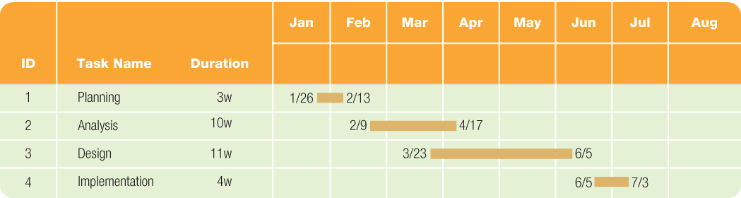
Phase 1: Planning the System
Gantt chart summarizes plans

Slide 26
Phase 1: Planning the System
Determining feasibility
Technical feasibility—Can be completed with existing, proven technology
Operational feasibility—Can be accomplished with available resources
Economic feasibility:
Can be done with available financial resources
Often involves a cost-benefit analysis
Analysis of losses and gains related to a project
Tangible and intangible benefits
Seeks a return on investment (ROI)

Slide 27
Phase 1: Planning the System
Preparing the project proposal
Project leader writes a report:
Identifies the problem.
Explains the proposed solution and benefits.
Gives details of the plan.
Concludes with a recommendation.
Includes scope, the sum of all project elements, as well as funds to cover scope creep.
The project proposal is the deliverable for Phase 1.

Slide 28
Phase 2: Analyzing and Documenting the Existing System
Analyzing the existing system
Identify activities needed to continue
Uncover problems not evident in Phase 1
Determining the new system requirements
State the requirements precisely
The listing of requirements is the deliverable for Phase 2

Slide 29
Phase 3: Designing the System
How the new system will work
Design Tools
ERD (Entity-relationship diagram)
All of the entities in the system as well as their relationships
Data flow diagram
Set of graphical symbols show data movement through system
Project dictionary
Explains all terminology relevant to project
Develop a data dictionary
Phase 3 deliverable—a logical diagram or design

Slide 30
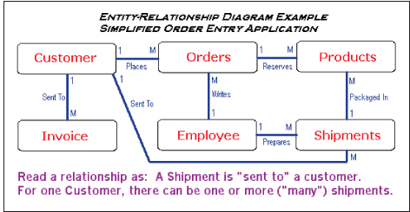
Phase 3: Designing the System
Design tools
Deliverable: ERD

Slide 31
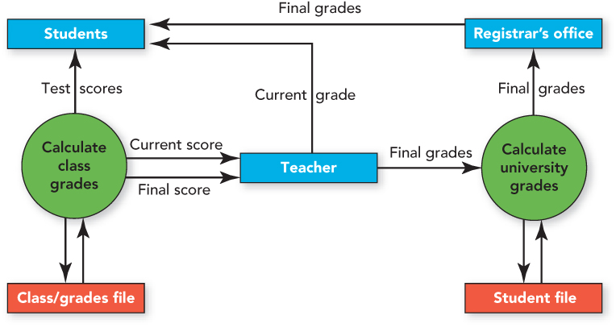
Phase 3: Designing the System
Design tools (con’t.)
Data flow diagram uses symbols for data movement

Slide 32
Phase 3: Designing the System
Two recent design approaches
Prototyping
RAD
Develop small scale mock-up
Provide enough functionality to get feedback
Advantage: Users have something concrete to review
CASE (Computer-aided software engineering)
Automates task of documenting entity relationships and data flows in complex system
Includes project management features, data dictionaries, documentation support, and graphical output support

Slide 33
Phase 4: Implementing the System
Build-or-buy decision
Develop in-house
Allows customization
Often more expensive
Purchase from outside vendor
Purchase off-the-shelf and customize
Outsource for specialized system creation
Request for quotation
Request for proposal
VAR (Value-added reseller)

Slide 34
Phase 4: Implementing the System
Developing the software
Subset of the systems development
Use PDLC (program development life cycle)
Testing
Application testing—assessing the programs separately and as a group
Acceptance testing—performed by the users and ensures the system works properly

Slide 35
Phase 4: Implementing the System
Training
Best methods include one-on-one training
Converting systems
Parallel conversion
Run new and old systems simultaneously
Pilot conversion
One part to new system for testing
Phased conversion
Implementation over different time periods
Direct (crash) conversion
Conversion to new system directly

Slide 36
Phase 5: Maintaining the System
Perform post implementation system review
Evaluates if goals have been met
Must meet the needs of the users
System must be maintained
Serves as the deliverable from Phase 5

Slide 37
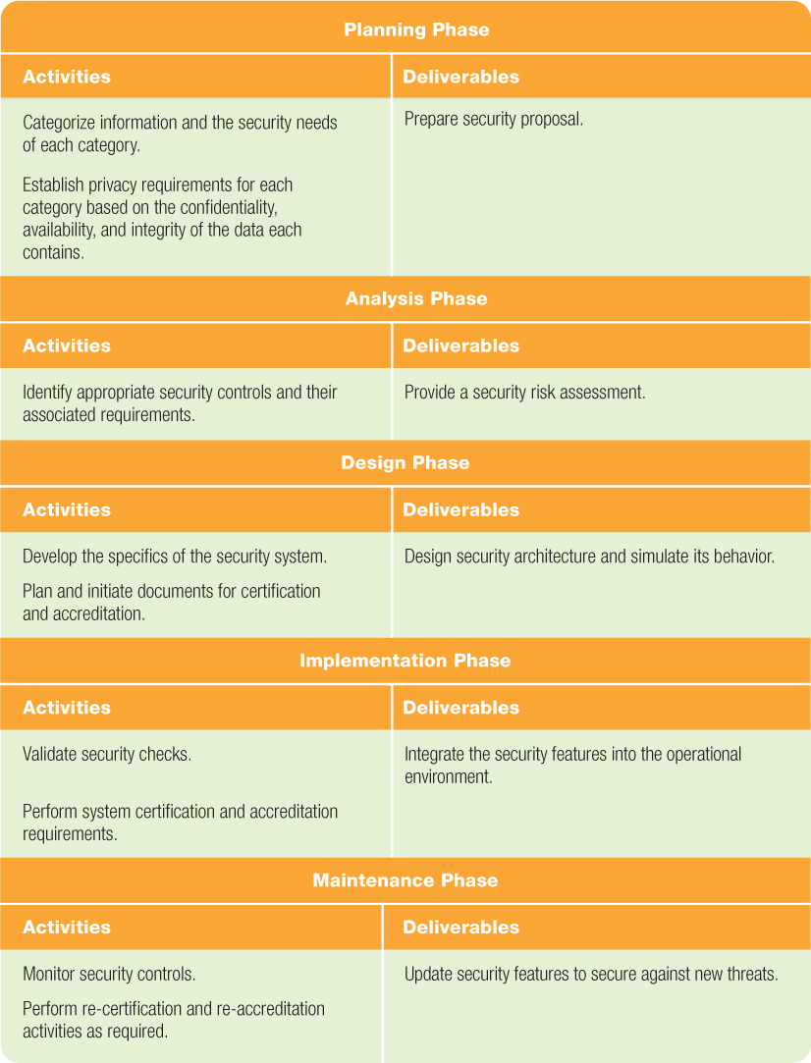
Security and the SDLC
Security
Needs to be integrated every step of SDLC

Slide 38
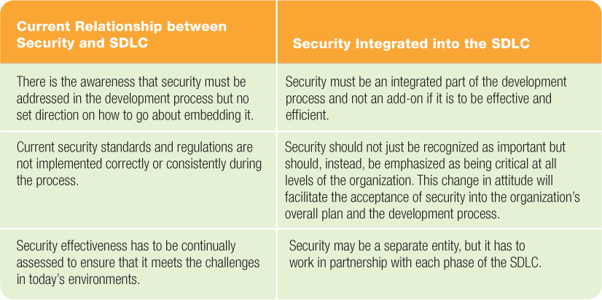
Security and the SDLC

Slide 39
Summary
Systems analysis is the field concerned with the planning, development, and implementation of artificial systems, including information systems.
Systems analysts work with users and management to develop a system.
A system is a group of interrelated components that accomplish a goal. A system requires modification over time.

Slide 40
Summary
SDLC provides structure to the development of the goal.
The five phases of the system development life cycle are:
Planning or investigation
Analysis
Design
Implementation
Maintenance or support

Slide 41
Summary
Lack of user involvement, poor project management, and lack of documentation cause projects to fail.
The SDLC phases should be completed in order with the results of one phase becoming the starting point for the next phase of the cycle.

Slide 42
Summary
SDLC phases:
Planning: Recognize need for information system
Analysis: Determine needs of new system
Design: Determine how new system will work
Implementation: Build-or-buy, develop, test, train, and convert
Maintenance: ongoing evaluation, and maintenance

Slide 43
Summary
Deliverables from each phase of the SDLC are input to the next phase:
Planning: Project proposal
Analysis: List of new system requirements
Design: Logical design that provides overall picture of system
Implementation: Conversion to new system
Maintenance: Post implementation review

Slide 44
Summary
Security is an interwoven element that is addressed at each phase of development.

Slide 45

All rights reserved. No part of this publication may be reproduced, stored in a retrieval system, or transmitted, in any form or by any means, electronic, mechanical, photocopying, recording, or otherwise, without the prior written permission of the publisher. Printed in the United States of America.
Copyright © 2012 Pearson Education, Inc.
Publishing as Prentice Hall

