Slide 1
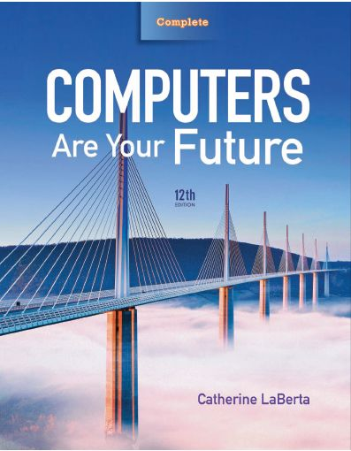
Computers Are Your Future Twelfth Edition
Chapter 7: Networks: Communicating
and Sharing Resources

Slide 2
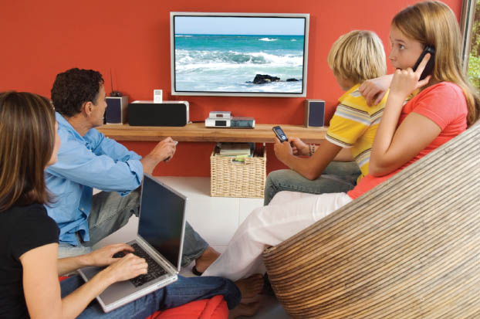
Networks: Communicating and Sharing Resources

Slide 3
Objectives
Understand basic networking concepts.
Distinguish between a WAN, LAN, MAN, CAN, HAN, and PAN.
Discuss the advantages and disadvantages of networks.
Distinguish between peer-to-peer, client/server, and virtual private local area networks (LANs).

Slide 4
Objectives
Define topology and understand how the three LAN topologies differ.
Explain the importance of network protocols.
Name the most widely used LAN protocol and their versions.
Identify the special components of a wide area network (WAN) that differentiate it from a LAN.

Slide 5
Objectives
Contrast circuit-switching and packet-switching networks and explain their respective strengths and weaknesses.
Identify the options, components, configuration, and maintenance of a home area network (HAN).

Slide 6
Network Fundamentals
Networks
Links multiple computer systems and enables them to share data and resources
Types of computer networks:
Local area network (LAN)
Wide area network (WAN)
Metropolitan area network (MAN)
Campus area network (CAN)
Personal area network (PAN

Slide 7
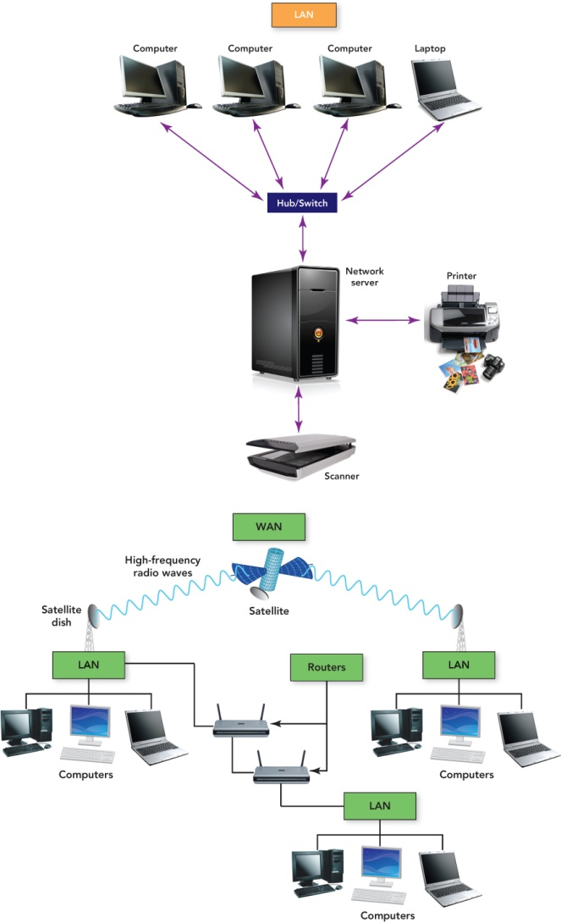
Network Fundamentals
Notes:
T

Slide 8
Network Fundamentals
LAN
Uses cables, radio waves, or infrared signals
Links computers in a limited geographic area
WAN
Uses long-distance transmission media
Links computer systems a few miles or thousands of miles
Internet is the largest WAN
MAN
Designed for a city
Larger than a LAN, smaller than a WAN

Slide 9
Network Fundamentals
CAN
Several LANs located in various locations on a college or business campus
Smaller than a WAN
Use devices such as switches, hubs, and routers
PAN
Network of an individual’s own personal devices
Usually within a range of 32 feet
Usually use wireless technology

Slide 10
Network Fundamentals
Communication devices
Convert data into signals to travel over a medium
Computers
Modems
Routers
Switches
Hubs
Wireless access points
Network interface cards (NICs)

Slide 11
Network Fundamentals
Node
Any device connected to a network
Logical address
Unique name assigned to each node on the network
Physical address
Unique numeric that identifies each node on the network built into the hardware
Network interface card (NIC)
Expansion board or adapter that provides a connection between the computer and the network
Notebook computers have wireless NICs

Slide 12
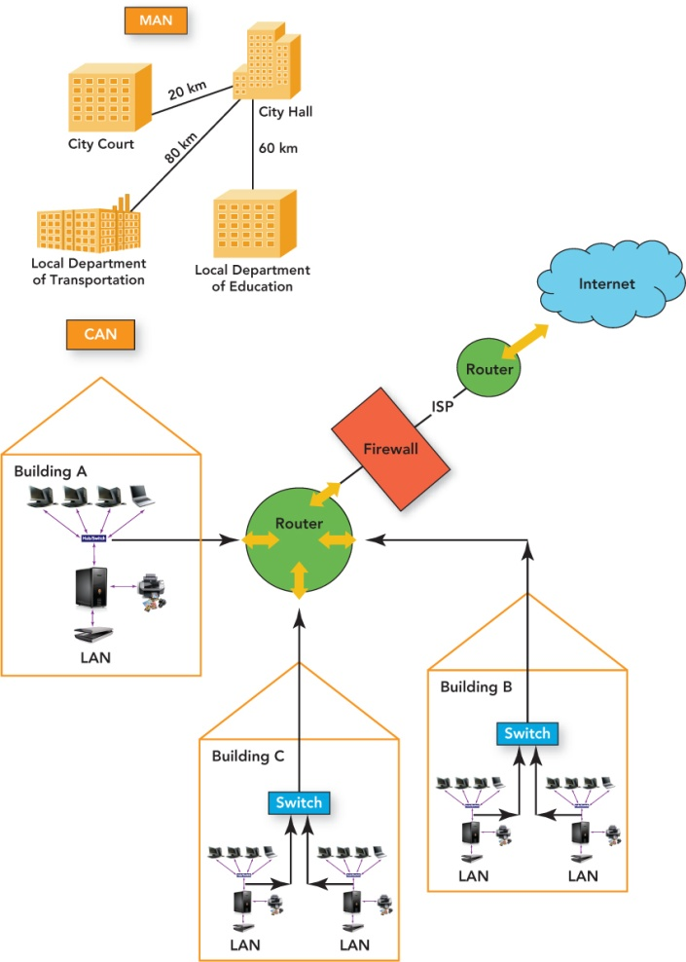
Network Fundamentals

Slide 13
Network Fundamentals
USB wireless network adapter
Plugs into a USB port
Usually provides an intuitive graphical user interface (GUI) for easy configuration
USB dongle
Device inserted into a USB port that adds additional features to the base system
Examples: enabling network connectivity and increasing RAM
Wireless PC card adapter
About the size of a credit card
Inserted into a slot on the side of most notebooks and netbooks
Has built-in WiFi antenna that provides wireless capability
LED lights that indicate whether the computer is connected

Slide 14
Network Fundamentals
Hub
Joins multiple computers together in a single network
Does not manage traffic between the connections
Switches
Filter and forward data between nodes
Are similar to routers but work within a single network
Routers
Connect two or more networks
Inspect the source and target of a data package
Determine the best route to transmit data

Slide 15
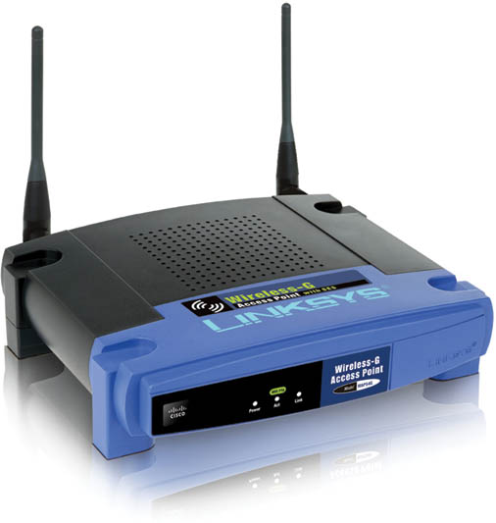
Network Fundamentals
Wireless access point (WAP)
Receives and transmits radio signals
Joins wireless nodes to a wired network

Slide 16
Network Fundamentals
Server
Computer or device with software that manages network resources, such as files, e-mails, printers, databases
File server
Most common type of server
High-speed computer that provides program and data files to network users
Contains the network operating system (NOS)
File directories for file and resource location on the LAN
Automated distribution of software updates to desktop computers on the WAN
Internet services support
Protection of services and data
Access to connected hardware by authorized users

Slide 17
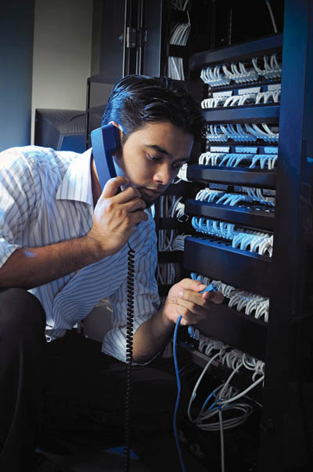
Network Fundamentals
Network administrator
Also called network engineer
Installs, maintains, supports computer networks
Interact with users
Handle security
Troubleshoot problems

Slide 18
Advantages and Disadvantages of Networking
Networking
Advantages
Reduced hardware costs
Application sharing
Sharing information resources
Data management centralization
Connecting people
Disadvantages
Loss of autonomy
Lack of privacy
Security threats
Loss of productivity

Slide 19
Local Area Networks
Peer-to-peer (P2P) networks
Share files without a file server
Easy to set up
Best used for home or small offices with no more than 10 computers
Do not require a network operating system
Can be slow if there are too many users
Security not strong

Slide 20
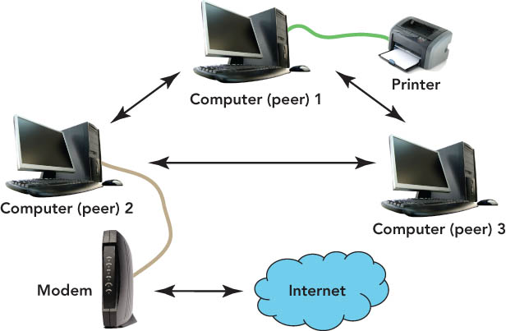
Local Area Networks
Peer-to-peer (P2P) networks

Slide 21
Local Area Networks
Wireless LAN
Connects users through radio waves instead of wires
Use includes networks in:
Homes
Hospitals
Colleges
Secured with a radio transmission technique that spreads signals over a seemingly random series of frequencies.
Effective inside range of between 125 and 300 feet

Slide 22
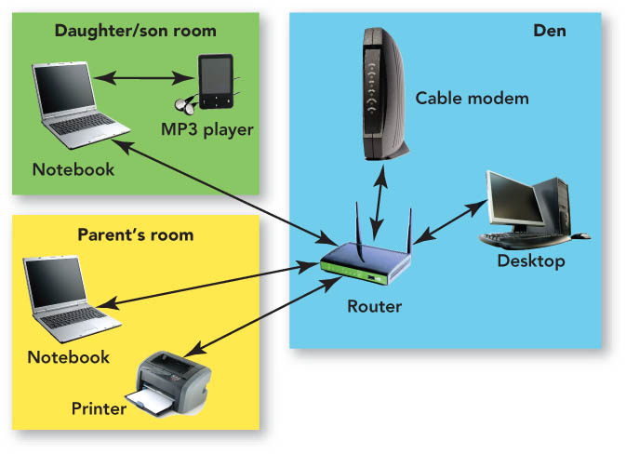
Local Area Networks

Slide 23
Local Area Networks
Client/server networks
Made up of one or more file servers and clients (any type of computer)
Client software enables requests to be sent to the server
Wired or wireless connections
Do not slow down with heavy use

Slide 24
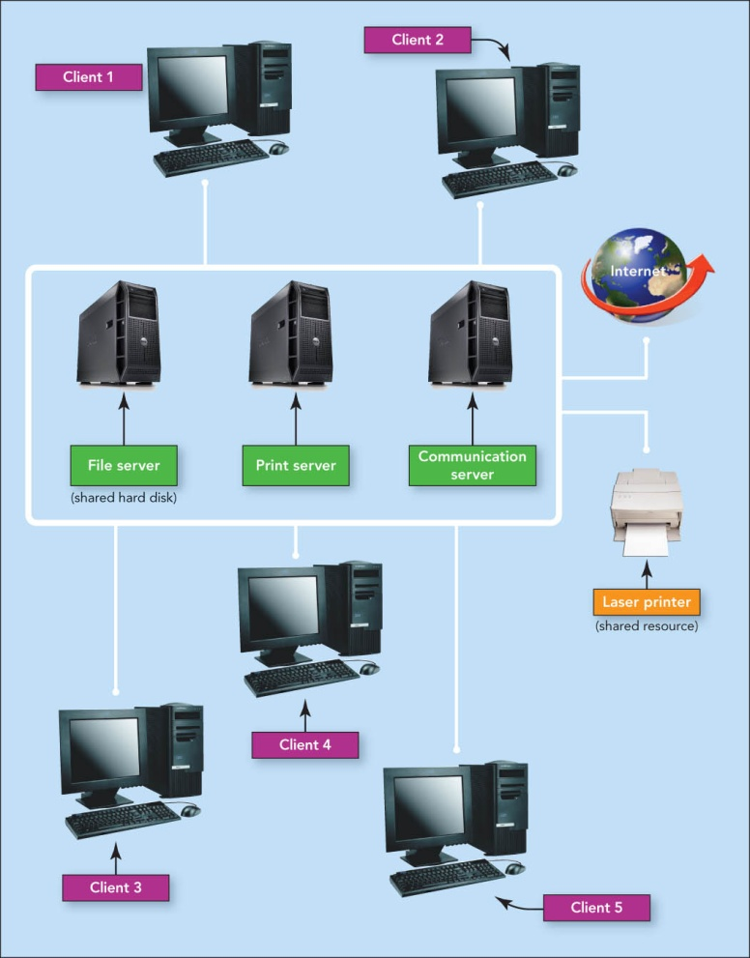
Local Area Networks

Slide 25
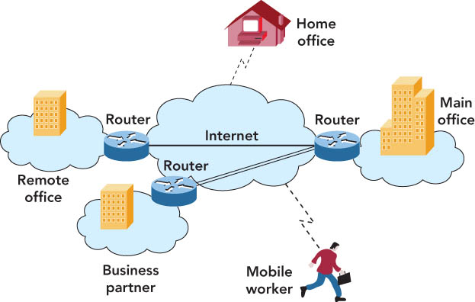
Local Area Networks
Intranet
Password-protected network controlled by the company
Accessed only by employees
Virtual private network
Operates over the Internet
Accessible by authorized users for quick access to corporate information
Uses secure, encrypted connections and special software

Slide 26
Local Area Networks
LAN topologies
Network topology
Physical design of a LAN
Topology resolves contention—conflict that occurs when two or more computers on the network attempt to transmit at the same time
Contention sometimes results in collisions—corruption of network data caused when two computers transmit at the same time

Slide 27
Local Area Networks
LAN topologies
Bus topology
Practical for home or small office
One node transmits at a time
Terminators signify the end of the circuit
Uses contention management—technique that specifies what happens when a collision occurs
Star topology
For office buildings, computer labs, and WANs
Easy to add users
Ring topology
For a division of a company or one floor
Not in common use today
Node can transmit only when it has the token—special unit of data that travels around the ring

Slide 28
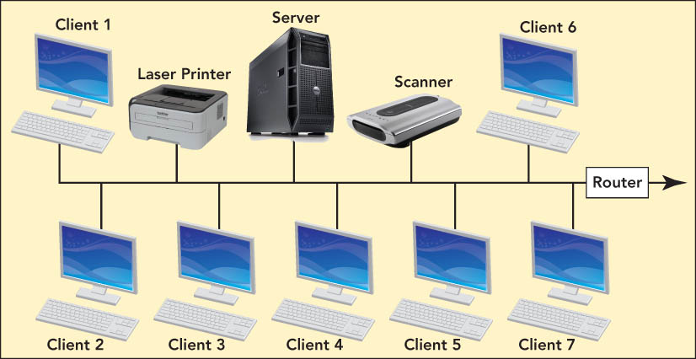
Local Area Networks

Slide 29
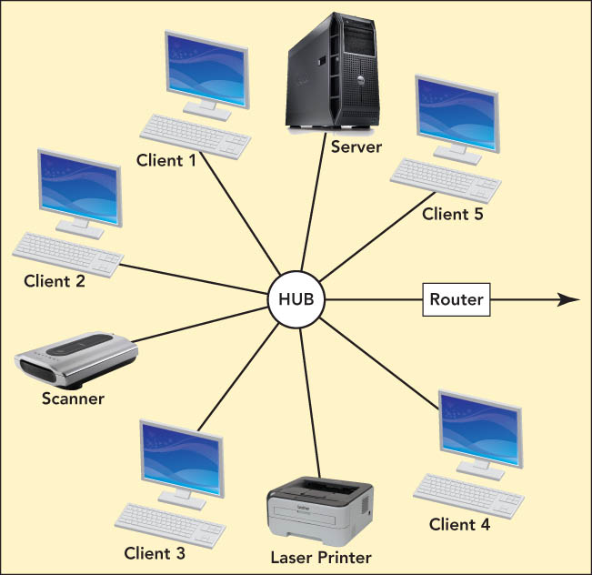
Local Area Networks

Slide 30
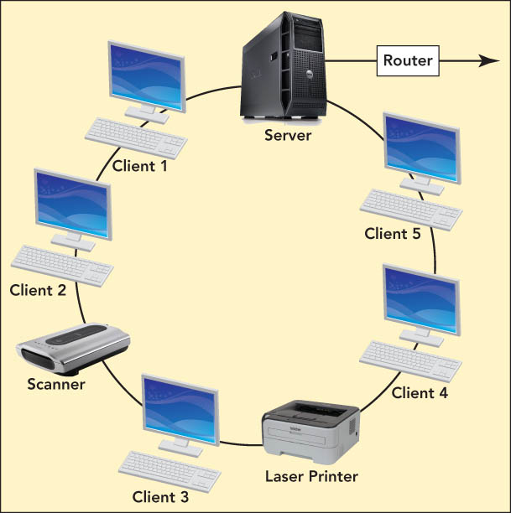
Local Area Networks

Slide 31
Local Area Networks
LAN protocols
Protocols—standards used by networks to permit communication between network-connected devices
Modulation protocols—ensure that the modem can communicate with another modem, even if by a different manufacturer
Protocol suite—contains the protocols of the network and specifies its network architecture, or how the network works

Slide 32
Local Area Networks
LAN protocols (con’t.)
Network layers—divide network architecture for separate treatment
Each network layer can operate and be governed by its own protocols.
Protocol stack—vertical arrangement of network layers

Slide 33
Local Area Networks
LAN technologies
Ethernet—most-used LAN protocol
Ethernet star networks
Most popular versions—use twisted-pair wiring and switches
Sends data in a fixed-size unit called a packet
WiFi
Uses radio waves to provide a wireless LAN standard at Ethernet speeds
Needs a central access point—could be a wireless router
Hot spots—public wireless access locations

Slide 34
Wide Area Networks
Point of presence (POP)
WAN connection point used to obtain access to the WAN
Wired or wireless
Backbones
High-capacity WAN transmission lines
gigaPoP (gigabits per second point of presence)—transfers data exceeding 1 Gbps (1 billion bits per second)

Slide 35
Wide Area Networks
WAN protocols
Internet protocols
Transmission Control Protocol/Internet Protocol (TCP/IP)
Protocols that define how the Internet works
Transmission Control Protocol (TCP)
Defines how Internet-connected computers can exchange, control, and confirm messages
Internet Protocol (IP)
Provides a distinct identification to any computer connected to the Internet: the IP address or Internet address

Slide 36
Wide Area Networks
WAN protocols (con’t.)
Circuit switching
Used by the public switched telephone network to send data over a physical end-to-end circuit
Provides a direct connection between devices
Packet switching
Used for computer communication
Divides and sends outgoing messages as packets, which are reassembled on receipt
More efficient and less expensive than circuit switching
Latency—delay introduced when a given packet is examined by many routers
Congestion—occurs when the network is overloaded, causing some packets to be further delayed

Slide 37
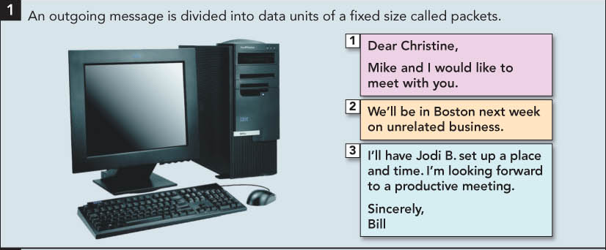
Wide Area Networks

Slide 38
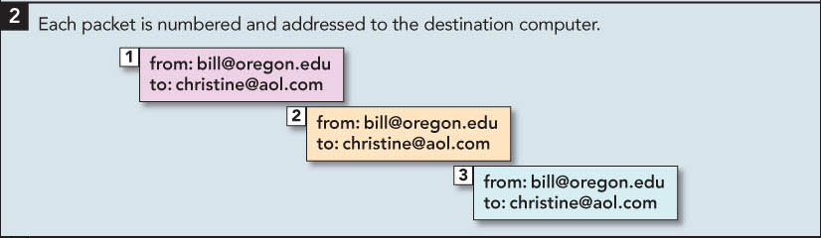
Wide Area Networks

Slide 39
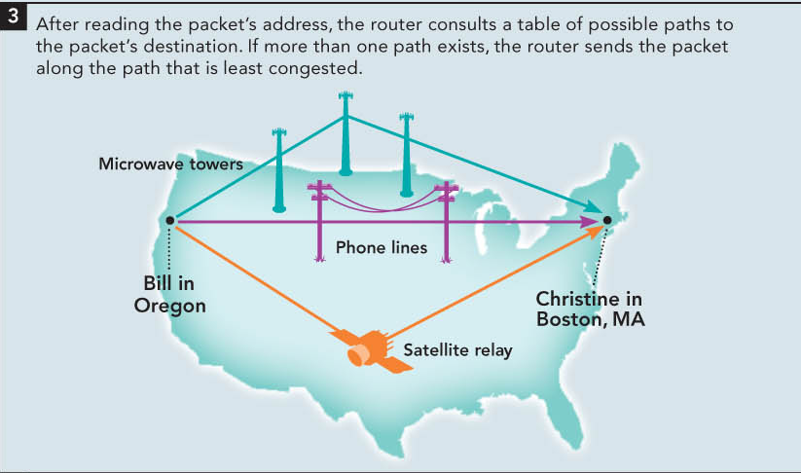
Wide Area Networks

Slide 40
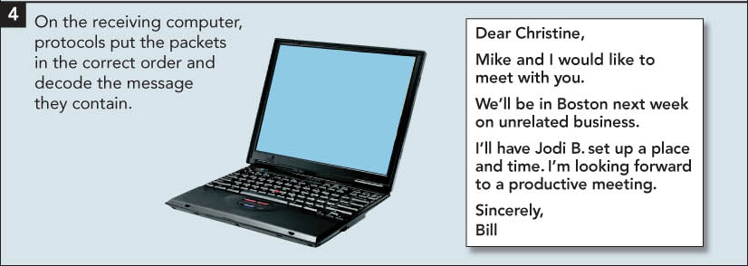
Wide Area Networks

Slide 41
Wide Area Networks
WAN applications
E-mail, conferencing, document exchange, remote database access
LAN to LAN connections connect two or more geographically separate locations
Transaction acquisition—the instant relay of transaction information from a point-of-purchase sale.

Slide 42
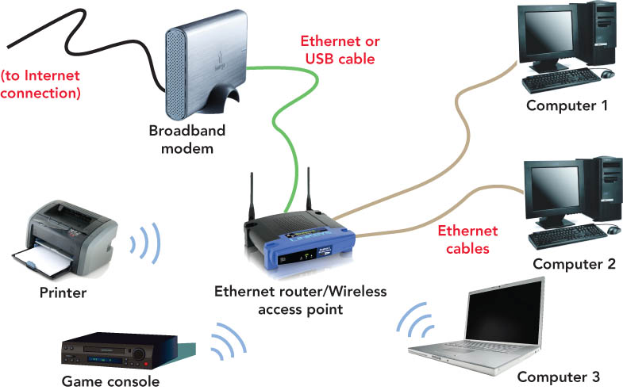
Home Networks
Home Area Networks (HANs)
Wired home networks
Wireless home networks
Hybrid networks
Combination of wired and wireless technology

Slide 43
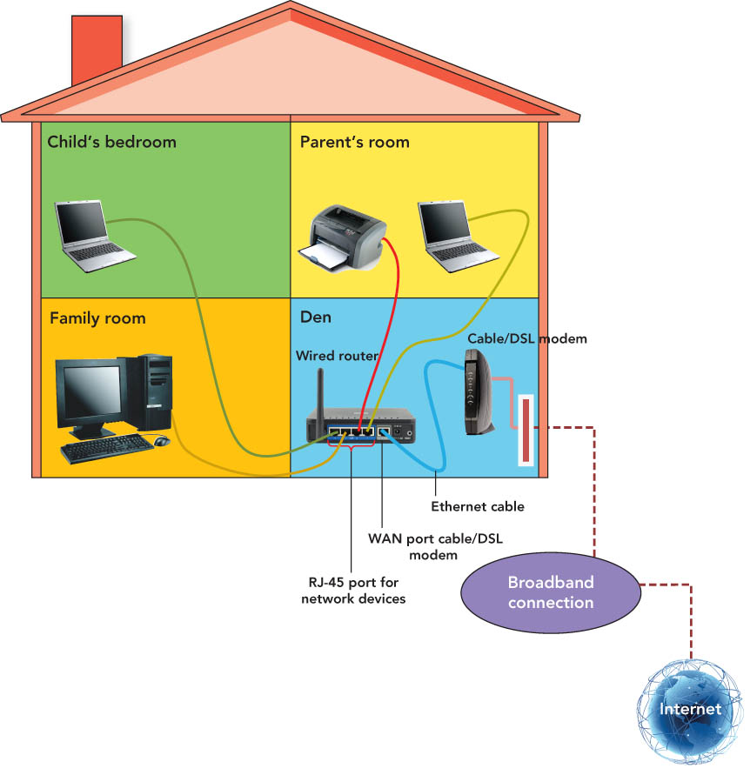
Home Networks
A Wired Home Network

Slide 44
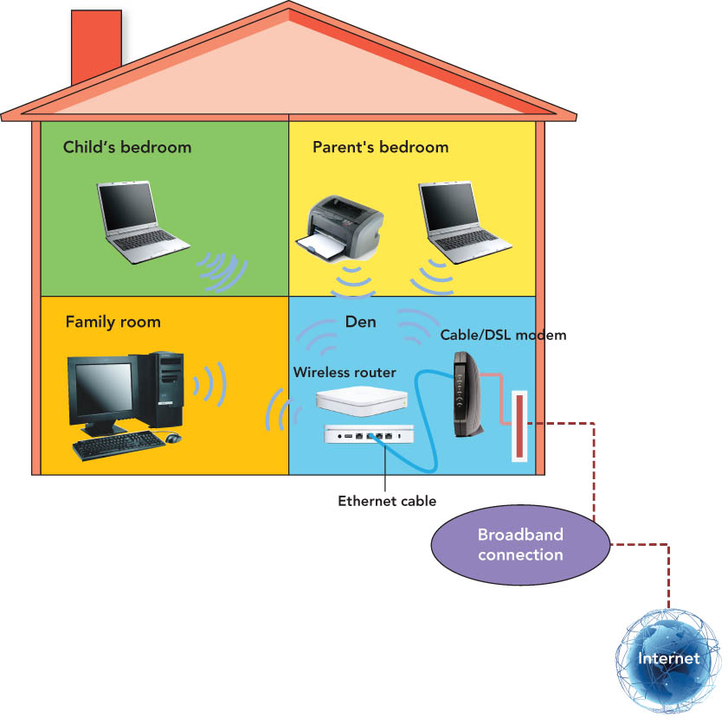
Home Networks
A Wireless Home Network

Slide 45
Home Networks
Setting up a home network
Planning
Select technology
Purchase equipment and firewall software
Configuring a wired network
Connect each computer to the router
Plug printer, scanner, etc., into a computer

Slide 46
Home Networks
Setting up a home network (con’t.)
Configuring a wireless network
Connect each node to wireless router with a wireless adapter
Connect DSL or cable modem to wireless router
Maintenance and support
Minimal maintenance required
Unplug power source from router and other peripherals and restart computer to correct problems

Slide 47
Home Networks
Future of home networking
Convergence will allow you to use home networks to
Control household appliances
Protect homes with security systems
Manage home network events through central control units in new homes
Utilize wireless systems
Control entertainment, temperature regulation, and lighting

Slide 48
Summary
Understand basic networking concepts.
Distinguish between a WAN, LAN, MAN, CAN, HAN, and PAN.
Discuss the advantages and disadvantages of networks.
Distinguish between peer-to-peer, client/server, and virtual private local area networks (LANs).

Slide 49
Summary
Define topology and understand how the three LAN topologies differ.
Explain the importance of network protocols.
Name the most widely used LAN protocol and their versions.
Identify the special components of a wide area network (WAN) that differentiate it from a LAN.

Slide 50
Summary
Contrast circuit-switching and packet-switching networks and explain their respective strengths and weaknesses.
Identify the options, components, configuration, and maintenance of a home area network (HAN).

Slide 51
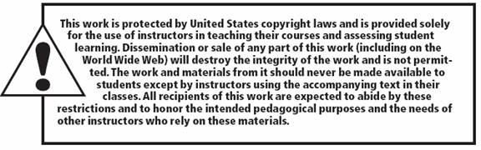
All rights reserved. No part of this publication may be reproduced, stored in a retrieval system, or transmitted, in any form or by any means, electronic, mechanical, photocopying, recording, or otherwise, without the prior written permission of the publisher. Printed in the United States of America.
Copyright © 2012 Pearson Education, Inc.
Publishing as Prentice Hall

