Slide 1

Computers Are Your Future Twelfth Edition
Chapter 8: Wired and Wireless Communication

Slide 2
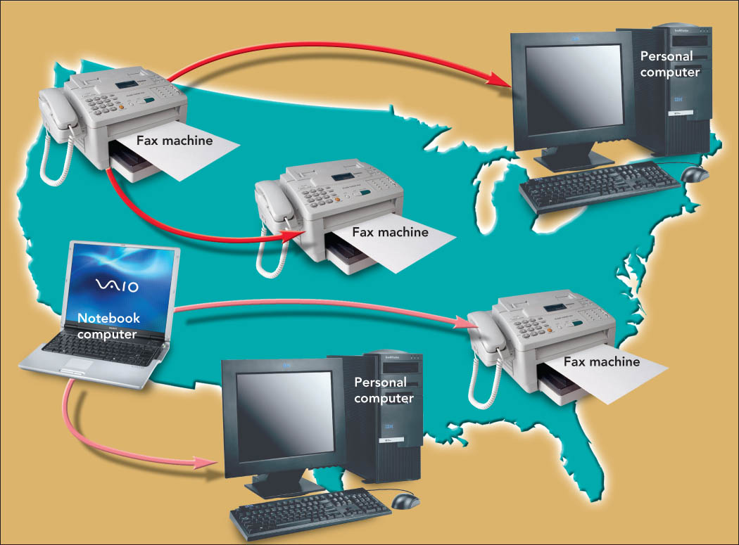
Wired and Wireless Communication

Slide 3
Objectives
Differentiate between bandwidth and throughput, and discuss the bandwidth needs of typical users.
Discuss how modems transform digital computer signals into analog signals and analog into digital.
List various physical and wireless transmission media and explain several transmission methods.

Slide 4
Objectives
Explain the limitations of the public switched telephone network (PSTN) for sending and receiving computer data.
Describe digital telephony and multiplexing, including their impact on line usage.
Discuss last-mile technologies that connect users with their communication providers.

Slide 5
Objectives
Provide examples of how digitization and convergence are blurring the boundaries that distinguish popular communications devices, including phones and computers.
Discuss various wired and wireless applications.

Slide 6
Moving Data: Bandwidth and Modems
Communications
Process of sending and receiving messages electronically between two points
Sending device—initiates the transmission
Receiving device—accepts the transmission and responds
Communications channel
Path to send and receive messages

Slide 7
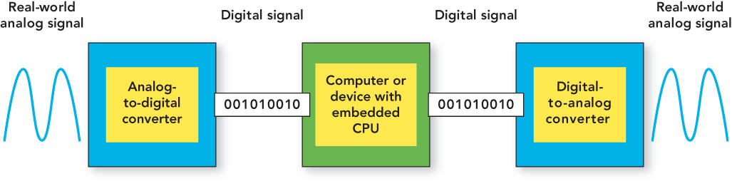
Moving Data: Bandwidth and Modems
Analog signals
Continuous waves
Digital signals
Discontinuous, discrete pulses
Converters
Translate signals:
Analog-to-digital converter (ADC)
Digital-to-analog converter (DAC)

Slide 8
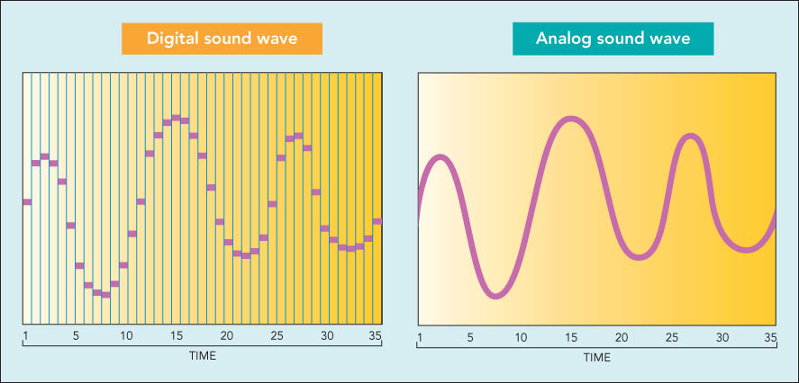
Moving Data: Bandwidth and Modems
Digital signal sampling

Slide 9
Moving Data: Bandwidth and Modems
Bandwidth
The maximum amount of data transmitted through a communication channel at one time
Throughput
The actual amount of data transmitted

Slide 10
Moving Data: Bandwidth and Modems
Broadband
Any transmission medium that carries several channels transporting data at high speeds
Streaming
The ability to hear or see content while it is being downloaded from a Web site

Slide 11
Moving Data: Bandwidth and Modems
Modem
A communication device used to send and receive data
The term modem comes from modulate and demodulate.
The sender uses modulation to transmit digital signals.
The receiver uses demodulation to return signals to digital form.

Slide 12
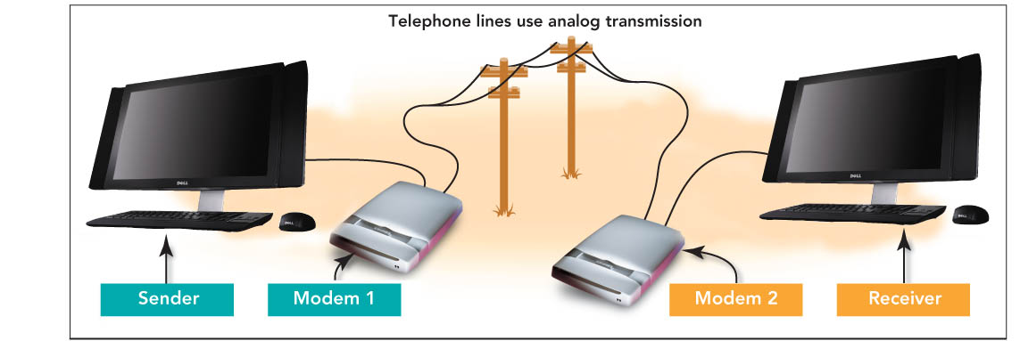
Moving Data: Bandwidth and Modems

Slide 13
Moving Data: Bandwidth and Modems
Types of modems
Analog
Digital subscriber line (DSL)
Cable
Integrated Services Digital Network (ISDN)
Data transfer rate
Rate at which two modems exchange data
Measured in bits per second (bps)
Baud
Number of signaling elements per second

Slide 14
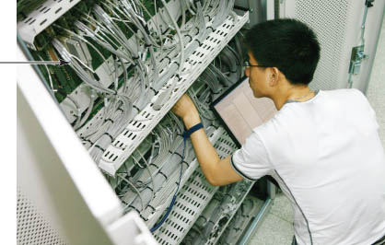
Wired Transmission Media
Wiring closet
Houses wiring that supports most types of data transfer needed

Slide 15
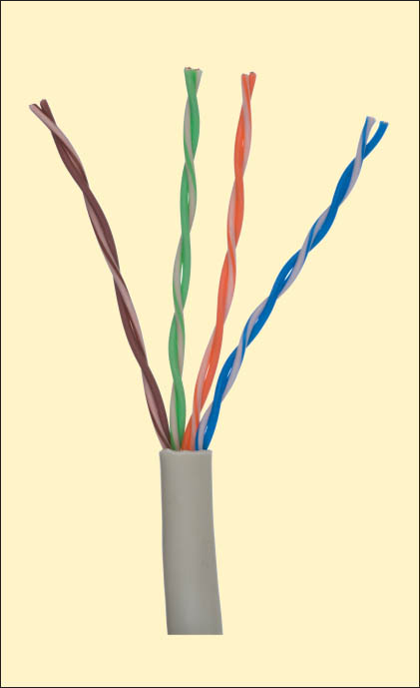
Wired Transmission Media
Twisted-pair wire
Copper wire used for telephone and data communication
Two pairs of interweaved wires twisted together
Inexpensive, but bandwidth too low for video, voice, and data at the same time

Slide 16
Wired Transmission Media
Key variations of twisted-wire pair
Category 5 (Cat-5)
Category 5 enhanced (Cat-5e)
Category 6 (Cat-6)

Slide 17
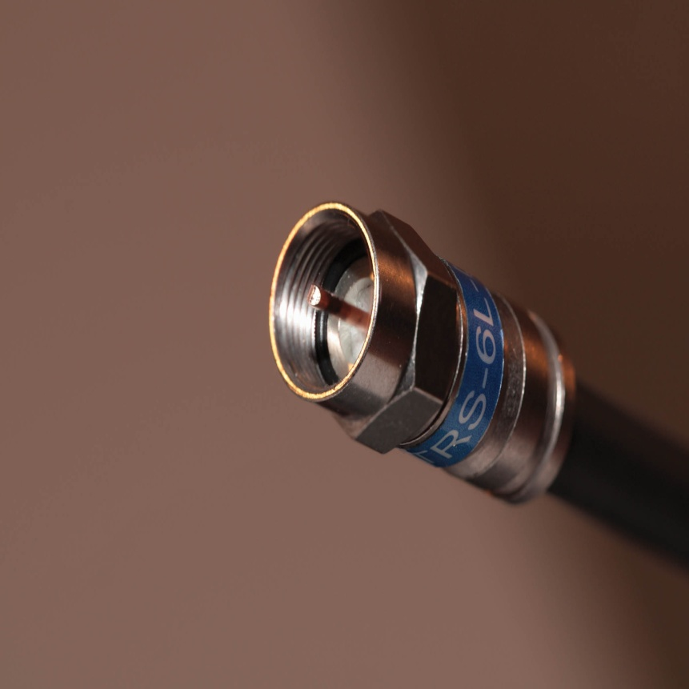
Wired Transmission Media
Coaxial cable
Consists of copper wire surrounded by insulation and braided wire
Broadband communication
Cable TV
10 Mbps transfer rate

Slide 18
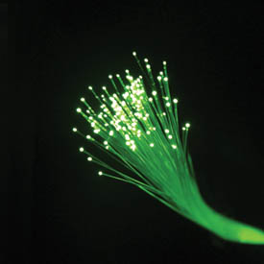
Wired Transmission Media
Fiber-optic cable
Consists of thin strands of glass or plastic that carry data through pulses of light
Broadband communication
10 Gbps transfer rate

Slide 19
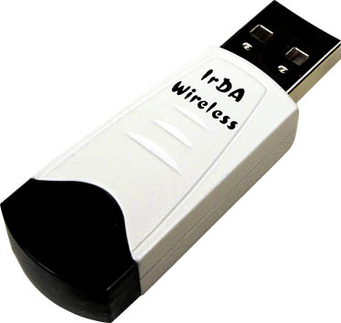
Wireless Transmission Media
Infrared
Wireless transmission medium that carries data through the air using light beams
Sending and receiving devices must be in line of sight
Uses an IrDA port to enable data transfer

Slide 20
Wireless Transmission Media
Radio transmission
Enables music, photos, and voice to travel through the air as radio frequency or radio waves
Bluetooth—radio transmission enables devices within 30 feet to communicate wirelessly
Does not require direct line of sight

Slide 21
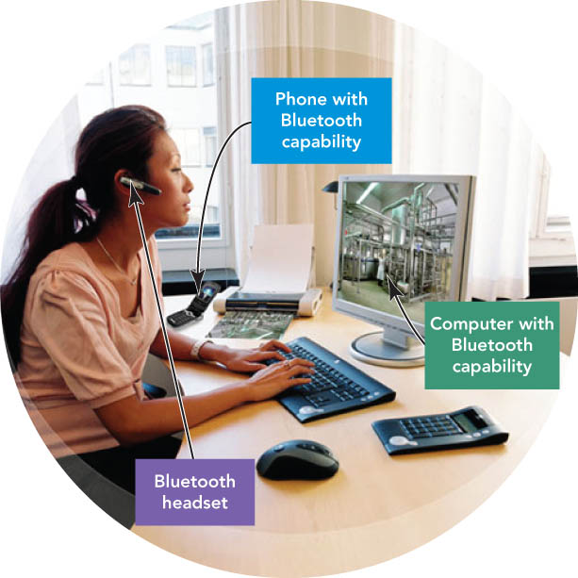
Wireless Transmission Media

Slide 22
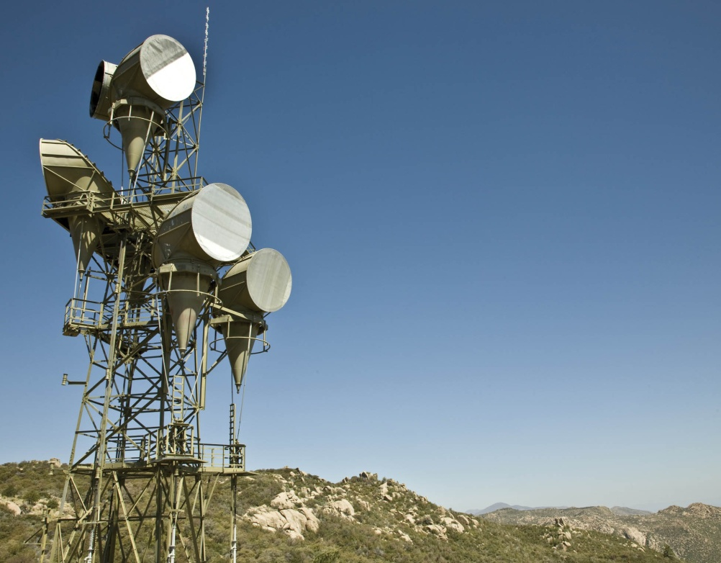
Wireless Transmission Media
Microwaves
Transmit data via electromagnetic radio waves with short frequencies

Slide 23
Wireless Transmission Media
Satellites
Microwave relay stations in space that transmit data through microwave signals
Direct broadcast satellite (DBS)—consumer satellite technology that receives digital TV signals through a reception dish
Requires the computer system to have a special communications device called a network access point—sends and receives data between computer that contain wireless adapters

Slide 24
Wired Communication via the PSTN
Public switched telephone network (PSTN)
Worldwide telephone system used for data and voice communications
Primarily digital
Subscriber loop carrier (SLC)
Links home and business telephones
Accommodates analog devices
Local loop
Area served by an SLC
Local exchange switch
Digital device capable of handling thousands of calls
Located at the local telephone’s central office

Slide 25
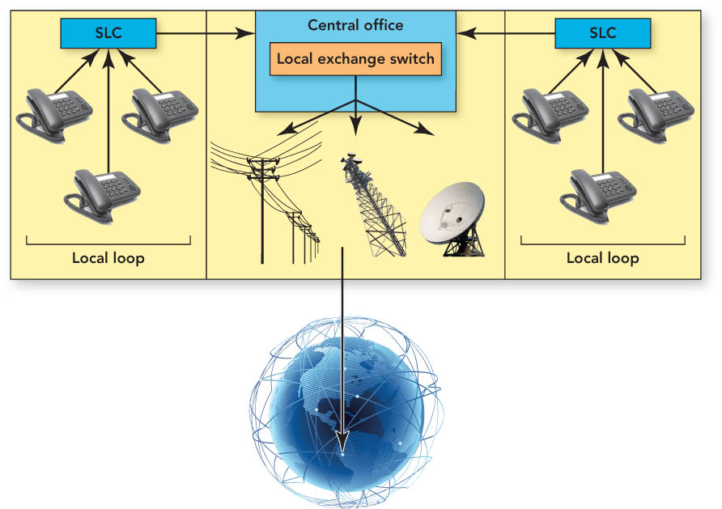
Wired Communication via the PSTN

Slide 26
Wired Communication via the PSTN
Digital telephony
Telephones and transmissions are digital
Companies—use a private branch exchange (PBX)
Multiplexing
Allows multiple calls over a single line
Long-distance carriers—transmit many calls in digital format in a single circuit

Slide 27
Wired Communication via the PSTN
Last-mile problem
Inability to access the PSTN’s high-speed, fiber-optic cables
Bottleneck of data on the last mile of twisted-pair phone lines
Last-mile technologies
Provide solutions for bottlenecks
Used while local loops are upgraded

Slide 28
Wired Communication via the PSTN
Last-mile technologies (con’t.)
Integrated services digital networking (ISDN)
Standard that provides digital telephone and data service
No lengthy dial-in procedures or connection delay
Requires an ISDN adapter/digital modem to connect computers to ISDN lines
May be the only broadband solution in rural areas

Slide 29
Wired Communication via the PSTN
Last-mile technologies (con’t.)
Digital subscriber line (DSL) (Also called xDSL)
Broad term for group of technologies offering high-speed access
ADSL (asymmetric digital subscriber line)
SDSL (symmetric digital subscriber line)
HDSL (high bit-rate digital subscriber line)
VDSL (very high bit-rate digital subscriber line)
Requires DSL modem—modulate and demodulate analog and digital signals
More expensive than dial-up—cheaper than other broadband options

Slide 30
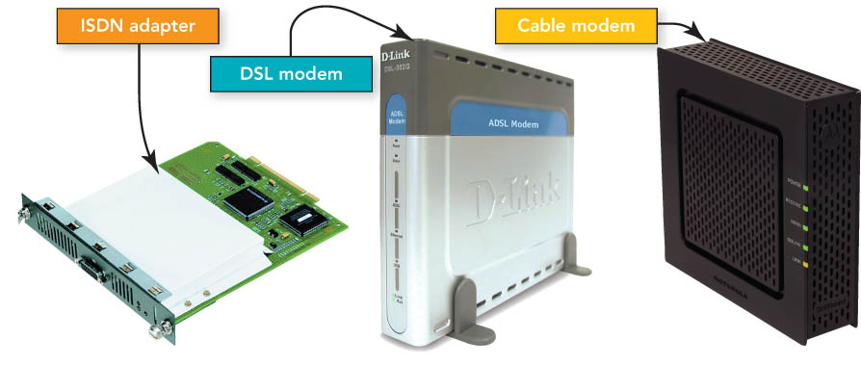
Wired Communication via the PSTN

Slide 31
Wired Communication via the PSTN
Last-mile technologies (con’t.)
Cable-based broadband
Provides Internet access through cable TV connections
Uses cable modems to obtain higher speeds than DSL
Leased lines
Specially conditioned telephone lines between two points
Example: T1 lines

Slide 32
Wired Communication via the PSTN
Last-mile technologies (con’t.)
T2 and T3 lines
SONET (synchronous optical network)
MMDS (Multichannel multipoint distribution service)
WiMAX (Worldwide interoperability for microwave access)

Slide 33
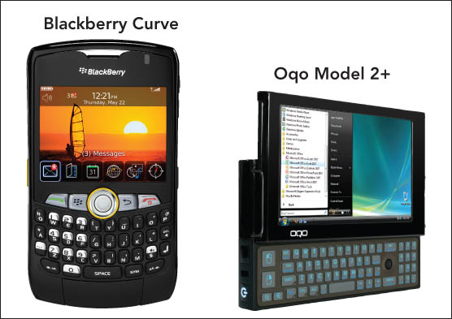
Convergence: Is It a Phone or a Computer?
Digitization
Process of transforming data into a digital form
Convergence
Blending
Multiple industries
Examples: Computers, consumer electronics, telecommunications
Products
Examples: Personal computers, telephones

Slide 34
Convergence: Is It A Phone or A Computer?
Cellular telephones
Digital transmission of voice, text, images, and video
Classified by generations—4G (fourth generation)—the current generation
Cell sites—network of transmitters broadcasts signals throughout geographic areas called cells

Slide 35
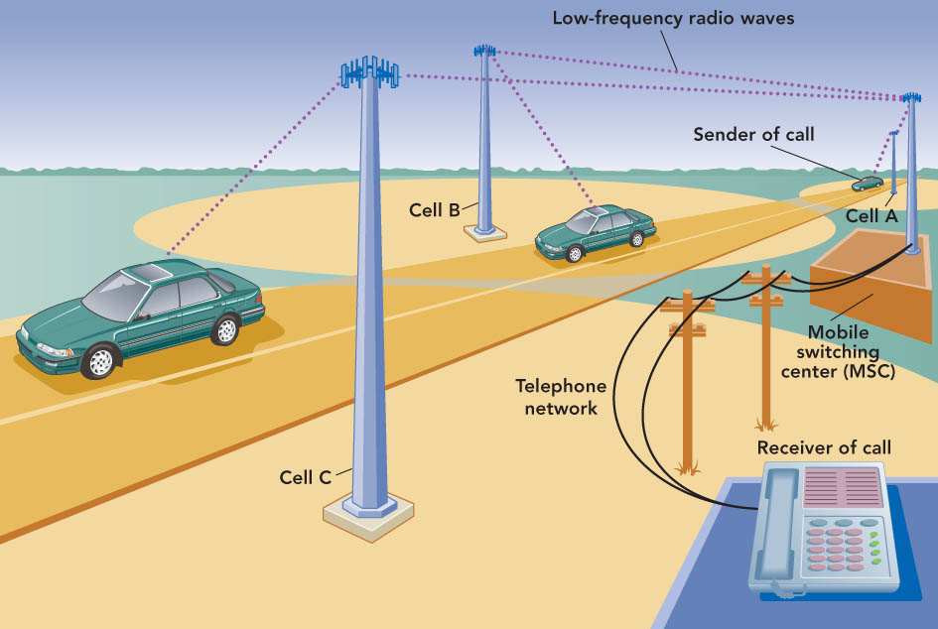
Convergence: Is It A Phone or A Computer?
Each cellular network includes multiple mobile switching centers (MSCs) that control communication within a set of cells.

Slide 36
Convergence: Is It A Phone or A Computer?
Personal communication service (PCS)
Group of digital cellular technologies replacing most analog cellular services
2G (second generation)—used to make smartphones, with features of phones and computing devices
3G—more data and voice customers and higher data transfer rates
4G—improved connectivity, data transfer rates, and support for the next generation of multimedia

Slide 37
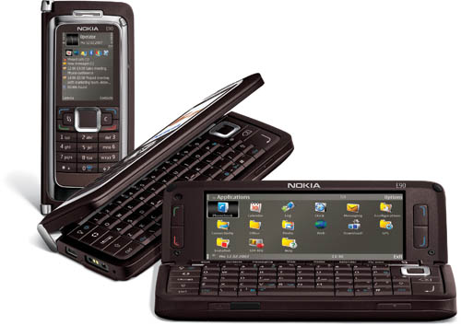
Convergence: Is It A Phone or A Computer?
Web-enabled devices
Display and respond to markup languages
Examples: HTML, XML—used to build Web pages
Examples
PDAs
Smartphones—replacing PDAs
Notebooks

Slide 38
Convergence: Is It A Phone or A Computer?
WAP (Wireless Application Protocol)
Standard—specifies how users can access the Web securely using:
Pagers
Smartphones
PDAs
Other wireless devices
Requires a microbrowser

Slide 39
Wired and Wireless Applications
Internet telephony, or VoIP (Voice over Internet Protocol)
Offers computer-to-phone and phone-to-phone transmission through the Internet
Placing calls requires:
Computer with a microphone, speakers or headphones
Internet connection
Telephony-enabled program

Slide 40
Wired and Wireless Applications
Internet telephony
Videoconferencing (Web conferencing)—transmits sound and video images using:
Video camera (Webcams)
Skype software
Whiteboards—enable participants to create a shared workspace
Webcams—inexpensive, low-resolution analog or digital video cameras
Internet TV—ability to view television shows, videos, and movies over the Internet

Slide 41

Wired and Wireless Applications

Slide 42
Wired and Wireless Applications
Facsimile transmission (fax)
Transmits documents over a telephone line or the Internet using either:
Standalone fax machine
Computer with a fax modem and a scanner

Slide 43
Wired and Wireless Applications
Satellite technology
Satellite radio
Not affected by location, distance, or obstructions
Uses satellites orbiting the Earth
Permits usage in areas with restricted local radio stations or poor AM/FM reception

Slide 44
Wired and Wireless Applications
Satellite technology (con’t.)
GPS (Global Positioning System)
System of 27 satellites allowing a receiver to pinpoint locations
Mobile units for cars
Installed car systems

Slide 45
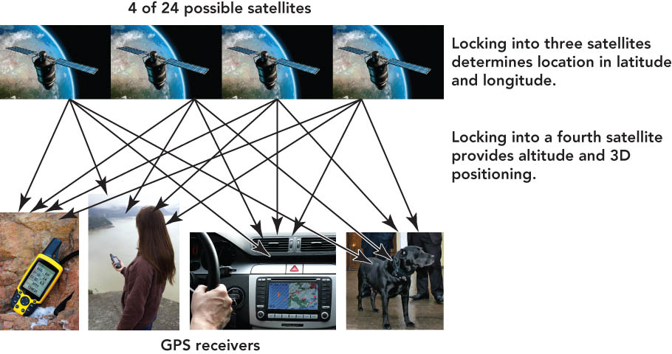
Wired and Wireless Applications

Slide 46
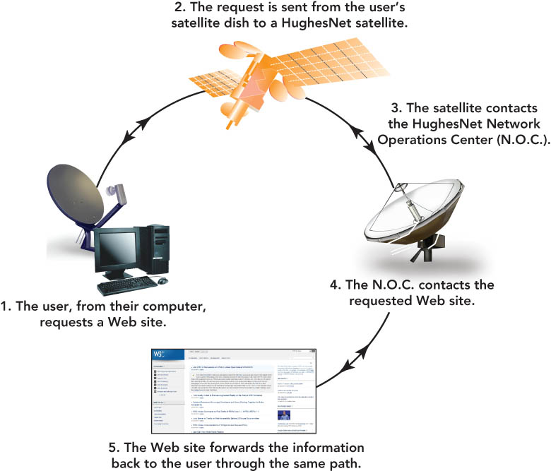
Wired and Wireless Applications

Slide 47
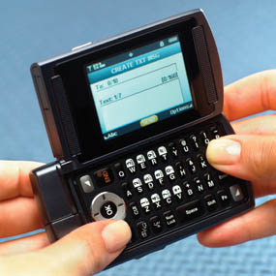
Wired and Wireless Applications
Text messaging (SMS)
Using cell phone for applications previously used on computers
Instant messaging
Brief e-mail

Slide 48
Wired and Wireless Applications
Picture messaging
MMS (multimedia messaging system)
Transmits color pictures and backgrounds
Cellular telephone acts as a camera
Location awareness
Also known as position awareness
Uses GPS-enabled chips to pinpoint the location of a cell phone
Popular with parents of teenagers

Slide 49
Wired and Wireless Applications
Surfing safely at public wireless hot spots
Malicious network (evil twin)—network set up by a hacker within the operating area of a legitimate hot spot
Use firewalls and antivirus software
Use legitimate networks to avoid “evil twins”
Do not perform financial transactions
Select appropriate operating system settings to avoid being detected

Slide 50
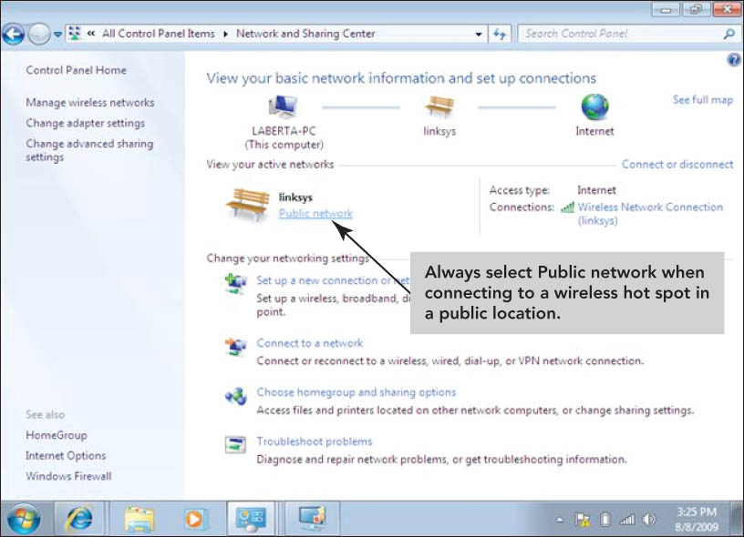
Wired and Wireless Applications

Slide 51
Summary
Differentiate between bandwidth and throughput, and discuss the bandwidth needs of typical users.
Discuss how modems transform digital computer signals into analog signals and analog into digital.
List various physical and wireless transmission media and explain several transmission methods.

Slide 52
Summary
Explain the limitations of the public switched telephone network (PSTN) for sending and receiving computer data.
Describe digital telephony and multiplexing, including their impact on line usage.
Discuss last-mile technologies that connect users with their communication providers.

Slide 53
Summary
Provide examples of how digitization and convergence are blurring the boundaries that distinguish popular communications devices, including phones and computers.
Discuss various wired and wireless applications.

Slide 54
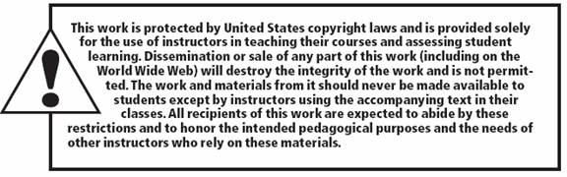
All rights reserved. No part of this publication may be reproduced, stored in a retrieval system, or transmitted, in any form or by any means, electronic, mechanical, photocopying, recording, or otherwise, without the prior written permission of the publisher. Printed in the United States of America.

