Slide 1
Chapter 1: Introduction

Slide 2
Chapter 1: Introduction
What Operating Systems Do
Computer-System Organization
Computer-System Architecture
Operating-System Structure
Operating-System Operations
Process Management
Memory Management
Storage Management
Protection and Security
Distributed Systems
Special-Purpose Systems
Computing Environments
Open-Source Operating Systems

Slide 3
Objectives
To provide a grand tour of the major operating systems components
To provide coverage of basic computer system organization
Explore core ideas in Operating Systems in two ways:
  1) understanding the concepts behind resource management, abstraction, hardware interface, protection, security, concurrency, and performance.
  2) practical coding experience with a real OS to understand challenges of systems

Slide 4
What is an Operating System?
A system software program that acts as an intermediary between a user of a computer and the computer hardware.
It provides abstractions for resources (CPU, memory and I/O devices)
  User View: A virtual machine on top of real machine to provide a more convenient user interface for the computer system
    hide the details of individual devices and components
    high level abstraction of the machine
  System View: A resource manager to make efficient use of computer systems components
    Shared resource: CPU, memory and I/O devices
    Multiprogrammed batch systems: allow multiple batch jobs share the computer system
    Time-sharing systems: allow multiple interactive jobs share the system
Provide environment in which applications software can execute as if they use the hardware alone.

Slide 5
History: Evolution of Systems
Batch Systems
  Goal: Maximize amount work done for multiple users
  Applications run one after the other. One application at a time!
  Application uses all computer resources
Batch Multiprogramming
  Multiple applications in memory
  When one waits for I/O, another executes
    Better utilization of CPU
Timesharing Systems
  Interactive use of computers
    Responsiveness matters
    Expect system to respond to keyboard input immediately
  Several users/applications can share computer
    Share CPU, Disk, Memory...
Real Time

Slide 6

Computer System Structure
Computer system can be divided into four components
  Hardware – provides basic computing resources
    CPU, memory, I/O devices
  Operating system
    Controls and coordinates use of hardware among various applications and users
  System/Application programs – define ways in which the system resources are used to solve the computing problems of the users
    Word processors, compilers, web browsers, database systems, video games
  Users
    People, machines, other computers
Four Components

Slide 7
Operating System Definition
OS is a resource allocator
  Manages all resources (CPU, memory, disk space, peripherals)
  Decides between conflicting requests for efficient and fair resource use
OS is a control program
  Controls execution of programs to prevent errors and improper use of the computer
No universally accepted definition
“Everything a vendor ships when you order an operating system” is good approximation
  But varies wildly
“The one program running at all times on the computer” is the kernel. Everything else is either a system program (ships with the operating system) or an application program. kernel
  provides resources to them
  Controls their execution

Slide 8
Computer Startup
How can an Operating system being loaded in Memory????
  Answer: we need a program that loads OS from Disk into memory. This program is the boostraper.
  bootstrap program is loaded at power-up or reboot
    Typically stored in ROM or EPROM, generally known as firmware
    Initializes all aspects of system
    Loads operating system kernel and starts execution

Slide 9

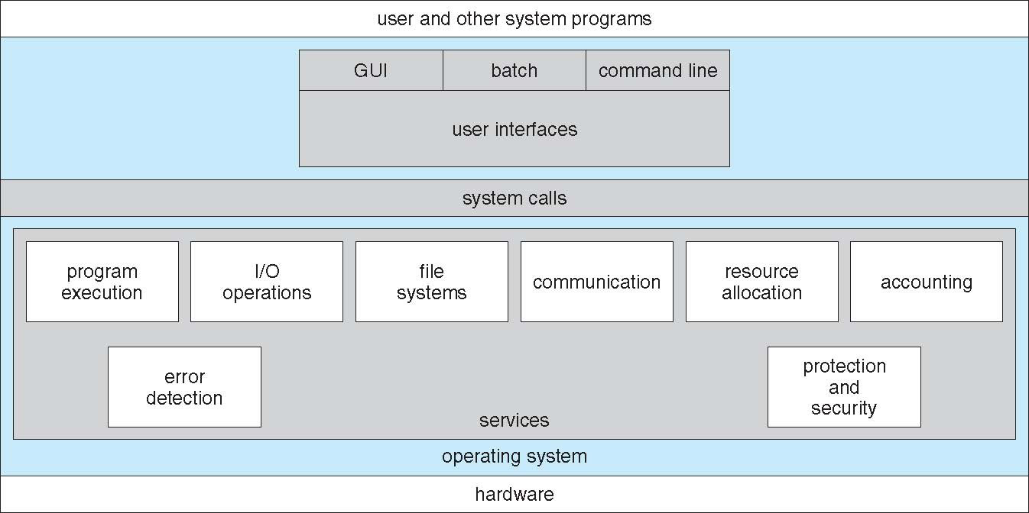
HW Architecture and OS Services
- How do hardware & applications interact with the OS?
Computer-system operation
  One or more CPUs, device controllers connect through common bus providing access to shared memory
  Concurrent execution of CPUs and devices competing for memory cycles

Slide 10
OS Services: I/O Management
Each device controller is in charge of a particular device type
Each device controller has a local buffer/control regs
CPU moves data from/to main memory to/from local buffers
Protocol: To get a byte of data from a device
  CPU sets registers in controller with command to read e.g. character from keyboard
  I/O is from the device to local buffer of controller
  Device controller informs CPU that it has finished its operation by causing an interrupt
  CPU moves data from controller to memory
I/O devices and the CPU can execute concurrently
Notes:
Interrupt
1. an external event raised by hardware: e.g. I/0
2. an internal event trigger by software: e.g. system calls
Interrupt Handler
an subroutine in the operating system to process a particulartype of interrupt
Interrupt Vector
an array of starting addresses of interrupt handlers
The index for a particular interrupt to the array is provided bythe hardware.

Slide 11
I/O
I/O Techniques
  Programmed I/O: processor interacts with I/O module directly
    issues I/O commands to I/O module
    interrogates status bits repeatedly (Pooling)
    reads or writes: transfers the data between CPU and I/O module
  Interrupt-Driven I/O: I/O module interrupts when I/O module is ready
    issues I/O commands to I/O module
    goes off to run other processes (doing something else)
    get interrupted when I/O module is ready and reads or writes in interrupt handlers
Direct Memory Access (DMA): A separate module called DMA module takes care of the interrupt from I/O and data transfer
  Processor sends request to DMA (starting address, number of bytes, address of I/0 device, read or write)
  DMA interacts with I/O module and completes the bulk transfer
  DMA interrupts processor when done

Slide 12
Interrupts
Interrupt
  1. an external event raised by hardware: e.g. I/0
  2. an internal event trigger by software: e.g. system calls (means application needs a service from the OS. It calls a service). TRAP
Interrupt Handler
  a subroutine in the operating system to process a particular type of interrupt
Interrupt Vector
  an array of starting addresses of interrupt handlers
  The index for a particular interrupt to the array is provided by the hardware.
IR
(printer)
IR
(Keyboard)
Interrupt Vector
Memory

Slide 13

CPU/Device Interaction: Interrupts
Interrupt transfers control to the interrupt service routine (ISR) generally, through the interrupt vector, which contains the addresses of all the service routines. ISR is identified by address in interrupt vector
Interruption handling (overhead)
  Interrupt architecture must save the address of the interrupted instruction
  After servicing interrupt, CPU resumes execution at previously interrupted address (or “flow of control”)

Slide 14
Interrupt Handling
The operating system preserves the state of the CPU by storing registers and the program counter
Determines which type of interrupt has occurred:
  Polling
    CPU repeatedly checks the status of a device
      Read a device register
      Has an I/O request finished, or not?
    If I/O has completed, CPU reads it into memory
    Frequency of polling impacts latency and throughput of I/O
  vectored interrupt system
Separate segments of code determine what action should be taken for each type of interrupt
Incoming interrupts are disabled while another interrupt is being processed to prevent a lost interrupt
An operating system is interrupt driven

Slide 15
I/O Structure - I/O Device driver
Operating systems have a device driver for each I/O controller.
  It understands the device controller (hide the peculiarities of the device)
  presents a uniform interface of the device to the rest of the operating system.
To start an I/O operation, the device driver
  loads the appropriate registers within the device controller to execute command on the controller
    Check and perform the desired actions (e.g. read from KB)
    Inform the device driver via Interrupt with the result of action
  Return status information and possible data to the operating system
To get a service from a device driver application make
  System call – request to the operating system to allow user to wait for I/O completion
    Device-status table contains entry for each I/O device indicating its type, address, and state

Slide 16
I/O Structure-Other Types of Interrupts
Other Types of Interrupts:
Application ↔ kernel NOT Device ↔ kernel
  Exceptions
    Program faults (e.g divide by zero)
    Not requested by executing application
  Traps/Software Interrupts
    Requested by application when it executes
      System call()
      specific instruction: sysenter or int %d on x86
Application state saved (as for interrupt) and can be resumed

Slide 17

I/O Structure- Sync and Async I/O
Synchronous : After I/O starts, control returns to user program only upon I/O completion
Asynchronous: After I/O starts, control returns to user program without waiting for I/O completion
Synchronous
Asynchronous

Slide 18
Direct Memory Access Structure
Keyboard device (slow device) doesn't cause many interrupts
  Interrupt per key press: say 50 interrupts/second
  ISR overhead of 2 microseconds → 1/10000th CPU time (total for 50)
Used for high-speed I/O (e.g. networking card 1G/sec) devices able to transmit information at close to memory speeds
Device controller transfers blocks of data from buffer storage directly to main memory without CPU intervention
Only one interrupt is generated per block, rather than the one interrupt per byte. Block size varies from device to device.
- CPU
  -Sets up (large) buffers in memory
  - Asks device controller to transfer into buffer
  - Receives single interrupt for whole buffer of data
- Device controller
  -When device I/O complete, transfer data directly into memory
  -Send interrupt when transfer complete
  -Avoids CPU intervention

Slide 19

How a Modern Computer Works
CPU :
processing unit where instructions are Executed
- Memory:
storage unit where both program and data are stored
I/O subsystem:
unit to input and output data
- Instruction Execution Cycle
do forever
1. fetch next instruction
2. execute the instruction
3. check and process interrupt

Slide 20
Storage Structure
Main memory – only large storage media that the CPU can access directly. It stores data and programs in execution (running process) until power is disconnected (Volatile storage)
Secondary storage – extension of main memory that provides large nonvolatile storage capacity. It stores programs (files) that can be executed when needed. Files remains stored until they are deleted.
Magnetic disks – rigid metal or glass platters covered with magnetic recording material
  Disk surface is logically divided into tracks, which are subdivided into sectors
  The disk controller determines the logical interaction between the device and the computer

Slide 21
Storage Hierarchy
Storage systems organized in hierarchy
  Speed
  Cost
  Volatility
Caching – copying information into faster storage system; main memory can be viewed as a last cache for secondary storage
  Important principle, performed at many levels in a computer (in hardware, operating system, software)
  Information in use copied from slower to faster storage temporarily
  Faster storage (cache) checked first to determine if information is there
    If it is, information used directly from the cache (fast)
    If not, data copied to cache and used there
  Cache smaller than storage being cached
    Cache management important design problem
    Cache size and replacement policy

Slide 22


Storage-Device Hierarchy: Attributes
- Movement between levels of storage hierarchy can be explicit or implicit
- Goal:
We want all accesses to be as fast as registers
...and also have the storage size of disk!

Slide 23
Computer-System Architecture
Most systems use a single general-purpose processor (PDAs through mainframes)
  Most systems have special-purpose processors as well
Multiprocessors systems growing in use and importance
  Also known as parallel systems, tightly-coupled systems
  Advantages include
    Increased throughput
    Economy of scale
    Increased reliability – graceful degradation or fault tolerance
  Two types
    Asymmetric Multiprocessing
    Symmetric Multiprocessing
  Problems (multi-processes, multiprocessor and distributed environment)
    Coherency (achieved by H.W.) and Consistency

Slide 24

Symmetric Multiprocessing Architecture

Slide 25

A Dual-Core Design

Slide 26
Clustered Systems
Like multiprocessor systems, but multiple systems working together
  Usually sharing storage via a storage-area network (SAN)
  Provides a high-availability service which survives failures
    Asymmetric clustering has one machine in hot-standby mode
    Symmetric clustering has multiple nodes running applications, monitoring each other
  Some clusters are for high-performance computing (HPC)
    Applications must be written to use parallelization

Slide 27
Operating System Structure
Why Multiprogramming? needed for efficiency use of HW resources
  Single user cannot keep CPU and I/O devices busy at all times
  Multiprogramming organizes jobs (code and data) so CPU always has one job to execute
  A subset of total jobs in system is kept in memory
  One job is selected and run via job scheduling
  When it has to wait (for I/O for example), OS switches to another job
Timesharing (multitasking) is logical extension in which CPU switches jobs so frequently that users can interact with each job while it is running, creating interactive computing
  Response time should be < 1 second
  Each user has at least one program executing in memory process
  If several jobs ready to run at the same time  CPU scheduling
  If processes don’t fit in memory, swapping moves them in and out to run
  Virtual memory allows execution of processes not completely in memory

Slide 28

Job Scheduling for Multiprogrammed System
How OS switches between jobs
OS keeps multiple jobs in memory. Jobs are loaded at a specific address in memory
OS gives each job multiple slots of CPU time until they finish their task.
choose one of them to get CPU for a period of time. How? FIFO, Priority…
  If that job finishes its task during the allotted time, this job is halted
  If that job does not finish its task and need more CPU time, it will be preempted (ready) and another job will be selected and given the CPU. The suspended job will later get another slot of CPU time
  If that job does I/O operation, this job will be waiting and CPU will be taken from that job and given to another selected job. The waiting job on I/O operation will resume operation later and get CPU only when the I/O is complete and the device interrupts OS

Slide 29
Job Scheduling for Multiprogrammed System- Timer
We must ensure that OS has control over CPU to schedule process.
To accomplish this, OS uses Timer to prevent infinite loop / process hogging resources
  The timer is Set to interrupt the system after specific period
  When time is up (counter = 0), Interrupt occurs and control goes to OS which can decide to treat it as error or it can set it again to give the process more time to run
    Example a process needs 7 min (420 sec), every sec generate an interrupt and decremented it by 1.
      Only when counter = 0, OS stop it.
  Set up before scheduling process to regain control or terminate program that exceeds allotted time. Thus preventing a process to run long period than it needed or deserved.

Slide 30
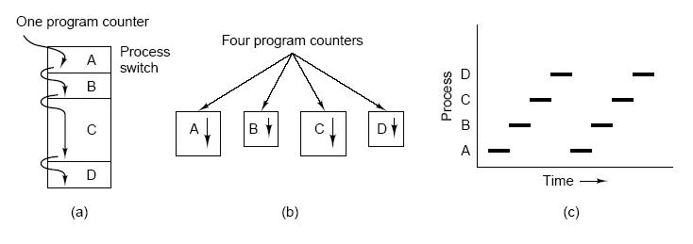
Scheduler-Timer Interrupts
How can OS prevent user processes from monopolizing the CPU?
Interrupt from on-processor time keeping device
  e.g. 100 times a second in Linux, every 10 milliseconds
Allows kernel to “keep time”
  Track amount of execution of different processes
  Schedule accordingly
Process' timeslice typically a multiple of a timer interrupt's inter-arrival time

Slide 31
Operating-System Operations
OSs are interrupt driven which means that OS responds to events that represent some work to be done. Events are signaled:
  Interrupt driven by hardware
  Software error or request creates exception or trap
    Division by zero, request for operating system service(system call)
When Interrupt or traps occurs they signal code segment of OS to execute to complete the required task corresponding to a specific event.
Due to sharing, OS should take care of many process problems include infinite loop, processes modifying each other or the operating system.
OS must protect processes from each other and also itself from those user processes. How? Dual mode!!!

Slide 32

Transition from User to Kernel Mode
Dual-mode operation allows OS to protect itself and other system components
  User mode and kernel mode . User mode is when the system is executing on behalf of application programs, Kernel mode is when the application request service from OS via system call
  Mode bit provided by hardware (there is set mode instruction)
    Provides ability to distinguish when system is running user code or kernel code
    Some instructions designated as privileged, only executable in kernel mode (I/O control and Interrupt and timer management)
    System call changes mode to kernel mode..Return from system call resets to user mode .

Slide 33
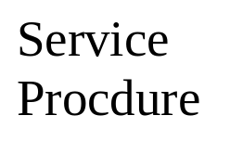
Transition from User to Kernel Mode
When a user program requests a service (1) via Sys. Call. ( to create, delete, and use (access) objects (process, files, memory, etc)
  a special instruction switches the machine from user mode to kernel mode (OS mode) where the OS is running. Set mode = 0
  Kernel examines the parameters of the sys. Call to determine which service is called (2). E.g read(fd, buf, 100)
  Kernel then executes the corresponding service procedure indexed in the dispatch table (3). Each sys call has service procedure to execute
  Finally, the sys. Call is finished and control is given back to the user program. Set mode = 1
User Program1
User Program2
User Mode
1
4
Kernel Mode
2
3
Dispatch Table

Slide 34
Process Management
A process is an abstraction of a running program. A process is a program in execution. It is a unit of work within the system. Program is a passive entity, process is an active entity.
Process needs resources to accomplish its task
  CPU, memory, I/O, files
  Initialization data
Process termination requires reclaim of any reusable resources
Single-threaded process has one program counter specifying location of next instruction to execute
  Process executes instructions sequentially, one at a time, until completion
Typically system has many processes, some user, some operating system running concurrently on one or more CPUs
  Concurrency by multiplexing the CPUs among processes

Slide 35
Kernel-Process Management Activities
The operating system is responsible for the following activities in connection with process management:
  Creating and deleting processes
  Suspending and resuming processes
  Providing mechanisms for process synchronization
  Providing mechanisms for process communication
  Providing mechanisms for deadlock handling

Slide 36
Kernel-Memory Management
All data in memory before and after processing
All instructions in memory in order to execute
Memory management determines what is in memory when
  Optimizing CPU utilization and computer response to users
Memory management activities
  Keeping track of which parts of memory are currently being used and by whom. How much free
  Deciding which processes (or parts thereof) and data to move into and out of memory (swapping/paging)
  Allocating and deallocating memory space as needed

Slide 37
Kernel-Storage Management
OS provides uniform, logical view of information storage
  Abstracts physical properties to logical storage unit - file
  Each medium is controlled by device drive ( e.g tape drive)
    Varying properties include access speed, capacity, data-transfer rate, access method (sequential or random)
File-System management
  Files usually organized into directories
  Access control on most systems to determine who can access what (Read-Write-Excecute)
  OS activities include
    Creating and deleting files and directories
    Primitives to manipulate files and dirs
    Mapping files onto secondary storage
    Backup files onto stable (non-volatile) storage media

Slide 38
Kernel- Mass-Storage Management
Usually disks used to store data that does not fit in main memory or data that must be kept for a “long” period of time
Proper management is of central importance
Entire speed of computer operation hinges on disk subsystem and its algorithms
OS activities
  Free-space management (used/free space)
  Storage allocation/deallocation
  Disk scheduling
Some storage need not be fast
  Tertiary storage includes optical storage, magnetic tape
  Still must be managed
  Varies between WORM (write-once, read-many-times) and RW (read-write)

Slide 39
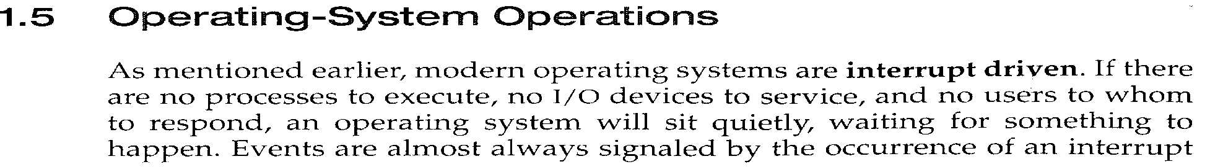
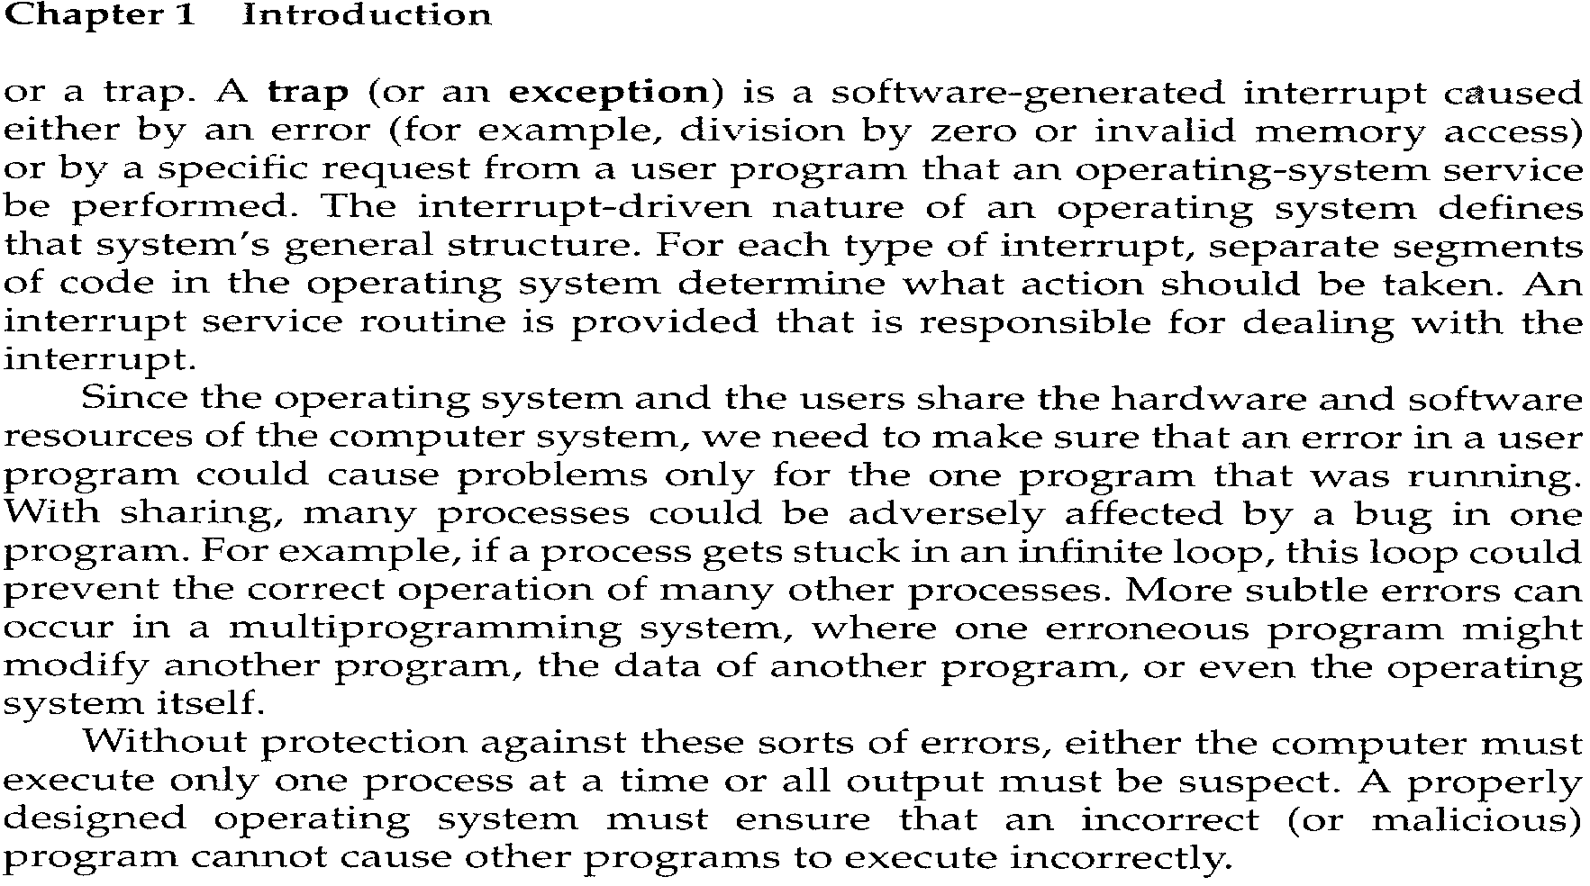

Slide 40
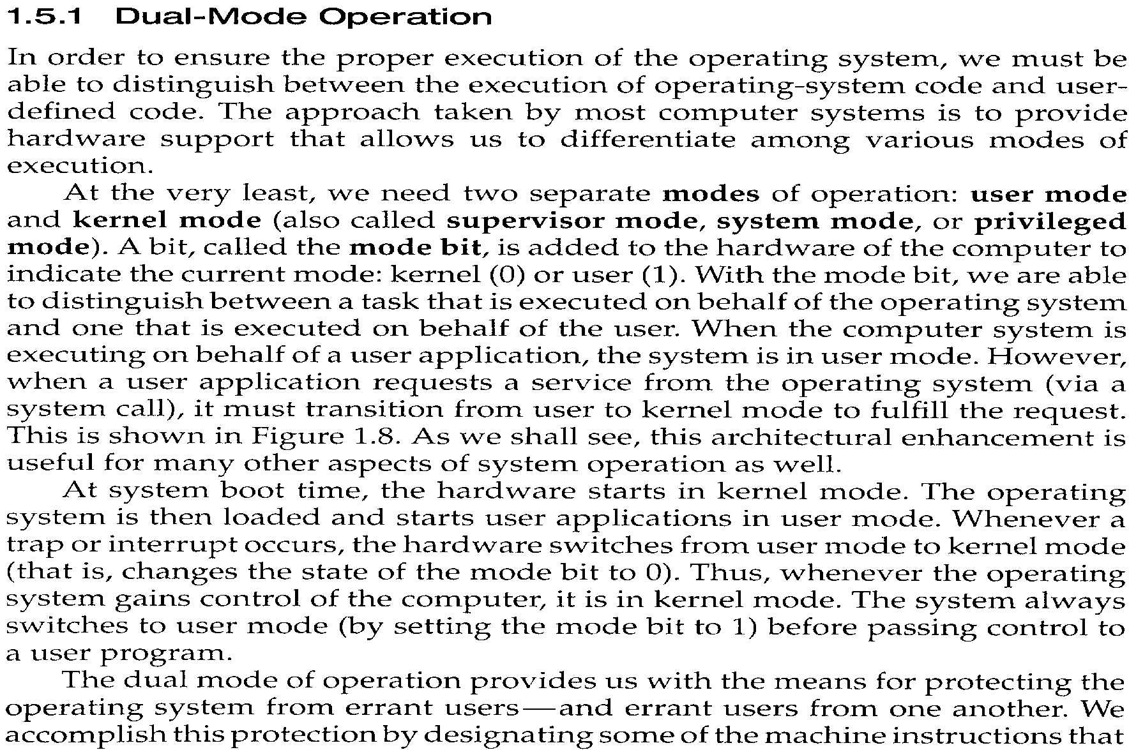

Slide 41
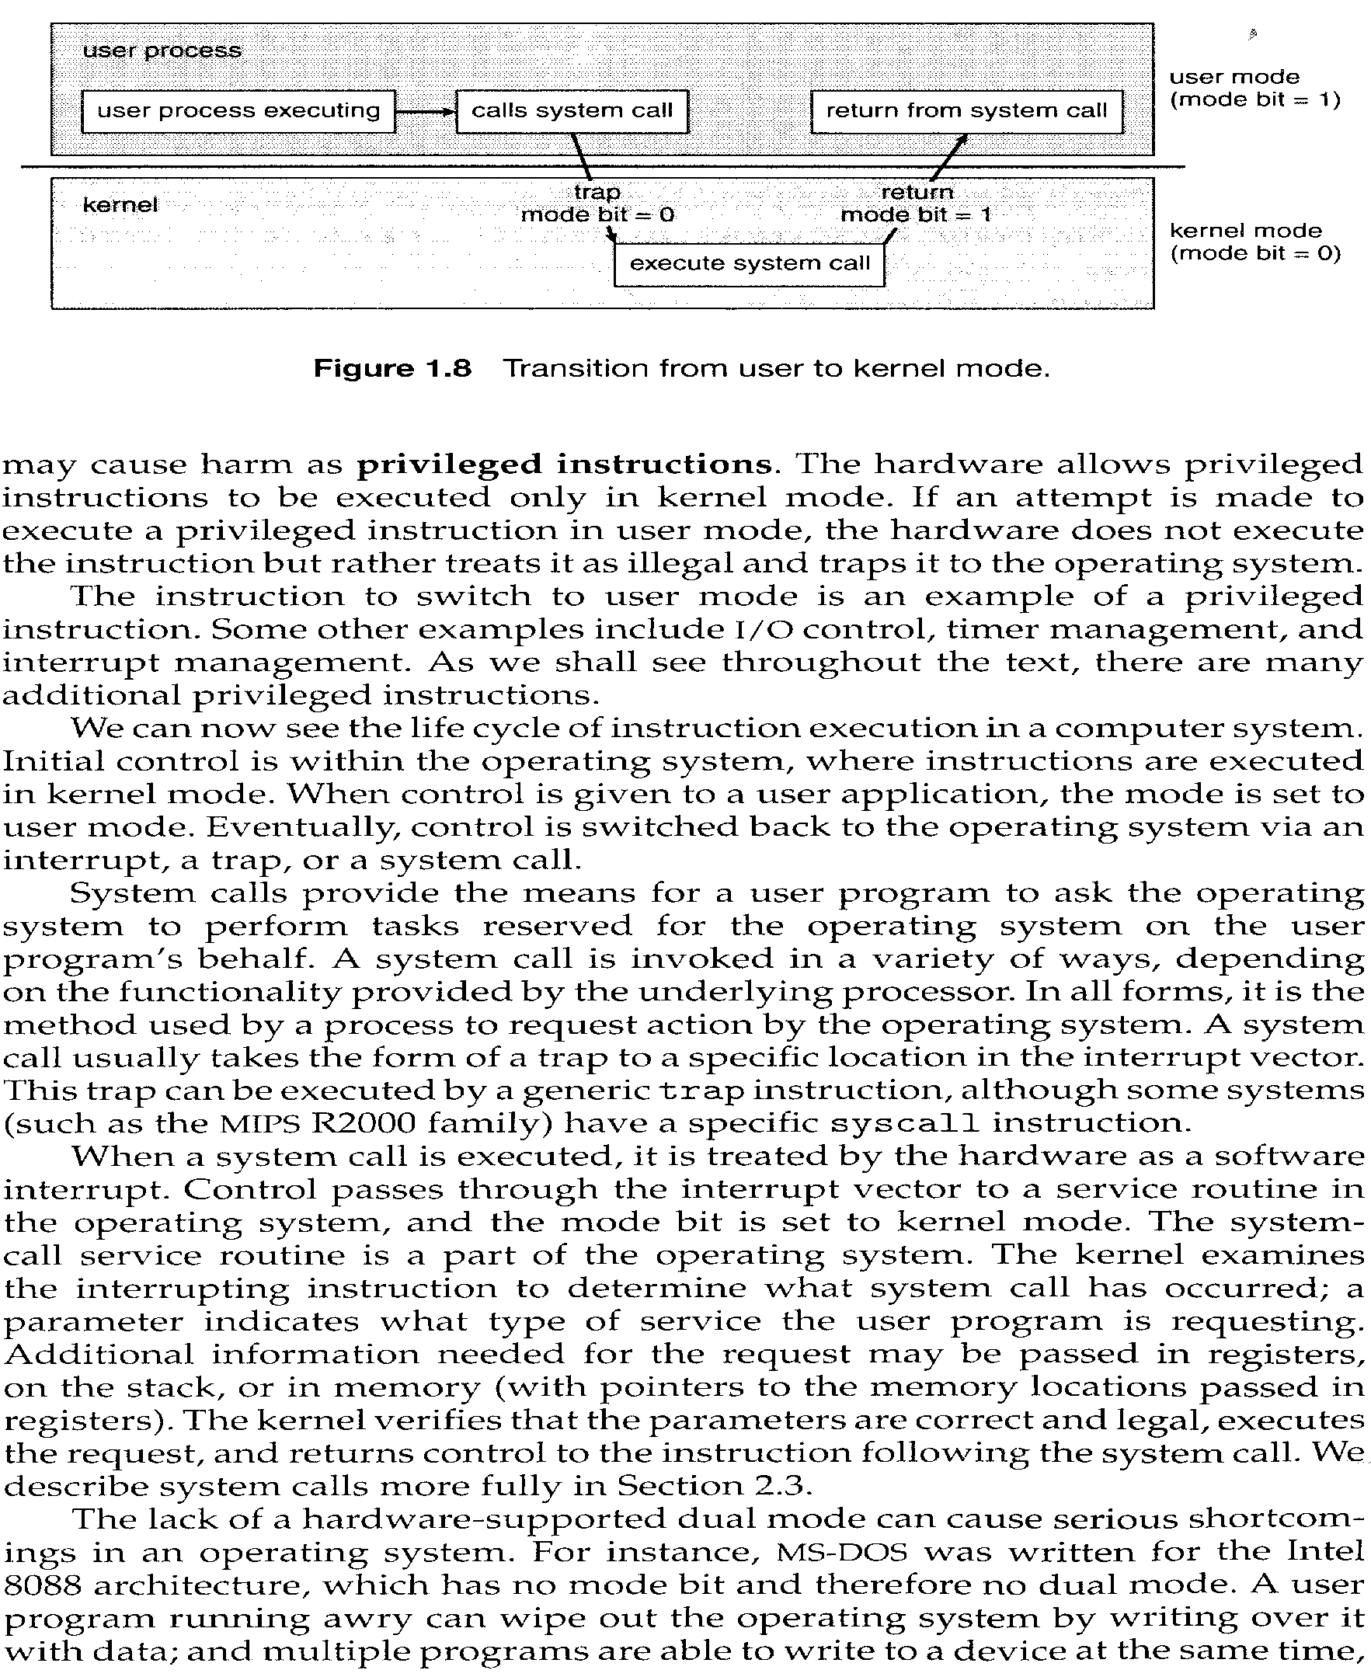

Slide 42
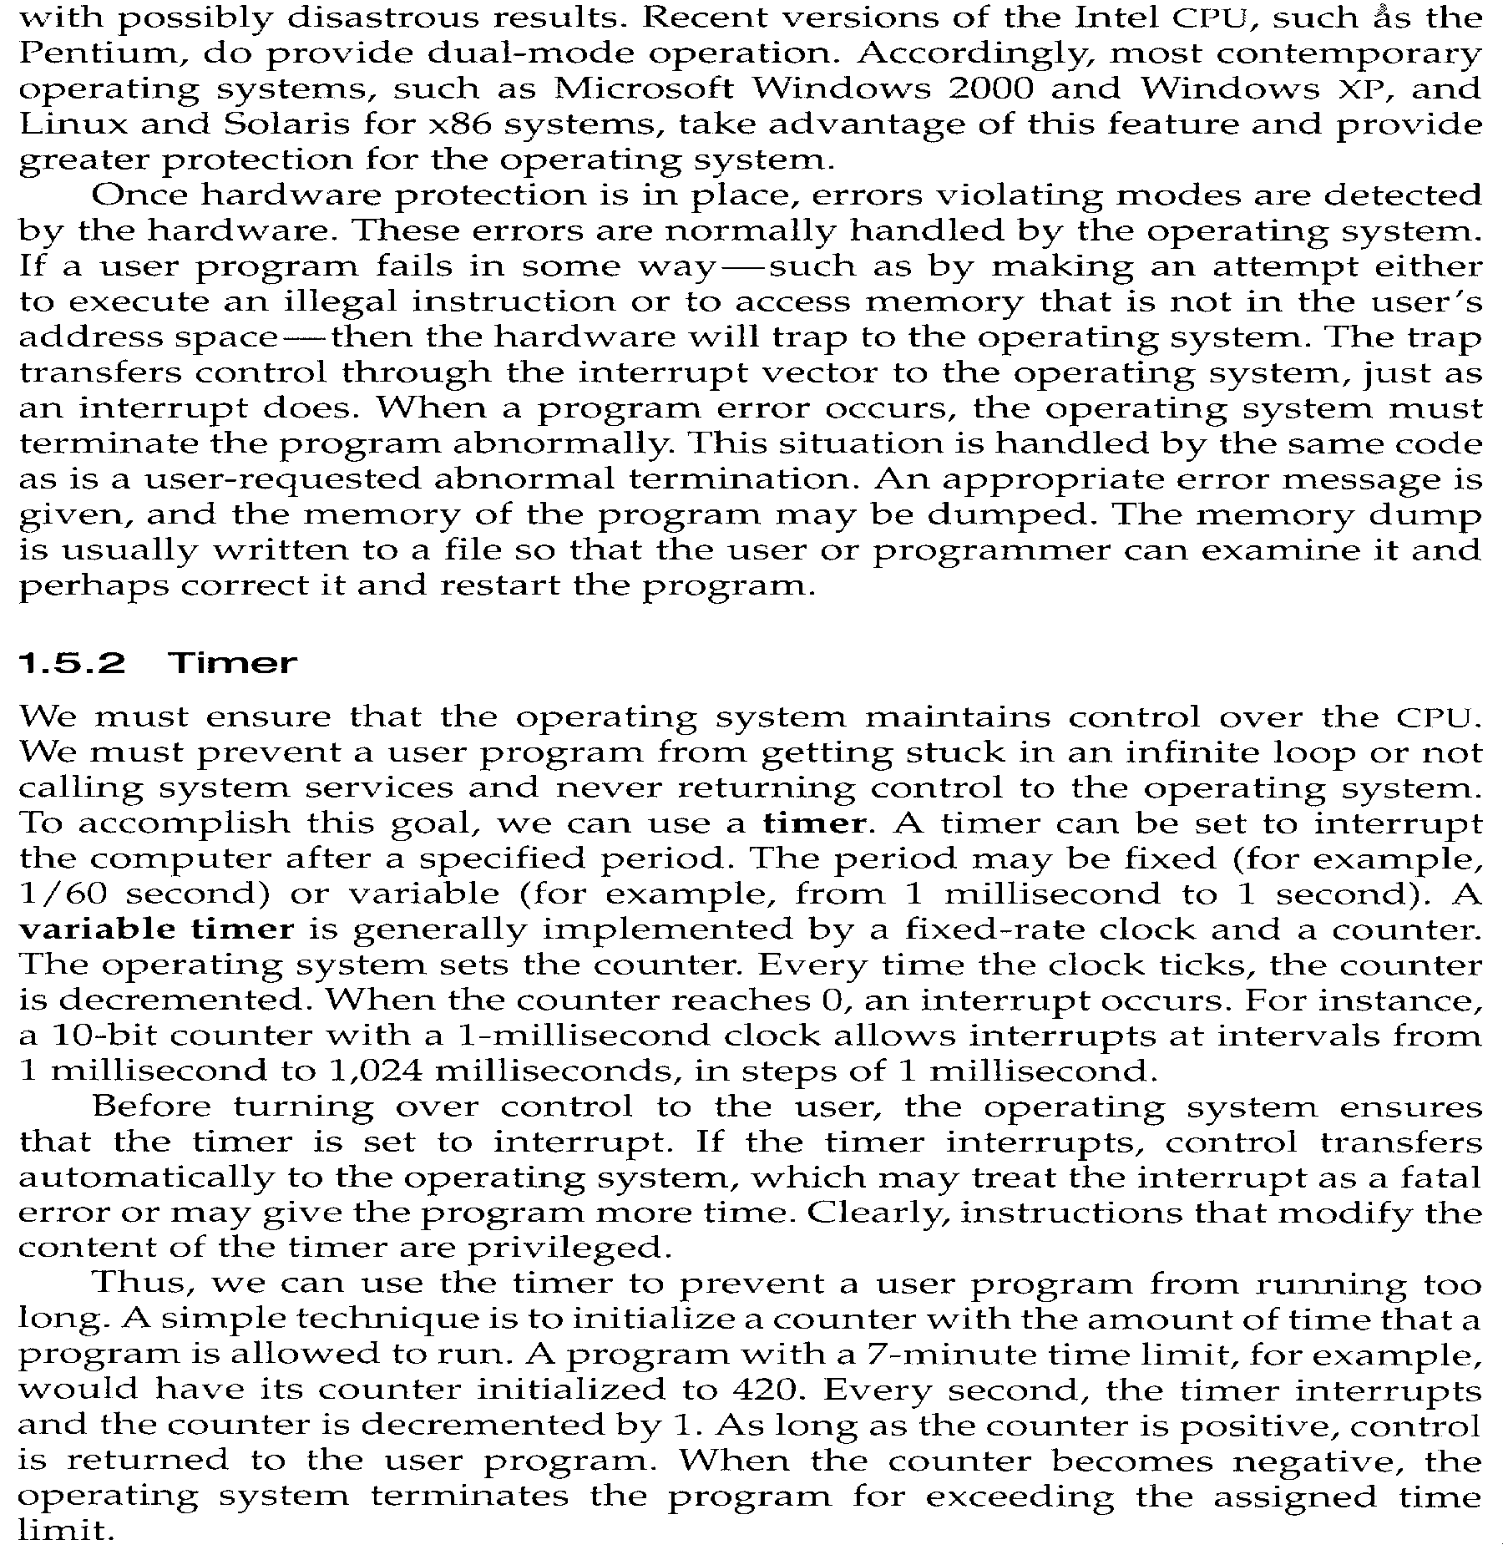

Slide 43

Migration of Integer A from Disk to Register
Multitasking environments must be careful to use most recent value, no matter where it is stored in the storage hierarchy
Multiprocessor environment must provide cache coherency in hardware such that all CPUs have the most recent value in their cache
Distributed environment situation even more complex
  Several copies of a datum can exist
  Various solutions covered in Chapter 17

Slide 44
I/O Subsystem
One purpose of OS is to hide peculiarities of hardware devices from the user
I/O subsystem responsible for
  Memory management of I/O including buffering (storing data temporarily while it is being transferred), caching (storing parts of data in faster storage for performance), spooling (the overlapping of output of one job with input of other jobs)
  General device-driver interface
  Drivers for specific hardware devices

Slide 45
Protection and Security
Protection – any mechanism for controlling access of processes or users to resources defined by the OS
Security – defense of the system against internal and external attacks
  Huge range, including denial-of-service, worms, viruses, identity theft, theft of service
Systems generally first distinguish among users, to determine who can do what
  User identities (user IDs, security IDs) include name and associated number, one per user
  User ID then associated with all files, processes of that user to determine access control
  Group identifier (group ID) allows set of users to be defined and controls managed, then also associated with each process, file
  Privilege escalation allows user to change to effective ID with more rights

Slide 46
Computing Environments
Traditional computer
  Blurring over time
  Office environment
    PCs connected to a network, terminals attached to mainframe or minicomputers providing batch and timesharing
    Now portals allowing networked and remote systems access to same resources
  Home networks
    Used to be single system, then modems
    Now firewalled, networked

Slide 47

Computing Environments (Cont)
Client-Server Computing
  Dumb terminals supplanted by smart PCs
  Many systems now servers, responding to requests generated by clients
    Compute-server provides an interface to client to request services (i.e. database)
    File-server provides interface for clients to store and retrieve files

Slide 48
Peer-to-Peer Computing
Another model of distributed system
P2P does not distinguish clients and servers
  Instead all nodes are considered peers
  May each act as client, server or both
  Node must join P2P network
    Registers its service with central lookup service on network, or
    Broadcast request for service and respond to requests for service via discovery protocol
  Examples include Napster and Gnutella

Slide 49
Web-Based Computing
Web has become ubiquitous
PCs most prevalent devices
More devices becoming networked to allow web access
New category of devices to manage web traffic among similar servers: load balancers
Use of operating systems like Windows 95, client-side, have evolved into Linux and Windows XP, which can be clients and servers

Slide 50
Open-Source Operating Systems
Operating systems made available in source-code format rather than just binary closed-source
Counter to the copy protection and Digital Rights Management (DRM) movement
Started by Free Software Foundation (FSF), which has “copyleft” GNU Public License (GPL)
Examples include GNU/Linux, BSD UNIX (including core of Mac OS X), and Sun Solaris

Slide 51
End of Chapter 1

