Slide 1
Chapter 3-4: Processes

Slide 2
Previous Lecture
Kernel interactions with the rest of the system
Devices
  I/O interrupts
  DMA
  Polling
User-level applications
  System calls (traps/software interrupts)
  Exceptions (errors i.e. division by zero)
OS structure
  Dual mode
  Virtual Machines
Abstraction over Hardware
  Hardware provides
    Sequential execution
    Interrupts
  OS should provide
    Multiple flows of sequential execution (diff apps)
    Separate resources for different applications
    Protection between these applications
      Security
      Fault isolation

Slide 3
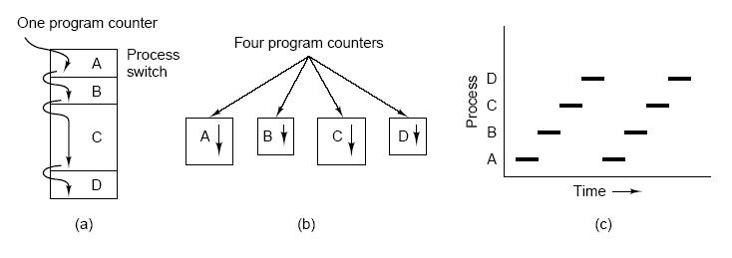
Scheduler
How can OS prevent user processes from monopolizing the CPU?
the CPU switches back and forth from process to process,
  running each one for ten or hundreds of milliseconds.
  On a uniprocessor machine, the CPU is running only one process at any instant of time but it switches among the competing processes.

Slide 4
OS Support for Process Memory
Hardware provides virtual address space (VAS)
● Each process thinks it has all memory
● 0 to 4GB on 32 bit architectures
● Provides protection between processes!
● Only subset of that address space is populated by actual memory for each process (heap, stack, text, data)
● Kernel exists in each virtual address space!
● What does pervent applications from corrupting kernel?
● microkernel places OS services in different VASes
● Kernel must manage virtual address spaces
● Create mapping between virtual and actual memory
● Switch between apps == switch between VAS

Slide 5
Chapter 3: Processes
Process Concept
Process Scheduling
Operations on Processes
Interprocess Communication
Examples of IPC Systems
Communication in Client-Server Systems

Slide 6
Objectives
To introduce the notion of a process -- a program in execution, which forms the basis of all computation
To describe the various features of processes, including scheduling, creation and termination, and communication
To describe communication in client-server systems

Slide 7
Process Concept
An operating system executes a variety of programs:
  Batch system – jobs
  Time-shared systems – user programs or tasks
Textbook uses the terms job and process almost interchangeably
Program: passive collection of code and data; kept in files on disk; brought into memory to execute
Process – a program in execution; process execution must progress in sequential fashion
A process includes:
  program counter
  stack
  data section
  Registers (instruction counter, stack pointer, etc..)
  heap

Slide 8

Structure of a Process in Memory
-Two process can be associated with the same program. You can have multiple copies running at the same time from e.g. internet explorer. What do you think will remain unchanged in all of them? Or which section(s) of those stack, heap data, text) will be write protected! You will not be able to change it/them during run time
-stack section contains temporary data (methods parameters, return address, local variable, ..)
-heap section is the dynamically allocated data area at run time
Data section contains the global data.
Text section contains the code to be executed.
malloc, free
int global_variable;
int main(void){return 0;}
-We have multiple process in memory and all have same structure

Slide 9

Process State and Diagram
During the life-time of a process, it needs resources (Memory, CPU, I/O) that may not be available at the moment. Resources are shared.
Those resources may be currently used by other processes in the system.
kernel moves a process from one state to another. Possible states:
  new: The process is being created (may be on disk in special area)
  running: registers loaded, Instructions are being executed
  waiting: The process is waiting for some event to occur (I/O)
  ready: runnable, but waiting to be assigned to a processor
  terminated: The process has finished execution
How many processes are in the running state? Single or multiple? What about ready and waiting states?

Slide 10
Process Control Block (PCB)
It serves as a repository of process information. Its structure is the same for all processes but its content differs depending on process information. Information associated with each process
  Process state
  Program counter
  CPU registers
  CPU scheduling information
  Memory-management information (amount of memory allocated, virtual address space mapping, stack location)
  Accounting information (exec time at user/kernel level)
  I/O status information - File info (open files)

Slide 11

Process Control Block (PCB)
Either ready, or running, or waiting, or …
Unique identifier which is used by OS
The address of the next instruction to be executed by this process
Accumulator, stack pointers, index reg., general purpose registers, condition status reg.,
Memory info( allocated area, VAS mapping,..)
Opened files info (owner, permissions….)
CPU scheduling info, I/O used info, ….

Slide 12

CPU Switch From Process to Process
- Context Switch from P₀ to P₁ then back to P₀
- Administrative
period (overhead).
CPU is switching from process to another.
- Kernel
a) stops P₀
b) saves everything about P₀ into its PCB to make it continue execution from the point it was stopped when it is rescheduled.
c) Load everything for P₁ from its PCB

Slide 13
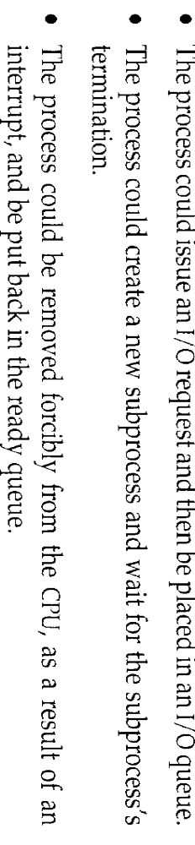
Process Scheduling Queues
Job (new) queue – set of all processes entering in the system
Ready queue – set of all processes residing in main memory, ready and waiting to execute
  Scheduler chooses next process to run
Device queues – set of processes waiting for an I/O device completion (interrupts)
  Typically one queue per device
Processes migrate among the various queues. One of the following could happen for the running process (Remember No queue for running state):
A process continues in this cycle until it terminates ⇒ deallocate PCB

Slide 14

Ready Queue And Various I/O Device Queues

Slide 15
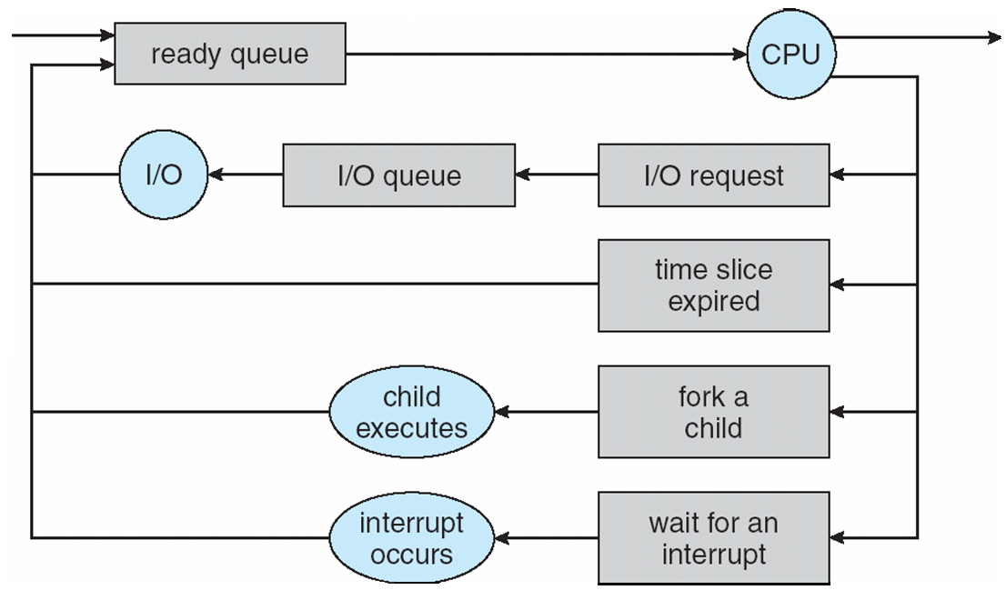
Representation of Process Scheduling

Slide 16
Schedulers-Who selects a process to run
The part of OS that decide(choose) which process to dispatch next from queues is the scheduler. Decision and management (Scheduling Algorithm) takes time and we have two general types of processes
    1) CPU bound: most time on CPU, not waiting for I/O
    2) I/O bound: short bursts of CPU usage, waiting on I/O
Long-term scheduler (or job scheduler) – selects which processes should be brought into the ready queue (may be from new or waiting)
  Control the degree of multiprogramming (No. of process in memory)
  Selects mix of I/O and CPU bound process to utilize resources good
  Long-term scheduler is adequate for batch jobs (on disks) and invoked very infrequently (seconds, minutes) ⇒ (may decide slow)
Short-term scheduler (or CPU scheduler) – selects which process should be executed next and allocated to CPU. Sure from ready queue
  is invoked very frequently (milliseconds) ⇒ (must decide fast)
  If it takes 10 msec to decide which process to get the CPU for only 100 msec, then 10% of CPU time is wasted for management.

Slide 17

Addition of Medium Term Scheduling
Unix and Windows have only CPU scheduler and leave stability (managing degree of multiprogramming) to human! The stability of those systems depends on either physical limitation or human adjustment.
To increase Degree of Multiprogramming (DOM) to an acceptable level and hence increase stability and performance, Medium Term Scheduling uses swapping technique.
- Swapping means processes are removed from main memory to disk (swapped out) to reduce DOM and later swapped in memory and rescheduled again. Process will continue execution from the point it was stopped.

Slide 18
Context Switch
Scheduler decides which process to run next
Dispatcher actually switches from the current process, to the next (chosen by the scheduler)
When CPU switches to another process, the system must save the state of the old process in its PCB and load the saved state for the new process via a context switch
Context of a process represented in the PCB
Context-switch time is overhead; the system does no useful work while switching (administrative time); should be minimal (typical msec)
Time depends on hardware support. It differs from a machine to another.
Context switch can occur when the CPU in user or kernel mode.
  at each interrupt where the OS changes mode from user to kernel mode to run the kernel routine.
  Save state of CPU ,execute interrupt routine and restore state of CPU
Does the size of the process affect the overhead time?

Slide 19
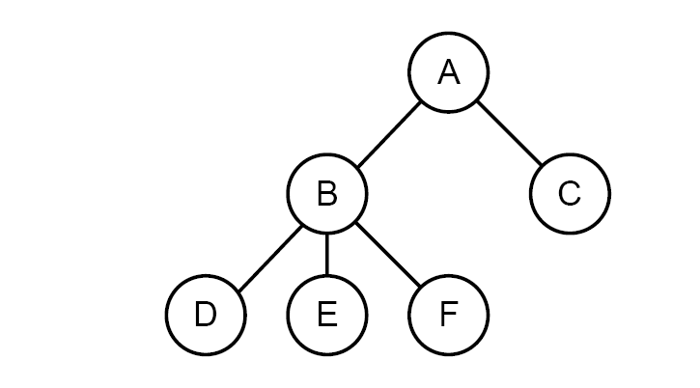
Process Creation
Process Operations
● Creation (fork) ● Termination (exit) ● Coordination (wait)
Parent process create children processes, which, in turn create other processes, forming a tree of processes
Generally, process identified and managed via a process identifier (pid)
Resource sharing
  Parent and children share all resources (e.g Open files)
  Children share subset of parent’s resources
  Parent and child share no resources
Execution
  Parent and children execute concurrently
  Parent waits until children terminate
  Parent can kill() its children
Process hierarchy

Slide 20
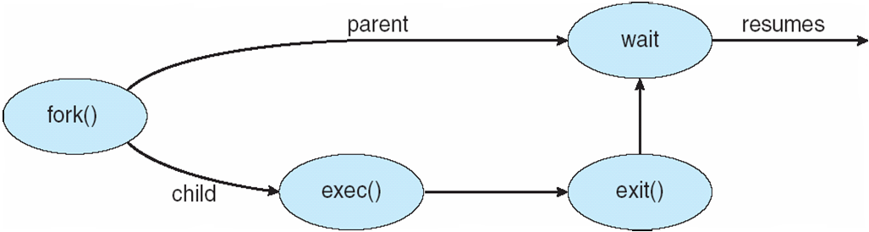
Process Creation (Cont)
Address space
  Child duplicate of parent
  Child has a program loaded into it
UNIX examples
  fork system call creates new process; creates a copy of the parent's address space for the child
    Copying all memory can be expensive!
  exec system call used after a fork to replace the process’ memory space with a new program loaded from disk into current process
So why copy all memory?
  COW – copy on write memory sharing
  vfork() – stop parent's execution till we exec()

Slide 21
C Program Forking Separate Process
int main()
{
pid_t pid; //PID of the created child process
/* fork another process */
pid = fork(); // create new duplicate process
if (pid < 0) { /* error occurred */
fprintf(stderr, "Fork Failed");
exit(-1);
}
else if (pid == 0) { /* child process */
execlp("/bin/ls", "ls", NULL);
} else { /* parent process */
/* parent will wait for the child to complete */
wait (NULL); //returns child PID-Blocking call
printf ("Child Complete");
exit(0);
}
}

Slide 22
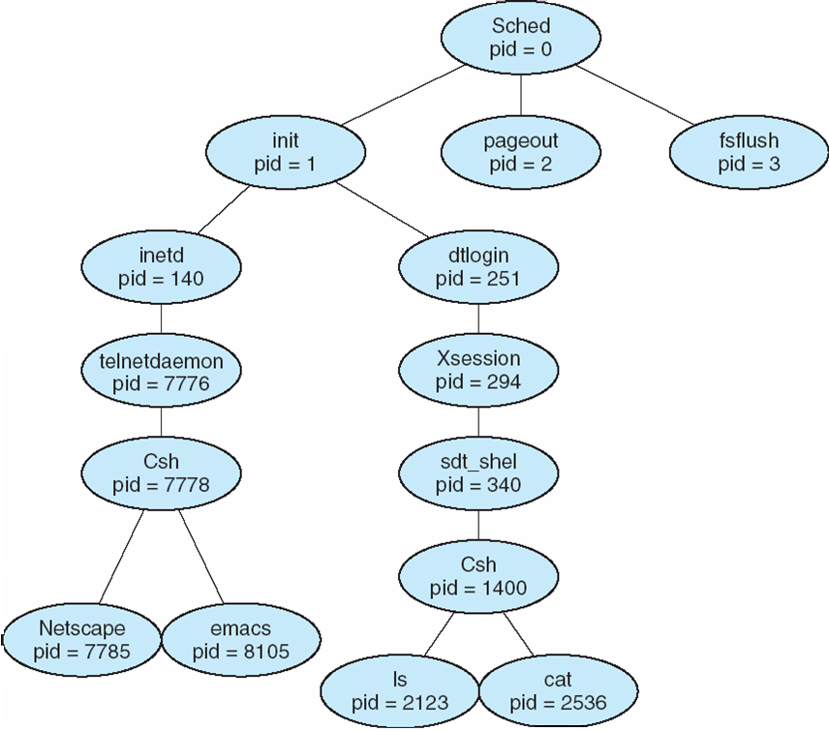
A tree of processes on a typical Solaris

Slide 23
Process Termination
Process executes last statement and asks the operating system to delete it (exit)
  Output data from child to parent (via wait() )
  Process’ resources are deallocated by operating system
Parent may terminate execution of children processes (abort)
  Child has exceeded allocated resources
  Task assigned to child is no longer required
  If parent is exiting
    Some operating system do not allow child to continue if its parent terminates
      All children terminated - cascading termination
      Some permits Orphans!

Slide 24
Interprocess Communication IPC
We've seen that processes can create each other, and child can pass return value/status to the parent. Can implement a shell using only this
Concurrency – execution order of two processes is not predetermined
  Multiple concurrently executing apps
  Coordination between I/O bound processes ( e.g. bittorrent)
Parallelism – on multi-processor systems, two processes can execute at the same time
Processes within a system may be independent or cooperating
Independent process don’t share data with any other process.
Cooperating process can affect or be affected by other processes, including sharing data
Reasons or advantages for cooperating processes:
  Information sharing- file sharing
  Computation speedup- break task into parallel sub-tasks( Multi-CPU)
  Modularity-Build a system from pieces (processes or threads)
  Convenience-User needs for printing, editing,and compiling in parallel

Slide 25

Communications Models
Cooperating processes need interprocess communication (IPC) that allow them to exchange data and information.
Communication should be controlled and provided to processes in a well-structured manner. Communication always means using shared media between the communicating processes.
Two data transfer models of IPC
  Message passing – exchange message by send and receive
  Shared memory – read and write shared region created by kernel

Slide 26
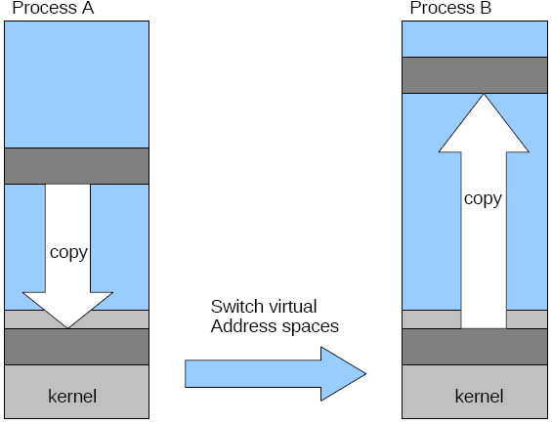
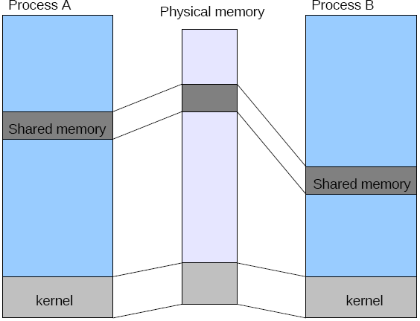
Message Passing vs. Shared Memory
Message passing
  Must copy data
  Must involve kernel
  Easy to implement
Shared memory
  Copying data optional
  Processes ensure not to write at the same memory location simultaneously. Kernel is not involved.
  Faster at the same computer!

Slide 27
Shared Memory & Message Passing
Criteria | Messages | Shared Memory
convenience | Small information exchanged between Interconnected computers. | larger information exchanged within preferred Single computer
Implementation | Several System Calls that need more time from kernel (not possible to use read(), write() | System Calls for establishment (shmget()) after then kernel treats them as normal routine (read() and write()(
Avoid Conflicts | Kernel assist | Application should take care
Speed | Slower (kernel is invoked all the time) | Faster Allows maximum speed (memory speed) within one computer

Slide 28
Producer-Consumer Problem
Paradigm for cooperating processes, producer process produces information that is consumed by a consumer process. Many Examples:
  Compiler produces assembly code that is consumed by the assembler
  Web-server provides HTML files that is read by the internet browser
  Sharing access to spooling directory, array, booking system , etc.
To allow producer (WRITER) to run concurrently with consumer (READER), we need a buffer:
  unbounded-buffer places no practical limit on the size of the buffer
  bounded-buffer assumes that there is a fixed buffer size
IPC mechanism use shared buffer. Where is it? The location of buffer!!!!
  Shared memory – buffer exist in the address space of creator (P or C) and other attach it. Kernel has no control about buffer!. It create it only. They (Not Kernel ) should ensure not to write in simultaneously.
  Message passing- buffer is in kernel address space but mapped to P and C
Producer
Consumer
Buffer

Slide 29
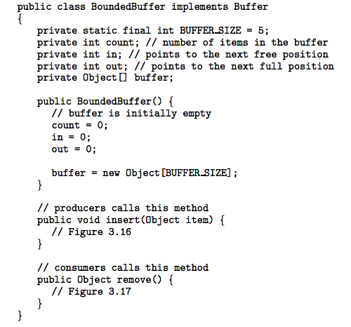
Bounded-Buffer – Shared-Memory Solution
Producer
Full
Count = size
R
A
B
Buffer
w
Synchronization
Empty
Count = 0
Consumer

Slide 30
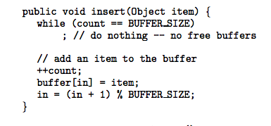
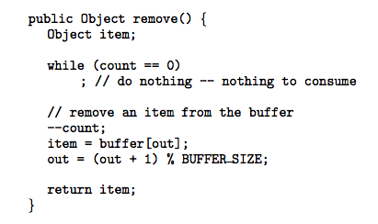
Bounded-Buffer – Producer
Shared
Bounded-Buffer – Consumer
Code correct? What can happen
if multiple P or C run concurrently?

Slide 31
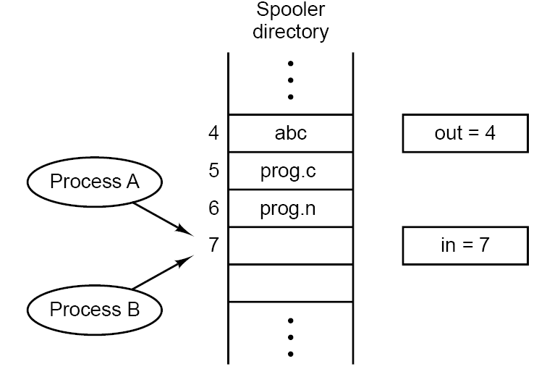
Producer-Consumer Problem
Sharing access to spooling directory, array, booking system , etc should be controlled to avoid problems!!!
Public void insert (object item) {
While (!(full()){ //(in+1) % Size) == out
buffer[in] = item; //produce an item
in = in+1; //in = (in+1)%BUFFER_SIZE
count++;
}
- CPU runs Proc A
  - stores item (file X) in slot 7
-CPU Switches from Proc A to Proc B
  stores item (file Y) in slot 7
  update in to be 8
  Increment count
-CPU Switches back to Proc A
  – updates in to be 8……
The final result: file x will NEVER be printed

Slide 32

Interprocess Communication – Message Passing
Is a Mechanism for processes to communicate and to synchronize their actions without sharing the same address space
Message system – processes communicate with each other without resorting to shared variables. Suitable for distributed systems. (e.g chatting)
IPC facility provides two operations:
  send(message) – message size is fixed or variable ?
  receive(message) – block caller or not ?
If P and Q wish to communicate, they need to:
  establish a communication link between them
  exchange messages via send/receive
Implementation of communication link
  physical (e.g., shared memory, hardware bus, network)
  logical (e.g. logical properties). This what we are interested in for now.

Slide 33
Implementation Questions
Different design issues for implementing message passing:
  How are links established?
  Can a link be associated with more than two processes?
  How many links can there be between every pair of communicating processes?
  What is the capacity of a link?
  Is the size of a message that the link can accommodate fixed or variable?
  Is a link unidirectional or bi-directional?

Slide 34
Direct or indirect Communication
Processes must name each other explicitly:
  Symmetric naming
  send (P, message) – send a message to process P
  receive(Q, message)– receive a message from process Q
  Asymmetric naming
  send (P, message) – send a message to process P
  receive(id, message)– receive a message from any process
  Disadvantage of explicitly:
    Limited modularity (hard-coding of names (check if P or Q change names?)
Processes send or receive messages to/from mailbox not directly between them. Mailbox (ports) is a message container.
  Each mailbox is created and has a unique id (name)
  Processes can communicate only if they share a mailbox
  send(A, message) – send a message to mailbox A
  receive(A, message) – receive a message from mailbox A
  Advantage of naming:
    Only mailbox id will be changed but process names NOT.

Slide 35
Direct and Indirect Communication
Properties of communication link
  Links are established automatically. Implicit creation.
  A link is associated with exactly one pair of communicating processes
  Between each pair there exists exactly one link
  The link may be unidirectional, but is usually bi-directional
Properties of communication link
  Link established only if processes share a common mailbox. Create/destroy OP:
    create a new mailbox
    destroy a mailbox
  A link may be associated with many processes
  Each pair of processes may share several communication links
  Link may be unidirectional or bi-directional
Mailbox (MB) has owner who can initially be its receiver. MB is part of its owner’s Address space. when MB terminates (destroyed) other users (senders) should be notified. Owner is responsible for MB creation. User process can create mailboxes by using OS system calls for creation/destroying/manage MB. OS decide which solution to use (Multiple sender, multiple receiver or single or mix?

Slide 36
Indirect Communication-Mailbox sharing
Mailbox sharing
  P₁, P₂, and P₃ share mailbox A
  P₁, sends; P₂ and P₃ receive
  Who gets the message? Answer depends on the selected solution:
    Allow a link to be associated with at most two processes
    Allow only one process at a time to execute a receive operation
    Allow the system to select arbitrarily the receiver. Sender is notified who the receiver was.
Mailbox Ownership (creator): Either User process or operating system
  Mailbox (MB) has owner who can initially be its receiver. MB is part of its owner’s Address space. When MB terminates other users (senders) should be notified. Owner is responsible for MB creation. User process can create mailboxes by using OS system calls for creation/destroying/manage MB. Operating system decide which solution to use (Multiple sender, multiple receiver or single or mix?

Slide 37
Synchronization
Message passing may be either blocking or non-blocking
Blocking is considered synchronous ( Rendezvous paradigm. Rendezvous is a French word “Randvou”).
  Blocking send has the sender block until the message is received by sender or MailBox.
  Blocking receive has the receiver block until a message is available
  Producer-Consumer problem solution is very trivial. Because both sender and receiver must be synchronized for the message to be produced and consumed.
Non-blocking is considered asynchronous
  Non-blocking send has the sender send the message and continue
  Non-blocking receive has the receiver receive a valid message or null

Slide 38
IPC Synchronization: Blocking/Nonblocking
Blocking/Synchronous operations (send, recv)
  Process put on kernel I/O waiting Queue
  Placed back into ready when communicating process recvs or sends
Blocking/Synchronous operations
1) Proc A: recv(m)
2) Kernel: remove from ready, placed on (I/O waiting state)
3) Kernel: switch to B
4) Proc B: send(m)
5) Kernel: move A to ready
6) Kernel: later switch to A
Nonblocking/ Asynchronous Ops
  send and recv don't block the process
No data to recv? recvs or sends
  return 0 (bytes read)
Nonblocking/ Asynchronous
Proc A: recv(m)
  If data to be read, return it
  Else return 0, continue computation
Proc B: send(m)
  Add data to queue to be read (later) by A

Slide 39
Buffering
Queue of messages attached to the link; implemented in one of three ways
  1. Zero capacity – 0 messages
  Sender must wait for receiver (rendezvous)
  2. Bounded capacity – finite length of n messages
  Sender must wait if link full Otherwise, sends and continue. Same for Receiver, blocked if buffer empty, otherwise consume and continue.
  3. Unbounded capacity – infinite length
  Sender never waits

Slide 40
END of chapter
Go and have fun in lab. Seeing is Believing. Doing is ……….. You will tell me.
IPC mechanism in different operating system
  Shell (fork() and exec())
  Shared memory
  Sockets
  Pipe

Slide 41
Examples of IPC Systems - POSIX
POSIX Shared Memory
  Process first creates shared memory segment
  segment id = shmget(IPC PRIVATE, size, S IRUSR | S IWUSR);
  Process wanting access to that shared memory must attach to it
  shared memory = (char *) shmat(id, NULL, 0);
  Now the process could write to the shared memory
  sprintf(shared memory, "Writing to shared memory");
  When done a process can detach the shared memory from its address space
  shmdt(shared memory);

Slide 42
Examples of IPC Systems - Mach
Mach communication is message based
  Even system calls are messages
  Each task gets two mailboxes at creation- Kernel and Notify
  Only three system calls needed for message transfer
  msg_send(), msg_receive(), msg_rpc()
  Mailboxes needed for commuication, created via
  port_allocate()

Slide 43
Examples of IPC Systems – Windows XP
Message-passing centric via local procedure call (LPC) facility
  Only works between processes on the same system
  Uses ports (like mailboxes) to establish and maintain communication channels
  Communication works as follows:
    The client opens a handle to the subsystem’s connection port object
    The client sends a connection request
    The server creates two private communication ports and returns the handle to one of them to the client
    The client and server use the corresponding port handle to send messages or callbacks and to listen for replies

Slide 44

Local Procedure Calls in Windows XP

Slide 45
Communications in Client-Server Systems
Sockets
Remote Procedure Calls
Remote Method Invocation (Java)

Slide 46
Sockets
A socket is defined as an endpoint for communication
Concatenation of IP address and port
The socket 161.25.19.8:1625 refers to port 1625 on host 161.25.19.8
Communication consists between a pair of sockets

Slide 47

Socket Communication

Slide 48
Remote Procedure Calls
Remote procedure call (RPC) abstracts procedure calls between processes on networked systems
Stubs – client-side proxy for the actual procedure on the server
The client-side stub locates the server and marshalls the parameters
The server-side stub receives this message, unpacks the marshalled parameters, and peforms the procedure on the server

Slide 49
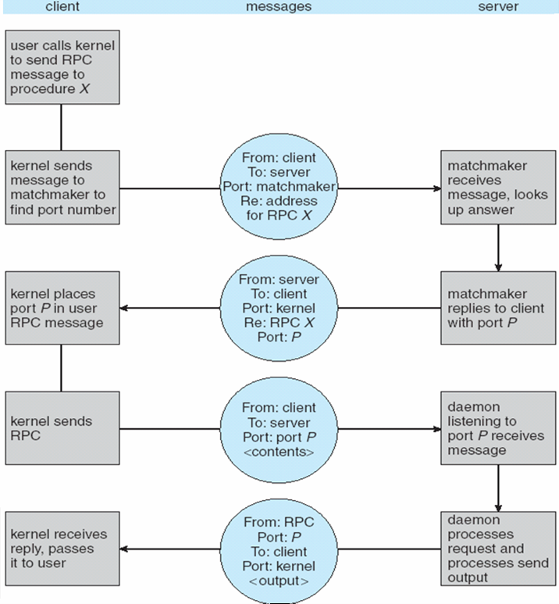
Execution of RPC

Slide 50
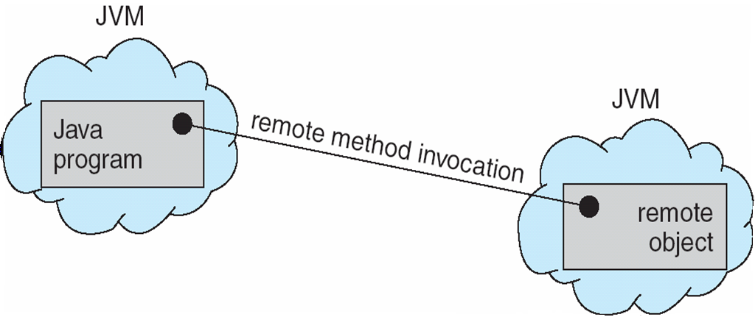
Remote Method Invocation
Remote Method Invocation (RMI) is a Java mechanism similar to RPCs
RMI allows a Java program on one machine to invoke a method on a remote object

Slide 51
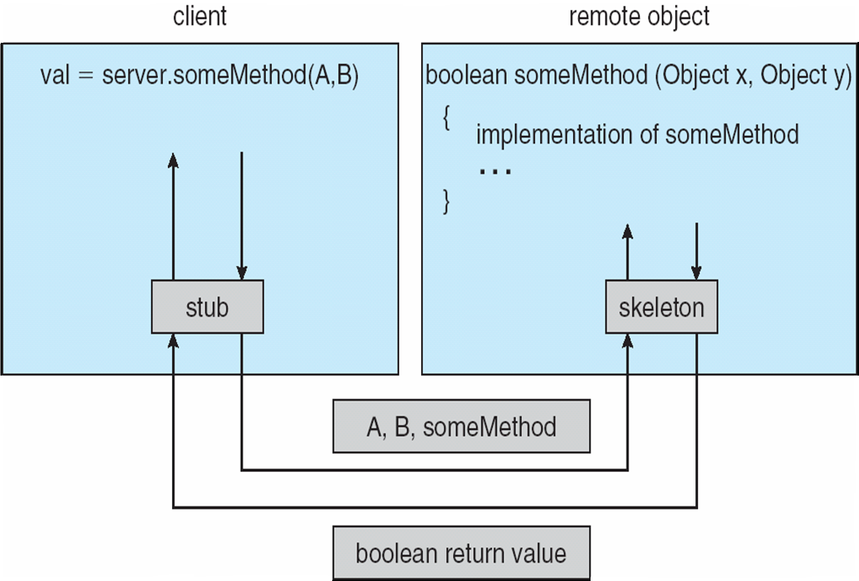
Marshalling Parameters

Slide 52
End of Chapter 3-4

