Slide 1
Chapter 5: CPU Scheduling

Slide 2
Chapter 5: CPU Scheduling
Basic Concepts
Scheduling Criteria
Scheduling Algorithms
Thread Scheduling
Multiple-Processor Scheduling (End of Chapter)
Operating Systems Examples
Algorithm Evaluation

Slide 3
Objectives
To introduce CPU scheduling, which is the basis for multiprogrammed operating systems
To describe various CPU-scheduling algorithms ( There is no one best solution. No one is perfect!)
To discuss evaluation criteria for selecting a CPU-scheduling algorithm for a particular system

Slide 4

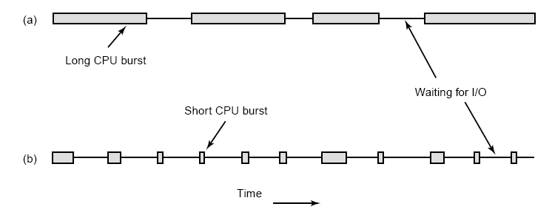
Basic Concepts
Maximum CPU utilization obtained with multiprogramming
CPU–I/O Burst Cycle – Process execution consists of a cycle of CPU execution and I/O wait. CPU burst distribution is shown below.

Slide 5

Histogram of CPU-burst Times

Slide 6
Scheduling. When is it done?
Basis for multiprogramming. Selects from among the processes in memory that are ready to execute, and allocates the CPU to one of them. Main question: how do we choose the next processes ?
CPU scheduling occurs when
  1) A process is created and is put in a ready state
  2) A process voluntarily yields the CPU
  3) A process switches from running to waiting state e.g. blocking on I/O
  4) A process switches from running to ready state e.g. because it is interrupted and its timeslice expires
  5) A process switches from waiting to ready state e.g. an interrupt signifies that I/O is complete
  6) A process terminates
Non-preemptive scheduling includes all but 4) and 5)
Preemptive scheduling includes all of the above
  Characterized by interrupts that result in some process being moved from running to ready state – being preempted

Slide 7
Dispatcher
Scheduler (Algorithm + Data Structure) decides which process to run next. Remember that decision always take time and resources.
Dispatcher module gives control of the CPU to the process selected by the short-term scheduler; this involves:
  switching context (save PCB of old process, load PCB of chosen process)
  switching to user mode () (change virtual address spaces)
  jumping to the proper location in the user program to restart that program
Dispatch latency – time it takes for the dispatcher to stop one process and start another process in order to run. This overhead define dispatch latency
At each clock interrupt, the OS gets to run and decide whether the currently running process should be allowed to continue or whether it has to choose another process and give it the CPU.

Slide 8
Scheduling Goals/Criteria
CPU utilization – keep the CPU as busy as possible
Throughput – # of processes that complete their execution per time unit
Turnaround time – amount of time to execute a particular process
  Sum of the periods spent during the life time of a process till terminate
Waiting time – amount of time a process has been waiting in the ready queue. Sum of the periods spent in ready (turnaround time – burst time)
Response time Interactivity: – amount of time it takes from when a request was submitted until the first response is produced, not output (for time-sharing environment). Time from beginning of execution, to when process can output or input
Fairness- Give CPU to all processes in a fair manner
Maximize which? Minimize which? It is desirable to
  Maximize CPU utilization - Maximize throughput
  Min turnaround time -Min waiting time -Min response time
Some goals are contradictory.
For example, to minimize response time for interactive users, the scheduler should not run any batch jobs at all.

Slide 9
Scheduling Goals/Criteria Conflicts
CPU utilization and response time: CPU utilization is increased if the overheads associated with context switching is minimized. The context switching overheads could be lowered by performing context switches infrequently. This could however result in increasing the response time for processes.
Average turnaround time and maximum waiting time: Average turnaround time is minimized by executing the shortest tasks first. Such a scheduling policy could however starve long-running tasks and thereby increase their waiting time.
I/O device utilization and CPU utilization: CPU utilization is maximized by running long-running CPU-bound tasks without performing context switches. I/O device utilization is maximized by scheduling I/O-bound jobs as soon as they become ready to run, thereby incurring the overheads of context switches.

Slide 10
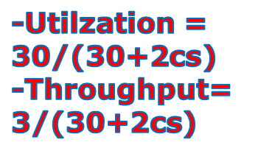
First-Come, First-Served (FCFS) Scheduling
One of the simplest scheduling policies
  non-preemptive. Once process is scheduled to run (get CPU), it keeps it until terminated or request I/O
      Process Burst Time
P₁ 24
P₂ 3
P₃ 3
Suppose that processes arrive in the order: P₁ , P₂ , P_{3 ,} all at time 0.
A Gantt Chart shows which process executed by the CPU at each time. The Gantt Chart (contains no Overhead time) for the schedule is:
Turnaround time for P_{1 ,} P₂ , and P₃ are 24, 27, 30 respectively
Waiting time = turnaround time - burst time
  Waiting time for P₁ = 0; P₂ = 24; P₃ = 27
  Average waiting time: (0 + 24 + 27)/3 = 17
P₁
P₂
P₃
0
24
27
30

Slide 11
FCFS Scheduling (Cont)
Suppose that the processes arrive in the order
P₂ , P₃ , P₁
The Gantt chart for the schedule is:
Turnaround time for P_{1 ,} P₂ , and P₃ are 30, 3, 6 respectively
Waiting time for P₁ = 6; P₂ = 0; P₃ = 3
  Average waiting time: (6 + 0 + 3)/3 = 3
Much better than previous case
Convoy effect short process behind long process. Lower CPU and device utilization than might be possible if the shorter processes were allowed to get CPU first.
FCFS is not suitable for time-sharing systems, where processes get a share of CPU at regular intervals-> suitable for batch systems
Can we build a preemptive FCFS???
P₂
P₃
P₁
0
3
6
30

Slide 12
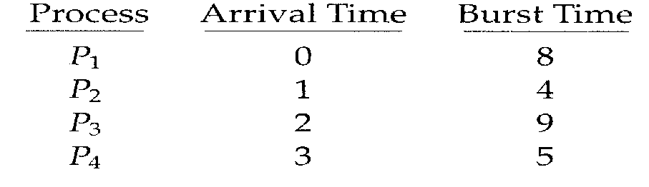
FCFS Scheduling (Cont)
Example without ignoring arrival time.
  _{Gantt Chart}
  0 8 12 21 26
  Average waiting time= [(0)+(8-1)+(12-2)+(21-3)]/4= 8.75 ms
  Average Turn Around time=[(8-0]+(12-1)+(21-2)+(26-3)]/4=15.25 ms
  Throughput = 4 jobs/26 ms = 0.15385 jobs/ms
P1 | P2 | P3 | P4

Slide 13

Shortest-Job-First (SJF) Scheduling
Associate with each process the length of its next CPU burst. Use these lengths to schedule the process with the shortest time. If several processes have the same CPU next burst time, use FCFS to select one
Not suitable for short-term scheduling because there is no way to know the next CPU burst. It is used in long-term scheduling
Process Arrival Time Burst Time
P₁ 0.0 6
P₂ 2.0 8
P₃ 4.0 7
P₄ 5.0 3
Non-Preemptive SJF scheduling Gannt chart
Turnaround time for P_{4 ,} P₁ , P₃ and P₂ are 3, 9, 16, 24 respectively
Average waiting time = (0 + 3+ 9 + 16) / 4 = 7 (ignore arrival time)
  Same problem with FCFS = 10.25 msec
P₄
P₁
P₃
P₂
0
3
9
16
24

Slide 14
Non-Preemptive Shortest-Job-First (SJF) Scheduling without Ignoring Arrival time
Process Arrival Time Burst Time
P₁ 0.0 7
P₂ 2.0 4
P₃ 4.0 1
P₄ 5.0 4
Non-Preemptive SJF scheduling Gannt chart
Turnaround time for P_{1 ,} P₃ , P₂ and P₄ are
(7-0), (8-4), (12-2) , (16-5) respectively
7 , 4 , 10 , 11
Average waiting time = (0 + (7-4) + (8-2) + (12-5) / 4 = 4
P₁
P₃
P₂
P₄
0
7
8
12
16

Slide 15

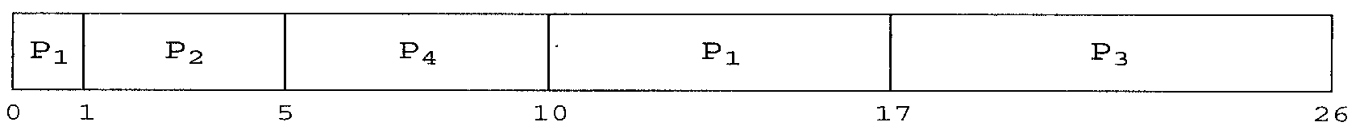
Preemptive SJF Scheduler
Preemptive SJF is optimal – gives minimum average waiting time for a given set of processes because it moves short process before a long one. It can’t be used for short-term scheduling
  The difficulty is knowing the length of the next CPU request. It is used frequently in long-term scheduling in batch systems because user can estimate running time needed
  Average waiting time= [(10-1)+(1-1)+(17-2)+(5-3)]/4= 6.5 ms
  Average Turn Around time=[(17-0]+(5-1)+(26-2)+(10-3)]/4=11.5 ms
  Throughput = 4 jobs/26 ms = 0.15385 jobs/ms
  Non-Preemptive scheduling waiting time = 7.75 ms

Slide 16

Shortest-Job-First (SJF) Scheduling without Ignoring Arrival time
Process Arrival Time Burst Time
P₁ 0.0 7
P₂ 2.0 4
P₃ 4.0 1
P₄ 5.0 4
Non-Preemptive SJF scheduling chart
Turnaround time for P_{1 ,} P₂ , P₃ and P₄ are
(16-0), (7-2), (5-4) , (11-5) respectively
16 , 5 , 1 , 6
Average waiting time = ((11-2) + (5-4)+ (4-4)+ (7-5)/ 4
₌ 9 + 1 + 0 + 2 )/4 = 3
P₁
P₂
P₃
P₂
P₄
P₁
0
2
4
5
7
11
16

Slide 17
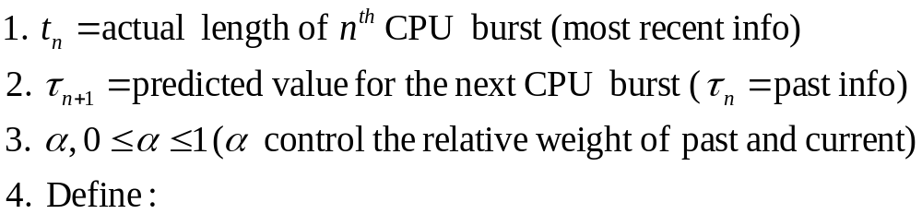
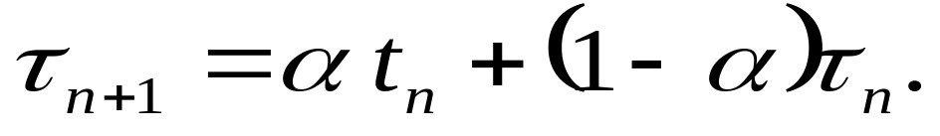

Determining Length of Next CPU Burst
The next CPU burst is predicted as an exponential average of the measured lengths of previous CPU bursts. Prediction depends on past history and current scheduling information

Slide 18
Examples of Exponential Averaging
α =0
  τ_{n+1} = τ_{n}
  Recent history does not count. Most recent behavior count! Suppose τ₀ = 10msec then prediction depends always on 10
α =1
  τ_{n+1} = α t_{n}
  Only the actual last CPU burst counts (scheduler is memory- less)
If we expand the formula, we get:
    τ_{n+1} = α t_{n}+ (1 - α) α t_{n-1} + …
    + (1 - α ) ^{j} α t_{n} _{-j} + …
    +(1 - α ) ^{n +1} τ₀
Since both α and (1 - α) are less than or equal to 1, each successive term has less weight than its predecessor
In figure shown before assume that α =0.5 and τ₀ = 10, then
τ₁ = 0.5 * 6 + (1- 0.5) 10 = 0.5 * 10 = 8

Slide 19
Priority Scheduling
SJF is priority scheduling where priority is the predicted next CPU burst T
Priority can be defined internally (to OS) or externally.
  Internal: CPU usage time, memory requirements, I/O usage
  External: importance, type, political issues
A priority number (integer) is associated with each process(small ≡ high)
The CPU is allocated to the process with the highest priority (smallest integer ≡ highest priority).
When a process arrives at ready state, its priority will be compared to priority of running process. If newly process has higher priority:
  Preemptive – it preempts the running one and old running one will be put into ready.
  Nonpreemptive- it does not preempt the running one and it will be put at the head of ready state.
Problem ≡ Starvation (indefinite blocking)– low priority processes may never execute
Solution ≡ Aging – As a process uses more execution time, dynamically decreases its priority or increase the priority of other lower processes (say increase priority by 1 every 15 min)

Slide 20
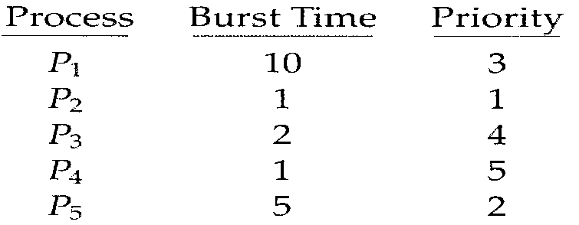
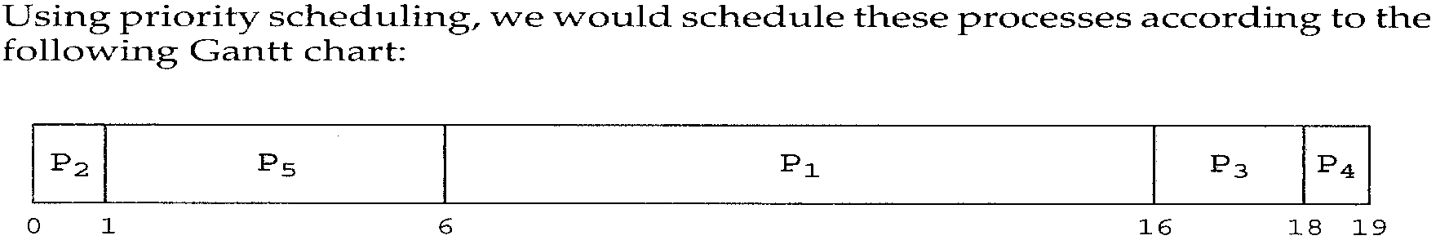
Priority Scheduling-Example
Highest
lowest
Average waiting time = (0+1+6+16+18)/5= 41/5= 8.2msec

Slide 21
Round Robin (RR)-Interactive systems
In Timesharing systems that wish to provide “fair” distribution of CPU resources one process can’t monopolize CPU
RR can be considered FCFS with preemption.
Each process is assigned a single time interval (timeslice) , called quantum, in which it is allowed to run (use CPU ) before it is preempted.
Each process gets a small unit of CPU time, usually 10-100 milliseconds.
  If process is still running at the end of the quantum, CPU is given to another process from ready queue and that process is preempted ⇒ move to ready
    RR puts those processes in ready queue. Where? Classical RR will put them at the end but priority RR puts them in right place according to CPU usage, the more CPU a process gets, the less dynamic priority it takes
      Assume quantum time = 100, A process used 2 msec will have priority of 1/f = ½ = 50. A process ran 50 msec before blocking will have the priority of 1/f = 1/50 = 2. A process used the whole quantum will have the priority of 1/f = 1/100 = 1 (Lowest priority=1)
  If the process has blocked before the quantum has reached, the CPU is preempted and that process is put at the end of I/O waiting queue .
  If process is finished=>move to terminated and choose another from ready
  Requires timer interrupt to measure timeslices and preempt
If there are n processes in the ready queue and the time quantum is q, each process gets 1/n of the CPU, in chunks of at most size Q (fairness)
No process waits for more than (N-1)Q time units before next quantum

Slide 22

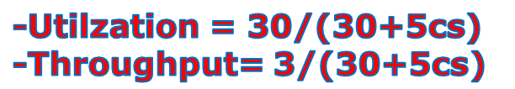
Example of RR with Time Quantum = 4
Process Burst Time
P₁ 24
P₂ 3
P₃ 3
The Gantt chart is:
Typically, higher average turnaround than SJF, but better responsiveness . Average = [(0+4+7)]/3= 3.6 msec. It gets better if the quantum is chosen smaller e.g Q=2=> [(0+2+4)]/3= 2msec.
Sure all above numbers ignore context switch time!
P₁
P₂
P₃
P₁
P₁
P₁
P₁
P₁
0
4
7
10
14
18
22
26
30
Average waiting time = (0+4+7+(10-4))/3= 17/3= 5.66msec
P₁
P₂
P₃
P₁
P₂
P₃
P₁
P₁
0
2
4
6
8
9
10
12
30

Slide 23

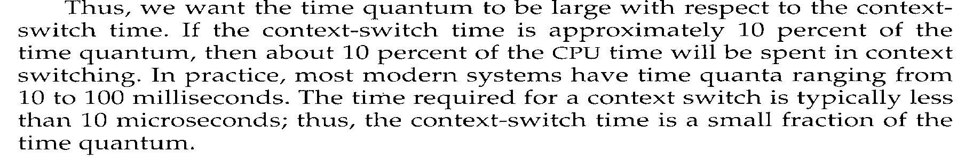
Time Quantum and Context Switch Time
Finish in
>1 Q
2 Q+Ov
10 Q+Ov
- Setting quantum too short → many process switches → lowers the CPU efficiency. Suppose: quantum = 20 msec. process switch = 5 msec. This yields a 20% CPU waste time and 80% usage.
- Setting the quantum too long → may cause poor response time to short interactive requests (e.g. 500 msec. And 5 → CPU wasted time less than 1%

Slide 24

Turnaround Time Varies With The Time Quantum
Turnarround time depends on size of quantum .
Average turnaround time does not necessarily improves as time quantum size increase.
Example1: Q = 1 and 3 processes of 10 time units each--→ average turnaround time = 29 msec
Example2: Q = 10 and 3 processes of 10 time units each--→ average turnaround time = (10+20+30)/3=20 msec
In general aveage Turnaround time can be improved if most processes finish their next CPU burst in a single Quantum.

Slide 25
Multilevel Queue Scheduling
Suitable for the case where processes can be classified in different groups according to some process criteria (type, size, priority,... )
Ready queue is partitioned into separate queues according to response time requirement . Processes have different scheduling needs:
  foreground (interactive) -high response time and have external priority
  background (batch) – has less interaction and less priority
Each queue has its own scheduling algorithm
  foreground – RR
  background – FCFS
Scheduling must be done between the queues. Two possibilities
  1) Fixed priority scheduling; (i.e., serve all from foreground then from background). Possibility of starvation.
    If a student process is running and an interactive process enters the ready queue, the student process will be preempted.
    Means that no process can run from batch if processes exist in the higher priority queues--→ Starvation is possible

Slide 26
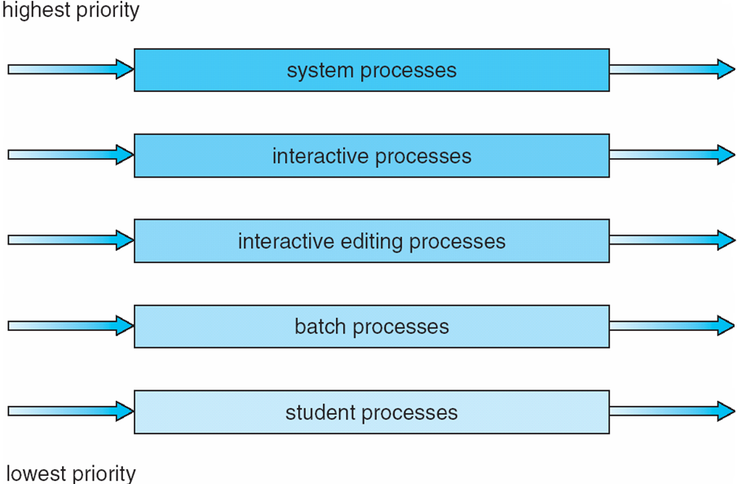
Multilevel Queue Scheduling(cont.)
  2) Time slice – each queue gets a certain amount of CPU time which it can schedule amongst its processes; i.e., 80% to foreground in RR and 20% to background in FCFS
Problem: normally a process enters a queue will remain there. System does not move it from queue to queue!. Permanent queue assignment

Slide 27
Multilevel Feedback Queue Scheduling
A process can move between the various queues:
  Separate processes according to their CPU bursts characteristics
    If a process uses too much CPU, move it to lower priority queue
  Use aging to prevent starvation
    If a process stay too long to get CPU, move it to higher priority queue
Multilevel-feedback-queue scheduler defined by the following parameters:
  number of queues
  scheduling algorithms for each queue
  method used to determine when to upgrade a process
  method used to determine when to demote a process
  method used to determine which queue a process will enter when that process needs service

Slide 28
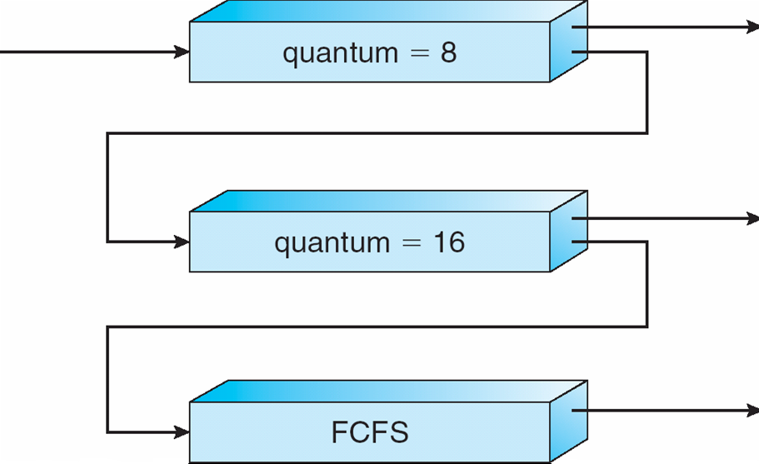
Example of Multilevel Feedback Queue
Three queues with different Q and priority and scheduling algorithm:
  Q₀ – RR with time quantum 8 milliseconds (Highest priority)
  Q₁ – RR time quantum 16 milliseconds
  Q₂ – FCFS (Lowest priority)
Scheduling
  A new job enters queue Q₀ which is served FCFS basis . When it gains CPU, job receives 8 milliseconds. If it does not finish in 8 milliseconds, job is moved to queue Q₁.
  At Q₁ job is again served FCFS basis and receives 16 additional milliseconds. If it still does not complete, it is preempted and moved to queue Q₂.
Short Process has higher priority:
Always run processes in Q₀
Only when Q₀ is empty, processes in Q₁ or Q₂ (if Q₁ is empty)get CPU
Preempt running process from Q₁ or Q₂ when a process enters Q₀

Slide 29
Multiple-Processor Scheduling
CPU scheduling more complex when multiple CPUs are available
Homogeneous processors within a multiprocessor. We can choose any processor to run a process because they are the same but when one processor has different i/o devices attached to it and a process needs a specific device, then that process must run on that processor.
Asymmetric multiprocessing – master-slave relationship between processors. Only one processor (master) accesses the system data structures to choose a processor (slave) to host (run) a process, alleviating the need for data sharing. Scheduling is central → easy
Symmetric multiprocessing (SMP) – each processor is self-scheduling, all processes in common ready queue, or each has its own private queue of ready processes. Multiple schedulers → cooperation between them must ensure that no more than one schedule selects the same process to run and hence we avoid having same process run on multiple processors.
Processor affinity – process has affinity for processor on which it is currently running. Keep the process run on the scheduled (chosen) processor until it is terminated. Don’t migrate a process to another processor because Cache memory contents will be invalid on another process if that content is not populated (migrated), too. Invalidating and re-populating of cache memory is costly and takes time.
  soft affinity- OS may decide to migrate a process to run on another processor. E.g. to balance load on processors.
  hard affinity- OS guarantees to keep process run on the same processor for the whole duration.

Slide 30
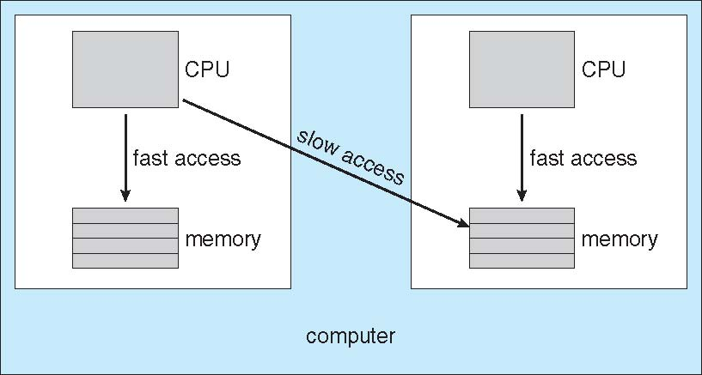
NUMA and CPU Scheduling

Slide 31
Multicore Processors
Recent trend to place multiple processor cores on same physical chip
Faster and consume less power
Multiple threads per core also growing
  Takes advantage of memory stall to make progress on another thread while memory retrieve happens

Slide 32

Multithreaded Multicore System

Slide 33
End of Chapter 5

Slide 34
Thread Scheduling
Distinction between user-level and kernel-level threads
Many-to-one and many-to-many models, thread library schedules user-level threads to run on LWP
  Known as process-contention scope (PCS) since scheduling competition is within the process
Kernel thread scheduled onto available CPU is system-contention scope (SCS) – competition among all threads in system

Slide 35
Pthread Scheduling
API allows specifying either PCS or SCS during thread creation
  PTHREAD SCOPE PROCESS schedules threads using PCS scheduling
  PTHREAD SCOPE SYSTEM schedules threads using SCS scheduling.

Slide 36
Pthread Scheduling API
#include <pthread.h>
#include <stdio.h>
#define NUM THREADS 5
int main(int argc, char *argv[])
{
int i;
pthread t tid[NUM THREADS];
pthread attr t attr;
/* get the default attributes */
pthread attr init(&attr);
/* set the scheduling algorithm to PROCESS or SYSTEM */
pthread attr setscope(&attr, PTHREAD SCOPE SYSTEM);
/* set the scheduling policy - FIFO, RT, or OTHER */
pthread attr setschedpolicy(&attr, SCHED OTHER);
/* create the threads */
for (i = 0; i < NUM THREADS; i++)
pthread create(&tid[i],&attr,runner,NULL);

Slide 37
Pthread Scheduling API
/* now join on each thread */
for (i = 0; i < NUM THREADS; i++)
pthread join(tid[i], NULL);
}
/* Each thread will begin control in this function */
void *runner(void *param)
{
printf("I am a thread\n");
pthread exit(0);
}

Slide 38
Operating System Examples
Solaris scheduling
Windows XP scheduling
Linux scheduling

Slide 39
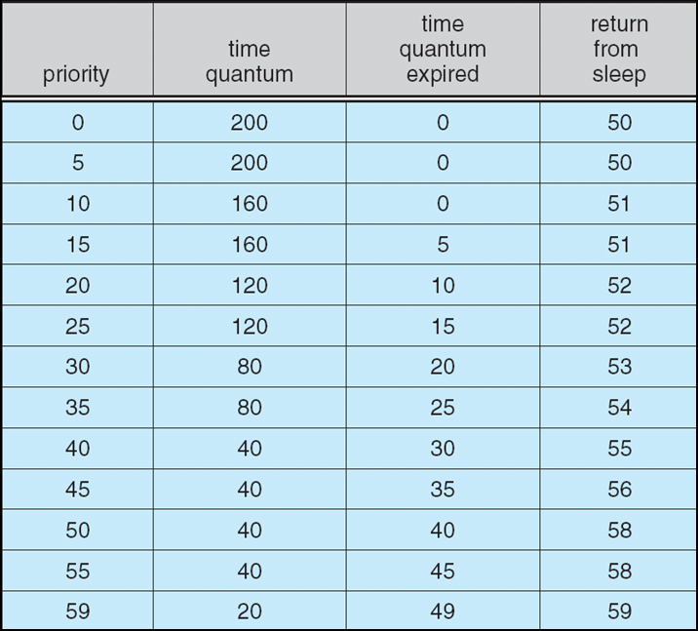
Solaris Dispatch Table

Slide 40
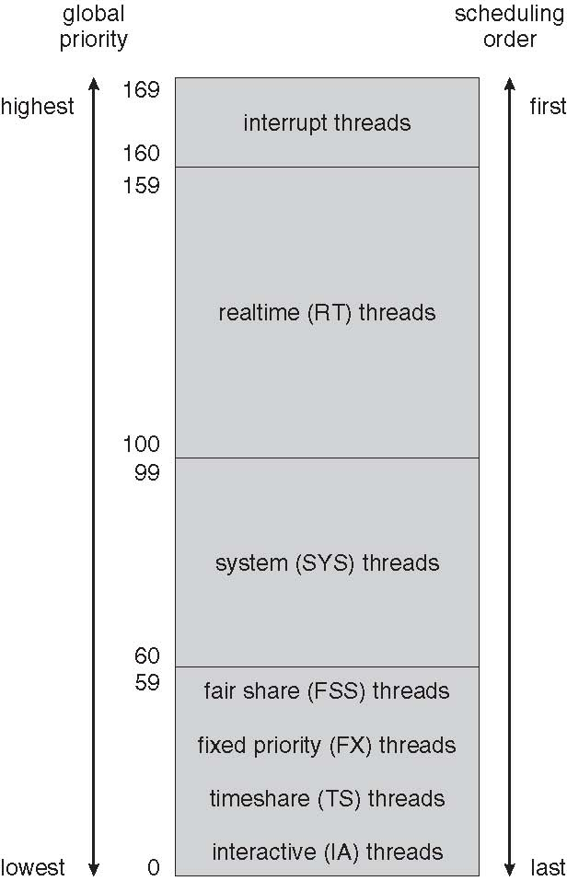
Solaris Scheduling

Slide 41
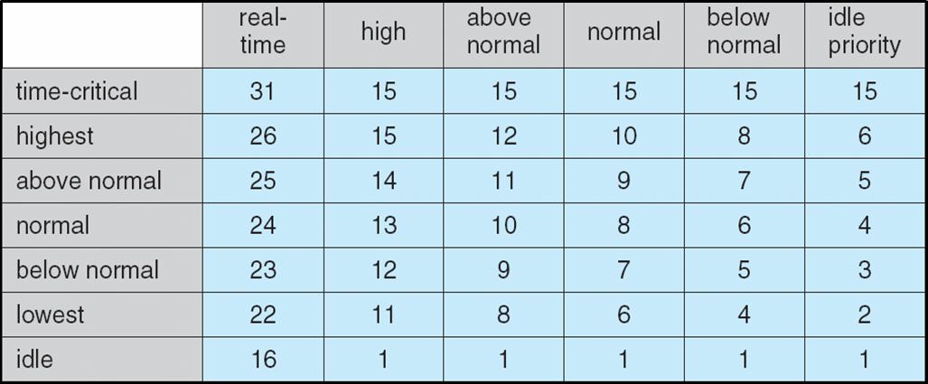
Windows XP Priorities

Slide 42
Linux Scheduling
Constant order O(1) scheduling time
Two priority ranges: time-sharing and real-time
Real-time range from 0 to 99 and nice value from 100 to 140
(figure 5.15)

Slide 43
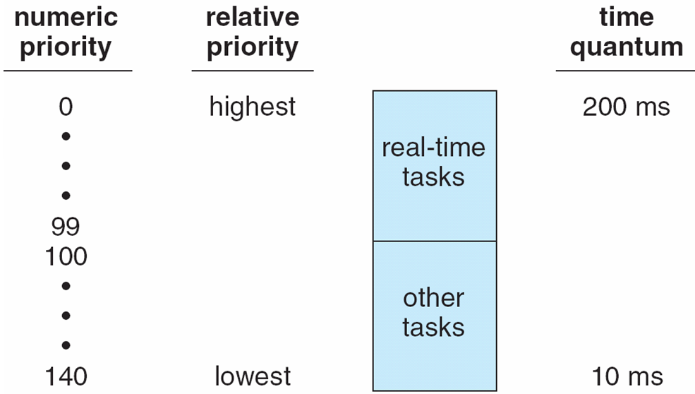
Priorities and Time-slice length

Slide 44
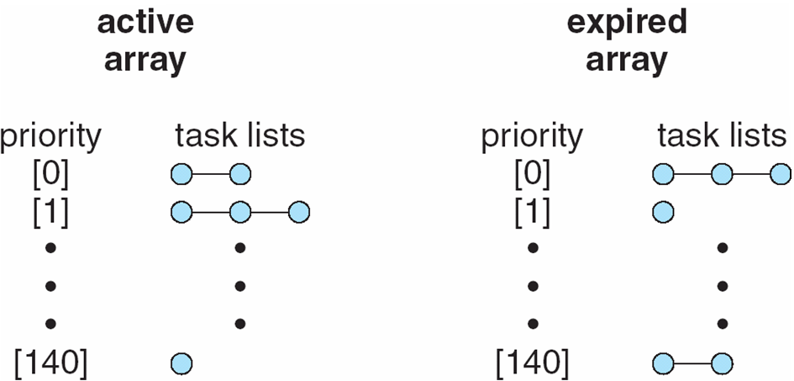
List of Tasks Indexed According to Priorities

Slide 45
Algorithm Evaluation
Deterministic modeling – takes a particular predetermined workload and defines the performance of each algorithm for that workload
Queueing models
Implementation

Slide 46
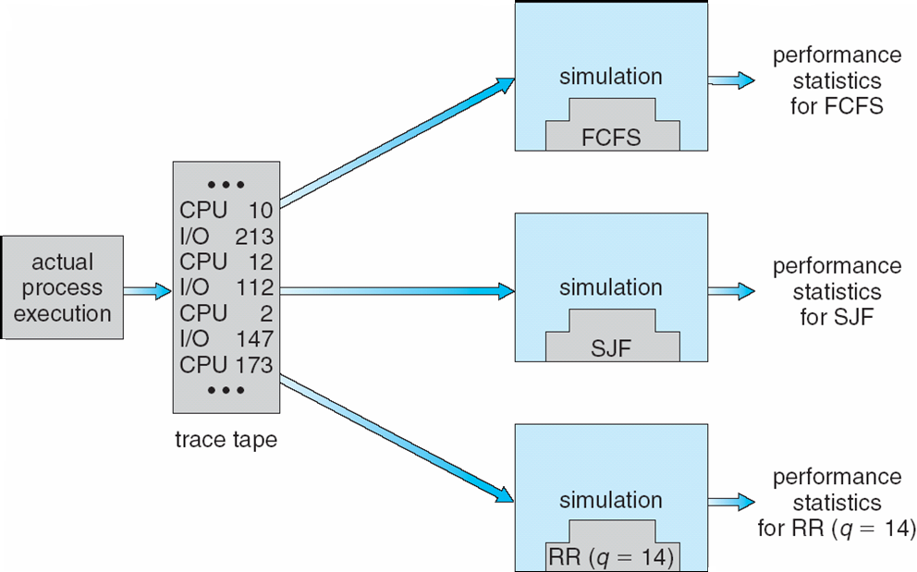
Evaluation of CPU schedulers by Simulation

Slide 47
End of Chapter 5

Slide 48
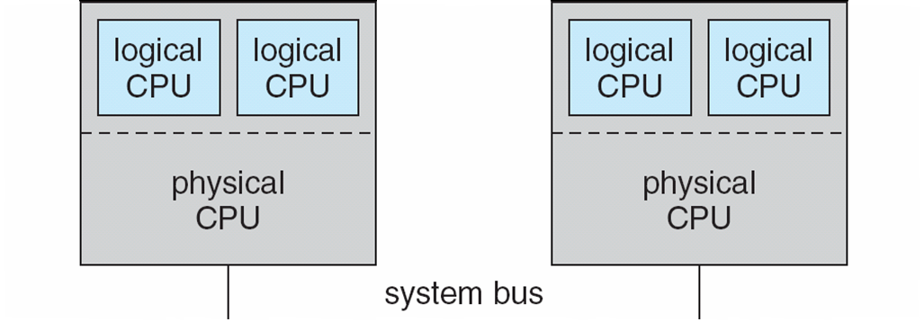
5.08

Slide 49
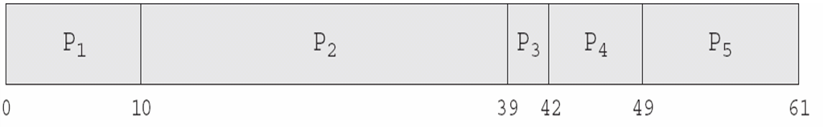
In-5.7

Slide 50
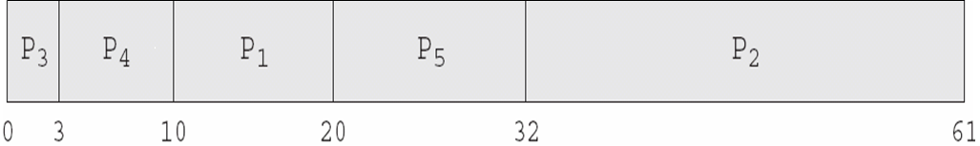
In-5.8

Slide 51

In-5.9

Slide 52

Dispatch Latency

Slide 53
Java Thread Scheduling
JVM Uses a Preemptive, Priority-Based Scheduling Algorithm
FIFO Queue is Used if There Are Multiple Threads With the Same Priority

Slide 54
Java Thread Scheduling (cont)
JVM Schedules a Thread to Run When:
  The Currently Running Thread Exits the Runnable State
  A Higher Priority Thread Enters the Runnable State
* Note – the JVM Does Not Specify Whether Threads are Time-Sliced or Not

Slide 55
Time-Slicing
Since the JVM Doesn’t Ensure Time-Slicing, the yield() Method
May Be Used:
while (true) {
// perform CPU-intensive task
. . .
Thread.yield();
}
This Yields Control to Another Thread of Equal Priority

Slide 56
Thread Priorities
Priority Comment
Thread.MIN_PRIORITY Minimum Thread Priority
Thread.MAX_PRIORITY Maximum Thread Priority
Thread.NORM_PRIORITY Default Thread Priority
Priorities May Be Set Using setPriority() method:
setPriority(Thread.NORM_PRIORITY + 2);

Slide 57
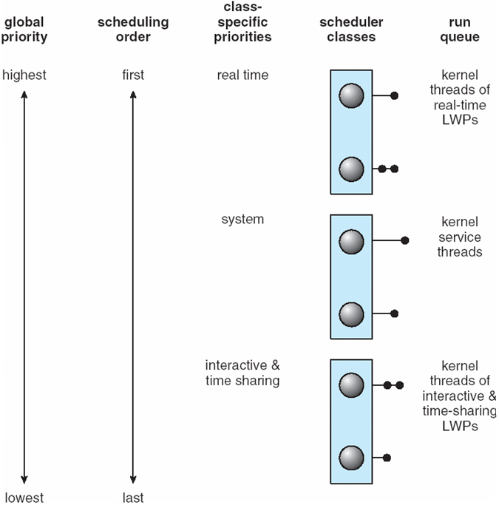
Solaris 2 Scheduling

