Slide 1
Chapter 6: Process Synchronization

Slide 2
Module 6: Process Synchronization
Background
The Critical-Section Problem
Peterson’s Solution
Synchronization Hardware
Semaphores (End of Chapter)
Classic Problems of Synchronization
Monitors
Synchronization Examples
Atomic Transactions

Slide 3
Objectives
To introduce the critical-section problem, whose solutions can be used to ensure the consistency of shared data
To present both software and hardware solutions of the critical-section problem
To introduce the concept of an atomic transaction and describe mechanisms to ensure atomicity

Slide 4
Background- Preemptive and Nonpreemptive Kernel
OS itself consists of many moduls (processes) that may run concorrently. What can happen to the shared data structures of the OS kernel? Say Process table, File table, memory allocation table.. etc?
There are 2 types of Kernel: preemptive and nonpreemptive
A preemptive kernel preempts a process while it is running in kernel mode
  Must be carefully designed to ensure that kernel shared data are free from race conditions especially on SMP architectures.
  More suitable for real time programming as it allows preemption
  May be more responsive (a process can’t run for long period)
A nonpreemptive kernel allows a process to run until it exits kernel mode, block, or voluntarily yields control of CPU.
  Because there is max one process in kernel mode, it is free from race conditions (situation to be controlled ) on kernel Data structure.
In both type of Kernel, user process can suffer from Race condition which occurs already on the producer-consumer problem. Do you still remember? It leads to inconsistency of data (in, out, count?

Slide 5
Background
Concurrent access to shared data may result in data inconsistency
Maintaining data consistency requires mechanisms to ensure the orderly execution of cooperating processes. Producer-Consumer is an example of cooperating processes where data consistency is an important issue:
  Compiler produces assembly code that is consumed by the assembler
  Web-server provides HTML files that is read by the internet browser
  Sharing access to spooling directory, array, booking system , etc
Suppose that we wanted to provide a solution to the consumer-producer problem that fills all the buffers. We can do so by having an integer count that keeps track of the number of full buffers. Initially, count is set to 0. It is incremented by the producer after it produces a new buffer and is decremented by the consumer after it consumes a buffer.
Producer
Consumer
Buffer

Slide 6
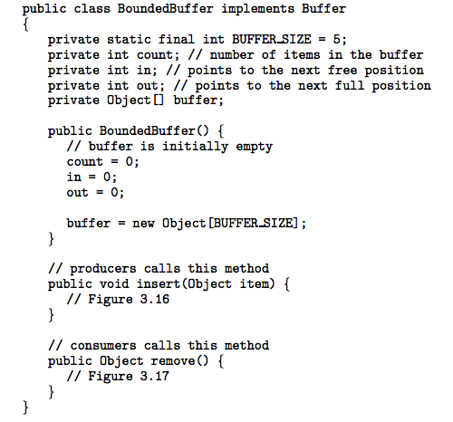
Bounded-Buffer – Shared-Memory Solution
Producer
Full
Count = size
R
A
B
Buffer
w
Synchronization
Empty
Count = 0
Consumer

Slide 7
Bounded-Buffer – Producer
while (true) {
/* produce an item and put in nextProduced */
while (count == BUFFER_SIZE)
; // do nothing
buffer [in] = nextProduced;
in = (in + 1) % BUFFER_SIZE;
count++; //Do further
}
Shared
Bounded-Buffer – Consumer
while (true) {
while (count == 0)
; // do nothing
nextConsumed = buffer[out];
out = (out + 1) % BUFFER_SIZE;
count--;
/* Do further*/
}
Code correct? Yes but Only if no concurrency. What can happen
if P and C run concurrently or multiple P or C run concurrently?

Slide 8
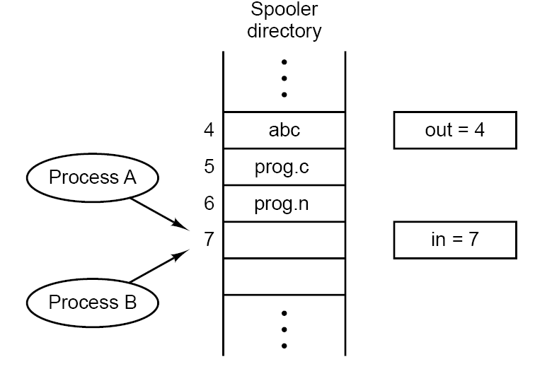
Producer-Consumer Problem
Sharing access to spooling directory, array, booking system , etc should be controlled to avoid problems!!! Data inconsistency problem
Public void insert (object item) {
While (!(full()){ //(in+1) % Size) == out
buffer[in] = item; //produce an item
in = in+1; //in = (in+1)%BUFFER_SIZE
count++;
}
- CPU runs Proc A
  - stores item (file X) in slot 7
-CPU Switches from Proc A to Proc B
  stores item (file Y) in slot 7
  update in to be 8
  Increment count
-CPU Switches back to Proc A
  – updates in to be 8……
The final result: file x will NEVER be printed
in variable is shared and should be handled in a critical section where using in is guaranteed to be exclusive (one and only one process can use it at a time.

Slide 9
Sharing Problems
Problems with Shared Variables
  possible context switch by time-out at end of every instruction
  Data may become inconsistent if shared variables are updated without proper control
Hardware Machine-Level Solution
  disable interrupt to ensure in-order execution of sequence of instructions (Critical section) without preemption (eg. count++).
    Work on multiprocessors? Not feasible and decreases efficiency of system
  atomic instructions
    Prevent preemption while executing instruction
  but, how can programmers control this?
Operating System Solution
  mark the shared instructions as a special section (critical section controlled by mechanism (IPC) which has
    entry code for entering critical section
    exit code after exiting critical section
  allow one process to execute the CS at a time and prevent others
  other processes are put into blocked state while the chosen one runs.

Slide 10
Race Condition
Race Condition is a situation that occurs when two or more concurrently processes are access (reading or writing) some shared data and the final results (outcome of the final result) depends on who runs precisely when (order of scheduling) . It leads to data inconsistency and should be avoided by guaranteeing that the communicating process are synchronized and coordinating in some way.
count++ could be implemented as 3 primitive operations (remember cpsc-204)
register1 = count
register1 = register1 + 1
count = register1
count-- could be implemented as
register2 = count
register2 = register2 - 1
count = register2
Consider this execution interleaving with “count = 5” initially:
  S0: producer execute register1 = count {register1 = 5}
  S1: producer execute register1 = register1 + 1 {register1 = 6}
  S2: consumer execute register2 = count {register2 = 5}
  S3: consumer execute register2 = register2 - 1 {register2 = 4}
  S4: producer execute count = register1 {count = 6 }
  S5: consumer execute count = register2 {count = 4}
If we reversed S4 and S5 (P runs before C) the outcome will be wrong (data inconsistence). Remember Context switch can occur at any time!!!!

Slide 11
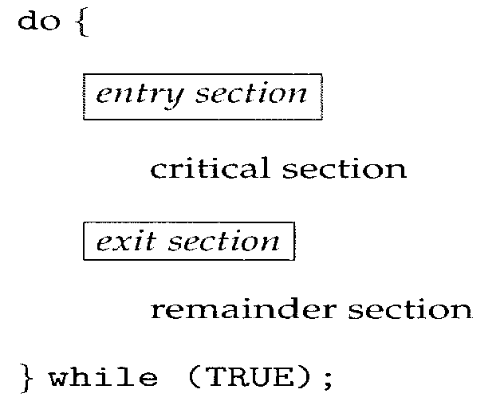
Critical Section
Let’s study the race condition situation more deeply to guard against it because Sharing for variable, files, … is needed everywhere.
Avoiding is possible if we guard the shared region (critical section (CS).
CS similar problem: “Design a protocol for a shared room in an apartment where no more than one person can be inside the room at any time”? Shared room is the CS which needs permission to use it alone and when you finished just give others the chance to use it. Mutual exclusive Solution? You inside, others outside. Buy LOCK or Don’t Disturb sign and use the shared room without race condition.
The general structure of a typical process Pi consists of many sections which consists of non-critical and critical (or mix of them) sections (regions). To enter CS a process needs permission (entry section). After it uses the critical section it release CS (exit section)
buf [in] = nextP;//produce item
in = (in + 1) % BUF_SIZE;
nextC = buf[out];//consume item
out = (out + 1) % BUF_SIZE
Count++
Count--
readLine()….
Println()….

Slide 12
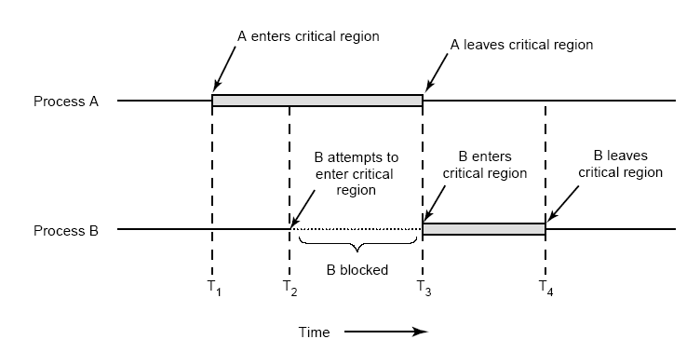
Critical Section (Cont.)
Critical section is part of program (process) where the shared data should be accessed in a mutual exclusion manner (besides other conditions) which guarantees that one and only one process is using the CS and the other processes are excluded from doing the same (they should be outside CS).
Following figure shows mutual exclusion using critical section.
Mutual exclusion is one condition from 3 to solve Critical section problem where racing does occur!

Slide 13
Solution to Critical-Section Problem
We can guard against race conditions if we designed a CS for which the following 3 conditions are hold:
Mutual Exclusion - If process P_{i} is executing in its critical section, then no other processes can be executing in their critical sections
“No two processes may be simultaneously inside their CS”
Progress - If no process is executing in its critical section and there exist some processes that wish to enter their critical section, then the selection of the processes that will enter the critical section next cannot be postponed indefinitely
“No process running outside its CS may block other process”.
Bounded Waiting - A bound must exist on the number of times that other processes are allowed to enter their critical sections after a process has made a request to enter its critical section and before that request is granted
“Fairness: No process should have to wait forever to enter CS”
  Assume that each process executes at a nonzero speed
  “No assumption about relative speed of the N processes and number of CPUs”

Slide 14
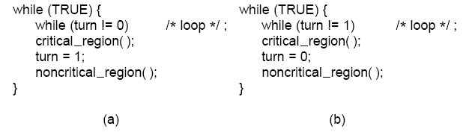
Critical section Solutions with bugs
while (TRUE){
while (turn != 0) //loop
; /* Do nothing*/
turn = 1; //Enter section
critical_region( );
turn = 0; //Exit section
noncritical_region( ); }
Lock Variable solution:
Process use Lock
  Lock = 0 if lock is opened,
  Lock = 1 if the lock is in use
1-Lock solution is not acceptable as
it is possible to have more than one
process inside CS because CPU can
be switched on after seeing lock=0
and before setting lock =1. This solution violates condition 1
2- Strict Alternate solution: requires that two processes strictly alternate in entering their CS. It depends on using a variable “turn” which keeps track of who is using it. The one who has it, can enter CS. This is my turn!
Suppose that P0 finishes it CS quickly and both P0 and P1 are in their non-critical section. Now P0 can not reenter its CS since P1 is slower in executing its non-critical section. This solution violates condition 2.
Mutual exclusion Proof: turn can’t be both 0 and 1 at a time
Bounded Waiting Proof: while P0 waits, P1 can enter at most once and vice versa

Slide 15
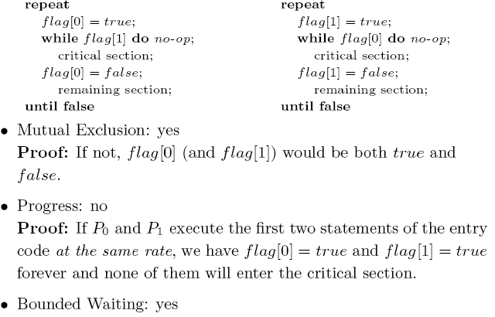
Critical section Solutions with bugs (cont.)
P0
P1
Both set or unset flag[i] if they are interested in CS or not and each check others interest flag[j] (where j =i-1) to enter CS;
Is there any correct solution. Any Algorithm for solving CS problem & satisfy all 3 conditions? YES

Slide 16
Peterson’s Solution
It is restricted to 2 processes that alternate execution between CS and RS (Reminder Section). But It can be extended for the case of many process.
It assumes that the LOAD and STORE instructions are atomic; that is, cannot be interrupted. If they are not atomic, produce incorrect result!
The two processes share two variables:
  int turn; // stores the ID of the process whose turn to enter CS. Turn can either be 0 or 1. it stores the last value set by either P₀ or P₁!!
  Boolean flag[2]; // interested process which are ready to enter CS
do {
flag[ i ] = TRUE;
turn = j;
while (flag[ j ] && turn == j)
; //Do nothing
critical section
flag[ i ] = FALSE;
remainder section
} while (TRUE);
P_{i=0} (other=j=1)
Flag[0] = true
turn = 1; //other can enter if it is interested
//P₀ is inside CS
//leave CS
//flag[0] = false
P_{i=1} (other=j=0)
Flag[1] = false
turn = 0;
//P₁ can’t enter CS. Only after P₀ leaves CS, P₁ can enter CS. This can happen when P₀
set flag[0] = false

Slide 17
Prove for Peterson’s Solution
The prove that Peterson’s solution is correct:
  Mutual Exclusion: if one process P_{i} (P₀ )is inside CS , the other process P_{j} (P₁ ) will be blocked in the while() and it waits (do nothing). It waits till flag[] is reset by P_{i} when it leaves the CS.
    It is possible for both process to set flag[i or j] = true but
    impossible for turn to have 2 values (0 and 1)!!! Either 0 or 1
  Progress: Since P_{i} does not change the value of variable turn while executing the while statement, it will prevent the other process P_{j} from entering CS while it does some progress in CS.
    If P₁ does not attempt to enter (very slow in remaining section), P₀ can enter repeatedly with flag[1] = false ( and vise versa)
    If both P₀ and P₁ attempt to enter, we will have both flag[0] = true and flag[1] = true. But turn will be either 0 or 1 because of the atomicity of store operation. One of P₀ and P₁ will enter in finite time.
  Bounded Waiting: no process that is not using CS is preventing the other ready or interested one. P_{j} will enter the CS after at most one entry by P_{i}
    While P₀ is waiting at while statement, we must have flag[1] = true and turn = 1. This allows P₁ to enter at most once because flag[0] = true and, before P₁ tries to enter again, it will set turn to 0

Slide 18
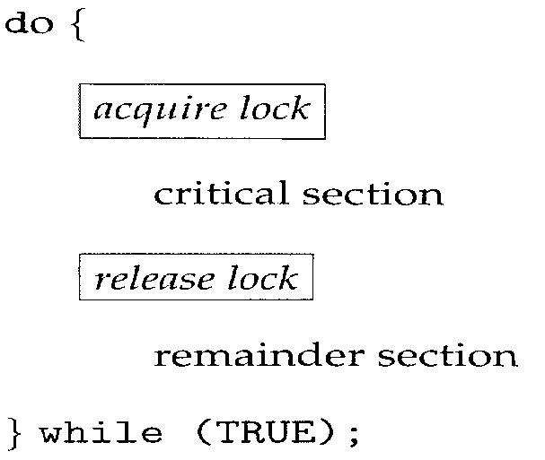
Lock with busy waiting/Blocking primitives
All solutions to CS problem like Peterson’s solution depends on Lock to coordinate access to shared variable (memory).
IPC based on busy waiting solutions wastes CPU time (continuously testing Lock (looping) that leads to unproductive CPU usage). It also can have unexpected effects especially when the scheduler is based on priority.
  Suppose that 2 processes H with high priority and L with low priority are sharing data based on any busy waiting solution.
  If L is in CS and H wants to enter its CS, CPU will be given to H but nothing will happen because L will not get the chance to leave its CS.
  This situation is called priority inversion problem.
  Some IPC solutions provide primitives that block the caller process if another process is using CS. The blocked process will be awaked up when the one using the CS is finished. This wouldn’t waste CPU time.
Peterson’s is a software solution that use LOCK

Slide 19
Synchronization Hardware
Many systems provide hardware support for solving critical section problem. Without Hardware feature, programming is possible but difficult!
Uniprocessors – could prevent (disable) interrupts from occurring while a shared variable is being used (Disable interrupts – run CS – enable)
  CS code would execute without preemption and hence prevents race condition
  This approach is taken by the nonpreemptive Kernel
  Generally disabling interrupts on multiprocessor systems is too inefficient because of message passing delays between processors.
    Operating systems using this not broadly scalable
Solution: Modern machines provide special atomic hardware instructions
    Atomic = non-interruptible (means instructions will be executed without interference. Actually those type of instructions are doing 2 functions ---- 2-in-1! (Do you remember primitive operations cpcs204)
  Either test memory (1st function) word and set value (2nd function)
  Or swap contents of two memory words. Operates on contents of 2 words

Slide 20
TestAndndSet() and Swap() Instruction
boolean TestAndSet (boolean *target)
{// returns current value of lock & changes it to true
boolean rv = *target;
*target = TRUE;
return rv;
}
CS solution based on TestAndndSet (satisfies only mutual exclution)
Shared boolean variable lock., initialized to false.
do {
while ( TestAndSet (&lock ) )
; // do nothing
// critical section
lock = FALSE;
// remainder section
} while (TRUE);
void Swap (boolean *a, boolean *b)
{// Swap values of variables A & B
boolean temp = *a;
*a = *b;
*b = temp;
}
CS solution based on Swap() (satisfies only mutual exclution)
Shared boolean variable lock., initialized to false. Each process has a local Boolean variable key
do {
key = TRUE;
while ( key == TRUE)
Swap (&lock, &key );
// critical section
lock = FALSE;
// remainder section
} while (TRUE);

Slide 21

Bounded-waiting Mutual Exclusion with TestandSet()
do { //satisfy all 3 conditions
waiting [ i ] = TRUE;
key = TRUE;
while (waiting [ i ] && key)
key = TestAndSet(&lock);
waiting[ i ] = FALSE;
// critical section
j = (i + 1) % n;
while ( ( j != i ) && !waiting[ j ] )
j = (j + 1) % n;
if ( j == i )
lock = FALSE;
else
waiting[ j ] = FALSE;
// remainder section
} while (TRUE);

Slide 22
Semaphore
Semaphore is a special data type for process synchronization in OSs and concurrent programs. It provides a low-level synchronization mechanism.
Semaphore
  integer variable S and can only be accessed via two indivisible (atomic) operations wait() and signal() that modify S. S has initial positive value.
OS implement it either using busy waiting or blocking. Little tiny differences between them exist but atomicity is ensured and their usage is the same:
  Can a semaphore S (integer value) have negative numbers? Busy never
  Does a semaphore have a queue associated with it? Yes for Blocking
Busy waiting implementation→ called Spinlock (process spins while waiting)
  wait(): while (s <= 0) wait until another process increments S (do signal); then s--;
  signal(): s++; increments S to signal other waiting process for S to become > 0
  If one process modifies S value, no other process can simultaneously modify it. Wait() and Signal() can’t be executed simultaneously.
  wait (S) {
  while S <= 0
  ; // no-op
  S--;
  }
  signal (S) {
  S++;
  }
  (Test and S-- ) are indivisible (uninterruptable)

Slide 23
Semaphore (Cont.)
  Does Busy waiting wastes CPU time? YES but if CS is too short it is a acceptable solution especially in SMP environment. A process Spins on one processor and executes CS on another processor. Context switch may take considerable time than testing lock for short time. Therefore, spinlocks can be advantageous, too. What If CS is too long? Efficiency?
Blocking implementation needs a semaphore queue (waiting queue)
  wait(): Block the caller if S is not positive and put it in the waiting queue (preempt CPU and let scheduler chooses another process). Process state is changed to waiting till another process signal().
  signal(): increments S and if any waiting process does exist, wake up it (change process state from waiting to ready to be rescheduled again)
  S may become negative. Magnitude equal number of waiting processes
  Semaphore waiting queue can be implemented by a link field in each process PCB.
    Each semaphore contains an integer and a pointer to a list of PCBs
    Any queue discipline can be implemented but to ensure bounded waiting condition use FIFO
wait (S) {
s = s - 1;
if (s < 0)
block current process
and put it in the queue;}
  signal (S) {
s = s + 1;
if (s <= 0) // never block
remove a process from
queue and wake it up;}
queue

Slide 24
Semaphore (Cont.)
Blocking implementation needs a semaphore queue (waiting queue)
  If one process modifies S value, no other process can simultaneously modify it. Wait() and Signal() can’t be executed simultaneously. (unfortunately we can’t ensure that without busy waiting!)
    On a single processor, Inhibiting interrupt during the time of wait() and signal() are executed and thereby instructions from different processes can’t interleaved. This means that busy waiting is needed during CS entry( wait() ) and leave( signal() ) but not inside CS. That is a gain, for sure.
    On a Multiprocessor, Inhibiting interrupt is a must to avoid interleaving instructions but it is very difficult task. Therefore SMP provides spinlocks to ensure that wait() and signal() are performed atomicity.
  If CS is too short, context switch will occur frequently but if context switch takes longer time than CS, semaphore processes will suffer (bad situation) but others processes in the system finally get the CPU and that was the goal to increase CPU efficiency.
wait (S) {
s = s - 1;
if (s < 0)
block current process
and put it in the queue;}
  signal (S) {
s = s + 1;
if (s <= 0) // never block
remove a process from
queue and wake it up;}
queue

Slide 25
Semaphore usage as General Synchronization Tool
1- Binary semaphore – integer value can range
only between 0 (means Taken and 1 Not Taken);
can be simpler to implement
  Also known as mutex locks
  Used to solve mutual exclusion
2- Counting semaphore – integer value S can range over an unrestricted domain
  Used for access control to a resource having finite number of instances.
    Semaphore initialized to number of instances of the resource.
      Count = n (means that all resources are available for processes).
      Count = 0 (means all resources are busy and in use-> wait() blocks caller until Count becomes positive ( when one process signal()).
    When a process needs a resource, it wait(). (test count and count--)
    When it finishes using it, it releases it by signal(). (Only count++)
3-Synchronization: Synch = 0,concurrently Processes P1 and P2 -> st2 after st1
  Semaphore mutex=1
  do {
  //Non-Critical Section
  wait (mutex);
  // Critical Section
  signal (mutex);
  // remainder section
  } while (TRUE);
  Statement1;
  signal (Synch);
  wait (Synch); Statement2;

Slide 26
Deadlock and Starvation
Deadlock – is an unpleasant situation where two or more processes are waiting indefinitely for an event that can be caused by only one of the waiting processes
It can occur when 2 process P₀ and P₁ are using 2 semaphores for synchronizing. Let S and Q be two semaphores initialized to 1
P₀ P₁
wait (S); wait (Q);
wait (Q); wait (S);
. .
. .
. .
signal (S); signal (Q);
signal (Q); signal (S);
What can happen if S initialized to 1 and Q initialized to 2!!!?
Starvation – indefinite blocking. A process may never be removed from the semaphore queue in which it is suspended. What should the “correct” queuing policy be?
Priority Inversion - Scheduling problem when lower-priority process holds a lock needed by higher-priority process
  1- Suppose P₀ is scheduled and execute wait(S).
  2- Now P₁ is selected to use CPU and wait(Q) and then wait(S). Now it is blocked because S = 0.
  3- Scheduler switches to P₀ and executes wait(Q) which blocks P_{0.}
  4- now Both S and Q = 0 and can’t be signaled (incremented).
  5- Both processes sleep forever. Deadlock

Slide 27
More Synchronization Examples
Semaphores
  Bounded buffer
  Readers-writers
  Dining philosophers

Slide 28
Classic Problem: Bounded Buffer
N buffers, each can hold one item
  One process consuming items
  from a buffer
  Other process producing items
  into a buffer
Need to ensure proper behavior when
buffer is
  Full: Blocks producer
  Empty: Blocks consumer
Need to provide mutually exclusive
access to buffer (e.g., queue)
Can solve with semaphores
    Semaphore mutex initialized to the value 1
    Semaphore full initialized to the value 0
    Semaphore empty initialized to the value N
Illustrates some different uses of semaphores: mutual exclusion, and counting.
Producer
Full
Count = size
R
A
B
Buffer
w
Synchronization
Empty
Count = 0
Consumer
Notes:
The solution that follows on the next slide solves a problem I hadn’t solved in my earlier bounded buffer/semaphore solution. It blocks the consumer when there is no item ready to be consumed.

Slide 29
Bounded Buffer Problem
// semaphores & data buffer shared across Processes(threads)
semaphore empty(BUFFER_LENGTH);
semaphore full(0);
semaphore mutex(1); // mutual exclusive access to buffer
// producer
do {
  // produce item
  wait(empty);
  wait(mutex);
  // c. s.
  // add item to buffer
  signal(mutex);
  signal(full);
while (true);
// consumer
do {
  wait(full);
  wait(mutex);
  // c. s.
  // remove item from buffer
  signal(mutex);
  signal(empty);
  // consume item
while (true);
Notes:
Supposing that there is a bounded buffer (e.g., an array), representing a queue, containing items. Array has length BUFFER_LENGTH.
Empty and full are being used as counting semaphores.
Mutex is being used as a lock.

Slide 30
Bounded Buffer Problem (Cont)
Semaphore should be used correctly in order to avoid DEADLOCK which can occur if each communicating process is waiting for an event that only another process can cause it, but that process is also waiting for an event from the other waiting one.
Suppose the wait() in the producer’s code are reversed in order. So mutex was decremented before empty instead of after it ( This means ->wait(mutex) then wait(empty))
  If the buffer were completely full, the producer would block with mutex = 0
  Now, the consumer tries to access the buffer, it does wait() on the mutex which equals 0. The consumer blocks too.
  Both processes are blocked forever and no work would be done!!!

Slide 31
Classic Problem: Readers-Writers
A data set is shared among a number of concurrent processes
  Readers – only read the data set; they do not perform any updates
  Writers – can both read and write
Problem – allow multiple readers to read at the same time. Only one single writer can access the shared data at the same time
  Multiple reader processes accessing data (e.g., a file)
  Single writer can be writing file
  Sometimes not just one process in critical section!
Shared Data
  Data set
  Semaphore mutex initialized to 1
  Semaphore wrt initialized to 1
  Integer readcount initialized to 0

Slide 32
Readers-Writers
semaphore wrt(1); // 1 writer or >=1 readers
semaphore mutex(1); // for test & change of readcount
int readcount = 0; // number of readers
// writer process
wait(wrt);
// code to perform
// writing
signal(wrt);
// reader process
wait(mutex);
readcount++;
if (readcount == 1) // first one in?
wait(wrt);
signal(mutex);
// code to perform reading
wait(mutex);
readcount--;
If (readcount == 0) // last reader out?
signal(wrt);
signal(mutex);
Notes:
This will starve writers if there is a steady stream of readers.

Slide 33
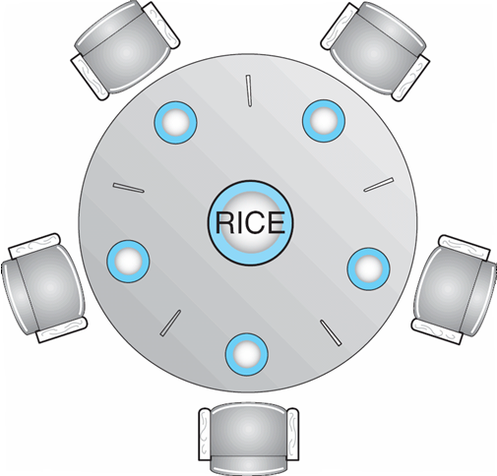
Classic Problem
Dining-Philosophers
  5 philosophers, eating rice, only 5 chopsticks
  Pick up one chopstick at a time
  What happens if each philosopher picks up a chopstick and tries to get a second?
Shared data
  Bowl of rice (data set)
  Semaphore chopstick [5] initialized to 1

Slide 34
Dining-Philosophers Problem (Cont.)
The structure of Philosopher i:
    do {
    wait ( chopstick[i] );
    wait ( chopStick[ (i + 1) % 5] );
    // eat
    signal ( chopstick[i] );
    signal (chopstick[ (i + 1) % 5] );
    // think
    } while (TRUE);

Slide 35
Problems with Semaphores
Incorrect use of semaphore operations:
  signal (mutex) …. wait (mutex)
  wait (mutex) … wait (mutex)
  Omitting of wait (mutex) or signal (mutex) (or both)

Slide 36
End
The End of this Chapter.
Solve Home work and deliver it on time

