Slide 1
Chapter 8: Main Memory

Slide 2
Chapter 8: Memory Management
Background
Swapping
Contiguous Memory Allocation
Paging
Structure of the Page Table
Segmentation
Example: The Intel Pentium

Slide 3
Objectives
To provide a detailed description of various ways of organizing memory hardware
To discuss various memory-management techniques, including paging and segmentation
To provide a detailed description of the Intel Pentium, which supports both pure segmentation and segmentation with paging

Slide 4
Background
Program must be brought (from disk) into memory and placed within a process for it to be run
CPU can access memory and registers directly
  Register access in one CPU clock (or less)
  Main memory can take many cycles
Cache sits between main memory and CPU registers
Protection of memory required to ensure correct operation
  Check each address generated by program running on CPU to see if it is within address space of process
    Address space is the set of addresses generated by a running program
  If not, generate an error(e.g., page fault or terminate the process)
CPU instruction execution cycle
  Repeat forever
    Check for hardware interrupts
    Fetch instruction from memory (RAM or cache)
    Decode instructions, may include fetching operands from memory
    Store results back to memory, if needed
Address Generation

Slide 5
Memory Management
Several programs (processes) and their data must be stored in Memory during execution to improve CPU utilization.
Memory (storage area) = array of bits from 0 → MAX_MEM
  Can we run our programs with only that mechanism? Sure not
  How could we address memory locations?
How should the OS manage memory? Why Memory Management?
  In order to run a user process, the operating system needs to
    allocate memory for the address space of the process, which consists of
      text
      initialized and uninitialized data
      stack for procedure calls and returns
      heap for dynamically allocated variables
  de-allocate the memory for the address space, when the user process is deleted.
  manage the entire physical memory for user processes so that multiple processes can share it.

Slide 6
Memory Management (Cont.)
Many Memory Management scheme (MMS) exist that reflect various approaches. Selection of MMS depends on many factors especially HW design. Each scheme requires its own HW support.
Requirements for Memory Management
  address binding
    determining the physical address for each memory reference in the program- be correct and flexible.
  sharing the physical memory between multiple user processes
  protection from illegal access
    preventing access from other processes
    preventing illegal operation from within the process
  Efficient use of physical memory: minimizing memory fragmentation (wasted memory space )
  fast access: do not slow down the memory access

Slide 7
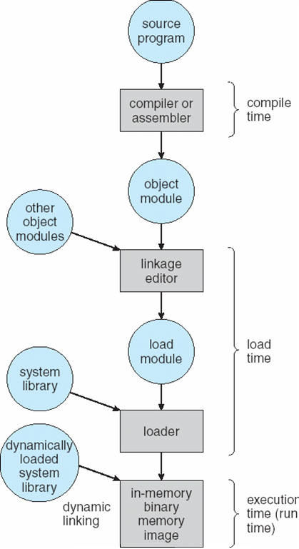
Binding of Instructions and Data to Memory
Address binding means converting the (relative or symbolic) address used in a program to an actual physical (absolute) RAM address
Address binding of instructions and data to memory addresses can happen at three different stages
  Compile time: If memory location known a priori, absolute code can be generated; must recompile code if starting location changes
  Load time: Must generate relocatable code if memory location is not known at compile time
  Execution time: Binding delayed until run time if the process can be moved during its execution from one memory segment to another. Need hardware support for address maps (e.g., base and limit registers)

Slide 8
Logical vs. Physical Address Space
The concept of a logical address space that is bound to a separate physical address space is central to proper memory management
  Logical/ virtual address – generated by process on the CPU and may needs translation to the actual physical memory address.
  Physical address – address seen by the memory unit. It is the value that is loaded into memory address register. Based on Offset value the logical address is translated (mapped) into the physical RAM of memory to access.
Logical (virtual) and physical addresses are
  same in compile-time and load-time address-binding schemes;
  differ in execution-time address-binding scheme. Need hardware support for address maps (e.g. base and limit registers).
The run-time mapping from logical to physical addressing is done by HW device called Memory Management Unit (MMU).
  There are many different mapping methods (Schemes).

Slide 9
Memory Management Hardware
Memory Management Unit (MMU)
CPU
Address generation:
CPU generates a logical address (a kind of relocatable address)
MMU translates logical address to physical address (an absolute address), and puts this in MAR
Physical address used to access RAM (i.e., load or store value at the physical address)
MAR= Memory Address Register
MAR
RAM
Address space: The set of addresses generated by a running program
Notes:
Omits consideration of cache memory

Slide 10
MMU: Memory Management Unit
MMU is a Hardware device that maps (converts) virtual address to physical address (address binding). This means that MMU translates logical addresses to physical addresses
  i.e., performs address binding
It also enables memory protection
MMU: Some MMU Possibilities
  Relocation register
  Base & limit register
  Page table support
  Segmentation support
Notes:
What is memory protection?
When I ask “why?” does the MMU need hardware support– what I’m trying to get them to consider are the alternatives to hardware support– i.e., using software

Slide 11

Memory-Management Unit (MMU)
In MMU scheme, the value in the relocation register (e.g base register) is added to every address generated by a user process at the time it is sent to memory.
  No Memory protection
The user program deals with logical addresses; it never sees the real physical addresses.
Logical address (0 - max) is mapped into physical memory in the range from (0 + R ) to ( R + max) for a base value R. User processes thinks it runs in memory location from 0 to max!

Slide 12

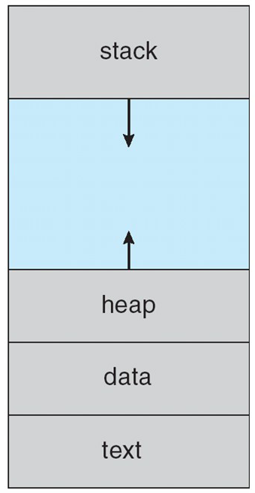
Base and Limit Registers
As a process is executed it accesses instructions and data from memory. Each process has its separate memory address space
Many Instructions of a process needs memory access to move data to and from CPU. Therefore, OS needs addressing scheme!
A pair of base and limit registers define the physical address space. Those registers determine the range of the legal memory address that a process can access( address space)--> HW protection
physical (base = min, limit = size ).
  requires that process be allocated to a contiguous series of physical memory addresses
o
MAX

Slide 13
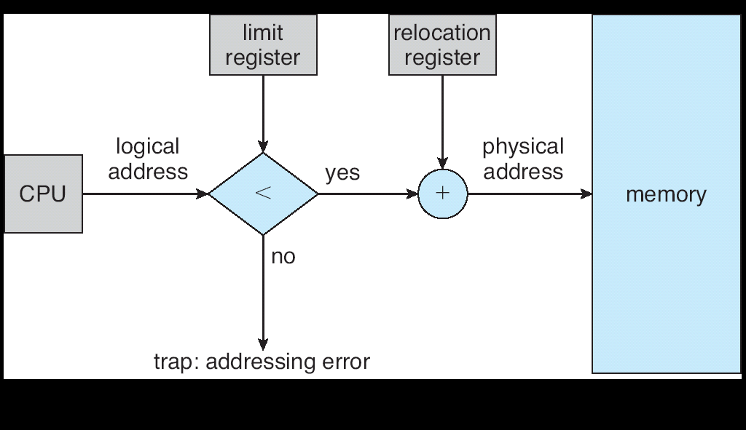
Memory Mapping and Protection
Main memory is usually divided into two partitions:
  Resident operating system, usually held in low memory with interrupt vector
  User processes then held in high memory
Base and Limit registers used to protect user processes from each other, and from changing operating-system code and data
  Base register contains value of smallest physical address
  Limit register (Size) contains range of logical addresses – each logical address must be less than the limit register
  This MMU scheme provides memory protection for the process, but note that it does no dynamic relocation

Slide 14

Memory Allocation
Classical Dynamic Storage Allocation Problem. Given that:
  single partition of storage space (memory) initially empty(hole)
  input queue of processes (job queue), each requiring a storage for its address space
    N of processes in the new state wants to enter ready state
How to satisfy a request of size n from a list of free holes?
  Devise an algorithm to satisfy as many as jobs as possible
RAM
Process
Where do we place a process in RAM?
Notes:
Let’s talk about where we should place a process in RAM

Slide 15
Design Issues for Memory Allocation
Is all of a program loaded into memory at once?
  YES: Then, is memory is allocated contiguously?
    A single sequence of physical addresses
    Or multiple, separated, sequences of physical addresses
  NO: Then
    When are the parts loaded into memory?
    How do we divide program into parts?
Does the program always stay in memory once loaded?
  What happens if we run out of memory?
These choices in memory allocation design
  affect how memory protection is implemented
  are affected by the hardware support available for memory management
Loading Entire Program at Once
  Two basic possibilities
    Contiguous memory allocation
    Non-contiguous memory allocation (e.g., paging)
Notes:
4/5/10. This was difficult to present last time. Perhaps a decision tree?

Slide 16
Contiguous Memory Allocation
All of program loaded into a single region of RAM
Relatively simple strategy-- memory protection can be provided by a MMU with base & limit registers
OS divides user memory up into relatively large partitions
Keeps a table of these partitions
One process per partition
Partition methods:
  Fixed size partitions
    When we have a single partition per process, there is a static (fixed) limit on degree of multiprogramming
  Variable size partitions

Slide 17
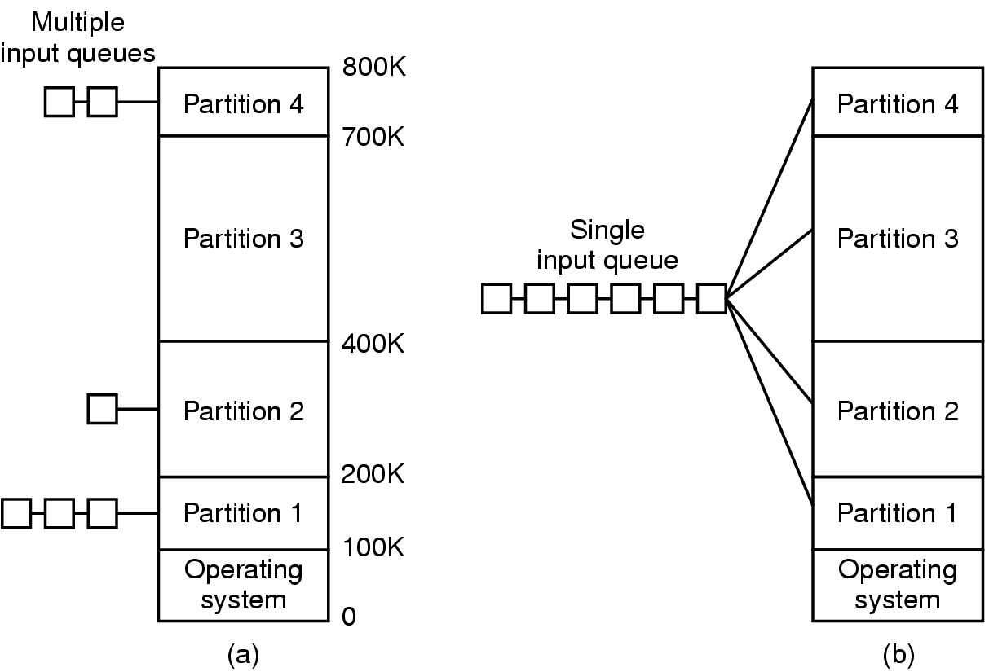
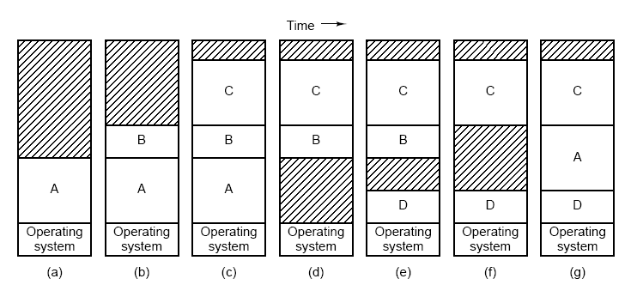
Contiguous Memory Allocation
1- Fixed size partitions
  (a) Load a job at any partition with enough space. The disadvantages:
    - unbalance load partition: some fully used and other not
    - internal fragmentations
  (b) Solve unbalance. It loads a job into the closest partition suitable to hold it.
    - Still, there can be internal fragmentations
2- Variable size partitions
  - Memory utilization can be improved (degree of multiprogramming) but
    - allocation and deallocation of memory is complicate.
    - external fragmentation

Slide 18
Contiguous Memory Allocation: Variable Size Partitions
Dynamic memory allocation
  OS table with start, end of allocated partitions, and unallocated partitions
  Unallocated partitions are “holes”
  When memory returned (deallocated), merge with neighboring hole
  Allocation of a new partition of size n
    First fit, Best fit, Worst fit, next fit
  First fit and best fit are better than worst-fit in terms of storage utilization.
Fragmentation
  External
    Free blocks of memory too small to be used
    Compaction can be used; need relocatable code
  Internal
    Allocating partitions larger than requested; unused space in partition for a process (more typical with fixed sized partitions)

Slide 19
Contiguous Memory Allocation: Variable Size Partitions (Contd.)
  A) maintains information about free space of contiguous memory (Data structure: list of holes + job input queue)
    Hole – block of available contiguous memory; holes
    of various size are scattered throughout memory
OS
OS
OS
OS
OS
process 5
process 5
process 5
process 5
process 9
process 9
process 8
process 10
process 2
process 2
process 2
process 2

Slide 20
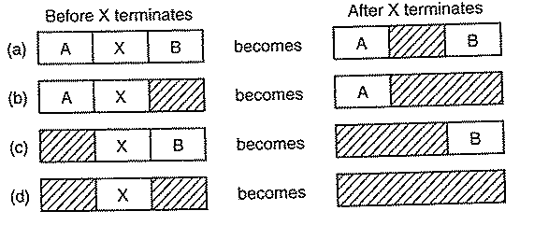
Contiguous Memory Allocation: Variable Size Partitions (Contd.)
B)Allocation/Deallocation Algorithm
  When a process arrives, it is allocated memory from a hole large enough to accommodate it
    Find a hole to match a job from the input queue
    Split the hole and return the unused (smaller) hole back to the list
    Merge the adjacent holes when the job is completed
How to find a hole? 3 strategies that maintain a list of holes
  First-fit: Allocate the first hole that is big enough. Search from begin.
  Best-fit: Allocate the smallest hole that is big enough; must search entire list, unless ordered (sorted) by size
    Produces the smallest leftover hole
  Worst-fit: Allocate the largest hole; must also search entire list
    Produces the largest leftover hole

Slide 21
Contiguous Memory Allocation: Variable Size Partitions (Contd.)
First-fit and best-fit better than worst-fit in terms of speed and storage utilization
All allocation schemes (sorted on size) have same disadvantages:
  When a process terminates or is swapped out, finding its neighbors to see if a merge is possible is expensive (needs time).
  If merging is not done, memory will quickly fragment into large number of small useless holes.
  External Fragmentation – total memory space exists to satisfy a request, but it is not contiguous. All the holes are too small to fit the requirement.
  Internal Fragmentation – allocated memory may be slightly larger than requested memory; this size difference is memory internal to a partition, but not being used
  Reduce external fragmentation by compaction
    Shuffle memory contents to place all free memory together in one large block->needs dynamic relocation at execution time.
    I/O problem
      Must be careful about pending I/O before initiating compaction.
      Do I/O only into OS buffers

Slide 22
Contiguous Memory Allocation: Variable Size Partitions (Contd.
Hardware requirements: base register and limit register
Physical address = virtual address + base register (relocation Register)
Why do we need the limit register? Protection
  If (physical address > base + limit) then exception fault

Slide 23
What do we do when we run out of memory?
E.g., all of the memory partitions of the operating system available for user processes are full
Options
  System.exit
  Something else (e.g swapping)

Slide 24
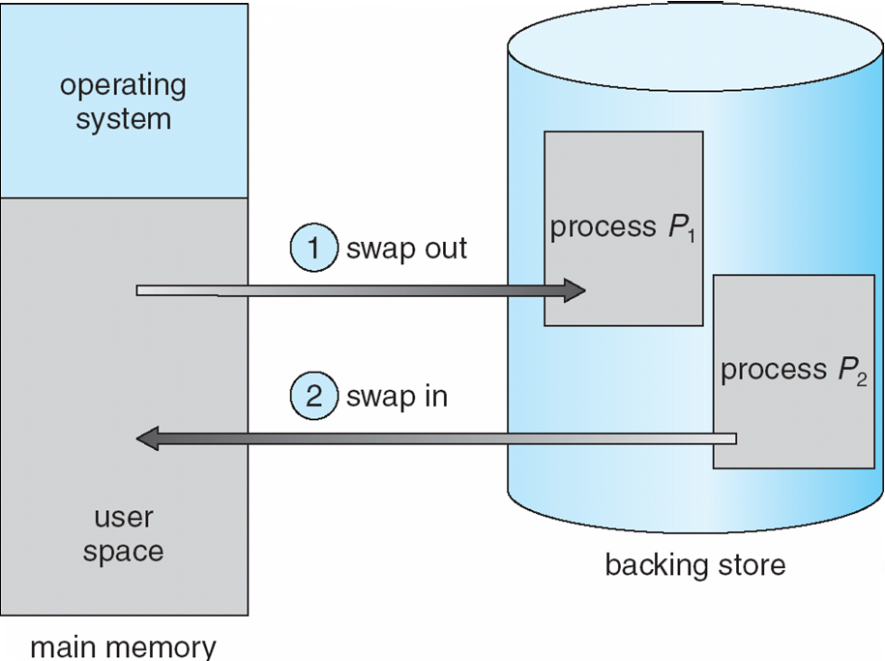
Swapping
A process needs to be loaded in memory to get CPU time to execute. To increase the degree of multi-programming multiple processes are loaded into memory but what can happen if memory is full?
A process can be swapped temporarily out of memory to a backing store, and then brought back into memory for continued execution
Backing store – fast disk large enough to accommodate copies of all memory images for all users; must provide direct access to these memory images. System maintains a ready queue of ready-to-run processes which have memory images on disk
1- Which process will be selected to go out of memory?
2-Where does swapped out process be loaded back in memory?
3- Does Context switch take longer time?

Slide 25
Swapping (Cont.)
Roll out, roll in –( swap in/ swap out) swapping variant used for priority-based scheduling algorithms; lower-priority process is swapped out so higher-priority process can be loaded and executed
Swapped out process will be brought back into memory. At which memory space? Answer: Depends on binding addressing used
  If binding is done at assembly time or load time-> different space is difficult!
  If execution time binding is used-> different space is possible because the physical addresses are computed at execution time.
Context switch in case of swapping needs more time than usual
  When the scheduler decides to execute a process it calls the Dispatcher ( as usual ).
  Dispatcher checks if that process is in memory or in swap area. It loads (swap in) it in memory if it is not there. Sure, it may need to free place first by swapping out another process.
    Major part of swap time is transfer time; total transfer time is directly proportional to the amount of memory swapped
  Save and load PCB ( as usual ).
  For efficient CPU utilization, the process execution time (quantum) should be long relative to swap time.
Modified versions of swapping are found on many systems (i.e., UNIX, Linux, and Windows)

Slide 26
Non-Contiguous memory Allocation
Memory manager can allocate for each process noncontiguous areas in memory.
Memory management Schemes (loading whole process):
  1- Paging
  2- Segmentation
  3- combination of both!
Eliminate external fragmentation and compaction. Internal fragments is minimal (at most one frame is partially used).
Still assuming all of a process NOT part of it is loaded into RAM at once to run.
  Only when we talk about demand paging we will see partial of a process can be in memory and the rest in disk

Slide 27
Paging
Paging technique permits the physical address space of a process to be noncontiguous but logical address of a process is contiguous.
  Process is allocated physical memory whenever the latter is available (noncontiguous memory holes (called frames))
  Divide physical memory (real RAM) into fixed-sized blocks called frames (size is power of 2 (bytes),between 512 and 8,192 bytes)
  Divide logical memory into blocks of same size called pages
    Making the page size = frame size eliminate external fragmentation
  Keep track of all free frames both in memory and backing store.
  To run a program of size n pages, need to find n free frames (not necessary contiguous) and load program
  Set up a page table to translate logical to physical addresses
    Needs fast address translation. Page table can be large and needs to be in memory. Each row contains several fields.

Slide 28
Paging: Example
Process address space:
  Logical is
  contiguous in pages.
  Physical is noncontiguous in frames
page 0 might be stored in frame 5
page 1 might be stored in frame 1
page 2 might be stored in frame 0
Who selects frame? OS allocates from currently free frames
RAM (6 frams, each frame=1024 byes)
Physical Memory
frame₀
Program (process) has 3 paqes, each 1024 bytes long)
frame₁
page₀
frame₂
page₁
frame₃
page₂
frame₄
frame₅
Arrows represent the mapping(page table)
Notes:
This mapping or correspondence is done by the operating system-- from the collection of currently free frames of RAM, frames are allocated to the process.

Slide 29
MMU with Paging
Remember that MMU does a) address binding, b) memory protection
  MMU needs information about correspondences between logical pages & physical pages (mapping)
How do we represent the address space of the process with paging?
How might the OS represent the information needed by the MMU?
Observe: The simple limit/relocation register pair mechanism is no longer sufficient.
Physical address
Byte in frame
Logical address
byte in page
Mapping
Page into frame
RAM
CPU
MMU

Slide 30
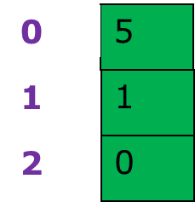
Page Table
Each process with an address space needs to have a page table
  Maintained by operating system (in kernel space)
  Part of the PCB for a process
  Memory management information
Page table maps from logical page numbers of a process to frame numbers of physical RAM
  PageTable[ LogicalPageNumber ] = PhysicalFrameNumber
  The page table for the previous example
  Page tables have one entry (row) per logical
  page of the process
  Each entry comprises (at least) a frame number
  Page tables entries will change a little when we talk about using a TLB with the MMU. In this case, will keep both page number and frame number in the TLB entries.
Notes:
Write this down– that Page table maps from logical page numbers to frame numbers

Slide 31
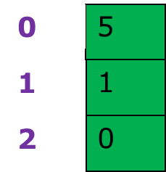
Paging Example: Still Continued
Physical Memory
With 1024 byte page/frame size:
What physical addresses
correspond to logical addresses:
0, 1024, 3000?
Answer
Logical address 0:
5 * 1024 = 5120
Logical address: 1024
1024
Logical address: 3000
0+952= 952
frame₀
Program (process)
frame₁
page₀
frame₂
page₁
frame₃
page₂
frame₄
Page table
frame₅
(base 10 addresses)
Notes:
p₀= 0 - 1023 f₀= 0 - 1023
p₁= 1024 - 2047 f₁= 1024 - 2047
p₂=2048 - 3071 f₂= 2048 - 3071
f₃= 3072 - 4095
f₄= 4096 - 5119
f₅= 5120 - 6143
(0-1023) P₀=>f₅=5120- 6143 means that byte 0→ 5120, 1→ 5121, 2→5122
(1024-2047) P₁=>f₁= 1024-2047 means that byte 1024→ 1024, 1025→ 1025
(2048-3071) P₂=>f₀= 0-1023 means that byte 2048→ 0, 2049→ 1, 2050→2

Slide 32
Address Structure
Usually the page/frame size is a power of two
  E.g., 1024, 2048, 4096
This separates memory addresses into two parts
  a) Top bits (say leftmost) – page number
  b) Bottom bits( rightmost) – page offset
    bits to index byte number within a page (and later in frame)
Example
  16 bit logical address (2^{m=15} →process size = 32KB
  1024 byte page size→ 1024 = 2^{n=10}
  Offset is lower 10 bits [2^10 = 1024; log₂(1024)=10]
    need 10 bits to index within a 1024 byte page
  Top 5 bits for page number→2^{m-n=5} = 32 pages
page number
page offset
p
d
m - n
n
Notes:
2¹⁵ 2¹⁴ … 2¹² 2¹¹ 2¹⁰ 2⁹ 2⁸ 2⁷ 2⁶ 2⁵ 2⁴ 2³ 2² 2¹ 2⁰
32768 16384. . 4096 2048 1024 512 256 128 64 32 16 8 4 2 1
Address space = 16 bits means we can address memory byes from 0 to 32767

Slide 33
16-bit address space
2¹⁵ 2¹⁴ … 2¹² 2¹¹ || 2¹⁰ 2⁹ 2⁸ 2⁷ 2⁶ 2⁵ 2⁴ 2³ 2² 2¹ 2⁰
32768 16384. . 4096 2048 || 1024 512 256 128 64 32 16 8 4 2 1
Address space = 16-bits means we can address memory byes from 0 to 32767
Examples:
< Page number > ||< Byte number inside page >
8-bits for number of pages= 2⁸=256 pages
8-bits for page size = 256 bytes per page
---------------------------------------------------------------------------------------------------------
< Page number > ||< Byte number inside page >
5-bits for number of pages= 2⁵=32 pages
10-bits for page size = 2¹⁰ = 1k= 1024 bytes per page
8 4 2 1 8421
-------------------------------------------------------------------------------------
(1024) ₁₀= 00001 000000000 means byte 0 inside page 0
(2058 ) ₁₀ = 00010 000001010 means byte 10 inside page 2

Slide 34
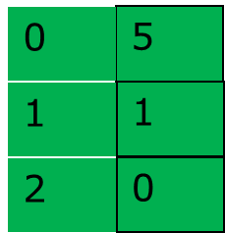
Example
With 1024 byte page/frame size, and 16 bit addresses:
a) Give the page table (with entries in base 10)
b) Give the binary logical and physical addresses for base 10 logical addresses 0, 1024, 2058?
Physical Memory
frame₀
Program (process)
frame₁
page₀
frame₂
page₁
frame₃
0= byte 0 in frame 0
page₂
000000
000000000
frame₄
1024 = byte 0 in frame1
Page table
000001
000000000
frame₅
2058 = byte 10 in frame2
000010
000001010
Notes:
2¹⁵ 2¹⁴ … 2¹² 2¹¹ 2¹⁰ 2⁹ 2⁸ 2⁷ 2⁶ 2⁵ 2⁴ 2³ 2² 2¹ 2⁰
32768 16384. . 4096 2048 1024 512 256 128 64 32 16 8 4 2 1
Address space = 16 bits means we can address memory byes from 0 to 32767
Page size= 1024 bytes, means that we will allocate logical address as follows:
P₀= 0-1023,
P₁= 1024-2047
P₂=2048-3071
P₃=3072- 4047
P₄=4048-5119
……
P₁₄= 30720-31743
P₁₅= 31744-32767
Binary Calculation:
1024 base 10 = 00001 0000000000 base 2
2¹⁵ 2¹⁴ … 2¹² 2¹¹ 2¹⁰ 2⁹ 2⁸ 2⁷ 2⁶ 2⁵ 2⁴ 2³ 2² 2¹ 2⁰
32768 16384. . 4096 2048 1024 512 256 128 64 32 16 8 4 2 1
0 0. . . 0 0 1 0 0 0 0 0 0 0 0 0 0
2058 base 10 = 00010 0000001010 base 2
2¹⁵ 2¹⁴ … 2¹² 2¹¹ 2¹⁰ 2⁹ 2⁸ 2⁷ 2⁶ 2⁵ 2⁴ 2³ 2² 2¹ 2⁰
32768 16384. . 4096 2048 1024 512 256 128 64 32 16 8 4 2 1
0 0. . . 0 1 0 0 0 0 0 0 0 1 0 1 0

Slide 35

What Does the MMU With Paging Look Like?
This figure assumes that the page table is stored in the MMU, which to a degree is true.
We’ll elaborate on this shortly.
f gives address in terms of frame/page size units in RAM, i.e., it’s a frame number
MMU
Figure 8.7: Paging Hardware

Slide 36
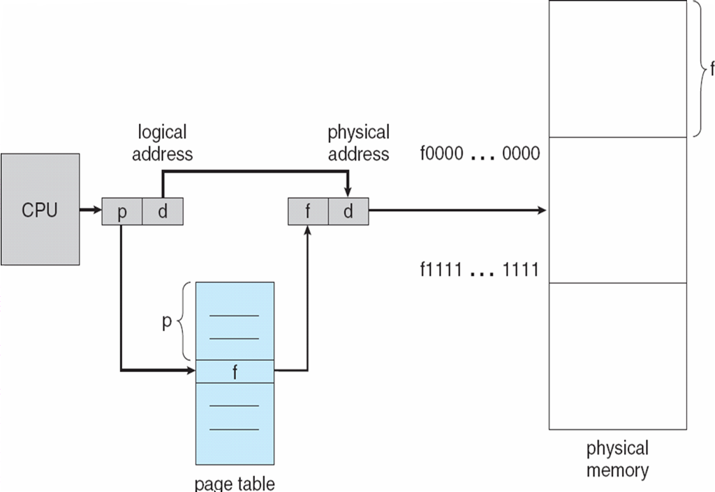
Address Translation Scheme
Address generated by CPU is divided into:
  Page number (p) – used as an index
  into a page table which contains base
  address of each page in physical memory
  Page offset (d) – combined with base address to define the physical memory address that is sent to the memory unit
  For given logical address space 2^{m} and page size 2^{n} , we have
  m-n pages. Paging Hardware needed for mapping p into f
page number
page offset
p
d
m - n
n

Slide 37

Example: 32-byte memory and 4-byte pages
p₀
f₀
Logical Address Space
  address space size: 2^{m} bytes
  page size: 2^{n} bytes (n < m)
  turning linear address, l into (p; d):
    p = l div 2^{n} (m - n bits)
    d = l mod 2^{n} (n bits)
Xxxxx
011||10 = (14)
Physical Address Space
  address space size: 2^{k} bytes
  page frame size: 2^{n} bytes (n < k)
  turning linear address, a, into (f; d):
    f = a div 2^{n} (k - n bits)
    d = a mod 2^{n} (n bits)
Mapping Logical to Physical
  extract p from logical address l
  extract d from logical address l
  map p to f using page table
  assemble physical address a
  using (f; d)
f₁
f₂
f₅
page number
page offset
p
d
m – n =3
n=2
Number of pages = 32/4 =8=2^{x} (x=3-bits)
Offset bits(d)= 5-3= 2 bits
Logical address 0 = page 0, offset 0
Indexing in page table yields
Page 0 in frame 5
Logical address 0 = 20 ((5*4)+0)
Logical address 3 = 23 ((5*4)+3)
Logical address 4 = 24 ((6*4)+0)
Logical address 13= 9 ((2*4)+1)

Slide 38
Paging Example-Answer it Yourself
What about 32 bit logical addresses (2³²) with a 4096 (2¹²) byte page size?
What are the:
  Number of bits in a page number?
  Number of bits in an offset?
  Maximum number of logical pages per process?
  Maximum number of bytes per logical process?
page number
page offset
p
d
m – n=20
n=12
Maximum number of physical frames per process?
The maximum number of physical pages per process will depend on the size of physical memory. For example, if frame addresses are at least 32 bits, we may be able to have a number of physical pages equal to the number of logical pages.

Slide 39
Memory Protection
Memory protection in a paged environment is accomplished
in 2 ways
A) Only frames that map via the page table can be accessed
B) Page table entries can be extended to include protection information (page-table length register can accomplish part of this goal)
Illegal page accesses are trapped by the operating system.
Valid-invalid bit is attached to each entry in the page table:
  “valid” indicates that the associated page is in the process’ logical address space, and is thus a legal page
  “invalid” indicates that the page is not in the process’ logical address space
Page-table length register (PRLR) indicates size of the page table. This value is checked against every logical address to verify that the address is in the valid range for a process.

Slide 40

Valid (v) or Invalid (i) Bit In A Page Table
This valid/invalid bit refers to whether or not a page is used by the process in its logical address space.
In Chapter 9, the same terminology (valid/invalid bit) is used to refer to whether or not, with demand paging, a page that is part of the processes logical address space has been paged in from disc.

Slide 41

Frame Table
Operating System has frame table which contains an entry for each frame indicating whether it is free or allocated and, if allocated, to which page of which process or processes.
when a process needs a frame, frame table is searched and the found frame number is stored in the page table of that process.
Before allocation
After allocation

Slide 42
Implementation of Page Table
Each user process has a page table (contains frame numbers &more)
  need to be saved and restored during the context switch (context switch ?)
  The page table can be extremely large.
    page table entries= 2(number of bits in address for page/frame number)
    With1024 byte page/frame size, 16 bit address; 6 bit page number: 2⁶ entries in each page table = 64 entries
    With say 4k page/frame size, a 32-bit address space (4 GB) has millions pages for each process!!!!
  When page size is small, number of entries of page table will increase and vice versa. But large size page will increase I/O efficiency.
Typically, not all of the page table is stored in fast memory in MMU
Instead, a cache (Translation Look-aside Buffer (TLB) -associative memory) is used to store only some of the entries in the MMU

Slide 43
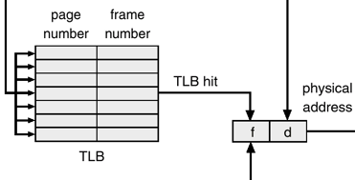
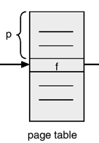
Implementation of Page Table(Contd.)
Page table is kept in main memory. A pointer to it is stored in PCB
Page-table base register (PTBR) points to the page table.
  When Context switch is done, dispatcher loads PTBR with the address of the page table in memory of the selected process.
In this scheme every data/instruction access requires two memory accesses. One for the page table and one for the data/instruction.
  The two memory access problem can be solved by the use of a special fast-lookup hardware cache called associative memory or translation look-aside buffers (TLBs)
  Some TLBs store address-space identifiers (ASIDs) in each TLB entry – allows the TLB to hold entries from multiple address spaces at the same time and uniquely identifies each process to provide address-space protection for that process.
MMU
logical address
CPU
p
d
Physical memory (RAM)
TLB miss

Slide 44
Paging Summery till now
Advantages
Easy to allocate memory
  Memory comes from a free list of fixed size chunks - simple
  Allocating a page is easy just removing it from the list
  External fragmentation not a problem
Easy to swap out chunks of a program
  All chunks are the same size
  Pages are a convenient multiple of the disk block size
  How do we know if a page is in memory or not?
  Solution – page the page tables (more later)
Limitations
Can still have internal fragmentation
  Process may not use whole frame
Memory reference overhead
  2 references per address lookup (page table, then memory)
  Solution – use a hardware cache of lookups (next)
Memory required to hold page table can be significant large
  Need one Page Table Entry (PTE) per page
  32 bit address space w/4KB pages = 2²⁰ PTEs ( 1MByte)
  4 bytes/PTE = 4MB/page table
  25 processes = 100MB just for page tables!
  ◉ Solution – page the page tables !!

Slide 45
Associative Memory
Expensive Hardware lookup cache with limited capacity (64-1024 entries) used to store subset of process page table.
Associative memory – parallel search
  Each entry:
    key (logical page #), and value (physical frame #)
  When a process needs to address a location
  in memory, its page number is presented to
  the TLB which is searched to find the
  corresponding frame number.
  Address translation (p, d)
    If p is in associative register, get frame # out
    Otherwise get frame # from page table in memory
      Store page # and frame # into associative table. Thus if the page is used again soon, the second time it will result in hit rather than a miss. This is TLB miss
        If associative memory is full, one entry is selected for replacement using Least Recently Used or random policy)
  On a TLB hit, rapidly obtain frame# for page#
  On a TLB miss, have to do two memory accesses
    Put cache key, value pair into TLB
Page #
Frame #

Slide 46
Effective Memory Access Time –Basics without paging
Suppose we already have the physical address – what is the effective (average) memory access time for a system with a single-level cache memory?
  Cache hit ratio (h_{r}): the fraction of all memory accesses that are found in the cache memory
  Memory access time: m
  Cache memory access time: c
Effective memory access time:
hit time + miss time
h_{r} * c + (1- h_{r}) * (c + m)
Example: c = 1 ns; m = 100 ns; h_{r} = 0.95
  Effective memory access time: 6 ns
Assume it takes 20 nsec to access Cache and 100 nsec to access memory.
80% of the time we get cache hit (Hit ratio).
EMA time = 0.80*20+0.20*120
= 40ns

Slide 47
Effective Access Time (E A T) with TBL
Hit ratio is the percentage of times that a particular page number is found in the TLB . Ratio related to number of associative registers .
Memory access time (Effective Access Time) will include:
  (a) time for accessing RAM and
  (b) time for accessing TLB
    Need to take into account TLB hits & TLB misses
EAT = P(hit) * hit-time + P(miss) * miss-time
Example : Assume it takes 20 nsec to search TLB and 100 nsec to access memory. 80% of the time we get a TLB hit (Hit ratio).
  What is hit-time? Miss-time? P(miss)? P(hit)? What is EAT?
  It takes 120 nsec , If page is found (20 +100) → hit-time
  It takes 220 nsec, if page not fount (20 +100+ 100) → Miss-time
  P(miss) = 0.20 and P(hit) = 0.80
  EAT = (0.80 * 120) + (0.20 * 220) = 140 nsec
    we suffer 40 nsec more but for 98% hit we suffer less 22 nsec
Notes:
Assume that Associative (TLB) Lookup is 20 nanoseconds
TLB Hit ratio – percentage of times that a page number is
found in TLB. Assume TLB Hit ratio is 98%
Effective Access Time (EAT):
EAT = 0.98 * 120 + 0.02 * 220 = 122 nanoseconds

Slide 48
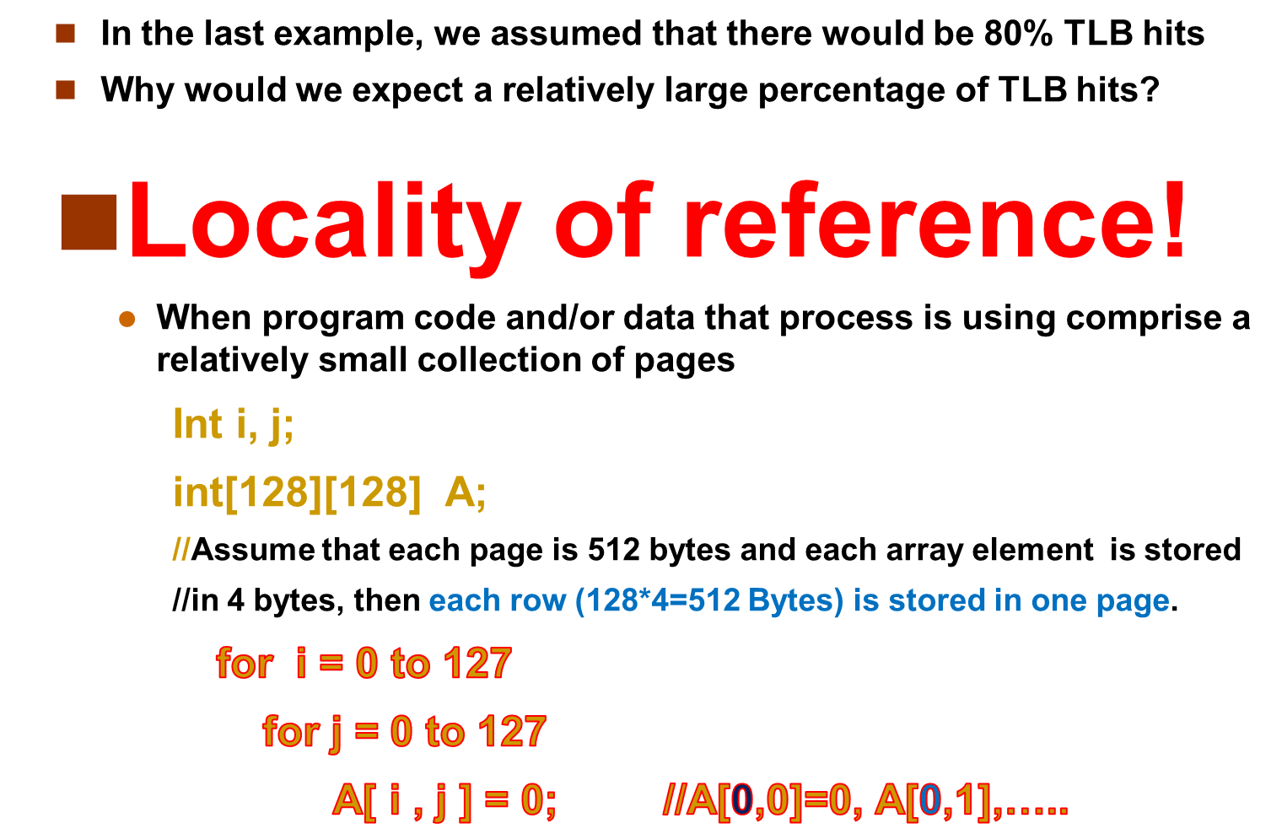
Assumption Underlying TLB
Notes:
Locality of reference. We would expect this if the program code and/or data that the process was using was relatively localized at any given point in time to a relatively small collection of pages.

Slide 49
Shared Pages
An advantage of paging is the possibility of sharing common code and hence save memory usage (e.g. Text editor).
Shared code and separate data
  Each process has its own data page
  One copy of read-only (reentrant) code shared among processes (i.e., text editors, compilers, window systems).
  Shared code must appear in same location in the logical address space of all processes.
  Reentrant code can not be modified during execution time (read only).
Private code and data
  Each process keeps a separate copy of the code and data
  The pages for the private code and data can appear anywhere in the logical address space

Slide 50
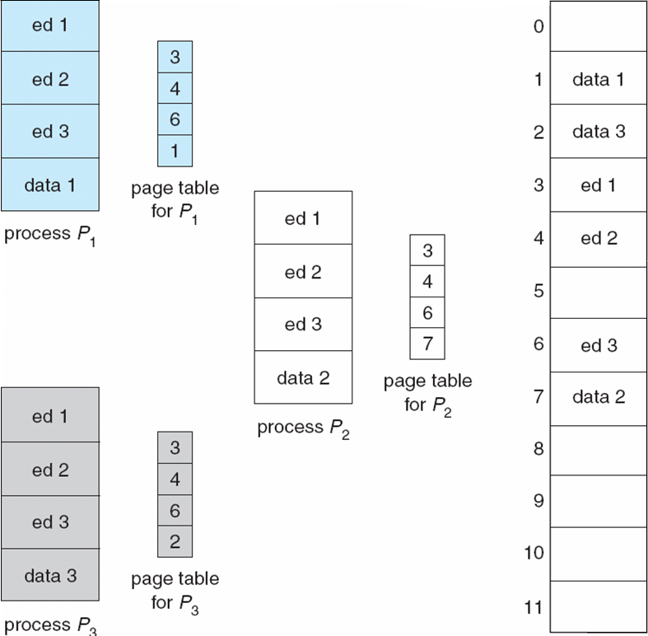
Shared Pages Example
3 process sharing text editor reentered code.
One copy of the text editor is kept in physical memory.
Each process has its own page data

Slide 51

Segmentation
Paging divides memory into equal sized units (pages, frames) and load every page into a frame without knowing its contents
Segmentation supports user view of memory.
  A program is a collection of segments. Each program is divided into blocks of unequal size but with semantics meaning.
    A segment is a logical unit such as: stack, data area, code area
A program is a collection of segments
  A segment is a logical unit such as:
    main program, method, object, local variables, global variables, stack, arrays, file, etc.

Slide 52
Segmentation (contd.)
Each Segment has different sized units and allocated contiguously in memory but different segments are allocated non-contiguously
Each segment sizes is depending on program parts
  Each segment has
    a name (segment id) and a length (size).
  Logical address space is a collection of
  segments and it consists of
  pairs: <segment number, offset>
User access memory by segment name
and offset within the segment.
Remember that in paging we use single
address which is resolved (mapped) into
page number and offset.
Contiguous memory is allocated for
each segment for the exact amount
needed (first-fit, best-fit). But different
segments of a process need not be
allocated contiguous.
  Unlike paging which suffers from
  internal fragmentation, segmentation
  suffers from external fragmentation!
1
4
1
2
3
4
2
3
physical
memory space
user space

Slide 53
Segmentation Architecture
Logical address consists of a two tuple: <segment-number s, offset d>,
  Segment number is used as an index into segment table
Hardware support
  Multiple base/limit pairs, one per segment (segment table)
  Segments named by #, used to index into table
Mapping logical address into physical address using:
Segment table – maps two-dimensional logical addresses
(contains 2 parts) into one physical addresses; each table entry has:
  base – contains the starting physical address where the segments reside in memory. It is added to the offset d to produce physical address.
  limit – specifies the length of the segment. Offset d must be
  between 0 and limit
Segment-table base register (STBR) points to the segment table’s location in memory
Segment-table length register (STLR) indicates number of segments used by a program; segment number s is legal if s < STLR
Notes:
This is a different meaning of base and limit than that used in p. 317, and Figure 8.2;
base here is the starting phys address of the segment; limit here is the max length of the segment

Slide 54
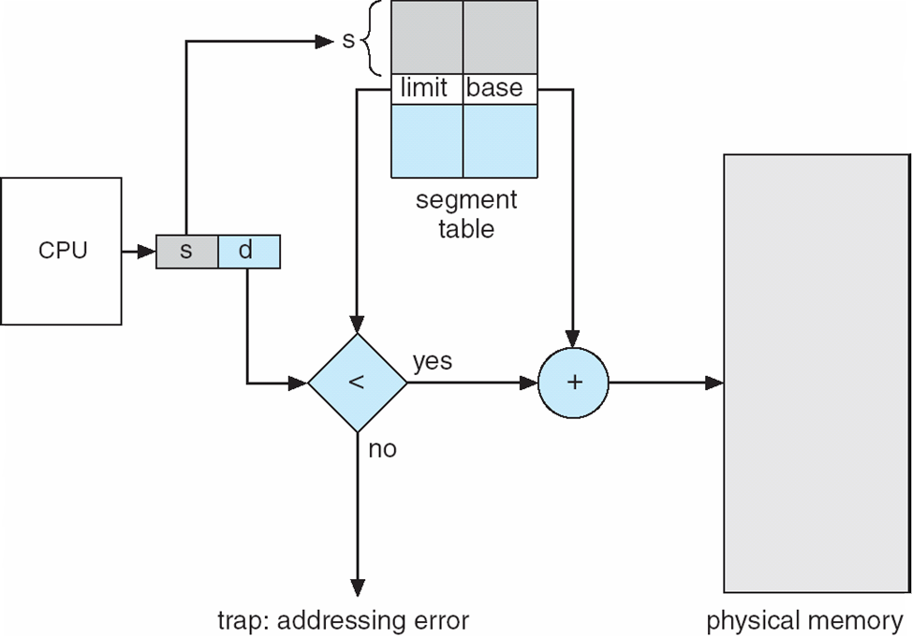
Segmentation Hardware
Segment table is an array of base –limit register pairs.
  Base- give the beginning address of segment in memory
  Limit- give the length of segment
- Offset d must be between 0 and the segment limit.
-If offset d is legal, add offset to segment base to produce the physical memory address.

Slide 55
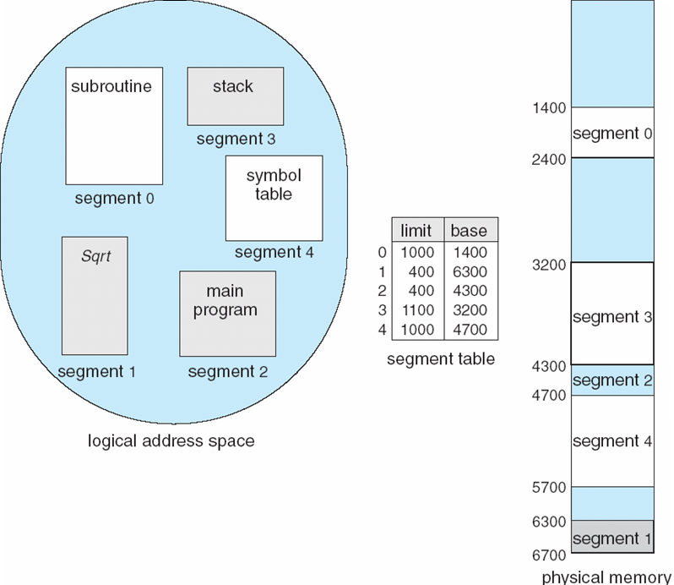
Example of Segmentation
We have 5 segments.
Segment 2 length = 400 and is stored in memory from 4300-4700.
  A reference to segment 2 byte 53 is mapped into 4353
  A reference to segment 3 byte 852 is mapped into 4052
  A reference to segment 0 byte 1222 results into trap (1222 <limit
  A reference to segment 7 byte 5 results into trap (s < STLR)

Slide 56
Segmentation Architecture (Cont.)
Protection
  With each entry in segment table associate:
    validation bit = 0 ⇒ illegal segment
    read/write/execute privileges
Protection bits associated with segments; code sharing occurs at segment level
Since segments vary in length, memory allocation is a dynamic storage-allocation problem
Sharing
  ◉ Segments are shared when entries in the segment tables of two different processes point to the same physical location.

Slide 57

Segmentation with Paging
Exploiting good properties of paging:
  No external fragmentation
  faster allocation.
Exploiting good properties of segmentation:
  Sharing.
    Segments are constructed according to user semantics.
    This easily enables segment sharing and protection according to user semantics.
  Protection.
Paying a small performance cost.
Many variations exist...

Slide 58
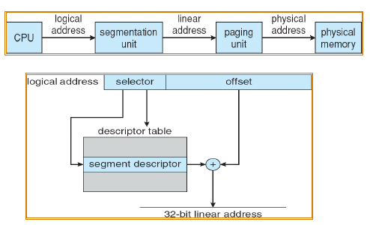

Segmentation with Paging: Intel Pentium
The Pentium architecture allows a page size of either
4 KB or 4 MB.
◻ For 4 KB pages, a two-level paging scheme is used.
32-bit address space 2^32
Page size = 4KB (2^12)
  so 20 bits are enough for segments up to 2^32 bytes.
  Max Number of pages in a segment= 2^10=1024
  Max number of segments = 2^10 = 1024

Slide 59
Architecture for Segmentation with Paging
segment table (for process)
segment
limit
page table
base
CPU
yes
s
so
<
so
Physical
Memory
Logical
Address
no
p
po
memory trap
+
s = segment number
so = logical offset in segment
p = page
po = offset in page
f = frame
page table (for segment)
f
f
po
Notes:
Suppose:
Segment max size = 65535 Bytes= 64KB( 2^16) then
Paging the segments in 1046 bytes pages (2^10) will result on
2^6 pages= 64 pages

Slide 60
Summery
◻ Virtual memory
  ◉ Processes use virtual addresses
  ◉ OS + hardware translates virtual address into physical addresses
◻ Various techniques
  ◉ Fixed partitions – easy to use, but internal fragmentation
  ◉ Variable partitions – more efficient, but external
  fragmentation
  ◉ Paging – use small, fixed size chunks, efficient for OS
  ◉ Segmentation – manage in chunks from user’s perspective
  ◉ Combine paging and segmentation to get benefits of both

Slide 61
End of Chapter 8

