Slide 1


O my Lord! Expand for me my chest [with assurance] and ease for me my task and untie the knot from my tongue that they may understand my speech. (Quran 20 : 25-28)

Slide 2
Decrease and Conquer

Slide 3
Decrease and Conquer
Reduce problem instance to smaller instance of the same problem
Solve smaller instance
Extend solution of smaller instance to obtain solution to original instance
Can be implemented either top-down (Recursively) or bottom-up (Incremental)

Slide 4
Decrease and Conquer
Decrease by a constant (usually by 1):
insertion sort
topological sorting
algorithms for generating permutations, subsets
Decrease by a constant factor (usually by half)
binary search and bisection method
exponentiation by squaring
Multiplication of TWO integer numbers
Variable-size decrease
Euclid’s algorithm
selection by partition
Nim-like games

Slide 5
Decrease by a Constant
Decrease and Conquer

Slide 6
Decrease by a Constant
the size of an instance is reduced by the same constant on each iteration of the algorithm
Typically, this constant is equal to one
other constant size reductions do happen occasionally

Slide 7
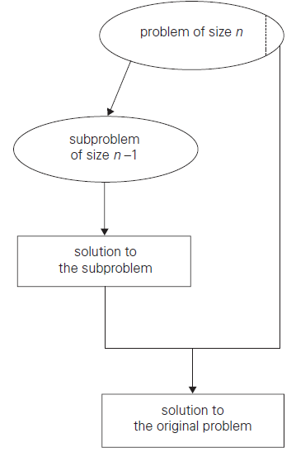



Example
Exponentiation a^{n}
So

Slide 8
Example - Exponentiation
public static int exp (int a, int n) {
if ( n == 0 )
return 1;
else
return exp (a, n-1) * a;
}

Slide 9
Decrease by a Constant Factor
Decrease and Conquer

Slide 10
Decrease by a Constant Factor
technique suggests reducing a problem instance by the same constant factor on each iteration of the algorithm
In most applications, this constant factor is equal to two
other constant factors may happen occasionally

Slide 11
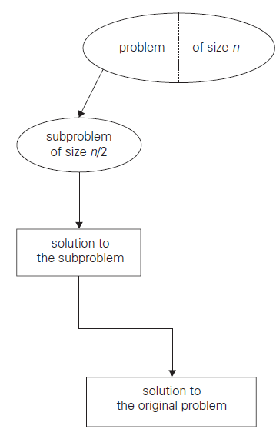

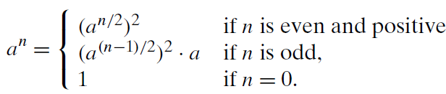
Example
Exponentiation a^{n}
So

Slide 12
Example - Exponentiation
public static int expFac(int a, int n) {
if (n == 0)
return 1;
else if (n == 1)
return a;
else if (n % 2 == 0)
return expFac (a * a, n / 2);
else
return a * expFac (a, n - 1);
}

Slide 13
Variable Size Decrease
Decrease and Conquer

Slide 14

Variable Size Decrease
The size-reduction pattern varies from one iteration of an algorithm to another
Euclid’s algorithm for computing the greatest common divisor

Slide 15
Example - GCD
public static int gcd (int m, int n) {
if ( n == 0 )
return m;
else
return gcd (n, m % n);
}

Slide 16
Insertion Sort
Decrease by a Constant

Slide 17
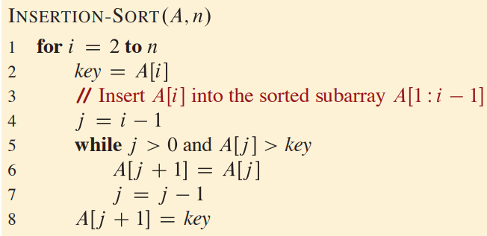
Example: Insertion sort

Slide 18
Example: Insertion sort

Slide 19
Analysis
Worst Case
T(n) = O(n²)
Best Case
T(n) = O(n)

Slide 20
Topological Sorting
Decrease by a Constant

Slide 21
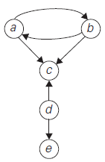
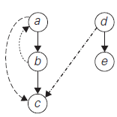
Topological Sorting
Applied in “Directed Graph” or “digraph”
Represented by “adjacency matrix” or “adjacency list”

Slide 22
Topological Sorting
Five required courses {C1, C2, C3, C4, C5} a part-time student has to take in some degree program.
The courses can be taken in any order
course prerequisites
C1 and C2 have no prerequisites
C3 requires C1 and C2
C4 requires C3
C5 requires C3 and C4.
The student can take only one course per term
In which order should the student take the courses?

Slide 23
Topological Sorting (Solution)
Directed Graph
Vertices will represent courses
Directed edge represents prerequisite
Arranging the edges is known as “Topological Sorting”
It can not be solved if it is not a “dag”

Slide 24
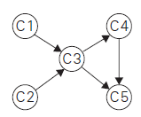





Topological Sorting
course prerequisites
C1 and C2 have no prerequisites
C3 requires C1 and C2
C4 requires C3
C5 requires C3 and C4.

Slide 25
Topological Sorting (Algo - 1)
Apply DFS
note the order in which vertices become dead-ends
Reversing this order yields a solution to the topological sorting problem

Slide 26




Topological Sorting (Algo - 1)
Apply DFS

Slide 27

Topological Sorting (Algo - 1)
note the order in which vertices become dead-ends
Reversing this order yields a solution to the topological sorting problem

Slide 28
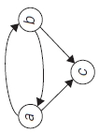
Topological Sorting (Algo - 2)
Apply Decrease by a Constant i.e. by 1
Identify a source, which is a vertex with no incoming edges
If there are several sources, break the tie arbitrarily
If there are none, stop because the problem cannot be solved
delete it along with all the edges outgoing from it

Slide 29
Topological Sorting (Algo - 2)
Identify a source, which is a vertex with no incoming edges
If there are several sources, break the tie arbitrarily
If there are none, stop because the problem cannot be solved
delete it along with all the edges outgoing from it

Slide 30

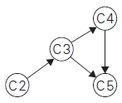
Topological Sorting (Algo - 2)
Identify a source, which is a vertex with no incoming edges
If there are several sources, break the tie arbitrarily
If there are none, stop because the problem cannot be solved
delete it along with all the edges outgoing from it

Slide 31




Topological Sorting (Algo - 2)
Identify a source, which is a vertex with no incoming edges
If there are several sources, break the tie arbitrarily
If there are none, stop because the problem cannot be solved
delete it along with all the edges outgoing from it

Slide 32



Topological Sorting (Algo - 2)
Identify a source, which is a vertex with no incoming edges
If there are several sources, break the tie arbitrarily
If there are none, stop because the problem cannot be solved
delete it along with all the edges outgoing from it

Slide 33
Generation Permutation
Minimum Change Requirement

Slide 34
Minimum Change Requirement
If n = 1 return 1;
Otherwise
generate recursively the list of all permutations of 12…n-1
insert n into each of those permutations by starting with inserting n into 12...n-1 by moving right to left
then switching direction for each new permutation

Slide 35
Minimum Change Requirement
If n = 1 return 1;
Otherwise
generate recursively the list of all permutations of 12…n-1
insert n into each of those permutations by starting with inserting n into 12...n-1 by moving right to left
then switching direction for each new permutation
Permutation for 1
1

Slide 36
Minimum Change Requirement
If n = 1 return 1;
Otherwise
generate recursively the list of all permutations of 12…n-1
insert n into each of those permutations by starting with inserting n into 12...n-1 by moving right to left
then switching direction for each new permutation
Permutation for 1, 2
1
1 2
2 1

Slide 37
Minimum Change Requirement
If n = 1 return 1;
Otherwise
generate recursively the list of all permutations of 12…n-1
insert n into each of those permutations by starting with inserting n into 12...n-1 by moving right to left
then switching direction for each new permutation
Permutation for 1, 2, 3
1 2
123, 132, 312
2 1
321, 231, 213

Slide 38
Generation Permutation
Johnson Trotter Algorithm

Slide 39

Johnson Trotter Algorithm
possible to get permutations of n elements without generating permutations for smaller values
associating a direction with each element k

Slide 40
Johnson Trotter Algorithm
Mobile element
In arrow-marked permutation if arrow points to a smaller number adjacent to it

Slide 41
Johnson Trotter Algorithm

Slide 42








Johnson Trotter Algorithm
Permutation for 1, 2, 3

Slide 43
Johnson Trotter Algorithm – Example 02
Using the given algorithm (Johnson Trotter), generate all permutations for 1234

Slide 44









Slide 45









Slide 46








Slide 47
Johnson Trotter Algorithm
Limitation
The result is not in Lexicographic Order
Solution
LexicographicPermute Algorithm

Slide 48
Generation Permutation
“LexicographicPermute” Algorithm

Slide 49

“LexicographicPermute” Algorithm

Slide 50
Status | 1 | 2 | 3 | i | j
❶
A
B
C
2
3
❷
A
C
B
1
3
B
C
A
❸
B
A
C
2
3
❹
B
C
A
1
2
C
B
A
❺
C
A
B
2
3
❻
C
B
A

Slide 51
Status | 0 | 1 | 2 | i | j
❶
1
2
3
1
2
❷
1
3
2
0
2
2
3
1
❸
2
1
3
1
2
❹
2
3
1
0
1
3
2
1
❺
3
1
2
1
2
❻
3
2
1

Slide 52
Generating Subsets Student Exercise
Binary Reflected Gray Code (BRGC) Algorithm

Slide 53
Binary Reflected Gray Code (BRGC)
minimal-change algorithm
generating 2^{n} bit strings
corresponding to all the subsets of an n-element set where n > 0

Slide 54
Binary Reflected Gray Code (BRGC)
If n=1
make list L of two bit strings 0 and 1
Else
generate recursively list L1 of bit strings of length n-1
copy list L1 in reverse order to get list L2
add 0 in front of each bit string in list L1
add 1 in front of each bit string in list L2
append L2 to L1 to get L
return L

Slide 55
Binary Reflected Gray Code (BRGC)
If n=1
make list L of two bit strings 0 and 1
Else
generate recursively list L1 of bit strings of length n-1
copy list L1 in reverse order to get list L2
add 0 in front of each bit string in list L1
add 1 in front of each bit string in list L2
append L2 to L1 to get L
return L

Slide 56
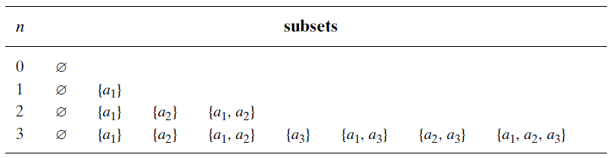
Binary Reflected Gray Code (BRGC)

Slide 57

Allah (Alone) is Sufficient for us, and He is the Best Disposer of affairs (for us).(Quran 3 : 173)

