Slide 1


O my Lord! Expand for me my chest [with assurance] and ease for me my task and untie the knot from my tongue that they may understand my speech. (Quran 20 : 25-28)

Slide 2
Divide and Conquer

Slide 3
Divide-and-Conquer
The most-well known algorithm design strategy:
Divide instance of problem into two or more smaller instances
Solve smaller instances recursively
Obtain solution to original (larger) instance by combining these solutions

Slide 4
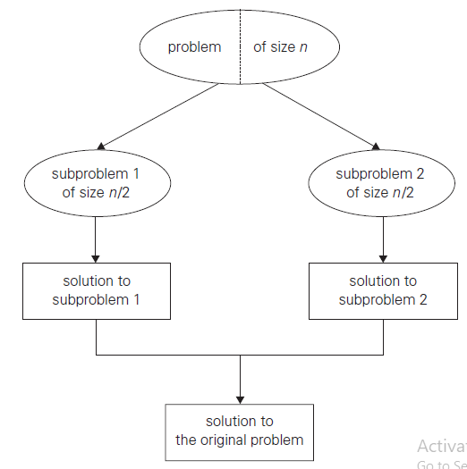
Divide-and-Conquer Technique

Slide 5
Divide-and-Conquer (Examples)
Sorting: mergesort and quicksort
Binary tree traversals
Multiplication of large integers
Matrix multiplication: Strassen’s algorithm
Closest-pair and convex-hull algorithms
Binary search: decrease-by-half (or degenerate divide&conq.)

Slide 6
General Divide-and-Conquer Recurrence
T(n) = aT(n/b) + f (n)
Note: The same results hold with O instead of Θ.
Examples: T(n) = 4T(n/2) + n ⇒ T(n) ∈ ?
T(n) = 4T(n/2) + n² ⇒ T(n) ∈ ?
T(n) = 4T(n/2) + n³ ⇒ T(n) ∈ ?

Slide 7
Merge Sort
Divide and Conquer

Slide 8
Mergesort
Split array A[0..n-1] in two about equal halves and make copies of each half in arrays B and C
Sort arrays B and C recursively
Merge sorted arrays B and C into array A as follows:
Repeat the following until no elements remain in one of the arrays:
compare the first elements in the remaining unprocessed portions of the arrays
copy the smaller of the two into A, while incrementing the index indicating the unprocessed portion of that array
Once all elements in one of the arrays are processed, copy the remaining unprocessed elements from the other array into A.

Slide 9
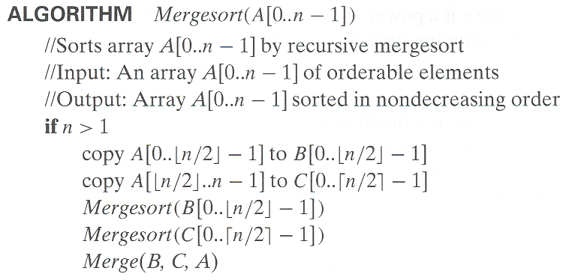
Pseudocode of Mergesort

Slide 10
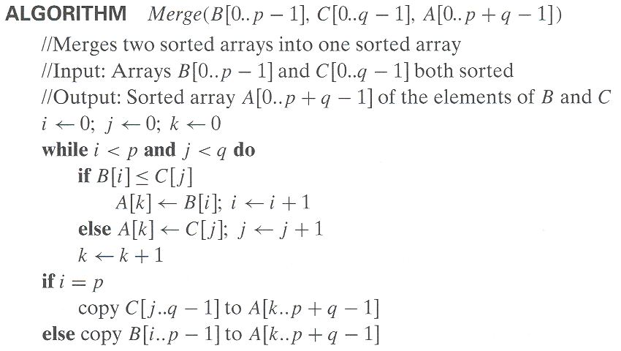
Pseudocode of Merge

Slide 11
MergeSort Example
Notes:
Go over this example in detail, then do another example of merging, something like:
(1 2 5 7 9)
(3 4 6)

Slide 12
Analysis of Mergesort
All cases have same efficiency: Θ(n log n)
Number of comparisons in the worst case is close to theoretical minimum for comparison-based sorting:
⎡log₂ n!⎤ ≈ n log₂ n - 1.44n
Space requirement: Θ(n) (not in-place)
Can be implemented without recursion (bottom-up)
Notes:
even if not analyzing in detail, show the recurrence for mergesort in worst case:
T(n) = 2 T(n/2) + (n-1)
worst case comparisons for merge

Slide 13
Quick Sort
Divide and Conquer

Slide 14
Quicksort
Select a pivot (partitioning element) – here, the first element
Rearrange the list so that all the elements in the first s positions are smaller than or equal to the pivot and all the elements in the remaining n-s positions are larger than or equal to the pivot (see next slide for an algorithm)
Exchange the pivot with the last element in the first (i.e., ≤) subarray — the pivot is now in its final position
Sort the two subarrays recursively
p
A[i]≤p
A[i]≥p

Slide 15
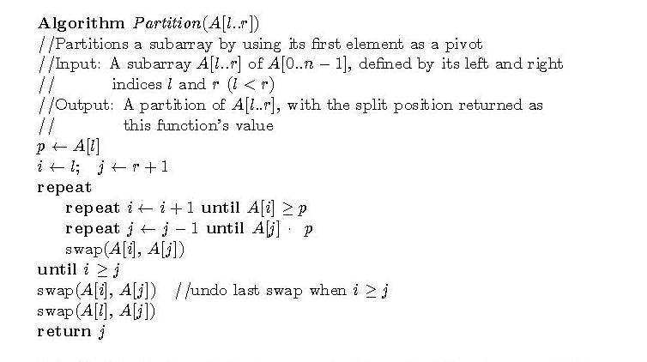
Hoare’s Partitioning Algorithm

Slide 16
Analysis of Quicksort
Best case: split in the middle — Θ(n log n)
Worst case: sorted array! — Θ(n²)
Average case: random arrays — Θ(n log n)
Improvements:
better pivot selection: median of three partitioning
switch to insertion sort on small subfiles
elimination of recursion
These combine to 20-25% improvement
Considered the method of choice for internal sorting of large files (n ≥ 10000)

Slide 17
Binary Tree
Divide and Conquer

Slide 18
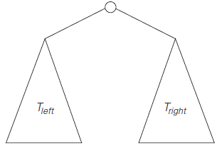
Introduction
A binary tree T is defined as a finite set of nodes
that is either empty
consists of a root and two disjoint binary trees T_{L} and T_{R}

Slide 19
Binary Tree Height
Divide and Conquer

Slide 20
Height
The length of the longest path from the root to a leaf
For node = 1
It will be “0”
For nodes > 1
the maximum of the heights of the root’s left and right subtrees plus 1

Slide 21
Height Algorithm

Slide 22
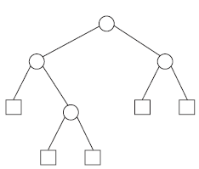
Height Algorithm (Analysis)
Number of Internal nodes, “n”
Number of External nodes, “x”
Number of comparison, C(n)
n + x
External nodes
x = n + 1
C(n) = 2n + 1 = Θ(n)

Slide 23
Binary Tree Traversal
Divide and Conquer

Slide 24
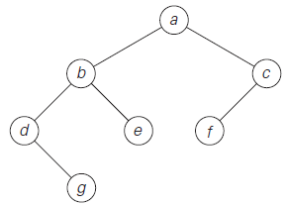
Tree Traversal
Preorder Traversal
Root – Left - Right
Inorder Traversal
Left – Root - Right
Postorder Traversal
Left – Right - Root

Slide 25
Tree Traversal
Preorder Traversal
Root – Left - Right
Inorder Traversal
Left – Root - Right
Postorder Traversal
Left – Right - Root

Slide 26
Tree Traversal
Preorder Traversal
Root – Left - Right
Inorder Traversal
Left – Root - Right
Postorder Traversal
Left – Right - Root

Slide 27
Tree Traversal
Preorder Traversal
Root – Left - Right
Inorder Traversal
Left – Root - Right
Postorder Traversal
Left – Right - Root

Slide 28
Tree Traversal
Preorder Traversal
Root – Left - Right
Inorder Traversal
Left – Root - Right
Postorder Traversal
Left – Right - Root

Slide 29
Tree Traversal
Preorder Traversal
Root – Left - Right
Inorder Traversal
Left – Root - Right
Postorder Traversal
Left – Right - Root

Slide 30
Tree Traversal
Preorder Traversal
Root – Left - Right
Inorder Traversal
Left – Root - Right
Postorder Traversal
Left – Right - Root

Slide 31
Tree Traversal
Preorder Traversal
Root – Left - Right
Inorder Traversal
Left – Root - Right
Postorder Traversal
Left – Right - Root

Slide 32
Tree Traversal
Preorder Traversal
Root – Left - Right
Inorder Traversal
Left – Root - Right
Postorder Traversal
Left – Right - Root

Slide 33
Tree Traversal
Preorder Traversal
Root – Left - Right
Inorder Traversal
Left – Root - Right
Postorder Traversal
Left – Right - Root

Slide 34
Multiplication of Large Integers
Divide and Conquer

Slide 35
Introduction
Multiplication of two numbers having “n” digits
Traditional
Number of “n²” digit multiplications
Improvement
Divide and Conquer

Slide 36










Integer Multiplication (Example)
Multiply 23 and 14

Slide 37



Integer Multiplication (Example-2digits)

Slide 38
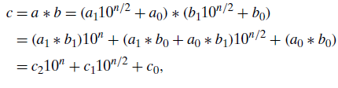
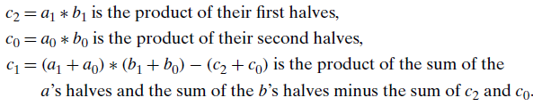
Integer Multiplication(Example-n digits)

Slide 39
Integer Multiplication (Analysis)

Slide 40
Integer Multiplication (Analysis)

Slide 41
Integer Multiplication (Analysis)

Slide 42

Integer Multiplication (Analysis)

Slide 43

Integer Multiplication (Analysis)

Slide 44

Integer Multiplication (Analysis)

Slide 45
Integer Multiplication (Analysis)

Slide 46
Integer Multiplication (Analysis)

Slide 47

Integer Multiplication (Analysis)

Slide 48

Integer Multiplication (Analysis)

Slide 49
Multiplication of Large Integers
Student Exercise

Slide 50

Multiplication of Large Integers
Find the efficiency of the algorithm including all operations i.e. Multiplication, Addition and Subtraction
Recurrence

Slide 51
Strassen’s Matrix Multiplication
Divide and Conquer

Slide 52


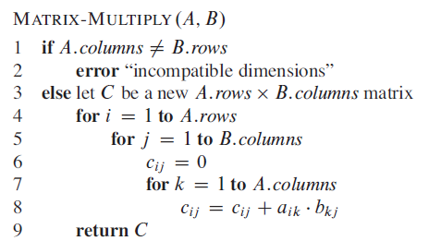
Strassen’s Matrix Multiplication

Slide 53

Strassen’s Matrix Multiplication

Slide 54
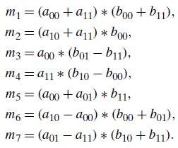
Strassen’s Matrix Multiplication

Slide 55

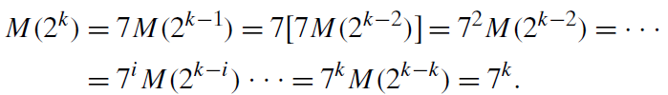


Strassen’s Matrix Multiplication

Slide 56
Strassen’s Matrix Multiplication
Student Exercise

Slide 57

Strassen’s Matrix Multiplication
Find the efficiency of the algorithm including all operations i.e. Multiplication, Addition and Subtraction
Recurrence

Slide 58
Closest Pair Problem
Divide and Conquer

Slide 59
Closest-Pair Problem
Find the two closest points in a set of n points (in the two-dimensional Cartesian plane).
Brute-force algorithm
Compute the distance between every pair of distinct points
and return the indexes of the points for which the distance is the smallest.

Slide 60

Closest-Pair Algorithm

Slide 61
Closest-Pair Problem
Let P be a set of n > 1 points in the Cartesian plane
Points are distinct
Points are ordered in non-decreasing order of their x coordinate
Make a list Q
Points are ordered in non-decreasing order of their y coordinate

Slide 62
Closest-Pair Problem
Step 1
Divide the points given into two subsets P_{l} and P_{r} by a vertical line x = m so that half the points lie to the left or on the line and half the points lie to the right or on the line.
x = m

Slide 63
Closest-Pair Problem
x = m
Step 2
Find recursively the closest pairs for the left and right subsets.
d
l
d
r

Slide 64
Closest-Pair Problem
x = m
Step 3
Set d = min{d_{l}, d_{r}}
We can limit our attention to the points in the symmetric vertical strip S of width 2d as possible closest pair. (The points are stored and processed in increasing order of their y coordinates.)
d
l
d
r
d
d

Slide 65
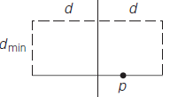
Closest-Pair Problem
Step 4
Scan the points in the vertical strip S from the lowest up. For every point p(x,y) in the strip, inspect points in the strip that may be closer to p than d.
x = m
d
l
d
r
d
d

Slide 66
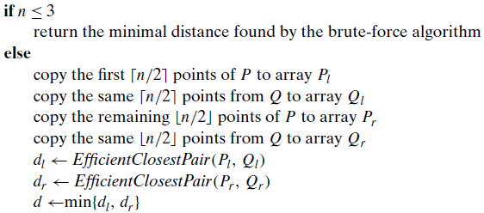
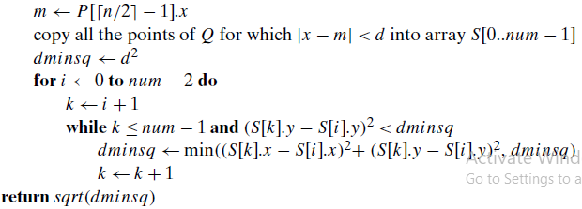
Closest-Pair Problem (Algorithm)

Slide 67
Closest-Pair Problem (Analysis)
T(n) = 2T(n/2) + O(n)
By the Master Theorem
T(n) ∈ O(n log n)

Slide 68
Quickhull Problem
Divide and Conquer

Slide 69
Convex-Hull Problem
Brute Force Solution
Draw line segments making up the boundary of a convex hull
a line segment connecting two points p_{i} and p_{j} of a set of n points is a part of the convex hull’s boundary if and only if all the other points of the set lie on the same side of the straight line through these two points

Slide 70
Convex-Hull Problem
Analysis
# of distinct pairs of points
n(n-1) / 2
# of points to process
n - 2
O(n³)

Slide 71
Quickhull Problem
smallest convex set that includes given points
points are sorted by x-coordinate values
Identify extreme points P₁ and P₂ (leftmost and rightmost)
Compute upper hull recursively:
find point P_{max} that is farthest away from line P₁P₂
compute the upper hull of the points to the left of line P₁P_{max}
compute the upper hull of the points to the left of line P_{max}P₂
Compute lower hull in a similar manner

Slide 72
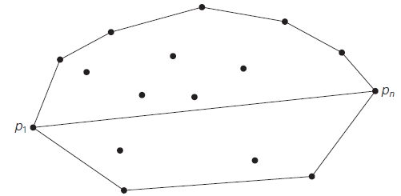
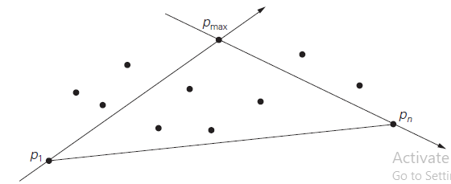
Quickhull Problem

Slide 73
Quickhull Problem (Analysis)
Worst case
Θ(n²)

Slide 74

Allah (Alone) is Sufficient for us, and He is the Best Disposer of affairs (for us).(Quran 3 : 173)

