Slide 1


O my Lord! Expand for me my chest [with assurance] and ease for me my task and untie the knot from my tongue that they may understand my speech. (Quran 20 : 25-28)

Slide 2
Transform and Conquer
Introduction

Slide 3
Transform and Conquer
This technique has first stage i.e. transformation to
a simpler/more convenient instance of the same problem instance simplification
a different representation of the same instance representation change
a different problem for which an algorithm is already available problem reduction

Slide 4



Transform and Conquer
This techniques has the second stage i.e. conquer
Provide the SOLUTION of the transformed instance of original problem

Slide 5
Instances Simplification
Transform and Conquer

Slide 6
Presorting
Solve a problem’s instance by transforming it into another simpler/easier instance of the same problem
Sorting
any sorting algorithm – Θ(n log n)
Example
Many problems involving lists are easier when list is sorted, e.g.
checking if all elements are distinct (element uniqueness)
computing the median (selection problem)
searching

Slide 7
Element Uniqueness Problem
Presorting

Slide 8
Element Uniqueness Problem
In a given array, find out either all elements are unique or not
Brute Force Approach
Unsorted data
Compare all values with each other
Θ(n²)

Slide 9





Element Uniqueness Problem (Analysis)

Slide 10
Computing a mode
Presorting

Slide 11
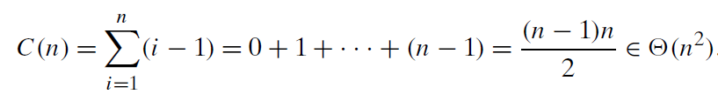

Computing a mode
A mode is a value that occurs most often in a given list of numbers
Brute Force Approach
Unsorted data

Slide 12






Computing a mode (Algorithm)

Slide 13
Computing a mode (Analysis)

Slide 14
Searching Problem
Presorting

Slide 15
Searching Problem
The problem is searching for a given value v in a given array of n items.
Brute Force Approach
Sequential / Linear Search
Θ(n)
Transform and Conquer
Sort the data Θ(n log n)
Binary Search Θ(log n)
T(n) = Θ(n log n) + Θ(log n) = Θ(n log n)

Slide 16
Gaussian Elimination
Instance Simplification

Slide 17
Gaussian Elimination
Given: A system of n linear equations in n unknowns with an arbitrary coefficient matrix.
Transform to: An equivalent system of n linear equations in n unknowns with an upper triangular coefficient matrix.
Solve: the latter by substitutions starting with the last equation and moving up to the first one.

Slide 18

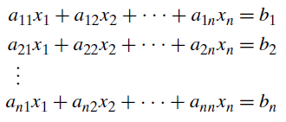
Gaussian Elimination

Slide 19
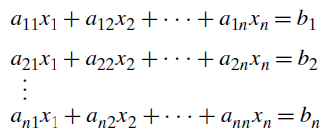
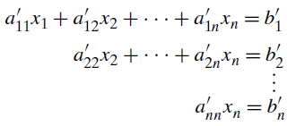

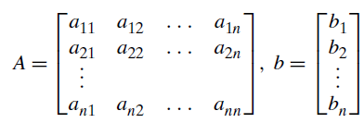
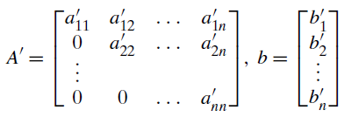
Gaussian Elimination

Slide 20

Gaussian Elimination

Slide 21
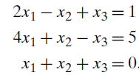







Gaussian Elimination (Example)

Slide 22

Gaussian Elimination (Example)

Slide 23
Gaussian Elimination (Algorithm)

Slide 24
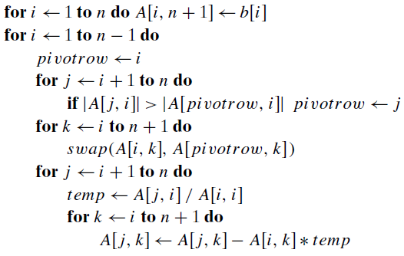
Gaussian Elimination (Algorithm)

Slide 25




Gaussian Elimination (Analysis)

Slide 26




Gaussian Elimination (Analysis)

Slide 27




Gaussian Elimination (Analysis)

Slide 28
LU Decomposition
Instance Simplification
Students’ Exercise

Slide 29
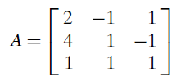
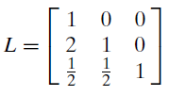

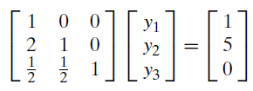
LU Decomposition

Slide 30


LU Decomposition

Slide 31
Balanced Search Tree
Instance Simplification

Slide 32
Adelson-Velsky and Landis AVL Tree
Binary Search Tree
It requires the absolute difference between the heights of the left and right subtrees of every node never exceed 1
Difference is known as Balance factor (+1, 0, -1)
Empty tree height is -1
One node tree height is 0

Slide 33
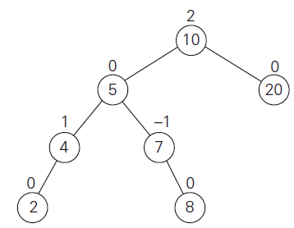
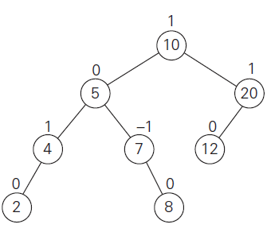
Adelson-Velsky and Landis AVL Tree

Slide 34
AVL Tree
At any time insertion of a new node makes an AVL tree unbalanced (Balance Factor +2, -2)
Solution – Rotation
Closest unbalanced node of the newly inserted node

Slide 35
AVL Tree
Rotation Types
Single right rotation, or R-rotation
Single left rotation, or L-rotation
double left-right rotation or LR-rotation
double right-left rotation or RL-rotation

Slide 36
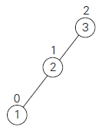
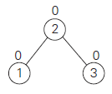

Single right rotation, or R-rotation
Rotating the edge connecting the root and its left child in the binary tree in to the right.

Slide 37
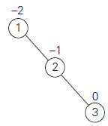
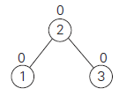

Single left rotation, or L-rotation
It is the mirror image of the single R-rotation

Slide 38

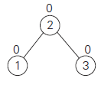

double left-right rotation or LR-rotation
a combination of two rotations:
L-rotation of the left subtree of root r
followed by the R-rotation of the new tree rooted at r

Slide 39
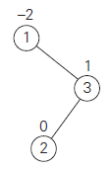
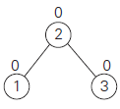

double right-left rotation or RL-rotation
It is the mirror image of the double LR-rotation

Slide 40


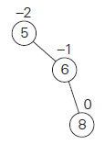
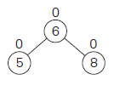

AVL Example: 5, 6, 8, 3, 2, 4, 7
5
,6
,8

Slide 41
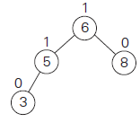
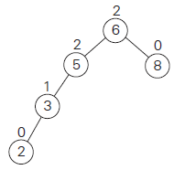
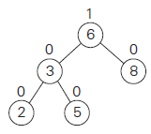

AVL Example: 5, 6, 8, 3, 2, 4, 7
5
,6
,8
,3
,2

Slide 42
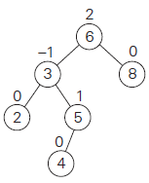
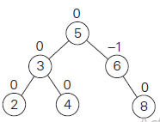

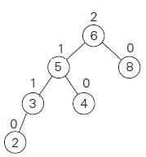
AVL Example: 5, 6, 8, 3, 2, 4, 7
5
,6
,8
,3
,2
,4

Slide 43
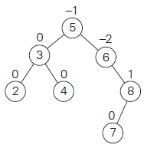
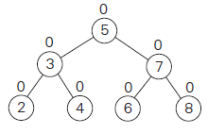

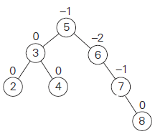
AVL Example: 5, 6, 8, 3, 2, 4, 7
5
,6
,8
,3
,2
,4
,7

Slide 44
AVL Example: 5, 6, 8, 3, 2, 4, 7
5
,6
,8
,3
,2
,4
,7
Θ( log₂ n)

Slide 45
Representation Change
Transform and Conquer

Slide 46
Transform and Conquer
This technique has first stage i.e. transformation to
a simpler/more convenient instance of the same problem instance simplification
a different representation of the same instance representation change
a different problem for which an algorithm is already available problem reduction

Slide 47
2 – 3 Trees
Representation Change

Slide 48
Multiway Search Trees
Multiple elements in a single node
Example
2-3 trees
2-3-4 trees
B-trees
Perfectly Balanced

Slide 49
2 – 3 Trees
Introduced by the U.S. computer scientist John Hopcroft in 1970
It can have nodes of two kinds:
2-nodes
3-nodes
All leaves are on same level
A 2-node contains a single key K has two children
left child serves as the root of a subtree whose key is less than K
right child serves as the root of a subtree whose key is greater than K

Slide 50
2 – 3 Trees
A 3-node contains two ordered keys K1 and K2 (K1<K2)
It has three children
leftmost child serves as the root of a subtree with keys less than K1
middle child serves as the root of a subtree with keys between K1 and K2
rightmost child serves as the root of a subtree with keys greater than K2

Slide 51
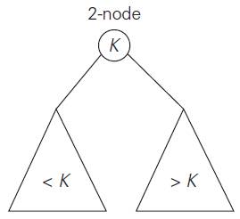
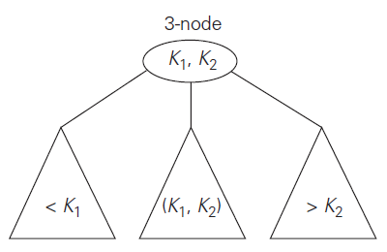
2 – 3 Trees

Slide 52
2 – 3 Trees (Insertion)
Insert a new key K in a leaf
Leaf is a 2-node
Insert K as first key if it is smaller than the node’s old key
Insert K as second key if it is larger than the node’s old key

Slide 53



Leaf has 2-nodes
K
K₁
OR
K₁ < K
K₁ > K

Slide 54
2 – 3 Trees (Insertion)
Leaf has 3-node:
Split the leaf in two
The smallest key is put in the first leaf
The largest key is put in the second leaf
The middle key is promoted to the old leaf’s parent. (If the leaf happens to be the tree’s root, a new root is created to accept the middle key.)

Slide 55

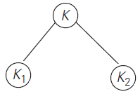
Leaf has 3-nodes
K
K₁
K₂
K₁ < K
K₁< K< K₂

Slide 56







2 -3 Tree (Example)
9
5
8
3
2

Slide 57

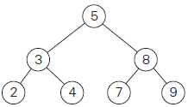


2 -3 Tree (Example)
2
4
7

Slide 58

2 -3 Tree (Analysis)
A 2-3 tree of height h
Smallest number of keys is a full tree of 2-nodes

Slide 59

2 -3 Tree (Analysis)
A 2-3 tree of height h
largest number of keys is a full tree of 3-nodes

Slide 60

2 -3 Tree (Analysis)
A 2-3 tree of height h
smallest number of keys
largest number of keys
Hence

Slide 61
Heap & Heap Sort
Representation Change

Slide 62
Heap
It is complete binary tree
If subscript start with “1”
Left(i) = 2 * i
Right(i) = 2 * i + 1
Parent(i)= i / 2

Slide 63
Heap
If subscript start with “0”
Left(i) = 2 * i + 1
Right(i) = 2 * i + 2
Parent(i)= (i -1)/ 2

Slide 64
Heap Types
Max Heap
A [ Parent(i) ] >= A [ i ]
Min Heap
A [ Parent(i) ] <= A [ i ]

Slide 65
Basic Procedures of Heap
MAX-HEAPIFY
BUILD-MAX-HEAP
HEAPSORT
MAX-HEAP-INSERT
HEAP-EXTRACT-MAX
HEAP-INCREASE-KEY
HEAP-MAXIMUM

Slide 66
Max-HeapIFY(A, i)
l ← left (i)
r ← right (i)
If l<= heap size[A] and A[l] > A[i]
then largest ← l
else largest ← i
If r<= heap size[A] and A[r]>A[largest]
then largest ← r
If largest != i
then exchange A [i] ↔ A [largets]
Max-HeapIFY(A, largest)

Slide 67
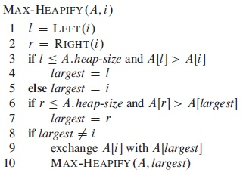
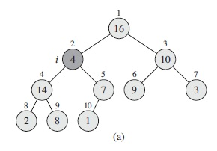
Max-HeapIFY(A, i)

Slide 68
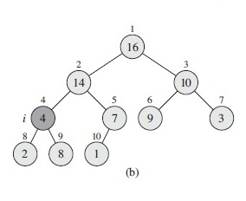
Max-HeapIFY(A, i)

Slide 69
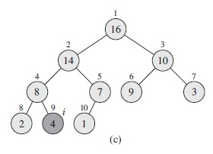
Max-HeapIFY(A, i)

Slide 70
Max-Heapify(A,i) - Analysis
Childern’s subtrees each have size at most 2n/3
T(n) ≤ T(2n/3) + Θ(1)

Slide 71
Max-Heapify(A,i) - Analysis
T(n) ≤ T(2n/3) + Θ(1)
Master Theorem
If f(n) = Θ(n ^{log}_{b} ª), then T(n)=Θ(n ^{log}_{b} ª lg n)
a = 1, b = 3/2, f(n) = 1
n ^{log}_{b} ª = n ^{log}_{3/2} ¹ = n⁰ = 1
T(n) = Θ (lg n)

Slide 72
Build-Max-Heap(A)
A[floor(n/2)+1.. n] are all leaves
heap-size [A] ← length [A]
for i ← floor(length [A] / 2) downto 1 do
Max-HeapIFY(A,i)

Slide 73
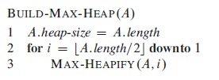
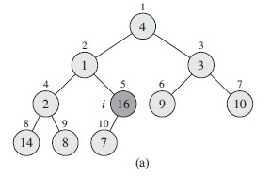
Build-Max-Heap(A) [4,1,3,2,16,9,10,14,8,7]

Slide 74
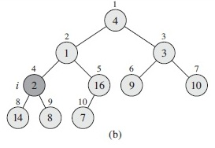
Build-Max-Heap(A)

Slide 75
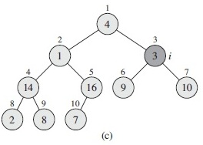
Build-Max-Heap(A)

Slide 76
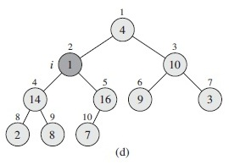
Build-Max-Heap(A)

Slide 77
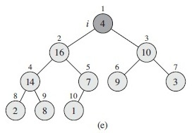
Build-Max-Heap(A)

Slide 78
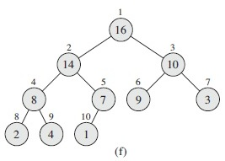
Build-Max-Heap(A)

Slide 79
Build-Max-Heap(A) (Analysis)
Max-Heapify(A,i)
O(lg n) = O(h)
Elements of “h”
Ceiling(n/2^{h+1})
Heights varies
0 to floor(lgn)

Slide 80






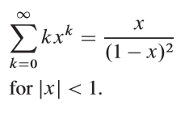
Build-Max-Heap(A) (Analysis)
Max-Heapify(A,i)
O(lg n) = O(h)
Elements of “h”
Ceiling(n/2^{h+1})
Heights varies
0 to floor(lgn)

Slide 81


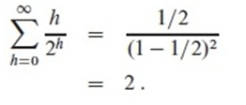
Build-Max-Heap(A) (Analysis)

Slide 82
HeapSort(A) (Algorithm)
Build-Max-Heap(A)
for i ← length [A] downto 2
do exchange A[1] ↔ A[i]
Heap-size[A] ← heap-size[A] – 1
Max-HeapIFY(A,1)

Slide 83
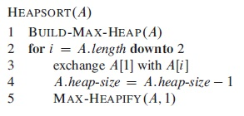
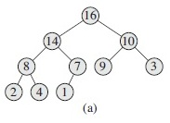
Heapsort(A) [16,14,10,8,7,9,3,2,4,1]

Slide 84

Heapsort(A) [16,14,10,8,7,9,3,2,4,1]

Slide 85

Heapsort(A) [16,14,10,8,7,9,3,2,4,1]

Slide 86

Heapsort(A) [16,14,10,8,7,9,3,2,4,1]

Slide 87

Heapsort(A) [16,14,10,8,7,9,3,2,4,1]

Slide 88

Heapsort(A) [16,14,10,8,7,9,3,2,4,1]

Slide 89

Heapsort(A) [16,14,10,8,7,9,3,2,4,1]

Slide 90

Heapsort(A) [16,14,10,8,7,9,3,2,4,1]

Slide 91

Heapsort(A) [16,14,10,8,7,9,3,2,4,1]

Slide 92

Heapsort(A) [16,14,10,8,7,9,3,2,4,1]

Slide 93
Heapsort(A) (Analysis)
T(n) =
O (n) +
n * O ( lg n)
=
O (n) +
O ( n lg n)
=
O ( n lg n)
Build-Max-Heap(A)
O (n)
Max-HeapIFY(A,i)
O (lg n) = O (h)

Slide 94

Allah (Alone) is Sufficient for us, and He is the Best Disposer of affairs (for us).(Quran 3 : 173)

