Slide 1

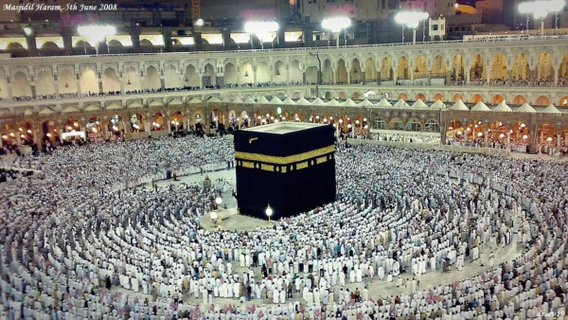
O my Lord! Expand for me my chest [with assurance] and ease for me my task and untie the knot from my tongue that they may understand my speech. (Quran 20 : 25-28)

Slide 2
Horner’s Rule
Representation Change

Slide 3
Horner’s Rule

Slide 4
Horner’s Rule
Computing the value of a polynomial

Slide 5
Horner’s Rule
Computing the value of a polynomial

Slide 6
Horner’s Rule
Computing the value of a polynomial
Introduced by W. G. Horner

Slide 7
Horner’s Rule
Computing the value of a polynomial
Introduced by W. G. Horner

Slide 8
Horner’s Rule (Application)

Slide 9
Horner’s Rule (Application)

Slide 10

Horner’s Rule (Application)

Slide 11
Horner’s Rule (Application)

Slide 12
Horner’s Rule (Example)

Slide 13

Horner’s Rule (Example)

Slide 14

Horner’s Rule (Example)

Slide 15
Horner’s Rule (Example)

Slide 16
Horner’s Rule (Example)

Slide 17
Horner’s Rule (Example)

Slide 18
Horner’s Rule (Example)

Slide 19
Horner’s Rule (Example)

Slide 20
Horner’s Rule (Example)

Slide 21
Horner’s Rule (Example)

Slide 22
Horner’s Rule (Example)

Slide 23
Horner’s Rule (Example)

Slide 24
Horner’s Rule (Example)

Slide 25
Horner’s Rule (Example)

Slide 26
Horner’s Rule (Example)

Slide 27
Horner’s Rule (Example)

Slide 28
Horner’s Rule (Example)

Slide 29
Horner’s Rule (Example)

Slide 30


Horner’s Rule (Algorithm)

Slide 31
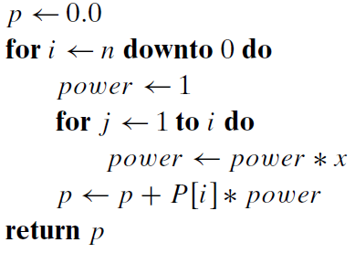
Horner’s Rule (Algorithm)
Brute Force Algo.

Slide 32


Horner’s Rule (Analysis)

Slide 33
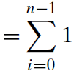
Horner’s Rule (Analysis)

Slide 34
Horner’s Rule (Analysis)

Slide 35
Binary Exponentiation Student Exercise
Representation Change

Slide 36

Binary Exponentiation
Computing a^{n}
Brute force needs n-1 multiplications
Better solution using Representation-Change
“n” is represented as binary number system

Slide 37
Binary Exponentiation
Value of n can be computed as the value of the polynomial
Example; n = 13 at x = 2
So a^{n} will be represented as

Slide 38
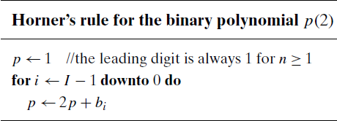
Horner’s Rule for p(2)
Example
n = 13
n = 1101

Slide 39
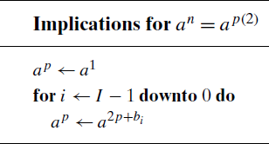
Calculation of a^{n}
Example
a^{n} = 3⁵

Slide 40





Binary Exponentiation
a^{2p+bi}
left-to-right binary exponentiation

Slide 41
Binary Exponentiation (a¹³)

Slide 42

Binary Exponentiation (Analysis)

Slide 43

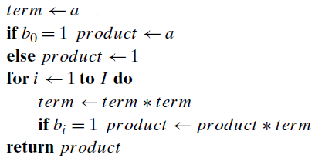
Binary Exponentiation (right-to-left binary exponentiation)

Slide 44
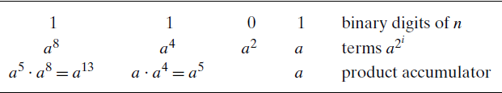
Binary Exponentiation

Slide 45
Transform and Conquer
This technique has first stage i.e. transformation to
a simpler/more convenient instance of the same problem instance simplification
a different representation of the same instance representation change
a different problem for which an algorithm is already available problem reduction

Slide 46





Problem Reduction
If you need to solve a problem, reduce it to another problem that you know how to solve
The practical difficulty: finding a problem to which the problem at hand should be reduced

Slide 47
Least Common Multiple
Problem Reduction

Slide 48
Least Common Multiple lmc (m,n)
The smallest integer that is divisible by both m and n
Example: (prime factors)
lcm (24, 60) = 120

Slide 49



Least Common Multiple lmc (m,n)

Slide 50
Counting Path in Graph
Problem Reduction

Slide 51
Counting Path in Graph
Number of different paths

Slide 52
Counting Path in Graph
Number of different paths
Length k > 0

Slide 53
Counting Path in Graph
Number of different paths
Length k > 0
From vertex “i” to “j”

Slide 54
Counting Path in Graph
Number of different paths
Length k > 0
From vertex “i” to “j”
(i, j)^{th} element of A^{k}

Slide 55
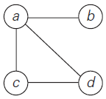
Counting Path in Graph
Number of different paths
Length k > 0
From vertex “i” to “j”
(i, j)^{th} element of A^{k}

Slide 56
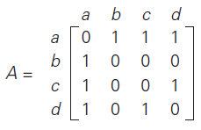
Counting Path in Graph
Number of different paths
Length k > 0
From vertex “i” to “j”
(i, j)^{th} element of A^{k}

Slide 57
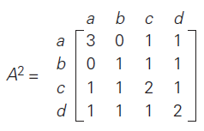
Counting Path in Graph
Number of different paths
Length k > 0
From vertex “i” to “j”
(i, j)^{th} element of A^{k}

Slide 58
Reduction of Optimization Problem
Problem Reduction

Slide 59
Reduction of Optimization Problem
Function f (x)

Slide 60
Reduction of Optimization Problem
Function f (x)
minimization problem

Slide 61
Reduction of Optimization Problem
Function f (x)
minimization problem
maximization problem

Slide 62

Reduction of Optimization Problem
Function f (x)
minimization problem
maximization problem

Slide 63

Reduction of Optimization Problem
Function f (x)
minimization problem
maximization problem

Slide 64
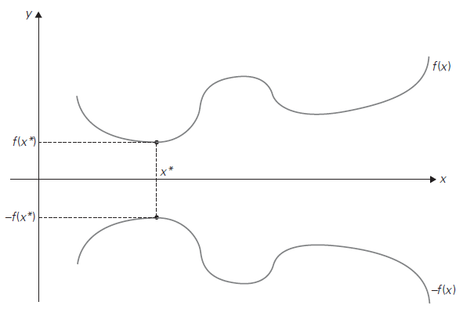
Reduction of Optimization Problem
Function f (x)
minimization problem
maximization problem

Slide 65
Reduction to Graph
Problem Reduction

Slide 66
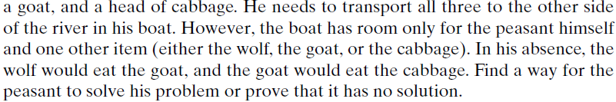
Reduction to Graph

Slide 67
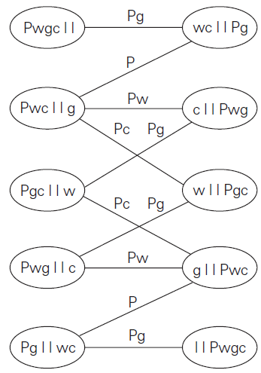
Reduction to Graph

Slide 68

Allah (Alone) is Sufficient for us, and He is the Best Disposer of affairs (for us).(Quran 3 : 173)

