Slide 1

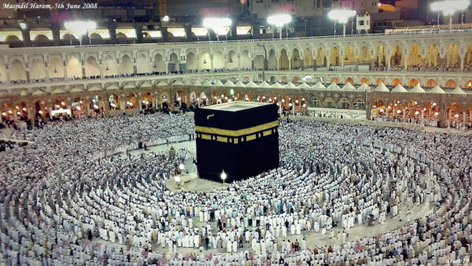
O my Lord! Expand for me my chest [with assurance] and ease for me my task and untie the knot from my tongue that they may understand my speech. (Quran 20 : 25-28)

Slide 2
Linear Time Sorting
Introduction

Slide 3
Linear Time Sorting
Sorting Techniques
No Comparison with different values
It sorts the data in Linear time.
Running time O (n)

Slide 4
Sorting Techniques
Counting Sort
Radix Sort
Bucket Sort

Slide 5
Counting Sort
Algorithm & Its Tracing

Slide 6
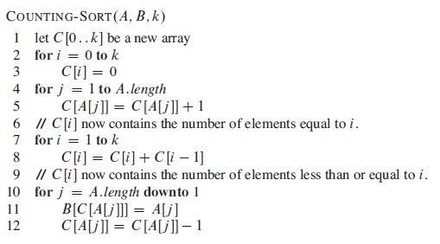
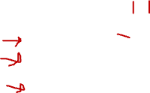
Counting Sort

Slide 7


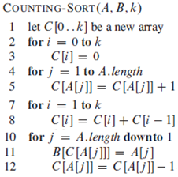








Counting Sort

Slide 8
Counting Sort
Analysis

Slide 9
Counting Sort
Statement Cost Iteration
1 c₁ 1
2 c₂ k+1
3 c₃ k
4 c₄ n
5 c₅ n – 1
6 0 1
7 c₇ k
8 c₈ k-1
9 0 1
10 c₁₀ n
11 c₁₁ n-1
12 c₁₂ n - 1
T(n) = c₁+c₂(k+1)+c₃k+c₄n+c₅(n-1)+c₇k+c₈(k-1)+c₁₀n+c₁₁(n-1)+c₁₂(n-1)
T(n) = an + c
T(n) = Θ(n)

Slide 10
Bucket Sort
Algorithm & Its Tracing

Slide 11
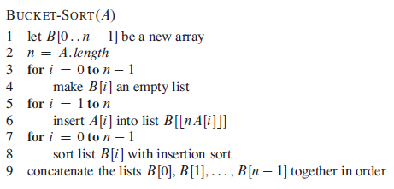
Bucket Sort

Slide 12


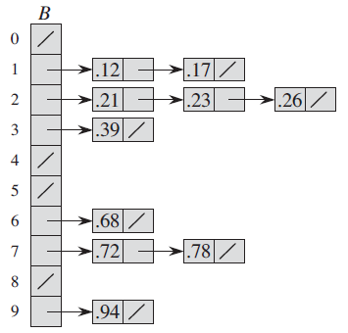
Bucket sort

Slide 13
Bucket Sort
Analysis

Slide 14




Bucket Sort

Slide 15





Bucket Sort

Slide 16






Bucket Sort

Slide 17





Bucket Sort
So by putting these valuse back in
E[T(n)]

Slide 18
Bucket Sort
E[T(n) ] = ϴ(n) + n . O(2-1/n)
= ϴ(n)

Slide 19
Radix Sort
Algorithm & Its Tracing

Slide 20

RADIX SORT

Slide 21
0 | 1 | 2 | 3 | 4 | 5 | 6
329 | 457 | 657 | 839 | 436 | 720 | 355
 | 0 | 1 | 2 | 3 | 4 | 5 | 6 | 7 | 8 | 9
1st
2nd
3rd
0 | 1 | 2 | 3 | 4 | 5 | 6

Slide 22
0 | 1 | 2 | 3 | 4 | 5 | 6
329 | 457 | 657 | 839 | 436 | 720 | 355
 | 0 | 1 | 2 | 3 | 4 | 5 | 6 | 7 | 8 | 9
1st |  |  |  |  |  |  |  |  |  | 329,
2nd
3rd
0 | 1 | 2 | 3 | 4 | 5 | 6

Slide 23
0 | 1 | 2 | 3 | 4 | 5 | 6
329 | 457 | 657 | 839 | 436 | 720 | 355
 | 0 | 1 | 2 | 3 | 4 | 5 | 6 | 7 | 8 | 9
1st |  |  |  |  |  |  |  | 457, |  | 329,
2nd
3rd
0 | 1 | 2 | 3 | 4 | 5 | 6

Slide 24
0 | 1 | 2 | 3 | 4 | 5 | 6
329 | 457 | 657 | 839 | 436 | 720 | 355
 | 0 | 1 | 2 | 3 | 4 | 5 | 6 | 7 | 8 | 9
1st |  |  |  |  |  |  |  | 457, 657 |  | 329,
2nd
3rd
0 | 1 | 2 | 3 | 4 | 5 | 6

Slide 25
0 | 1 | 2 | 3 | 4 | 5 | 6
329 | 457 | 657 | 839 | 436 | 720 | 355
 | 0 | 1 | 2 | 3 | 4 | 5 | 6 | 7 | 8 | 9
1st |  |  |  |  |  |  |  | 457, 657 |  | 329, 839
2nd
3rd
0 | 1 | 2 | 3 | 4 | 5 | 6

Slide 26
0 | 1 | 2 | 3 | 4 | 5 | 6
329 | 457 | 657 | 839 | 436 | 720 | 355
 | 0 | 1 | 2 | 3 | 4 | 5 | 6 | 7 | 8 | 9
1st |  |  |  |  |  |  | 436 | 457, 657 |  | 329, 839
2nd
3rd
0 | 1 | 2 | 3 | 4 | 5 | 6

Slide 27
0 | 1 | 2 | 3 | 4 | 5 | 6
329 | 457 | 657 | 839 | 436 | 720 | 355
 | 0 | 1 | 2 | 3 | 4 | 5 | 6 | 7 | 8 | 9
1st | 720 |  |  |  |  |  | 436 | 457, 657 |  | 329, 839
2nd
3rd
0 | 1 | 2 | 3 | 4 | 5 | 6

Slide 28
0 | 1 | 2 | 3 | 4 | 5 | 6
329 | 457 | 657 | 839 | 436 | 720 | 355
 | 0 | 1 | 2 | 3 | 4 | 5 | 6 | 7 | 8 | 9
1st | 720 |  |  |  |  | 355 | 436 | 457, 657 |  | 329, 839
2nd
3rd
0 | 1 | 2 | 3 | 4 | 5 | 6

Slide 29
0 | 1 | 2 | 3 | 4 | 5 | 6
329 | 457 | 657 | 839 | 436 | 720 | 355
 | 0 | 1 | 2 | 3 | 4 | 5 | 6 | 7 | 8 | 9
1st | 720 |  |  |  |  | 355 | 436 | 457, 657 |  | 329, 839
2nd |  |  | 720,
3rd
0 | 1 | 2 | 3 | 4 | 5 | 6

Slide 30
0 | 1 | 2 | 3 | 4 | 5 | 6
329 | 457 | 657 | 839 | 436 | 720 | 355
 | 0 | 1 | 2 | 3 | 4 | 5 | 6 | 7 | 8 | 9
1st | 720 |  |  |  |  | 355 | 436 | 457, 657 |  | 329, 839
2nd |  |  | 720, |  |  | 355,
3rd
0 | 1 | 2 | 3 | 4 | 5 | 6

Slide 31
0 | 1 | 2 | 3 | 4 | 5 | 6
329 | 457 | 657 | 839 | 436 | 720 | 355
 | 0 | 1 | 2 | 3 | 4 | 5 | 6 | 7 | 8 | 9
1st | 720 |  |  |  |  | 355 | 436 | 457, 657 |  | 329, 839
2nd |  |  | 720, | 436, |  | 355,
3rd
0 | 1 | 2 | 3 | 4 | 5 | 6

Slide 32
0 | 1 | 2 | 3 | 4 | 5 | 6
329 | 457 | 657 | 839 | 436 | 720 | 355
 | 0 | 1 | 2 | 3 | 4 | 5 | 6 | 7 | 8 | 9
1st | 720 |  |  |  |  | 355 | 436 | 457, 657 |  | 329, 839
2nd |  |  | 720, | 436, |  | 355, 457,
3rd
0 | 1 | 2 | 3 | 4 | 5 | 6

Slide 33
0 | 1 | 2 | 3 | 4 | 5 | 6
329 | 457 | 657 | 839 | 436 | 720 | 355
 | 0 | 1 | 2 | 3 | 4 | 5 | 6 | 7 | 8 | 9
1st | 720 |  |  |  |  | 355 | 436 | 457, 657 |  | 329, 839
2nd |  |  | 720, | 436, |  | 355, 457, 657
3rd
0 | 1 | 2 | 3 | 4 | 5 | 6

Slide 34
0 | 1 | 2 | 3 | 4 | 5 | 6
329 | 457 | 657 | 839 | 436 | 720 | 355
 | 0 | 1 | 2 | 3 | 4 | 5 | 6 | 7 | 8 | 9
1st | 720 |  |  |  |  | 355 | 436 | 457, 657 |  | 329, 839
2nd |  |  | 720, 329 | 436, |  | 355, 457, 657
3rd
0 | 1 | 2 | 3 | 4 | 5 | 6

Slide 35
0 | 1 | 2 | 3 | 4 | 5 | 6
329 | 457 | 657 | 839 | 436 | 720 | 355
 | 0 | 1 | 2 | 3 | 4 | 5 | 6 | 7 | 8 | 9
1st | 720 |  |  |  |  | 355 | 436 | 457, 657 |  | 329, 839
2nd |  |  | 720, 329 | 436, 839 |  | 355, 457, 657
3rd
0 | 1 | 2 | 3 | 4 | 5 | 6

Slide 36
0 | 1 | 2 | 3 | 4 | 5 | 6
329 | 457 | 657 | 839 | 436 | 720 | 355
 | 0 | 1 | 2 | 3 | 4 | 5 | 6 | 7 | 8 | 9
1st | 720 |  |  |  |  | 355 | 436 | 457, 657 |  | 329, 839
2nd |  |  | 720, 329 | 436, 839 |  | 355, 457, 657
3rd |  |  |  |  |  |  |  | 720
0 | 1 | 2 | 3 | 4 | 5 | 6

Slide 37
0 | 1 | 2 | 3 | 4 | 5 | 6
329 | 457 | 657 | 839 | 436 | 720 | 355
 | 0 | 1 | 2 | 3 | 4 | 5 | 6 | 7 | 8 | 9
1st | 720 |  |  |  |  | 355 | 436 | 457, 657 |  | 329, 839
2nd |  |  | 720, 329 | 436, 839 |  | 355, 457, 657
3rd |  |  |  | 329, |  |  |  | 720
0 | 1 | 2 | 3 | 4 | 5 | 6

Slide 38
0 | 1 | 2 | 3 | 4 | 5 | 6
329 | 457 | 657 | 839 | 436 | 720 | 355
 | 0 | 1 | 2 | 3 | 4 | 5 | 6 | 7 | 8 | 9
1st | 720 |  |  |  |  | 355 | 436 | 457, 657 |  | 329, 839
2nd |  |  | 720, 329 | 436, 839 |  | 355, 457, 657
3rd |  |  |  | 329, | 436, |  |  | 720
0 | 1 | 2 | 3 | 4 | 5 | 6

Slide 39
0 | 1 | 2 | 3 | 4 | 5 | 6
329 | 457 | 657 | 839 | 436 | 720 | 355
 | 0 | 1 | 2 | 3 | 4 | 5 | 6 | 7 | 8 | 9
1st | 720 |  |  |  |  | 355 | 436 | 457, 657 |  | 329, 839
2nd |  |  | 720, 329 | 436, 839 |  | 355, 457, 657
3rd |  |  |  | 329, | 436, |  |  | 720 | 839
0 | 1 | 2 | 3 | 4 | 5 | 6

Slide 40
0 | 1 | 2 | 3 | 4 | 5 | 6
329 | 457 | 657 | 839 | 436 | 720 | 355
 | 0 | 1 | 2 | 3 | 4 | 5 | 6 | 7 | 8 | 9
1st | 720 |  |  |  |  | 355 | 436 | 457, 657 |  | 329, 839
2nd |  |  | 720, 329 | 436, 839 |  | 355, 457, 657
3rd |  |  |  | 329, 355 | 436, |  |  | 720 | 839
0 | 1 | 2 | 3 | 4 | 5 | 6

Slide 41
0 | 1 | 2 | 3 | 4 | 5 | 6
329 | 457 | 657 | 839 | 436 | 720 | 355
 | 0 | 1 | 2 | 3 | 4 | 5 | 6 | 7 | 8 | 9
1st | 720 |  |  |  |  | 355 | 436 | 457, 657 |  | 329, 839
2nd |  |  | 720, 329 | 436, 839 |  | 355, 457, 657
3rd |  |  |  | 329, 355 | 436, 457 |  |  | 720 | 839
0 | 1 | 2 | 3 | 4 | 5 | 6

Slide 42
0 | 1 | 2 | 3 | 4 | 5 | 6
329 | 457 | 657 | 839 | 436 | 720 | 355
 | 0 | 1 | 2 | 3 | 4 | 5 | 6 | 7 | 8 | 9
1st | 720 |  |  |  |  | 355 | 436 | 457, 657 |  | 329, 839
2nd |  |  | 720, 329 | 436, 839 |  | 355, 457, 657
3rd |  |  |  | 329, 355 | 436, 457 |  | 657 | 720 | 839
0 | 1 | 2 | 3 | 4 | 5 | 6

Slide 43
0 | 1 | 2 | 3 | 4 | 5 | 6
329 | 457 | 657 | 839 | 436 | 720 | 355
 | 0 | 1 | 2 | 3 | 4 | 5 | 6 | 7 | 8 | 9
1st | 720 |  |  |  |  | 355 | 436 | 457, 657 |  | 329, 839
2nd |  |  | 720, 329 | 436, 839 |  | 355, 457, 657
3rd |  |  |  | 329, 355 | 436, 457 |  | 657 | 720 | 839
0 | 1 | 2 | 3 | 4 | 5 | 6
329

Slide 44
0 | 1 | 2 | 3 | 4 | 5 | 6
329 | 457 | 657 | 839 | 436 | 720 | 355
 | 0 | 1 | 2 | 3 | 4 | 5 | 6 | 7 | 8 | 9
1st | 720 |  |  |  |  | 355 | 436 | 457, 657 |  | 329, 839
2nd |  |  | 720, 329 | 436, 839 |  | 355, 457, 657
3rd |  |  |  | 329, 355 | 436, 457 |  | 657 | 720 | 839
0 | 1 | 2 | 3 | 4 | 5 | 6
329 | 355

Slide 45
0 | 1 | 2 | 3 | 4 | 5 | 6
329 | 457 | 657 | 839 | 436 | 720 | 355
 | 0 | 1 | 2 | 3 | 4 | 5 | 6 | 7 | 8 | 9
1st | 720 |  |  |  |  | 355 | 436 | 457, 657 |  | 329, 839
2nd |  |  | 720, 329 | 436, 839 |  | 355, 457, 657
3rd |  |  |  | 329, 355 | 436, 457 |  | 657 | 720 | 839
0 | 1 | 2 | 3 | 4 | 5 | 6
329 | 355 | 436

Slide 46
0 | 1 | 2 | 3 | 4 | 5 | 6
329 | 457 | 657 | 839 | 436 | 720 | 355
 | 0 | 1 | 2 | 3 | 4 | 5 | 6 | 7 | 8 | 9
1st | 720 |  |  |  |  | 355 | 436 | 457, 657 |  | 329, 839
2nd |  |  | 720, 329 | 436, 839 |  | 355, 457, 657
3rd |  |  |  | 329, 355 | 436, 457 |  | 657 | 720 | 839
0 | 1 | 2 | 3 | 4 | 5 | 6
329 | 355 | 436 | 457

Slide 47
0 | 1 | 2 | 3 | 4 | 5 | 6
329 | 457 | 657 | 839 | 436 | 720 | 355
 | 0 | 1 | 2 | 3 | 4 | 5 | 6 | 7 | 8 | 9
1st | 720 |  |  |  |  | 355 | 436 | 457, 657 |  | 329, 839
2nd |  |  | 720, 329 | 436, 839 |  | 355, 457, 657
3rd |  |  |  | 329, 355 | 436, 457 |  | 657 | 720 | 839
0 | 1 | 2 | 3 | 4 | 5 | 6
329 | 355 | 436 | 457 | 657

Slide 48
0 | 1 | 2 | 3 | 4 | 5 | 6
329 | 457 | 657 | 839 | 436 | 720 | 355
 | 0 | 1 | 2 | 3 | 4 | 5 | 6 | 7 | 8 | 9
1st | 720 |  |  |  |  | 355 | 436 | 457, 657 |  | 329, 839
2nd |  |  | 720, 329 | 436, 839 |  | 355, 457, 657
3rd |  |  |  | 329, 355 | 436, 457 |  | 657 | 720 | 839
0 | 1 | 2 | 3 | 4 | 5 | 6
329 | 355 | 436 | 457 | 657 | 720

Slide 49
0 | 1 | 2 | 3 | 4 | 5 | 6
329 | 457 | 657 | 839 | 436 | 720 | 355
 | 0 | 1 | 2 | 3 | 4 | 5 | 6 | 7 | 8 | 9
1st | 720 |  |  |  |  | 355 | 436 | 457, 657 |  | 329, 839
2nd |  |  | 720, 329 | 436, 839 |  | 355, 457, 657
3rd |  |  |  | 329, 355 | 436, 457 |  | 657 | 720 | 839
0 | 1 | 2 | 3 | 4 | 5 | 6
329 | 355 | 436 | 457 | 657 | 720 | 839

Slide 50




Radix Sort

Slide 51
Radix Sort
Analysis

Slide 52
Radix Sort
T(n) = c1. d + c2 (d-1)
T(n) = (c1+c2) d – c2
T(n) = ad + b
T(n) = Θ(d)

Slide 53
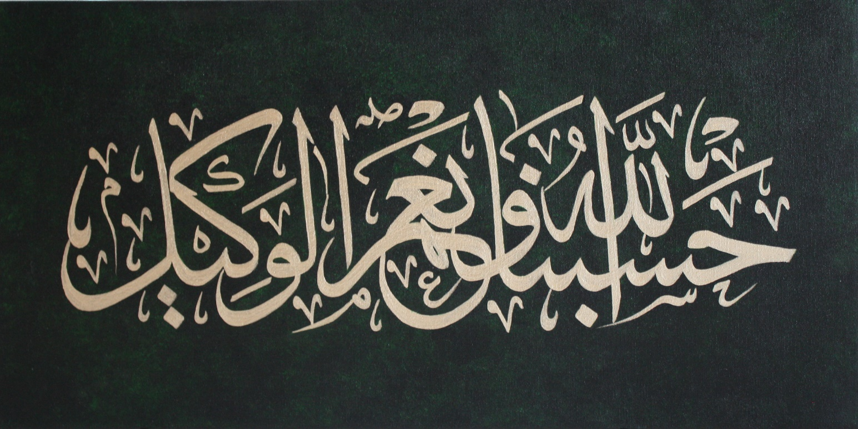
Allah (Alone) is Sufficient for us, and He is the Best Disposer of affairs (for us).(Quran 3 : 173)

