Slide 1


O my Lord! Expand for me my chest [with assurance] and ease for me my task and untie the knot from my tongue that they may understand my speech. (Quran 20 : 25-28)

Slide 2
Space and Time Tradeoff
Introduction

Slide 3
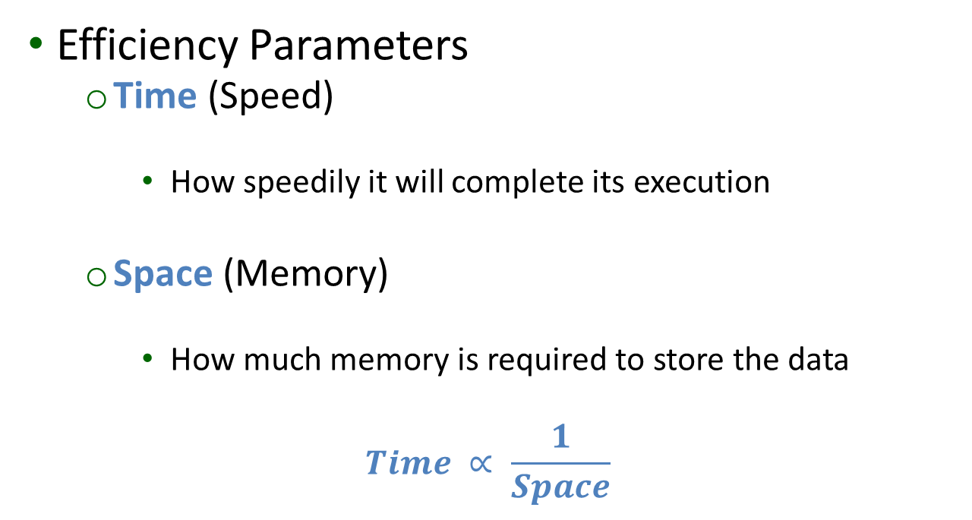
Algorithm Analysis
Efficiency Parameters
Time (Speed)
How speedily it will complete its execution
Space (Memory)
How much memory is required to store the data
$$Time ∝ \frac{1}{Space}$$

Slide 4
Space Time Trade Off
Preprocess the problem input
Partial or Whole
Store Additional Information
Space-for-Time Trade-Off
Time-for-Space Trade-Off

Slide 5
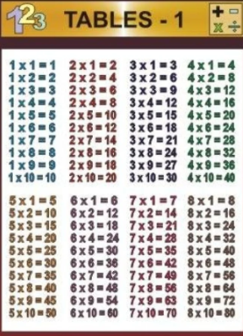
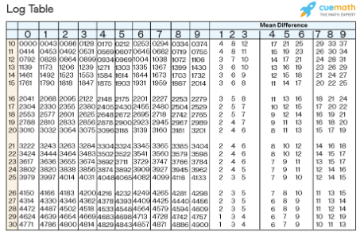
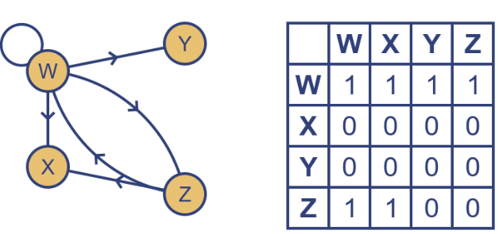
Space Time Trade Off
Space-for-Time trade-offs
Number Tables
Logarithmic Tables etc.
Adjacency Matrix
Adjacency List

Slide 6
Space-for-time trade-offs
Input Enhancement
Counting Methods for Sorting
String Matching Algorithms
Horspool’s Algorithm
Boyer-Moore
Pre Structuring
Hashing
Indexing with B-Trees

Slide 7
Sorting by Counting
Input Enhancement

Slide 8
Sorting by Counting
Comparison Counting Sort
Distribution Counting Sort

Slide 9
Input Enhancement
Comparison Counting Sort

Slide 10
Comparison Counting Sort
We apply input enhancement technique for sorting a list of numbers.
For each element of the list, we shall count the number of elements smaller than this element and record the results in a table.
Count the total number of smaller elements compared to key value
e.g. for “count” 10, the element will be placed at 11th position

Slide 11
Comparison Counting Sort
Finally, we shall copy the elements of this resultant list to their appropriate positions in a new sorted list.
This algorithm is called “Comparison Counting Sort”.

Slide 12
Comparison Counting Sort

Slide 13
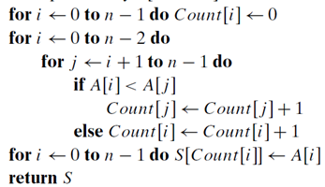






Comparison Counting Sort
A
Count
 | 31 |  | 62
 | 31 |  | 62 | 84
 |  |  | 62
19 | 31 | 47 | 62 | 84 | 96
19 | 31 |  | 62 | 84 | 96
 | 31 |  | 62 | 84 | 96
0
1
2
3
4
5

Slide 14
Comparison Counting Sort (Student Example)
0 | 1 | 2 | 3 | 4 | 5
15 | 75 | 45 | 25 | 5 | 55

Slide 15

Comparison Counting Sort (Analysis) Formal Analysis
The 1st ‘for’ loop runs from 0 to n-1 i.e. n times whereas the last ‘for’ loop also runs from 0 to n-1 i.e. n times.
In the nested ‘for’ loops, the outer ‘for’ loop runs from 0 to n-2 whereas the inner ‘for’ loop runs from i+1 to n-1.
Thus the total running time of above algorithm is

Slide 16









Comparison Counting Sort (Analysis) Formal Analysis

Slide 17









Comparison Counting Sort (Analysis) Informal Analysis

Slide 18
Comparison Counting Sort
Running Time
Quadratic (n²)
Similar to Insertion sort, Selection Sort
Applicable for atomic values
Not appropriate for a data set containing multiple occurrences of a key value
Requires additional space
Minimum movement of data to rearrange
Directly placed on appropriate position
More useful on small set of domain values

Slide 19
Input Enhancement
Distribution Counting Sort
(1st Variant)

Slide 20
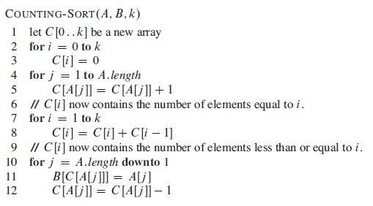
Distribution Counting Sort
*Reference Book: “Introduction To Algorithm, 3rd Edition pp:195

Slide 21










Distribution Counting Sort

Slide 22
Distribution Counting Sort (Student Example – 1st Variant)
1 | 2 | 3 | 4 | 5 | 6 | 7 | 8 | 9 | 10 | 11 | 12 | 13 | 14 | 15
7 | 3 | 6 | 7 | 7 | 3 | 2 | 5 | 1 | 5 | 9 | 3 | 1 | 4 | 5

Slide 23
Input Enhancement
Distribution Counting Sort
(2nd Variant) – Student Exercise

Slide 24
Distribution Counting Sort
Count number of occurrences of key value
Estimate the last location of the key to be placed
Process the input array from right to left
Lowest value will be copied from position 0 to F[0] -1
Next value will be copied to position from F[0] to (F[0] + F[1]) - 1

Slide 25

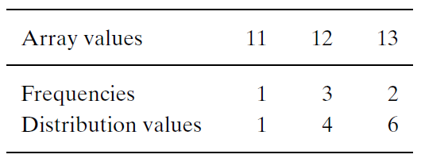
Distribution Counting Sort
Input Enhancement

Slide 26
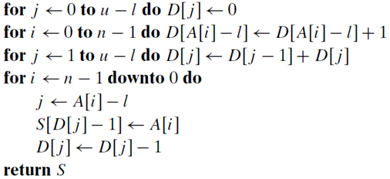
Distribution Counting Sort

Slide 27

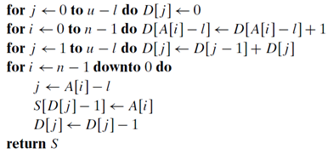


Distribution Counting Sort
A
D
S
0 | 0 | 0
0 | 1 | 2 | 3 | 4 | 5
11 | 12 | 12 | 12 | 13 | 13

Slide 28
Distribution Counting Sort (Student Example – 2nd Variant)
1 | 2 | 3 | 4 | 5 | 6 | 7 | 8 | 9 | 10 | 11 | 12 | 13 | 14 | 15
7 | 3 | 6 | 7 | 7 | 3 | 2 | 5 | 1 | 5 | 9 | 3 | 1 | 4 | 5

Slide 29
Distribution Counting Sort
Running Time
Linear (n)
Better than Insertion sort, Selection Sort, Quick Sort, Merge Sort etc.
Appropriate for atomic, non-atomic (i.e. record) , multiple occurrences of values
Requires additional space
Minimum movement of data to rearrange
Directly placed on appropriate position

