Slide 1
Modern Systems Analysis and Design Sixth Edition Jeffrey A. Hoffer Joey F. George Joseph S. Valacich
Chapter 1
Systems Development in an Organizational Context

Slide 2
Learning Objectives
Define information systems analysis and design.
Describe the information Systems Development Life Cycle (SDLC).
Explain Computer Aided Software Engineering (CASE).
Notes:
the process of studying a procedure or business in order to identify its goals and purposes and create systems and procedures that will achieve them in an efficient way

Slide 3
Introduction
Information Systems Analysis (Systems analysis): is the study of sets of interacting entities, including computer systems analysis.
This field is closely related to requirements analysis.
Design (Systems design): is the process of defining the architecture, components, modules, interfaces, and data for a system to satisfy specified requirements
Notes:
Systems analysis
It is a process of collecting and interpreting facts, identifying the problems, and decomposition of a system into its components
It is a problem solving technique that improves the system and ensures that all the components of the system work efficiently to accomplish their purpose.
Systems design It is a process of planning a new business system or replacing an existing system by defining its components or modules to satisfy the specific requirements.
Before planning, you need to understand the old system thoroughly and determine how computers can best be used in order to operate efficiently.

Slide 4
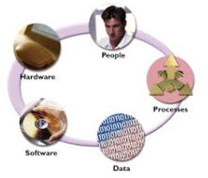
Information systems (IS)
IS is the study of complementary networks of hardware and software that people and organizations use to collect, filter, process, create, and distribute data.
Complex organizational process
Used to develop and maintain computer-based IS
Used by a team of business and systems
professionals
Notes:
Information system consists of five components:
Hardware : physical device,
Software: tells the hardware what to do
Data: information manipulated by the software,
People: all people involved
Process: the steps to accomplish a goal

Slide 5
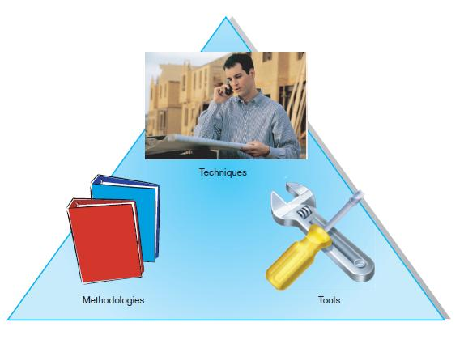
Methodologies, Techniques and Tools
- Techniques are particular process that you should follow to help ensure that your work is complete and comprehensible.
- It includes tasks such as conducting interviews to collect system requirements, diagram the system logic, ..etc.
- Methodologies is multiple-step approaches to system development that guide your work.
- It involved many techniques
- Tools are computer programs make it easy to use and benefit from techniques and to follow guidelines of the overall development methodology
FIGURE 1-1 An organizational approach to systems analysis and
design is driven by methodologies, techniques, and tools

Slide 6
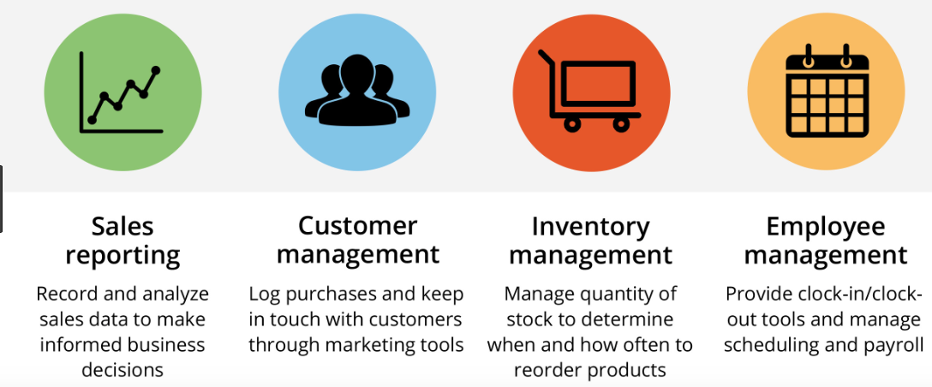
Definitions
Application Software
Computer software designed to support organizational functions or processes such as inventory management or payroll systems.

Slide 7
Definitions
Systems Analyst
Organizational role most responsible for analysis and design of information systems
Study the problems and needs for organizations in order to determine how methods, people, and information technology can be combined to bring improvements to the organizations.

Slide 8
Developing Information Systems
System Development Methodology is a standard set of steps followed in an organization to develop and support their information systems
Development of information systems follows Life Cycle
System Development Life Cycle (SDLC)
Notes:
System methodology is the system of methods used. The common is the SDLC
For example: the commerical product : its sales increase,peak or decline. Finally the product is removed and replace by something else

Slide 9
Systems Development Life Cycle (SDLC)
Traditional methodology used to develop, maintain, and replace information systems.
Phases in SDLC:
Planning
Analysis
Design
Implementation
Maintenance
Notes:
Is a comon methdology gor systems development in many otganization: several phases that mark the progress of the s

Slide 10
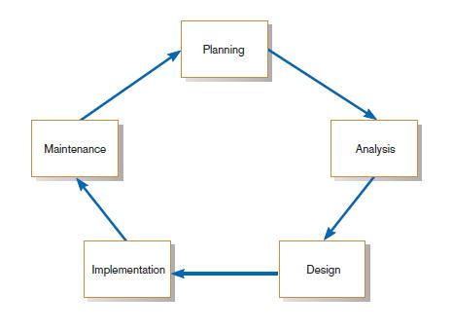
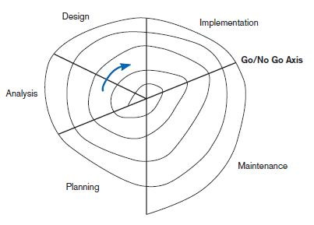
Standard and Evolutionary Views of SDLC
FIGURE 1-3 Evolutionary model
FIGURE 1-2
The systems development life cycle
Notes:
Some times the life cycle is iterative, like a spiral until acceptable system is found

Slide 11
Systems Development Life Cycle (SDLC) (Cont.)
Planning – an organization’s total information system needs are identified, analyzed, prioritized, and arranged
Analysis – system requirements are studied and structured: two phases:
Requirements determination
Study requirements and remove redundant
Notes:
Planning. The scope of the proposed system: someone identifies the need for a new or enhanced system (the needs)
Investigation of the system problem (presentation of why the system should or should not by the organization). The anaylysist produce a specific plan for the proposed project the team will follow using the remaining SDLC system
Has 2 sub phases of analysis.
1- requirement determination. The analysis work with users to determine what the uses want from a proposed system
2- Analysis study the requirement and structure them according to their interrelationships, and eliminate the redundancies

Slide 12
Systems Development Life Cycle (SDLC) (Cont.)
Design – a description of the recommended solution is converted into logical and then physical system specifications
Logical design – all functional features of the system chosen for development in analysis are described independently of any computer platform

Slide 13
Systems Development Life Cycle (SDLC) (Cont.)
Physical design – the logical specifications of the system from logical design are transformed into the technology-specific details from which all programming and system construction can be accomplished

Slide 14
Systems Development Life Cycle (SDLC) (Cont.)
Implementation – the information system is coded, tested, installed and supported in the organization
Maintenance – an information system is systematically repaired and improved

Slide 15
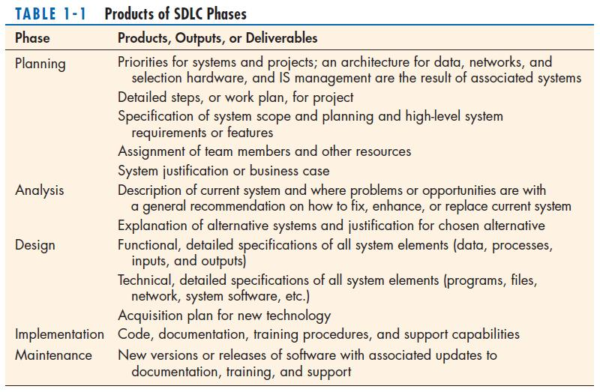

Slide 16
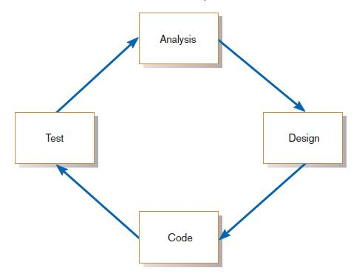
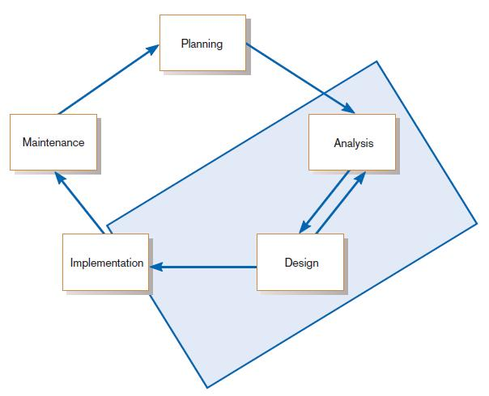
The Heart of the Systems Development Process
FIGURE 1-7
The analysis–design–code–test loop
Current practice combines analysis, design, and implementation into a single iterative and parallel process of activities.
Notes:
The heart of the system development process

Slide 17
Computer-Aided Software Engineering (CASE) Tools
Software package that provides support for the design and implementation of information systems.
Diagramming tools enable graphical representation.
Computer displays and report generators help prototype how systems “look and feel”.
Notes:
CASE tools are computer-based products that support one or more phases within the SDLC. These tools help reduce or eliminate many of the design and development problems inherent in projects produced by manual methods.
CASE tools are set of software application programs, which are used to automate SDLC activities. CASE tools are used by software project managers, analysts and engineers to develop software system.
CASE Tools: The essential idea of CASE tools is that in-built programs can help to analyze developing systems in order to enhance quality and provide better outcomes. Throughout the 1990, CASE tool became part of the software lexicon, and big companies like IBM were using these kinds of tools to help create software.
CASE provide automated support for some portion of the systems development process.
CASE tools are used to support a wide variety of SDLC activities.
There are variety of reasons why organizations choose to adopt case partially or not use it at all.
Lack of vision for applying CASE to all aspects of the SDLC
belief that CASE technology will fail to meet an organization unique system development needs

Slide 18
Computer-Aided Software Engineering (CASE) Tools (Cont.)
Analysis tools automatically check for consistency in diagrams, forms, and reports.
A central repository provides integrated storage of diagrams, reports, and project management specifications.
Documentation generators standardize technical and user documentation.
Code generators enable automatic generation of programs and database code directly from design documents, diagrams, forms, and reports.
Notes:
Central database called REPOSITORY is the common method for providing product and tool integration
(something like project dictionary or workbook)

Slide 19
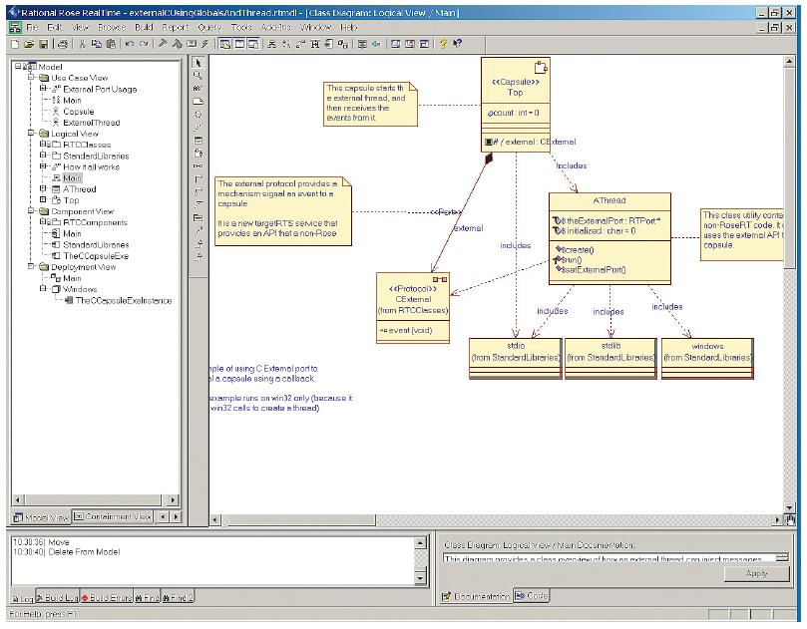
CASE Tools (Cont.)
FIGURE 1-10
A class diagram from IBM’s Rational Rose
(Source: IBM)

Slide 20
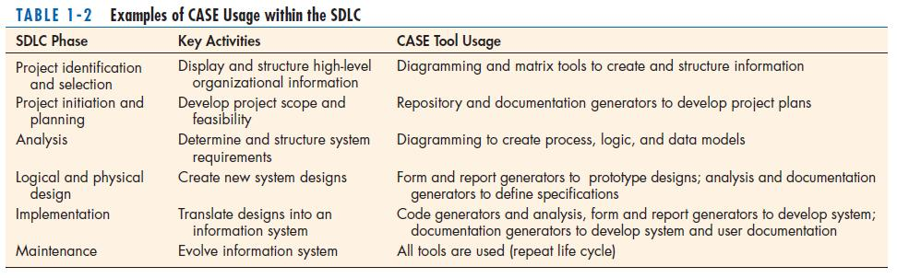
CASE Tools (Cont.)

Slide 21
All rights reserved. No part of this publication may be reproduced, stored in a retrieval system, or transmitted, in any form or by any means, electronic, mechanical, photocopying, recording, or otherwise, without the prior written permission of the publisher. Printed in the United States of America.
Copyright © 2011 Pearson Education, Inc.

