Slide 1
Chapter 9: Virtual Memory

Slide 2

Observations
In many cases, not all of the logical address space of a process is accessed during the life of a process:
  80-20 rule: only, say, 20% is used code while the rest is error handling etc, which is rarely used.
  Arrays, lists, tables - many times are allocated to be able to contain the maximal need, which is rarely needed.
And, of course, not all of the logical memory space is needed at the same time ( loops, recursive functions, etc.

Slide 3

Virtual Memory
Virtual memory is a scheme that allows a process to execute while it is only partially in memory:
  A process is no longer constrained by the amount of physical memory available.
    Process size can exceed the physical memory size
  More programs could be run at the same time, increasing the utilization and throughput of the machine.
  Less I/O is required to load each program and start running it, so each program would start to run faster.

Slide 4
Fetch Policy
Determines when a page should be brought into main memory. Two common policies:
  Demand paging only brings pages into main memory when a reference is made to a location on the page (paging on demand only).
    many page faults when a process is started but should decrease as more pages are brought in.
    It uses lazy swapper (never swap pages into memory unless they are needed)
  Prepaging brings in more pages than needed.
    It is more efficient to bring in pages that reside contiguously on the disk.
    efficiency not definitely established: the extra pages brought in are “often” not referenced.
  Pager is used instead of swapper

Slide 5
Demand Paging
Initially, valid bit is set to 0 for all page table entries.
During address translation, if valid bit in page table entry is 0, a page fault trap occurs.
Some commands makes multiple reference to memory
  Example: Add A, B ( Fetch Instruction ADD, Fetch A, Fetch B, Add A,B, Store Sum into C)
frame
valid
0
A
0
0
3
v
1
B
1
1
i
2
C
2
2
5
v
3
D
3
A
4
3
i
E
4
4
7
v
A
B
5
F
5
C
5
i
C
D
E
6
G
6
6
i
logical memory
7
E
page table
physical memory
Notes:
The valid/invalid bit here might be better named as resident/nonresident because of the conflict in naming with the valid/invalid terms from the last chapter.

Slide 6
Page Fault
Page fault can occur at any memory reference.
Trap to the operating system (save registers and state).
Operating system looks at the process PCB to decide whether:
  Not in logical address space ⇒ abort the process.
  Page is not in memory ⇒ continue:
Allocate a free frame in memory. ∗∗∗
Schedule a disk read of the page to the free frame. This process now in waiting state. Say it is P0
Allocate the CPU to some other process. This process now runs. Say P1
≈
Interrupt from the disk (I/O completed).
Save registers and state for currently running process (P1).
Update original process (P0) page table (the desired page is in memory).
Move original process (P0) to ready queue - will wait for CPU allocation.
≈
Restore registers and state then restart the trapped instruction of P0.

Slide 7
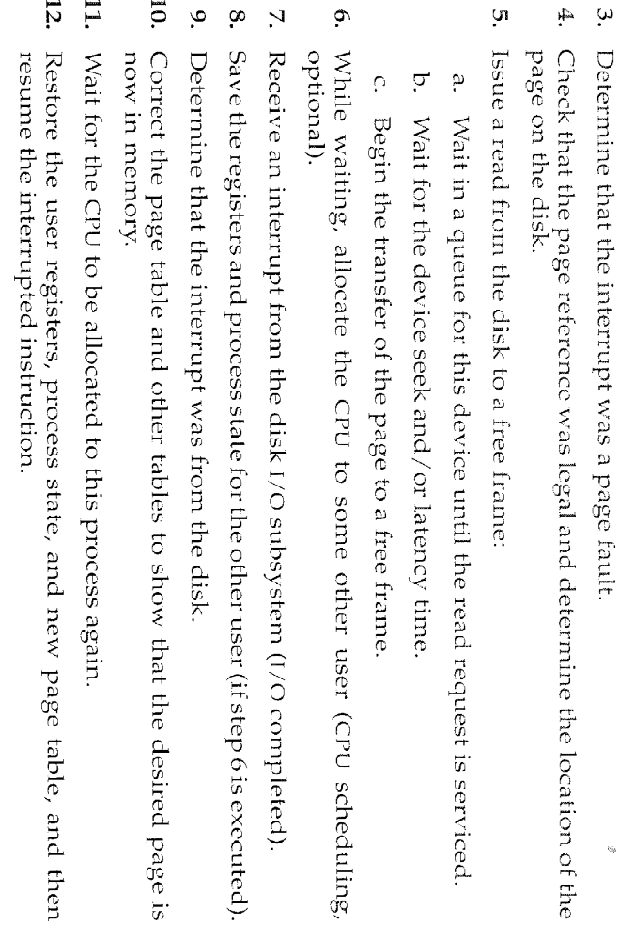
Page Fault-From BOOK

Slide 8
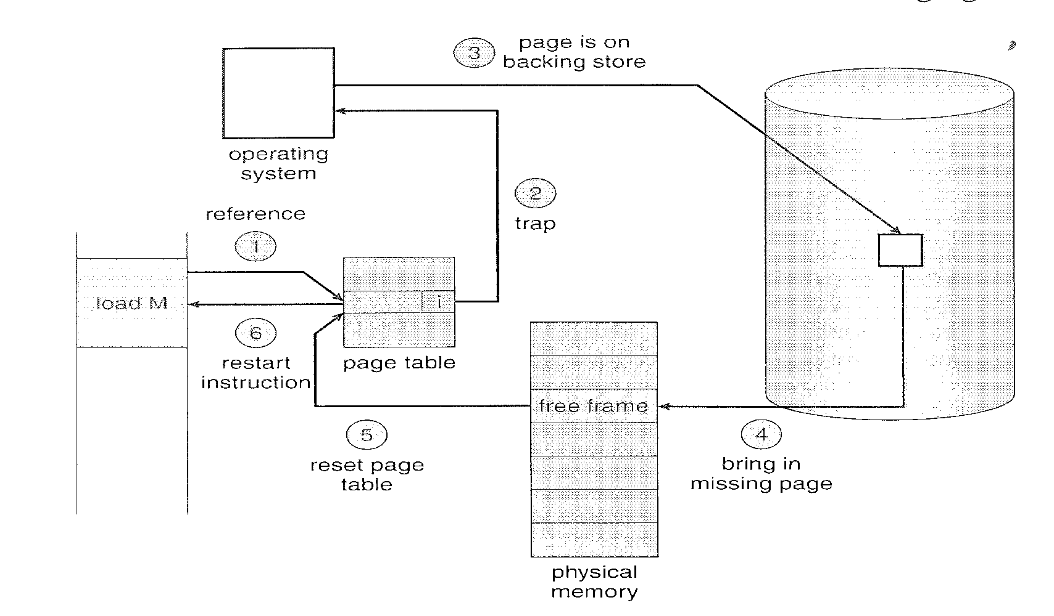
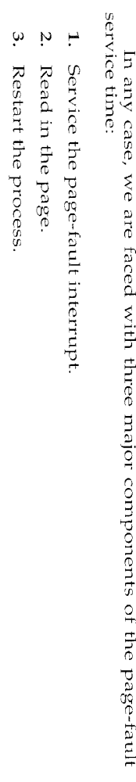
Page Fault (Cont.)

Slide 9
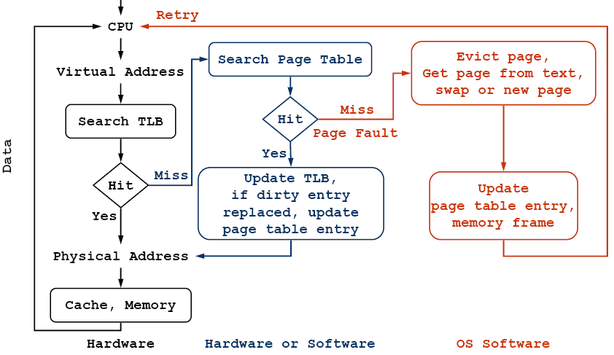
Page Fault (Cont.)

Slide 10

Performance of Demand Paging
Page fault rate 0 ≤ p ≤ 1
  if p = 0, no page faults
  if p = 1, every reference results in a page fault.
Effective Access Time:.
  EAT =
  (1 - p) effective_memory_access +
  p ( page fault overhead + [swap out] + swap in + restart overhead )
Restart overhead includes access to the data (which is now in memory) via the page table.
Note that we pay the TLB penalty in this case but the TLB will definitely fail.

Slide 11
Performance Example
Effective access time is directly proportional with rate of page faults
Suppose:
  Effective Memory access time = 200 nanosec.
  Average page fault service time = 8 milisec ( 8 * 10⁶ nsec)
  Effective access time = (1 - p) * 200 + p (8 milisec)
  = (1 - p) * 200 + p (8,000,000) nano sec
  = 200 + 7,999,888 p
  If 1 access out of 1000 causes page faults, then
  200 + 7,999,888 p = 200 + 7,999,888 * .001 = 8199.888 nanosec= 8.20 microsec
    Computer will be slowed down by factor 40 because of demand paging ( 200 nsec become 8.20 micro)
    If we want the performance degradation not to be less than 10% of 200 nsec ( 10% of 200 = 20)
      220 >200 + 7,999,888 p
      20 > 7,999,888 p
      P > 0.0000025
    In other words, to keep the slowdown of the system at reasonable level, we can allow fewer than one memory access out of 399,990 to page faults.
Notes:
0.0000025 means 25 memory access of 10000000 causes page faults
This means 1 memory access out of 10000000/25=400000 memory acccesses will results on page faults

Slide 12
Performance Example
Suppose:
  Memory access time is 100 nano sec.
  Effective_memory_access is 107 nano sec (with TLB when TLB access is 5 nano sec).
  Page fault overhead is 100 micro sec.
  Page swap time is 10 millisecond.
  50% of the time, the page that is being replaced has been modified and therefore needs to be swapped out.
  Restart overhead is 20 micro sec.
  p - page fault rate.
  Effective Access Time = 107* (1-p) +
  (100,000 + 10,000,000 + 0.5*10,000,000+ 20,000+5+200)*p
  EAT = 107 *(1-p) + 15,120,205*p.
Notes:
1 sec
1 sec = 1 * 10^3= 1000 milisec
1 sec = 1 * 10^6= 1000 000 microsec
1 sec = 1 * 10^9 = 1 000 000 000 nanosec
100 micro sec = 100 *1000 nano sec= 100 000 nanosec
10 milisec = 10 * 1 000 000 nano sec = 10 000 000 nano sec
20 microsec = 20 000 nanosec

Slide 13

Performance Example (cont).
So: What is a good page fault rate?
  Effective Access Time = 107* (1-p) +( 100,000+ 10,000,000+0.5*10,000,000+20,000+205)*p
  EAT = 107 *(1-p) + 15,120,205*p.
Suppose p is 1% ⇒ EAT = 151,309
Talking about a slowdown of 1414!!!
For the luxury of Virtual Memory to cost only 10% overhead, we need p to be around 0.00000066 !!!!.
This means one page fault for every 1,500,000 memory accesses !!!

Slide 14
When Will Paging Work?
􀂉 OS allocates memory frames to programs on demand (page fault)
􀂉 If no frame is available, then OS needs to evict another page to free a frame
􀂉 Which page should be evicted?
    A page “cache” miss is similar to a TLB miss or a memory cache miss
    However, a miss may require accessing the disk
      So miss handling can be very expensive
      Disk access times are at least 1000x memory access times
􀂉 Paging can only work if it occurs rarely
􀂉 Paging schemes depend on locality of reference
    Spatial locality
      Programs tend to use a small fraction of their memory, or
      Memory accesses are near memory accessed recently
    Temporal locality
      Programs use same memory over short periods of time, or
      Memory accessed recently will be accessed again
􀂉 Programs normally have both kinds of locality
    Hence, overall cost of paging is not very high bcz of locality

Slide 15
Page Replacement Algorithms
􀂉 It is important to reduce page misses
􀂉 Need to use “informed” page replacement algorithm
  􀂉 Page table, MMU, TLB handling are VM mechanisms
  􀂉 Page replacement is VM policy
􀂉 Several Algorithms
  The Optimal Page Replacement Algorithm
  First In First Out (FIFO)
  Not Recently Used (NRU)
  Second Chance / Clock
  Least Recently Used (LRU)
  Working Set/WSClock
  Page Fault Frequency

Slide 16
Page Replacement
What happens if there is no free frame to allocate? We take a frame (victim) that is presently being used by another process & allocate!
Here comes page replacement - find a page in memory that is “not that used” and swap it out. A free frame was just created.
  Note that the same page may be brought into memory several times over the life of a process.
  Use a modified bit (dirty bit) to reduce overhead of page transfers - only modified pages need to be written to disk, unmodified pages can be discarded.
Page replacement completes the separation between logical memory and physical memory. Large virtual memory can be provided on a smaller physical memory.
2. Modify to invalid
1. swap out
i
4. Modify to f, valid
f
v
f
victim
3. swap in

Slide 17
Page Replacement Algorithms
Goal
  Lowest page fault rate.
Evaluation
  Usually by running it on reference stings and counting the number of page faults.
Adding more memory
  Should hopefully lead to lower page fault rate.
Number of page faults
Number of frames

Slide 18

First In First Out (FIFO)
The victim is the oldest page in memory.
Assume 4 frames and the following reference string:
1 2 3 2 4 3 5 1 5 2 4 5

Slide 19
First In First Out (FIFO)
Replace the oldest page in memory.
Assume 4 frames and the following reference string:
1 2 3 2 4 3 5 1 5 2 4 5
1
1
1
1
1
1
5
5
5
5
5
5
2
2
2
2
2
2
1
1
1
1
1
3
3
3
3
3
3
3
2
2
2
4
4
4
4
4
4
4
4
f
f
f
f
f
f
f
Easy algorithm to understand and implement:
  Put with each page the time it was brought into a physical frame
  Select as a victim page to be replaced, the oldest page
  Implement with a FIFO queue of references to pages
Will adding memory always improve things?
Notes:
This algorithm is relatively cheap (wrt time) to implement because we just have to keep track of when the page was brought into RAM. We don’t have to update this list for each memory access, only update on a page fault.
Write algorithm on board

Slide 20
First In First Out (FIFO)
FIFO suffers from the following anomaly which is called Belady’s anomaly.
1 2 3 4 1 2 5 1 2 3 4 5
1
1
1
1
1
1
5
5
5
5
4
4
2
2
2
2
2
2
1
1
1
1
5
3
3
3
3
3
3
2
2
2
2
4
4
4
4
4
4
3
3
3
f
f
f
f
f
f
f
f
f
f
Try it with 3 frames...

Slide 21
First In First Out (FIFO)
FIFO suffers from the following anomaly which is called Belady’s anomaly.
1 2 3 4 1 2 5 1 2 3 4 5
1
1
1
1
1
1
5
5
5
5
4
4
2
2
2
2
2
2
1
1
1
1
5
3
3
3
3
3
3
2
2
2
2
4
4
4
4
4
4
3
3
3
f
f
f
f
f
f
f
f
f
f
1
1
1
4
4
4
5
5
5
5
5
5
2
2
2
1
1
1
1
1
3
3
3
3
3
3
2
2
2
2
2
4
4
f
f
f
f
f
f
f
f
f

Slide 22
FIFO Example (3 frames)
Study it yourself
*
*
*
*
*
*
*
*
*
*
*
*
*
*
*
7 | 0 | 1 | 2 | 0 | 3 | 0 | 4 | 2 | 3 | 0 | 3 | 2 | 1 | 2 | 0 | 1 | 7 | 0 | 1
7 | 7 | 7 | 2 | 2 | 2 | 2 | 4 | 4 | 4 | 0 | 0 | 0 | 0 | 0 | 0 | 0 | 7 | 7 | 7
 | 0 | 0 | 0 | 0 | 3 | 3 | 3 | 2 | 2 | 2 | 2 | 2 | 1 | 1 | 1 | 1 | 1 | 0 | 0
 |  | 1 | 1 | 1 | 1 | 0 | 0 | 0 | 3 | 3 | 3 | 3 | 3 | 2 | 2 | 2 | 2 | 2 | 1
So, 15 page faults for this reference string, FIFO, & 3 frames

Slide 23
FIFO Implementation
􀂉 Keep list of all pages in memory
􀂉 Updating the list
  When new page is accessed
    Add it to the front of list
􀂉 On a page fault
  Choose page at end of list for replacement
􀂉 Problem
  The oldest page may be needed again soon
    Some page may be important throughout execution
    When it gets old, replacing it causes page fault
  Suffers from Belady’s Anomaly
    Faults might increase when algorithm is given more memory!

Slide 24

Belady’s Anomaly
Graph gives performance of FIFO on reference string:
1, 2, 3, 4, 1, 2, 5, 1, 2, 3, 4, 5

Slide 25
Belady’s Anomaly
Graph gives performance of FIFO on reference string:
1, 2, 3, 4, 1, 2, 5, 1, 2, 3, 4, 5

Slide 26
Belady’s Anomaly
Graph gives performance of FIFO on reference string:
1, 2, 3, 4, 1, 2, 5, 1, 2, 3, 4, 5

Slide 27
Belady’s Anomaly
This is where we see the anomaly: Page fault rate increased with an increase RAM
Graph gives performance of FIFO on reference string:
1, 2, 3, 4, 1, 2, 5, 1, 2, 3, 4, 5

Slide 28
Belady’s Anomaly
Graph gives performance of FIFO on reference string:
1, 2, 3, 4, 1, 2, 5, 1, 2, 3, 4, 5

Slide 29

The Optimal Algorithm (OPT)
Assumes knowing the future. Prediction or guessing or really know? Makes difference
  Int I, x = 5;
  For ( i= 0; i< 200; i++)
  X = x * 2;
  Assume that block of code is stored in a page and the rest of the program is stored in other pages. Can u know when u will use those pages!!!
Can you think of it?
Lowest page fault rate of any page replacement algorithm
  Replace the page that will not be used for the longest period of time.

Slide 30
The Optimal Algorithm (OPT)
Assumes knowing the future.
Can you think of it?
Replace the page that will not be used for the longest period of time.
Page 2 is the oldest but Page 4 will be selected as victim because the future says that others pages will be used (referenced) soon and therefore non of them are selected (candidate) as victim.
1 2 3 4 1 2 5 1 2 3 4 5
1
1
1
1
1
1
1
1
1
1
4
4
2
2
2
2
2
2
2
2
2
2
2
3
3
3
3
3
3
3
3
3
3
4
4
4
5
5
5
5
5
5
f
f
f
f
f
f
1and 2 are used before 4 in the future, so replace 4

Slide 31
OPT Example (3 frames)
Future of page references
Study it yourself
*
*
*
*
*
*
*
*
*
7 | 0 | 1 | 2 | 0 | 3 | 0 | 4 | 2 | 3 | 0 | 3 | 2 | 1 | 2 | 0 | 1 | 7 | 0 | 1
7 | 7 | 7 | 2 | 2 | 2 | 2 | 2 | 2 | 2 | 2 | 2 | 2 | 2 | 2 | 2 | 2 | 7 | 7 | 7
 | 0 | 0 | 0 | 0 | 0 | 0 | 4 | 4 | 4 | 0 | 0 | 0 | 0 | 0 | 0 | 0 | 0 | 0 | 0
 |  | 1 | 1 | 1 | 3 | 3 | 3 | 3 | 3 | 3 | 3 | 3 | 1 | 1 | 1 | 1 | 1 | 1 | 1
0 and 1 are used before 7 in the future, so replace 7
0 and 1 are used before 2 in the future, so replace 2
So, 9 page faults for this reference string, OPT, & 3 frames (15 for FIFO)

Slide 32
Least Recently Used (LRU)
Well, OPT is not possible... we don’t know the sequence of future pages required by a process
LRU approximates OPT (future) with the history of page usage
Replace the page that has NOT been used for the longest period of time.
  Page 3 is not used (referenced) for 3 memory cycles. Therefore it is candidate to be selected as victim.
1 2 3 4 1 2 5 1 2 3 4 5
1
1
1
1
1
1
1
1
1
1
1
5
2
2
2
2
2
2
2
2
2
2
2
3
3
3
3
5
5
5
5
4
3
4
4
4
4
4
4
3
3
4
f
f
f
f
f
f
f
f
LRU or OPT does not suffer from Belady’s anomaly:
  set of pages in memory for n frames is always a subset of the set of pages that would be in memory with n+1 frames.

Slide 33
LRU Example (3 frames)
Study it yourself
History of page references
*
*
*
*
*
*
*
*
*
*
*
*
7 | 0 | 1 | 2 | 0 | 3 | 0 | 4 | 2 | 3 | 0 | 3 | 2 | 1 | 2 | 0 | 1 | 7 | 0 | 1
7 | 7 | 7 | 2 | 2 | 2 | 2 | 4 | 4 | 4 | 0 | 0 | 0 | 1 | 1 | 1 | 1 | 1 | 1 | 1
 | 0 | 0 | 0 | 0 | 0 | 0 | 0 | 0 | 3 | 3 | 3 | 3 | 3 | 3 | 0 | 0 | 0 | 0 | 0
 |  | 1 | 1 | 1 | 3 | 3 | 3 | 2 | 2 | 2 | 2 | 2 | 2 | 2 | 2 | 2 | 7 | 7 | 7
So, 12 page faults for this reference string, LRU, & 3 frames

Slide 34
LRU Implementations
Counter implementation:
  Every page entry of a page table has a counter.
  Every time a page is referenced, increment a global counter and store it in the page counter. Needs memory access (update counter for each memory)!
  For page replacement, select the page with the lowest counter (search for it).
Stack implementation:
  Maintain a stack of page number in a double link list.
  When a page is referenced, remove it and put it on top of the stack.
    Move a referenced page to the top (locate and change pointers).
    The result is a linked list with the most referenced page at HEAD and the least referenced page at TAIL.
  There is not search for replacement. For page replacement, take the bottom page. But each update is expensive.
In any case:
  LRU is hard to implement as is. It requires too much work per page access or too much hardware support. Reference bit!!!

Slide 35
LRU Implementations
Let’s discuss the following algorithm and data structure.
Maintains a linked list of all pages in memory
  the most recently used page at the head and
  the LRU page at the tail.
  The list must be updated on every memory reference.
It is realizable but not cheap: Finding a page in the list, deleting it, then moving it to the front is a very time consuming operation which must be applied on each instruction. Software and Hardware solution???
HW Solution
For each machine with n page frames the LRU HW maintains a matrix of n*n bits, initially all zero. Assume 4 frames then we have a 4*4 matrix
  When a page frame k is referenced, the HW
    first sets all the bits of row k to 1, then
    sets all the bits of column k to 0.
The row whose binary value is lowest is the one that is recently used one.

Slide 36
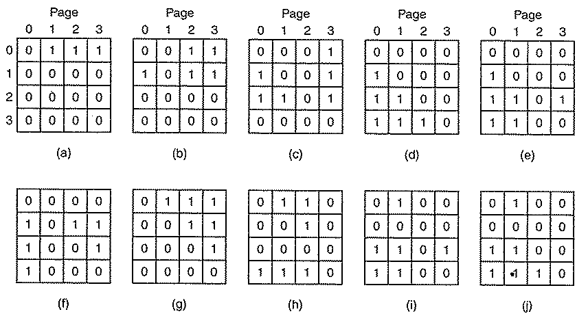
LRU Implementations
Assume page reference is: 0 1 2 3 2 1 0 3 2 3,
  After page 0 is referenced then either page 1 or 2 or 3 are victum (a)
  After page 1 is referenced then page 2 or 3 are victum (b)
we select the one with the lowest counter value
After the last page 3 is referenced,

Slide 37
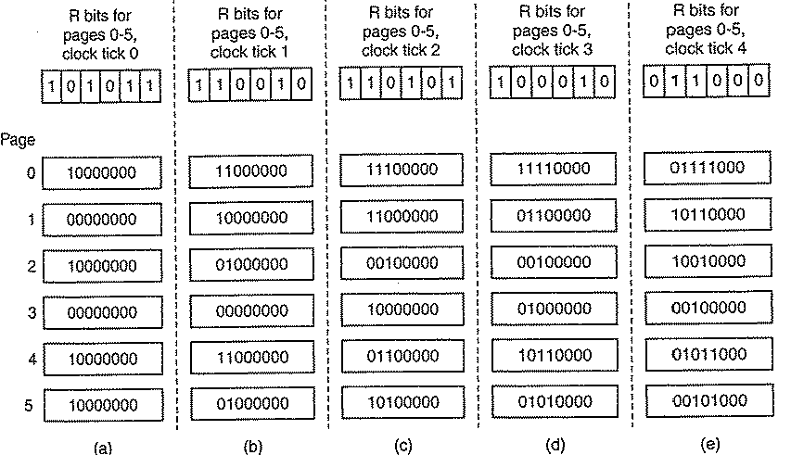
LRU apprx (LFU with aging)
SW Solution: assume this page references-- 0 2 4 5 0 1 4 0 1 3 5 0 4 1 2
A software counter is associated with each page and initially equal to 0.
At each clock interrupt, the counter values are each
  shifted right 1 bit before the R-bit is added in.
  Then the R-bit is added to the leftmost bit.
When a page fault occurs, the page whose counter is the lowest is evicted

Slide 38
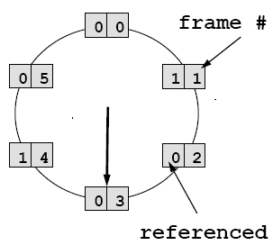

LRU Apprx.: Second-Chance Algorithm
Also called the clock algorithm. Second-Chance algorithm is actually a FIFO replacement algorithm with a small modification that causes it to approximate LRU.
When a page is selected according to a FIFO order, we check its reference bit. If it is set (the page was referenced), we clear it and look for another page.
On a page fault
  Clock sweeps over circular list and the page
  pointed to with the hand is checked
    If referenced bit is set
      Unset referenced bit, continue
    Else if referenced bit is not set
      If page is dirty
        Schedule page write, continue
      Else page is clean
        Select it for replacement, done
  In all cases above, advance hand to next page, Instead of moving pages in FIFO list
In the worst case, when all bits are set, the pointer cycles through all of the pages, giving each page a second chance and clearing its bit. Requires hardware support for reference bit and optionally dirty bit.

Slide 39
Enhanced Second-Chance
(Not Recently Used (NRU) Algorithm
Replace page that is not recently used. Initially, all pages have
  Referenced bit = 0
  Modified (Dirty) bit = 0
Periodically (timer interrupt) clear the referenced bit of all pages
  Then, referenced bit indicates which page was recently accessed
Considers both reference bit and modify bit.
We have the following four possible cases (classes):
  (0, 0) - neither recently used nor modified - best page to replace.
  (0, 1) - not recently used but modified - not as good because we need to swap out a page, but still better than used pages.
  (1, 0) - recently used but unmodified.
  (1, 1) - recently used and modified - the worst page to replace.
On a page fault , choose a page from lower numbered classes E.g., choose from clase 3, if there are no pages in classes 1 and 2.
Requires hardware support for reference and modify bits and may require two cycles.

Slide 40
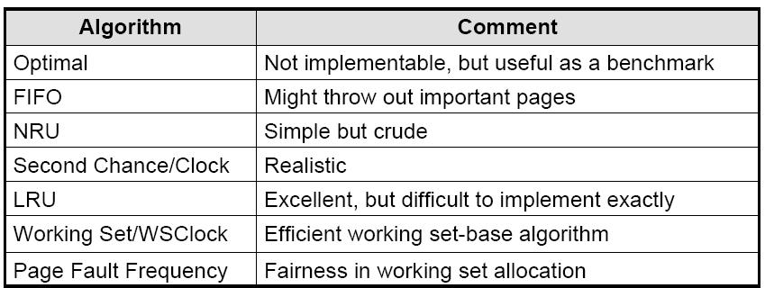
Summery: Page Replacement Algorithms

Slide 41
Page Buffering
As an add-on to any previous algorithm.
  A pool of free frames is maintained.
It is expensive to run replacement algorithm on each page fault
Instead, OS can use a paging daemon to maintain a pool of free frames
  Runs replacement algo. when pool reaches low watermark
  Writes out dirty pages and frees them
  Frees enough pages until pool reaches high watermark
When a page fault occurs, the desired page is read into a free frame from the pool. The victim frame is later swapped out if necessary and put into the free frames pool.
Plus - Process is put back to ready queue faster.
Minus - less pages are in use overall.

Slide 42
Frame Allocation
Minimum number of frames in memory per process
  Architecture dependent: All of the pages needed for any possible instruction need to be in memory for this instruction to be executed.
  Example: the IBM 370 move block operation will need up to 6 pages in memory at the same time in order to execute (two for the instruction, two for the source and two for the destination).
Equal allocation
  Each process gets the same number of frames. Divide the frames equally between the processes.
Proportional allocation
  Allocate frames according to size of process.
Priority allocation
  Higher priority processes get more frames.

Slide 43
Global versus Local Frame Allocation
With multiple processes competing for frames, Page replacement algorithms can be classified into 2 categories:
  Global replacement
    Allows a process to select a victim frame from the set of all frames->a process can allocate other processes frames (means that those can page fault).
    Page fault rate does not depend only of the process behavior but depends on other processes behavior.
  Local replacement
    Number of frames allocated for each process can not be changed
    A victim frame is selected from the set of frames allocated to this process.
    The set of pages in memory for a process is affected by the behavior of only that process not others
Global replacement is more efficient overall and therefore is commonly used. It increases throughput and also easier to implement.
Local replacement prevents external influences on the page fault rate of this process as long as the same number of frames is allocated.

Slide 44

I/O Interlock
Sometimes it is necessary to lock pages in memory so that they are not paged out.
Examples:
  I/O operation - the frame into which the I/O device was scheduled to write should not be replaced.
  New page that was just brought - looks like the best candidate to be replaced because it was not accessed yet, nor was it modified.

Slide 45

Thrashing
Why does paging work in practice ?
  Because of locality of reference in practical programs.
If a process does not have “enough” pages to capture this locality of reference (varies from program to program and over time), the resulting page fault rate will be very high.
  Careful selection of data and programming structures can increase locality and lower page fault rate.
  Example:
    Long ArrayOfObject[10000 ,10000];
      for i = 1 to 10000
      for j = 1 to 10000
      A[i,j] = i*j;
  Do all programs use locality? Sure not
Low CPU Utilization- ready state may be near empty but waiting for page device is near full (waiting for frames to be free! Global allocation frame scheme is used
    The operating system will think that it needs to increase the degree of multiprogramming (bring back swapped processes into memory)
  This will make the problem even worse because of the increase of page fault rate!!!

Slide 46
Thrashing (cont.)
Thrashing is caused by under allocation of the minimum number of pages required by a process, forcing it to continuously page fault.
Operating system can detect thrashing by evaluating the level of CPU utilization as compared to the level of multiprogramming.
It can be eliminated by reducing the level of multiprogramming.
Thrashing - Operating System is busy swapping pages in and out:
  Not enough memory to capture locality for all processes:
  ∑size of locality for in-memory processes > total memory size.
  Processes don’t do much progress->CPU utilization is decreased. Results in severe performance problems
CPU Utilization
A process is thrashing if it spends more time paging (i.e., doing page faults) than executing
Degree of
Multiprogramming

Slide 47
Thrashing (cont.)
Thrashing - Operating System is busy swapping pages in and out:
  Not enough memory to capture locality for all processes: ∑size of locality for in-memory processes > total memory size.
Solutions: BUY more Memory? Run more programs? Suspend processes?
Are we here or there?
CPU Utilization
Degree of
Multiprogramming

Slide 48
Page Fault Frequency Scheme
PFF = page faults / instructions executed
if PFF rises above threshold, process needs more memory
  not enough memory on the system? Swap out.
if PFF sinks below threshold, memory can be taken away
Establish acceptable page-fault rates.
  Upper watermark.
  Lower watermark.
If Actual rate lower
than lower watermark,
multiprogramming can
be increased
(swap in additional process).
If Actual rate higher than upper watermark, multiprogramming should be decreased
(swap out additional process).
Page fault rate
Multiprogramming

Slide 49

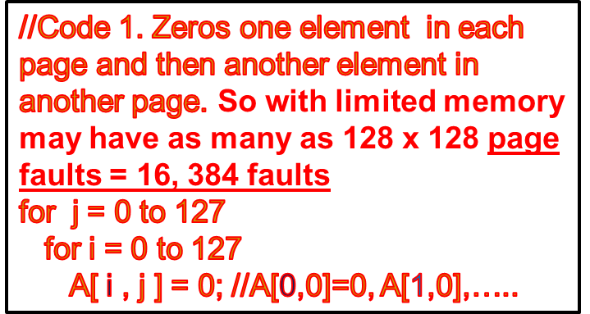
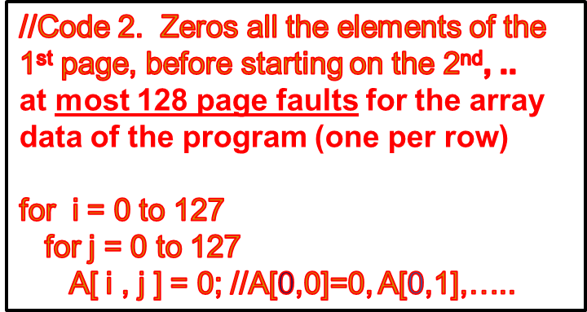
Program Structure
Users are unaware of paging but their knowledge increase performance.
  Careful selection of data and programming structures can increase locality and lower page fault rate.
Example:
  Assume that we want to initialize 2-dimentional array of size 128*128 with 0.
  Assume that array is stored in row major A[0,0]= 0, A[0,1]= 0, …A[0, 127]=0, A[1, 0]=0, A[1,1]=0,…A[1,127]=0, …,A[127,0]=0, A[127,1]=0,…,A[127,127]=0.
  Assume that each page is 512 bytes and each array element is stored in 4 bytes, then each row (128*4=512 Bytes) is stored in one page.
    Int i, j;
    int[128][128] A;

Slide 50

Page Size Considerations
How to select a page size?
Tradeoffs:
  Size of the page table - to keep it relatively small, we need bigger pages).
  Memory utilization - better with smaller pages because of less internal fragmentation.
  I/O time - latency / throughput characteristics call for bigger pages.
  Capturing locality - better with smaller pages because of better resolution.
Historical trend is for bigger page sizes.
  Memory is cheap so we care less about utilization.
  Disk access advances in slower advance rate compared with memory/CPU so I/O factor is most important.

Slide 51
Q & A
Consider a demand-paging system with the following time-measured utilizations:
  CPU utilization 20%
  Paging disk 97.7%
  Other I/O devices 5%
Which (if any) of the following will (probably) improve CPU utilization? Explain your answer.
  a. Install a faster CPU.
  b. Install a bigger paging disk.
  c. Increase the degree of multiprogramming.
  d. Decrease the degree of multiprogramming.
  e. Install more main memory.
  f. Install a faster hard disk or multiple controllers with multiple
  hard disks.
  g. Add prepaging to the page fetch algorithms.
  h. Increase the page size.

Slide 52
Q & A
Answer: The system obviously is spending most of its time paging, indicating over-allocation of memory.
  If the level of multiprogramming (degree of multi-programming) is reduced resident processes would page fault less frequently and the CPU utilization would improve.
  Another way to improve performance would be to get more physical memory or a faster paging disk (back store swap device).
a. Get a faster CPU
  No.
b. Get a bigger paging disk (drum)
  No.
c. Increase the degree of multiprogramming
  No.
d. Decrease the degree of multiprogramming
  Yes.

Slide 53
Q & A
e. Install more main memory
  Likely to improve CPU utilization as more pages can remain resident and not require paging to or from the disks.
f. Install a faster hard disk, or multiple controllers with multiple hard disks
  Also an improvement, for as the disk bottleneck is removed by faster response and more throughput to the disks, the CPU will get more data more quickly.
g. Add prepaging to the page fetch algorithms
  Again, the CPU will get more data faster, so it will be more in use. This is only the case if the paging action is amenable to prefetching (i.e., some of the access is sequential).
h. Increase the page size
  Increasing the page size will result in fewer page faults if data is being accessed sequentially. If data access is more or less random, more paging action could ensue because fewer pages can be kept in memory and more data is transferred per page fault. So this change is as likely to decrease utilization as it is to increase it.

Slide 54
Summery
Pure Paging
  Has advantages, but requires entire process to be in main memory
Virtual memory
  Adds capability of enabling process to run without all pages resident in main memory
Some benefits
  Programs can be larger than physical memory
  Programmer views computer as having large memory
  More programs can be partially resident, potentially increasing CPU utilization
Drawbacks
  Complexity of implementation (O/S)
  Performance penalties (e.g., page faults)

Slide 55
Exercise
Problem 10.11, page 367, solve for four frames only.
1 | 2 | 3 | 4 | 2 | 1 | 5 | 6 | 2 | 1 | 2 | 3 | 7 | 6 | 3 | 2 | 1 | 2 | 3 | 6

