Slide 1
Chapter 10-11: File-System Interface

Slide 2
Chapter 10: File-System Interface
File Concept
Access Methods
Directory Structure
File-System Mounting
File Sharing
Protection

Slide 3
Objectives
To explain the function of file systems
To describe the interfaces to file systems
To discuss file-system design tradeoffs, including access methods, file sharing, file locking, and directory structures
To explore file-system protection

Slide 4
Operating Systems – Abstraction
Make the system easier to use.
Abstract many of the details of the physical hardware away
  Scheduling – illusion of exclusive execution
  Virtual Memory – illusion of exclusive memory access
Need abstractions/interfaces for
  Interacting with devices (disks, terminals, keyboards)
  Interacting with other processes
Abstraction of Disk
  Disk, like memory is a large array of bits
  Partitioned into sectors (usually 512 bytes)
    Unit of transfer to and from disk
  Non-volatile – data persists across reboots/power downs
  How do we share the disk between processes?
    Protection/Security
  How do we make the disk easy to use? While maintaining efficiency

Slide 5

Magnetic Media (Disk)
Disks have multiple platters
  Each platter has a head
  The different heads are attached to a single arm
  The different heads can access data in parallel
Each platter has multiple concentric tracks
  A cylinder is same track across different platters
Each track has multiple sectors
  A sector typically has preamble, data and ECC

Slide 6
Magnetic Disk (Cont.)
Disks are accessed at the granularity of sectors Typically, 512 bytes
A file system allocates data in chunks called blocks
  A block contains 2^{n} contiguous sectors
  Reduces overhead of managing individual bytes
  Large blocks improve throughput but increase internal fragmentation
File systems view the disk as an array of blocks
Disks can process I/O requests in parallel
Many I/O requests for blocks can be pending at a given time
Disks are slow!
  ~10 ms latency to access a block1
  Versus 0.0002 ms to access to memory
  Versus 0.000001ms to access to register
Minimize frequency of slow disk access! So cache file data in memory
  Paging (page cache) treats disk as extension of the storage hierarchy. When we didn't have enough memory, write out to disk. Buffer cache holds file's data, treats memory as a cache for disk data

Slide 7
Magnetic Disk (Cont.)
Track
Sector
Cylinder: all the tracks under the
heads at a given point on all surface
Read/write data is a three-stage
process:
  Seek time: position the head/arm over the proper track (into proper cylinder) =>arm motion (say forth and back motion)
  Rotational latency: wait for the desired sector to rotate under the read/write head ( rotation motion)
  Transfer time: transfer a block of bits (sector)
  under the read-write head
Disk Latency = Queuing Time + Controller time +
Seek Time + Rotation Time + Xfer Time
Highest Bandwidth:
  transfer large group of blocks sequentially from one track
Head
Cylinder
Platter
Software
Queue
(Device Driver)
Hardware
Controller
Media Time
(Seek+Rot+Xfer)
Request
Result
Notes:
To read write information into a sector, a movable arm containing a read/write head is located over each surface.
The term cylinder is used to refer to all the tracks under the read/write head at a given point on all surfaces.
To access data, the operating system must direct the disk through a 3-stage process.
(a) The first step is to position the arm over the proper track. This is the seek operation and
the time to complete this operation is called the seek time.
(b) Once the head has reached the correct track, we must wait for the desired sector to
rotate under the read/write head. This is referred to as the rotational latency.
(c) Finally, once the desired sector is under the read/write head, the data transfer can begin.
The average seek time as reported by the manufacturer is in the range of 12 ms to 20ms and is calculated as the sum of the time for all possible seeks divided by the number of possible seeks.
This number is usually on the pessimistic side because due to locality of disk reference, the actual average seek time may only be 25 to 33% of the number published.
+2 = 34 min. (Y:14)

Slide 8
Magnetic Disk (Cont.)
Disks: Not just slow, Complex
  Seeks between cylinders are expensive
    Random vs. sequential access
Sequential access – platter rotation
  80 MB/s bandwidth
  0.16 ms latency
Random access – head seeks
  0.5 MB/s bandwidth
  10 ms latency
All sorts of fail
  Lots of errors possible
  E.g., latent sector errors,
  mis-directed writes, etc.
  Transient vs. hard errors
Bad sectors
  Allocate spare sectors per track
  Block can be mapped to spare in factory, by device controller, by OS
  OS can hide bad sectors by allocating them to a special hidden file
  Physical backup programs have to be careful
Disk can be subdivided into partitions which can be used ad raw – without a file system, or formatted (having structure) with a file system.
Entity containing file system known as a volume. Each volume containing file system also tracks that file system’s info in device directory or volume table of contents

Slide 9
File Systems
3 criteria for long-term information storage:
  Should be able to store very large amount of information
  Information must survive the processes using it
  Should provide concurrent access to multiple processes
Solution:
  Store information on disks in units called files
  Files are persistent, and only owner can explicitly delete it
  Files are managed by the OS
File Systems: How the OS manages files!
File systems have different types
  File system partitions have types
    e.g., swap space, EXT3, FAT32, NTFS

Slide 10
File System (Cont.)
File System: Layer of OS that transforms block interface of disks (or other block devices) into Files, Directories, etc.
File System Components
  Disk Management: collecting disk blocks into files
  Naming: Interface to find files by name, not by blocks
  Protection: Layers to keep data secure
  Reliability/Durability: Keeping of files durable despite crashes, media failures, attacks, etc
User vs. System View of a File
  User’s view:
    Durable Data Structures: directories and files.
  System’s view (system call interface):
    Collection of Bytes (UNIX)
    Doesn’t matter to system what kind of data structures you want to store on disk!
  System’s view (inside OS):
    Collection of blocks (a block is a logical transfer unit, while a sector is the physical transfer unit)
    Block size ≥ sector size; in UNIX, block size is 4KB

Slide 11
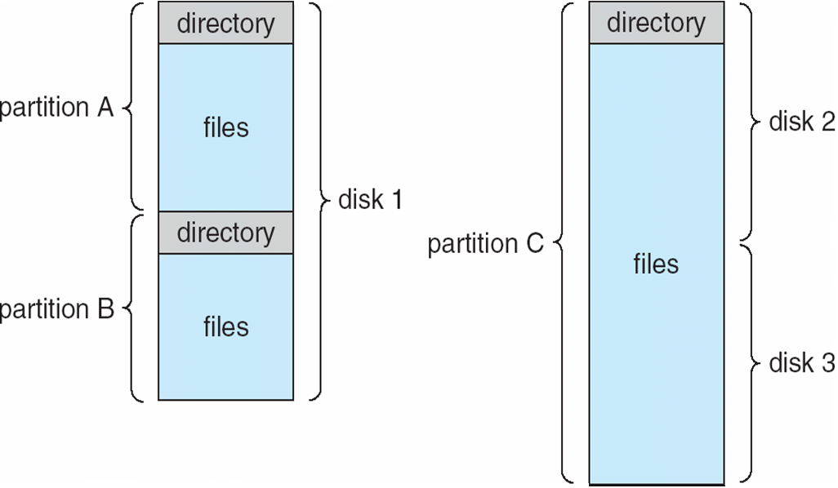
File Systems (Cont.)
A file system provides an abstraction for storing, organizing and accessing persistent data. It is a Layer of OS that transforms block interface of disks (or other block devices) into Files, Directories, etc.
  File-system data is organized as logical files
    Accessed via system calls
    Files have names and are organized as directories
  Directory structure maintains info of all files in the volume
    Name, location, size, type, …
    The list of blocks containing the data
    Other information such as access control list or permissions, owner, time of access, etc?

Slide 12


Translating from User to System View
File
System
What happens if user says: give me bytes 2—12?
  Fetch block corresponding to those bytes
  Return just the correct portion of the block
What about: write bytes 2—12?
  Fetch block
  Modify portion
  Write out Block
Everything inside File System is in whole size blocks
  For example, getc(), putc() ⇒ buffers something like 4096 bytes, even if interface is one byte at a time
From now on, file is a collection of blocks (i.e. systems view inside OS)

Slide 13
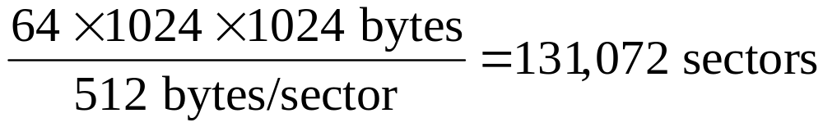
What is a File?
A file is a sequence of bytes contained in multiple, ordered, sectors (blocks) on non-volatile devices such as disks
  Disk space is always allocated in blocks
A sector is a fixed size block of data
  E.g., 512 bytes
Example
  With a 512 byte sector size, a 64 MB file (MB = 1024* 1024 bytes) would have how many sectors?
  Remember Block size ≥ sector size

Slide 14
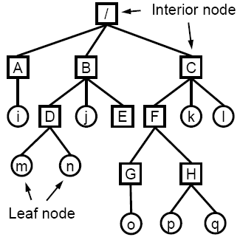
Directories
A Directory Store a list of directory entries
that point to files or subdirectory. Method for naming and locating a file
  Efficiently locate and identify files
  Allow intuitive grouping of objects
  like files together
  Useful for both OS and users
Modern systems use hierarchical directories
  A directory contains files or sub-directories
  E.g., B contains entries for D, j and E
Files are accessed with pathnames
  Absolute pathname. path of file from the root directory e.g. cat /B/D/n
  Relative pathname path from the current working directory e.g. cd B/D; cat n
  two special entries in each directory:
  “.” for current directory and “..” for parent
Operations Performed on Directory
  1- Search for a file
  2- Create a file
  3- Delete a file
  4- Truncate a file
  5- List a directory
  6- Rename a file
7- Traverse file system

Slide 15
File Structure and Attributes
The OS typically treats files as an unstructured sequence of bytes
Programs create files and they can impose any format on files
  E.g., application programs may look for specific file extension to indicate the file’s type
However, OS needs to understand the format of executable files to execute programs(text, data, heap, stack sections)
Files have various attributes associated with them. These attributes are called file metadata or File Control Block (FCB) or I-node and is maintained in file system data structures for each file. They vary a lot across different operating systems. Examples:
  Name – only information kept in human-readable form
  Identifier – unique tag (number) identifies file within file system
  Type – needed for systems that support different types
  Location – pointer to file location on device
  Size – current file size
  Protection – controls who can do reading, writing, executing
  Time, date, and user identification – data for protection, security, and usage monitoring

Slide 16
File Operations
1- Create a file: create new file in a directory
  Find space in the file system, add directory entry. Create() can open()!
2- Open file: fetch existing file attributes and disk addresses in memory
  System call specifying name of file.
  system searches directory structure to find file.
  System keeps current file position pointer to the location where next write/read occurs
  System call returns file descriptor (a handle) to user process
3- Write in file: write content of buffer in memory into disk blocks- Increase size
  System call specifying file descriptor and information to be written
  Writes information at location pointed by the files current pointer
4- Read from a file: read disk blocks into buffer in memory
  System call specifying file descriptor and number of bytes to read (and possibly where in memory to stick contents).
5- Repositioning within a file: move to specific block
  System call specifying file descriptor and new location of current pointer. Also called a file seek even though does not interact with disk

Slide 17
File Operations (Cont.)
6- Sharing a file:
  Sharing may be done through a protection scheme
  Some systems provide file sharing by maintaining a single copy of a file; other systems maintain several copies, one for each of the users
    With a single copy, several concurrent updates to a file may result in user obtaining incorrect information, and the file being left in an incorrect state.
    With multiple copies, there is storage waste and the various copies may not be consistent with respect to each other.
7- Delete (unlink) a file: remove directory entry, free up space
8- Truncate a file: free up space, set file length to zero
9- Closing a file: entry removed from open file table
  System call specifying file descriptor
  Call removes current file position pointer and file descriptor associated with process and file

Slide 18
File Protection
File owner/creator should
be able to control:
  what can be done
  by whom
Types of access
  Read
  Write
  Execute
  Append
  Delete
  List
Categories of Users
  Individual user
    Log in establishes a user-id
    Might be just local on the computer or could be through interaction with a network service
  Groups to which the user belongs
    For example, “it” is in “IT-department”
    Again could just be automatic or could involve talking to a service that might assign, say, a temporary cryptographic key

Slide 19
File Protection(Cont.)
Linux Access Rights (chmod, uid, grpid….)
Mode of access: read, write, execute
Three classes of users RWX
a) owner access 7 ⇒ 1 1 1
RWX
b) group access 6 ⇒ 1 1 0
RWX
c) other access 1 ⇒ 0 0 1
For a particular file (say game) or subdirectory, define an appropriate access.
owner
group
public
chmod
761
game
$ ls -l game
-rwxrw--- 4 user group 6 Mar 11 12:50 game
Windows XP Access-control List Management

Slide 20
Multiple users of a file
Several pieces of data are needed to manage open files:
  File pointer: pointer to last read/write location, per process that has the file open
  File-open count: counter of number of times a file is open – to allow removal of data from open-file table (in memory) when last processes closes it
  Disk location of the file: cache of data access information
  Access rights: per-process access mode information
OS typically keeps the above information in two levels of internal tables:
Per-process table
  Information about the use of the file by the user (e.g. current file position pointer).
System wide table
  Gets created by first process which opens the file
  Location of file on disk
  Access dates
  File size
  Count of how many processes have the file open (used for deletion)

Slide 21

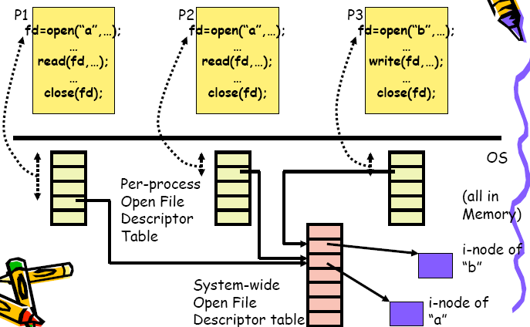
Files Open and Read (OS structure)

Slide 22
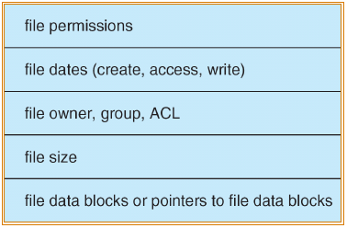
Structures That Implement a File System
On-disk structures
Boot control block
  Info to boot the OS from the disk
  Typically, the first block of the boot partition (boot block)
Partition control block
  Info about a file system (number of blocks -- fixed size)
  Includes free block information (superblock)
Directory Structure
File Control Blocks
  Logical file system’s representation of a file -- stored on disk
    In UNIX, called an inode
In-memory structures
Partition table
Current mounted partitions
Directory structure
  Information on recently access directories
System-wide, open file table
  All the currently open files
Per-process, open file table
  All this process’s open files
See figure in Slide 24/33

Slide 23
File System Design
A file system performs four main tasks
  Block allocation and placement
    Maps (potentially non-contiguous) blocks to the file
    Issues similar to virtual memory, placement unique to disks
  Free block management
    Allocates blocks to a file, manages free blocks
      Uses bitmaps or linked list
      Issues similar to memory, swap management
  Directory management
    Maps file names to location of starting block of file
  Buffer cache management
    Caches disk blocks in memory to minimize I/O

Slide 24
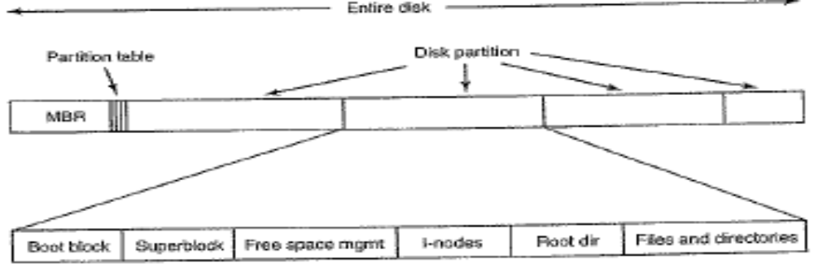
File Allocation
Direct access of disks gives us flexibility in implementing files
  Relate to memory management problem
Choices
– Contiguous allocation
– Non-contiguous allocation
  Linked
  Indexed
UNIX File SYSTEM

Slide 25
Common methods of allocation
Directories and Files needs to be allocated on disk. Directories and files may occupy multiple data blocks on the disk.
  Not only directories/Files but also their FCB may actually be multiple blocks on disk ( E.g., if information about data blocks require more space than can fit in a single disk block)
Linked:
  Use space in each disk block for a pointer to next block; indicate end block with special value pointer (e.g., ‐1 or 0)
  FCB has pointer to first block in linked list
Contiguous:
  Blocks for a specific file allocated together in a sequence on the physical device
  FCB records number of blocks in file and a pointer to first block
Indexed:
  Use separate (index) blocks of disk space for pointers to data blocks of the file
  FCB contains pointer(s) to index block(s)

Slide 26
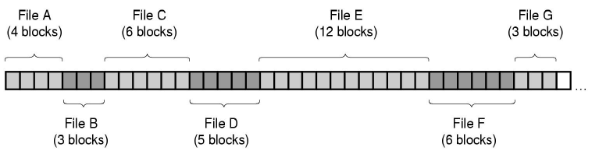
Contiguous Allocation
All blocks in a file are contiguous on the disk
Advantages
  Easy to find file’s block. Need starting disk address and number of blocks (length of file). Efficient for direct access.
  Performance is good for sequential reading ( need one seek only)
Disadvantages
  File size has to be known a priori.
  File growth requires copying
  Disk becomes fragmented after deletion (external fragmentation)
  Will need periodic compaction (No special HW like MMU!!!!)
Good for CD-ROMs where Files are never deleted
  All file sizes are known in advance

Slide 27
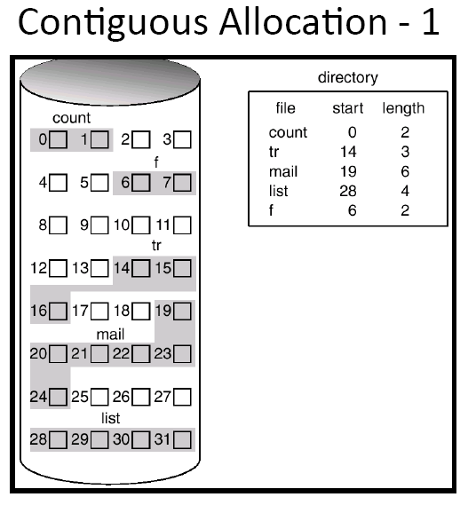
Assume that disk block=1024 bytes.
What is the physical location of logical byte 1045 in file mail?:
you need one disk access (reference) assuming that the directory FCB is stored in memory. It is located in the 21th byte within Block number 20 that is relative to the known starting physical block 19.
Notes:
19 20 21
|-----------------------------|--------------------------------|-------------------------
0 1024 2028
|
|
1045

Slide 28
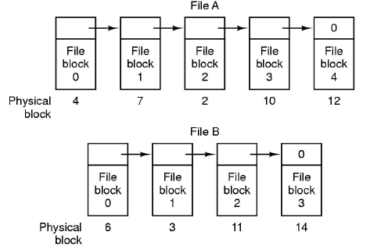
Non-contiguous: 1- Linked Allocation
Each file is a linked list of blocks. Keep a pointer to first block of a file in the directory.
The first few bytes of each block point to the next block of this file.
Advantages: No external fragmentation but internal in the last block.
Disadvantages: 1- Random access is slow!. 2- Reliability: If one block pointer is corrupted, we loose file after that point
Directory
File A | 4
File B | 6
File A: blocks 4, 7, 2, 10, 12
File B: Blocks 6 , 3, 11, 14
Notes:
Example Assume that block size is 1024 , What is the physical location of logical byte 1045 in file A?:
read byte 1045 in fileA needs 2 disk access and it is mapped to the 21th byte in 7th block

Slide 29
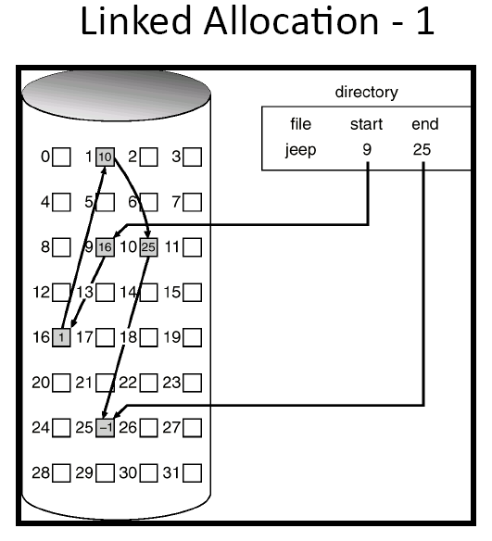
Assume that disk block=1K bytes & block address is 4 bytes. Each block can store 1024-4=1020 bytes
What is the physical location of logical byte 4079 in file jeep:
you need i disk access (reference) where i = 4 assuming that the directory FCB is stored in memory. It is located in the last (1023^{th)} byte within Block number 10 that is relative to the known starting block 9.
Notes:
4 byes for block number=> remain 1020 for data
0-1019 (first data block)
1020-2039 (second)
2040-3059(third)
3060-4079(fourth)
4080-5099 (fifth) ----→ 4091-4080-0011

Slide 30
Indexed Allocation
In the prev. scheme, we needed to go to disk to chase pointers since memory cannot hold all the blocks.
Store separate blocks, per file, containing pointers to disk blocks contained in the file
Two types of blocks per file
  Index blocks
  Data blocks
Positive aspects
  More efficient method for direct access (than linked)
  Also good for sequential access
Issues
– Overhead for pointers increases; Why?
– Fragmentation
What if a large file requires more space than a single index block?
  Linked index blocks
  Mulilevel indexing

Slide 31
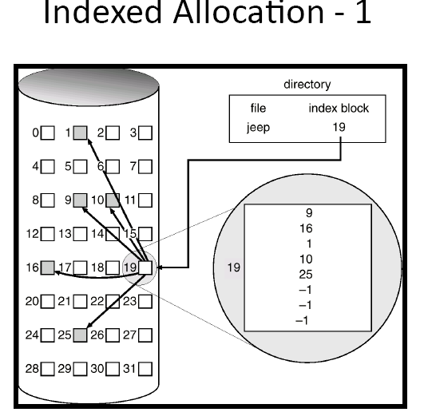
Same example as in list allocation but needs 2 disk accesses to locate byte 4079. one for block 19 (that contains all the links for file jeep) and then block 10. Direct access
What if we keep index 19 in memory?
Yields one disk access

Slide 32
Fragmentation Allocation Methods
Internal: Areas within a file that are unused
External: Blocks outside of files that are unused
Fragmentation | Contiguous | Linked | Indexed
Internal | May have to specify the maximum extent to which the file will grow | On average ½ of last block goes unused | • On average ½ of last index block goes unused • On average ½ of last data block goes unused
External | May have sufficient number of disk blocks to create a new file, but they may not be in a contiguous sequence | None | None

Slide 33

File Allocation Table (FAT) File system
File allocation table resides at the beginning of the volume.
Root folder must be stored in a fixed location so that the files needed to start the system can be correctly located.
A volume formatted with the FAT file system is allocated in clusters.
A partition is divided up into identically sized clusters, small blocks of contiguous space.
  Cluster sizes vary depending on the type of FAT file system being used and the size of the partition, typically cluster sizes lie somewhere between 2 KB and 32 KB.
  Each file may occupy one or more of these clusters depending on its size; thus, a file is represented by a chain of these clusters (referred to as a singly linked list). However these clusters are not necessarily stored adjacent to one another on the disk's surface but are often instead fragmented throughout the Data Region

Slide 34
File Allocation Table (FAT) File system
System | Bytes Per Cluster Within File Allocation Table | Cluster limit
FAT12 | 1.5 (only 12 of 16 bits are used) | Fewer than 4087 clusters.
FAT16 | 2 (16 Bits) | Between 4087 and 65526 clusters, inclusive.
FAT32 | 4 (only 28 of 32 bits are used) | Between 65526 and 268,435,456 clusters, inclusive.
Disk allocation on the basis of a cluster instead of the actual block represents more disk space for the same number of bits of pointers
Examples: Assume all the blocks are data blocks
A) 32 bit pointers with 512 byte blocks can represent max 2,097,152 MB
B) 32 bit pointers with 2 K (K=1024 bytes) clusters can represent 8,388,608 MB
Notes:
FAT12=>1.5 pointer length=>2¹²=>4096 clusters=>9 clusters (4096-4087) r used to store FAT itself and the rest 4087 clusters for data!
-------------------------------------------------------------
Example A: 512/4= 128 pointers per block, and max total clusters =268,435,456 , 128 pointers per total of clusters 268,435,456 /128 = 2,097,152 MB
2k= 4*512, 4* 2,097,152 = 8,388,608 MB
------------------------------------------------------------
32 bit pointers with 512 byte blocks can
represent what maximum size?
– Each different pointer represents (points to) a
different 512 byte block
– We have 232 different pointers
– Thus, we have 232 x 512 bytes that can be represented
= 2.20 x 1012 bytes
2.20 x 1012 bytes / (1024 x 1024) = MB
= 2,097,152 MB
– Not accounting for links or other allocation strategies,
or other meta information
Example B:
32 bit pointers with 2 K (K=1024 bytes) clusters can
represent what maximum size?
– Each different pointer represents (points to) a
different 512x4 byte = 2048 byte cluster
– We have 232 different pointers
– Thus, we have 232 x 2048 bytes that can be
represented
= 8.80 x 1012 bytes
8.80 x 1012 bytes / (1024 x 1024) = MB
= 8,388,608 MB
– Not accounting for links or other allocation strategies,
or other meta information

Slide 35
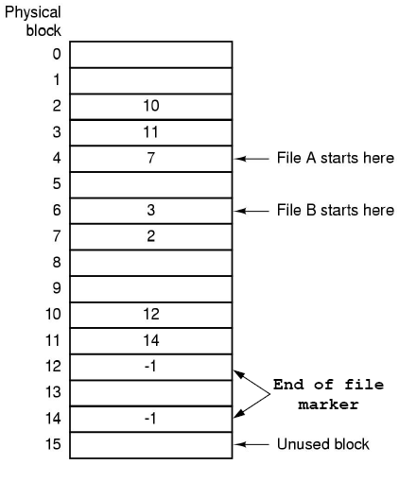
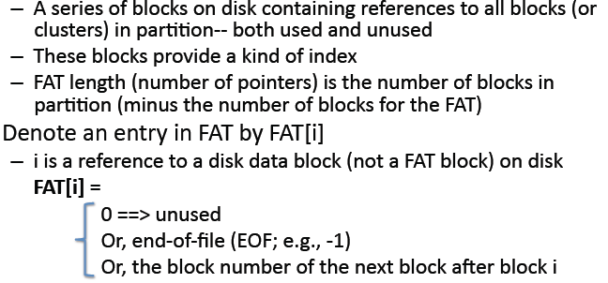
FAT
Consists of entries. Each entry contains the address of the next block/cluster. It is cached in memory
File A: blocks 4, 7, 2, 10, 12
File B: Blocks 6, 3, 11, 14
Disadvantages
  Entire FAT table stored in memory!
  Does not scale well for large files . 200 GB disk with 1 KB/block needs 200 million entries .
4 bytes block number yields FAT table of 800 MB
Notes:
200 GB disk with 1 KB/block needs 200 million entries
200GB/1KB = 200Milion entries=> If each entry needs 4 bytes=> 200*4=>800MB

Slide 36
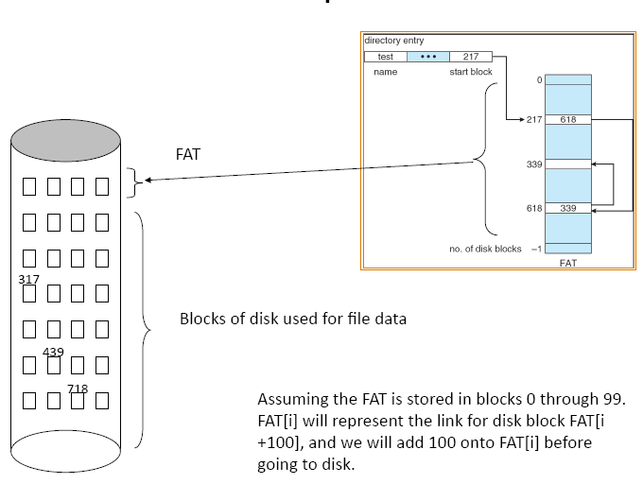
FAT Example

Slide 37
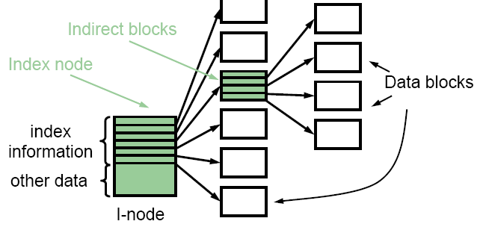
UNIX I-node Structure
List allocation spreads index information on disk, slowing random access
FAT keeps
linked-list index
information in
memory but that
limits size of file
system
I-node Idea
inode is the UNIX FCB (file control block)
Variable level indexed allocation method
  Direct
    Pointers contained in FCB
    These disk block addresses refer directly to data blocks stored on disk
  Variable level indirect index blocks
    These refer to index blocks, which store blocks of disk addresses
i-node contains:
File attributes + 10 direct pointers+ 3 levels of indirect pointers

Slide 38
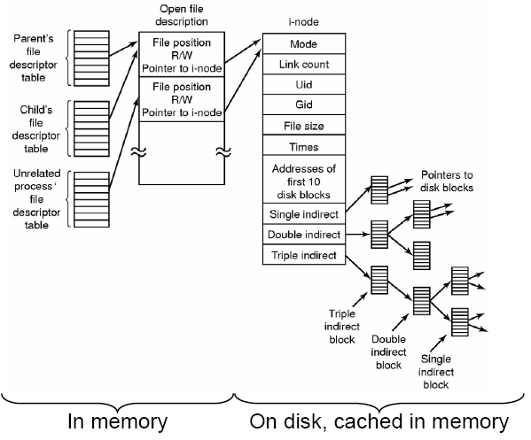
The UNIX File-System Data Structures

Slide 39
The UNIX File-System Data Structures(Cont.)
Suppose that a file is 1MB and a block is 8KB. Then the file will have 128 blocks. The question is: how do we keep track of these 128 data blocks of the file. We can do this by using index blocks (also called indirect blocks) that contain pointers to other index and data blocks.
In Unix each file or directory has inode that is 64 or 128 bytes and contains
  Attributes +
  13 pointers
    The first 10 pointers are to store the addresses of first 10 data blocks.
    The 11th pointer points to a single indirection index block, i.e. an index block with pointers to data blocks(points to 2^10 Data blocks)
    The 12th pointer points to a double indirection index block, i.e. an index block that points to index blocks that point to data blocks (2^20)
    The 13th pointer points to a triple indirection index block. (2^30)
If we assume that a block is 8KB and a pointer is 8Bytes, then an index block will contain 1K pointers. Then, it can point to 1024 data blocks. The maximum size of a file will be
8KB*(10 + 2**10 + 2**20 + 2**30), that is more than 8TByte file size.
Notes:
The first 10 pointers directly to data blocks = 10 * 8K data blocks->>>>means that a file of max 80KB can be accessed in 1 disk access!
The 11th pointer points to a single indirection index block which:
has 1K pointers. Each pointer points to one data block. This 11th pointer points to 1024 * 8KB data blocks->>
The 12th pointer points to a double indirection index block which points to 1024*1024 (2^20) data blocks. Its
first Index block has 1K pointers (1024 pointers=2^10). Each pointer points to
second Index block that has 1K pointers. Each pointer points to one data block
The 13th pointer points to a triple indirection index block which points to 1024*1024 *1024 (2^30) data blocks. Its
first Index block has 1K pointers (1024 pointers=2^10). Each pointer points to
second Index block that has 1K pointers. Each pointer points to one index block. This is the
triple Index block that has 1K pointers. Each pointer points to one data block
Assume that block size = 8 KB and a pointer is 4 Bytes
Index block will contain 2K pointers (each pointer occupies 4 bytes)
The maximum size of a file will be
8KB*(10 + 2**11 + 2**22 + 2**33),

Slide 40
The UNIX File-System Data Structures(Cont.)
Access time is different at different locations in a file. Again assume that a block is 8KB and a pointer is 8Bytes, then an index block will contain 1K pointers
  The first 10 data blocks are accessed with a single read (the pointers are in main memory where the inode is brought when the file is opened). From 0 till (8*10KB - 1)
    Logical byte o or 100 or 5000 or 50239 needs single disk access.
  The next data blocks require up to two reads, one for the index block and one for the data block. (byte addresses from 80KB till 8*1024KB -1 )
  The next data blocks require up to three reads (8MB– 8GB -1)
  The next data blocks require up to four reads (8GB-8TB)
Clearly access time is good at the beginning of the file and gets worse and worse as we move towards its end.
At which index block can you find a pointer to the data record that contains byte 100,000,000 in a file (look at the note)
Notes:
100000000 /1024 /8=12207.031
12207 * 1024 * 8 = 99999744
100000000 – 99999744 = 256
For example, if we seek for byte 100,000,000 in a file, we need to go to the 12,207 block, and then look for the 256th byte. We skip the first 10 pointers (each to a block) thus remaining with 12197 to go. We skip the 11th pointer (which points to a single indirection index block with 1024 pointers to data blocks) thus skipping 1024 blocks remaining with 11173 blocks. We are now at the 12th inode pointer. From the 12th inode pointer we go to a double indirection index block. Here each pointer counts as 1K blocks. Thus we have to skip 10 pointers (i.e. 10*1K=10,240 blocks, thus remaining with 933 blocks to go) and follow the 13th pointer to a single indirection index block. Here we go to the 933 pointer and follow it to a data block where the 256th byte is what we are aiming for. Clearly we can write a procedure to do this calculation and to allocate index and data blocks if it is necessary for a write operation.

Slide 41

Block Sizes
Larger block sizes => higher internal fragmentation.
  Not good for small files because they waste Disk space
Smaller block sizes => Files span multiple blocks and this need multiple seeks and rotations to read data => reduce performance.
Thus if the allocation unit of block is too large we waste space and if it is small we waste time
Larger block sizes => higher disk transfer rates
Median file size in UNIX environments ~ 1K
Typical block sizes are of the order of 512, 1K or 2K.

Slide 42
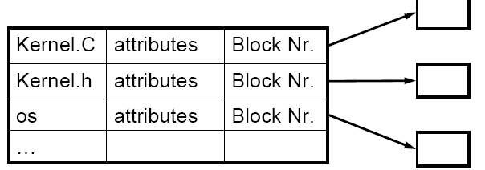
Directory Structure
A directory contains zero or more entries
  One entry per file or sub-directory that resides in the directory
Entry maps file names to location of starting block
  Each entry has file name and attributes
    In windows, each entry has
      Fname , Extension , Attributes , Time , Date , Size , First Block #
    In UNIX, each entry has
      Fname, i-node #
Block number of first block of the file
Data Block

Slide 43
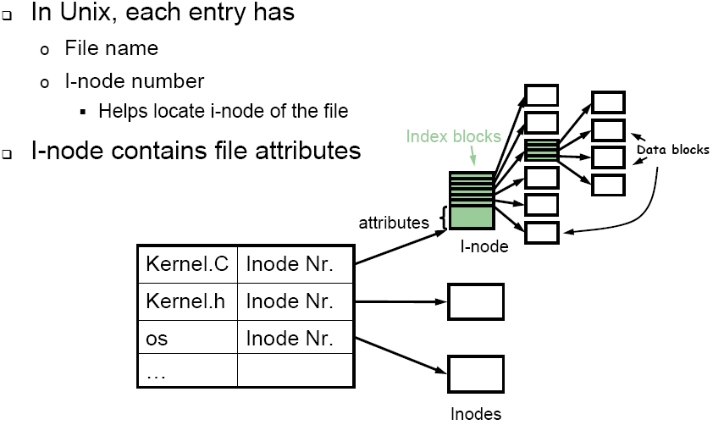
Unix Directories
i-node contains:
File attributes + 10 direct pointers+ 3 levels of indirect pointers

Slide 44
Accessing a file block for \a\b
DOS(windows)
Go to “\” FAT entry (in memory)
Go to corresponding data block(s) of “\” to find entry for “a”
Read 1st data block of “a” to check if “b” present.
Else, use the FAT entry to find the next block of “a” and search again for “b”, and so on. Eventually you will find entry for “b”.
Read the relevant block of “b”, by chasing the FAT entries in memory.
UNIX
Get “/” i-node from disk (usually fixed, e.g. #2)
Get block after block of “/” using its i-node till entry for “a” is found (gives its i-node #).
Get i-node of “a” from disk
Get block after block of “a” till entry for “b” is found (gives its i-node #)
Get i-node of “b” from disk
Find out whether block you are searching for is in 1st 10 ptrs, or 1-level or 2-level or 3-level indirect.
Based on this you can either directly get the block, or retrieve it after going through the levels of indirection.

Slide 45
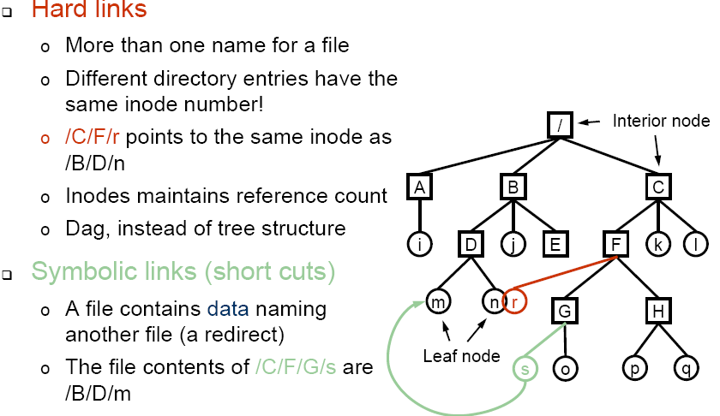

Unix Directories

Slide 46
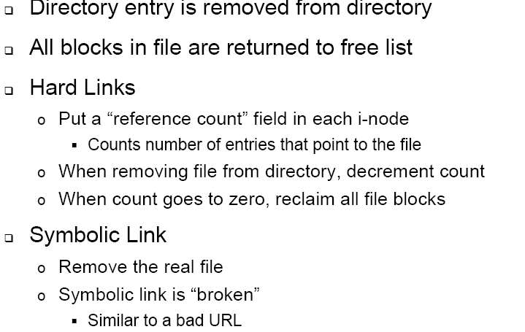
File Deletion

Slide 47
End of Chapter 10
Promise is promise. What is this?
Dinosaur becomes so small!!!

