Slide 1
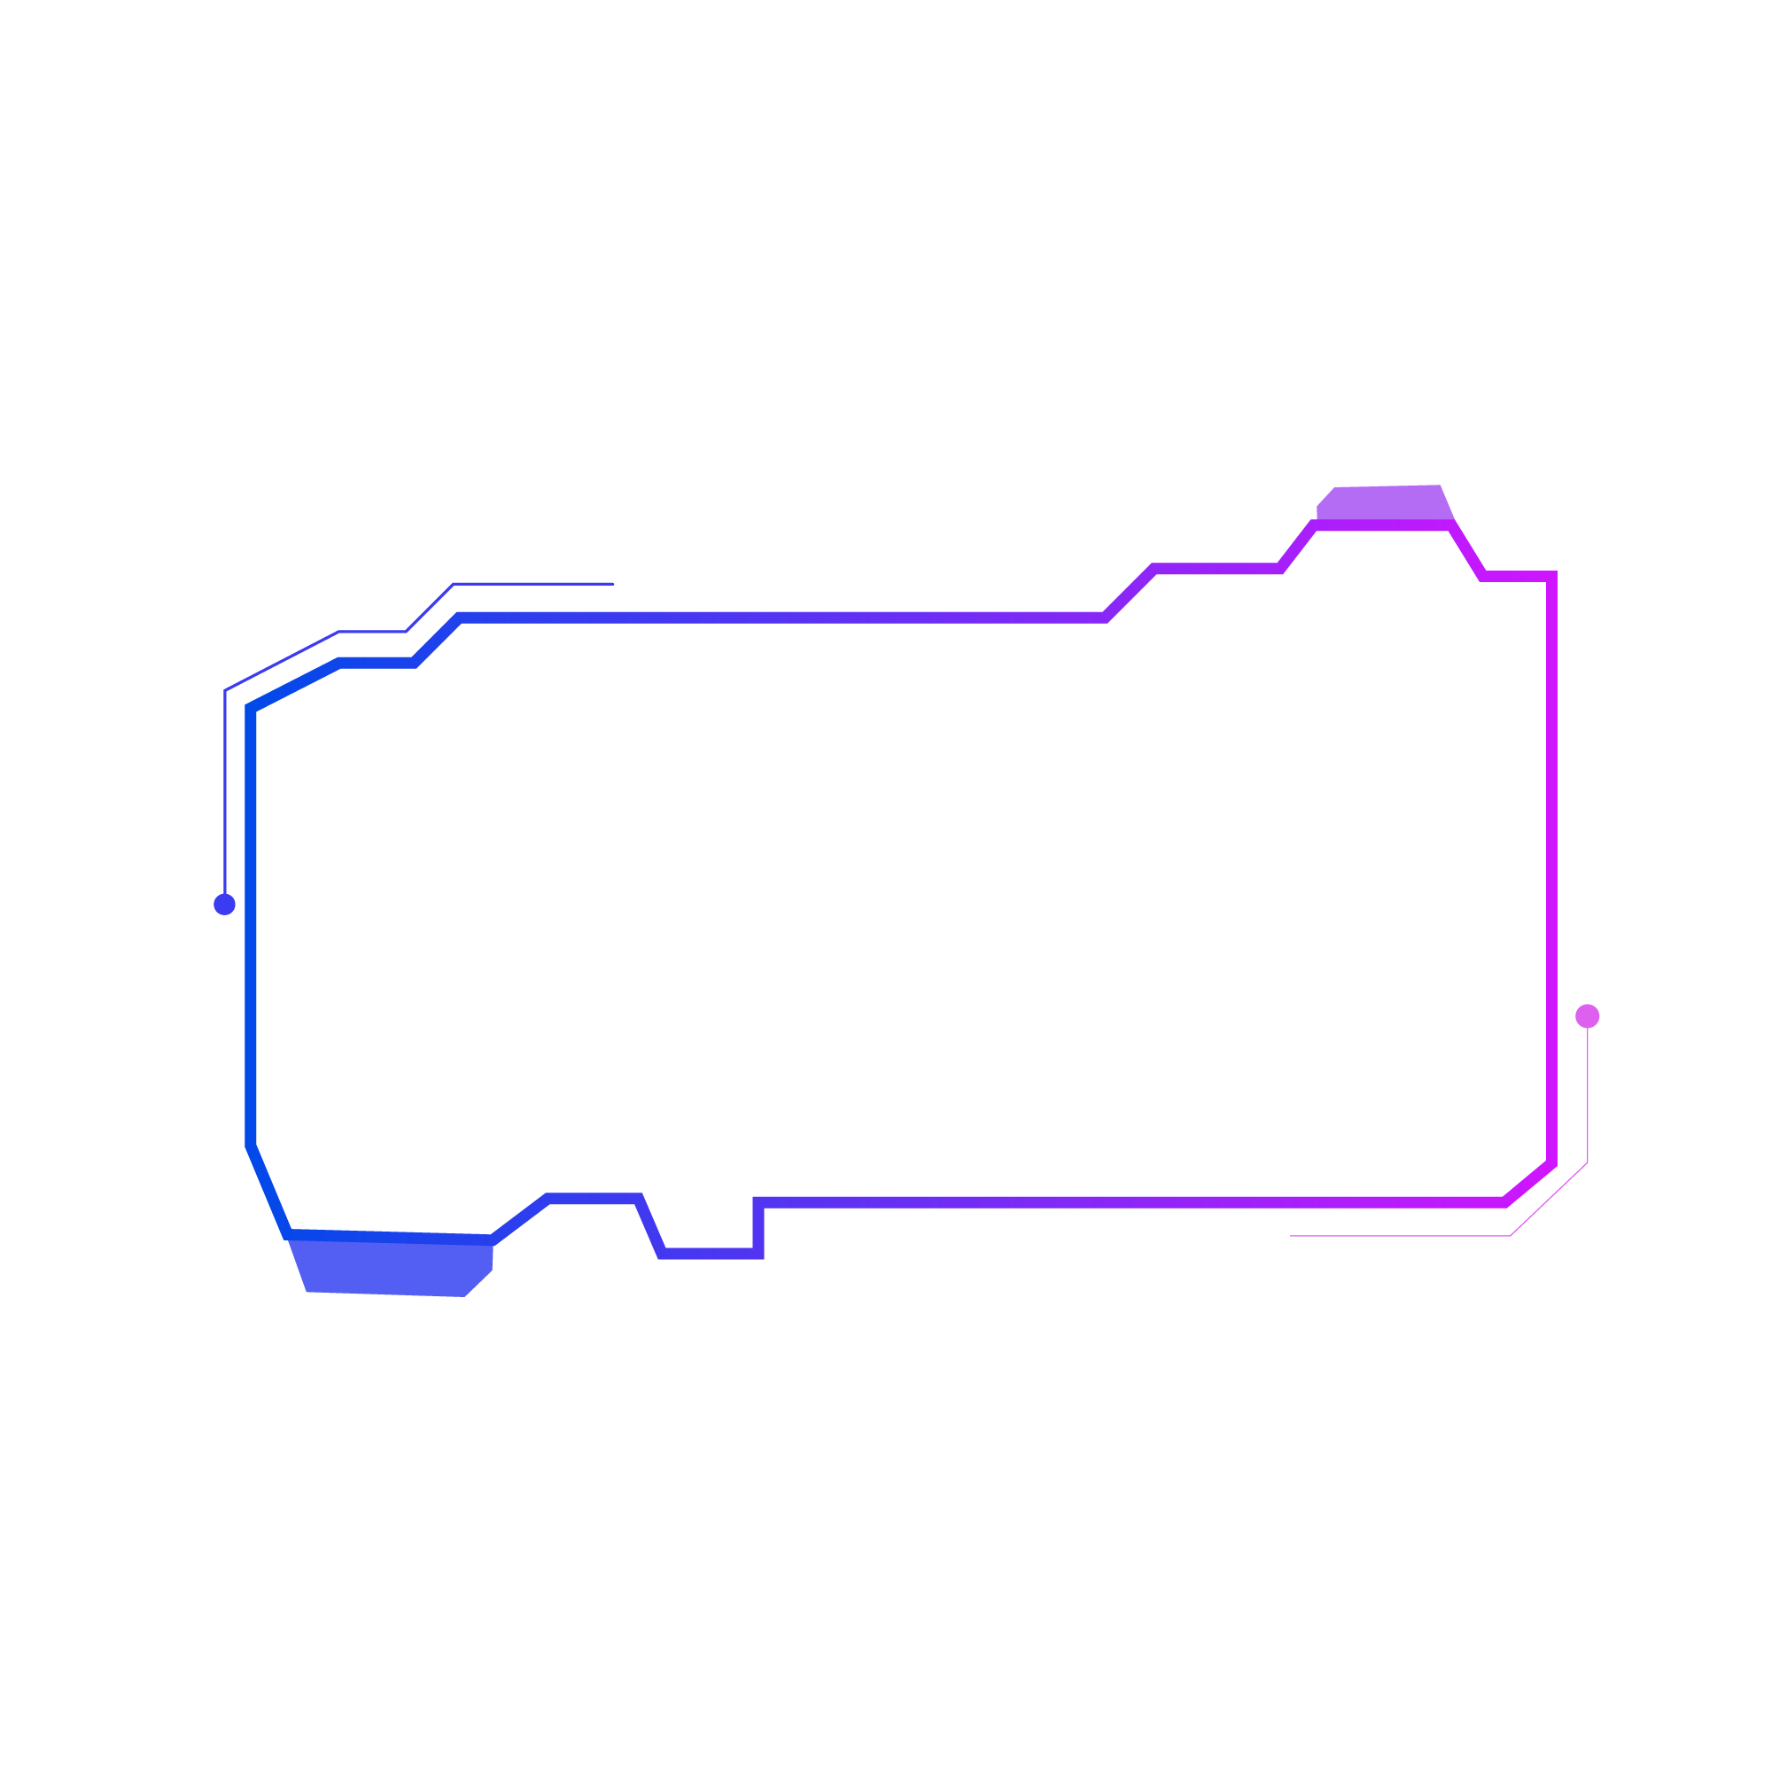


Dušan Janković 16110
Lazar Pavlović 16268

Slide 2
Vert.x
Vert.x is a tool-kit for building reactive applications on the JVM.

Slide 3

Scaleable
Eclipse Vert.x is event driven and non blocking. This means your app can handle a lot of concurrency using a small number of kernel threads. Vert.x lets your app scale with minimal hardware.

Slide 4
Polyglot
You can use Vert.x with multiple JVM languages including Java, JavaScript and Groovy and more. Vert.x doesn't care what language is best — you use what language(s) that you want depending on the task at hand and the skill-set of your team.
It doesn't just force you to use Java API in other languages - it provide idiomatic APIs for every language that Vert.x supports.

Slide 5
General purpose
Vert.x is incredibly flexible - whether it's simple network utilities, sophisticated modern web applications, HTTP/REST microservices, high volume event processing or a full blown back-end message-bus application, Vert.x is a great fit.
Vert.x is used by many different companies from real-time gaming to banking and everything in between.

Slide 6
Unopinionated
You can use Vert.x for all kinds of applications, for example: web applications and enterprise back-end applications.
Vert.x is not a framework or a container and there is no correct way to write an application. Instead it gives you a lot of useful tools and lets you create your app the way you want to.

Slide 7
Vertex is
Lightweight - Vert.x core is around 650kB in size.
Fast.
An ideal choice for creating light-weight, high-performance, micro-services.
Not an application server. There's no monolithic Vert.x instance into which you deploy applications. You just run your apps wherever you want to.
Modular - when you need more bits just add the bits you need and nothing more.
Simple but not simplistic. Vert.x allows you to create powerful apps, simply.

Slide 8
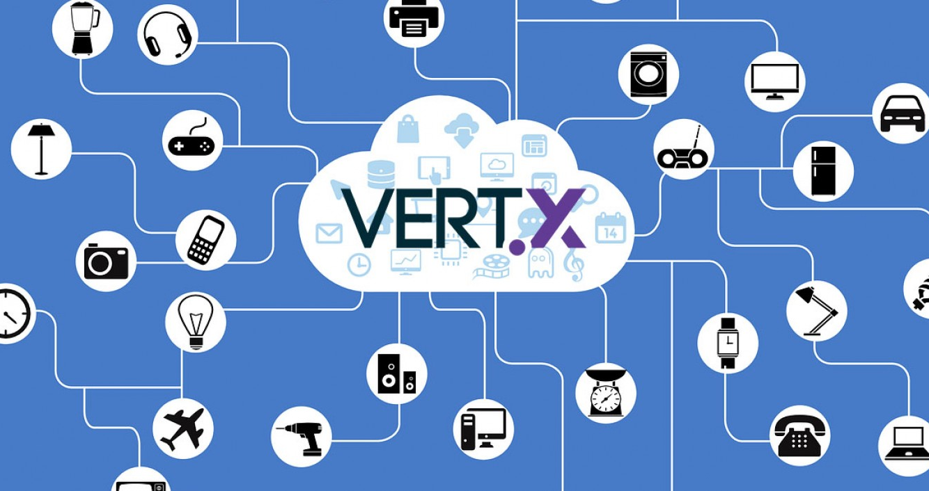

Slide 9
Explore
Vert.x contains several different components designed to make it easier for you to write compelling reactive applications in a range of different languages.
You don't have to only use components provided by Vert.x. You can also use Vert.x with all the usual libraries that you like.
On the next page there is a list of some of the components that are part of the official Vert.x stack.(there are more)

Slide 10
Some of the Components
01.
02.
03.
04.
Core
Web
Data acces
Microservices

Slide 11

PART ONE
Core

Slide 12
Vert.x core functionalities
Writing TCP clients and servers
Writing HTTP clients and servers including support for WebSockets
The Event bus
Shared data - local maps and clustered distributed maps
Periodic and delayed actions
Deploying and undeploying Verticles
Datagram Sockets
DNS client
File system access
High availability
Native transports
Clustering

Slide 13
At the heart of Vert.x is a set of Java APIs that we call Vert.x Core
The functionality in core is fairly low level - you won’t find stuff like database access, authorisation or high level web functionality here - that kind of stuff you’ll find in Vert.x ext (extensions).
Vert.x core is small and lightweight. You just use the parts you want. It’s also entirely embeddable in your existing applications - it doesn’t force you to structure your applications in a special way just so you can use Vert.x.

Slide 14
Don't call us, we'll call you
The Vert.x APIs are largely event driven. This means that when things happen in Vert.x that you are interested in, Vert.x will call you by sending you events.
Some example events are:
a timer has fired
some data has arrived on a socket,
some data has been read from disk
an exception has occurred
an HTTP server has received a request

Slide 15
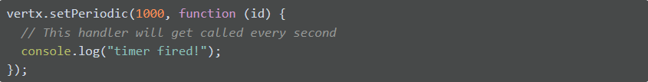
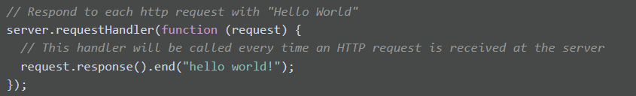
You handle events by providing handlers to the Vert.x APIs. For example to receive a timer event every second you would do:
Or to receive an HTTP request:

Slide 16
Don’t block me!
With very few exceptions (i.e. some file system operations ending in 'Sync'), none of the APIs in Vert.x block the calling thread.Because none of the Vert.x APIs block threads that means you can use Vert.x to handle a lot of concurrency using just a small number of threads.

Slide 17
Multi-Reaktor pattern!
In most cases Vert.x calls your handlers using a thread called an event loop.
As nothing in Vert.x or your application blocks, the event loop can merrily run around delivering events to different handlers in succession as they arrive.
Because nothing blocks, an event loop can potentially deliver huge amounts of events in a short amount of time. We call this the Reactor Pattern.
In a standard reactor implementation there is a single event loop thread which runs around in a loop delivering all events to all handlers as they arrive.
Vert.x works differently here. Instead of a single event loop, each Vertx instance maintains several event loops. By default we choose the number based on the number of available cores on the machine, but this can be overridden.
Aka. Multi-Reactor Pattern

Slide 18
The Golden Rule - Don’t Block the Event Loop

Slide 19
Verticles
Modules are a collection of Verticles which are packaged together and can be deployed either stand-alone or with other modules.
Verticles are typically small collections of code which serve a single purpose. An application would typically be composed of many verticle instances running in the same Vert.x instance at the same time. The different verticle instances communicate with each other by sending messages on the event bus.

Slide 20
Event Bus
The event bus is the nervous system of Vert.x which allows different parts of your application to communicate with each otherIt can.
It can even be bridged to allow client-side JavaScript running in a browser to communicate on the same event bus.
The event bus forms a distributed peer-to-peer messaging system spanning multiple server nodes and multiple browsers.
The event bus supports:
publish/subscribe
point-to-point
and request-response
messaging.

Slide 21
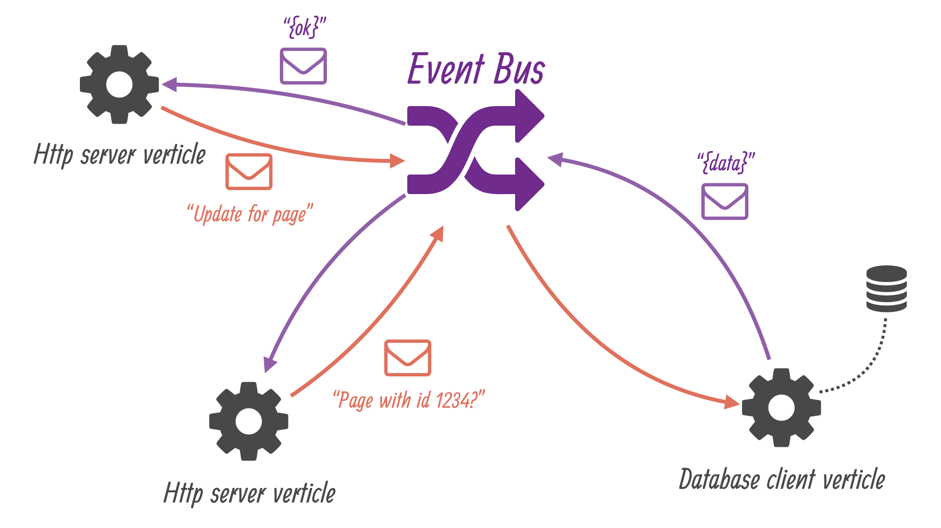
Event Bus

Slide 22
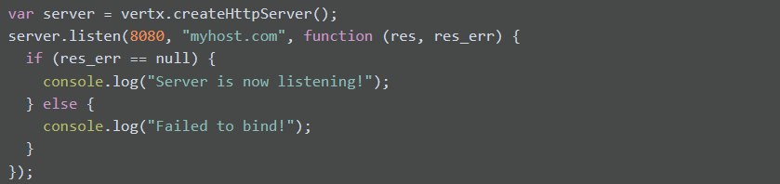
Writing Http servers

Slide 23
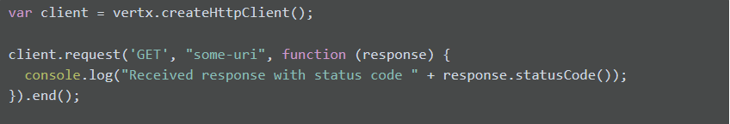
Writing Http clients

Slide 24

PART TWO
Web

Slide 25
Vert.x-Web
Vert.x-Web builds on Vert.x core to provide a richer set of functionality for building real web applications, more easily.
You can use Vert.x-Web to create classic server-side web applications, RESTful web applications, 'real-time' (server push) web applications, or any other kind of web application you can think of. Vert.x-Web doesn’t care.
Vert.x-Web is a great fit for writingRESTful HTTP micro-services

Slide 26
Some of the key features of Vert.x-Web include
Routing (based on method, path, etc)
Regular expression pattern matching for paths
Extraction of parameters from paths
Cookie parsing and handling
Multipart forms
Multipart file uploads
JWT based authorization

Slide 27
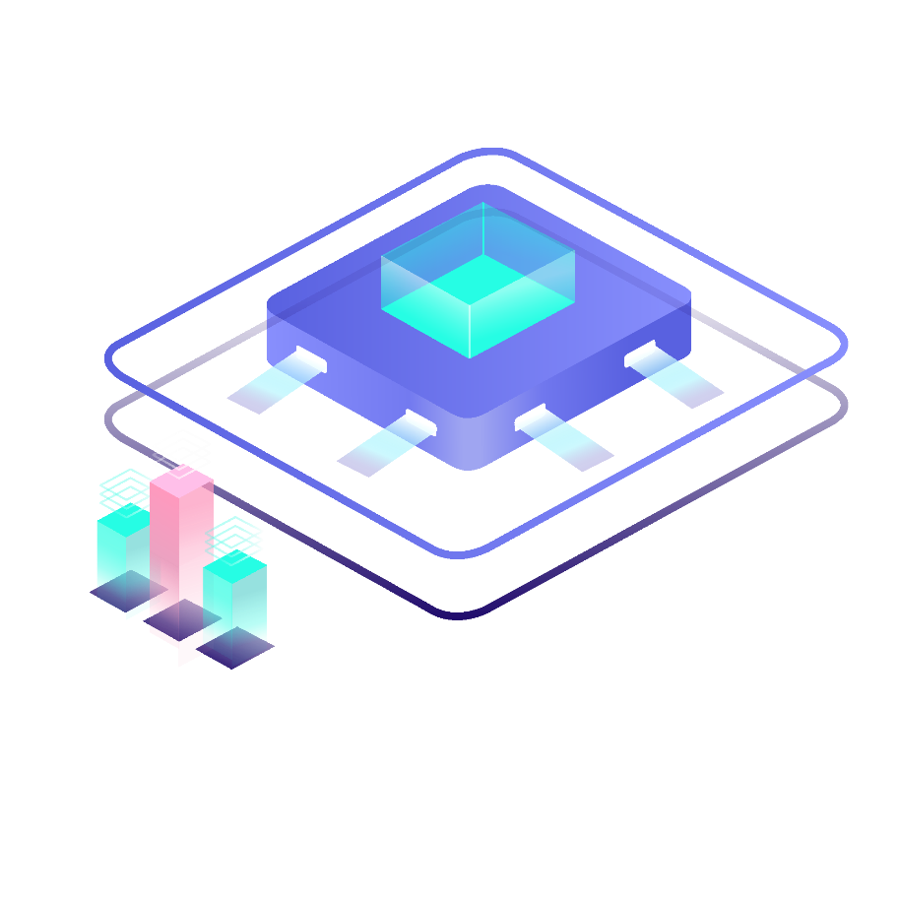
PART THREE
Data Access

Slide 28
Data access
Vert.x provides a few different asynchronous clients for accessing various data stores from your application. You don't have to use these clients - you could use clients direct from the vendor if you prefer, but these provide a simple async API which is available in various languages. Some of the available data access clents are:
MySql
MongoDB
Redis
Cassandra
PostgreSQL

Slide 29
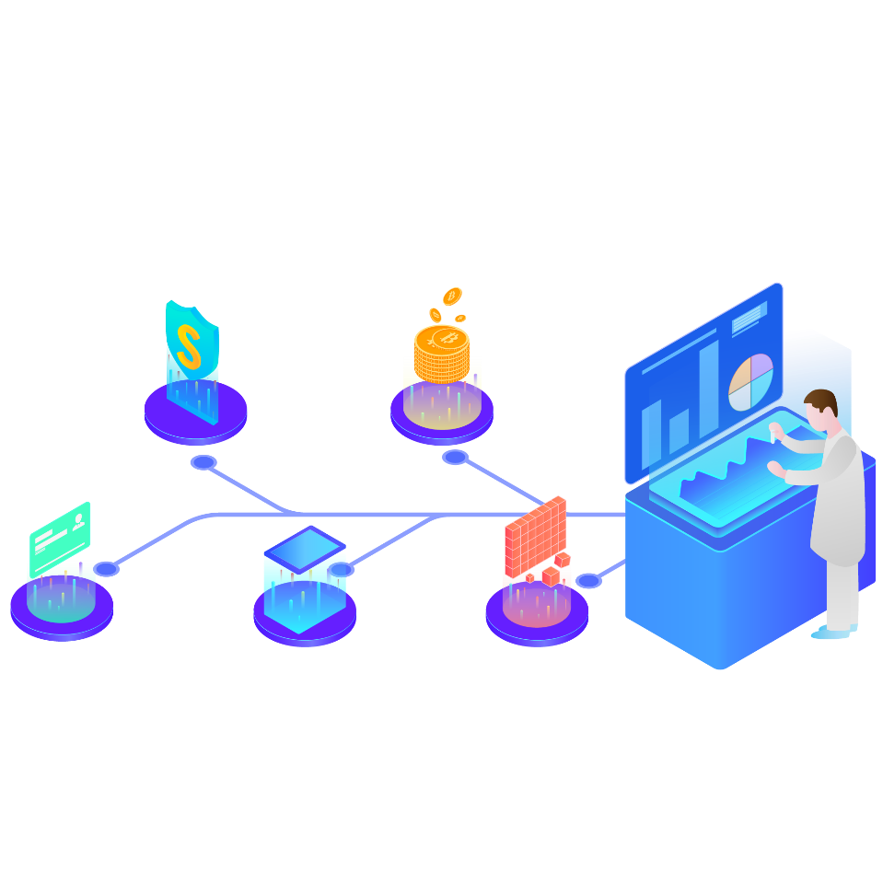
PART FOUR
Microservices

Slide 30
Microservices
Vert.x offers various component to build microservice-based applications.
Vert.x Service Discovery
This component lets you publish, lookup and bind to any type of services.
Vert.x Circuit Breaker
This component provides an implementation of the circuit breaker pattern for Vert.x
Vert.x Config
This component provides an extensible way to configure Vert.x applications.

Slide 31
Questions?

Slide 32
THANKS

