Slide 1
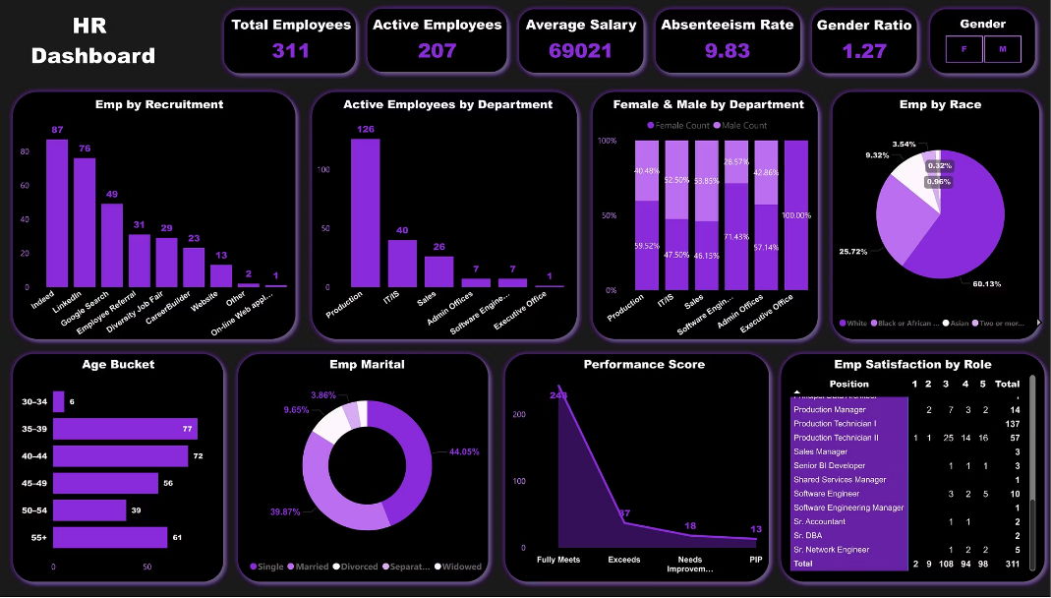
Data-Driven HR Analytics
Project Link

Slide 2
🔍 Project Objective & Goals
Our project aims to:
Analyze HR data to uncover workforce trends.
Identify areas for improvement in employee engagement and diversity.
Support data-driven decisions in HR management.
Use visual insights to present key KPIs and workforce metrics.
"We began this project with the goal of turning raw HR data into meaningful insights. This would help stakeholders understand employee demographics, performance, diversity, and engagement to better manage HR operations."

Slide 3

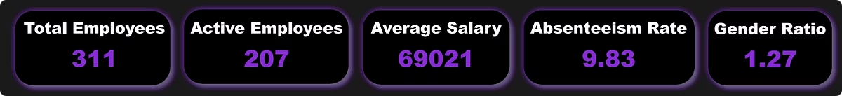
📈 Key HR KPIs
311
207
Total Employees
Active Employees
$69,021
9.83%
Average Salary
Absenteeism Rate
Gender Ratio (M/F): 1.27
"Here are five KPIs we tracked to measure workforce health. These provide a snapshot of employee count, salary trends, and diversity."

Slide 4
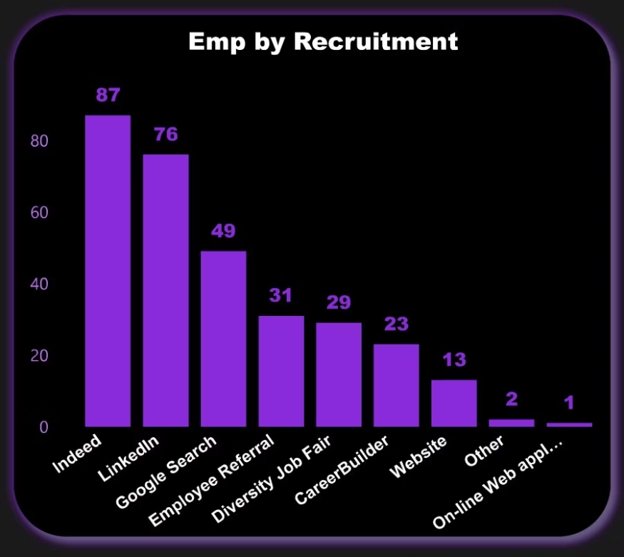
📦 Employees by Recruitment Source
"This visual helps us understand where most employees are being recruited from, with Indeed and LinkedIn leading as the most effective hiring platforms."

Slide 5
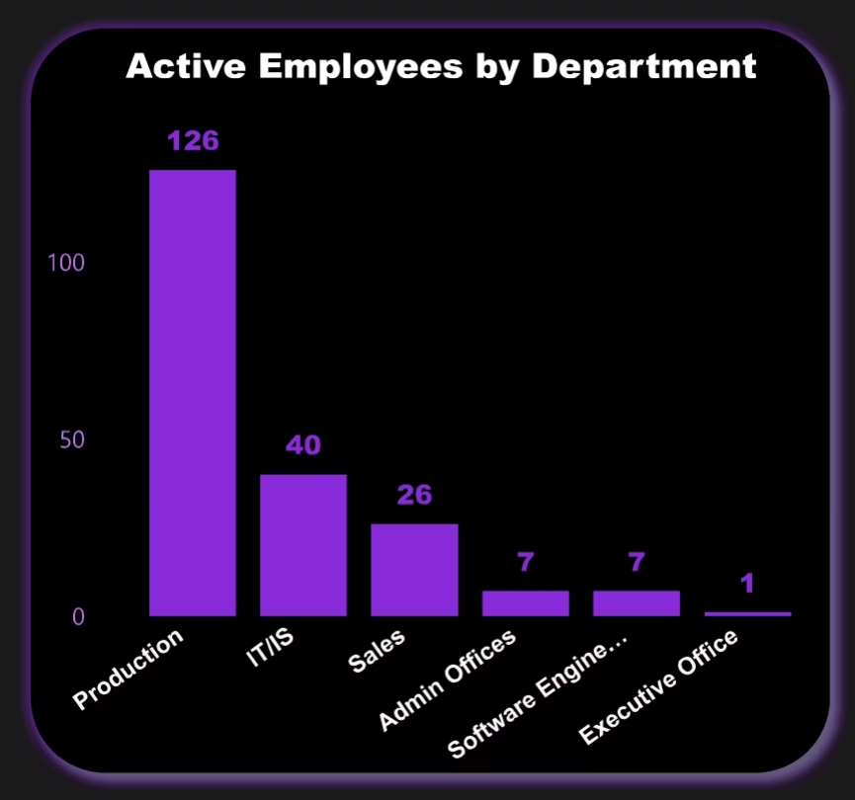
🏢 Active Employees by Department
"This shows which departments have the most active employees. Production and IT/IS clearly make up the largest portion of our workforce."

Slide 6
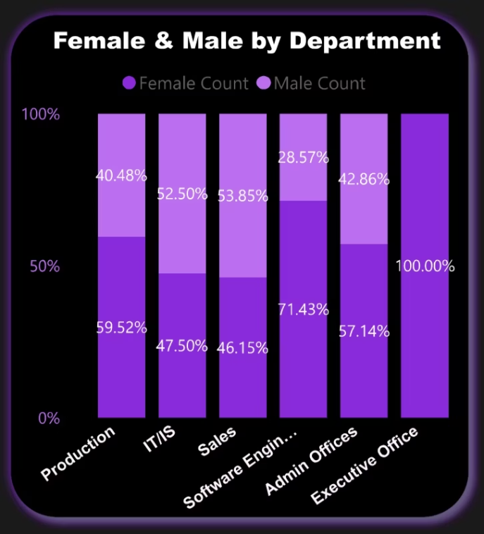
🚻 Gender Distribution Across Departments
Key Findings
IT/IS department has the highest male-to-female ratio
Admin shows the most balanced gender distribution
Production maintains a slight male majority
Sales has near-equal representation
"This visualization highlights gender distribution across departments, giving insight into diversity and inclusion."

Slide 7
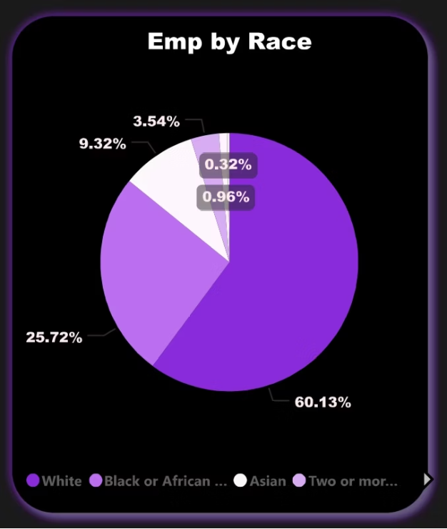
🌍 Employee Diversity by Race
"White employees make up the majority, but we also see diversity among other racial backgrounds. This helps assess the inclusiveness of hiring practices."

Slide 8

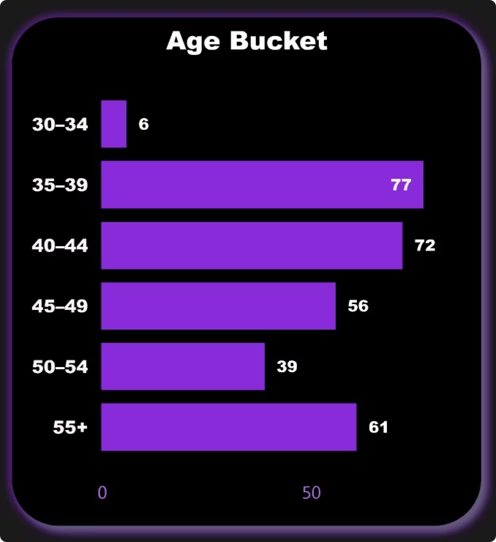
🎂 Age Group Distribution
30-34 Age Group
Early career professionals
Growing segment of workforce
35-39 Age Group
Mid-career professionals
Largest age demographic
40-44 Age Group
Experienced professionals
Second largest age demographic
45-49 Age Group
Experienced and Near 50s Fourth largest
"We've created age groups to understand the overall workforce maturity. Most employees fall in the 35–44 range."

Slide 9

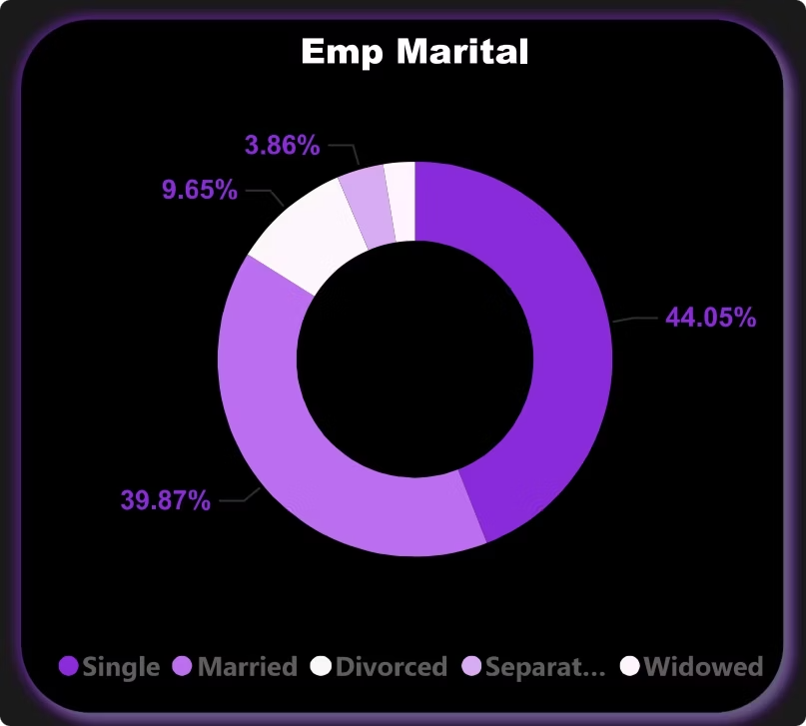




💍 Marital Status of Employees
Single
Married
40.05% of employees
39.87% of employees
Divorced
Separated
Significant minority
3.86% of employees
"Understanding the marital profile helps HR with benefit planning and employee assistance programs."

Slide 10
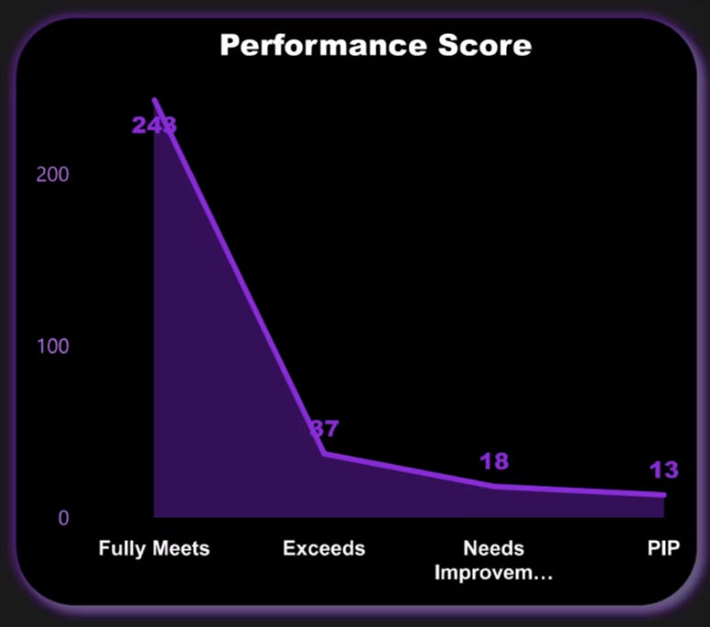



📊 Performance Evaluation Trend
Exceeds Expectations
37 employees
Fully Meets Expectations
284 employees
Needs Improvement
18 employees
Performance Improvement Plan
13 employees
"This chart summarizes performance reviews. The majority 'fully meets expectations,' with smaller groups needing improvement or exceeding."

Slide 11

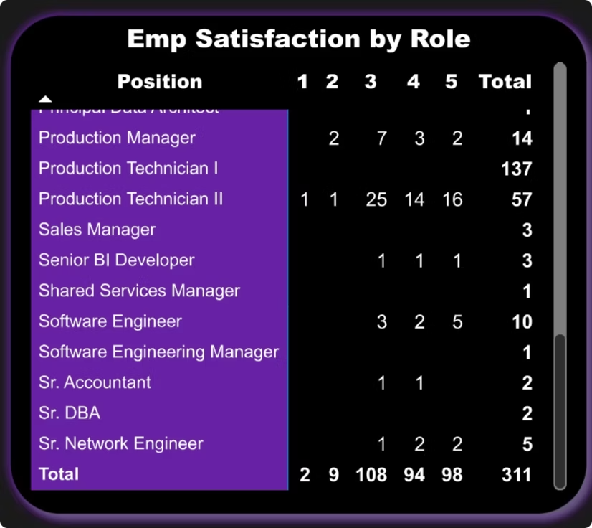
😊 Employee Satisfaction by Role
"This matrix visual connects job roles to satisfaction levels. Production Technician 2 roles are among the most satisfied, highlighting strong engagement in that position."

Slide 12
Thank You!
Empowering HR with Data-Driven Insights for Smarter Decision-Making.

