Slide 1

Top Instagram Influencers Dashboard
This dashboard explores data from top Instagram influencers with the goal to:
Evaluate influencer performance based on key engagement metrics
Identify top-performing influencers by likes, followers, and average engagement
Highlight geographic influence using country-based analysis
Project Link

Slide 2

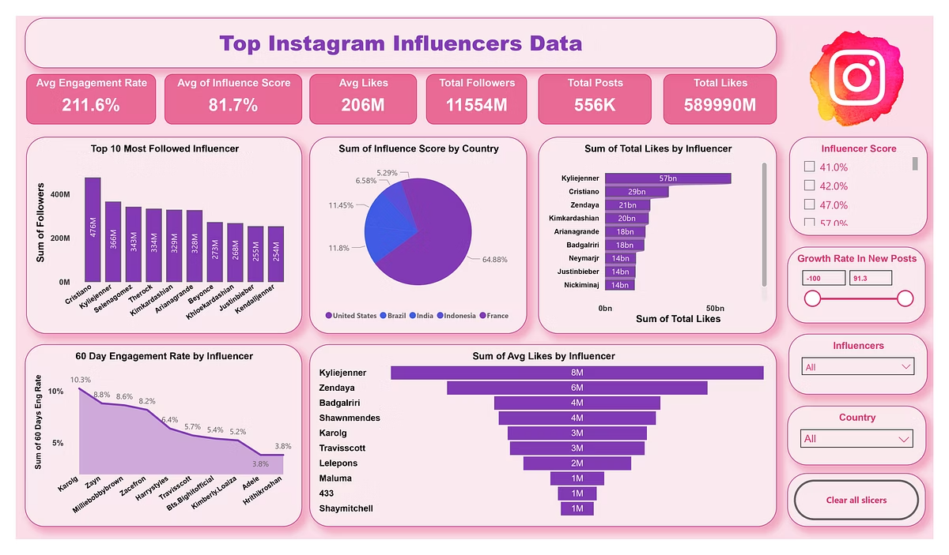
Objective
Goal: The goal of this dashboard is to analyze top Instagram influencers across key performance metrics to help brands, marketers, and analysts identify the most impactful creators based on engagement, popularity, and audience reach.
This includes an overview of influencer performance via KPIs such as average engagement rate, influence score, follower count, likes, and post activity — along with visuals to highlight top performers and trends across countries.

Slide 3
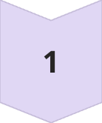
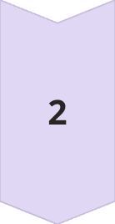
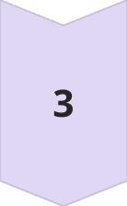
Dataset Overview
Import Data & Initial Cleaning
Data Import
Import the dataset into Power Bi.
Field Overview
Verify the data types for each column:
○ rank (integer), channel_info (string), influence_score (float), posts (integer), followers (integer), avg_likes (float), 60_day_eng_rate (float), new_post_avg_like (float), total_likes (integer), and country (string).
Initial Cleaning
○ Remove or fill null values (if any).
○ Ensure columns like influence_score and engagement_rate are correctly formatted as percentages where needed.

Slide 4










Defining Key Performance Indicators (KPIs)
KPIs will measure influencer performance and engagement.
Average Engagement Rate
Total Followers
The average 60 day eng rate.
Sum of followers across all influencers.
Average Likes per Post
Calculated by total likes / posts.
Country with Highest Influencers
Influence Score Distribution
A count of influencers by country to determine top regions.
Distribution analysis of influence score across countries or ranks.

Slide 5
Creating Calculated Fields
Calculated fields will enhance the data by creating new insights.
Engagement Rate (ER) Calculation
Growth Rate in New Post Likes
Like-to-Follower Ratio
○ Formula: [total_likes] / [followers]
○ Formula: ([avg_likes] / [followers]) * 100
○ Formula: ([new_post_avg_like] - [avg_likes]) / [avg_likes] * 100
○ Useful for identifying influencers whose total engagement surpasses their followers.
○ This will standardize engagement rates to help compare across different influencer follower counts.
○ This field will indicate the growth or decline in average likes over time.

Slide 6
KPIs Overview Slide
All 6 KPIs
1️⃣ Average Engagement Rate
2️⃣ Average of Influence Score
- What it means: Measures how actively the audience engages with influencer content (likes, comments vs. followers).
- What it means: A composite score based on reach, engagement, content quality, or credibility (depends on dataset).
- Why it matters: A high engagement rate indicates a loyal and responsive audience.
- Why it matters: It ranks the influencer's overall impact in their niche.
3️⃣ Average Likes
4️⃣ Total Followers
- What it means: Average number of likes per post across influencers.
- What it means: Combined follower count of all listed influencers.
- Why it matters: Indicates how appealing the content is to followers.
- Why it matters: Shows the potential total reach if brands partnered with these influencers.
5️⃣ Total Posts
6️⃣ Total Likes
- What it means: Sum of all posts made by the influencers in the dataset.
- What it means: All likes received across all influencer posts.
- Why it matters: Reflects content consistency and activity levels.
- Why it matters: Measures total engagement footprint.

Slide 7
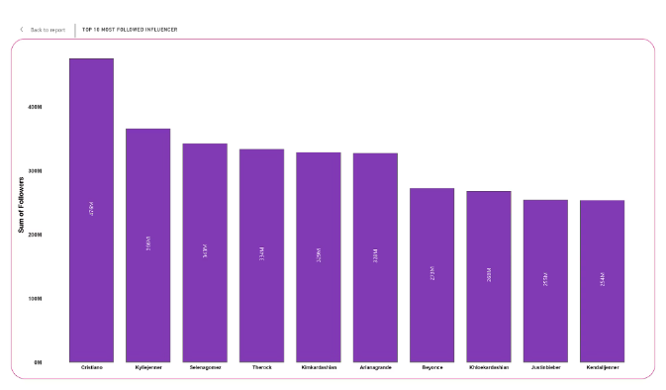
Dashboard Visualizations
Visual 1: Top 10 Most Followed Influencers – Clustered Column Chart
Purpose: This chart displays the top 10 influencers based on their total follower count.
Insights:
Cristiano Ronaldo leads with 476M followers, followed by Kylie Jenner (366M) and Selena Gomez (343M).
The chart provides a quick comparison of audience size across top influencers.
Useful for brands who want maximum reach through collaborations.

Slide 8
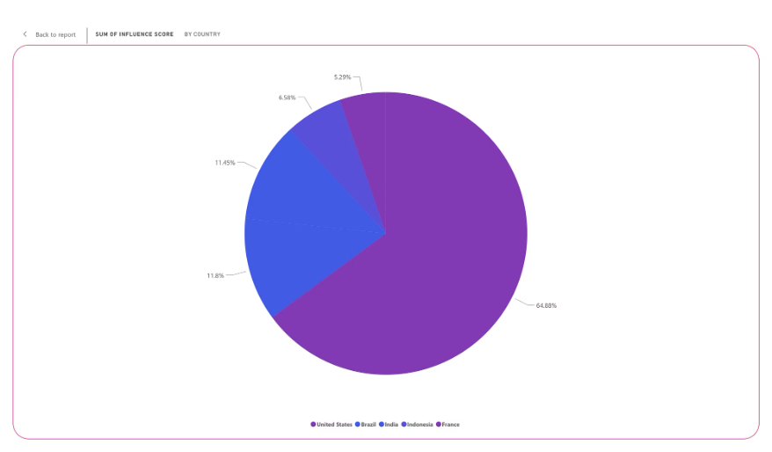
Visual 2: Influence Score by Country – Pie Chart
Purpose: This pie chart shows the sum of influence scores distributed across the top 5 countries.
Insights:
The top countries with the highest influence scores are USA, Brazil, India, Indonesia, and France.
Helps identify which countries have the strongest influencer presence.
Useful for brands planning location-specific influencer campaigns.

Slide 9
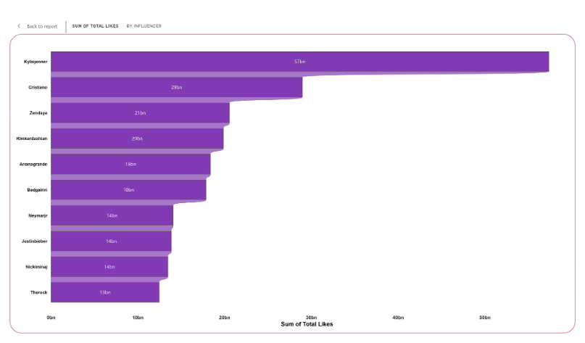
Visual 3: Total Likes by Influencer – Stacked Bar Chart
Purpose: This chart highlights how many total likes each top influencer has received.
Insights:
Kylie Jenner leads with 57 billion likes, followed by Cristiano Ronaldo (29 billion) and Zendaya (21 billion).
This gives a deeper measure of audience interaction, not just passive following.
Supports understanding of content popularity among followers.

Slide 10
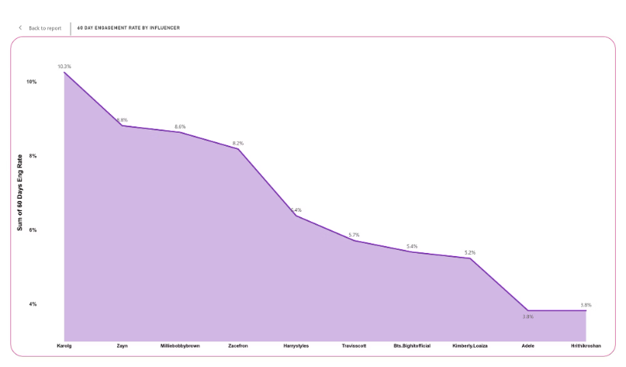
Visual 4: Engagement Rate Trend – Line Chart
Purpose: This line chart shows the 60-day engagement rate trend for selected influencers.
Insights:
Tracks influencers like Karol G, Zayn, Millie Bobby Brown, Zac Efron, and Harry Styles over time.
Helps visualize audience interaction patterns and fluctuations.
Useful to predict the best timing and choice for brand partnerships.

Slide 11
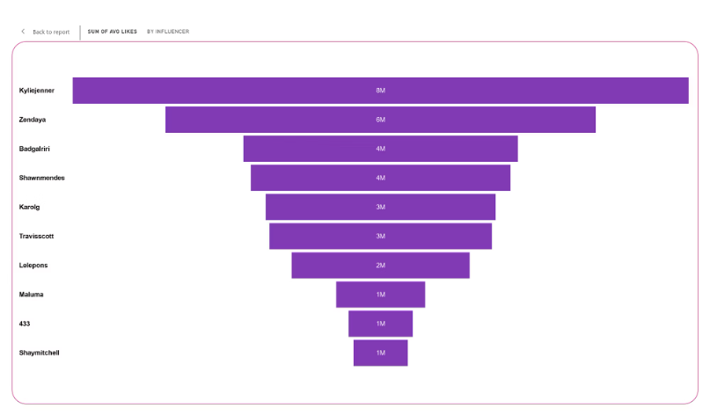
Visual 5: Avg Likes by Influencer – Funnel Chart
Purpose: This funnel chart displays the average likes per influencer in descending order.
Insights:
Kylie Jenner averages 8 million likes per post, followed by Zendaya with 6 million likes.
Visualizes influencer performance at a glance, ranking them based on audience engagement quality.
Great for identifying influencers with the strongest average post-performance.

Slide 12





Interactive Slicers Overview
What users can filter
Purpose: Slicers allow users to interact with the dashboard and customize the view based on specific needs.
Influence Score
Vertical list to filter influencers between 41.0% to 93.0%.
Growth Rate in New Posts
Slider to filter influencers from -100 to 91.3 growth rate.
Influencers
Dropdown menu to select a specific influencer.
Country
Dropdown menu to select influencers by country.
Clear All Slicers Button
Resets all filters to show the full dataset.
Benefit: Enables dynamic analysis, focusing only on specific influencers, countries, or performance levels as per user preference.

Slide 13
Summary / Key Insights
Top Influencers
Engagement Leaders
Geographic Distribution
Cristiano Ronaldo is the most followed influencer with 476M followers, making him highly attractive for brand collaborations.
Kylie Jenner leads in total likes (57 billion) and average likes per post (8 million), showing not just popularity but strong audience engagement.
USA, Brazil, and India are the top three countries with the highest influence scores, highlighting strong regional opportunities.
Notable Performers
Engagement Trends
Performance Distribution
Zendaya and Selena Gomez also perform strongly across multiple engagement metrics.
Engagement rates vary across influencers, with some maintaining consistent interaction trends over 60 days (e.g., Karol G and Harry Styles).
The funnel chart shows that influencers at the top (like Kylie Jenner) have significantly higher average post performance compared to others.
Interactive Analysis
Interactive slicers allow filtering the data for deeper analysis by influence score, growth rate, influencer name, and country.

Slide 14





Recommendations / Conclusion
Prioritize Top Performers
Brands should prioritize collaborations with influencers like Cristiano Ronaldo, Kylie Jenner, and Zendaya for maximum reach and engagement.
Target Key Regions
Focus marketing campaigns in top-performing countries (USA, Brazil, India) to leverage regional influence.
Balance Metrics
When selecting influencers, consider not only follower count but also average likes and engagement trends to ensure active audience participation.
Track Consistency
Monitor engagement rate trends over time to identify influencers with consistent performance, not just short-term spikes.
Customize Analysis
Utilize the dashboard slicers to tailor influencer selections based on specific campaign needs, such as high growth rate influencers for emerging markets.
Overall, the analysis supports data-driven influencer marketing decisions, maximizing campaign ROI.

Slide 15
Thank You
"This dashboard empowers brands to make smarter influencer choices based on real engagement data."

