Slide 1
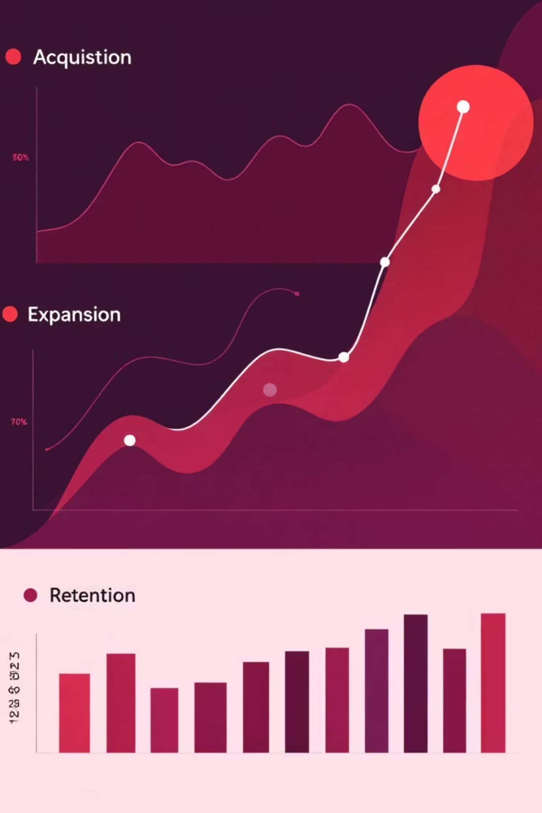



Q3 2025 Business Performance Snapshot
New Customer Acquisition
Between April and August 2025, new customer acquisition steadily increased, peaking at 80 in July. A slight dip to 70 occurred in August, but the overall trend remained positive.
Expansion Opportunities
Our recent analysis identified 10 high-potential expansion candidates. These clients currently have a median of 25 seats and demonstrate robust sales activity, averaging 400 contacts per account.
Customer Retention & Churn
Churn rates saw a peak of 8% in July, but significantly improved to 6.5% in August. Encouragingly, our active customer base remained stable, holding steady at approximately 870 customers.

