Slide 1
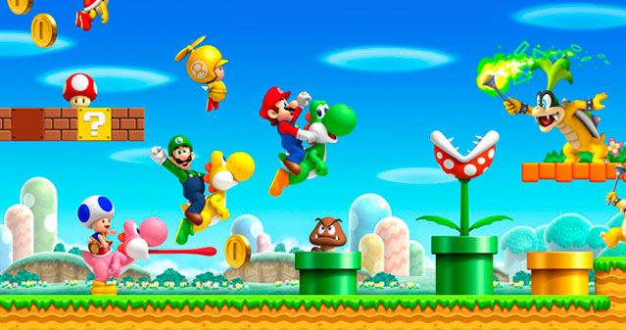
Automatic Game Level Generation
Super Mario Edition
Profesor Coordonator: Florea Adrian
Student: Luchin Cristina

Slide 2


