Slide 1
Automatic Game Level Generation
Super Mario Edition
Profesor Coordonator: Florea Adrian
Student: Luchin Cristina

Slide 2
Introduction
Game Level Generation with Genetic Algorithms for Mario
Based on a Paper by Lucas Ferreira, Leonardo Pereira and Claudio Toledo
Challenges when writing the application

Slide 3
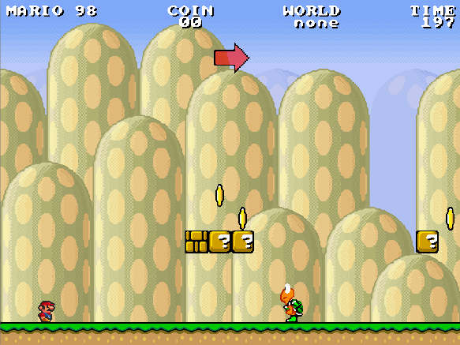
The Game
Mario Can:
Walk or jump to get to the end of the level
Jump on blocks, collect power-ups (blocks)
Collect coins (coins)
Fight enemies
Notes:
To be a major slide

Slide 4
Limitations
Mario can only jump 4 blocks in height
Mario has a limit as to how long a gap he can jump

Slide 5
The proposed algorithm [1]
A Multi-population Genetic Algorithm for Procedural Generation of Levels for Platform Games - Lucas Ferreira, Leonardo Pereira, Claudio Toledo

Slide 6
Representation
Level is to be represented as 4 vectors:
Ground
Blocks
Enemies
Coins
Notes:
TO BE a major slide

Slide 7
Ground
Defined by heights
Can take values from 0 to 15
Value 0 represents a gap

Slide 8
Blocks
Placed over the ground
Height values of 1 to 4 (when 1 only small Mario can hit)
Types
Empty
Power-up
Coin
Rock

Slide 9
Coins
Each entry represents height
Values from 0 to 10

Slide 10
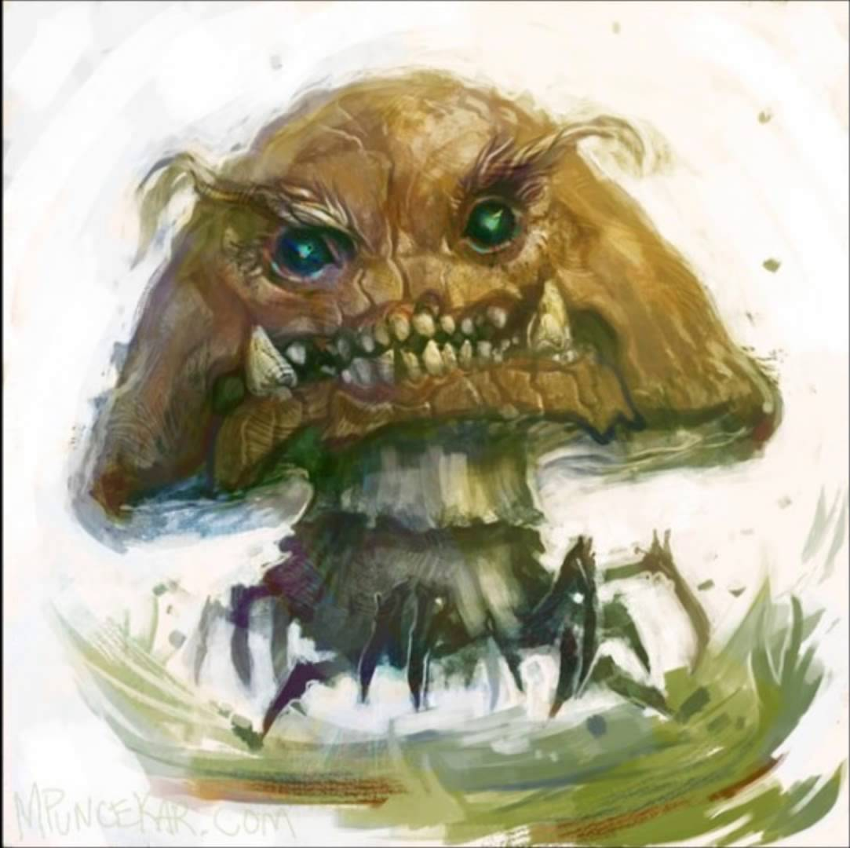

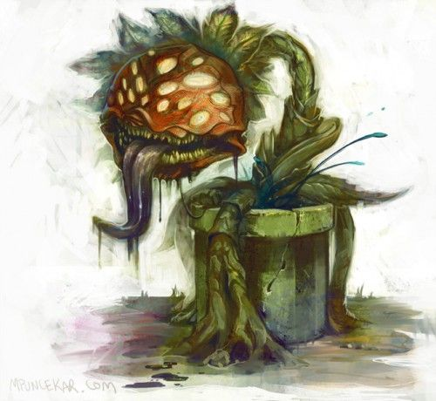
Enemies
Placed on ground => no flying enemies
Types:

Slide 11
How to evaluate the fitness?

Slide 12
Ground levels – Entropy
Entropy - noun
1. PHYSICS - a thermodynamic quantity representing the unavailability of a system's thermal energy for conversion into mechanical work, often interpreted as the degree of disorder or randomness in the system.
2. lack of order or predictability; gradual decline into disorder.

Slide 13

Entropy formula [2]
$$H=−K\sum_{i=1}^{n}{p_{i}∗ \log_{2}{p_{i}}}$$
Where K is a positive constant

Slide 14

Assets and Enemies – Sparseness [3]
An array is sparse if the average distance between two elements is high.
$$2∗\left(\sum_{i=1}^{n}{\sum_{j=1}^{n}{dist\left(i,j\right)}}\right)∗ \frac{1}{\left(n ∗ n − 1\right)}$$
Where n is the number elements (ex: coins on the map)

Slide 15
Using batches for evaluation
Avoid having either:
a flat shape (minimal entropy)
Too uncertain terrain (maximal entropy)

Slide 16
Variation on the original algorithm
Develop each aspect individually (ground, blocks, coins, enemies)
Get the best individual in each population and combine to get a single level
Develop all aspects as a single level being generated.

Slide 17
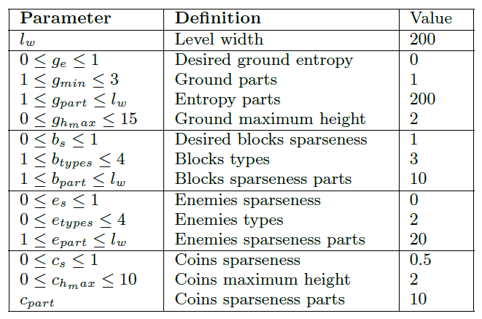
Getting to the actual level generation
I believe this to be “Ground minimum height”
Fitness evaluation by computing distance to desired function value

Slide 18
The application

Slide 19
Issues or plausibility checks
Generated level might not be playable due to:
Gaps Mario can not jump
Ground that increases in height too fast and Mario can not climb
Enemies placed in gaps
Coins placed over blocks
Coins that can not be reached
Proper aggregation function for the entropy and sparseness evaluation

Slide 20

Making it playable
Link here
HTML5 Game Engine
JavaScript-friendly syntax
Provides plugins, events and a selector syntax
Basically it is highly extensible code
Allows fast development of games
Implementation requires:
Implementing the game in Quintus
Generating the TMX map file from the result of the genetic algorithm (ground and blocks)
Adding the assets (enemies and coins) to the game using JavaScript

Slide 21
Bibliography
[1] A Multi-population Genetic Algorithm for Procedural Generation of Levels for Platform Games - Lucas Ferreira, Leonardo Pereira, Claudio Toledo
[2] A Mathematical Theory of Communication - C. E. Shannon
[3] Multi-Faceted Evolution Of Simple Arcade Games - Michael Cook and Simon Colton

Slide 22

Questions?

