Slide 1
Progress Presentation
A Stability-Centered Framework for
Early Final GPA Prediction
Identifying Group-Specific Reliable Prediction Points
Sayuri Witharana
Supervisor: Dr. Tiloka De Silva
Faculty of Business, University of Moratuwa
2025

Slide 2
The Problem
Why accuracy alone is not enough?
Universities increasingly use GPA prediction to guide academic advising and student intervention. Most models ask:
RQ1
At what earliest semester can final GPA be predicted reliably and equitably across different student performance groups?
"Is the model accurate?"
But they overlook three critical questions:
⚡ When does prediction become stable enough for intervention?
Research Gap
Existing studies prioritize predictive accuracy, but rarely evaluate prediction stability, subgroup reliability, and systematic bias in early GPA forecasting.
⚖ Does reliability emerge equally across student performance groups?
📉 Do early predictions systematically overestimate at-risk students?

Slide 3
Why This Matters
⚠ The Harm of False Reassurance
A model that overpredicts an at-risk student's GPA delivers false reassurance → no intervention is triggered → student's outcome worsens. This an equity problem with real consequences.
👤For At-Risk Students
⚙ For Academic Decision-Making
🏫 Institutional
Early unstable predictions can delay support
• Overestimating struggling students creates false reassurance
• Delayed intervention reduces recovery opportunities
• Understanding bias helps identify hidden risk earlier
Institutions need to know when predictions are trustworthy
• Acting too early may rely on unstable predictions
• Acting too late loses valuable intervention time
• Reliability thresholds help balance timing and confidence
Student Batches change over time
• Academic distributions vary across batches
• A model trained once may not remain reliable forever
• A reusable framework helps generate updated cohort-specific insights

Slide 4
Data & Exploratory Analysis
271
178
93
9
Total students
(2017–2019)
Training
(2017–2018)
Test set
(2019)
Semester
snapshots
Performance Groups
Features Used
Key EDA Findings
Performing
n=89
Pre-academic & Demographic
Academic
No missing values or duplicates
Z-score: right-skewed distribution
Average
n=43
Categorical Variables: Gender, Department, District, Medium of A/L
GPA: left-skewed by later semesters
Outliers retained — they represent genuine academic risk signals
Underperforming
n=46
Academic: Semester GPA (S1–S5), Z Score
StandardScaler selected to preserve low-GPA signals
Defined by final GPA thresholds
Used only for evaluation — not model inputs.
Faculty of Business, University of Moratuwa

Slide 5
Methodology
01
02
03
04
05
EDA and Preprocessing
Semester Snapshots
Model Development
Validation Strategy
Evaluation
Categorical encoding (OHE)
Numerical scaling (StandardScaler)
Integrated into pipeline — no data leakage
9 cumulative feature sets
S0 (pre-academic) → S5
Each predicts Final GPA
Ridge Regression vs Random Forest evaluated
Ridge selected for stability & small-data suitability
5-fold × 10-repeat Stratified CV on 2017–2018 data
50 evaluations Per Model
2019 cohort = test set
RMSE, SD(RMSE)
Group-wise bias
ΔRMSE per semester
All-four-criteria rule
Training: 2017–2018 (n=178) | Test: 2019 (n=93) | Temporal split preserves realistic deployment conditions

Slide 6
Model Selection: Ridge vs Random Forest
Dimension
Criterion
Ridge
Random Forest
Winner
Accuracy
Overall RMSE
Lower in 7/12
group-sem pairs
Comparable;
RF edges avg students
Ridge
Stability
SD(RMSE)
Consistently lower;
SD improves Sem2→3
SD rises slightly
Sem2→3 (0.034→0.036)
Ridge
Equity
Group Bias
Wins 8/12
group comparisons
Higher bias for
underperformers at Sem3
(−0.115 > 0.10)
Ridge
✓ Ridge Regression selected — dominant on stability and equity; the two criteria most critical to this research framework.

Slide 7
The Reliability Decision Framework
1. RMSE
2. SD(RMSE)
3. Group Bias
4. ΔRMSE
Threshold
Threshold
Threshold
Threshold
≤ 0.25 (perf/avg)
≤ 0.35 (underperf)
≤ 0.04
+ plateauing
≤ 0.05 negligible
≤ 0.10 tolerable
> 0.10 disqualifying
< 0.03 per semester OR Diminishing Returns
Justification
Justification
Justification
Justification
On a 4-point GPA scale, 0.25 ≈ half a grade band — minimum precision for an actionable advising decision. Higher threshold for underperforming students reflects inherent outcome variance in this group.
Across repeated CV, stable models showed RMSE variation around 0.03–0.04. We set 0.04 as the upper limit because anything beyond that suggests the model is too dependent on the train/validation split.
Overpredicting an at-risk student produces false reassurance and withholds intervention — the most harmful failure mode. A bias > 0.10 consumes 40% of the RMSE budget through systematic directional error alone.
Anchored to the model's own noise floor (SD ≈ 0.03–0.04). Gains below this level are indistinguishable from resampling noise. Also < 12% of the RMSE threshold — does not change any advising decision.
Conjunction rule: a semester is the earliest reliable point only when ALL four criteria are satisfied simultaneously.

Slide 8
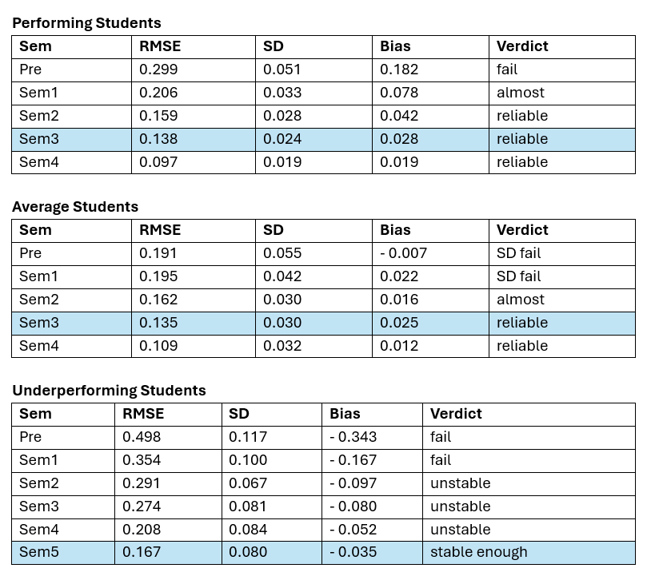
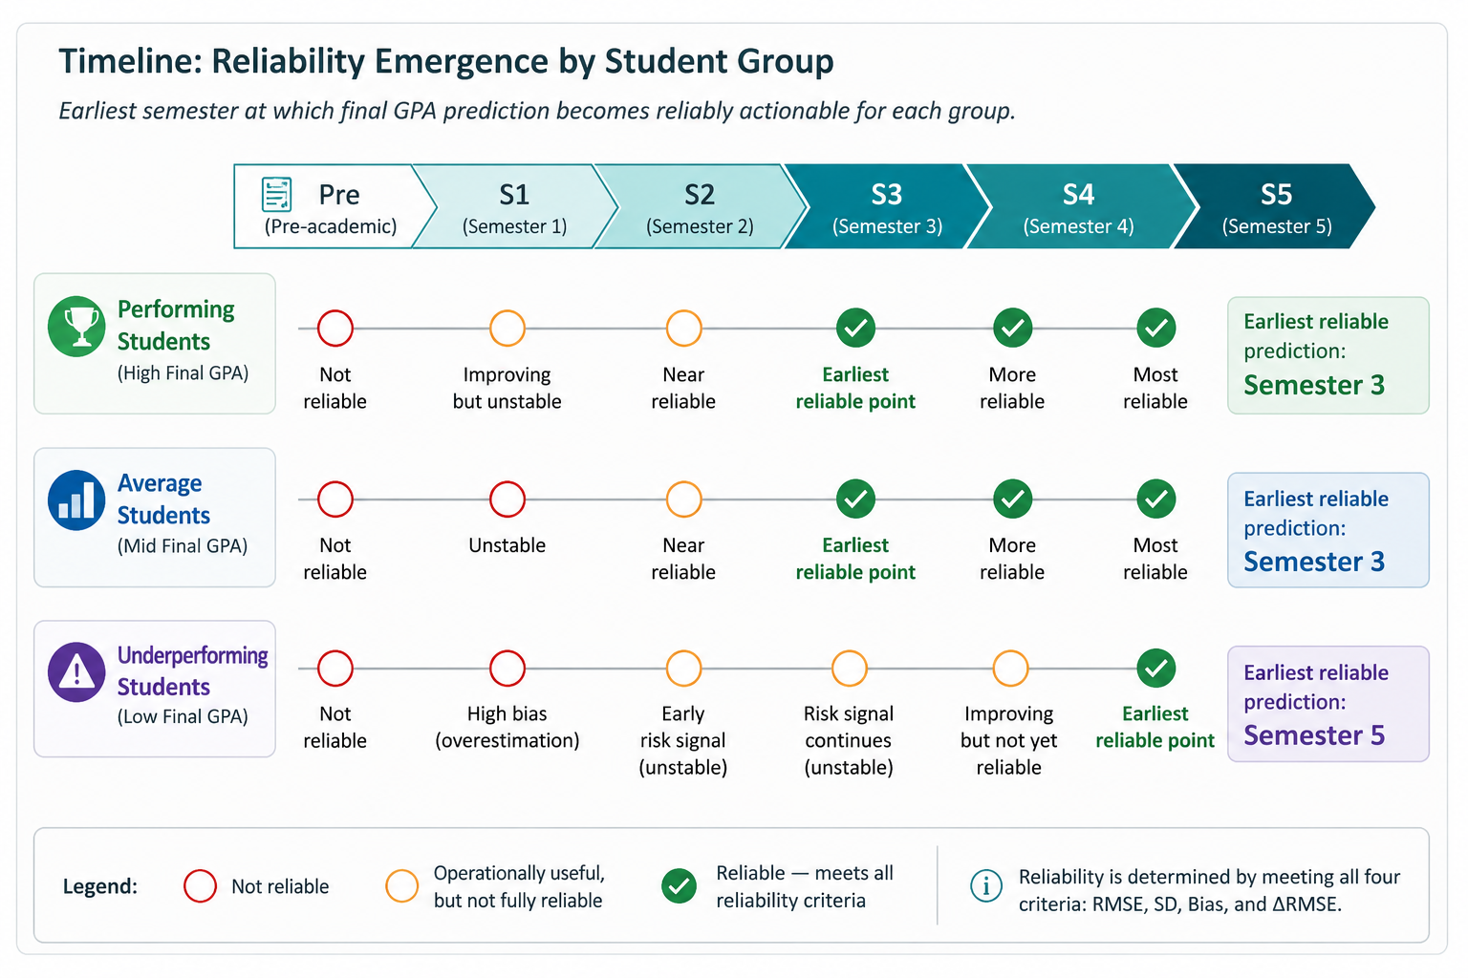
Results: Earliest Reliable Prediction Semesters
Reliability is group-dependent — a single university-wide trigger cannot be justified
R² caveat: Average group shows negative subgroup R² — predictions are accurate in absolute terms but cannot reliably rank within-group

Slide 9
External Validation: 2019 Test Set
Group
Earliest Sem
CV RMSE
Test RMSE
CV Bias
Test Bias
Verdict
Performing
Sem 3
0.138
0.142
+0.028
−0.087
Strong ✓
Average
Sem 3
0.135
0.228
+0.025
−0.149
Partial ⚠
Underperf.
Sem 5
0.167
0.163
−0.035
−0.035
Strong ✓
Performing: RMSE gap only 0.004. Bias shifts direction but stays within tolerable ≤0.10.
Average: RMSE within threshold (≤0.25) but test bias exceeds 0.10. Average group most sensitive to cohort differences.
Underperf.: Test RMSE marginally better than CV. Bias near-zero. Sem 5 conclusion strongly confirmed.

Slide 10
Additional Finding: Cohort Sensitivity
When the model trained on 2017–2019 was tested on the 2020 cohort, test RMSE degraded substantially compared to the 2019 test set — particularly for performing and average students. This was initially alarming, but investigation revealed a distributional shift in the 2020 data.
🦠 COVID-19 disruption
📊 Distributional shift
🔁 Not a model failure
2020 entrants experienced disrupted A-Level exams and transitioned to online learning in early semesters — altering their academic trajectory patterns relative to 2017–2019 cohorts.
GPA distributions of the 2020 cohort diverged from training data. The model learned relationships from a stable pre-COVID population — these did not fully transfer.
A good model that encounters a shifted distribution should show degraded test performance. This is expected behavior — not a bug. The 2019 test set, drawn from the same distribution, confirmed the framework.
What This Means for the Framework
The contribution of this study is not a fixed semester recommendation for a specific institution — it is a reusable methodological framework. When academic distributions shift (due to curriculum changes, external disruptions, or policy changes), the framework should be re-applied on updated cohort data to generate current reliability estimates. This makes the approach generalisable and institutionally sustainable.

Slide 11
Conclusions & Implications
1
Reliability is group-dependent
Performing and Average students reach reliable prediction at Semester 3. Underperforming students require until Semester 5. A single university-wide prediction trigger is not justified — group-specific intervention timelines are needed.
2
Prediction errors are asymmetric
Early-semester models systematically overpredict underperforming students — false reassurance. For example, a Semester 3 prediction of 2.80 may correspond to an actual GPA closer to 2.50. Even unreliable early predictions are useful as directional risk signals when bias is accounted for.
3
Stability must be evaluated, not assumed
A model with good mean RMSE can still be fragile under resampling. SD(RMSE) across 50 evaluations revealed that average students' predictions were unstable through Semester 2 despite acceptable RMSE — a finding invisible to standard single-split evaluation.
4
The framework is the contribution
The four-criterion reliability framework — not the Ridge model or the specific semesters — is the transferable output. Applied periodically to updated cohort data, it generates institution-specific reliability insights under changing academic distributions.

Slide 12
Ongoing Research Extension
Temporal Feature Explainability
Using SHAP
Method
RQ: How does the explanatory importance of the strongest predictors of final GPA evolve over time, and which features serve as early indicators of potential underperformance?
SHAP values on test set per semester
TreeSHAP (RF) / Linear SHAP (Ridge)
Which features drive GPA prediction at each semester snapshot?
Mean |SHAP| per feature over time
How does feature importance shift as more academic data accumulates?
Robustness check via CV fold stability
Which early-semester features consistently signal future underperformance?
Focus on underperforming group signals
Do pre-academic features (Z-score) remain important as semester GPAs accumulate?

Slide 13
References
Arnold, K. E., & Pistilli, M. D. (2012). Course signals at Purdue: Using learning analytics to increase student success. Proceedings of the 2nd International Conference on Learning Analytics and Knowledge (LAK '12), 267–270.
Barocas, S., Hardt, M., & Narayanan, A. (2019). Fairness and Machine Learning: Limitations and Opportunities. fairmlbook.org.
Chouldechova, A. (2017). Fair prediction with disparate impact: A study of bias in recidivism prediction instruments. Big Data, 5(2), 153–163.
Essa, A., & Ayad, H. (2012). Improving student retention using predictive models and data visualisation. Proceedings of the International Conference on e-Learning, e-Business, Enterprise Information Systems, and e-Government.
Mukherjee, S., Tamayo, P., Rogers, S., Rifkin, R., Engle, A., Campbell, C., Golub, T. R., & Mesirov, J. P. (2003). Estimating dataset size requirements for classifying DNA microarray data. Journal of Computational Biology, 10(2), 119–142.
Pedregosa, F., et al. (2011). Scikit-learn: Machine learning in Python. Journal of Machine Learning Research, 12, 2825–2830.
Romero, C., & Ventura, S. (2010). Educational data mining: A review of the state of the art. IEEE Transactions on Systems, Man, and Cybernetics, Part C, 40(6), 601–618.

