Slide 1
A Group-Stratified Reliability Framework for Trustworthy Early-GPA Prediction in Higher Education
Sayuri Witharana | Tiloka de Silva
Faculty of Business Science, University of Moratuwa
ICODE 2026

Slide 2
The Problem: Why Accuracy Alone Isn't Enough
Universities increasingly use GPA prediction to guide academic advising and student intervention.
Today's evaluation asks only “is it accurate?” — hiding a real inequity: a model can look fine overall while failing the students who need help most.
Three questions accuracy alone can't answer:
When does a prediction become stable enough to act on?
Does reliability emerge equally across performance groups?
Do early predictions systematically overpredict at-risk students?

Slide 3
Research Question & the Gap in the Literature
RQ: What is the earliest semester a student's final GPA can be forecasted reliably across performance groups, accounting for prediction stability and error asymmetry among student groups?
Source | What It Shows | Critical Gap
212-study systematic review (Gunasekara & Saarela, 2025) [6] | Explainability-focused EDM literature | Only 3.3% report stability; 5.6% report fairness metrics
24-study GPA prediction survey (Alturki et al., 2020) [5] | 75% frame outcomes as pass/fail or degree class | Continuous error magnitude & group-level bias rarely quantified
Comparative GPA model study (Putpuek et al., 2018) [7] | Very high recall for good students | Near-zero recall for poor students — error asymmetry ignored

Slide 4
Data used in the research
Source: Faculty of Business Science, University of Moratuwa
Three cohorts, 2017–2019: 271 total students
178 (2017–2018) → training set
93 (2019) → held-out external test set
Features
Group | Final GPA Threshold | n
Underperforming | ≤ 2.99 | 46
Average | 2.99 – 3.29 | 43
Performing | > 3.29 | 89
Pre-academic
Z-score, English marks, A-level medium
Demographics
Gender, department, district
Academic
Semester GPA, S1–S8
Used for stratification & evaluation only. Never a model input.

Slide 5
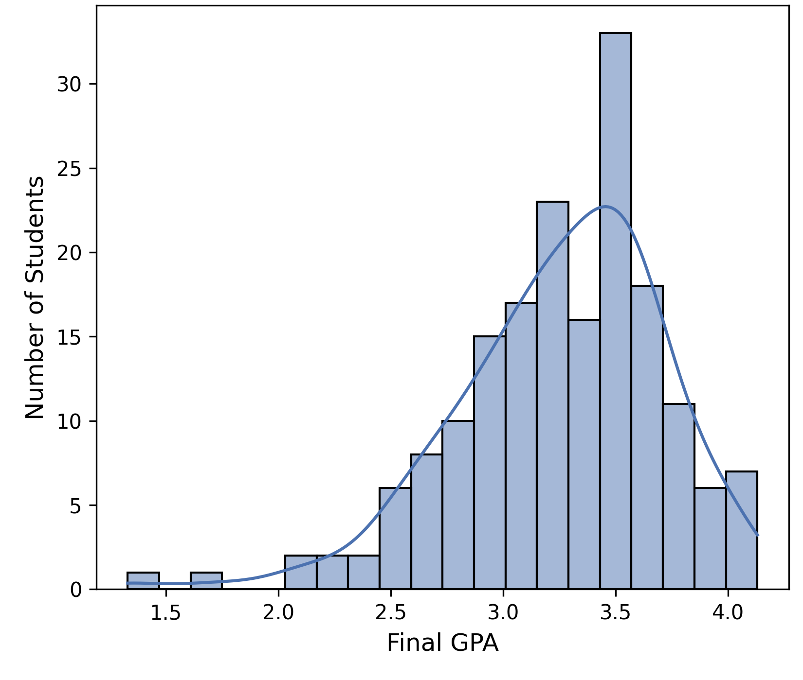
Exploratory Data Analysis
Near-complete data. English marks missing (6/178), median-imputed.
Final GPA is left-skewed, and the skew deepens by later semesters
Outliers retained deliberately as they are the at-risk signal this study is trying to catch, not noise

Slide 6
Methodology — Design & Model Selection
Semester checkpoints: S0 (pre-academic only) → S6 — snapshots exist out to S8, but every group's reliability point was already confirmed by S6
Two-stage evaluation: Stage 1 = 5-fold × 10-repeat stratified CV (50 splits) on 2017–2018
Stage 2 = confirm on the untouched 2019 cohort
Metric | S0 Ridge | S0 RF | S3 Ridge | S3 RF | S6 Ridge | S6 RF
RMSE | 0.346 | 0.364 | 0.181 | 0.182 | 0.087 | 0.143
SD (RMSE) | 0.063 | 0.066 | 0.038 | 0.051 | 0.036 | 0.053
|Bias| | 0.001 | 0.002 | 0.004 | 0.011 | 0.001 | 0.009
Ridge matches or beats Random Forest on accuracy, stability, and equity at 6 of the 7 checkpoints — the only exception is Semester 1.

Slide 7
Methodology — The Three-Criterion Framework
1. Accuracy (RMSE)
≤ 0.25 GPA (Performing / Average)
≤ 0.35 GPA (Underperforming)
0.25 ≈ half a meaningful grade band (0.5) on this 4-point scale
2. Stability (SD of RMSE)
Must show a declining trend
Catches models that look accurate on average but are fragile to which students land in which fold.
3. Equity (Group Bias)
|mean bias| ≤ 0.10 GPA points
Caps systematic over/under-prediction to 40% of the RMSE through directional error.
These thresholds are grounded in this 4-point GPA scale. What transfers to other institutions is the three-criterion structure, not these exact numbers.

Slide 8
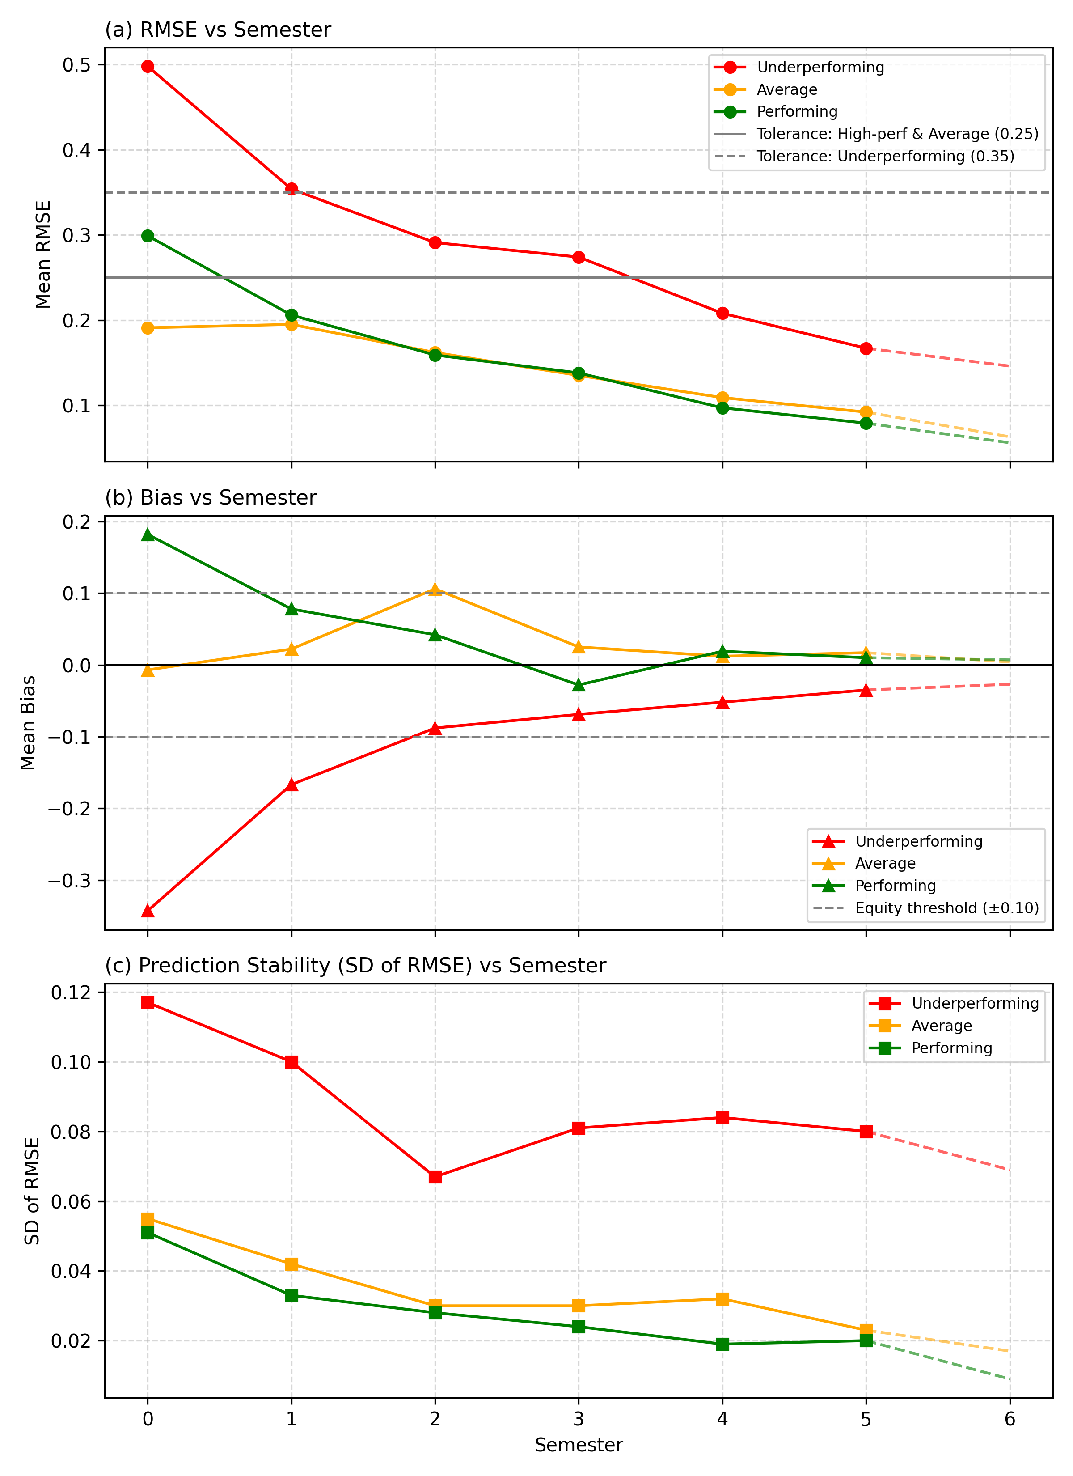
Results I — Convergence of the Three Criteria (Cross-Validation)
Performing & Average clear all three bars earliest in cross-validation.
Underperforming's SD(RMSE) stays elevated and non-monotonic through Semesters 3–4 — the binding constraint, reflecting real prediction difficulty for this smaller group (n=46).
Accuracy is not the group-defining bottleneck; stability and bias are.

Slide 9
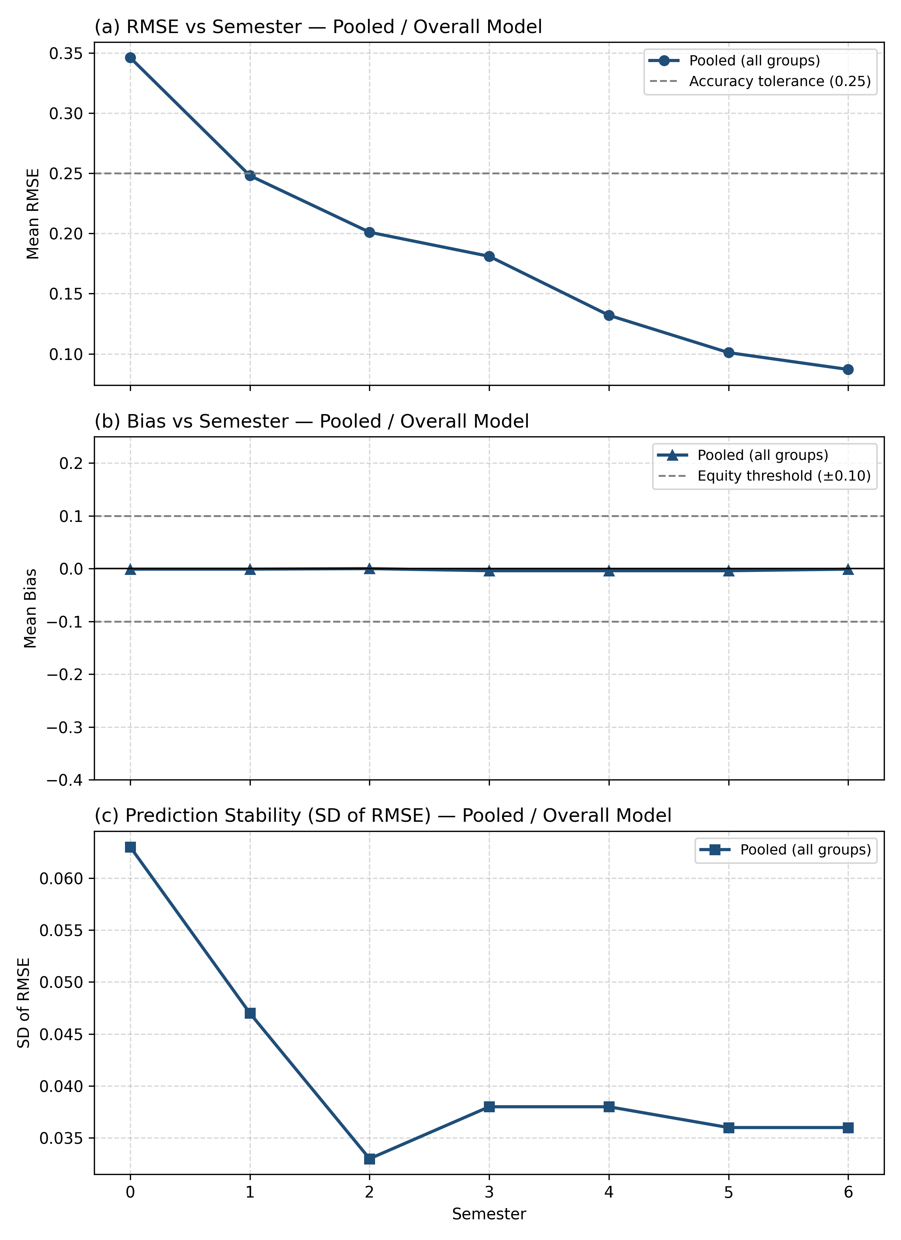
Results I — Overall Model Accuray Measure
Pooled RMSE results look reassuring from an early stage. RMSE clears the 0.25 threshold by Semester 1-2.
Reading only this chart, you'd conclude prediction is reliable at a very early stage for everyone.

Slide 10
Results II — External Validation (2019 Test Set)
Sem | HP RMSE | HP Bias | Avg RMSE | Avg Bias | UP RMSE | UP Bias
2 | 0.208 | -0.152 | 0.378 | -0.321 | 0.603 | -0.480
3 | 0.142 | -0.087 | 0.228 | -0.149 | 0.426 | -0.302
4 | 0.091 | -0.017 | 0.144 | -0.072 | 0.305 | -0.202
5 | 0.072 | 0.048 | 0.094 | 0.041 | 0.163 | -0.035
HP = High-performing Avg = Average UP = Underperforming highlighted = confirmed point
Bias exceedance at the CV candidate semester pushes the confirmed point one semester later for High-performing and Average.
CV and external evidence agree for underperformers.

Slide 11
Discussion
Accuracy alone is an insufficient deployment criterion.
Reliable timing is group-dependent. A single university-wide semester is not justified by the data.
What this means for advising systems:
A bias-corrected prediction (raw estimate + tier correction) can be generated automatically at early stages in the advising systems.
For Underperforming-tier students before Semester 5, this bias-corrected estimate, flagged as less-than-full-confidence, can still be built into advising systems as an early support signal.

Slide 12
Limitations & Future Directions
Contribution: a reusable, equity-aware three-criterion framework.
Limitations:
small sample, especially from177 overall only 46 Underperforming students, ~9 per CV fold, likely driving that group's noisy stability trend.
Findings from this study needs to be validated on a larger sample.
Future direction: adds module-level grades + SHAP to find early explanatory warning signals (Sem 0–2); independent of the numeric prediction's own reliability.

Slide 13
Thank you for your attention.

