Slide 1

Monofeya Heroes
WELCOME
EVERY ONE
WWW.MONOFEYAHEROES.IO

Slide 2

Monofeya Heroes
Wellcome
OUR CHALLANGE:
CHRONICLES OF EXOPLANET EXPLORATION
WWW.MONOFEYAHEROES.IO

Slide 3
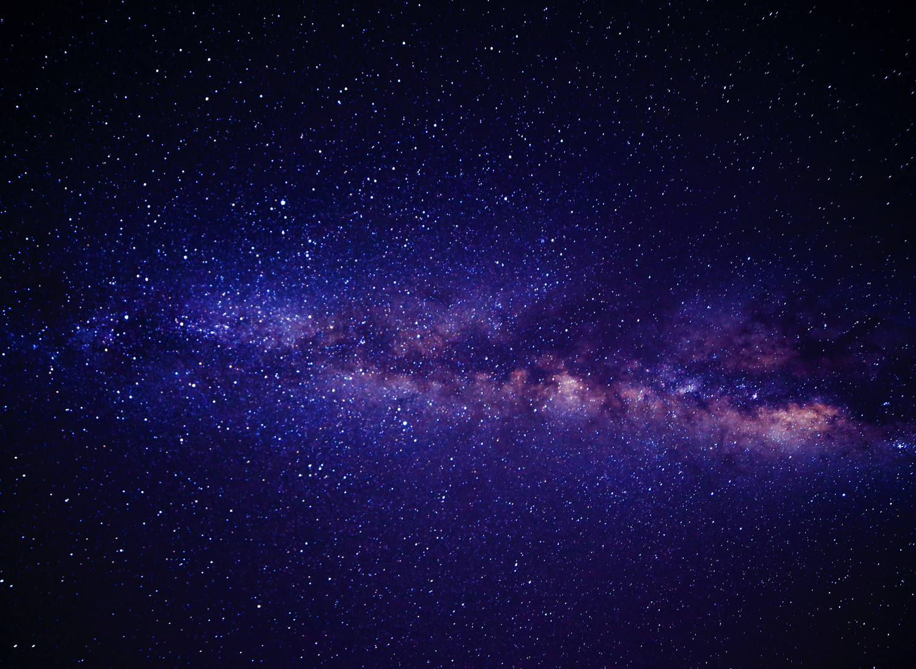
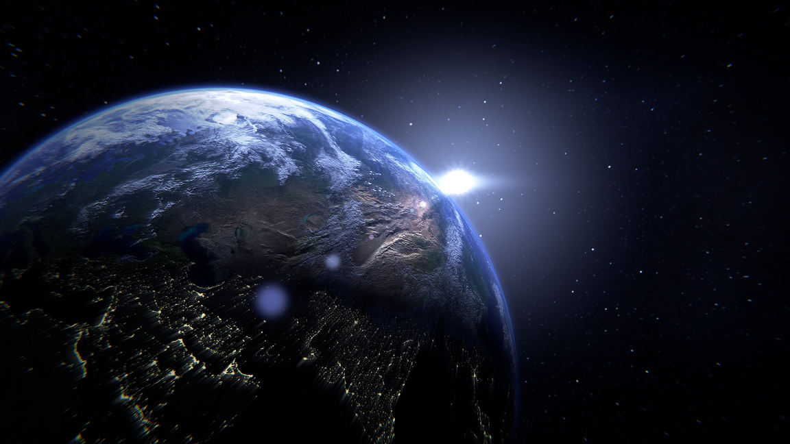
Monofeya Heroes
Intro
WHAT IS SPACE ?
"Space" refers to the vast, seemingly infinite expanse that exists beyond Earth's atmosphere, encompassing everything in the universe—planets, stars, galaxies, and all forms of matter and energy. It’s often called "outer space" and is defined as the region that starts about 100 kilometers above sea level, where Earth's atmosphere thins out and space begins.
In space, there is no air to breathe or carry sound, and temperatures can vary dramatically depending on exposure to the sun. It is also a vacuum, meaning it has very low pressure compared to Earth's atmosphere.
Space exploration has led to discoveries about the universe’s structure, the solar system, black holes, and much more.
1
2

Slide 4
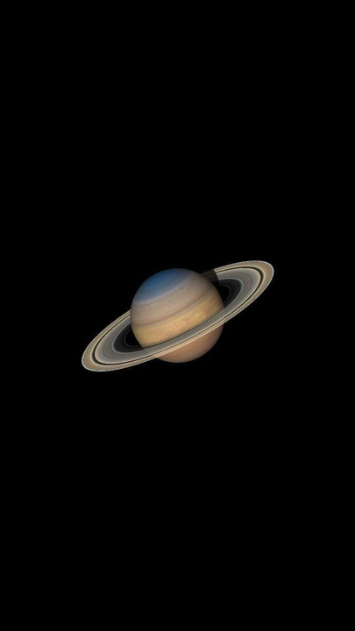

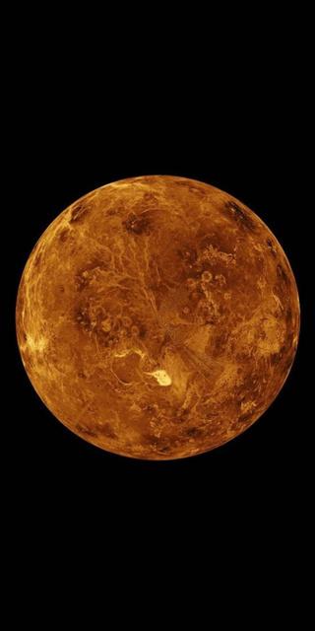
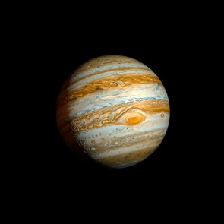
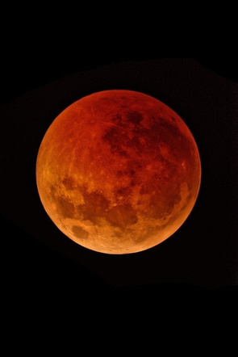
Monofeya Heroes
Challenge
CHRONICLES OF EXOPLANET EXPLORATION
"Chronicles of Exoplanet Exploration" is one of the challenges featured in NASA's Space Apps Challenge 2024. This challenge invites participants to explore and creatively present the history and discoveries surrounding exoplanets—planets located outside our solar system. The goal is to highlight significant milestones in exoplanet research and raise awareness about the ongoing search for Earth-like planets and potential extraterrestrial life.
NASA’s Exoplanet Exploration Program plays a critical role in this, focusing on discovering and studying planetary systems beyond our own, particularly those that could potentially support life. This challenge encourages innovative storytelling or technological solutions that can help convey these discoveries to a broader audi

Slide 5
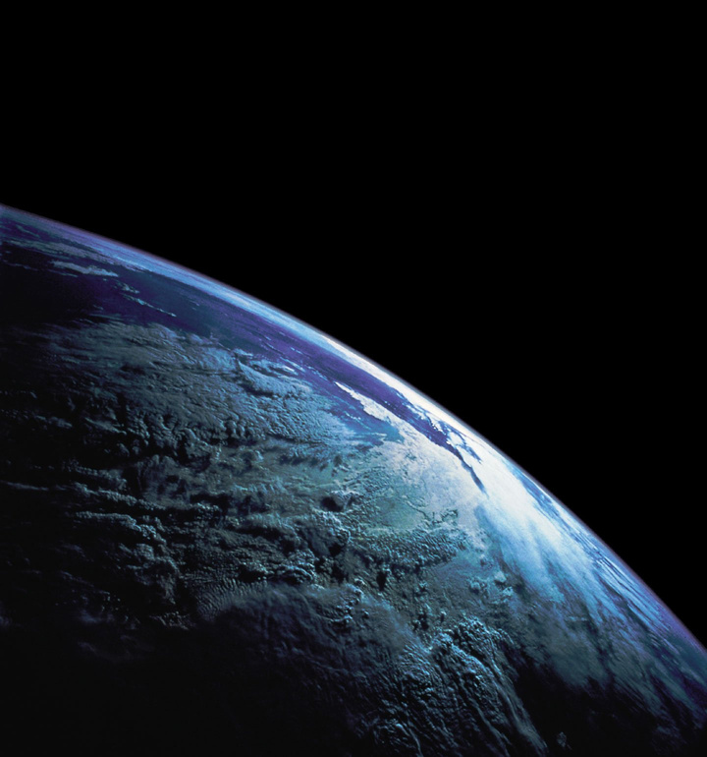
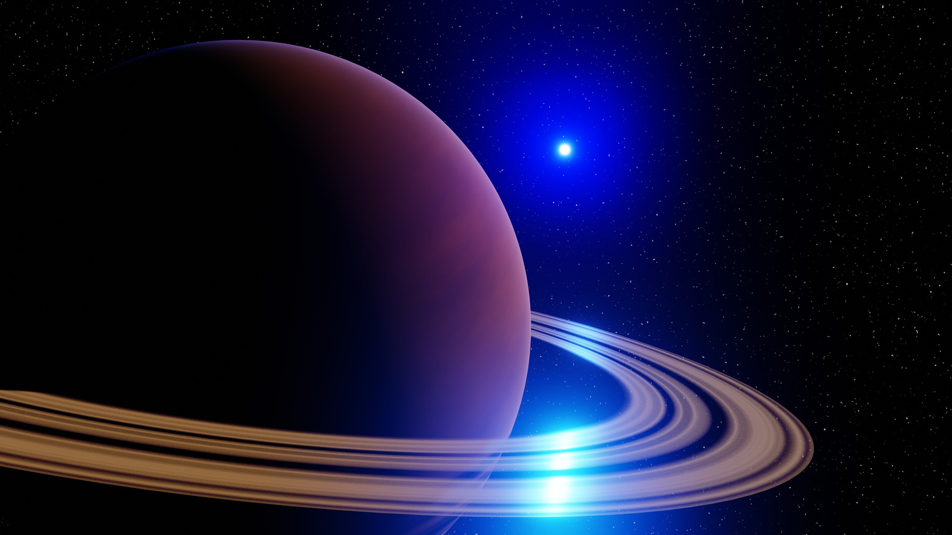
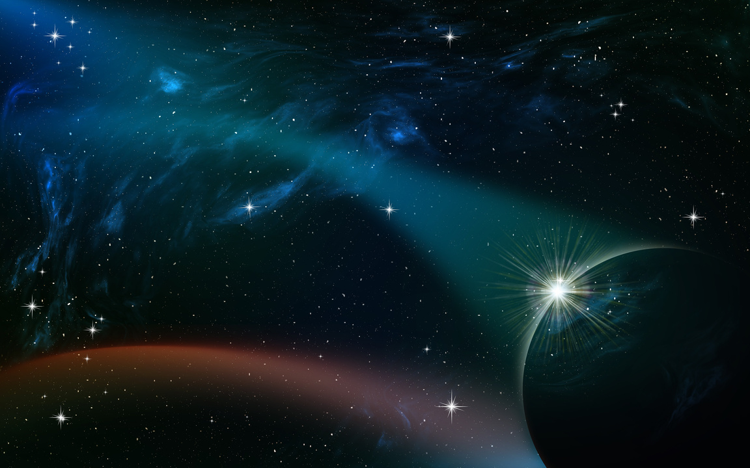
Monofeya Heroes
Our Solution
OUR SOLUTION
1
Making Website Using Nasa Resources for exploring space to facilitate space conditions
2
Use Generative Ai for asking him about planets and space
3
Play a Game to learn about space and different challenges

Slide 6

Monofeya Heroes
Scan Me

Slide 7
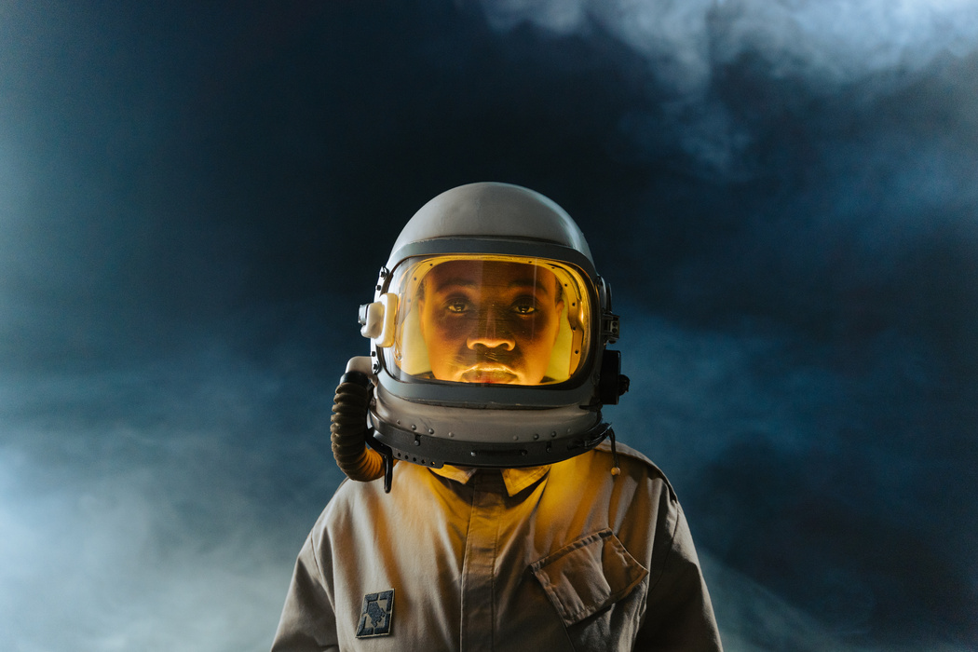
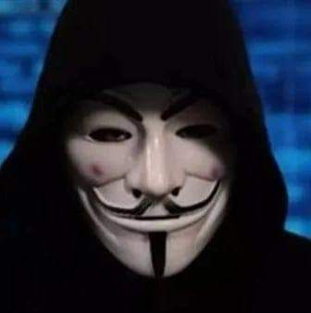

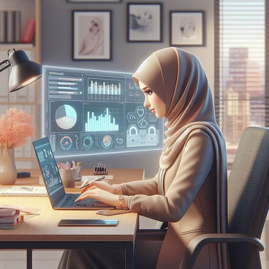
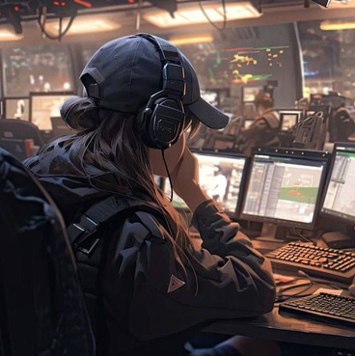
Monofeya Heroes
Our Team
Ahmed Mohammed
Mohammed Sayyad
Momen Alaa
Alhoda Alaa
Jana Ahmed

