Slide 1
McDonald's Financial Dashboard Summary

Slide 2
Dashboard Overview
• Interactive dashboard built using Power BI
• Key KPIs: Revenue, Earnings, EPS, Margins, Market Cap
• Time-series trends and valuation metrics included
• Filters and slicers for dynamic year selection
• Consistent color theme and navigation menu

Slide 3
Key Financial KPIs
Revenue reached $23.18B in 2022, marking a return to pre-pandemic highs.
EPS surged to $8.33, showing strong profitability momentum.
Operating Margin remained steady at 45.87%, reflecting effective operational efficiency.
Dividend Yield held at 2.1%, continuing McDonald’s commitment to shareholders.
Market Cap hit $198.5B, supported by strong earnings and consistent dividend growth.

Slide 4
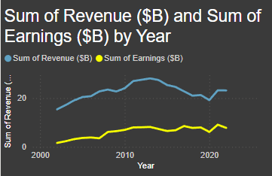
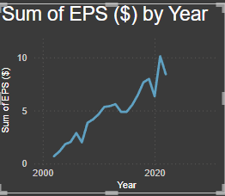
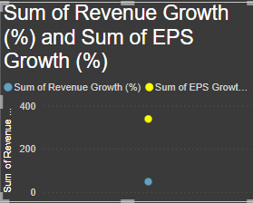
Time-Series Analysis
• Revenue & Earnings Over Time
• EPS and EPS Growth %
• Revenue Growth Trends

Slide 5
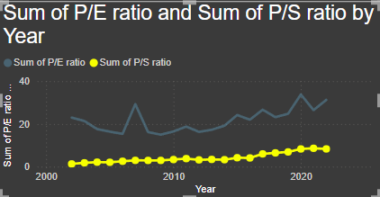
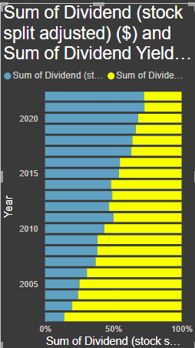
Valuation and Dividend Metrics
• P/E Ratio, P/S Ratio Over Time
• Dividend & Yield Analysis

Slide 6
Business Insights Summary
Revenue reached $23.18B in 2022, marking a return to pre-pandemic highs.
EPS surged to $8.33, showing strong profitability momentum.
Operating Margin remained steady at 45.87%, reflecting effective operational efficiency.
Dividend Yield held at 2.1%, continuing McDonald’s commitment to shareholders.
Market Cap hit $198.5B, supported by strong earnings and consistent dividend growth

