Slide 1

Predictive Maintenance & Analytics Brochure
Oct'2025

Slide 2
Executive Summary
Overview : The mining industry is increasingly data-rich with Crusher and grinding operations generate millions of sensor data points daily with KPIs like vibration, oil pressure, and temperature variations that hold early signs of mechanical stress and efficiency loss. Our predictive AI solution, transforms this data into actionable foresight, helping plant teams transition from reactive firefighting to predictive intelligence.
Key Highlights :
Unified Predictive Layer: Continuously learning “normal” equipment behavior across sensors and identifies deviations long before failures occur.
AI Core: Combines ML/AI algorithms for known anomaly patterns and capture unknown novel, unseen behaviors.
Deployment Flexibility: Offered as a SaaS Platform with stringent data security and Governance framework.
Business Value :
Delivers measurable results by converting complex sensor readings into interpretable health indicators, empowering maintenance teams to act early. With every cycle, its learning tightens, ensuring continuous improvement and sustainable operational excellence. Downtime reduction, optimized maintenance cost, safer environment, and improved throughput consistency.

Slide 3
Data & SCADA Integration
Foundation for Intelligence:
Solution strength begins with data, sourced from sensors, SCADA systems, and plant historians. These feeds capture dynamic operational states, making them ideal for real-time model learning.
Data Sources :
Historian logs, maintenance tickets, and production parameters.
KPIs like Vibration, temperature, power draw, pressure, throughput, and bearing wear.
Integration Steps:
Ingestion: Sensor/ SCADA → Quality Validation → Standardization.
Preprocessing: Missing value imputation, smoothing, scaling, and windowing.
Data Storage: Centralized or edge-based storage aligned with data governance policies.
Outcome :
Reliable, harmonized data flows that feed both anomaly detection models and visualization layers , setting the stage for scalable, repeatable AI across mining sites.

Slide 4


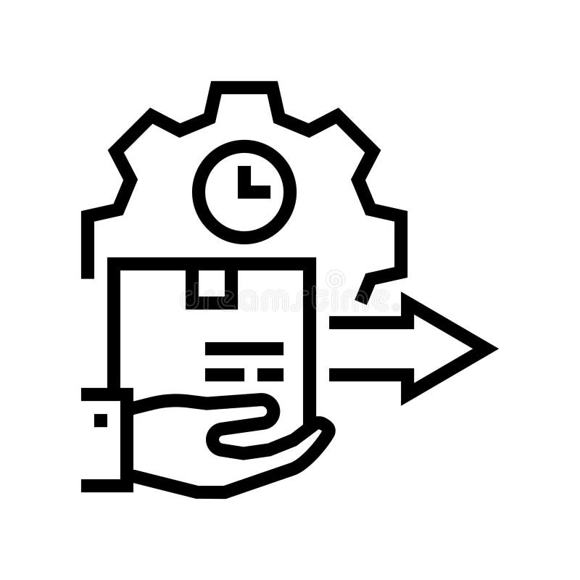

Proposed Solution Flow
Multi-Model Development
for Failure Prediction
Unsupervised Learning
Semi-supervised Learning
Time Series Based
BI Dashboard
Visualizations
Real Time Monitoring
Alerting
Model Serving
Batch Jobs
Rest APIs
Data Sources
Sensors
SCADA
Master Data
CI/CD
Model Drift
Model Monitoring
MLOps & ​
Governance​
Data Prep/
Feature Engineering
Cleaning
Imputing
Scaling
Data Ingestion Pipeline

Slide 5
Dashboard Experience (Predictive & Conversational Intelligence Layer)
User Views :
Operations View – Real-Time Analytics: Displays close to real time KPI trends, anomaly counters, and machine health indicators. Operators gain instant visibility into plant status with dynamic alerts for deviations or performance drifts.
Engineer View – Predictive Analytics: Enables early fault prediction through PCA plots, correlation analysis, and trend forecasting. Engineers can pinpoint degrading components and schedule timely interventions.
Supervisor View – LLM Chat Interface: An AI assistant powered by a domain-trained LLM lets users ask natural language questions such as “Which crusher shows abnormal vibration?” or “Summarize root causes from this week.”
Key Features :
Predictive Analytics: Forecasts asset health for the next 24–48 hours using AI-driven anomaly patterns.
Real-Time Insights: Continuously ingests SCADA and sensor data for second-by-second operational awareness.
LLM Chat Companion: Delivers quick summaries, anomaly pattern insights, and action recommendations conversationally.
Business Value:
A unified, intelligent dashboard that predicts issues, explains anomalies, and provide insights. Combining predictive models, real-time analytics, and an LLM interface, it reduces downtime, accelerates decisions, and improves collaboration across operations, engineering, and maintenance teams, transforming Business's maintenance strategy into a proactive, insight-driven system.

Slide 6
Proposed engagement roadmap for MVP (Indicative – Based on Data Availability)
Phase 1: Discovery & Alignment (Weeks 1–3)
Stakeholder workshops, KPI finalization, and ROI baseline setup.
Phase 2: Data Readiness (Weeks 4–5)
Ingest & clean SCADA/sensor data, establish security pipeline.
Phase 3: Prototype/MVP & Co-Creation (Weeks 6–9)
Build and validate ML/AI models, deploy dashboards.
Phase 4: Pilot Go live & Feedback (Weeks 10–12)
* Assumption: The above indicative timeline is applicable if historical sensor data and metadata are readily available.
* Scope Assumption: Up to 3 crusher machines and approximately 30 sensors will be considered during this MVP phase.
* Dependencies: Timely access to SCADA/sensor data, stakeholder alignment, and environment readiness (security & connectivity)

Slide 7
Thank you

Slide 8
Annexure
Model Development & Dashboard views

Slide 9
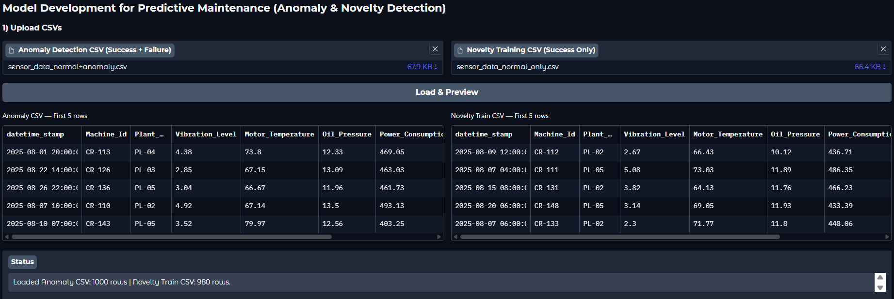
Predictive Maintenance – Model Development

Slide 10
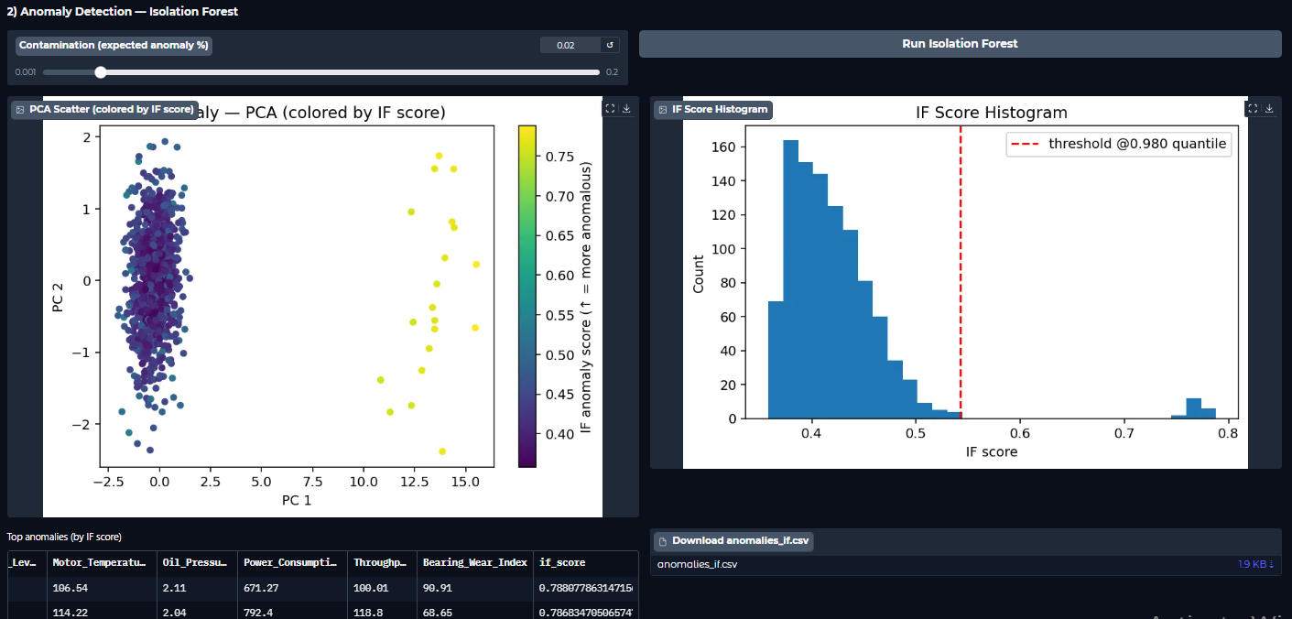
Predictive Maintenance – Model Development

Slide 11
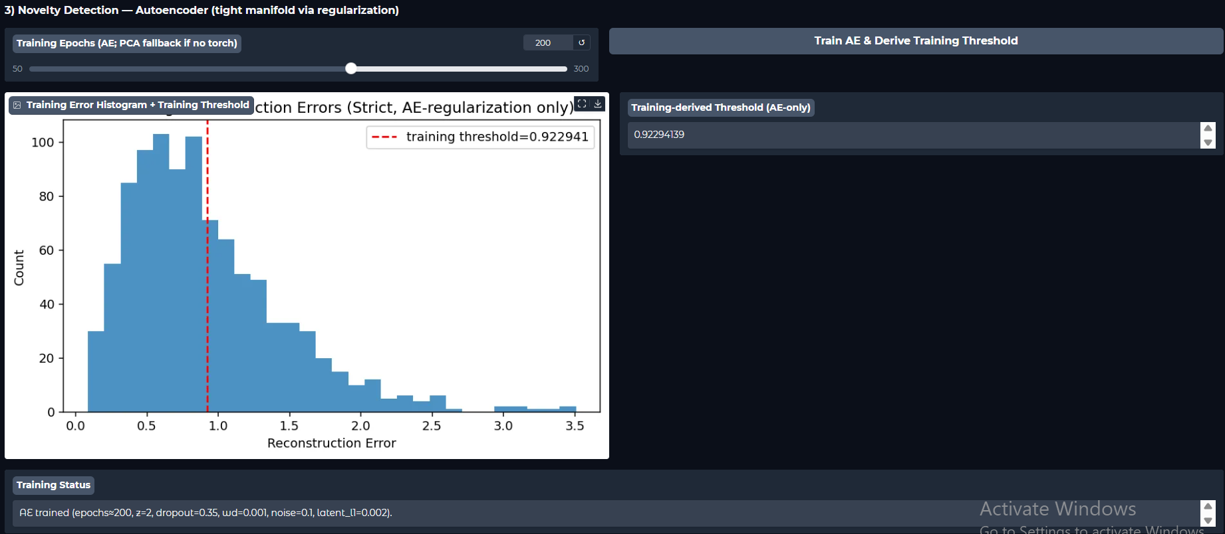
Predictive Maintenance – Model Development

Slide 12
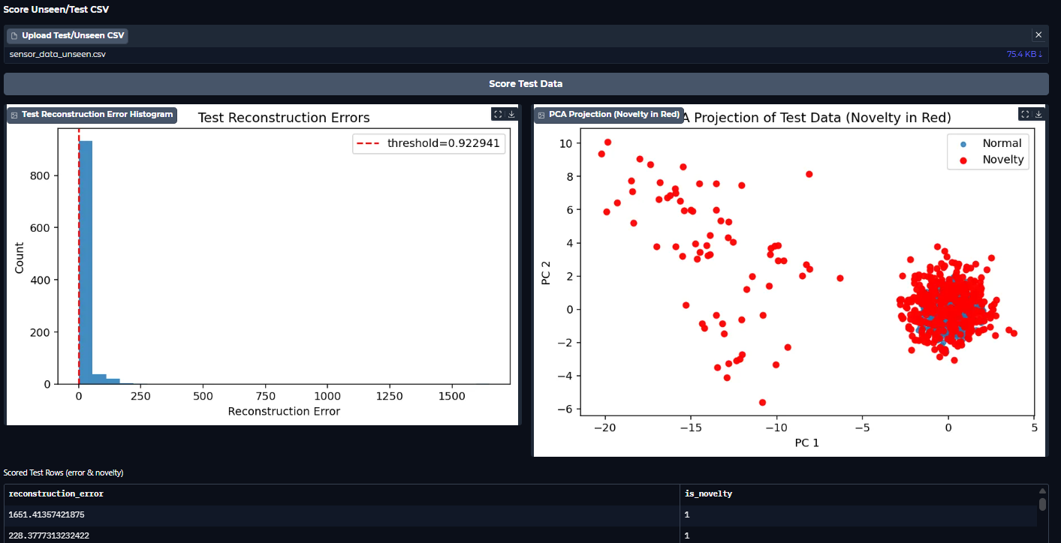
Predictive Maintenance – Model Development

Slide 13
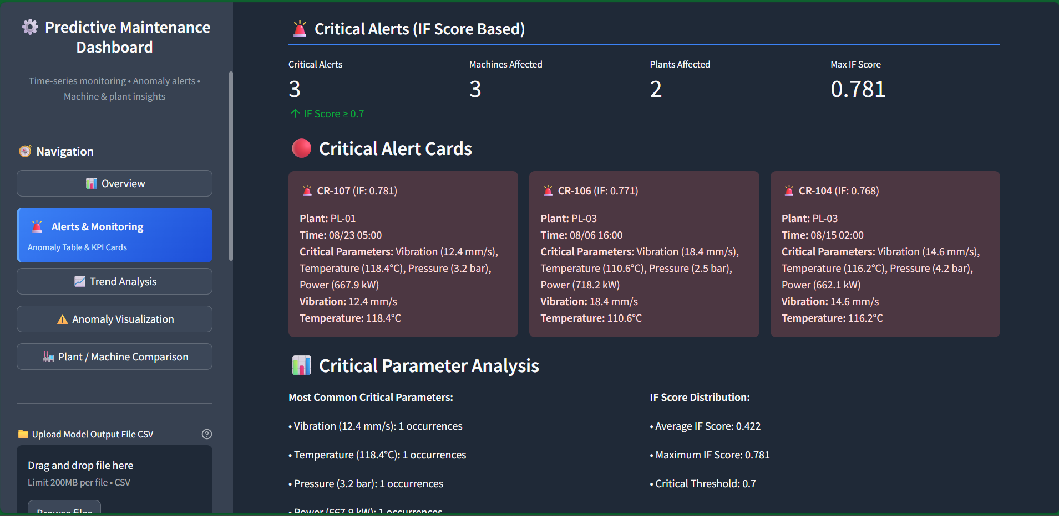
Predictive Maintenance Dashboard – Visualizations

Slide 14
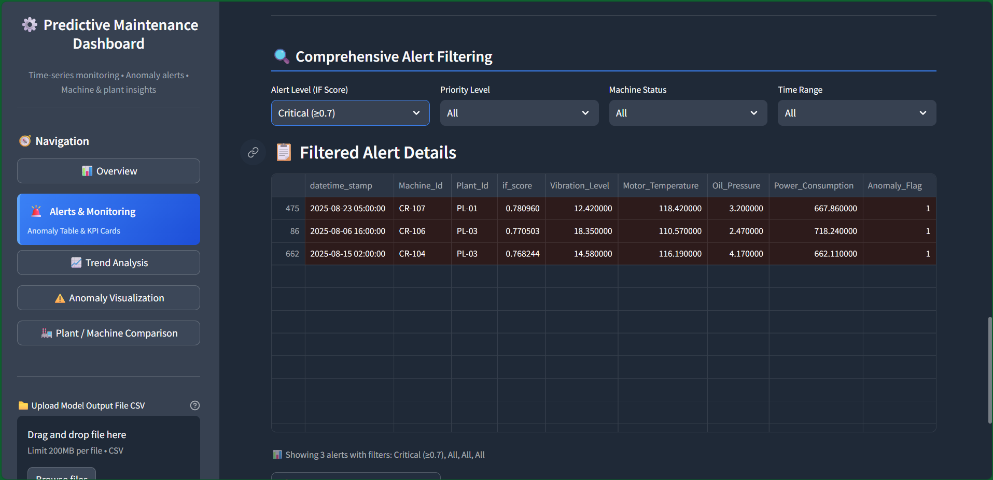
Predictive Maintenance Dashboard – Visualizations

Slide 15
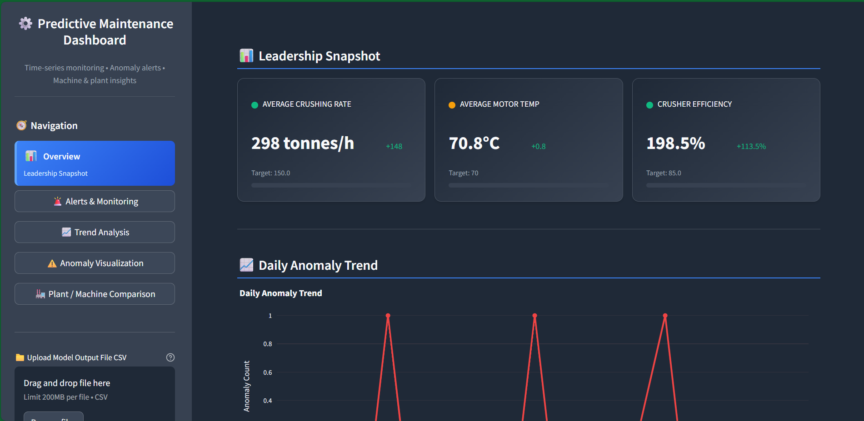
Predictive Maintenance Dashboard – Visualizations

Slide 16
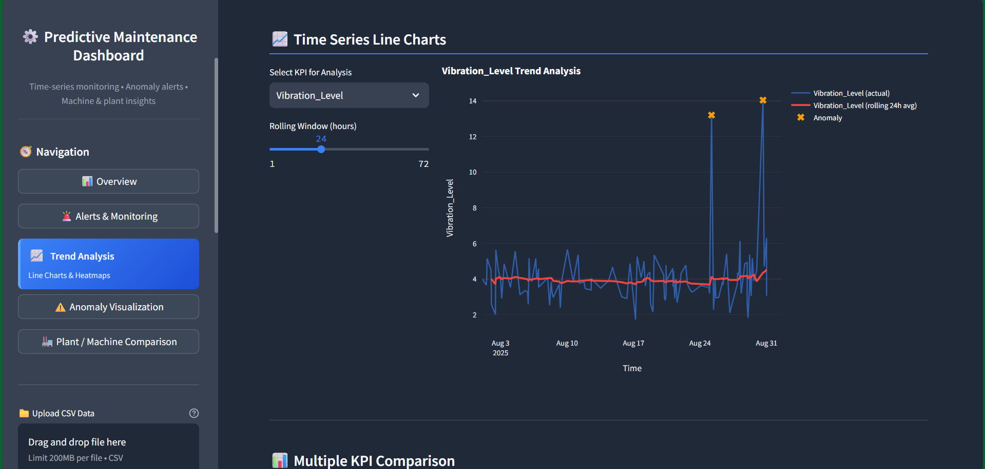
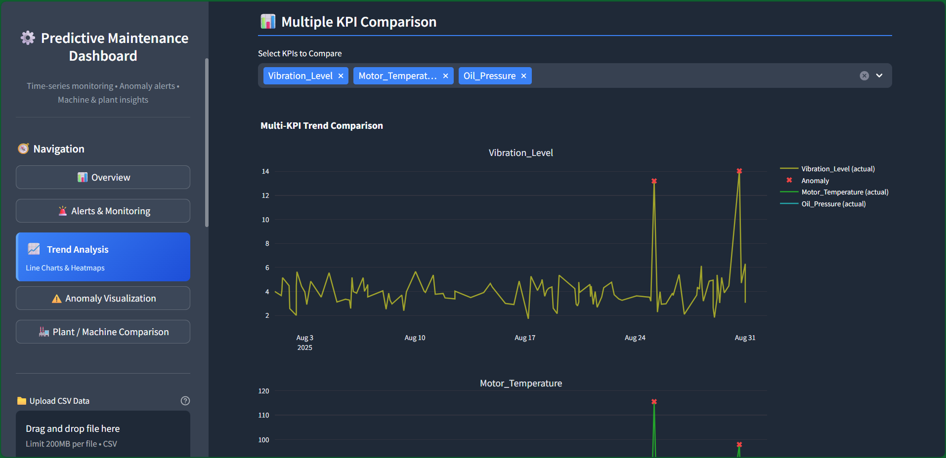
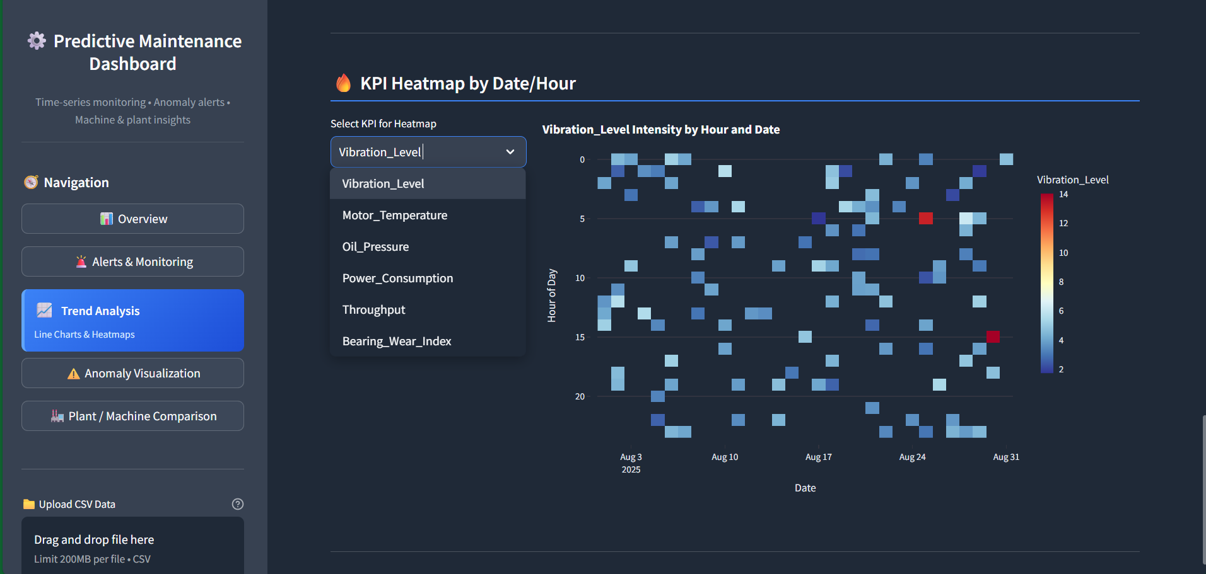
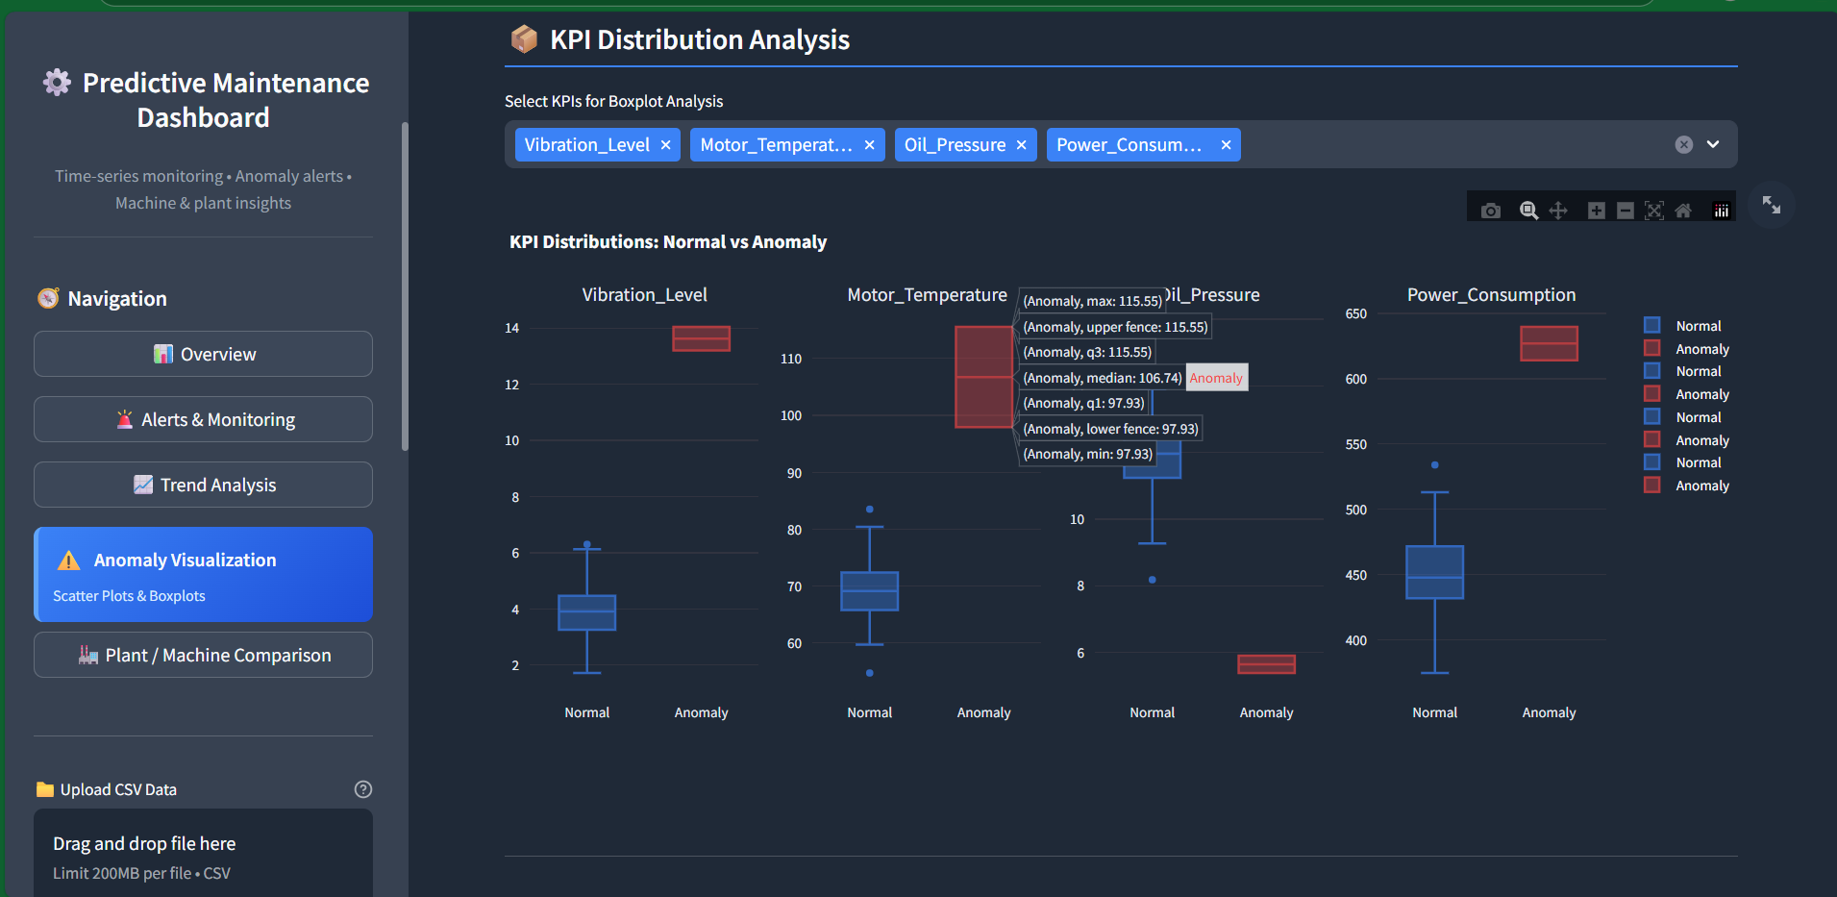
Predictive Maintenance Dashboard – Visualizations

Slide 17
Thank you

