Slide 1
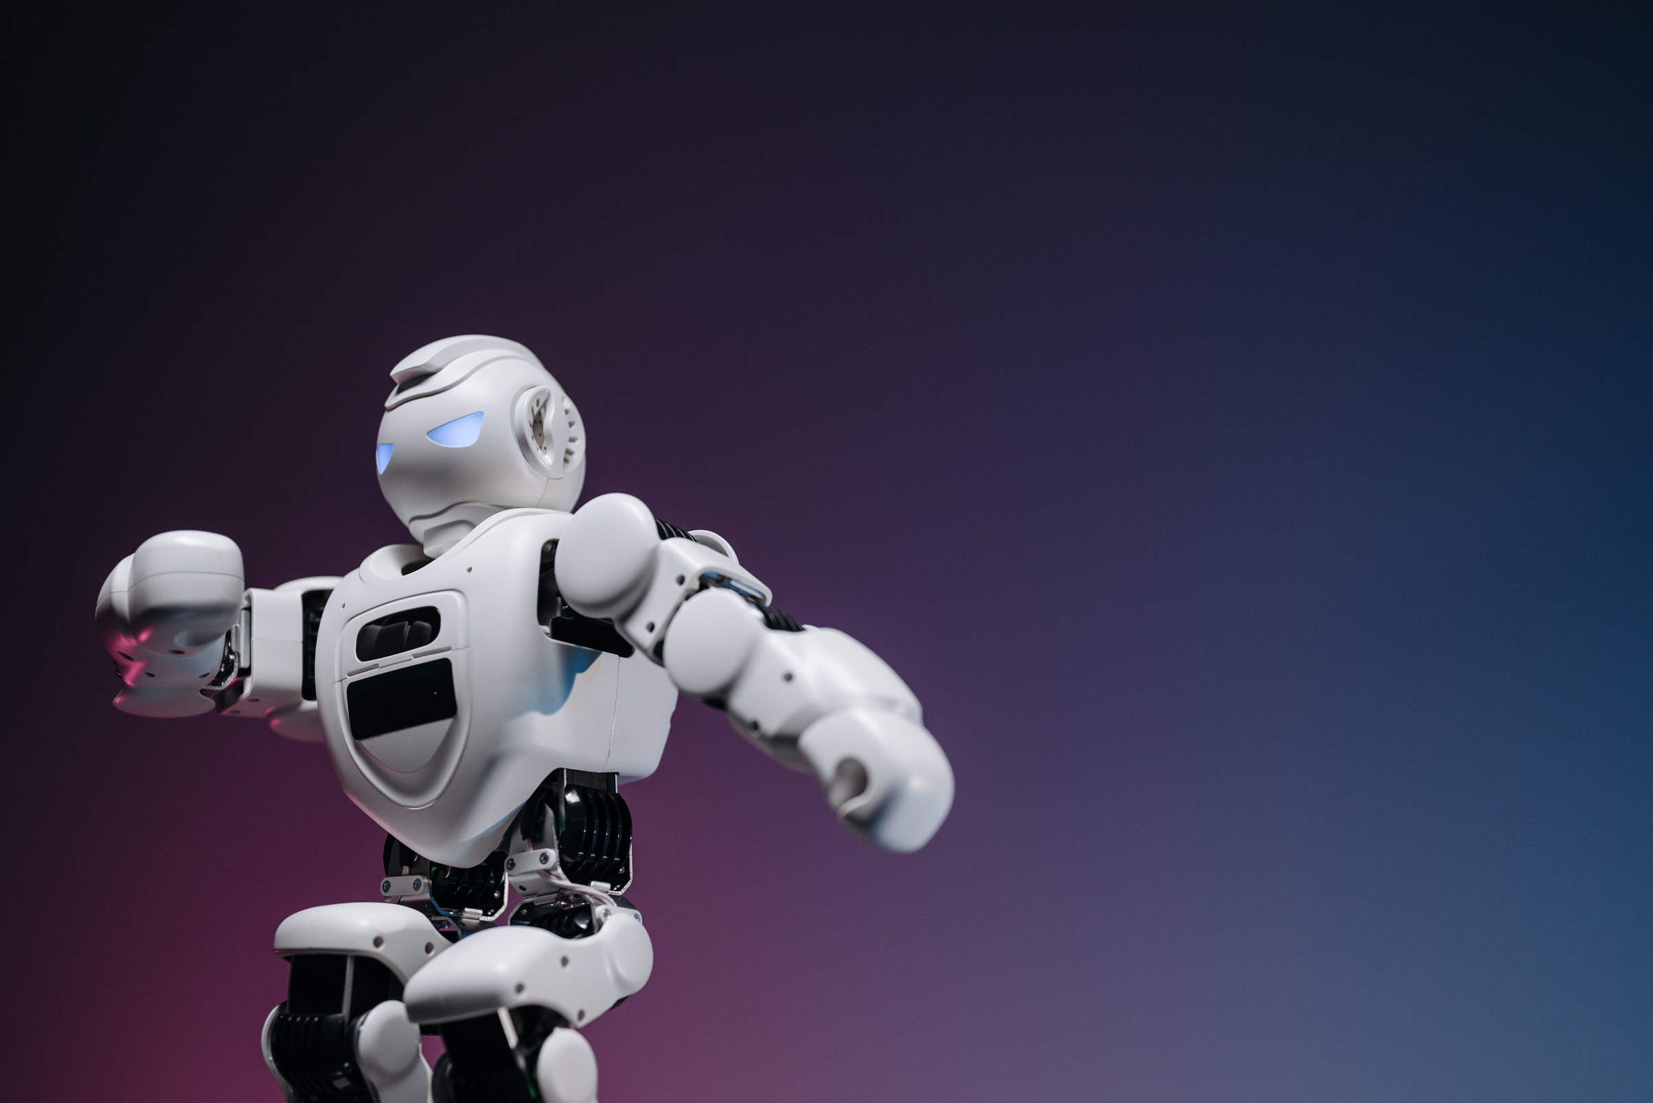
Seedance 2 .0
AI video generation model
Shivani Kinagi
Sayyam Jain
Janhvi Saste

Slide 2
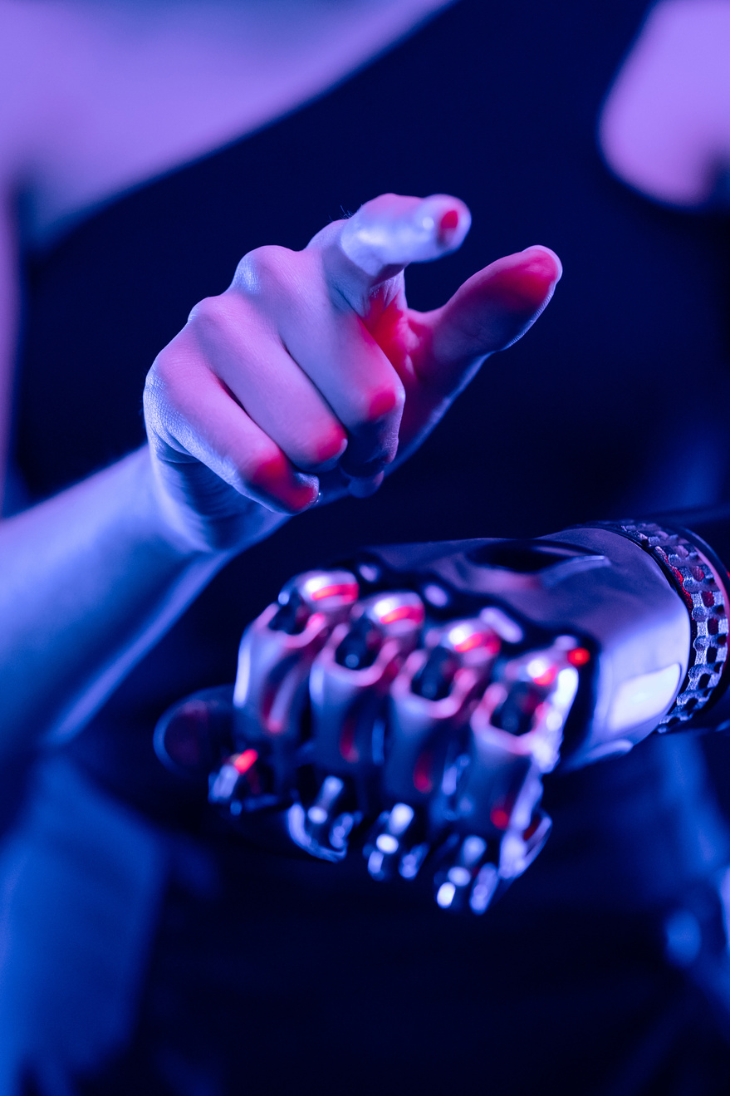


Seedance 2.0 : Introduction
Seedance 2.0 is an advanced AI video generation model capable of producing highly realistic cinematic videos from text prompts or images.
Instead of filming a real scene with cameras and actors, the AI synthesizes the entire video using deep learning models.
What Seedance 2.0 Does
Seedance 2.0 converts natural language descriptions or input images into short video clips.
Generates Output in :
720p–4K quality clips
realistic motion
film-like camera effects
physics-aware movement
Seedance 2.0 was developed by ByteDance, the company behind the popular social platform TikTok.
Seedance 2.0 is estimated to have ~1 trillion parameters.

Slide 3

Diffusion Models
Used for high-quality visual generation.
Produces detailed frames with realistic textures, lighting, and scenes.
Benefit: Generates visually rich and realistic video content.
Core Technology Behind Seedance 2.0
Seedance 2.0 generates videos using a combination of three key AI technologies: diffusion models, transformer-based prompt understanding, and spatio-temporal modeling. Each component handles a different part of the video generation process.
Transformer-based Prompt Understanding
Uses transformer architectures to interpret user prompts.
Converts text instructions into semantic representations for video generation.
Benefit: Improves understanding of complex scene descriptions.
Spatio-Temporal Modeling
Handles spatial information (objects, positions) and temporal information (motion over time).
Ensures stability and continuity in generated videos.
Benefit: Maintains consistent motion and scene structure.

Slide 4
How Seedance 2 .0 Works
Text - to - video Generation
Image - to - video Generation
Step 1 — Understand the Prompt
User enters a text description of the scene.
AI language models analyze the prompt and convert it into numerical embeddings representing the scene.
Step 1 — Understand the Image & Prompt
User provides an image and optional text prompt.
AI analyzes the image (objects, background, lighting) and converts the prompt into numerical embeddings.
Step 2 — Generate Visual Content
Uses diffusion models to create visuals.
Starts with random noise → gradually removes noise → forms clear images.
Multiple frames are generated for video.
Step 2 — Plan Motion
The model predicts how objects and the camera should move over time.
Creates a temporal motion plan for the video.
Step 3 — Generate Frames
Uses diffusion models to create frames.
Starts with random noise → gradually removes noise → produces clear frames.
Step 3 — Maintain Motion Across Frames
Ensures smooth motion and consistency across frames.
Objects remain stable, characters move naturally.
This is called temporal consistency.
Step 4 — Render Final Video
Ensures consistency across frames for smooth motion.
Frames are combined into a short cinematic video clip (around 4–15 seconds).
Step 4 — Render Final Video
Generated frames are combined into a video clip.
Output: 5–15 sec high-resolution cinematic video.

Slide 5
Concerns and Challenges
Issue 2 — Style Replication
Seedance can generate videos in the style of specific creators.
Artists argue this copies their artistic style.
Seedance 2.0 has triggered debate around AI copyright and ownership.
Issue 3 — Deepfakes
Realistic video generation can enable deepfake content.
Issue 4 — Ownership of Generated Content
Issue 1 — Training Data
It is still unclear who owns AI-generated videos:
the user
the AI company
or the dataset creators.
Models are trained on massive internet datasets.
Creators argue their work was used without permission.

Slide 6

Trend in AI
Seedance 2.0 in Context of Recent AI Trends
Part of the multimodal foundation model trend.
Converts text or images into realistic videos using diffusion and transformer architectures.
LLMs → Multimodal AI → Video generation models.
Trend in Generative AI
Seedance 2.0 is a Generative AI model focused on video synthesis.
Supports text-to-video and image-to-video creation.
Prompt → Multimodal Model → Frame Generation → AI Video
Trend in Agentic AI
Seedance fits into creative AI agents.
Can be integrated into AI agents that automatically plan scenes, generate frames, and create complete videos from prompts.

Slide 7

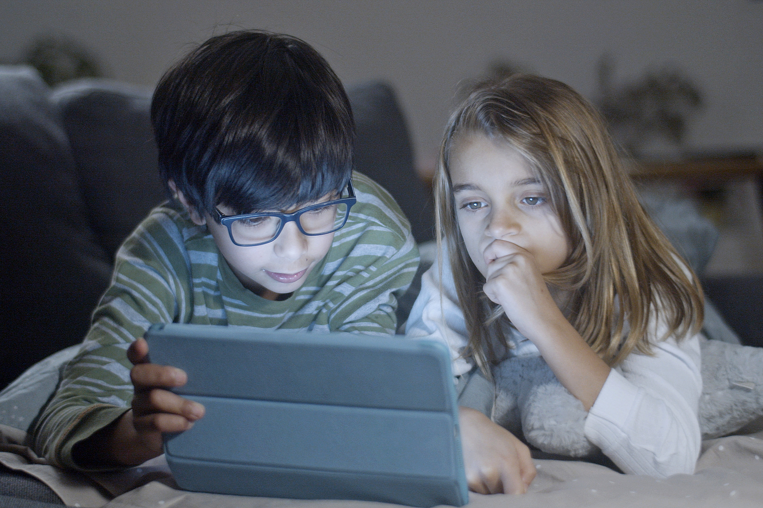
Common technologies behind systems like Seedance:
Deep Learning Frameworks
PyTorch
TensorFlow
Model Architectures
Diffusion models
Transformers
Video diffusion pipelines
Supporting Libraries
Hugging Face Transformers
Diffusers
OpenCV
Tools &
Frameworks

Slide 8

Seedance like models are integrated into creative AI platforms :
TikTok
Runway Gen‑2
Pika
Sora
These tools aim to automate video production and storytelling.
Difference between Seedance 1.0 and Seedance 2.0
Video Quality : Seedance 2.0 generates more cinematic and realistic videos than Seedance 1.0.
Motion Consistency : Seedance 2.0 provides smoother and more natural motion.
Audio Support : Seedance 2.0 supports native audio-video generation, unlike 1.0.
Resolution : Seedance 2.0 supports higher resolution (up to ~2K).
Multimodal Inputs : Seedance 2.0 supports text, image, video, and audio inputs, while 1.0 mainly used text.
Control & Understanding : Seedance 2.0 has better prompt understanding and advanced cinematic control.
Major competing video models include :
Sora
Runway Gen-2
Pika
Veo
Kling
Seedance 1.0 is estimated to have tens to hundreds of billions of parameters.
It is smaller than Seedance 2.0, which is estimated to be around ~1 trillion parameters.

Slide 9
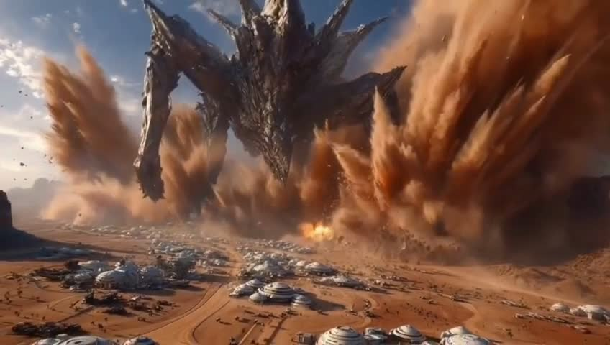
Demo Video 1

Slide 10
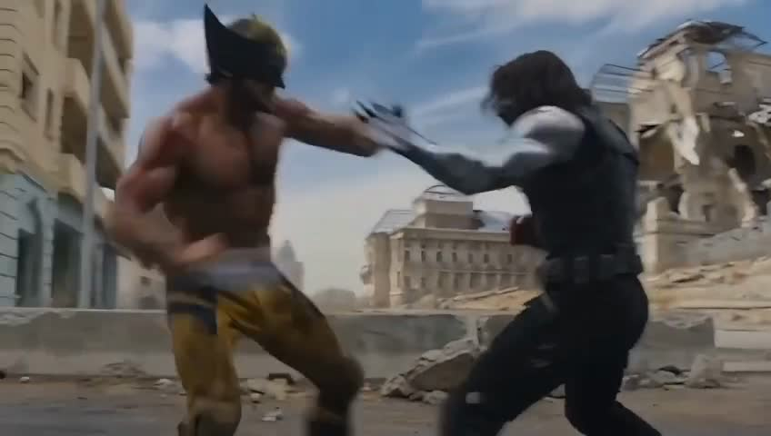
Demo Video 2

Slide 11
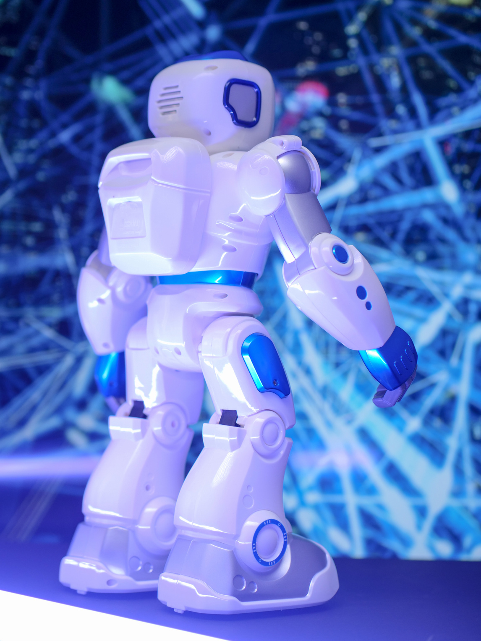
Seedance 2.0 represents the next wave of Generative AI where multimodal foundation models and agentic workflows enable automatic cinematic video creation from simple prompts.
Thank you !

