Slide 1
Universal Data Formatter Tool
A Comprehensive Tool to Efficient Data Conversion!
Prepared By:- Sayyam Jain

Slide 2
INTRODUCTION
Converts data between formats (JSON, CSV, XML, YAML, EXCEL)
User-friendly and efficient

Slide 3
PROBLEM STATEMENT
Problems Faced
Organizations and individuals often deal with data in various formats like JSON, CSV, XML, YAML, and EXCEL.
Converting data between these formats can be tedious and error-prone, especially for users who lack programming skills or technical knowledge.
Challenges in Data Conversion
Frequent or large-scale data conversion involves repetitive and manual steps.
Existing tools might not offer a simple and intuitive interface, making the process even more cumbersome for non-technical users.

Slide 4
SOLUTION OVERVIEW
Introducing Universal Data Formatter:
A versatile, user-friendly, python GUI based automated tool.
Converts data files between different formats like JSON, CSV, XML, YAML and EXCEL.
Allow users to easily select input and output files, choose their desired formats, and perform the conversion seamlessly with a simple click.
Cater to users with minimum technical knowledge, enabling efficient and accurate data transformations.

Slide 5

TECH STACK
Programming Language: Python
GUI Framework: tkinter
Data Handling Libraries:
JSON: Built-in 'json' module
CSV: Built-in 'csv' module
XML: Built-in 'xml.etree.ElementTree' module
YAML: Built-in ‘yaml' module
EXCEL: Built-in 'openpyxl' module
Development Environment: Visual Studio Code
Operating System: Cross-platform (Windows, macOS, Linux)

Slide 6

FEATURES
Automated conversion from one format to another with a few clicks.
Proper Error Handling for conversion or file type with relevant error messages.
Output file path creation based on the input file path along with output file extension (e.g., .json, .xml, .xlsx) both automatically and manually.
Display of real-time status of the process.

Slide 7
BENEFITS
Increased Efficiency: Streamlines the data conversion process, saving time and reducing the effort required for manual conversions.
User-Friendly: Provides a simple and intuitive GUI, enabling users with minimal technical knowledge to perform data conversions without any coding.
Error Reduction: Minimizes human errors by automating the conversion process, ensuring data integrity and consistency.
Versatility: Supports multiple data formats (JSON, CSV, XML, YAML, EXCEL), making it a versatile tool for various data management tasks.
Cost Savings: Reduces the need for specialized software or hiring technical staff for data conversion tasks.
Improved Data Accessibility: Facilitates easy access and manipulation of data across different formats, enhancing data usability for analysis and reporting.
Scalability: Can be adapted for larger-scale data conversion tasks with minimal adjustments.

Slide 8
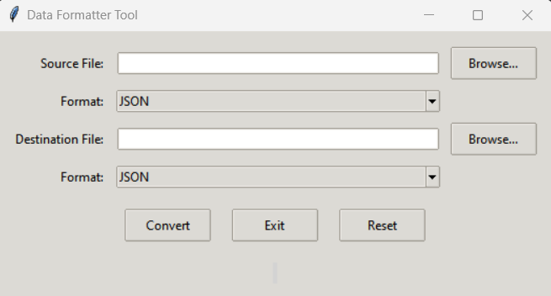
DEMO (Tool GUI)
Buttons description:
Browse: Clicking this allows the user to select the input/output file.
Convert: Clicking this allows the user to perform conversion.
Exit: Exit/Close the tool.
Reset: Reset all the inputs to default sate.

Slide 9
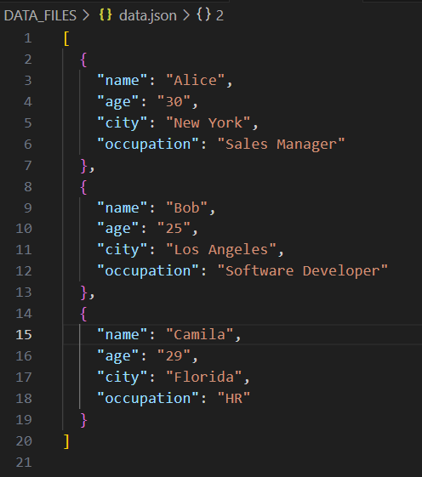
DEMO (Tool GUI)
Provided is the content of the JSON file we used as an Input File

Slide 10
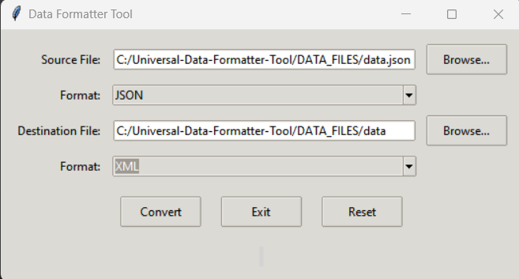
DEMO (Tool GUI)
Here we are converting ‘data.json’ file which is in JSON format to XML format.

Slide 11
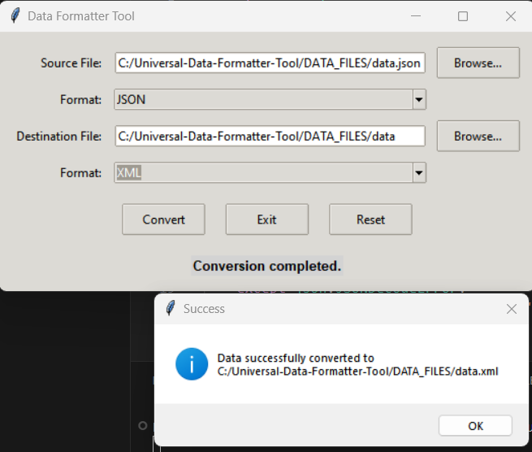
DEMO (Tool GUI)
Successfully converted ‘data.json’ file from JSON format to XML format with file name ‘data.xml’ which is populated automatically.
We can also see ‘Conversion Completed’ below buttons that is the Status Box which will show real-time status.

Slide 12

DEMO (Tool Output)
Content of converted XML file ‘data.xml’ is as below:

Slide 13
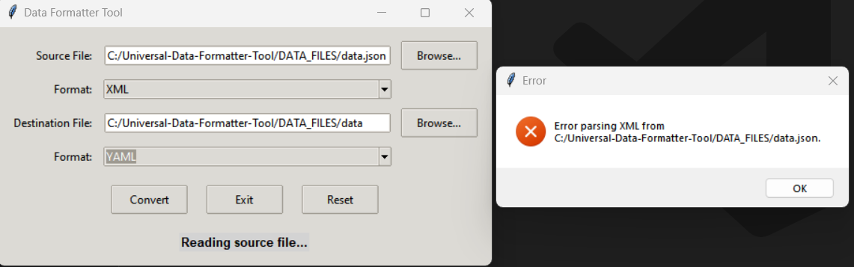
DEMO (Tool Output)
We got an error when trying to convert ‘data.json’ file having data in JSON format, but we selected Input Format as XML:

Slide 14
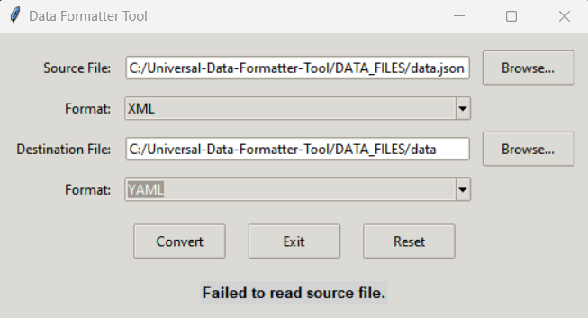
DEMO (Tool Output)
We can see final status message as “Failed to read source file” from the tool.

Slide 15
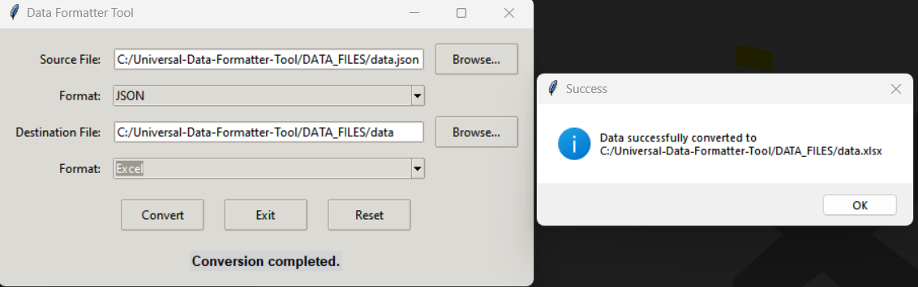
DEMO (Tool Output)
Converting ‘data.json’ file having data in JSON format to EXCEL format, and it got converted to ‘data.xlsx’

Slide 16
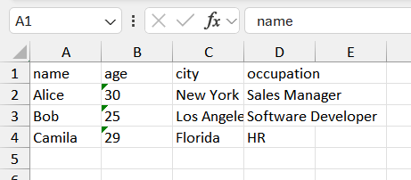
DEMO (Tool Output)
Content of ‘data.xlsx’ file which is in EXCEL format:

Slide 17
Thank You

