Slide 1

Problem Statement:
The inefficient management of inventory leading to financial losses from expired products, high capital tied up in overstock, and potential stockouts of critical medicines.

Slide 2

Data Overview:
Dataset Size : 204199 rows × 18 columns
Period Covered: Jan 2024 – Jul 2025
Key Features : Product Name , Product Category
Synthetic Features :Manufacturer , Transaction Date , Expiry Date ,Cost Price , Stocks On Hands
Features Engineering: Received Stocks , Days Until Expiry , Expenditure
Target Variable: Revenue Loss (Expiry + Overstock + Stockouts)
Units & Metrics : Revenue in ₹ Crores, Stock in Units,
Sources: Kaggle dataset on pharmaceutical sales.

Slide 3
Methodology :
[Data Collection] → [Data Cleaning] → [Feature Engineering] → [Exploration ] → [Visualization] → [Insights]
Data Collection → The dataset was collected from database.
Data Cleaning → Removed 0.38% missing values, standardized date formats.
Feature Engineering → Created Expiry Loss and Stock Turnover Ratio.
Data Exploration → Descriptive stats, checked expiry/stockout distribution.
Visualization → Built line, bar, and pie charts for expiry, overstock, stockout.
Insights → Identified overstock and Expiry as the largest contributor to revenue loss.

Slide 4
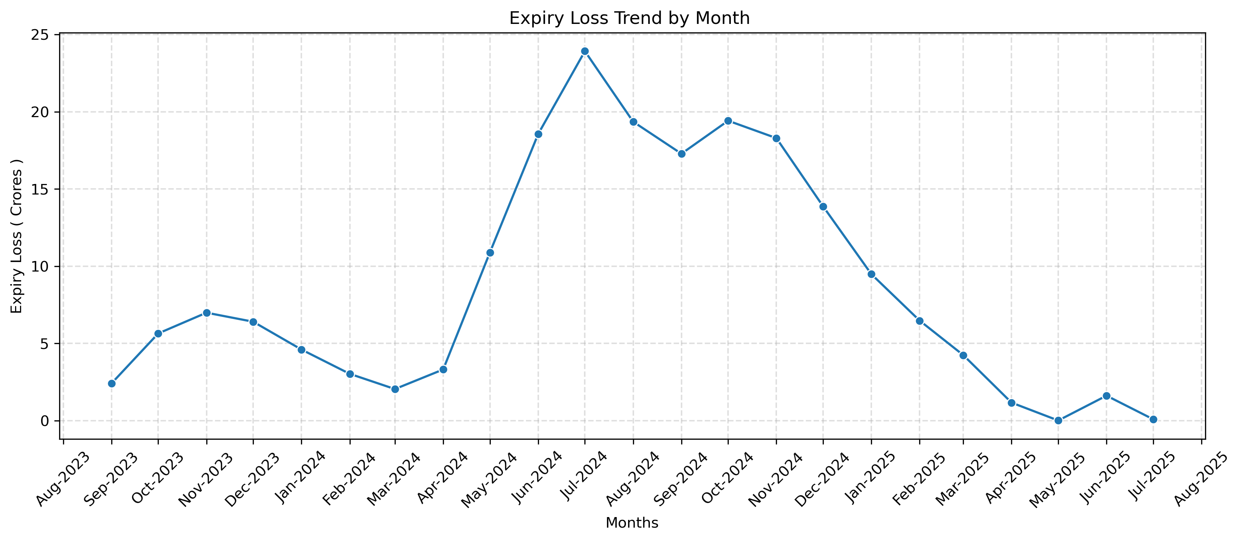
Expiry Losses Analysis:
Expiry losses remained stable at low levels around 5 Cr from Aug 2023 to Mar 2024, indicating controlled costs initially.
Losses increased significantly from Apr 2024 to Feb 2025, peaking at 25 Cr in Jun 2024 and marking a period of elevated costs.
Losses declined consistently post-peak, reaching near 0 Cr by Aug 2025, showing effective recovery measures.

Slide 5
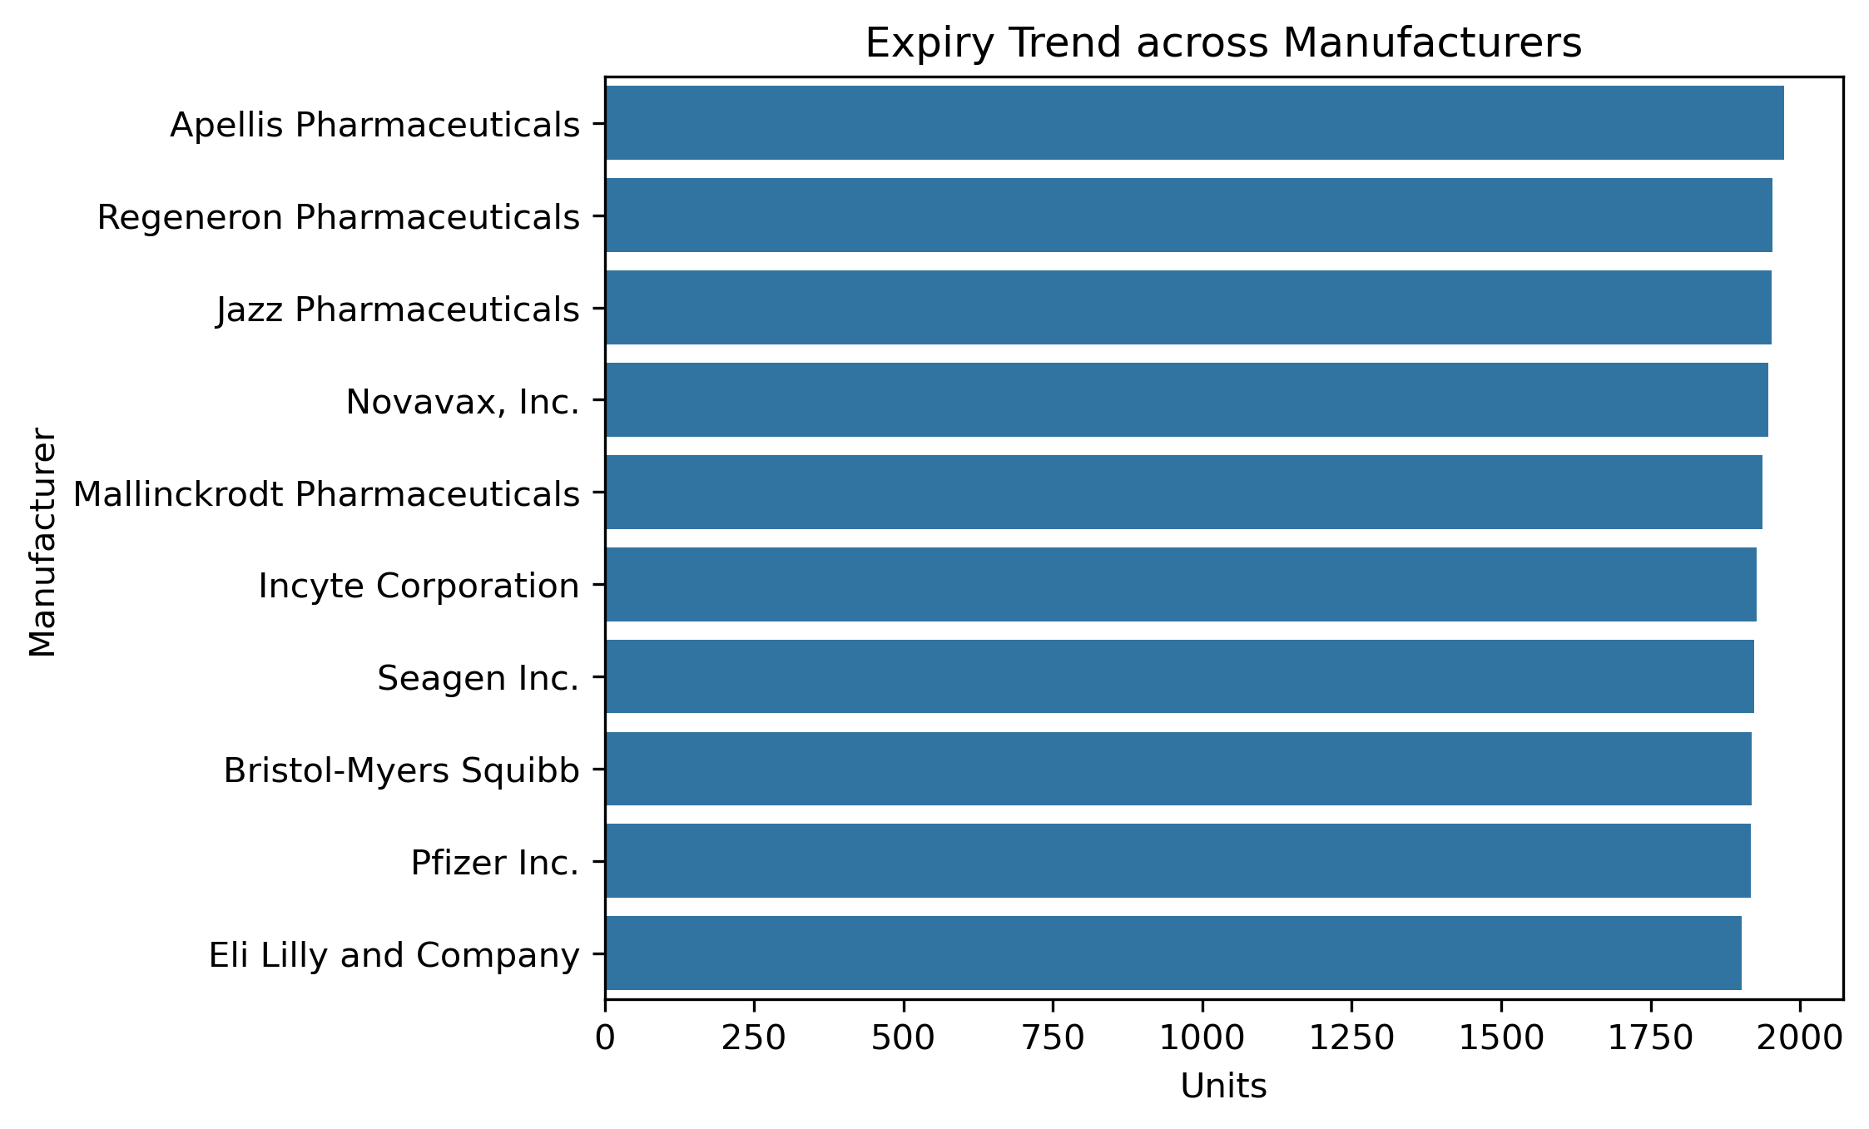
The top 10 manufacturers each have around 1,800 expiry units, totaling ~18,000, indicating that expiry issues are widespread and systemic rather than limited to specific vendors."

Slide 6
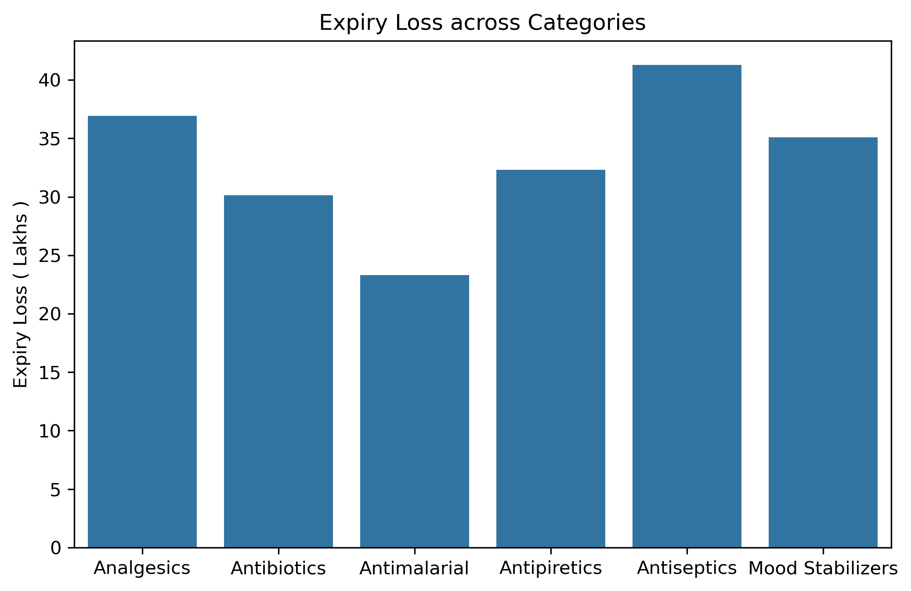
Expiry losses are uneven across categories, with Antiseptics leading at ₹42 Cr and Antimalarials lowest at ₹23 Cr; overall, 57% of the ₹201 Cr loss is concentrated in just three categories—Antiseptics, Analgesics, and Mood Stabilizers—highlighting key targets for waste reduction."

Slide 7
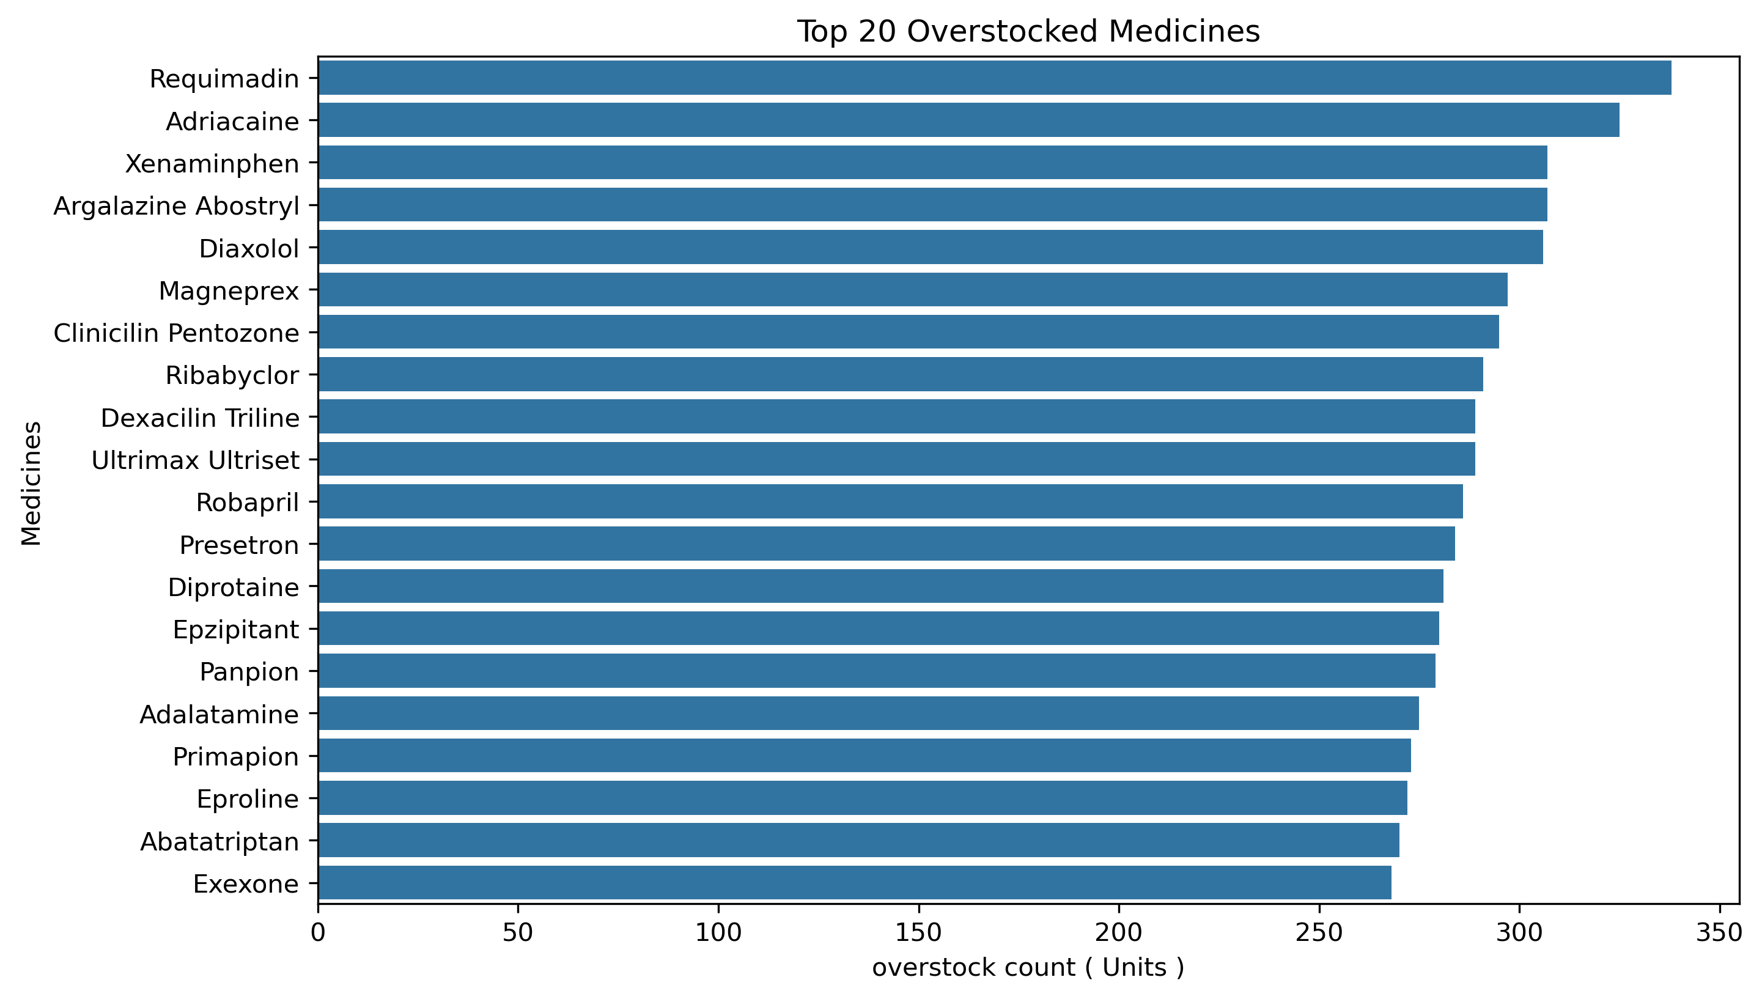
Over Stocks Analysis :
Among 240 medicines, 148 show overstock levels. The top 20 medicines alone contribute 13% of the total excess inventory, each holding more than 260 units, while over 103 products record overstock levels exceeding 200 units

Slide 8
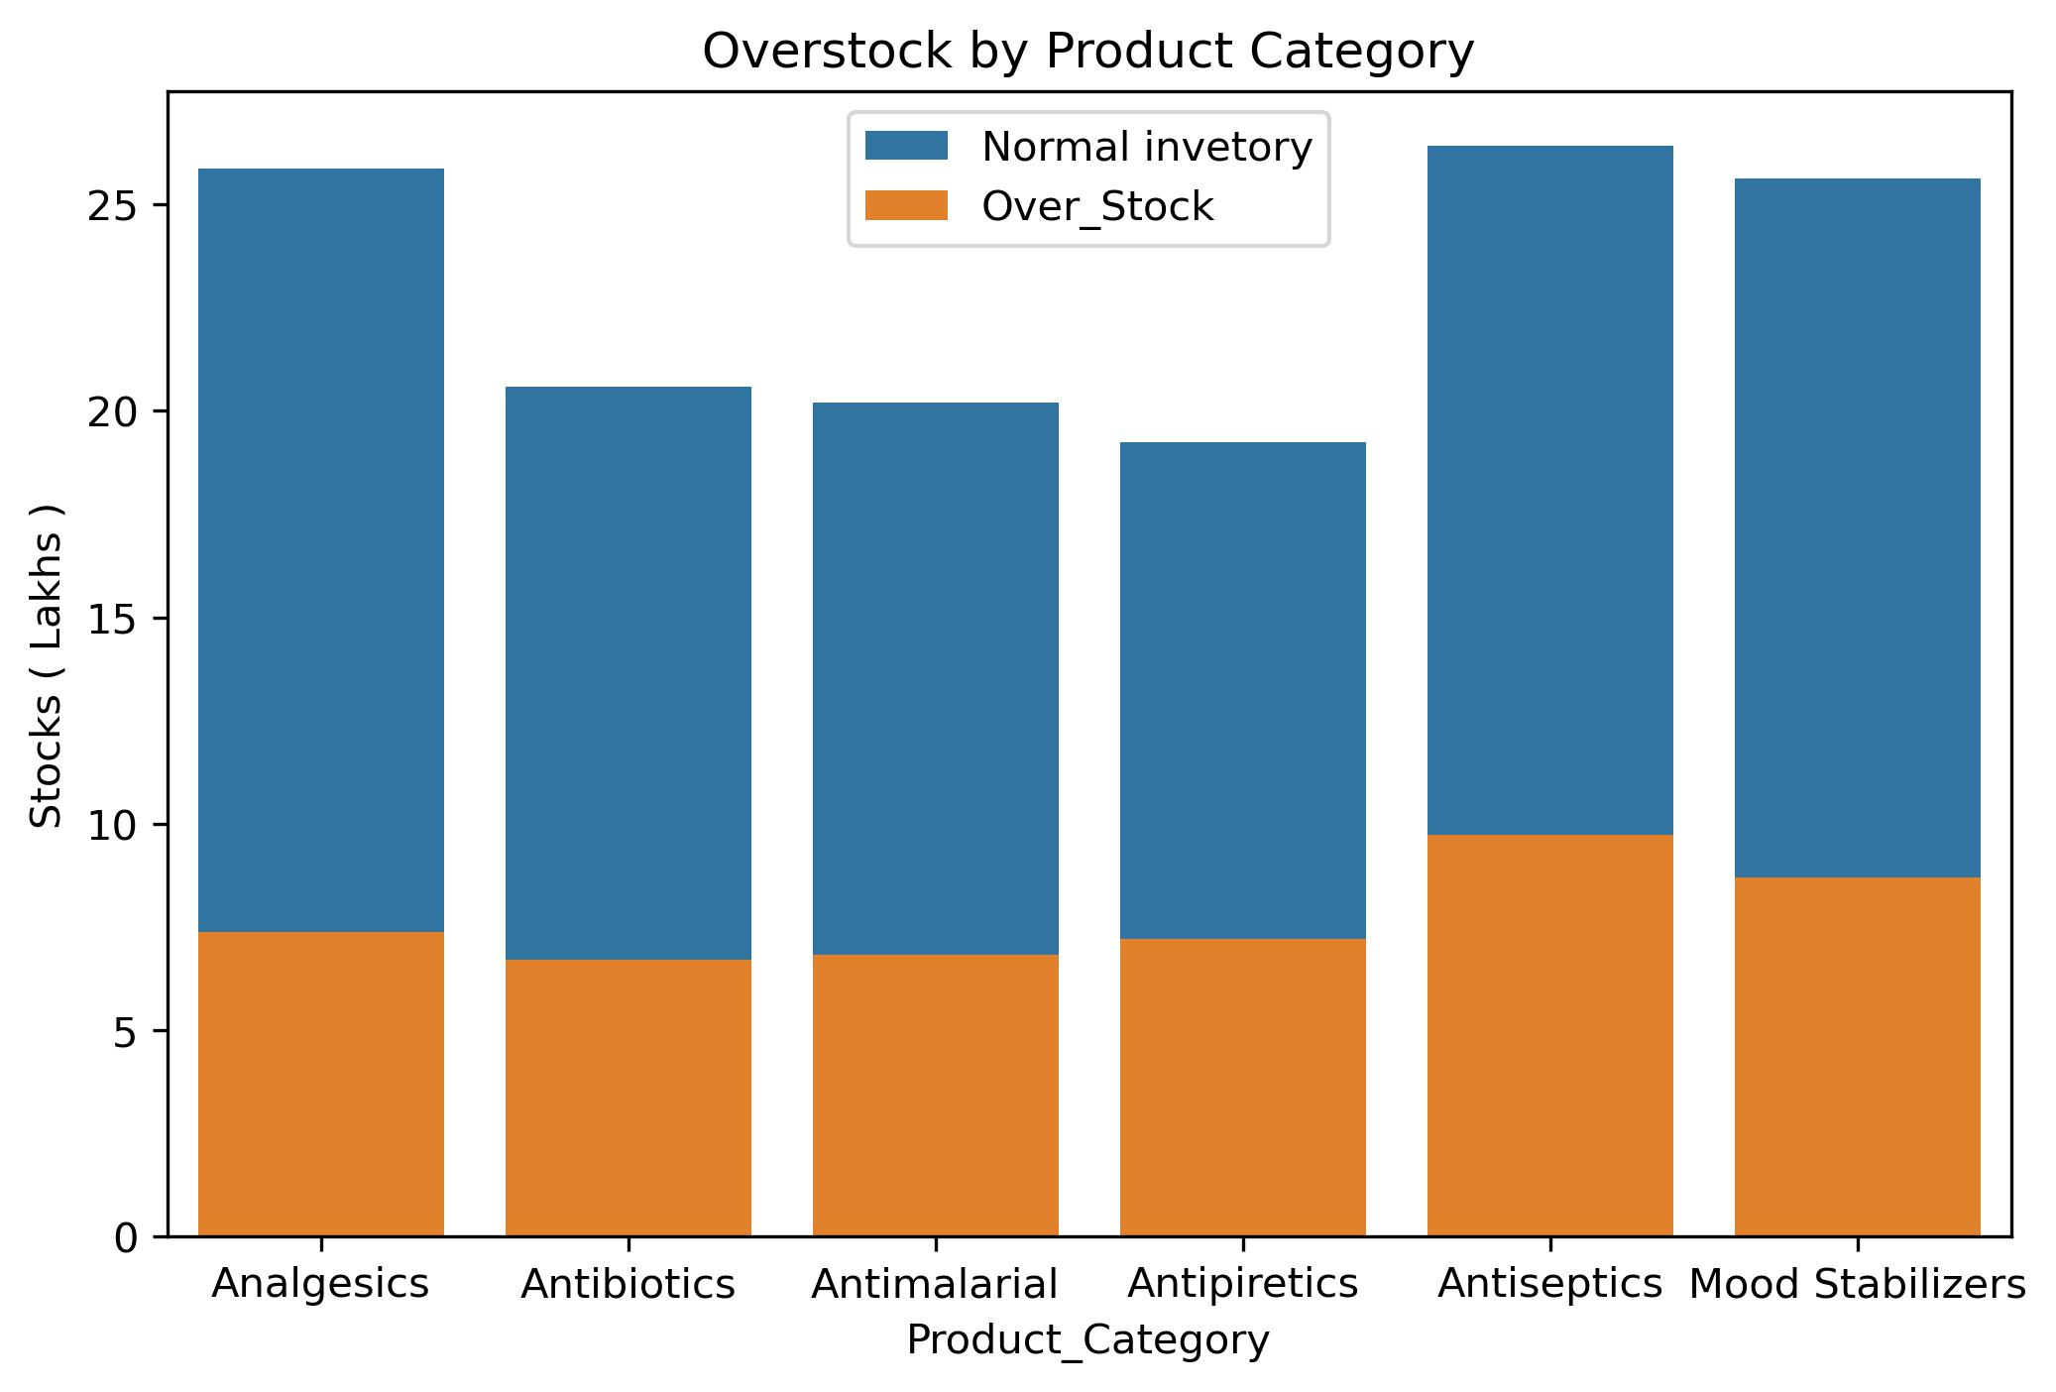
Across all product categories, around one-third of total stock is excess. Antiseptics and Analgesics show the highest overstock levels

Slide 9
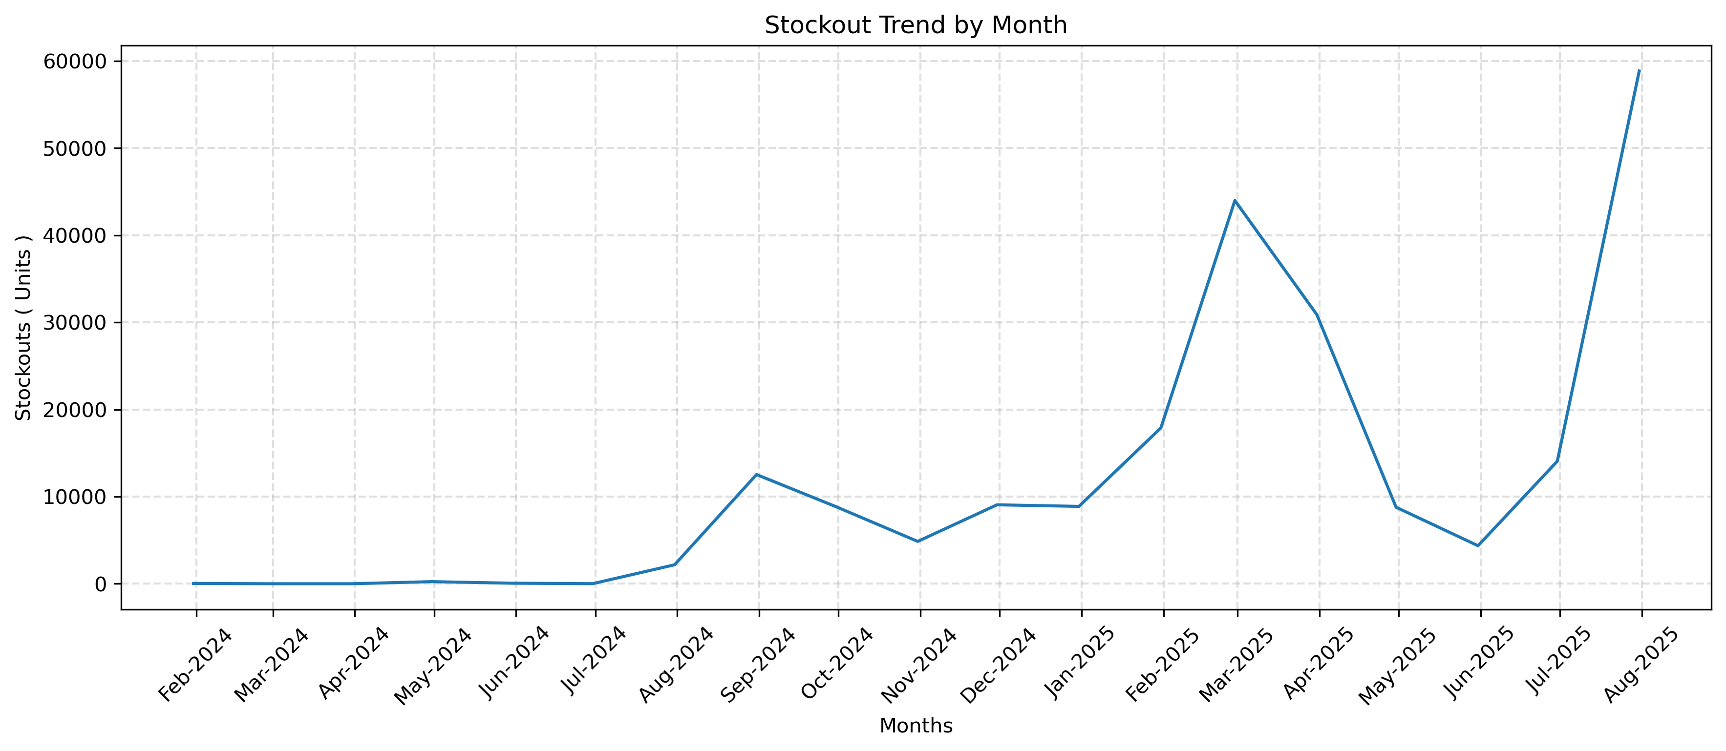
Stockouts Analysis:
A sharp rise in stockouts began from September 2024 showing the start of recurring supply chain disruptions.
The highest spike occurred in July 2025, with stockouts peaking above 5,000 units, signaling a major breakdown in inventory management.
Frequent fluctuations between late 2024 and mid-2025 suggest systemic demand-supply mismatches rather than isolated issues.

Slide 10
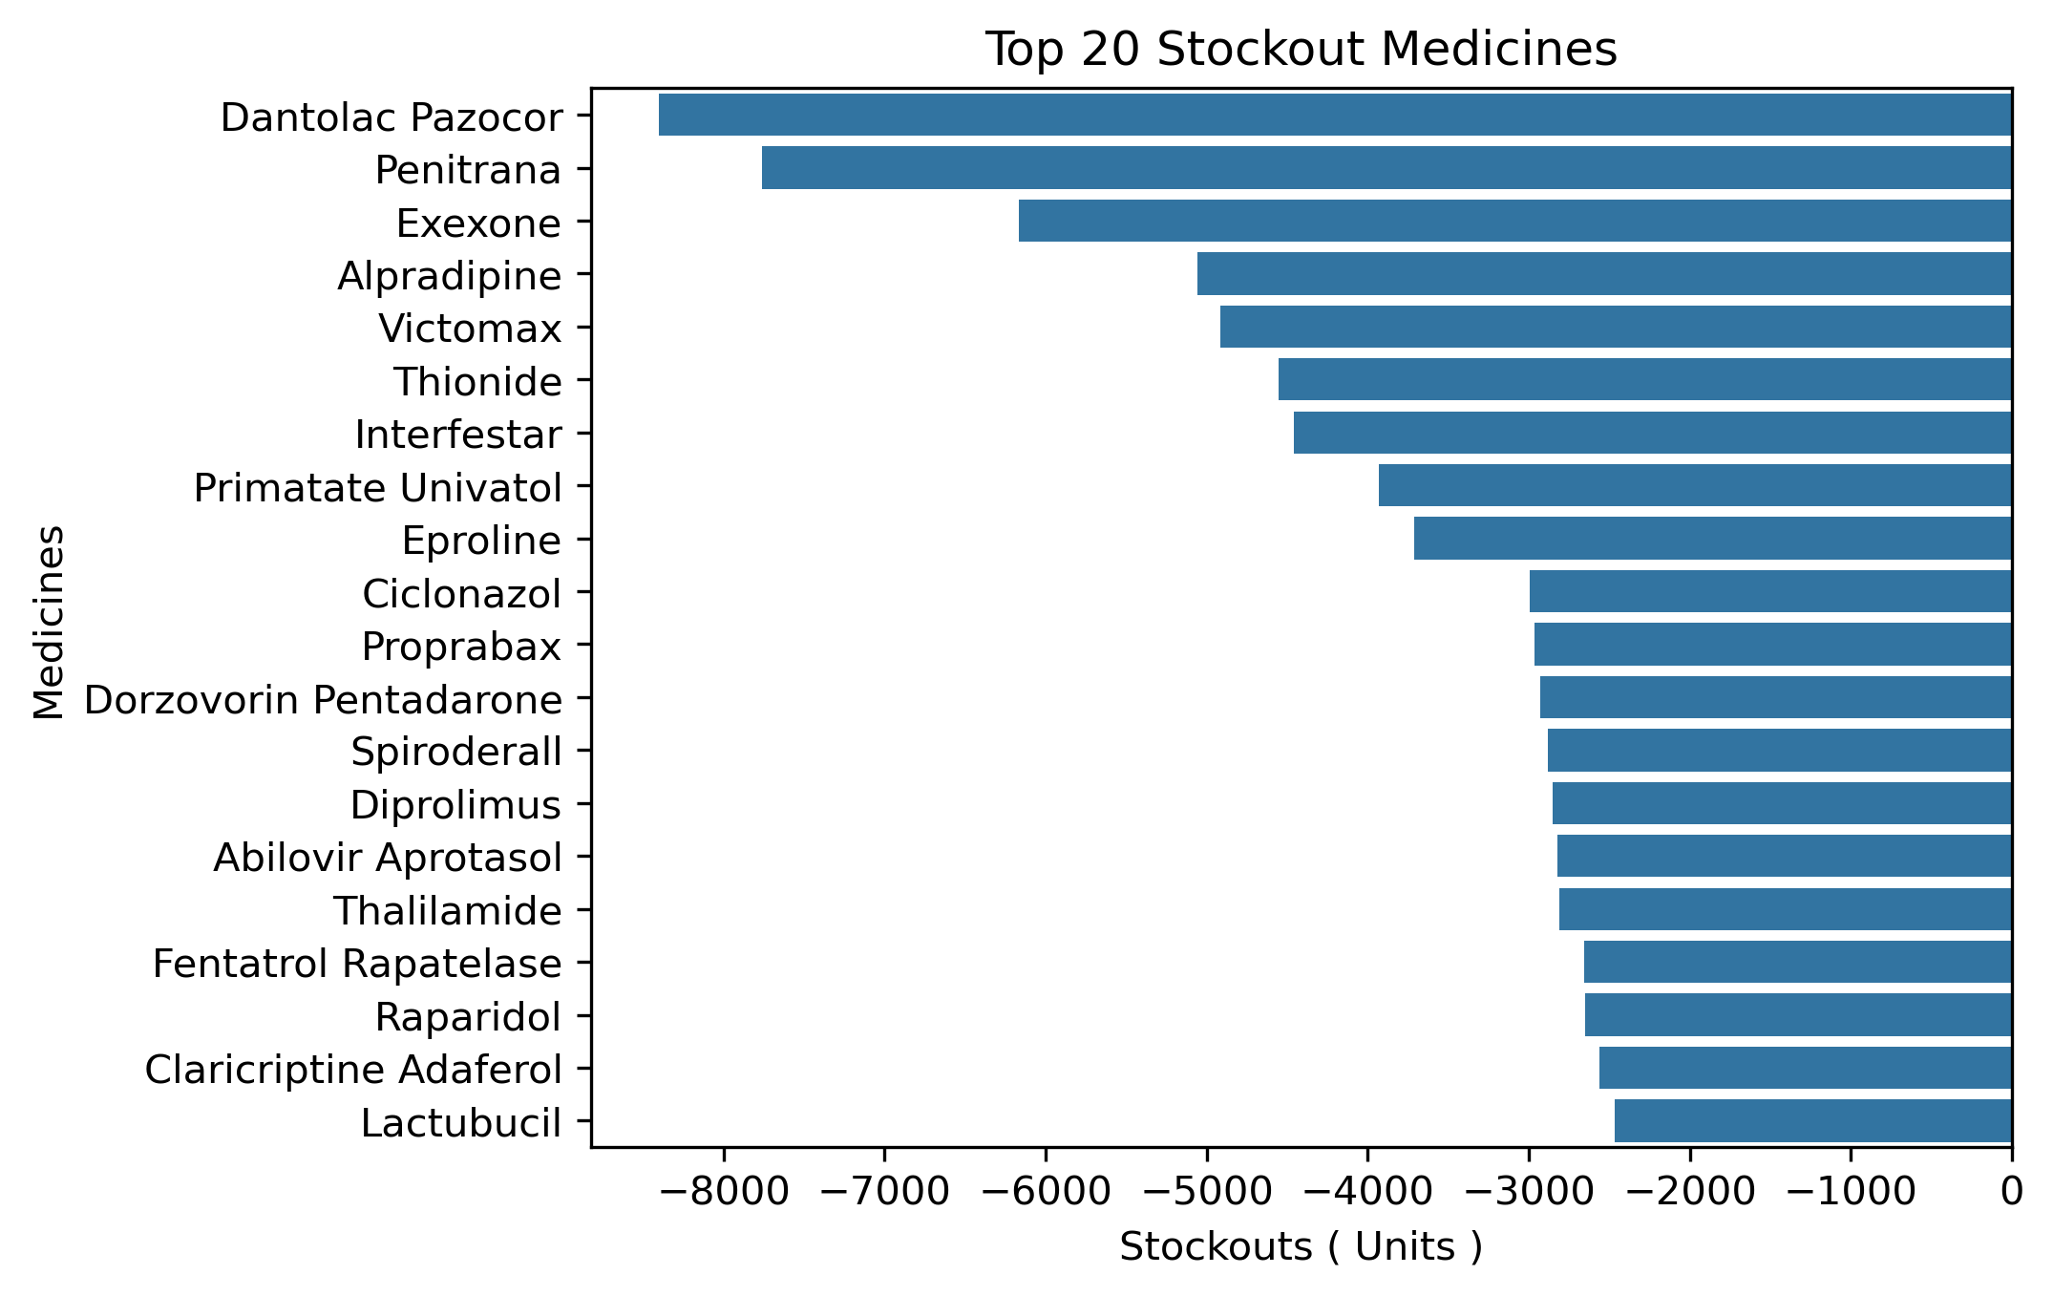
The top 20 most-requested medicines, including Dantrolac and Penitrana, account for ~80,000 stockouts, mostly 3,000–7,000 units each, highlighting widespread depletion across key treatments from cardiovascular to antiviral drugs.

Slide 11
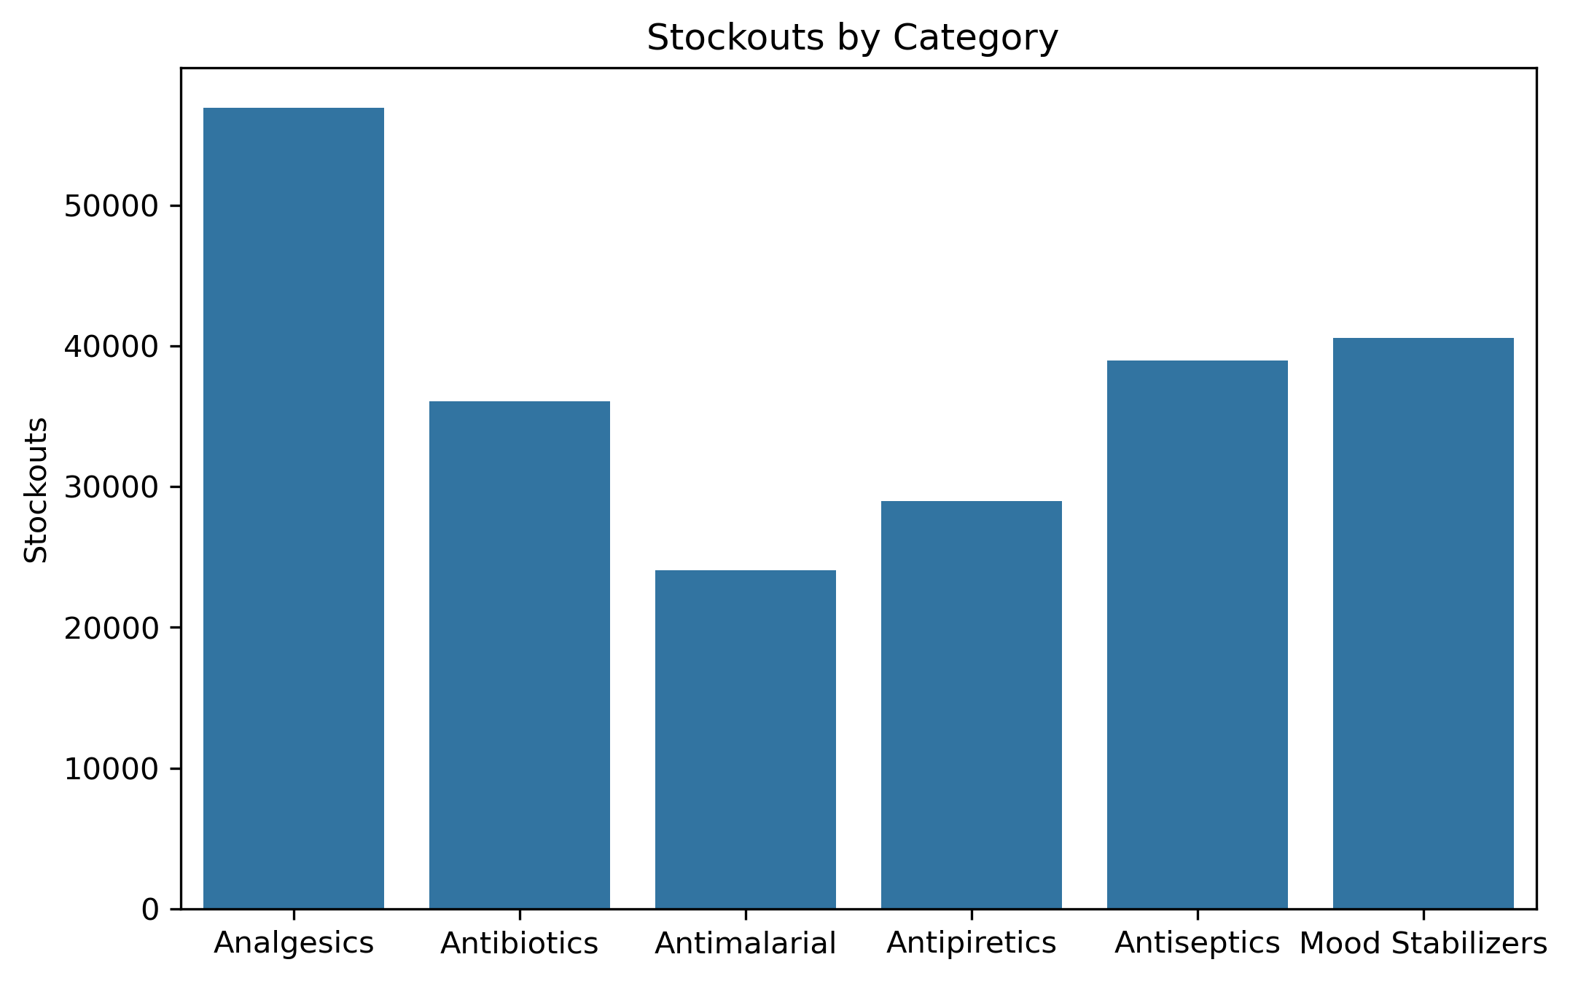
The chart shows ~225,000 stockout units, with Analgesics leading at 50,000; the top three categories—Analgesics, Antibiotics, and Antiseptics—account for 60% of shortages, highlighting the hardest-to-stock drug groups

Slide 12
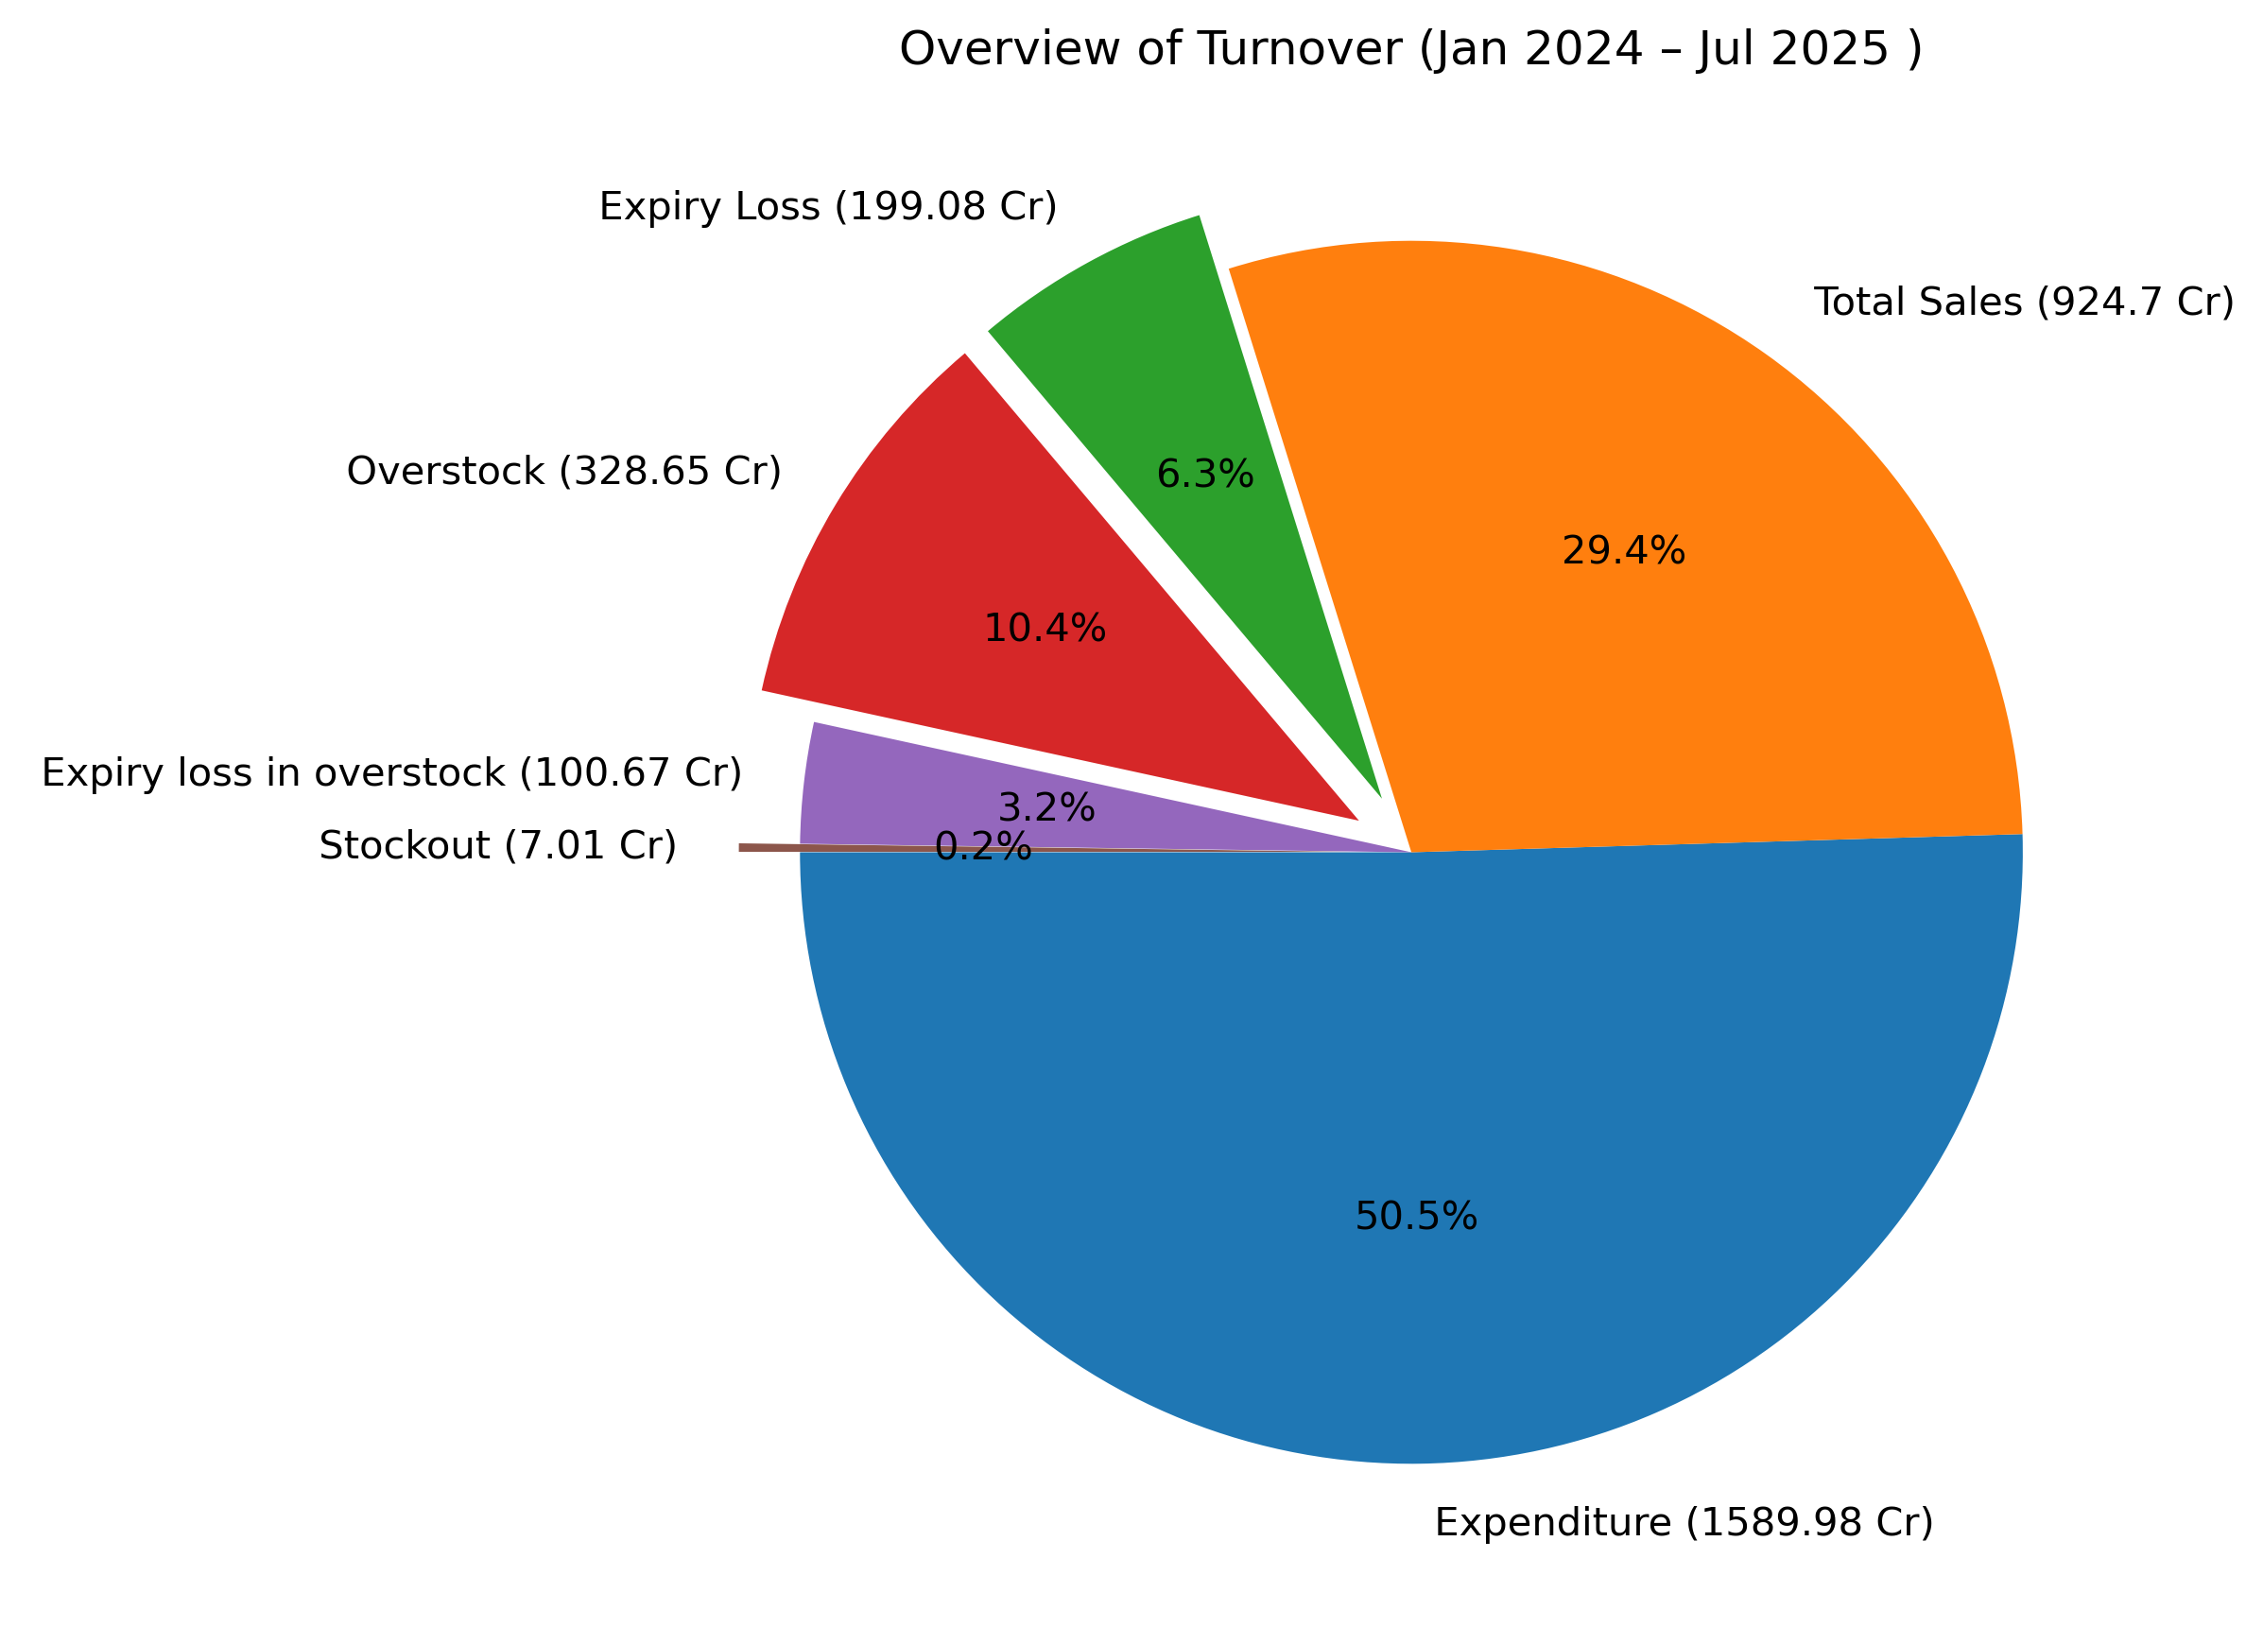
Business Metrics (KPIs):
💰 Profit: ₹182.10 Cr
📉 Total Loss: ₹306.76 Cr
📦 Overstock: 36% of inventory
🚫 Stockout Events: 1762 (in 2 years)
🕒 Expiry Loss: 9.5%

Slide 13
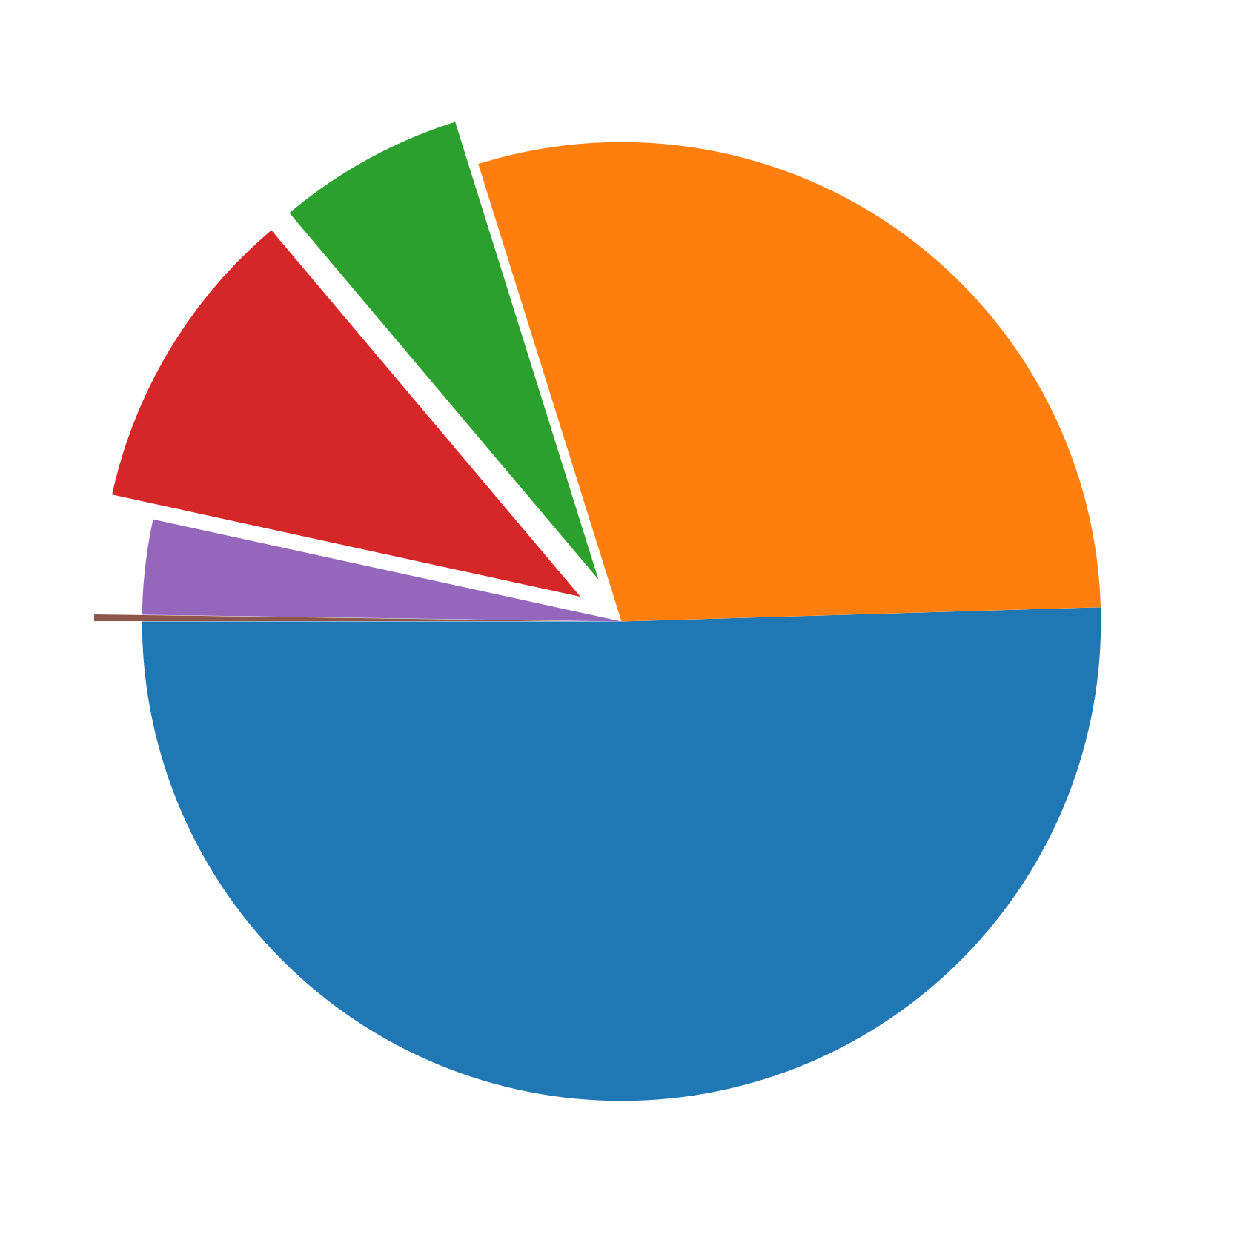
Business Metrics Overview (Jan 2024 – Jul 2025 ) :
Expenditure Dominates: 50.5% of turnover (₹1,589.98 Cr) goes to expense
Strong Sales Performance: Sales contribute 29.4% (₹924.7 Cr), showing good market reach and revenue generation.
Expiry Losses: 6.3% (₹199.08 Cr) lost due to expired products.
High Overstock: 10.4% (₹328.65 Cr) tied up in excess inventory.
Expiry within Overstock: 3.2% (₹100.67 Cr) of overstock expires.
Minimal Stockouts: Only 0.2% (₹7.01 Cr) lost—supply chain is reliable and ensures customer fulfillment.

Slide 14
Insights & Recommendations :
Optimize Inventory Turnover:
Implement Just-in-Time (JIT) procurement.
Use FEFO (First Expire, First Out) to reduce wastage.
Aim to cut overstock value by ~15% through better supplier coordination.
Revenue Growth Potential:
Reducing expiry and overstock can improve net profit margin by 20–30% .
Enhance Demand Forecasting:
Use predictive analytics to align inventory with demand fluctuations.
Target a 8–10% reduction in stockouts and overstock based on 2024–2025 trends.
Cost Control Measures:
Audit procurement and logistics for inefficiencies.
Use targeted promotions to improve sales efficiency to reduce the expenditure share.

