Slide 1
Breast Cancer Detection using AdaBoost Classifier
Presented by
Team 4

Slide 2
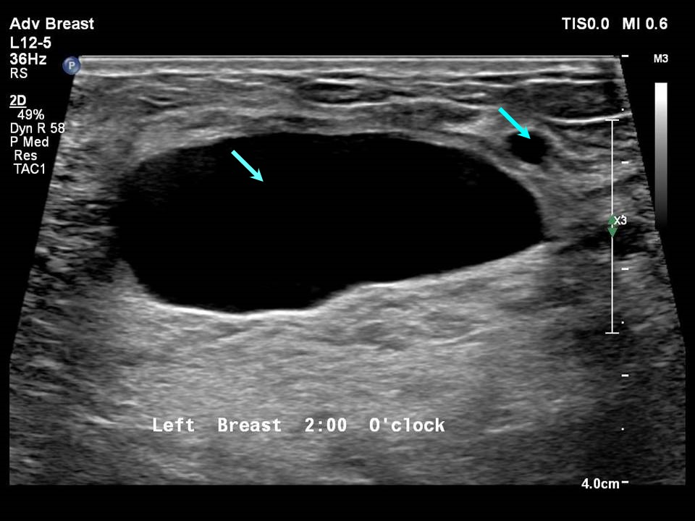
Introduction to Breast Cancer
The disease occurs when abnormal cells in the breast grow uncontrollably, forming a tumor. These tumors can be benign (non-cancerous) or malignant (cancerous). Malignant tumors have the potential to invade nearby tissues and spread (metastasize) to other parts of the body through the lymphatic system or bloodstream.
Breast cancer is a complex and devastating disease, but advancements in machine learning are revolutionizing its diagnosis. Early detection is crucial, and cutting-edge AI models are enhancing our ability to identify malignant tumors with unprecedented accuracy.

Slide 3
Malignant Vs Benign
Malignant Tumor:
Cancerous
Aggressive
Metastasis
Life-threatening
Benign Tumor:
Non-cancerous
Slow-growing
No metastasis
Not life-threatening

Slide 4


Machine Learning in HealthCare
Disease Prediction and Diagnosis: ML algorithms analyze patient data (e.g., imaging, genetic information) to predict diseases like cancer, diabetes, and cardiovascular conditions early.
Medical Imaging: ML models help detect patterns in medical images (X-rays, MRIs, CT scans) to identify abnormalities like tumors, fractures, or infections.
Personalized Treatment Plans: ML can create customized treatment recommendations by analyzing patient histories, genetic data, and drug responses.
Predictive Analytics: ML models predict patient outcomes, readmission risks, and future health conditions, enabling proactive care.

Slide 5


Why early detection of Breast Cancer is important?
1. Higher Survival Rates:
Breast cancer detected at an early stage (before it spreads) is easier to treat successfully.
2. Less Aggressive Treatment:
Early-stage breast cancer often requires less invasive treatments, such as smaller surgeries (e.g., lumpectomy instead of mastectomy) and lower doses of chemotherapy or radiation therapy.
3. Lower Risk of Metastasis:
Catching the cancer early means it is less likely to have spread (metastasized) to other organs, which makes it harder to treat and lowers the chances of long-term survival.
4. Reduced Healthcare Costs:
Treating early-stage breast cancer is less costly than advanced stages, as advanced cancer requires more complex and prolonged treatments.

Slide 6
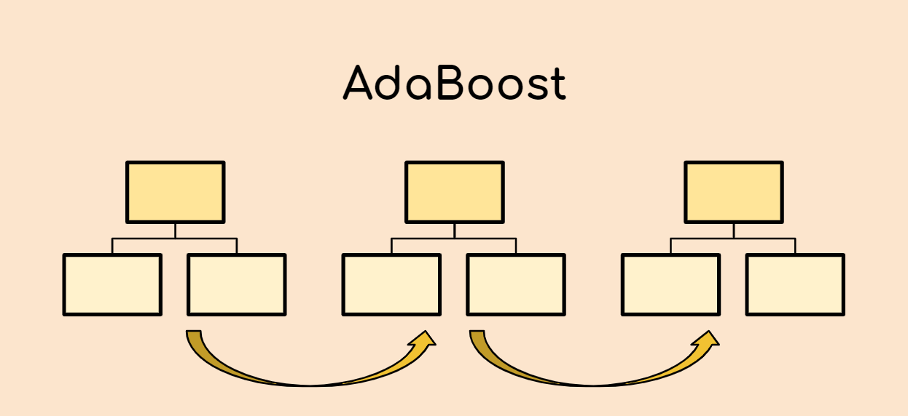
AdaBoost Classifier
The AdaBoost classifier is a machine learning method that helps improve the accuracy of predictions by combining the strengths of many weak models (often called "weak learners").
AdaBoost takes weak models and makes them work together. It boosts their performance by focusing on the mistakes made by the previous models.
In each step, AdaBoost trains a new model and gives more importance (or "weight") to the data points that were misclassified by the previous models. This way, the new model focuses more on the difficult cases.
Finally, AdaBoost combines all the models into a single strong model, where each weak model's vote is weighted based on its accuracy.

Slide 7
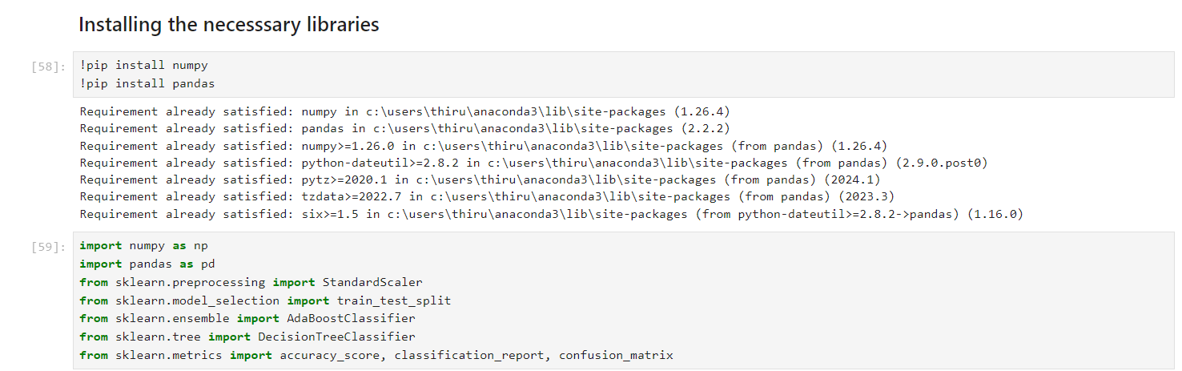
Data Collection and Preprocessing
At first installing all necessary libraries for our project

Slide 8
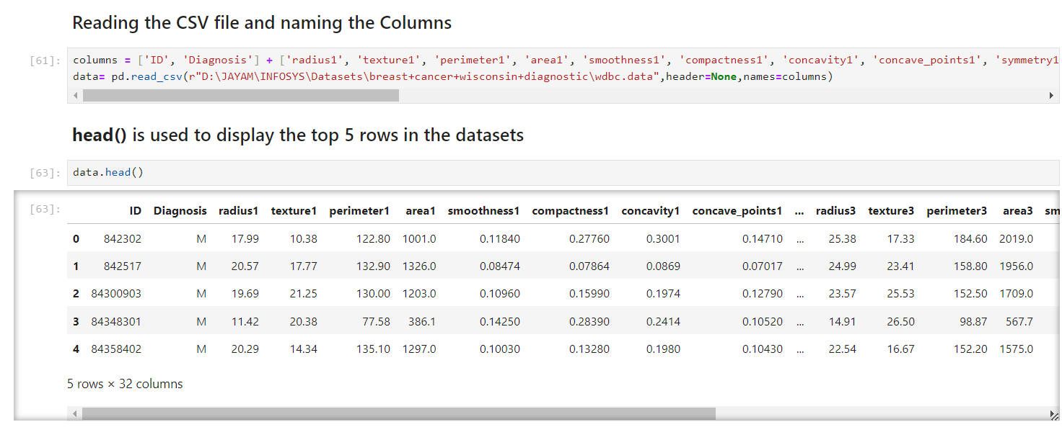
Data Collection and Preprocessing
Then, collect and preprocess breast cancer data, typically sourced from datasets like the UCI Breast Cancer Wisconsin dataset.

Slide 9
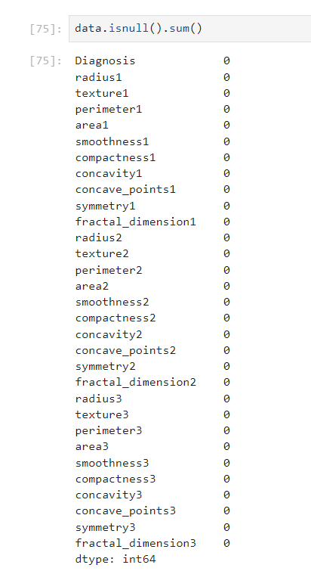


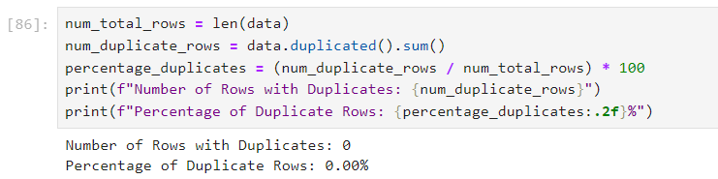
Data Collection and Preprocessing
Handle missing values
Finding the dimensions of the Dataset
Finding the duplicate values

Slide 10
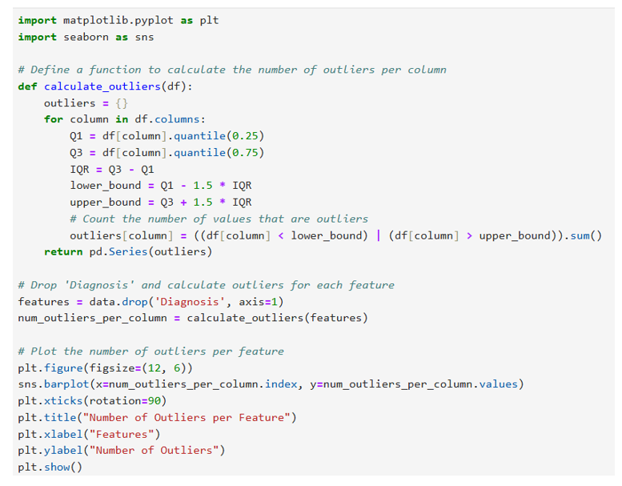
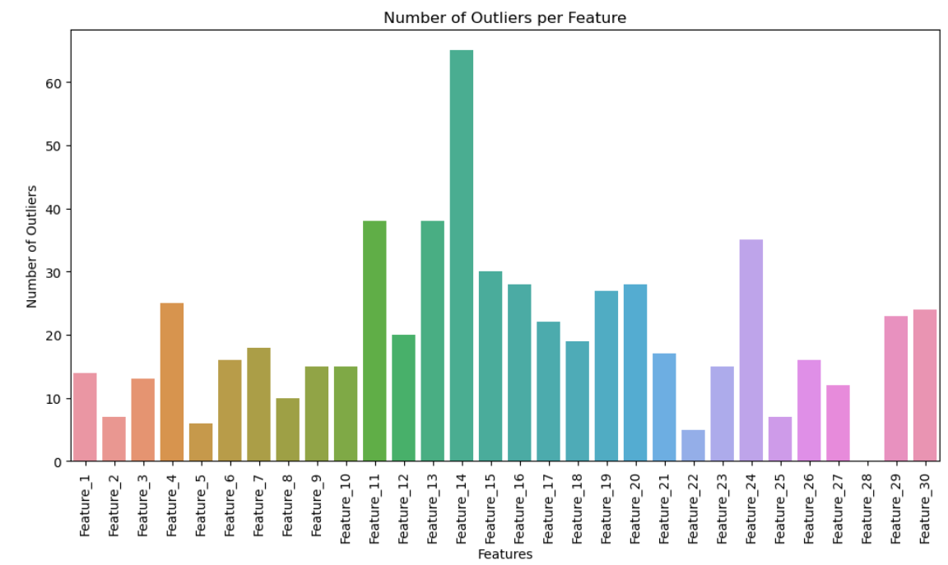
Data Collection and Preprocessing
Outlier Detection: Using IQR (Interquartile Range)

Slide 11

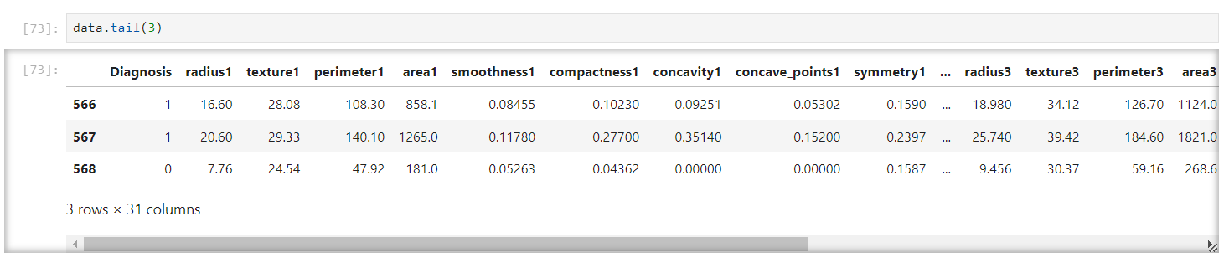
Data Collection and Preprocessing
Encode categorical labels
Categorical labels like M and B is encoded as 1 and 0 respectively

Slide 12
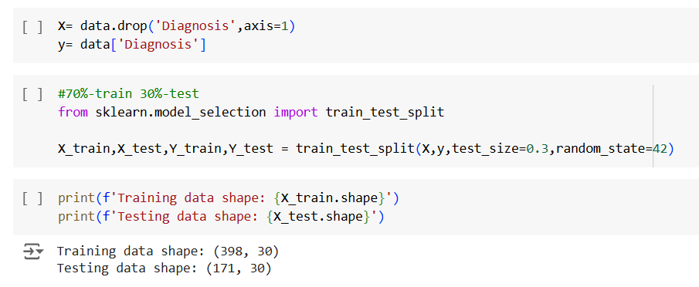
Data Collection and Preprocessing
Scaling features and Splitting the Data

Slide 13
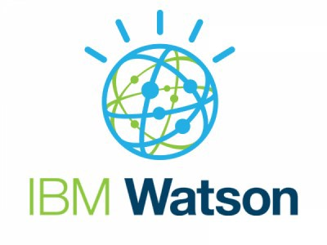

Real-World Examples
IBM Watson
IBM Watson Health uses AI and machine learning to analyze large volumes of medical data, including imaging data, pathology reports, and patient history. Its machine learning models assist doctors in making more informed decisions.
Google Health / DeepMind
Google's DeepMind has developed AI models that analyze mammograms to detect breast cancer with performance on par with or better than radiologists. The model has been tested in real-world settings to reduce both false positives and false negatives in screening programs.

Slide 14

Presented by TEAM-4

