Slide 1
Breast Cancer Detection using AdaBoost Classifier
Presented by
Team 4

Slide 2
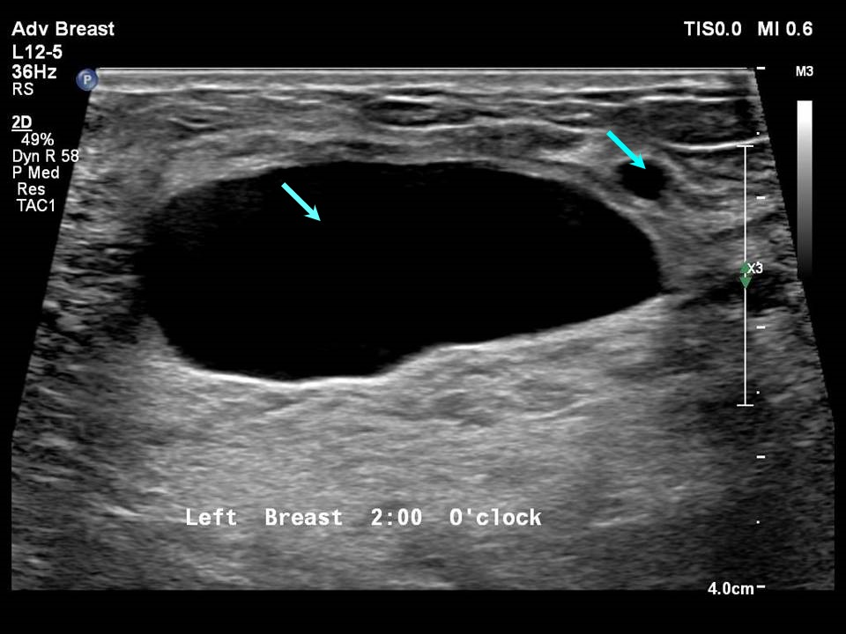
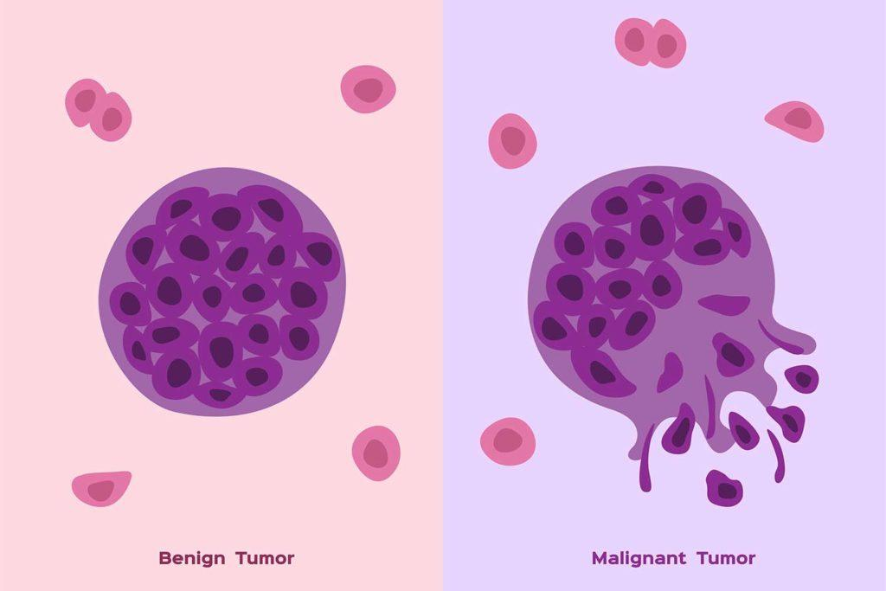
Introduction to Breast Cancer
The disease occurs when abnormal cells in the breast grow uncontrollably, forming a tumor. These tumors can be benign (non-cancerous) or malignant (cancerous).

Slide 3
Malignant Vs Benign
Malignant Tumor:
Cancerous
Aggressive
Metastasis
Life-threatening
Benign Tumor:
Non-cancerous
Slow-growing
No metastasis
Not life-threatening

Slide 4


Machine Learning in HealthCare
Disease Prediction and Diagnosis
Medical Imaging
Personalized Treatment Plans
Predictive Analytics

Slide 5


Why early detection of Breast Cancer is important?
Higher Survival Rates
Less Aggressive Treatment
Lower Risk of Metastasis
Reduced Healthcare Costs

Slide 6

Problem Statement
A project focused on detecting breast cancer using the AdaBoost classifier. To develop a machine learning model that accurately classifies breast cancer as either malignant or benign using the AdaBoost algorithm.

Slide 7

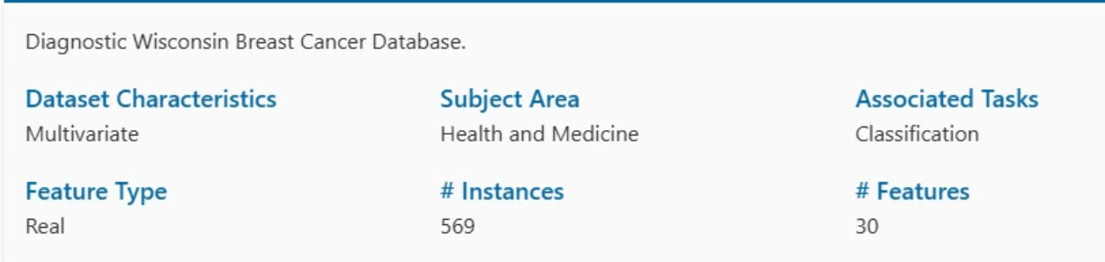
Data Collection
Collect and preprocess breast cancer data, typically sourced from the “UCI Breast Cancer Wisconsin dataset.”

Slide 8
Installing necessary libraries
Pandas
Seaborn
Matplotlib
Numpy
Sklearn
imblearn.over_sampling
Pickle

Slide 9
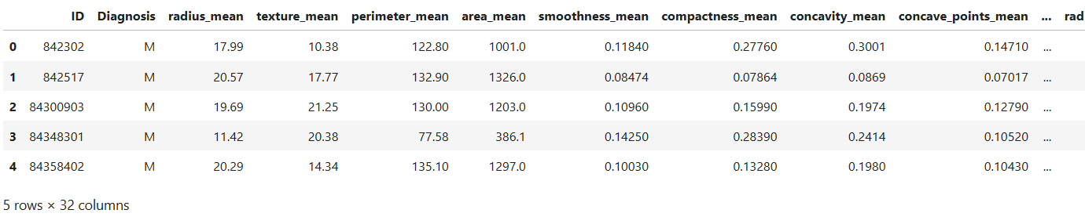


Reading the CSV file and naming the Columns
Analysis and Preprocessing of Dataset
Shape:
Number of duplicated rows:

Slide 10
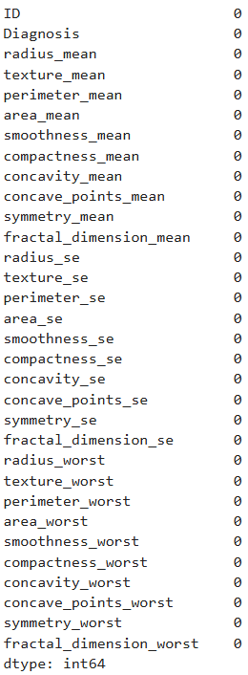
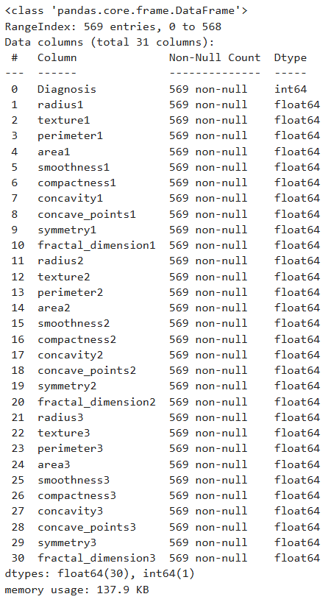
Number of NULL or missing values:
Analysis and Preprocessing of Dataset
info:
There is no missing or NULL values in our dataset

Slide 11
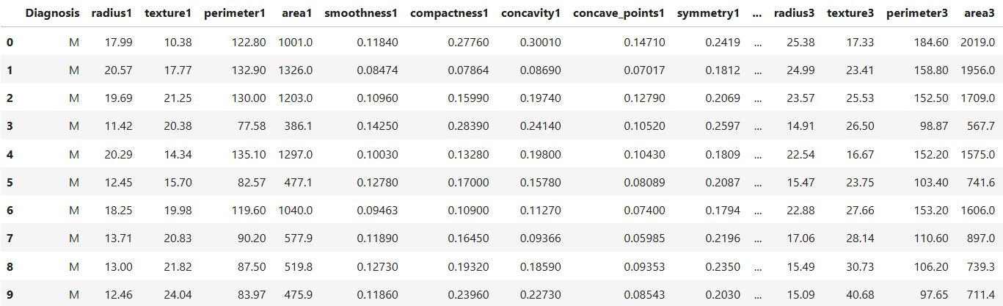
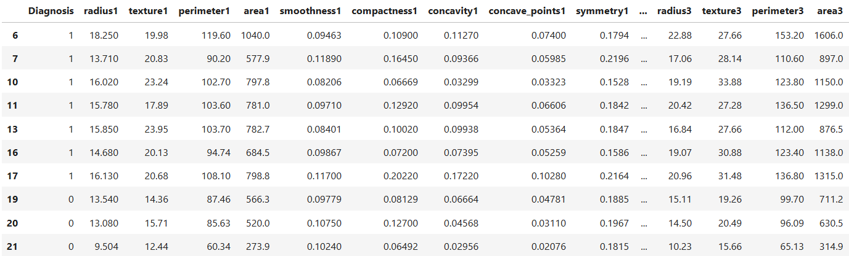
Encode categorical labels
Encoding categorical labels is important because:
Mathematical Interpretability
Model Compatibility
Improved Model Performance
Mapping
Malignant = 1
Benign = 0

Slide 12
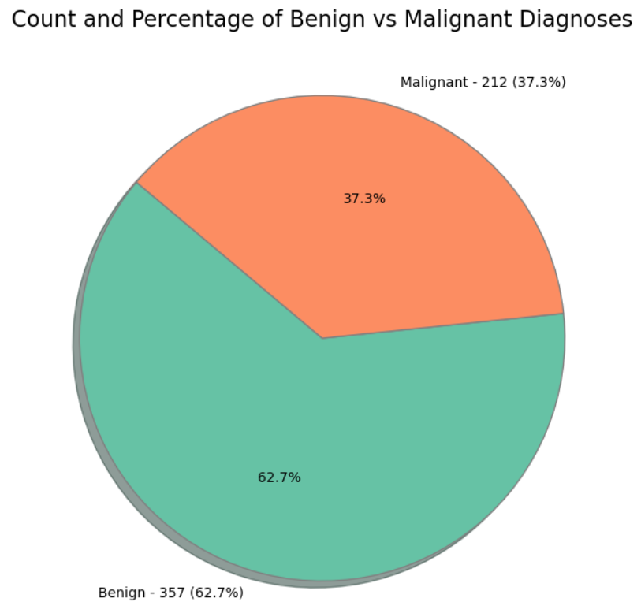
Data visualization
The given dataset is imbalanced which leads to
High False Negatives/Positives
Poor Performance on Minority Class
Misleading Evaluation Metrics
Percentage of benign cases = 62.7
Percentage of malignant cases = 37.3

Slide 13
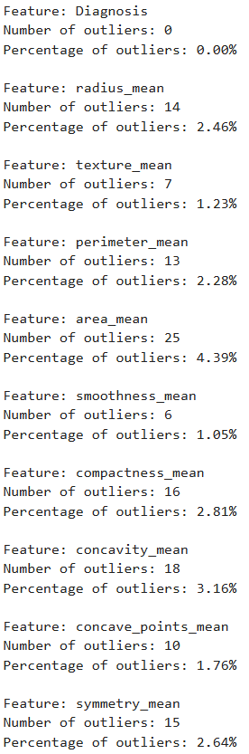
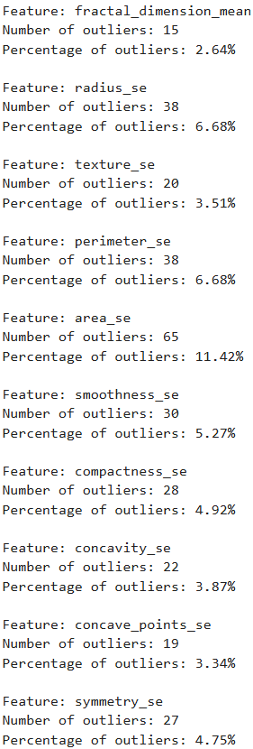
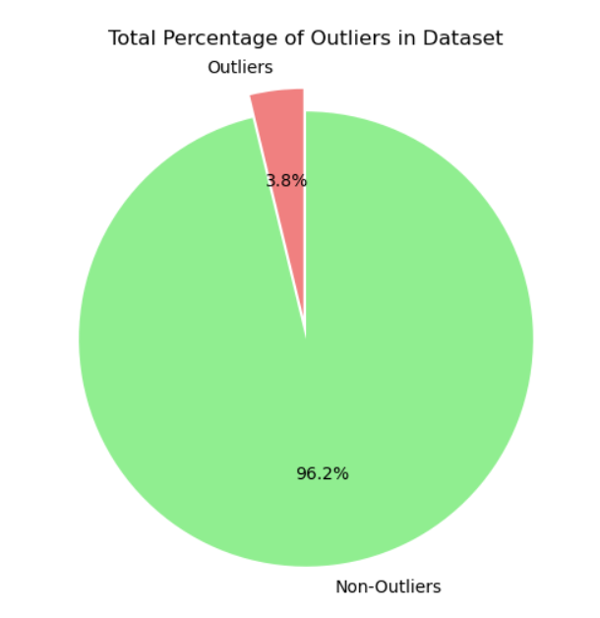
Data cleaning
Outlier Detection: Using IQR (Interquartile Range)
Diagnosis = 0.0% (LOW)
Area_se = 11.42% (HIGH)
Avg is around 4%
So, we can conclude that Outliers did not play significant role in our dataset.
And we remove the ID column which is not required for our Model

Slide 14
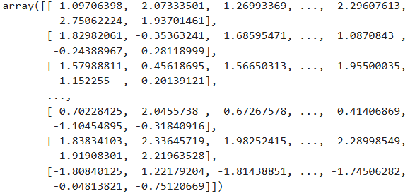
Scaling the data
By initializes a StandardScaler (from sklearn lib.) object which will standardize the features by removing the mean and scaling to unit variance.

Slide 15
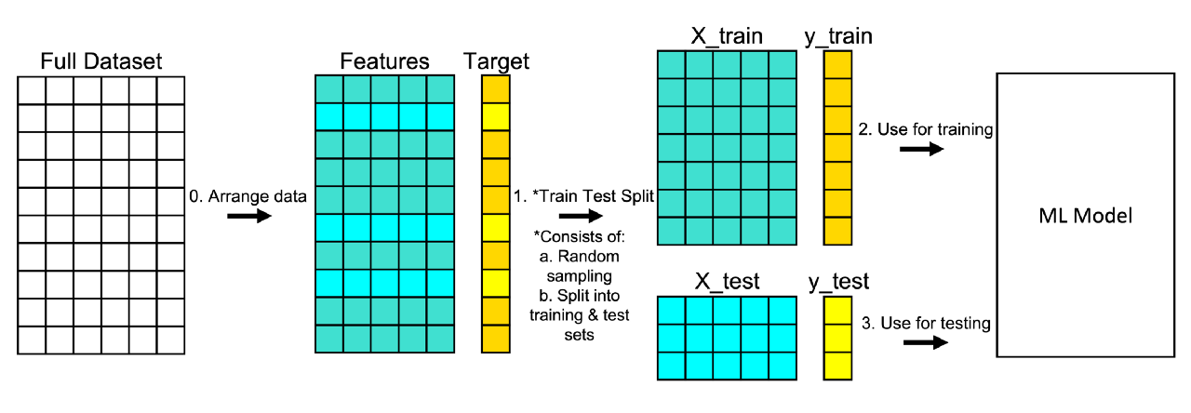

Data splitting
Before splitting Dataset
Shape of dataset:
After splitting Dataset
We have split the data with the ratio of 70:30

Slide 16
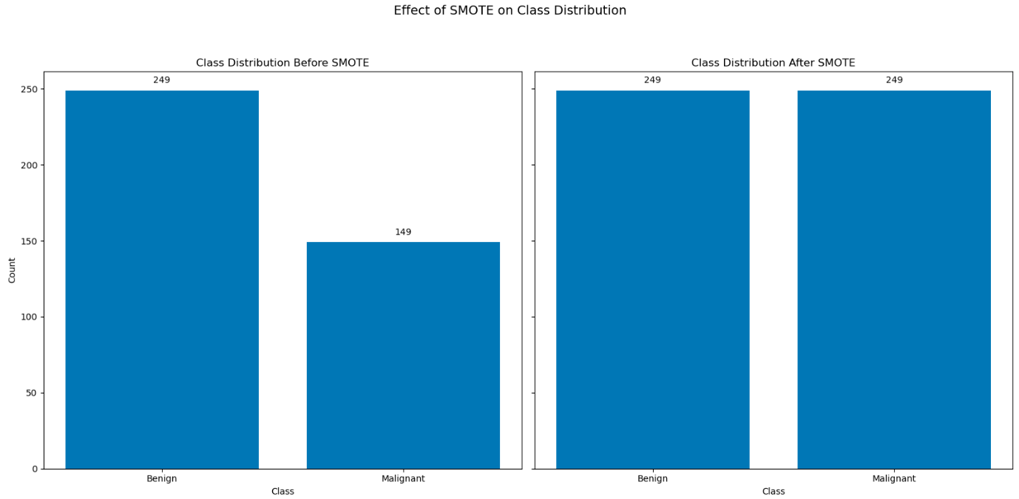
Synthetic Minority Over-sampling Technique, is a method used to handle imbalanced datasets.
Implementing SMOTE
SMOTE is implemented in train data after splitting the Original dataset.
not @test data

Slide 17
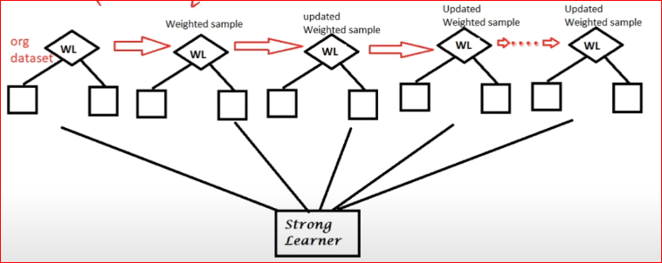
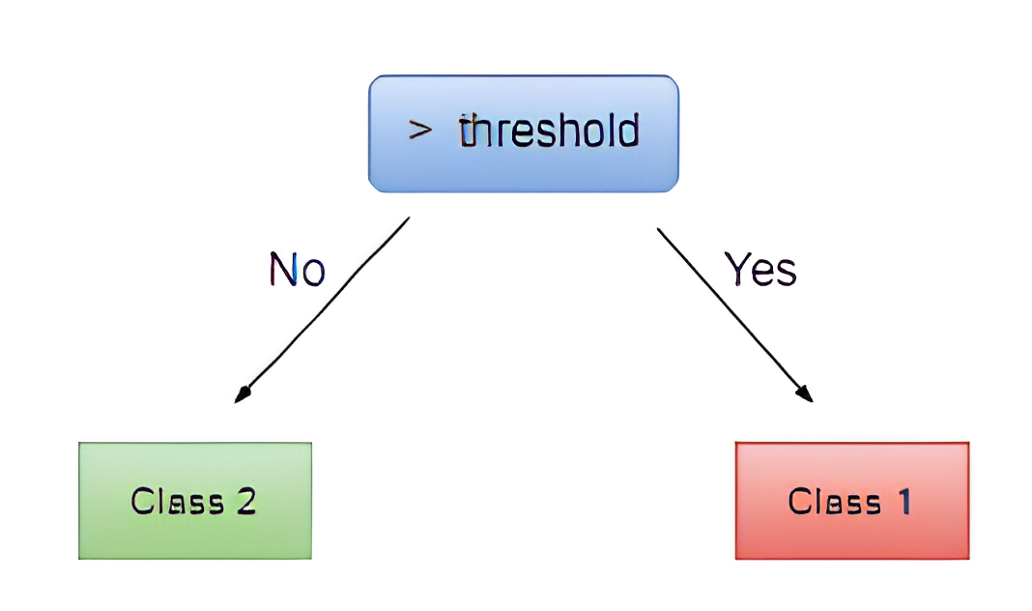
Implementation of ADABOOST Classifier
decision stump
AdaBoost (Adaptive Boosting) is a popular ensemble method that improves the performance of weak learners, typically decision trees, by combining multiple models into a single, strong model.
We use scikit-learn to implement Adaboost in our dataset

Slide 18


Performance Evaluation (Before SMOTE)
In our Dataset we have, we TRAINED the model with and without outliers
WITH Outlier
WITHOUT Outlier
In our case the Performance reduced after removing outliers but precision has been improved.

Slide 19


Performance Evaluation (After SMOTE)
In our Dataset we have, we TRAINED the model with and without outliers
WITH Outlier
WITHOUT Outlier
In our case the Performance reduced again after removing outliers

Slide 20
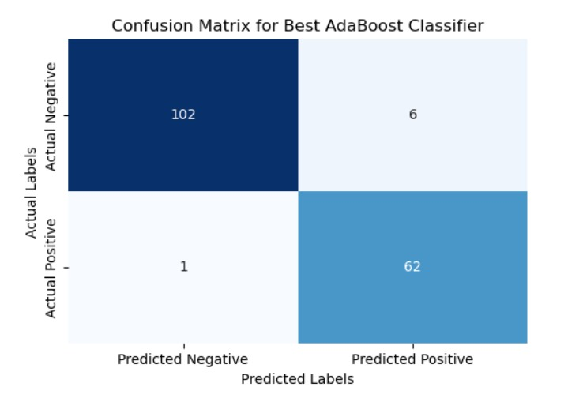
Confusion Matrix
Finally we proceed with dataset with SMOTE and with Outliers applied.
The confusion matrix shows that the AdaBoost classifier correctly predicted 102 true negatives and 62 true positives, with only 7 misclassifications (6 false positives and 1 false negative). This indicates high overall accuracy with minimal false predictions.

Slide 21
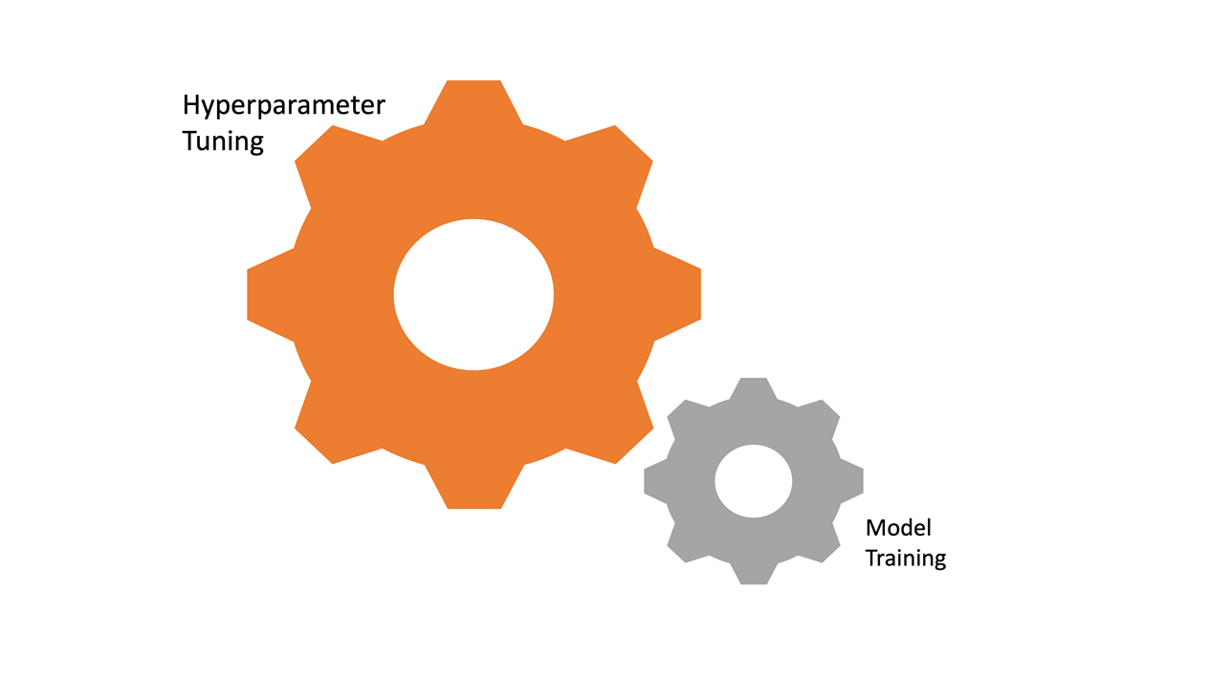
Hyperparameter Tuning
Parameters for the AdaBoost classifier are estimators, learning rate of the base estimator.
Used GridSearchCV to test combinations of parameters with 5-fold cross-validation, optimizing for accuracy.
Identified the best combination of hyperparameters based on performance metrics.

Slide 22

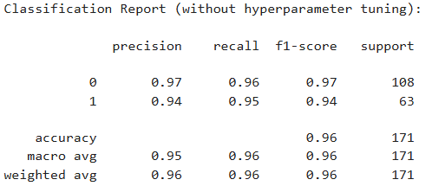
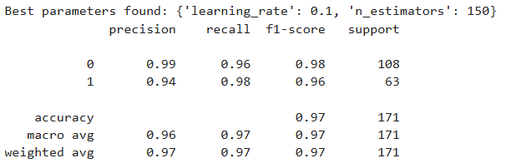
Performance Evaluation
Our precision, recall, f1-score have been improved after hyper tuning.
And we got best model as ‘learning_rate’:0.1, ‘n_estimators’:150

Slide 23
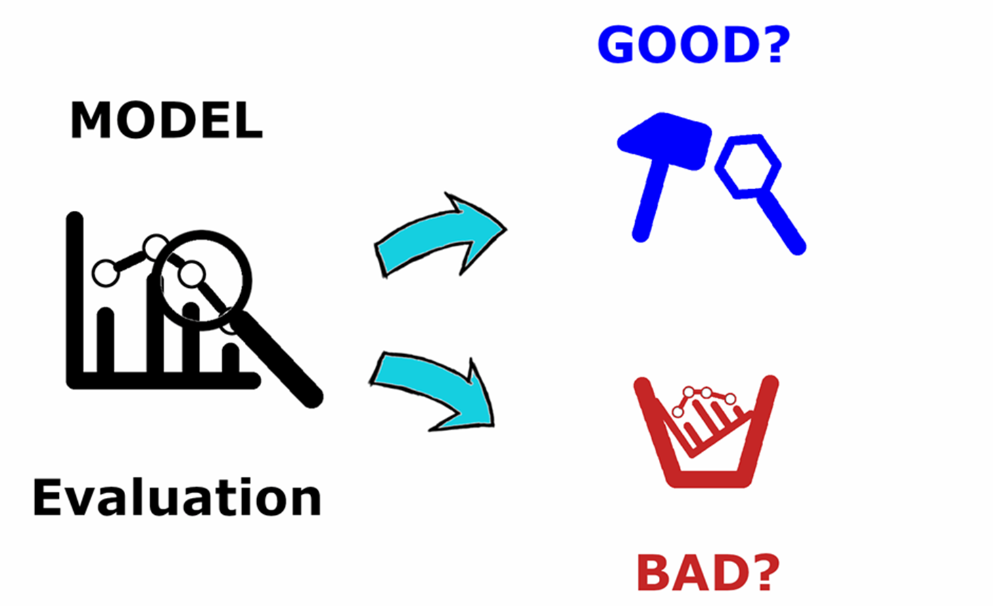
Importance of Recall and Precision in Medical Diagnosis
In breast cancer detection, recall is critical to ensure cancer cases aren’t missed, as false negatives could delay treatment.
Precision also matters to reduce false positives, minimizing unnecessary anxiety and tests.
The F1 score provides a balanced measure, combining both precision and recall.

Slide 24
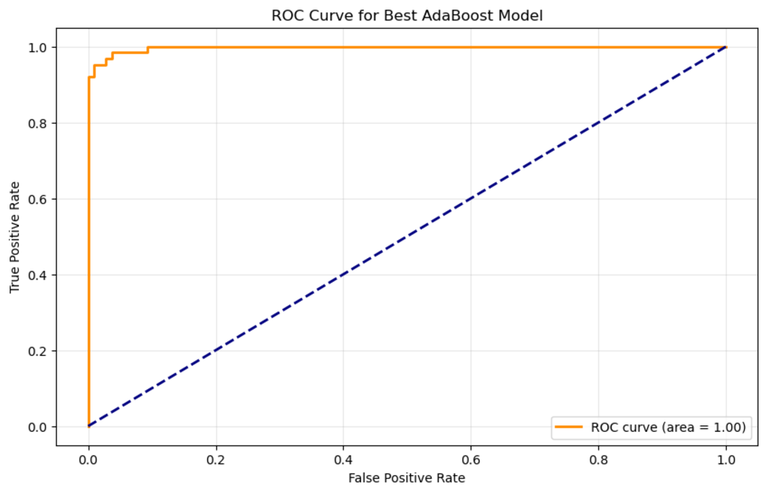
ROC Curve
This ROC curve shows that the AdaBoost model has perfect classification performance, with an AUC of 1.00, indicating it accurately distinguishes between positive and negative classes.

Slide 25
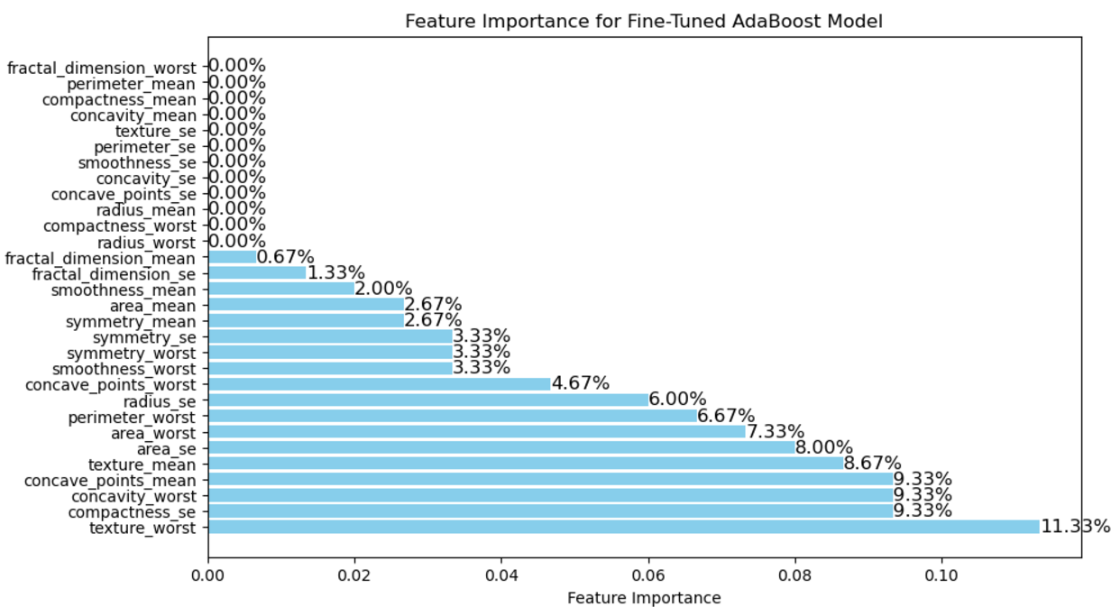
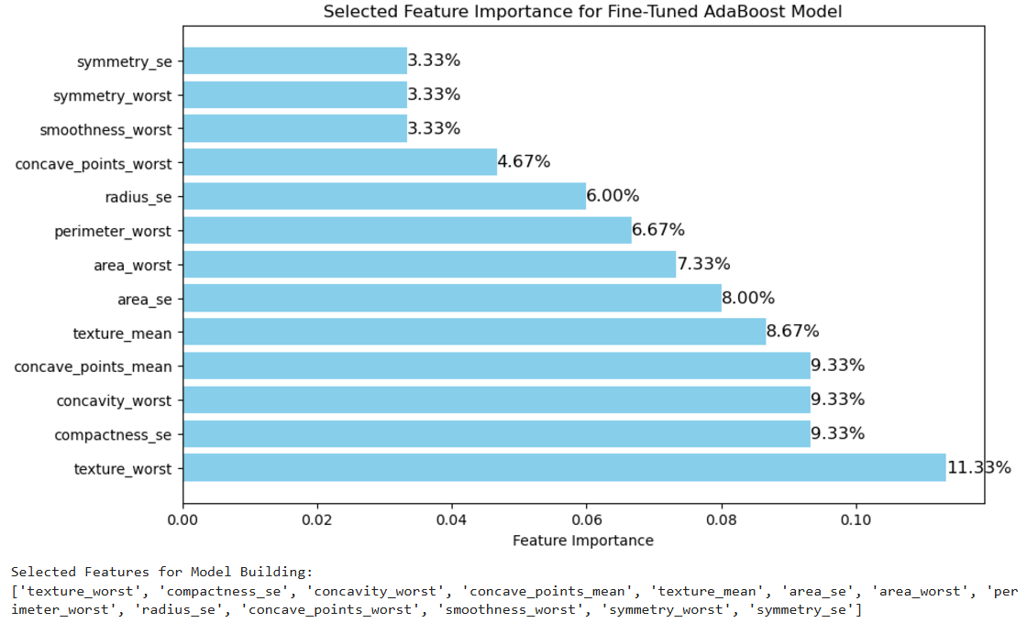
Feature Selection
Here, we have chosen feature importance above 3%.
The graph shows the feature importance for a fine-tuned AdaBoost model, with texture_worst being the most significant at 11.33%, while several features like perimeter_mean and compactness_mean have zero importance.
Then, we re-train the model using the selected features in the AdaBoost classifier to save it for Streamlit deployment.

Slide 26
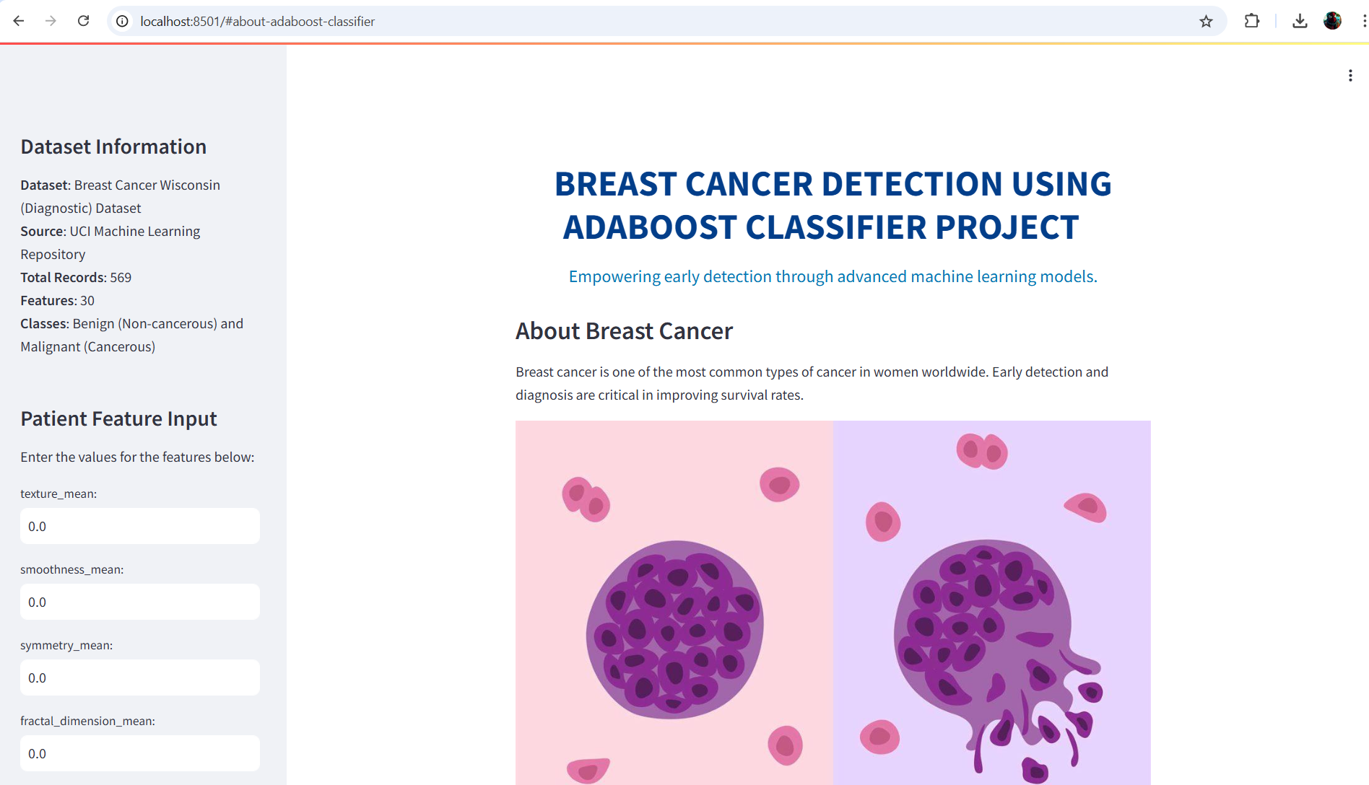
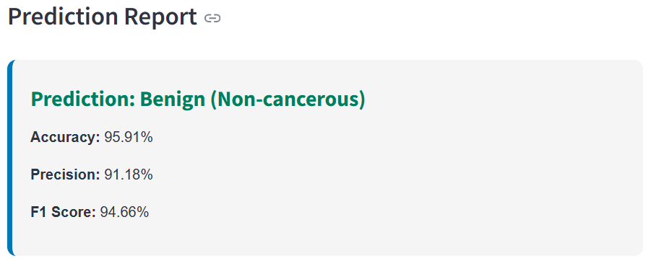
Deploy the Model
We have deployed the best model from all other combination using Streamlit.

Slide 27

Presented by TEAM-4
Sayyad Nizar M
Bala Sairam Goli
Jayam V
A V K Sai Surya
Shaik Moinuddin Chisty

