Slide 1
Waste Management System Salma Nazaralieva COMFCI-25

Slide 2
Project Overview
This project is a console-based Waste Management System.
It allows users to manage waste records including date, type, and amount.

Slide 3
Features
Функции программы
Add new waste record
View all records
Save data to file
Load data from file
“Используются методы saveToFile и loadFromFile”

Slide 4
Structure (ООП)
Структура программы
WasteManager — manages records and file operations
Record — stores data (id, date, type, amount)

Slide 5
Code Example
Пример работы с данными\
String[] parts = line.split(",");
int id = Integer.parseInt(parts[0]);
double amount = Double.parseDouble(parts[3]);
“Здесь данные читаются из файла и преобразуются”

Slide 6
Conclusion
The project demonstrates basic Java concepts such as OOP, file handling, and data processing.

Slide 7
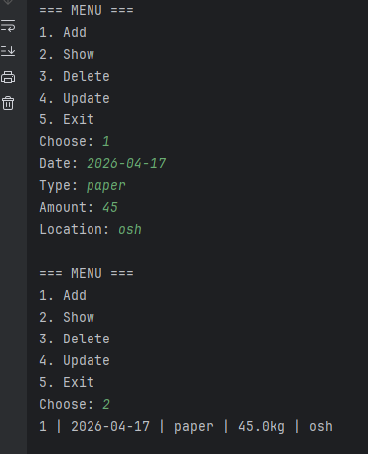
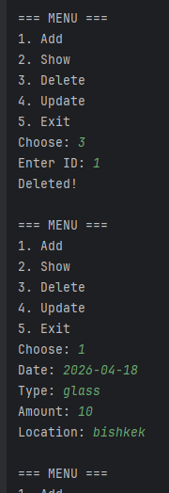
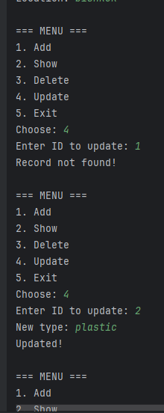
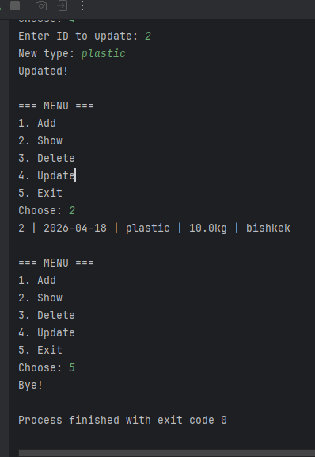

Slide 8
