Slide 1

Capacity Building on e-GOV Services
Electronic Payment and Collection Facility (EPCF)
HARLAN D. VILLANUEVA
Sept. 08, 2016

Slide 2




Objectives
Faster transactions;
Payment anytime (24/7), anywhere;
Accurate recording; and
Saves time and transportation costs

Slide 3
Objectives
Pursue commitments of the Philippine government on the reforms initiated by the Ease of Doing Business-Task Force, an inter-agency team created by Pres. Benigno S. Aquino III under Administrative Order No. 38
To provide better service to members/member-employers
through the following:
  Expansion of the local and overseas collection channels of the Fund
  Broaden network and support the e-collection and disbursement platforms
  Provision to members/employers the convenience of e-banking
Notes:
These are the two (2) governing laws that supports the mandate of Pag-IBIG Electronic Payment and Collection Facility (EPCF).

Slide 4
Legal Basis
Republic Act No. 8792
(E-Commerce Act of 2000)
Mandating all GOCCs to provide a method and manner of acceptance of payment or settlement of fees thru systems using electronic data messages systems
Administrative Order No. 38
(May 17, 2013)
Creating an Inter-agency Task Force to initiate, implement,
and monitor ease of doing business reforms
Notes:
These are the two (2) governing laws that supports the mandate of Pag-IBIG Electronic Payment and Collection Facility (EPCF).

Slide 5
Legal Basis
Pag-IBIG Circular No. 355
(July 1, 2015)
Mandating all employers from the government and private sectors to remit their employees’ membership savings (contributions) and loan amortization through Pag-IBIG’s partner-banks via an Electronic Payment and Collection Facility (EPCF) platform.
Notes:
With those 2 laws, Pag-IBIG issued this Circular No. 355.

Slide 6





















_{Payment Channels}
Partner-Banks
Notes:
As of now, these are the Pag-IBIG partner-banks such as Unionbank, BPI, Security Bank, Bank Members of BancNet such as China Bank, Asian United Bank, DBP, CBC Bank, East West Bank, CTBC; and Landbank.

Slide 7
Accredited Banks Required ADB
BANK | ADB (Php) | FACILITY
UBP | 35,000.00 | One Hub
BPI | 10,000.00 | Express Link
LBP | 500.00 | wePayAccess / weAccess
SBC | 50,000.00 | Digibanker
BancNet: |  | eGOV
AUB | 25,000.00
China Bank | 0.00
CitiBank | 0.00
CTBC | 25,000.00
DBP | 0.00
East West Bank | 50,000.00
MBTC | 10,000.00
PNB | 0.00
RCBC | 50,000.00
Standard Chartered Bank | 100,000.00
Philtrust Bank | 2,000.00
PBCom | 10,000.00
Bank of Tokyo | 100,000.00
Bank of Commerce | 25,000.00
Notes:
These are the Required Average Daily Balance (ADB) of Pag-IBIG partner-banks.

Slide 8
ELECTRONIC PAYMENT AND
COLLECTION FACILITY (EPCF)
Process Flow

Slide 9
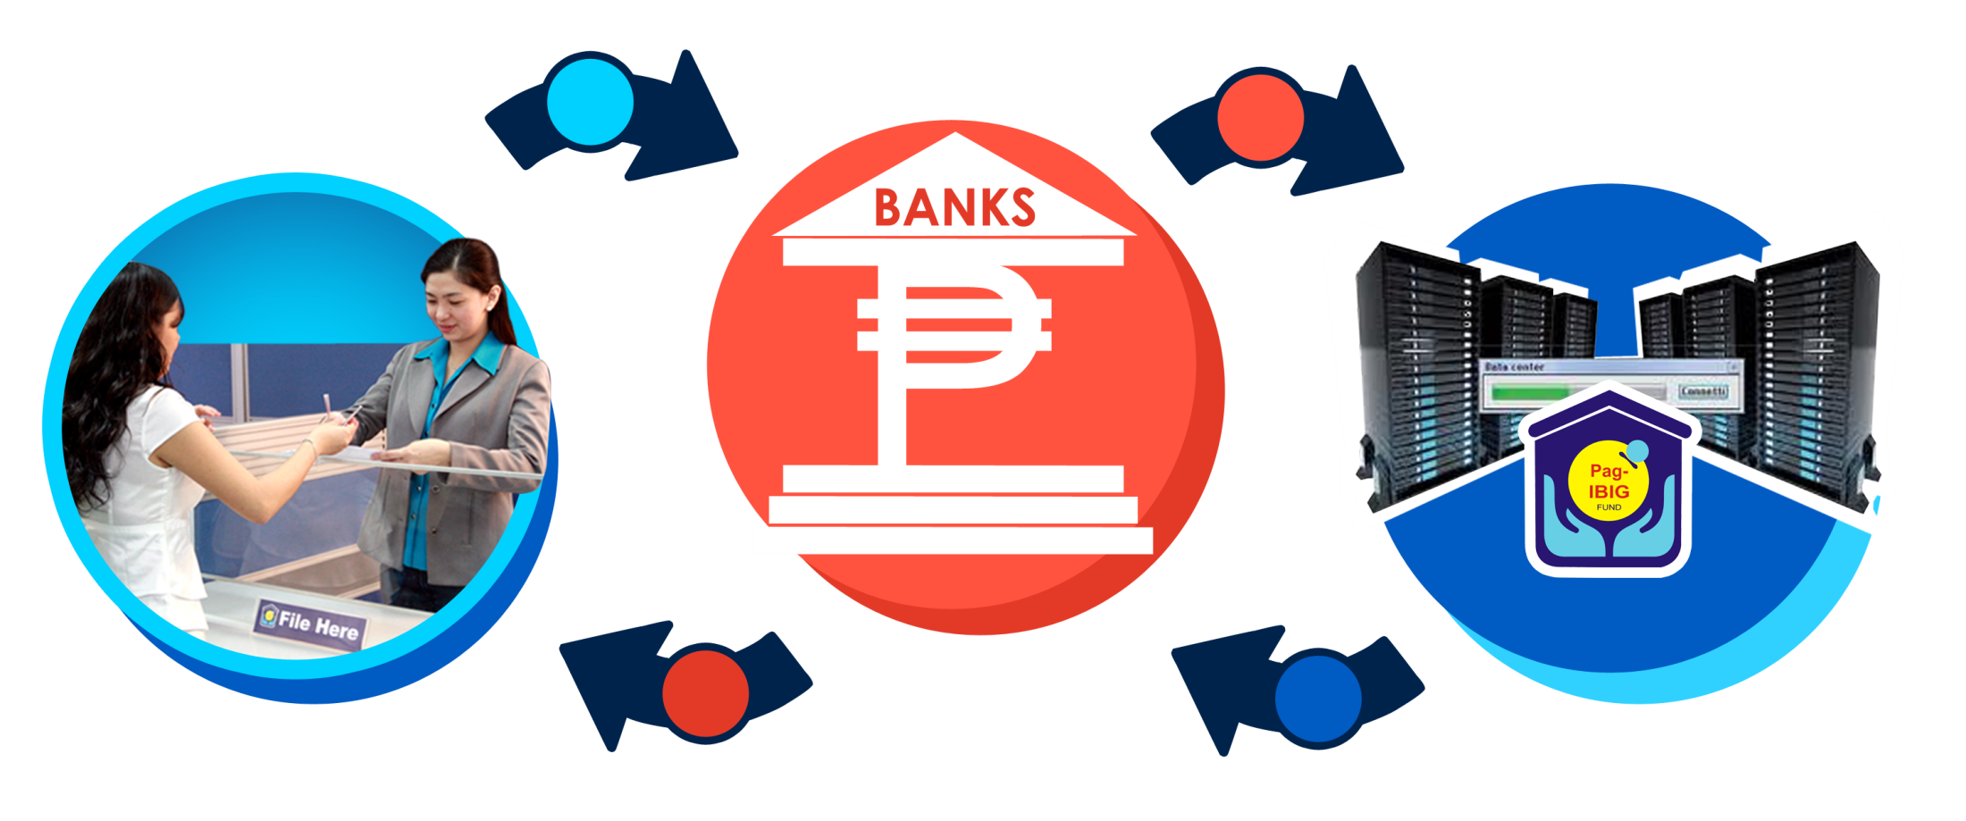
Employer Enrollment
1
2
4
3
For Employer with ERID, sends duly accomplished Enrollment Form to the partner-bank (NOTE: If without ERID, the employer shall register first with the nearest Pag-IBIG branch)
Partner-Bank Administrator enrolls employer to Pag-IBIG Hub (UBP), BPI ExpressLink, LBP wePayAccess, SBC’s DigiBanker or Pag-IBIG Net (BancNet’s participating banks) and sends to Pag-IBIG Fund for validation.
Upon verification, Pag-IBIG Fund sends confirmation of employer enrollment to the partner-banks.
Partner-Bank sends User IDs and Passwords to newly enrolled employer.
Notes:
With complete documentation on or before 3rd day confirmation of enrollment, banks will send username and password; incomplete documentation will received message from the bank

Slide 10

e-Filing of Remittance
1
2
Registered Processor (Maker) of Employers log-in to the Bank’s government portal (UBP’s One Hub.gov / BPI ExpressLink / LBP wePayAccess/SBCs DigiBanker/BancNet)
1.1 Select the Pag-IBIG tab
  1.2 Upload MS (Membership Savings) and STL (Short Term Loan) Amortization files
  1.3 Bank validates files
2. Bank system sends auto-eMail notifications to Registered Authorizer/Approver of Employers for each successful upload.
Notes:
Can be done a month, week, three days before actual due date. On the day itself, yes however tight.

Slide 11

e-Payment Process
1
2
4
3
1. Registered Authorizer of Employers log-in to the Bank’s government portal (UBP’s One Hub.gov / BPI ExpressLink / LBP wePayAccess / SBC’s DigiBanker/BancNet)
  1.1 Select the Pag-IBIG tab
  1.2 Approve Payment for MS (Membership Savings) and STL (Short Term Loans) Amortization
  1.3 Bank debits employer’s bank account and credits Pag-IBIG Fund account
2. Registered Authorizer of Employer retrieves e-Receipt from the bank’s system
3. MS/STL files together with the Collection Reports are sent to Pag-IBIG Fund via Secured File Transfer Protocol (SFTP)
4. Pag-IBIG Fund posts payments for MS/STL via upload to the system; and
sends; Acknowledgment to the Bank

Slide 12
Thank you
Notes:
That’s it. As we continue to use the facility, we will discover that this is indeed a Fast, Accessible, Convenient, and Efficient way of remitting the Membership Savings (MS) and paying the Short Term Loan (STL) amortization. Thank you.

Slide 13
Strategic Plan to Promote EPCF
Collaterals (July 2015 Onwards)
  Publication of Circular #355
  Posters/Flyers/Brochures
  Q & A
Nationwide Awareness Campaign
  Briefing and Training Session (October 2015)
  Employers Forum thru FCC (November 2015-January 2016)
  Meeting with the World Bank (WB) IFC
Letter to Partner Banks (compliance to MID)
Letter to employers
Press Conference
Notes:
The payments status, which is considered also the Bank Receipt can be viewed and printed, for reference by the employer.

Slide 14

Walkthrough on
Filing of Remittance
Notes:
To give you a glimpse of the system for filing of remittance, we will present to you a Walkthrough on Filing of Remittance. This will be done by the Employer assigned Maker.

Slide 15
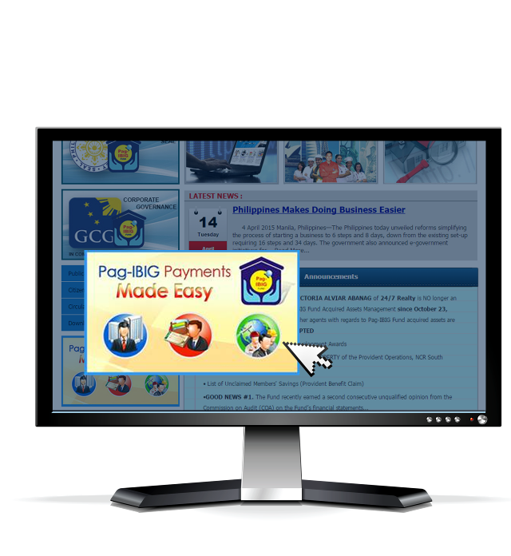
Visit the Pag-IBIG Fund website
Open the Pag-IBIG website
by typing www.pagibigfund.gov.ph in the URL, then CLICK
Pag-IBIG Payment
Made Easy
Notes:
Here you will access the Pag-IBIG Fund website, by typing www.pagibigfund.gov.ph. Then click Pag-IBIG Payment Made Easy.

Slide 16
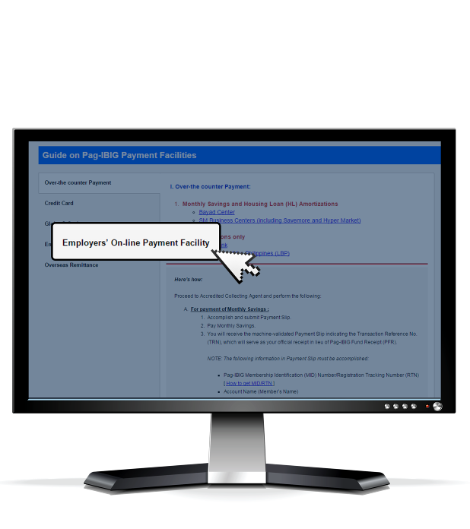
Click Employer’s On-Line Payment Facility

Slide 17
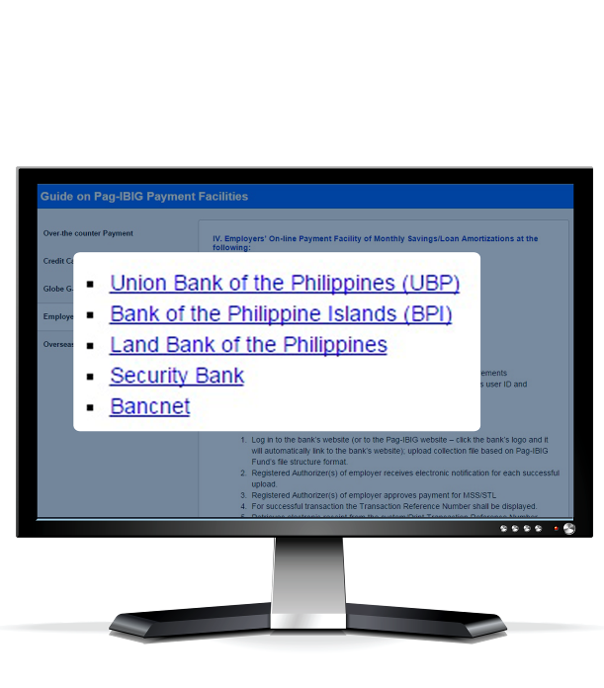
Click the Partner-Bank
of your choice

Slide 18
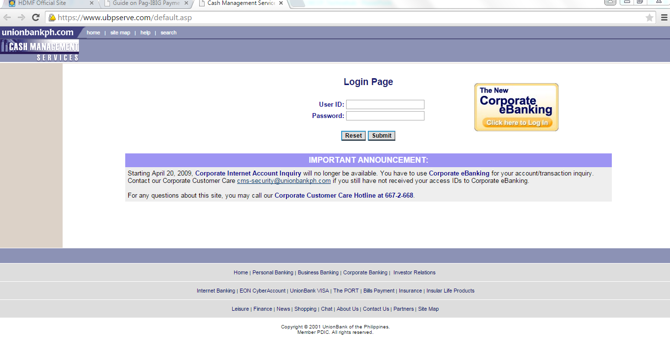
Union Bank of the Philippines
Notes:
If you choose, Union Bank, this is the sample system you will access to. Key in the User ID and password provided you as the maker. The User ID is the same for the Approver.

Slide 19
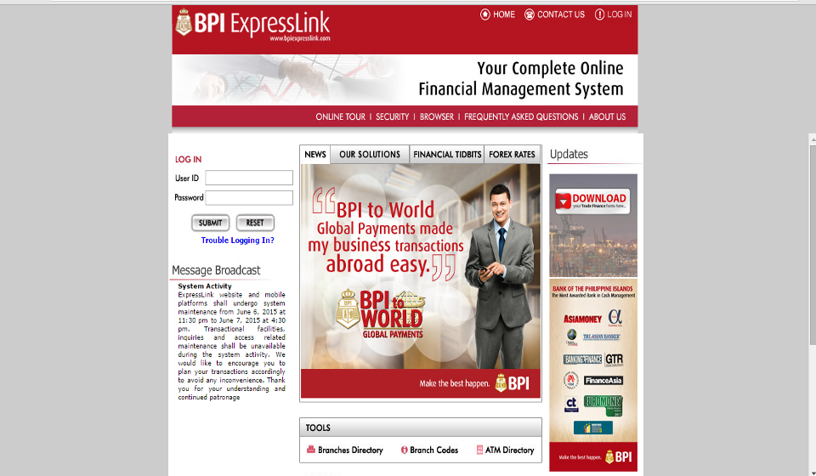
Bank of the Philippine Islands
Notes:
This is the sample of BPI ebanking site

Slide 20
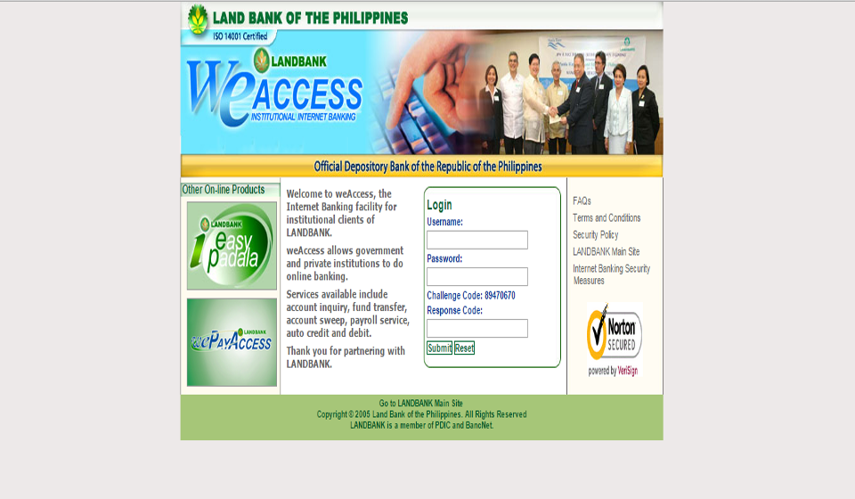
Land Bank of the Philippines
Notes:
Another one, here’s for the LBP ebanking site

Slide 21
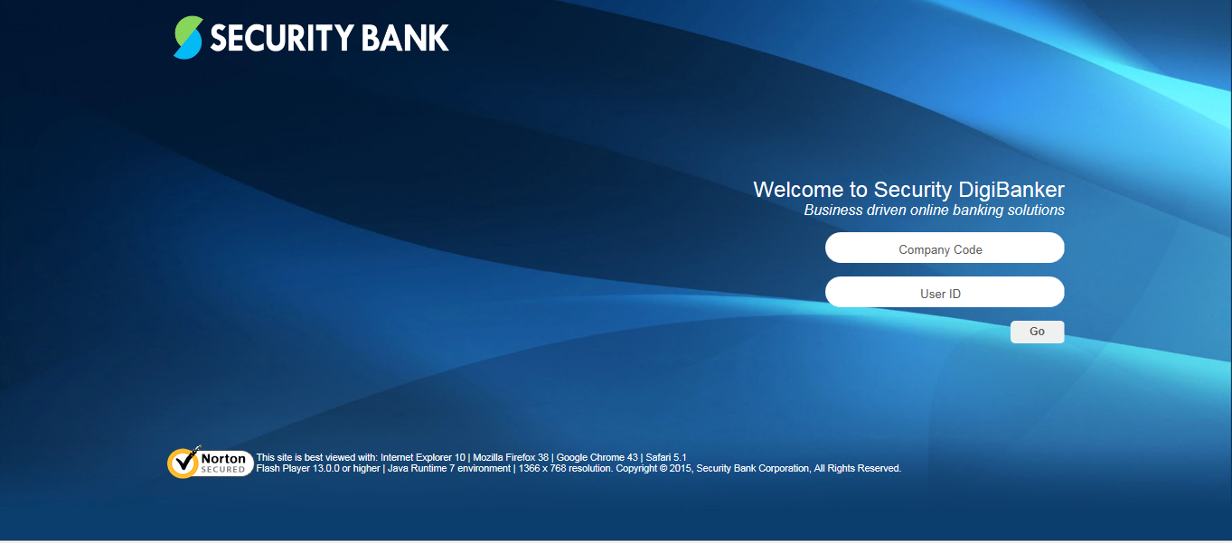
Security Bank
Notes:
Also, sample of Security Bank ebanking site

Slide 22
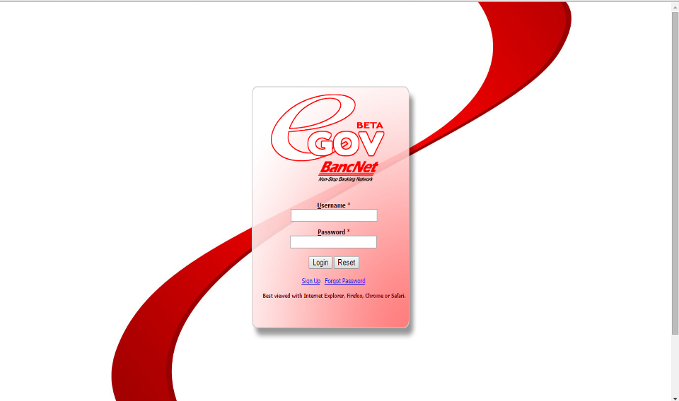
BancNet
Notes:
Lastly, sample of BancNet ebanking site

Slide 23
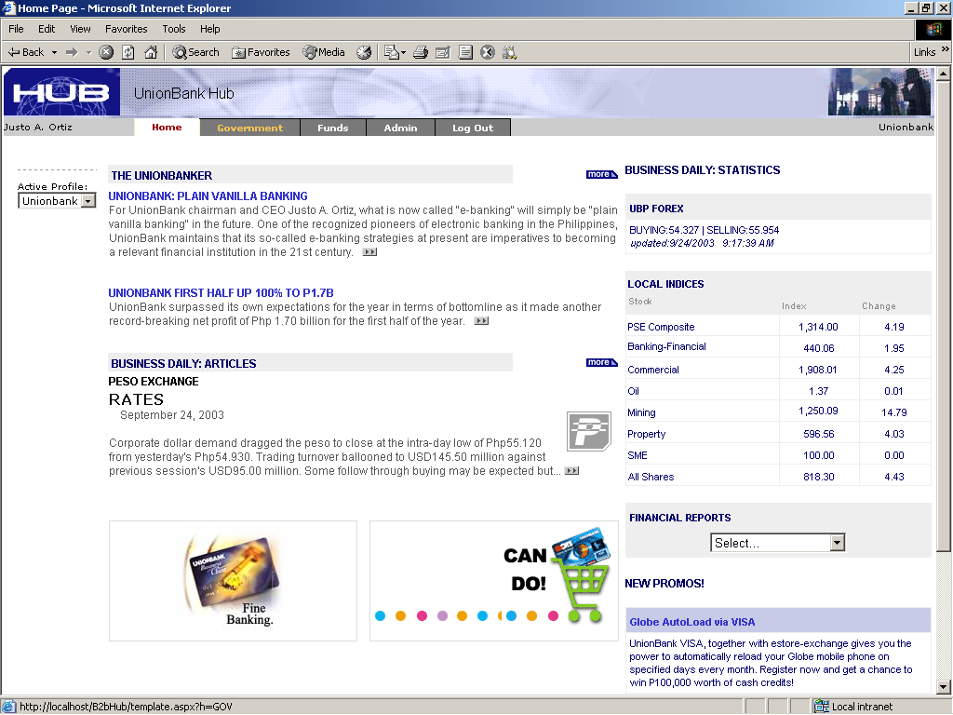
Select the “Government” tab
Notes:
To continue with the Walkthrough, we will assume the an employer has enrolled in Union Bank Hub, select the government tab for Pag-IBIG payments.

Slide 24
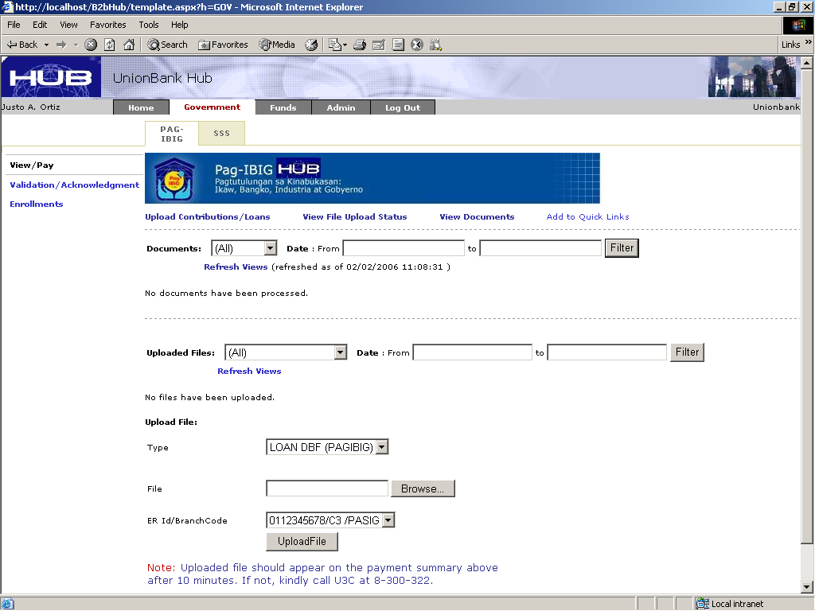
Select the “Pag-IBIG” tab
Notes:
Then, click Pag-IBIG tab.

Slide 25
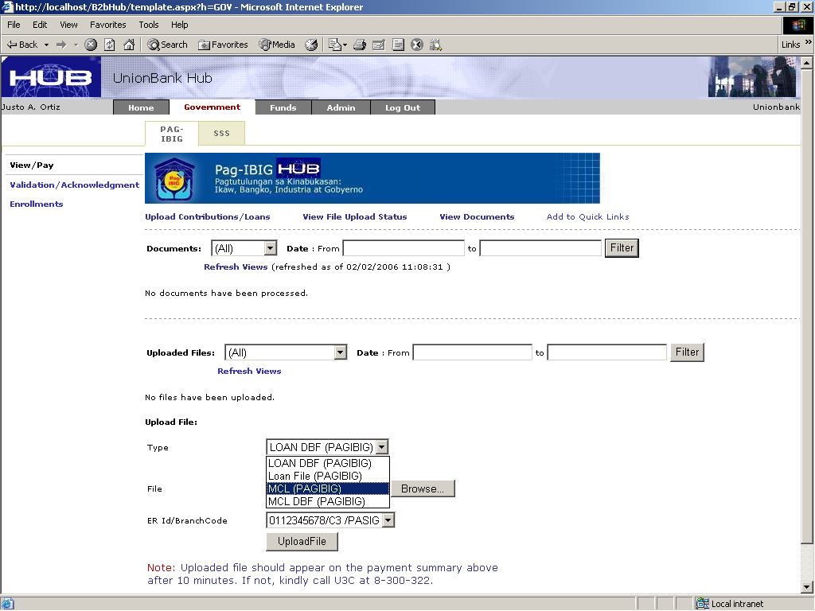
Choose the type of file to be uploaded
Choose the TYPE of file to be uploaded
Notes:
Choose the type of file to select, example Loan (for STL amaortization) or MCL for membership savings file.

Slide 26
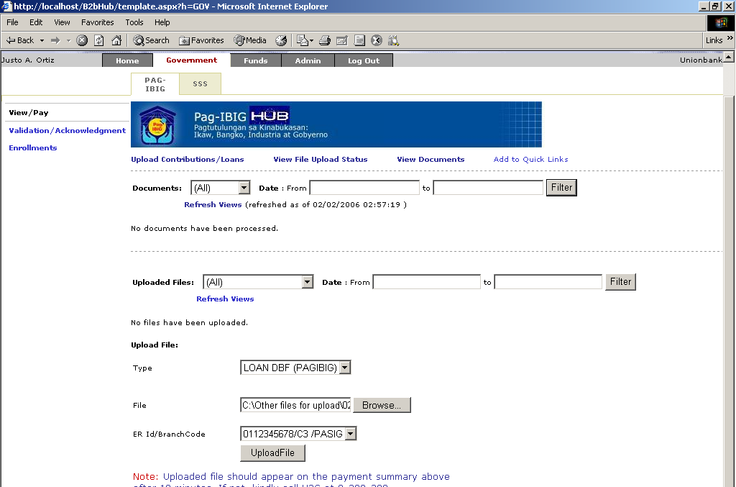
Uploading of file
Choose the file to be uploaded, key in ERID, and click “Upload File”
Notes:
Browse on the file to be uploaded, key in the ERID/Branch Code then click “Upload File”. Take Note: Uploaded file should appear on the payment summary above after 10 mins. If not, you need to call the partner bank’s contact. We will provide you with the List of SPOC in your Info Kit for your guidance/or email you with the file.

Slide 27

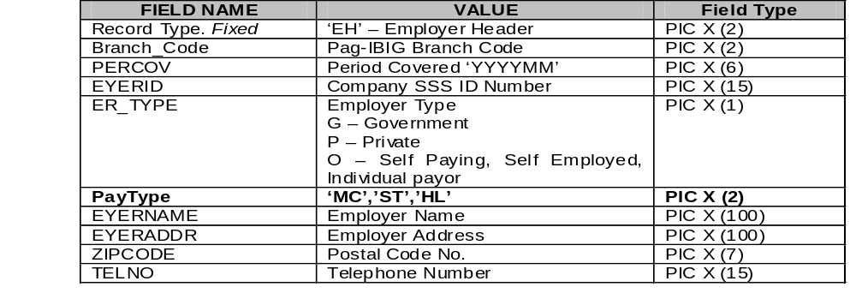
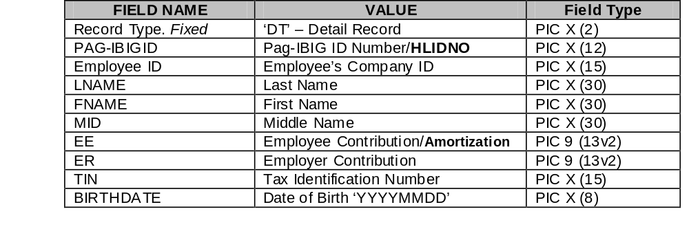
FILE STRUCTURE (EMPLOYERS)
Notes:
You need herein Pag-IBIG file structure for your collection file to upload.

Slide 28
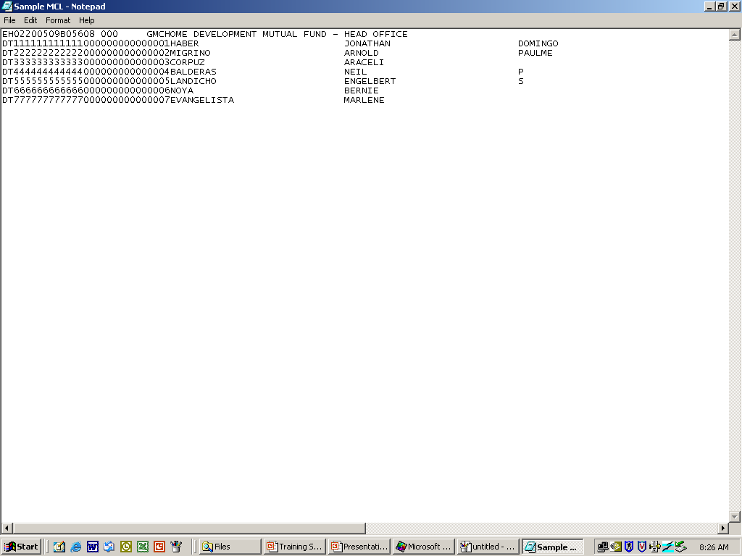
Sample Text of File to upload
MCL FILE
SAMPLE TEXT FILE (EMPLOYERS)
Notes:
This is the sample text of the file you need to upload.

Slide 29
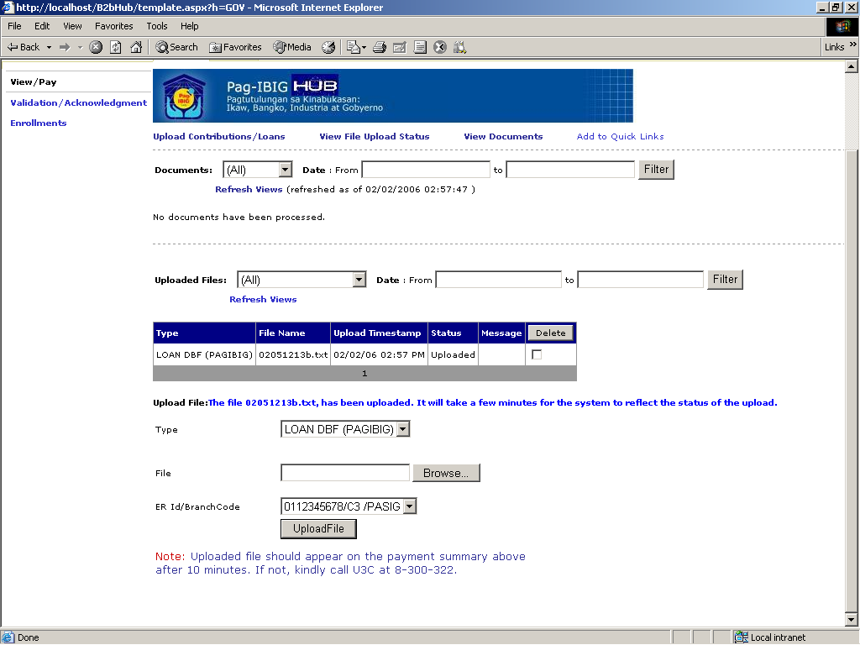
File successfully uploaded
File SUCCESFULLY uploaded
Notes:
Upon successful uploading your will view this. Notice Status Column with notation as “Uploaded”.

Slide 30
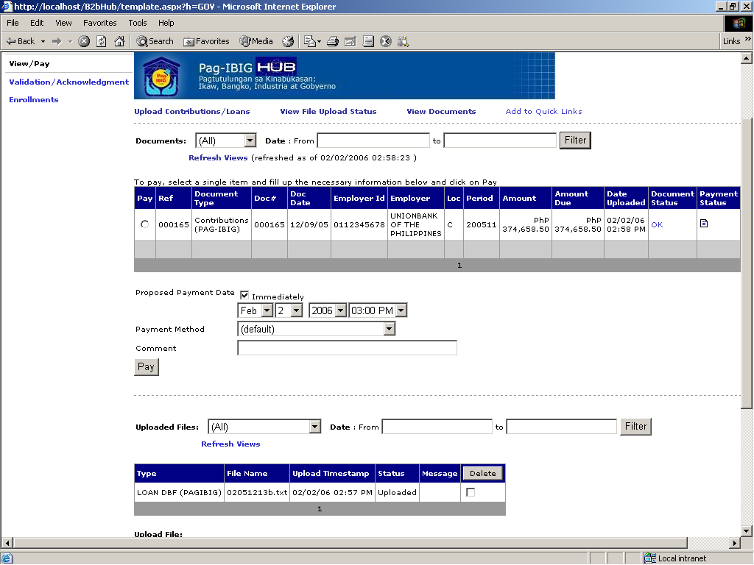
View payments, date, and time
for approval
View payments for approval
Select desired DATE & TIME
Notes:
Review detail of information when you view payments for approval. Key in also the desired date and time for payment.

Slide 31
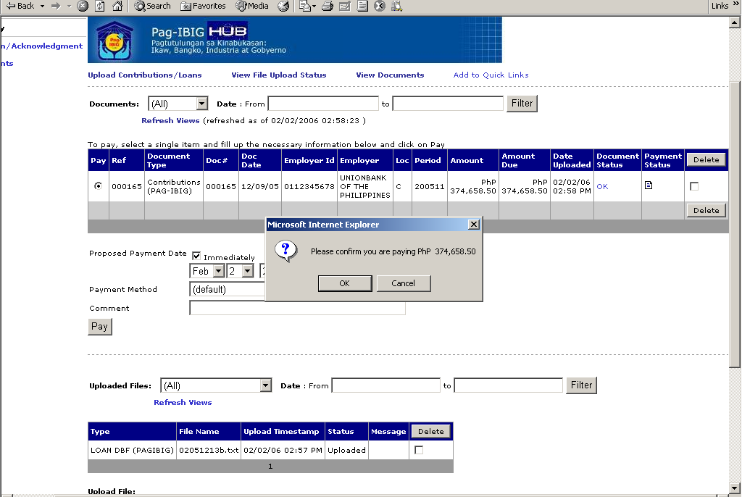
Confirm details of Payment
Notes:
Confirm if you agree with the details viewed, or cancel to edit details.

Slide 32
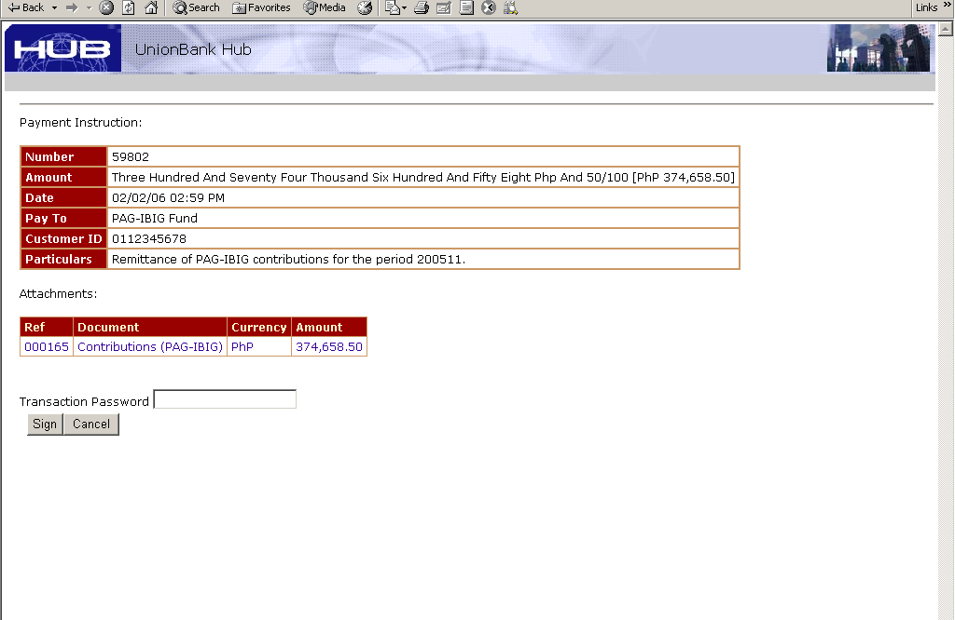
Key in Maker password
Key in Maker password
Notes:
To continue, key in the processor (this is the Maker referred to) password.

Slide 33

Click sign to confirm payment
Notes:
Then click “Sign” to continue.

Slide 34
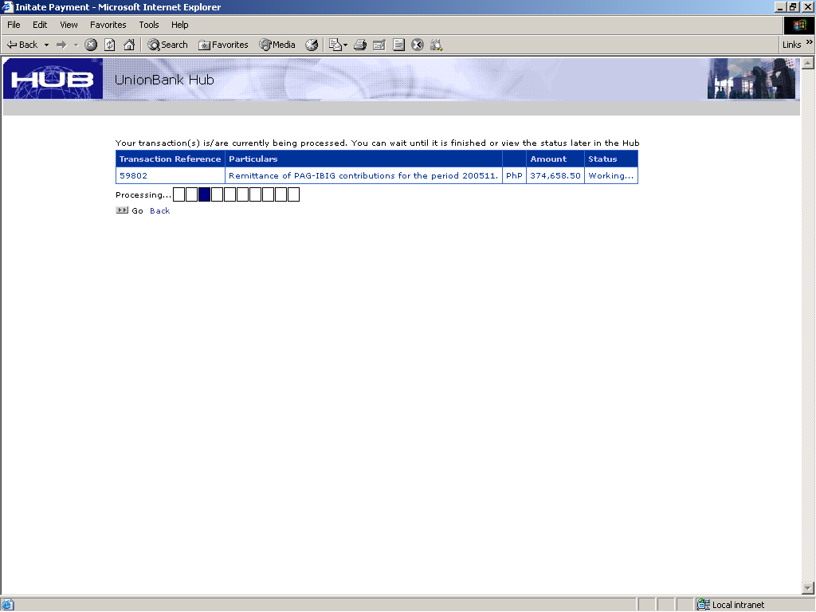
Shows transaction being processed
Notes:
You will be able to view this screen, which means that your transaction is being processed.

Slide 35
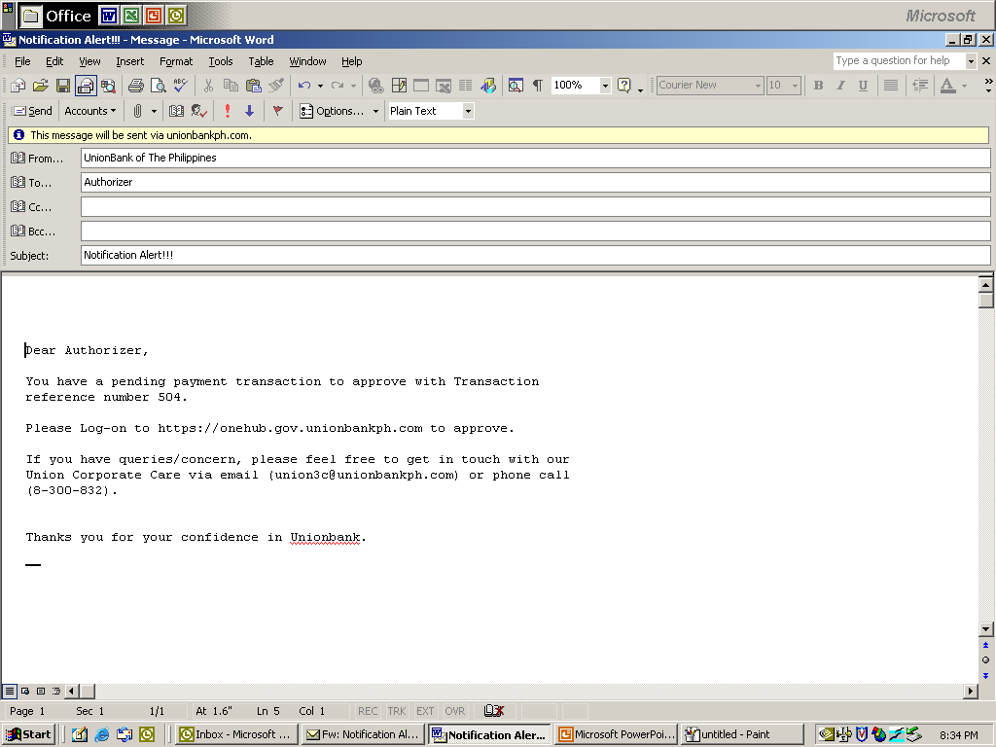
Direct to Authorizer Auto Email Reminder to ePay
Notes:
The maker will be able to receive this auto email reminder on pending payment transaction to remind also the Approver of payments to approve.

Slide 36
Walkthrough on
Approval of Payments
Notes:
Now, we will show you a Walkthrough on the Approval of Payments. This is the assignment of the Approver.

Slide 37
Visit the Pag-IBIG Fund website
Open the Pag-IBIG website
by typing www.pagibigfund.gov.ph in the URL, then CLICK
Pag-IBIG Payment
Made Easy
Notes:
In the same way, the Approver will start accessing the Pag-IBIG website

Slide 38
Click Employer’s On-Line Payment Facility
Notes:
Click on Employer’s On-line Payment Facility

Slide 39
Click the Partner-Bank
of your choice
Notes:
Select the partner-bank where the employer has enrolled.

Slide 40
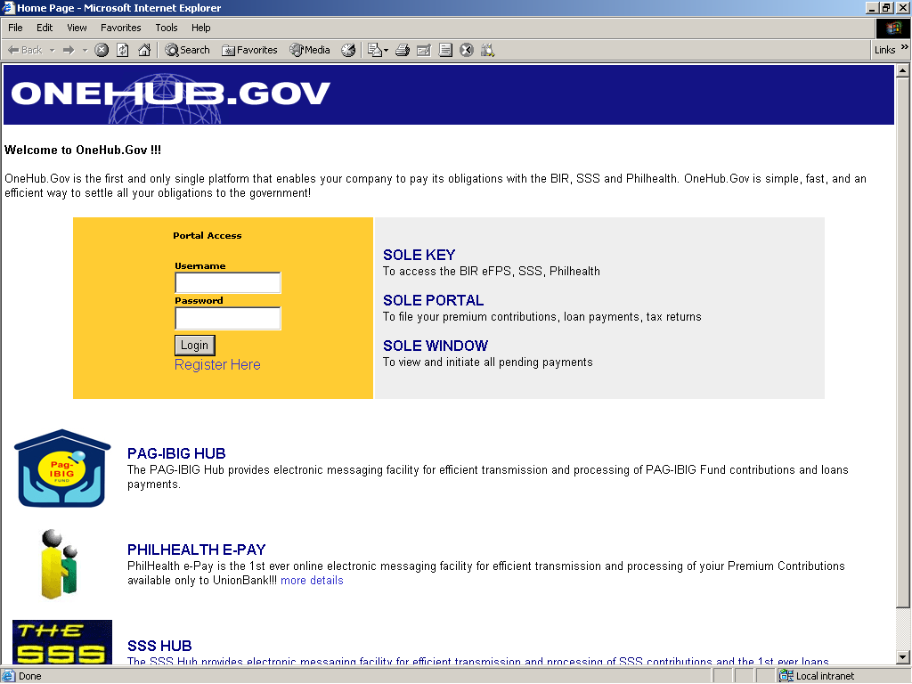
Log on to
https://onehub.gov.unionbankph.com
Notes:
Again, we will continue to use the Union Bank site as example. Of course, you will key in the User ID and approver password to continue.

Slide 41
Select the “Government” tab
Notes:
Click the “government” tab.

Slide 42
Select the “Pag-IBIG” tab
Notes:
Select “Pag-IBIG” tab.

Slide 43
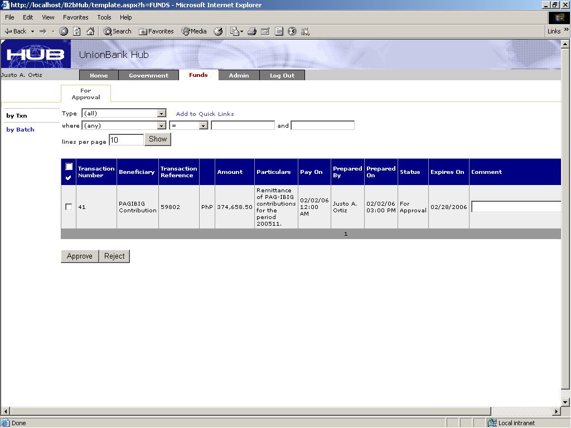
Select the “Funds” Tab to view payment to be made
Select the “Funds” tab
Notes:
Select the “Fund’s” to view payments to be made.

Slide 44

View all payments to be approved
Notes:
Here is the sample screen to view all payments to be approved by the approver. The Type of transaction, amount to be paid, covering month, and date when to pay is listed in the screen.

Slide 45
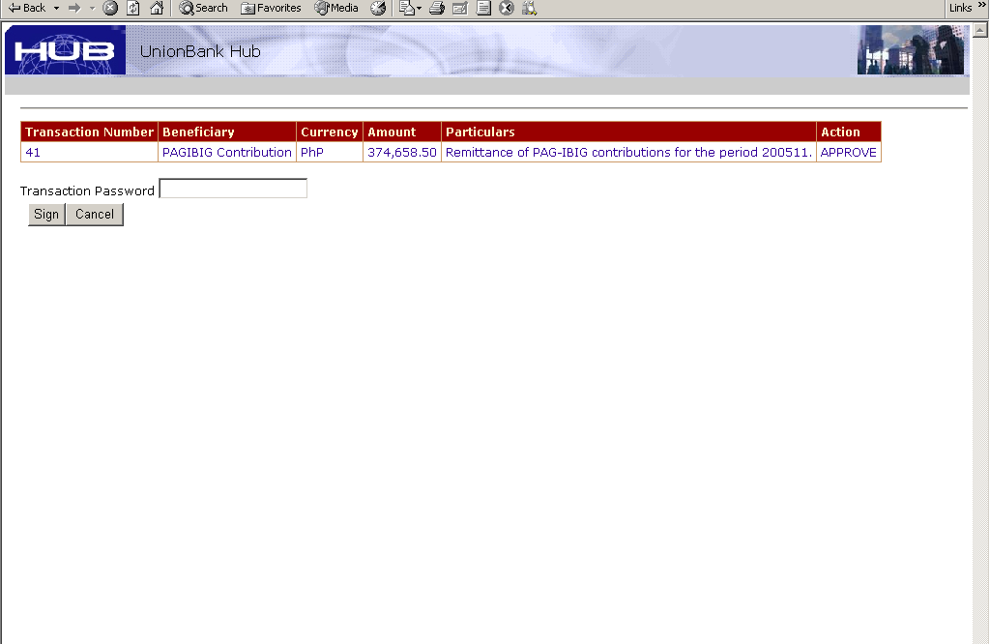
Key in Approver password
Key in APPROVER password
Notes:
Again the approver will key in his password as shown in the arrow.

Slide 46

Click sign to confirm payment
Notes:
The approver then click “Sign” tab.

Slide 47
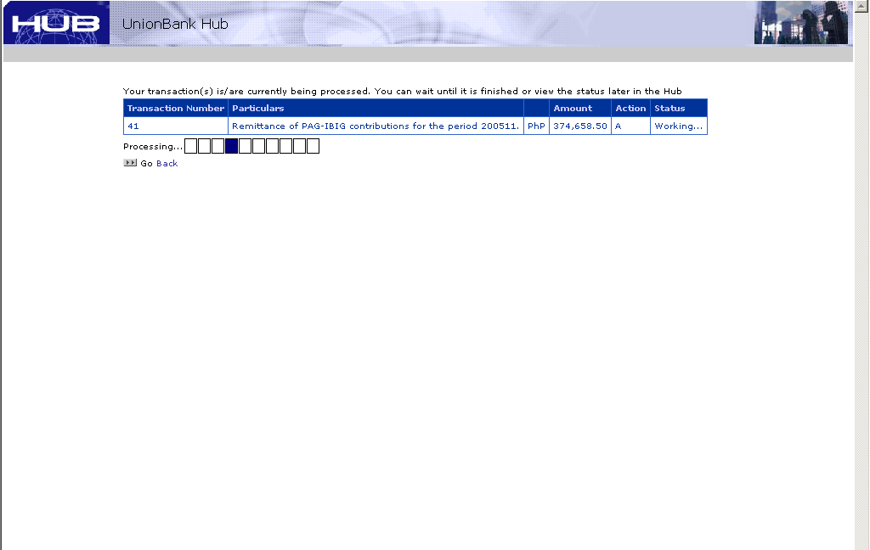
Shows transaction being processed
Notes:
This next screen will now show that the transaction is being processed.

Slide 48
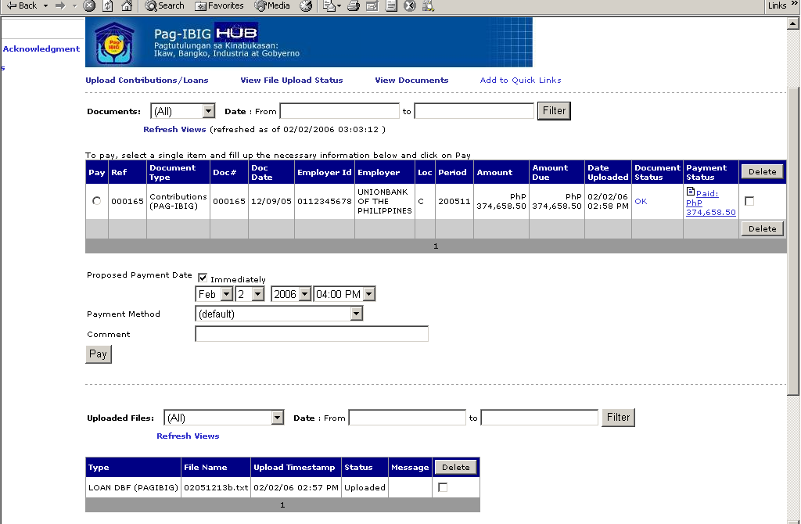
Successful Payment
SUCCESSFUL payment.
Notes:
Finally, you will notice in the Payment Status Column confirmation of payment as “Paid and the amount”.

Slide 49
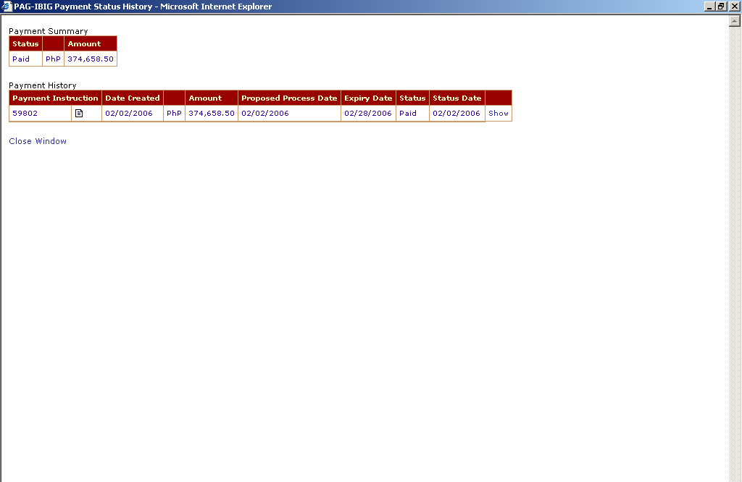
View Payment approved
Notes:
Click on show to view payment made.

Slide 50
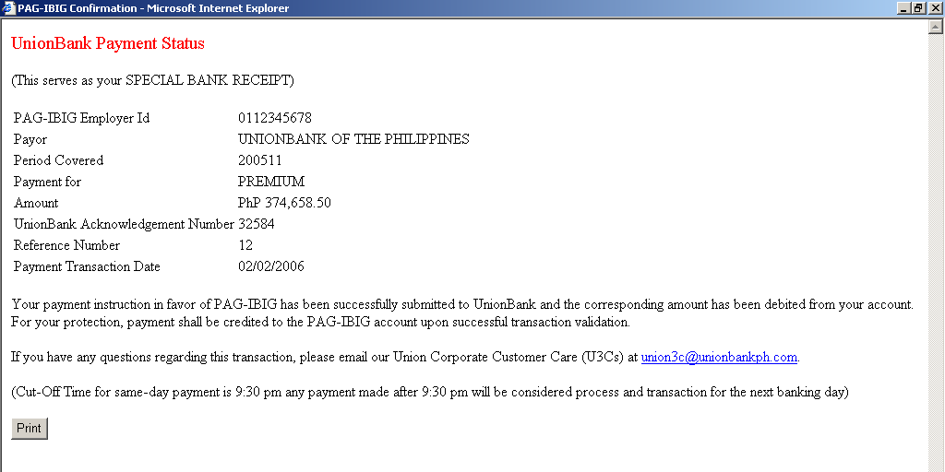
Payment Status (Bank Receipt)
Notes:
The payments status, which is considered also the Bank Receipt can be viewed and printed, for reference by the employer.

Slide 51
Thank you
Notes:
That’s it. As we continue to use the facility, we will discover that this is indeed a Fast, Accessible, Convenient, and Efficient way of remitting the Membership Savings (MS) and paying the Short Term Loan (STL) amortization. Thank you.

