Slide 1


Software Project Lab-1
Project Name: Chat Server
Presented By: Supervised By
Sazidur Rahman Mahin Dr. Zerina Begum
Roll: 1414 Professor
Session: 2021-2022 IIT,University Of Dhaka

Slide 2
Table of Contents
Project Motivation
Introduction Of AES(Advance Encryption Algorithm)
Internal Structure of AES Algorithm
Socket Programming
One to One Chatting
One to Everyone Chatting
One To Specific chatting

Slide 3
Motivation
Group Chatting
Simplified Communication
Secure Chatting

Slide 4



AES Block Diagram
Plaintext (128 bits)
AES
Key (128-256 bits)
Ciphertext (128 bits)

Slide 5
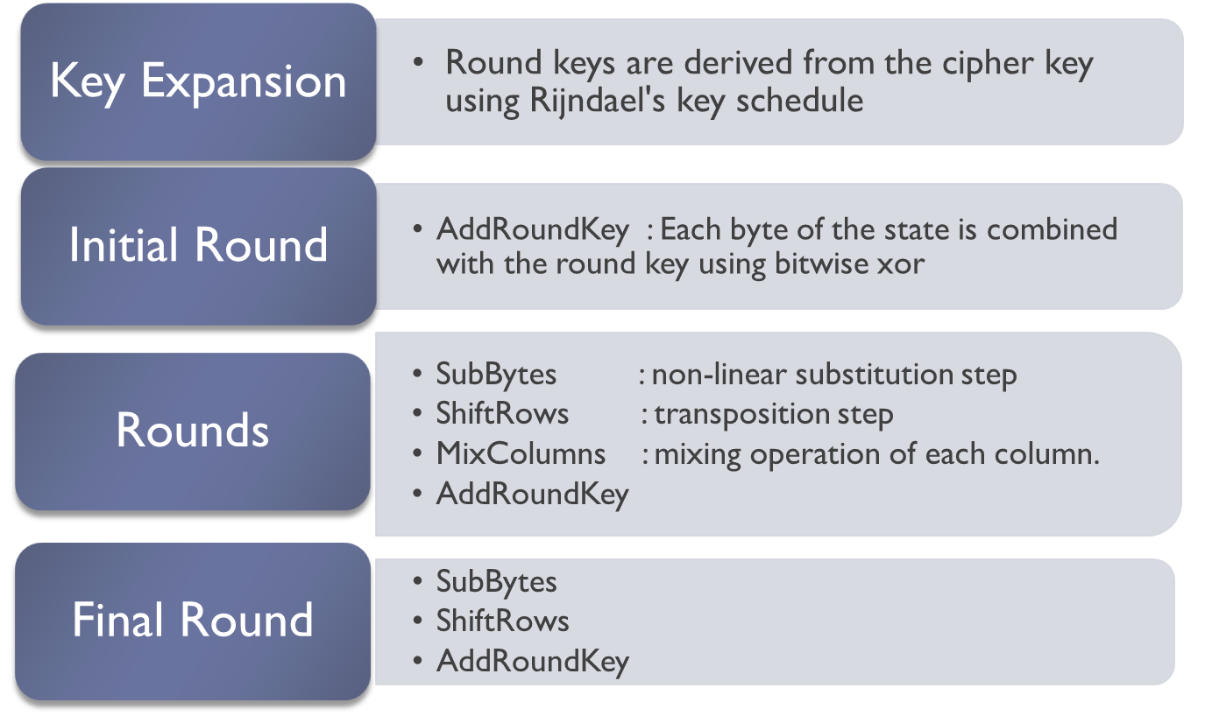
Basic Operation Of AES Algorithm
No MixColumns
Notes:
The input to the AES encryption and decryption algorithms is a single 128-bit block, depicted in FIPS PUB 197, as a square matrix of bytes .This block is copied into the State array, which is modified at each stage of encryption or decryption. After the final stage, State is copied to an output.
The key is expanded into 44/52/60 lots of 32-bit words (see later), with 4 used in each round.
The data computation then consists of an “add round key” step, then 9/11/13 rounds with all 4 steps, and a final 10th/12th/14th step of byte subs + mix cols + add round key. This can be viewed as alternating XOR key & scramble data bytes operations. All of the steps are easily reversed, and can be efficiently implemented using XOR’s & table lookups.

Slide 6
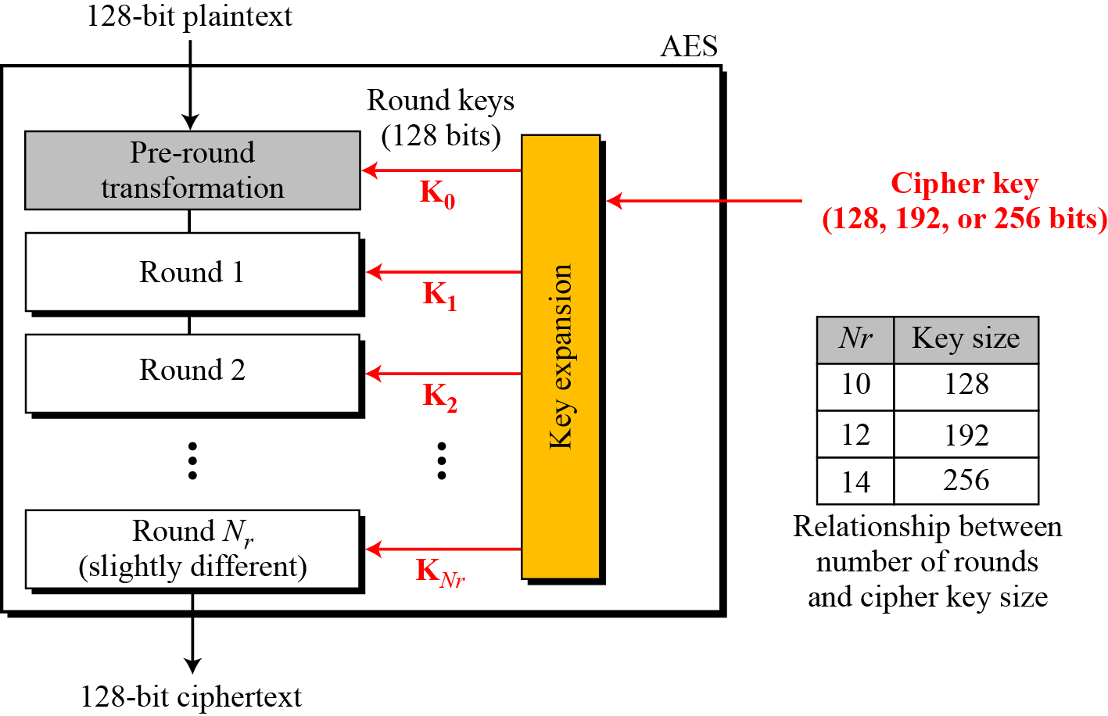
Types of AES Based On Number of Rounds
Notes:
The input to the AES encryption and decryption algorithms is a single 128-bit block, depicted in FIPS PUB 197, as a square matrix of bytes .This block is copied into the State array, which is modified at each stage of encryption or decryption. After the final stage, State is copied to an output.
The key is expanded into 44/52/60 lots of 32-bit words (see later), with 4 used in each round.
The data computation then consists of an “add round key” step, then 9/11/13 rounds with all 4 steps, and a final 10th/12th/14th step of byte subs + mix cols + add round key. This can be viewed as alternating XOR key & scramble data bytes operations. All of the steps are easily reversed, and can be efficiently implemented using XOR’s & table lookups.

Slide 7
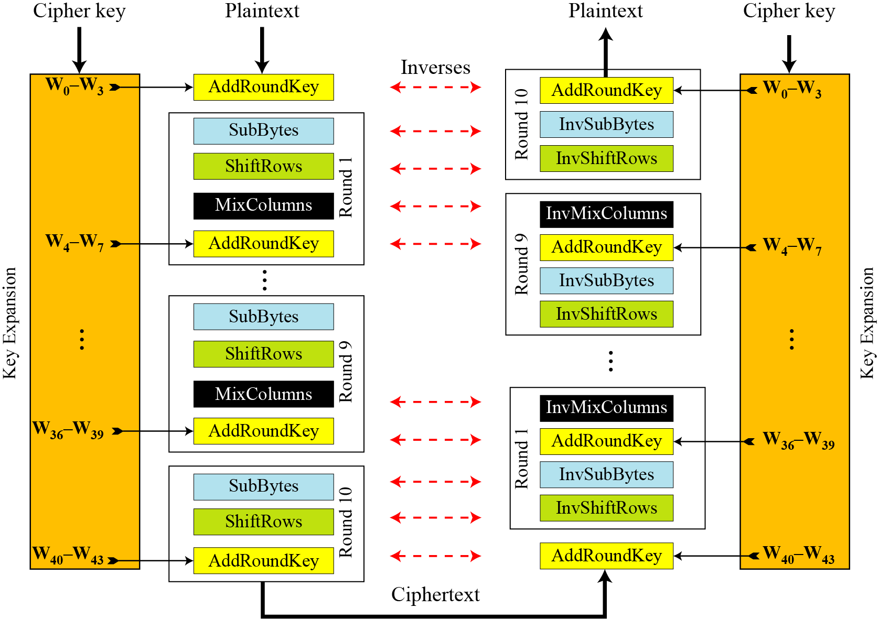
Over veiw AES Encryption AND Decryption
Notes:
Stallings Figure 5.1 shows the overall structure of AES, as detailed on the previous slide.

Slide 8
Array Representation of Message
Data block viewed as 4-by-4 table of bytes
Represented as 4 by 4 matrix of 8-bit bytes.
Key is expanded to array of 32 bits words
1 byte

Slide 9
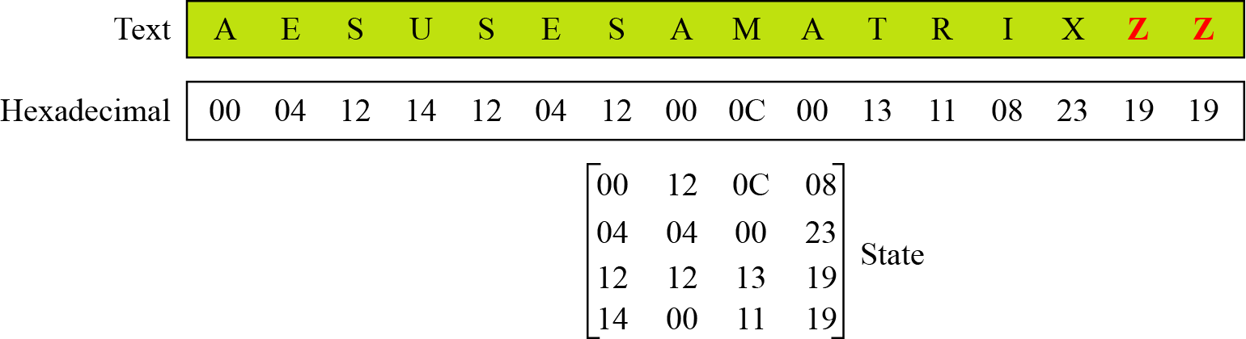
Changing Plaintext to State

Slide 10
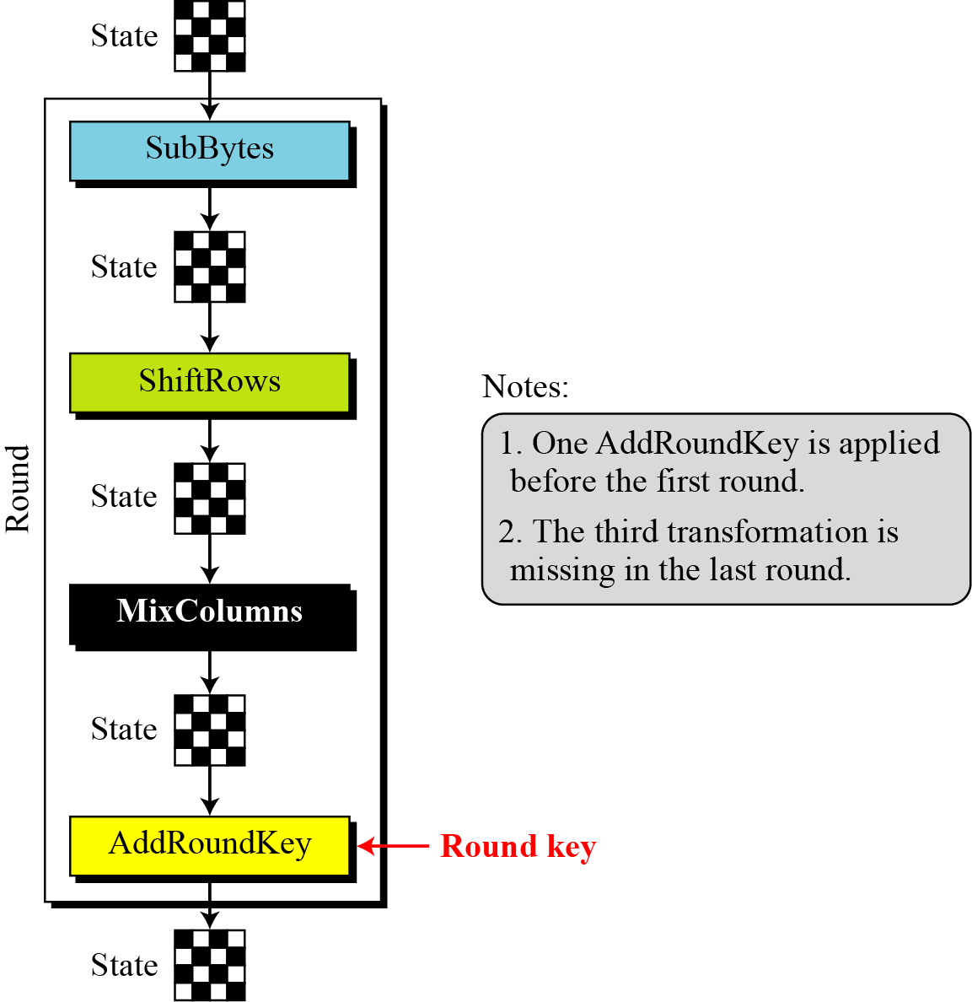
Each Round Of AES

Slide 11
SubBytes: Byte Substitution
A simple substitution of each byte
  provide a confusion
Uses one S-box of 16x16 bytes containing a permutation of all 256 8-bit values
Each byte of state is replaced by byte indexed by row (left 4-bits) & column (right 4-bits)
  eg. byte {95} is replaced by byte in row 9 column 5
  which has value {2A}
S-box constructed using defined transformation of values in Galois Field- GF(2⁸)
Notes:
Now discuss each of the four stages used in AES. The Substitute bytes stage uses an S-box to perform a byte-by-byte substitution of the block. There is a single 8-bit wide S-box used on every byte. This S-box is a permutation of all 256 8-bit values, constructed using a transformation which treats the values as polynomials in GF(2⁸) – however it is fixed, so really only need to know the table when implementing. Decryption requires the inverse of the table. These tables are given in Stallings Table 4.5.
The table was designed to be resistant to known cryptanalytic attacks. Specifically, the Rijndael developers sought a design that has a low correlation between input bits and output bits, with the property that the output cannot be described as a simple mathematical function of the input, with no fixed points and no “opposite fixed points”.

Slide 12
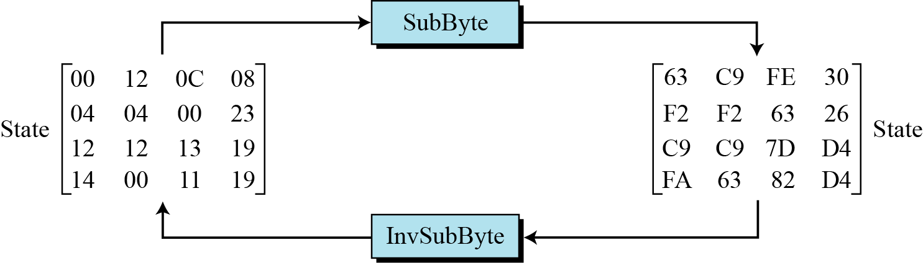
Sample SubByte Transformation
The SubBytes and InvSubBytes transformations are inverses of each other.

Slide 13
ShiftRows Operation
Shifting, which permutes the bytes.
A circular byte shift in each each
  1st row is unchanged
  2nd row does 1 byte circular shift to left
  3rd row does 2 byte circular shift to left
  4th row does 3 byte circular shift to left
In the encryption, the transformation is called ShiftRows
In the decryption, the transformation is called InvShiftRows and the shifting is to the right
Notes:
The ShiftRows stage provides a simple “permutation” of the data, whereas the other steps involve substitutions. Further, since the state is treated as a block of columns, it is this step which provides for diffusion of values between columns. It performs a circular rotate on each row of 0, 1, 2 & 3 places for respective rows. When decrypting it performs the circular shifts in the opposite direction for each row. This row shift moves an individual byte from one column to another, which is a linear distance of a multiple of 4 bytes, and ensures that the 4 bytes of one column are spread out to four different columns.

Slide 14
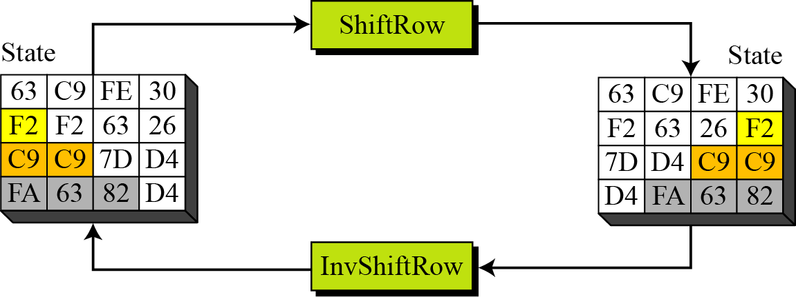
Shift Row and Inverse Shift Row

Slide 15
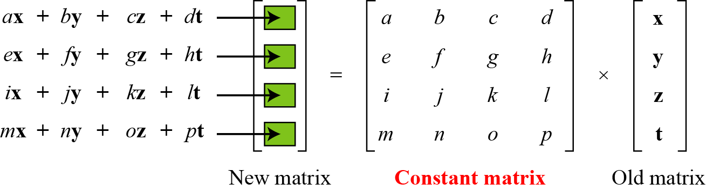
MixColumns
ShiftRows and MixColumns provide diffusion to the cipher
Each column is processed separately
Each byte is replaced by a value dependent on all 4 bytes in the column
Effectively a matrix multiplication in GF(2⁸) using prime poly m(x) =x⁸+x⁴+x³+x+1
Notes:
The MixColumns stage is a substitution that makes use of arithmetic over GF(2^8). Each byte of a column is mapped into a new value that is a function of all four bytes in that column. It is designed as a matrix multiplication where each byte is treated as a polynomial in GF(2⁸). The inverse used for decryption involves a different set of constants.
The constants used are based on a linear code with maximal distance between code words – this gives good mixing of the bytes within each column. Combined with the “shift rows” step provides good avalanche, so that within a few rounds, all output bits depend on all input bits.

Slide 16
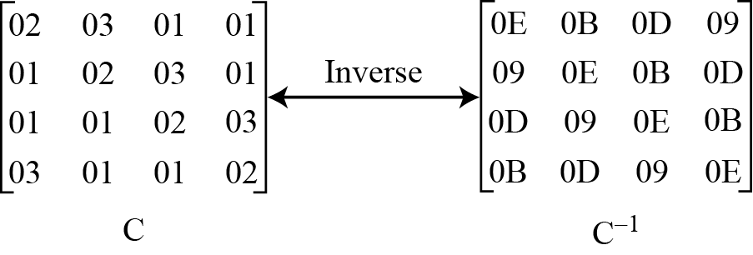
MixColumn and Inverse MixColumn

Slide 17
AddRoundKey
XOR state with 128-bits of the round key
AddRoundKey proceeds one column at a time.
  adds a round key word with each state column matrix
  the operation is matrix addition
Inverse for decryption identical
  since XOR own inverse, with reversed keys
Designed to be as simple as possible
Notes:
Lastly is the Add Round Key stage which is a simple bitwise XOR of the current block with a portion of the expanded key. Note this is the only step which makes use of the key and obscures the result, hence MUST be used at start and end of each round, since otherwise could undo effect of other steps. But the other steps provide confusion/diffusion/non-linearity. That us you can look at the cipher as a series of XOR with key then scramble/permute block repeated. This is efficient and highly secure it is believed.

Slide 18

AES OVERALL REPRESENTATION
Notes:
Can thus now view all the internal details of the AES round, showing how each byte of the state is manipulated, as shown in Stallings Figure 5.3.

Slide 19
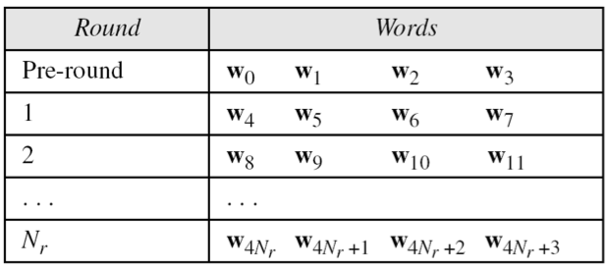
AES Key Scheduling
takes 128-bits (16-bytes) key and expands into array of 44 32-bit words
Notes:
The AES key expansion algorithm takes as input a 4-word (16-byte) key and produces a linear array of words, providing a 4-word round key for the initial AddRoundKey stage and each of the 10/12/14 rounds of the cipher. It involves copying the key into the first group of 4 words, and then constructing subsequent groups of 4 based on the values of the previous & 4th back words. The first word in each group of 4 gets “special treatment” with rotate + S-box + XOR constant on the previous word before XOR’ing the one from 4 back. In the 256-bit key/14 round version, there’s also an extra step on the middle word.

Slide 20
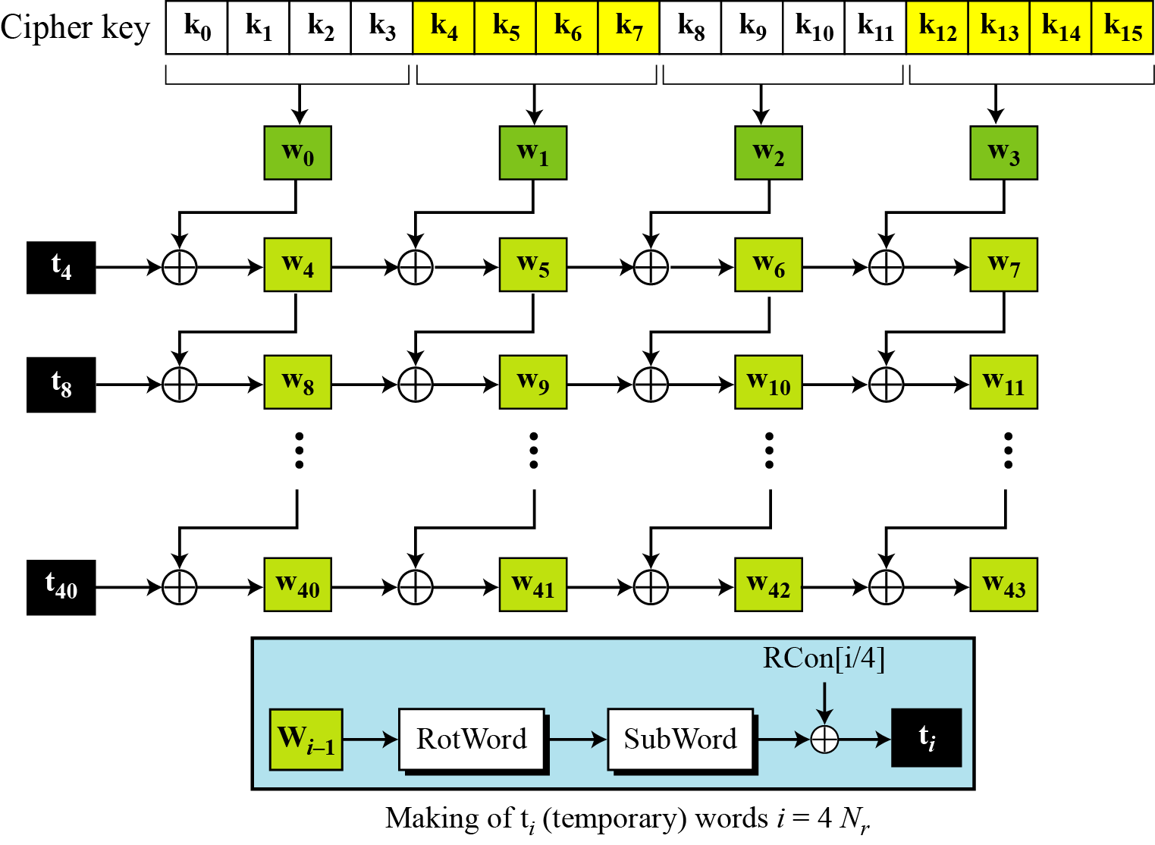
Key Expansion Scheme

Slide 21
Socket Programming
Socket: A socket is an endpoint for sending or receiving data across a computer network. It provides an abstraction for network communication, allowing processes on different devices to exchange data.
Server and Client: In socket programming, there are typically two roles: the server and the client. The server waits for incoming connections, while the client initiates a connection to the server. This client-server model is commonly used in chat systems.

Slide 22
Socket Creation and Configuration
socket(): This function creates a new socket and returns a socket descriptor that can be used for communication.
bind(): Binds a socket to a specific IP address and port number on the local machine.
listen(): Puts a server socket into listening mode, allowing it to accept incoming client connections.
accept(): Accepts an incoming client connection and returns a new socket descriptor for communication with that client.

Slide 23
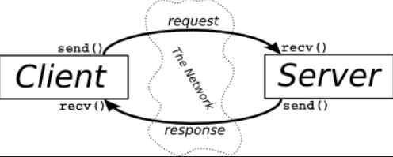
One To One Chat

Slide 24
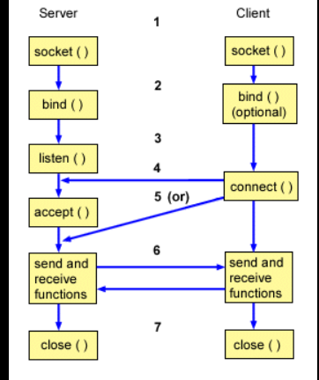
Client Server Architecture

Slide 25
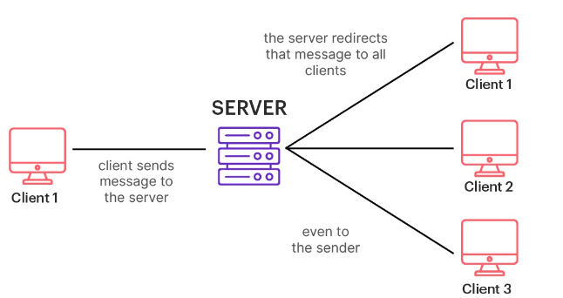
Chat With Multiple Client

Slide 26
Thank You

