Slide 1
CSE 465.1: Pattern Recognition and Neural Networks
Farzeen Naz Promi (1620225042)

Slide 2
The Topic
Plant Disease Detection Pattern recognition can be used in many aspects of agriculture, one of which is Plant disease detection. Image and pattern recognition techniques are applied to a dataset of images of a large variety of plants to train them to identify if a plant is diseased and if it is, to specify its disease.

Slide 3
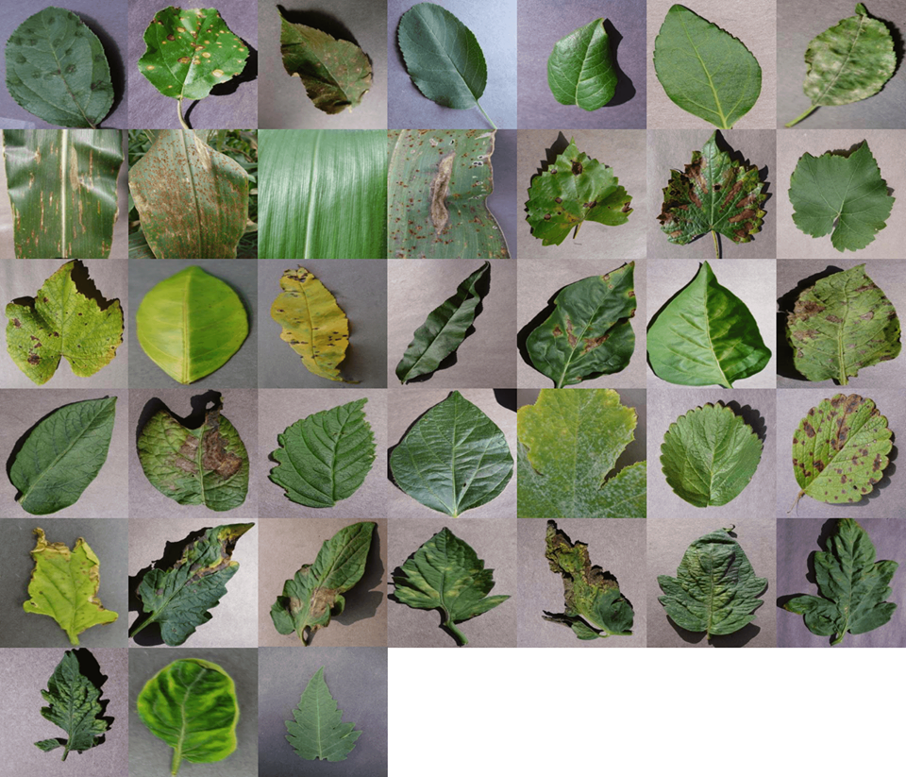
Dataset
The dataset we have chosen to use for our project is the Plant Village dataset
Sample images all 38 classes:

Slide 4
Problems:
Large size of dataset:
As the dataset was too large to use with the computational power available, a sample was use.
This sample included 3 plants and 15 diseases.
Lack of Computational powers:
Even after reducing the size of the dataset, it was seen that device could not provide it with the power needed. to overcome this, this project has been done directly on Kaggle Kernels.
Over Fitting
Due to dataset sampling which reduced the size of the dataset, over fitting because an issue. The Training accuracy was significantly higher than test accuracy showing the occurrence of memorization.
This was fixed by changing parameters and reducing the number of epochs.

Slide 5
Algorithm:
Convolutional Neural Network

Slide 6
Libraries used:
numpy as np
pickle
cv2 (open cv)
sklearn
matplotlib
tensorflow
Layers
BatchNormalization
Conv2D
MaxPooling2D
Flatten
Dropout
Dense
Softmax

Slide 7
Functions:
Batch Normalization-
Allows more stable distribution of inputs and thus accelerates the training
MaxPooling2D
Its function is to progressively reduces amount of parameters and computation in the network
Flatten
Converts the pooled feature map to a single column that is passed to the fully connected layer
Dropout
Prevents over fitting
Dense
Adds the fully connected layer to the neural network
Softmax
Calculates the probabilities distribution of the event

Slide 8
Work Done:
Select dataset
Download Dataset
Load the data
Augmentation
Convert Images to numpy array
Convert Labels to binary
Choose Algorithm
Run Model
Parameter tuning
Pretrained model application
Comparison

Slide 9
Model FlowChart:
2D CONVOLUTIONAL LAYER
FLATTEN
DROPOUT
MAX POOLING
DENSE
2D CONVOLUTIONAL LAYER
DENSE
MAX POOLING
DENSE
2D CONVOLUTIONAL LAYER
SOFTMAX
BATCH NORM
MAX POOLING
2D CONVOLUTIONAL LAYER
CLASSIFICATION
MAX POOLING

Slide 10
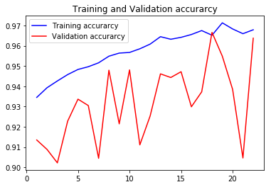
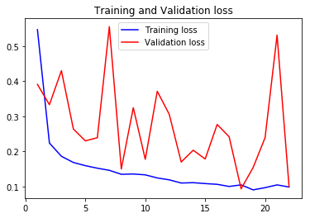
Results:
Train Accuracy: 96.37
Test Accuracy: 96.37

Slide 11
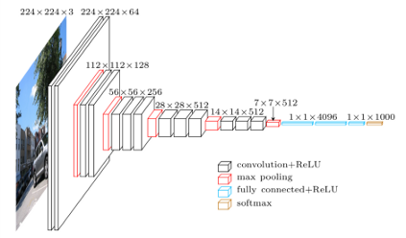
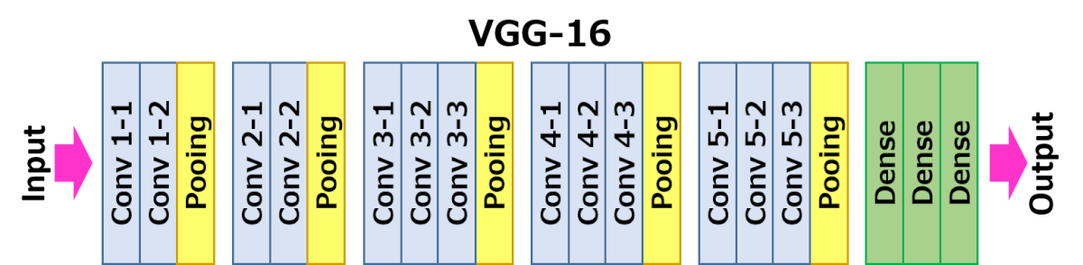
VGG16:
0.9768

Slide 12
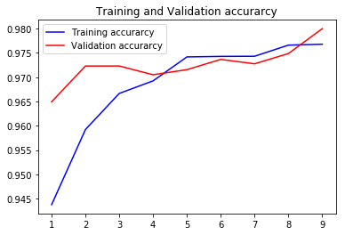
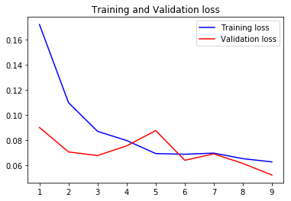
VGG16:
97.998
0.9768
Train Accuracy:97.68
Test Accuracy:98.00

Slide 13
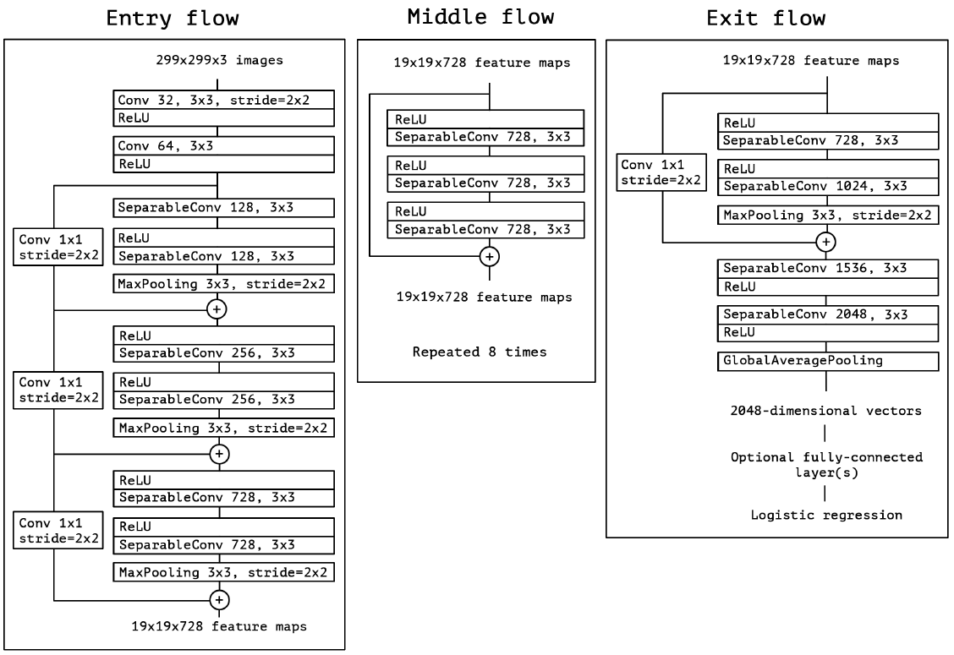
XCEPTION:
97.998
The Xception architecture has 36 convolutional layers forming the feature extraction base of the network

Slide 14
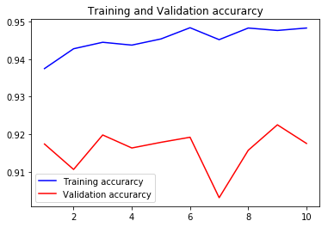
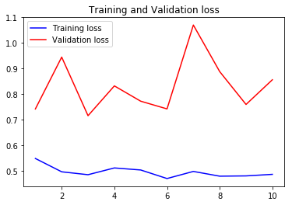
XCEPTION:
97.998
0.9768
Train Accuracy:94.78
Test Accuracy:92.2

Slide 15
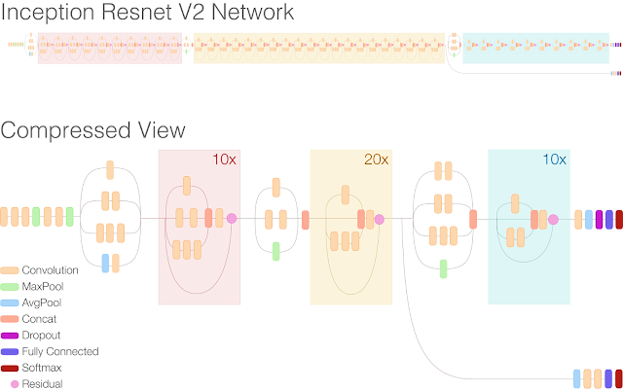
InceptionResNetV2
Inception-ResNet combines Inception and Residual network architectures to further boost the performance.

Slide 16
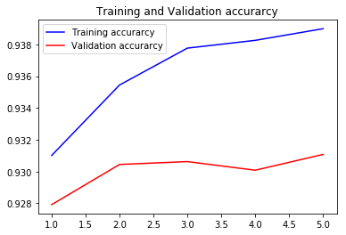
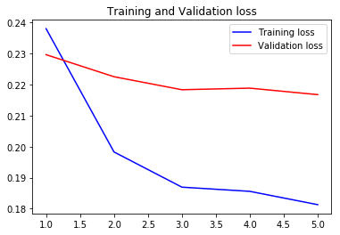
InceptionResNetV2
97.998
0.9768
Train Accuracy:93.88
Test Accuracy: 93.11

Slide 17
Conclusion:
From the experiments conducted, it can be seen that when comparing the models applied, the best result was obtained from VGG16 network with a test accuracy of 98%

